Slide 1




Exploring Online Data Assimilation for Paleoclimate Reconstruction
Using an Idealized OSSE Framework
Atsushi Okazaki¹, Takemasa Miyoshi¹,
Kei Yoshimura², Fuqing Zhang³
¹RIKEN Center for Computational Science
²Institute of Industrial Science, The University of Tokyo
³Pennsylvania State University
Notes:
I’m Atsushi Okazaki from RIKEN, Japan.
I’m gonna talk about our recent work on online-data assimilation on paleoclimate.
I will explain what “online” and “offline” are and compare them.

Slide 2
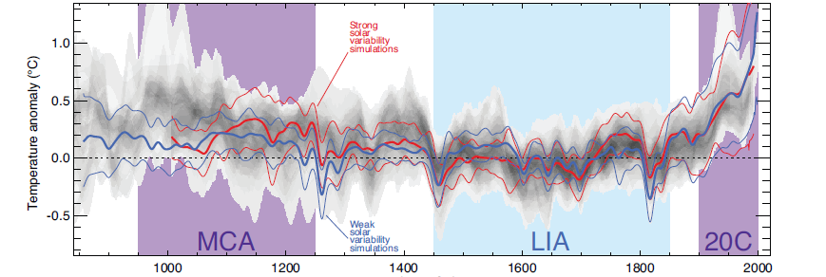
Paleoclimate and data assimilation
Observation- (shaded) and GCM-based (line) NH temperature
Observation-based
uncertain
certain
GCM-based
90% range
Ensemble mean
Year
IPCC AR5 WG1 (2013)
Both reconstructions based on observation and simulation are uncertain ➔ Data assimilation
Notes:
Recently data assimilation has been applied to the field of paleoclimate to faithfully reconstruct paleoclimate.
DA is expected to produce best reconstruction by combining uncertain observation and simulation.
------------------------------------------------------------------------------------
Overlap of reconstructed temperatures shown by gray shading

Slide 3

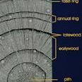
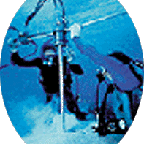
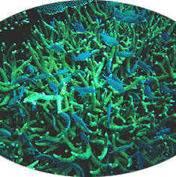
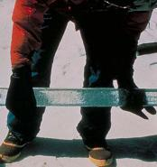
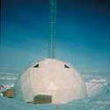
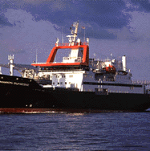


Difficulty in paleo-DA; observation
 | NWP | Paleoclimate
Variable | Direct State (e.g. temperature) | Indirect state (e.g. tree-ring width)
Amount | N>10⁷/day | N~10³/year
Frequency | Finer than daily | Longer than annual
Representativeness | Instantaneous | Time-averaged
Difficult to analyze the initial condition for the next DA-cycle with time-averaged data
Information does not accumulate over time due to the low observation frequency and the chaotic nature
Tree-ring
Coral
Ice core
photos from
NOAA Paleoclimatology
Datasets
Foraminifera
Speleothem
Notes:
However to apply data assimilation for NWP to paleoclimate is not trivial due to the difference in observation.
This slide compares observation for the present day NWP and for paleoclimate.
First, we cannot know direct state of the climate but what we can get is indirect state like tree-ring width, isotope ratio in ice cores, etc.
Second, the amount of observation is much small for paleoclimate.
Moreover, observation frequency is low in paleoclimate and typically longer than annual. And what we can get is not instantaneous but time-averaged value.
In this study, we focus on these points.
What’s the problem with such data?
First of all, it is difficult to analyze the initial condition for the next DA-cycle with time-averaged data
Second, even if the initial condition are successfully analyzed, the observation information does not propagate over time due to the low temporal resolution
-----
https://www.ncdc.noaa.gov/data-access/paleoclimatology-data/datasets

Slide 4
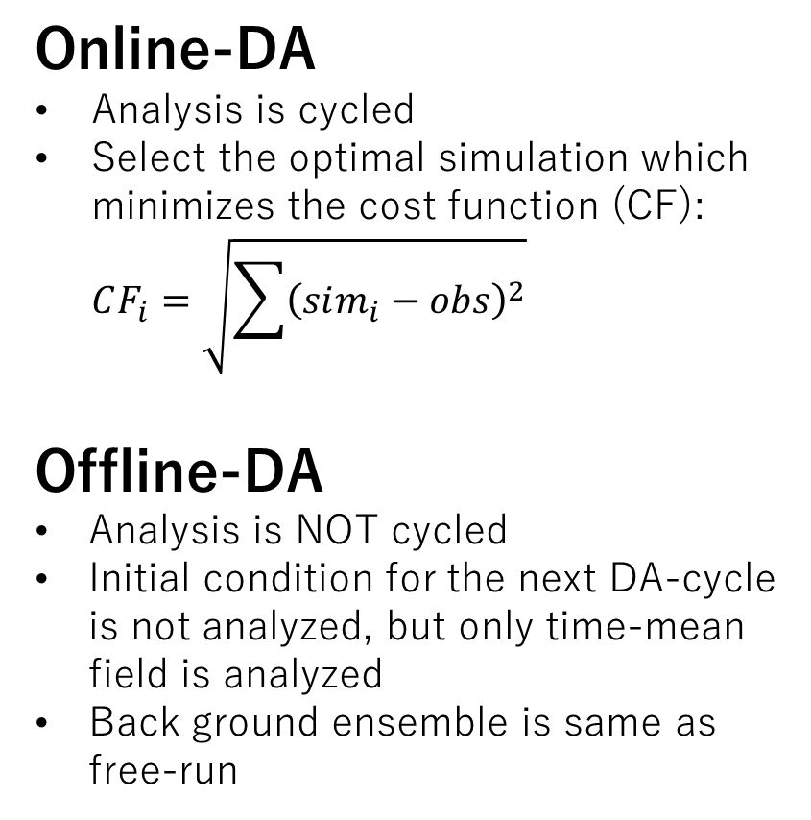
DA-algorithm in Paleoclimate
Acevedo, W., Fallah, B., Reich, S., Cubasch, U., Assimilation of pseudo-tree-ring-width observations into an atmospheric general circulation model, Clim. Past, 12, 545-557, 2017.
observation
Online-DA
Analysis is cycled
Select the optimal simulation which minimizes the cost function (CF):
$CF_{i}=\sqrt{\sum{{\left(sim_{i}−obs\right)}^{2}}}$
Offline-DA
Analysis is NOT cycled
Initial condition for the next DA-cycle is not analyzed, but only time-mean field is analyzed
Back ground ensemble is same as free-run
(e.g. Goosse et al., 2006)
Forecast
Analysis
Online-DA
(e.g. Bhend et al., 2012)
Offline-DA
Notes:
To assimilate such observations, unique DA methods have been proposed in the field of paleoclimate.
The methods can be classified into two method, online and offline-DA
In the online-DA, the initial condition for the next DA-cycle is somehow analyzed and the analysis is cycled to the simulation.
In the analysis step, a method proposed by Goosse et al. simply selects an ensemble member which fit for observations the best.
In offline-DA, the initial condition for the next DA-cycle is not analyzed, but only time-mean field is analyzed. As such, the simulation is not constrained at all, and therefore, the back ground ensemble does not contain year specific information.
We can use existing simulations.

Slide 5
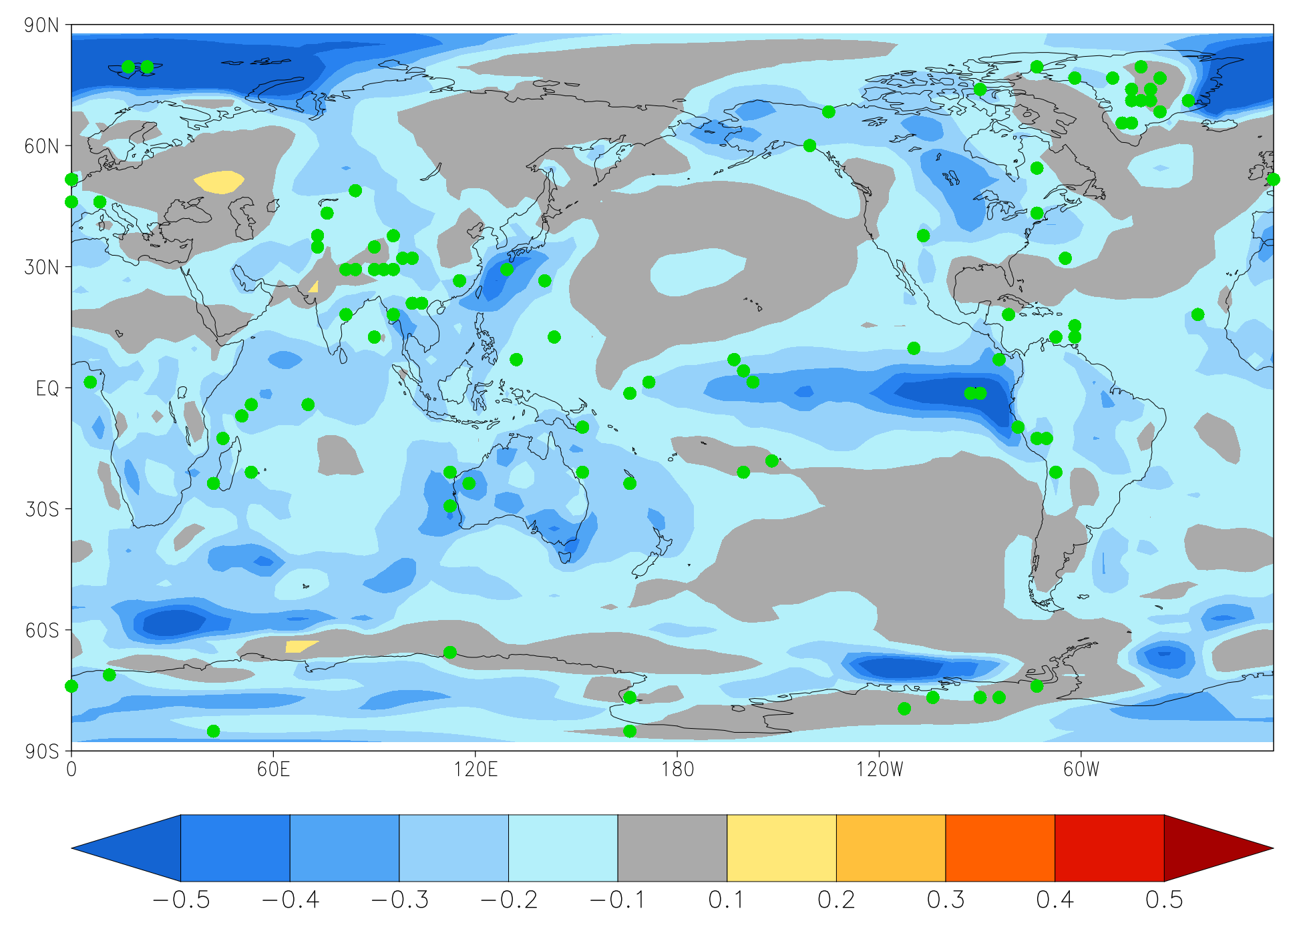
Online or Offline?
● observation
RMSE difference in offline-DA (ANL-FCT)
SAT [K]
 | Online-DA | Offline-DA
Information propagation by the model | Yes | No
Computational cost | High | Low
Area where observation is sparse will never get better
➔ Computationally heavy but online-DA is preferable
Okazaki, A., and Yoshimura, K., Development and evaluation of a system of proxy data assimilation for paleoclimate reconstruction, Clim. Past, 13, 4, 379, 2017.
Notes:
Then, the question is which method is better for paleo-climate?
This slide compares them conceptually.
In online-DA, information contained in observations can be propagated by the model within the range of the predictability.
However, its computational cost is prohibitably expensive. Ensemble simulation with coupled model for thousand years sounds unrealistic, light?
On the other hand, because existing simulations can be used in the offline-DA, the computational cost is cheap.
But the information cannot be propagated, and the area where observation is sparse will never get better.
So conceptually, Online-DA is preferable even though they’re heavy.
--------
このスライドを現在気候でのonlineとofflineの比較にすればよかったのか

Slide 6
Online or Offline?
Acevedo, W., Fallah, B., Reich, S., Cubasch, U., Assimilation of pseudo-tree-ring-width observations into an atmospheric general circulation model, Clim. Past, 12, 545-557, 2017.
__ online-forecast
__ free-forecast
__ online-analysis
__ offline-analysis
RMSE for SAT [K]
Annual mean surface air temperature (SAT)
Atmospheric GCM coupled with slab ocean
Offline-DA: EnKF based (Bhend et al., 2012)
Online-DA: TAU (Dirren and Hakim, 2005)
Online-DA does not outperform offline-DA with annual-mean data
➔ Offline-DA has been more popular than online-DA
Notes:
Several studies compared their skills.
Let me introduce one study by Acevedo et al., 2017.
In the paper they assimilated 1-year averaged surface air temperature, and investigated which DA-method is better.
The figure compares the RMSE in online-DA and offline-DA for SAT. Blue is offline-DA and green is online-DA analysis. As you can see, offline is below online and they concluded that online-DA does not outperform offline-DA with annual mean data.
Given the performance and the computational cost, offline-DA has been more popular than online-DA these days.

Slide 7
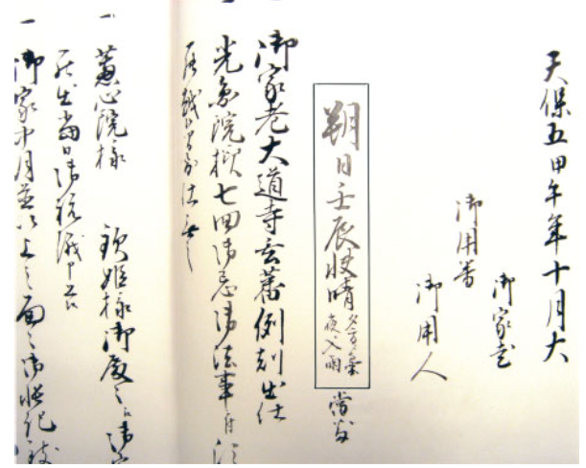
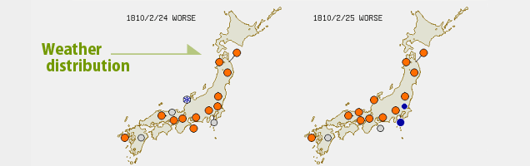
Observation gets finer!
←Zhu, M., Stott, L., Buchley, B., and Yoshimura, K., 20th century seasonal moisture balance in Southeast Asian montane forests from tree cellulose δ¹⁸O, Climatic Change, 115, 3-4, 505-517, 2012.
↓https://tk2-202-10627.vs.sakura.ne.jp/
Isotope ratio in tree-ring cellulose @ Thailand
Weather data on diary @ Japan
Daily - monthly data is nowadays available from the proxies
Notes:
The previous studies compared the skills with annual mean data.
But, recently temporal resolution of the observations gets finer and finer.
In the case of isotope ratio in tree-ring cellulose, we can get as fine as monthly information.
We can get even daily weather data on for example personal diaries.

Slide 8

Question
Online-DA > Offline-DA in NWP (instantaneous data)
Online-DA $≤$ Offline-DA with annual-mean data
Notes:
We can easily expect that online-DA is better than offline-DA in numerical weather prediction in which instantaneous data is assimilated
Also we know that online-DA is not better than offline-DA with annual-mean data assimilation from the previous studies.
And Now we have observation finer than annual data.

Slide 9
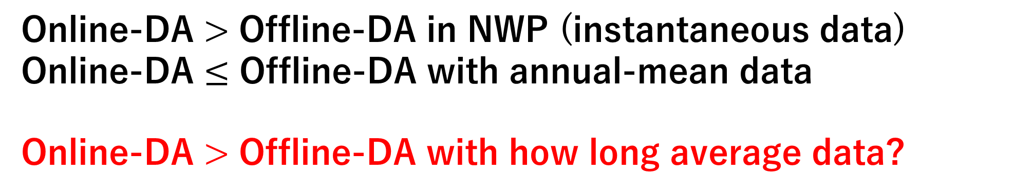
Question
Online-DA > Offline-DA in NWP (instantaneous data)
Online-DA $≤$ Offline-DA with annual-mean data
Online-DA > Offline-DA with how long average data?
Notes:
So it’s natural to pose the question, with how long average data online-DA is better than offline-DA.

Slide 10
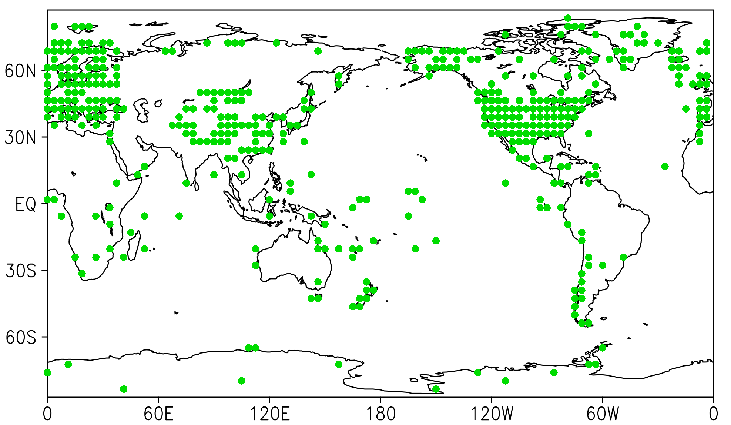
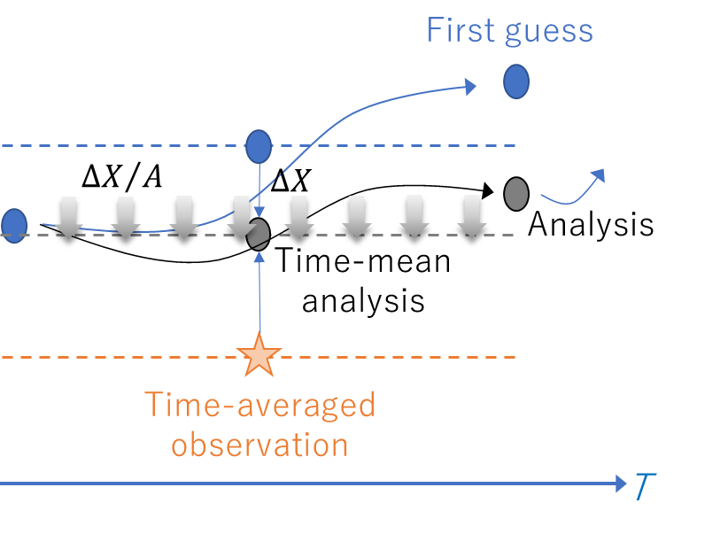
Experimental design
Observation site
Assimilate various time-averaged data
Surface temperature (SAT, SST) (N=435)
1dy, 3dy, 10dy, 1mo, 3mo, 6mo, 1yr mean
Perfect model OSSE
SPEEDY w/ slab ocean (Molteni, 2003)
LETKF (Hunt, 2007) with 30 member
IAU
Experiments
NoDA
Offline (Bhend et al., 2012)
IAU (Online-DA; Bloom et al., 1998)
  Analyze time-mean field first
  The time-mean field analysis is incremented every model step
Notes:
To answer the question, we assimilated various time-averaged data in the framework of the perfect model OSSE.
The observations are daily to 1-year mean surface air temperature and sea surface temperature.
The distribution of the observation mimics that of real proxy.
The model used is SPEEDY coupled with slab ocean.
And, we used LETKF with 30 ensemble member to create analysis.
We did 3 experiments; NoDA, offline, and IAU which is an online-DA. In the IAU simulations are conducted twice. Firstly it analyze time-mean field after the first run. Then the time-mean field is incremented every model time-step in the second run. By doing this, mean field in the second run is expected to be nudged toward the time-mean analysis.

Slide 11
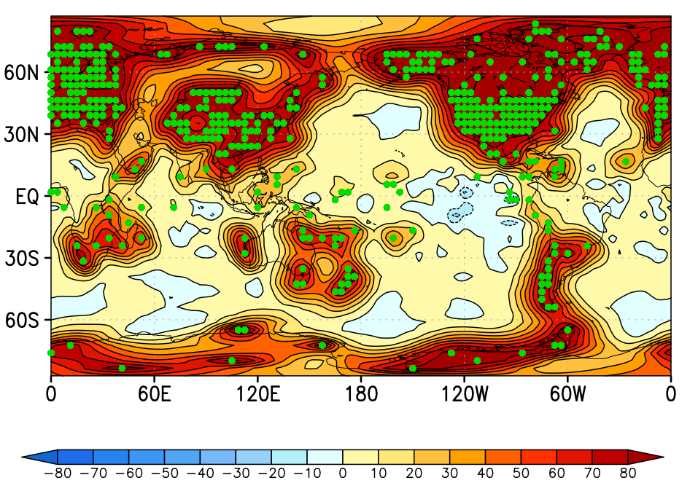
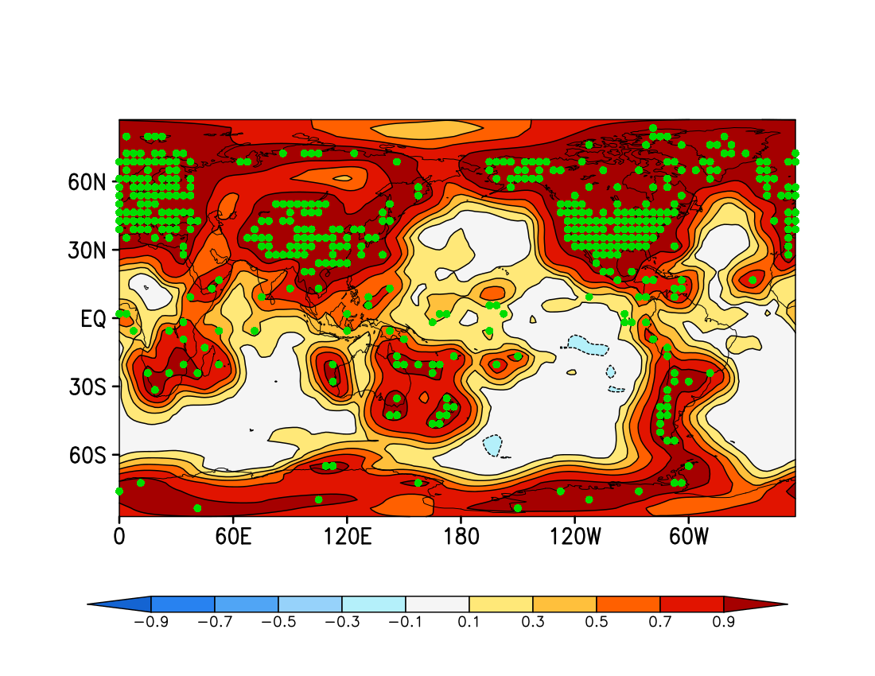

IAU improves state estimates
RMSE reduction [%]
● observation
relative to NoDA
$$RMSE reduction=\frac{RMSE_{NoDA}−RMSE_{IAU}}{RMSE_{NODA}}×100 [\%]$$
Global average of RMSE reduction [%]
Corr. [-]
RMSE reduction [%]
1-yr simulation
15-yr simulation
Temporal representation of obs. (=DA cycle)
Notes:
Let’s move on to the result.
First, we confirmed whether IAU works well or not.
The bar graph compares RMSE of time-mean analysis in IAU with NoDA.
The vertical axis is the IAU RMSE relative to NoDA and the horizontal axis shows the temporal representation of observations assimilated.
The color of the bar represents the variables.
As you can see, for almost all the observations, all the variables, IAU is better than NoDA.
Now we confirmed that IAU works well.

Slide 12
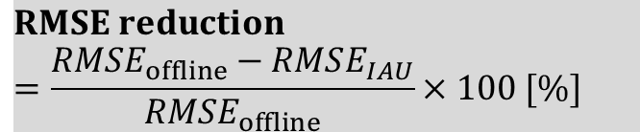
IAU outperforms Offline?
$$RMSE reduction \\ =\frac{RMSE_{offline}−RMSE_{IAU}}{RMSE_{offline}}×100 [\%]$$
RMSE reduction [%]
Suboptimal filter (e.g., too small ensemble spread)
Atmosphere skill is better
Ocean skill is better
Temporal representation of obs. (=DA cycle)
Notes:
But the question is the skill of IAU relative to offline.
The figure is the same as the previous one but for the RMSE relative to the offline.
With daily mean data, IAU is better than offline for both atmosphere and ocean
The result shows that the IAU is better than offline for atmosphere up to 10-day mean. It is reasonable considering that the atmospheric predictability is on the order of two weeks
While the ocean skill in IAU is better than that in offline up to 3 to 6 months.

Slide 13
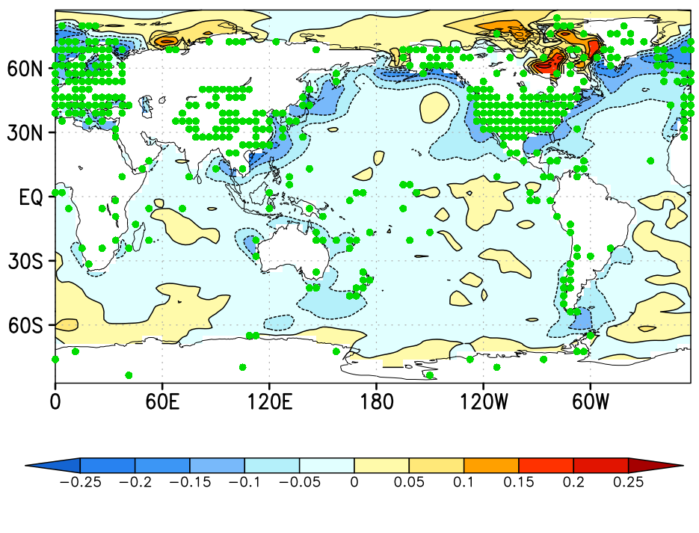
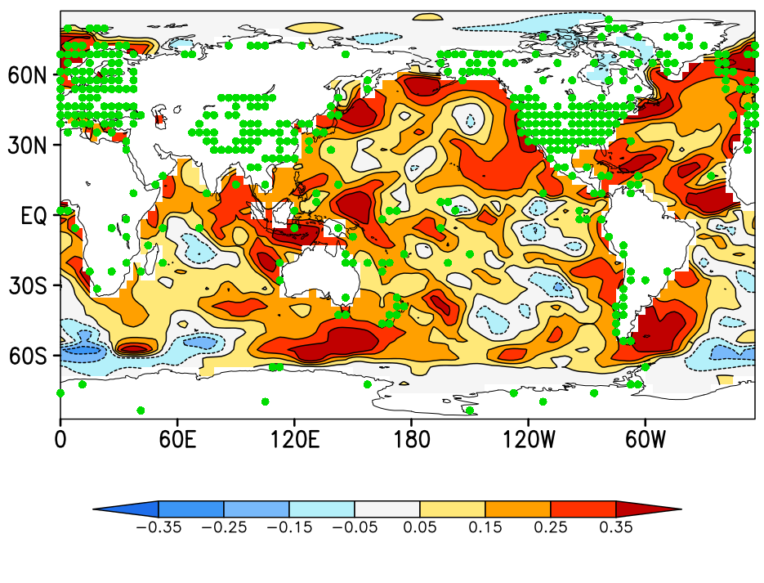
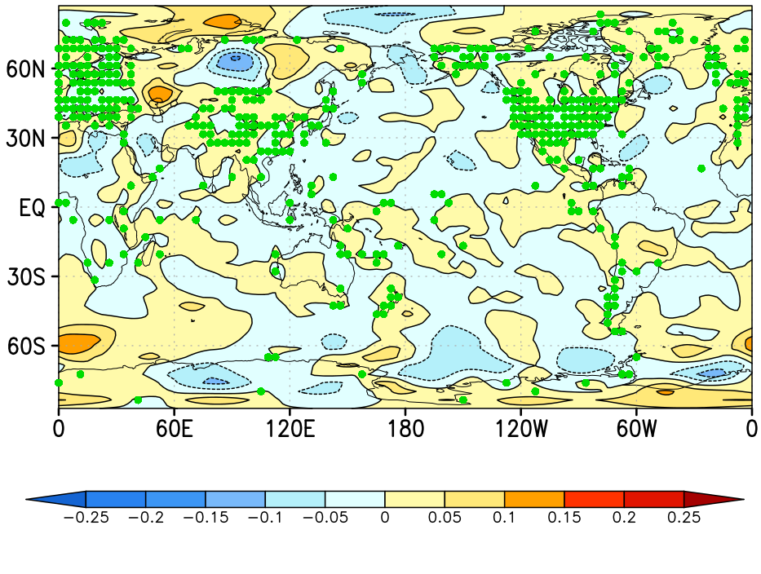
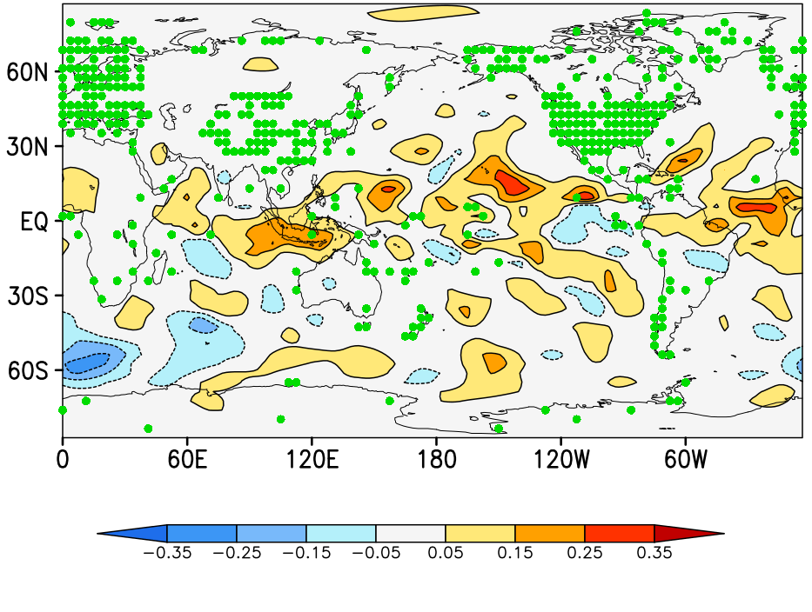
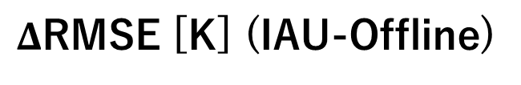
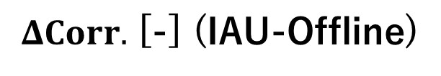
Skill difference (IAU-Offline): 1mo-mean DA
$Δ$RMSE [K] (IAU-Offline)
$ΔCorr.$ [-] (IAU-Offline)
SST
SAT
IAU is better←
→IAU is better
Notes:
The figures compare skill difference between IAU and offline for 1mo-mean DA.
The left panels are RMSE difference and the right are temporal correlation difference for SST and SAT.
The improvement is clear in SST fields but it is very limited for SAT.
So, the figures tells that the ocean carries information, thanks to its long memory.
囲まれたところでは海だけのスキルが顕著に高い
→前のSSTのanalysisの効果が残っているため
→memory次第
→slab oceanのパラメタによって変わる

Slide 14
Sensitivity to the depth of mixed layer
As the depth of the slab ocean model increases,
Ocean skill increases
(Pendergrass et al., 2012)
Skill difference between IAU and Offline become smaller
RMSE SST [K]
The difference between Online-DA and Offline-DA may be further small in reality given that the predictability of the ocean is longer than that in the slab ocean,
Considering that full-ocean model can propagate information by advection, the difference between Online-DA and Offline-DA may be further larger
Slab ocean depth
Pendergrass, A. P., Hakim, G. J., Battisti, D., S., Roe, G., Coupled air-mixed layer temperature predictability for climate reconstruction, J. Clim., 25, 459-472, 2012.
Notes:
Now we are using slab-ocean model and its memory is tunable.
To see the sensitivity, we changed the depth of the slab ocean model and repeated the same experiments.
The bar graph shows the RMSE for monthly SST in IAU and Offline.
Basically, as the depth of the slab ocean model increases, ocean skill increases.
When you see the difference between IAU and offline, as the depth increases, the skill difference become smaller. This is because ocean become stiff with the large depth, and the flow dependence plays minor role.
The result indicate that~.

Slide 15
Summary and future perspective
With this IAU, online-DA outperforms offline-DA till 10-day mean data for atmosphere, and 3-month for ocean
Monthly SST will enable to create daily-scale “paleo-reanalysis” combined with e.g. daily diary data (c.f. Toride et al., 2017)
Toride, K., Neluwala, P., Kim, H.-J., Yoshimura, K., Feasibility study of the reconstruction of historical weather with data assimilation, MWR, 145, 3563-3578, 2017.
Online-DA
w/ monthly proxy
Monthly SST
Online-DA
w/ diary data
Daily scale paleo reanalysis
Notes:
Now that we have monthly data, and we know that online-DA is better than offline-DA for SST on that time scale, we can create better monthly SST.

Slide 16
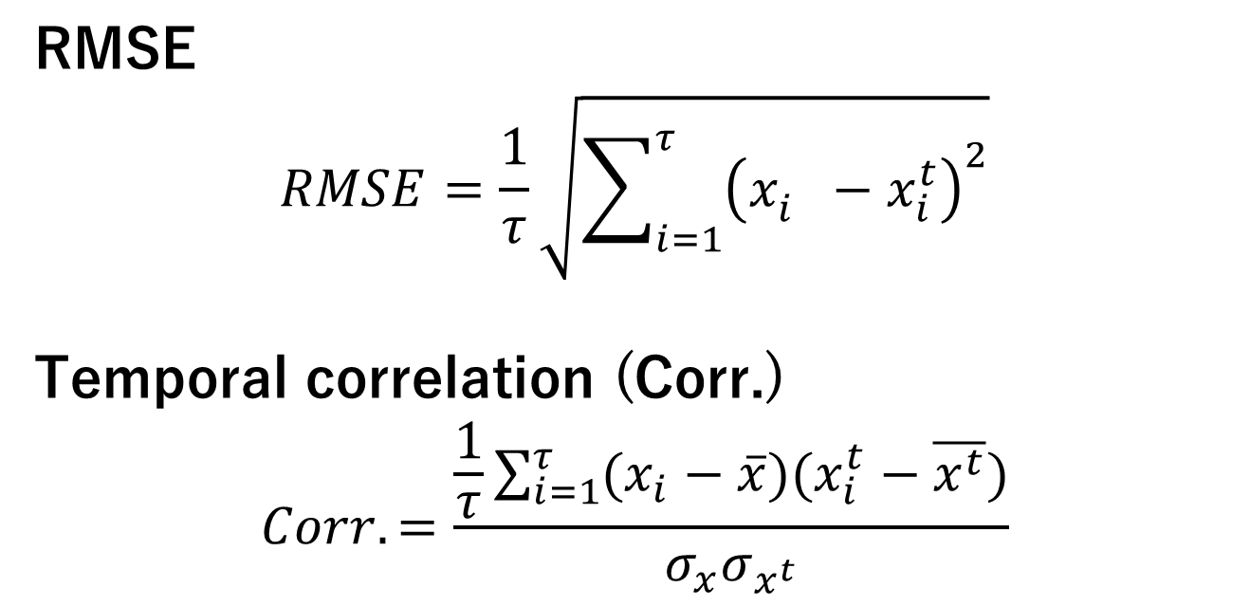
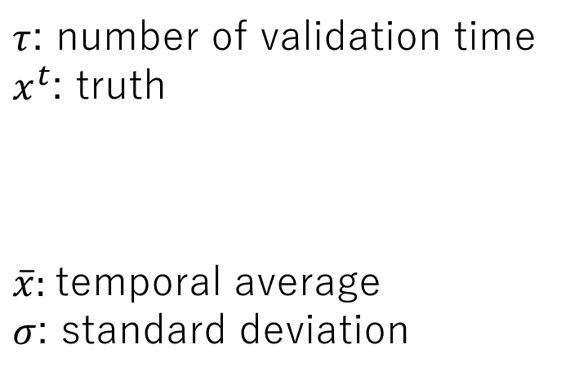
Skill metrics
Skills for time-mean state will be compared
RMSE
$$RMSE=\frac{1}{τ}\sqrt{\sum_{i=1}^{τ}{{\left(x_{i}^{}−x_{i}^{t}\right)}^{2}}}$$
Temporal correlation (Corr.)
$$Corr.=\frac{\frac{1}{τ}\sum_{i=1}^{τ}{(x_{i}−\overline{x})(x_{i}^{t}−\overline{x^{t}})}}{σ_{x}σ_{x^{t}}}$$
$τ$: number of validation time
$x^{t}$: truth
$\overline{x}$: temporal average
$σ$: standard deviation
Climatology is subtracted before calculating Corr.

Slide 17
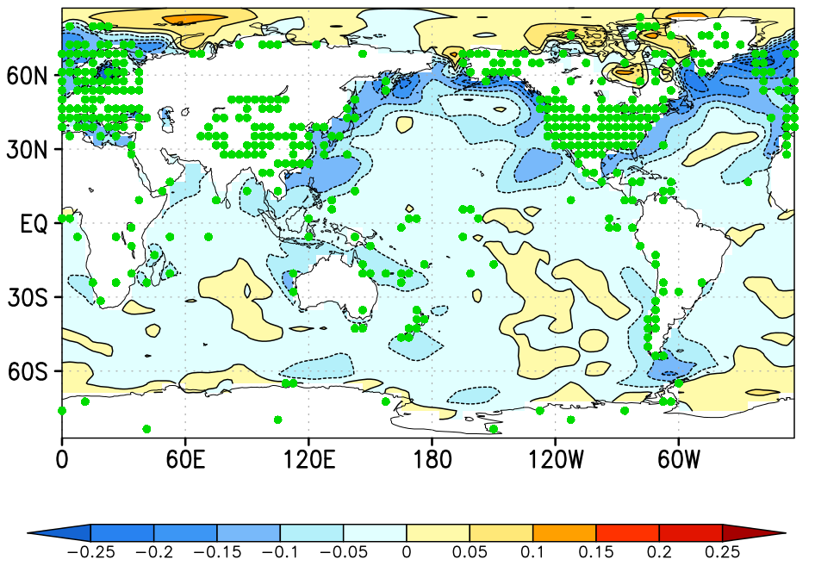
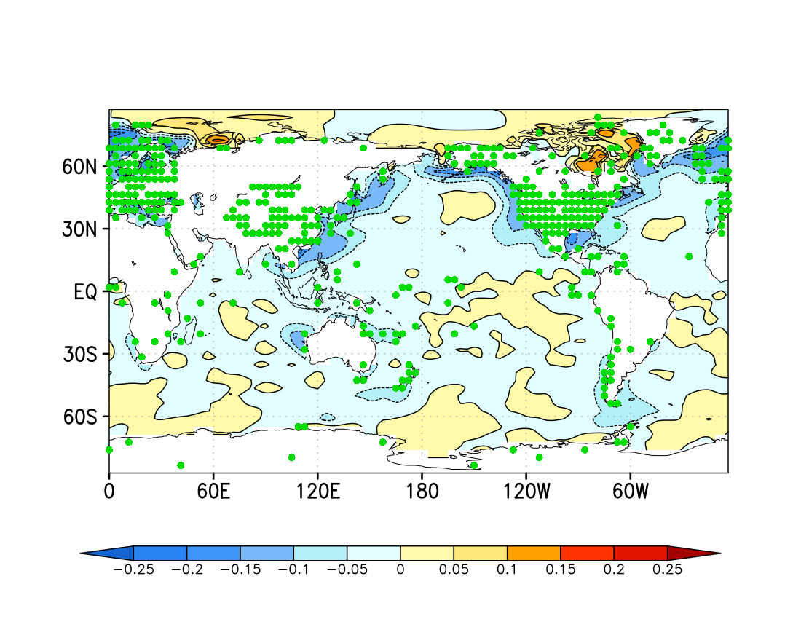
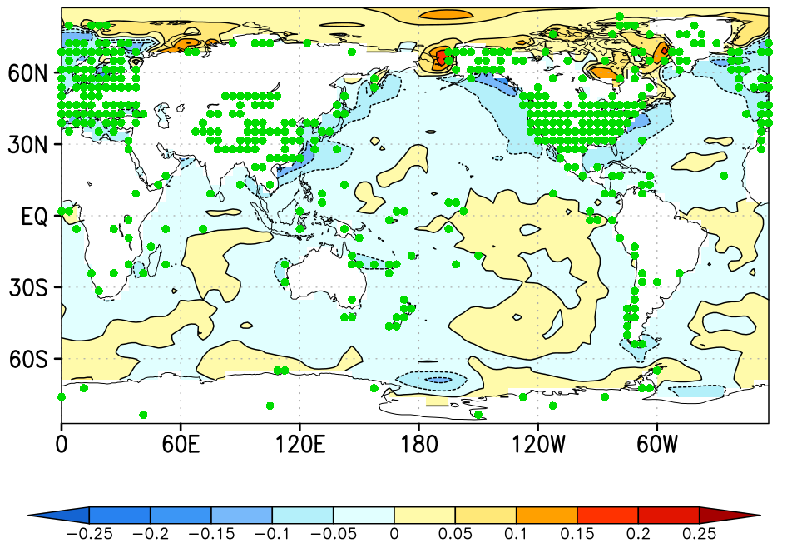
Sensitivity to the depth of mixed layer
$Δ$RMSE (IAU-Offline) for SST [K]
20m/30m
40m/60m
80m/120m

Slide 18
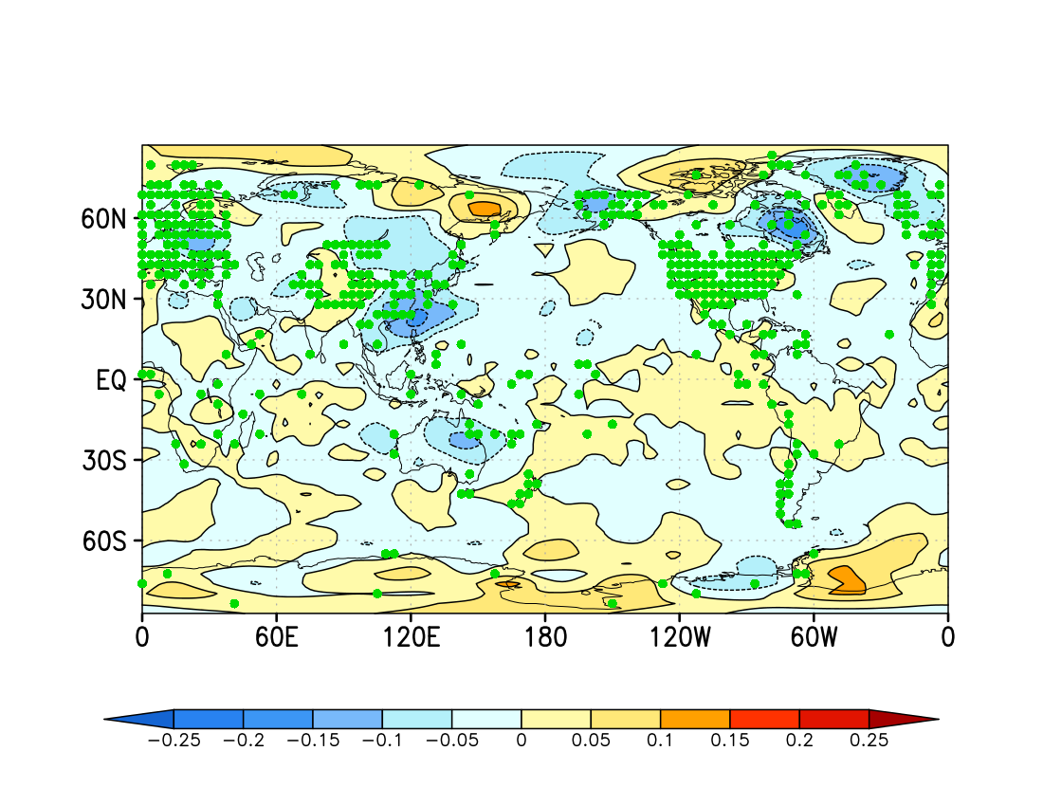
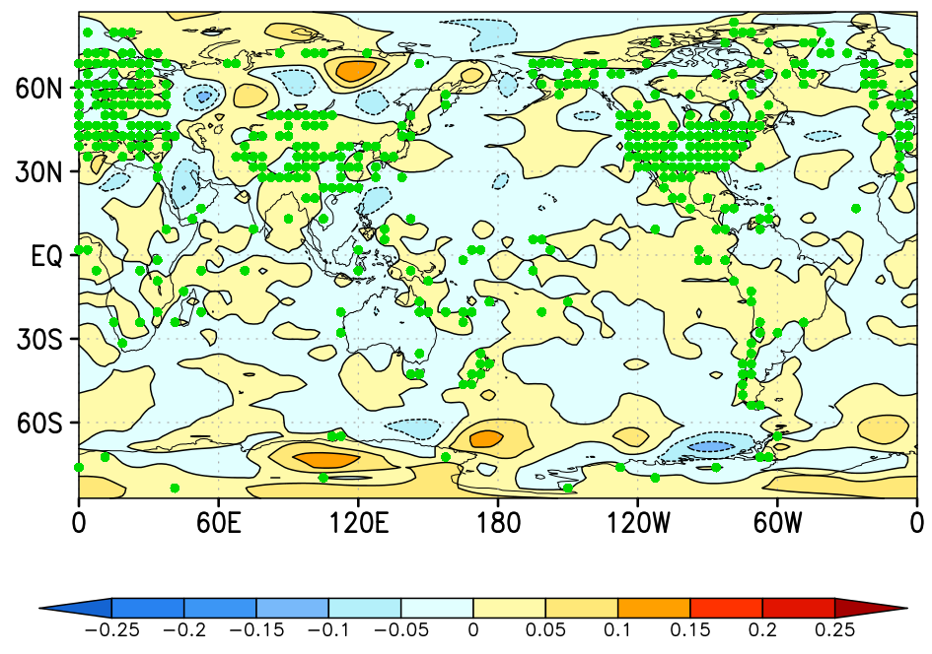
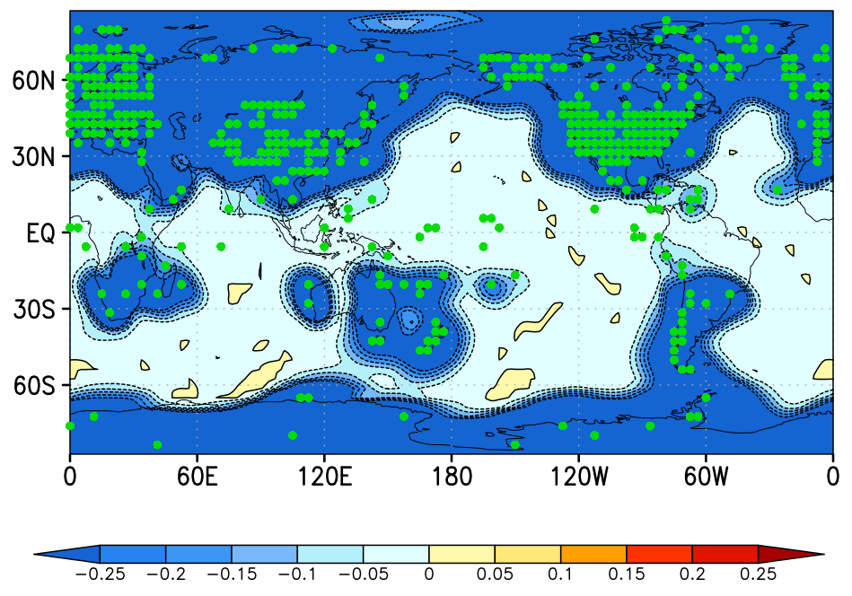
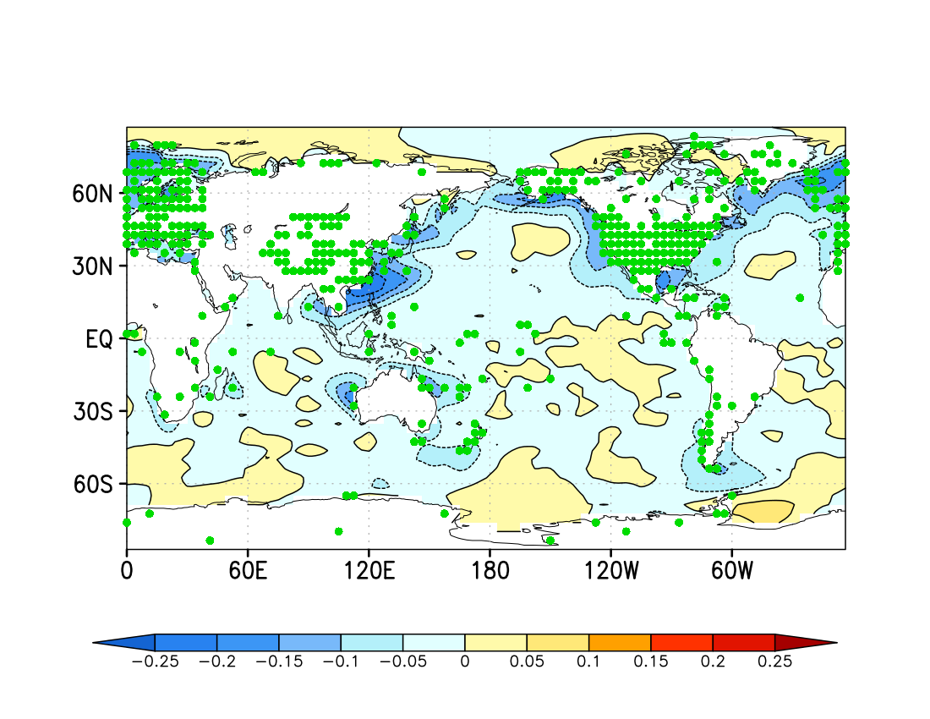
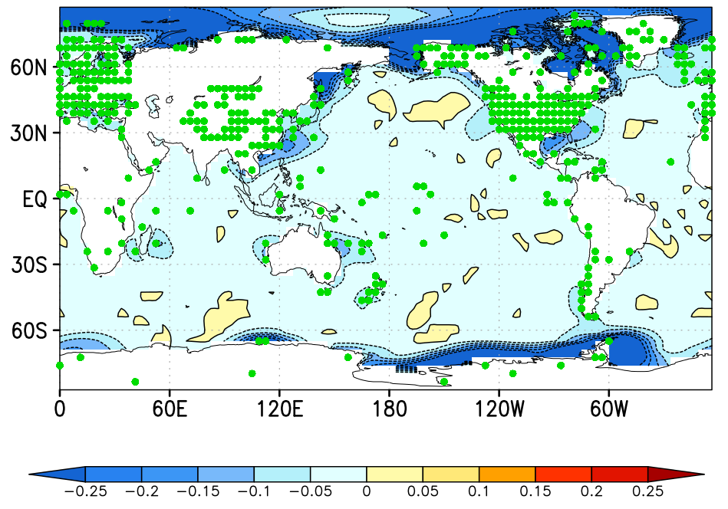
What carries information?

Slide 19
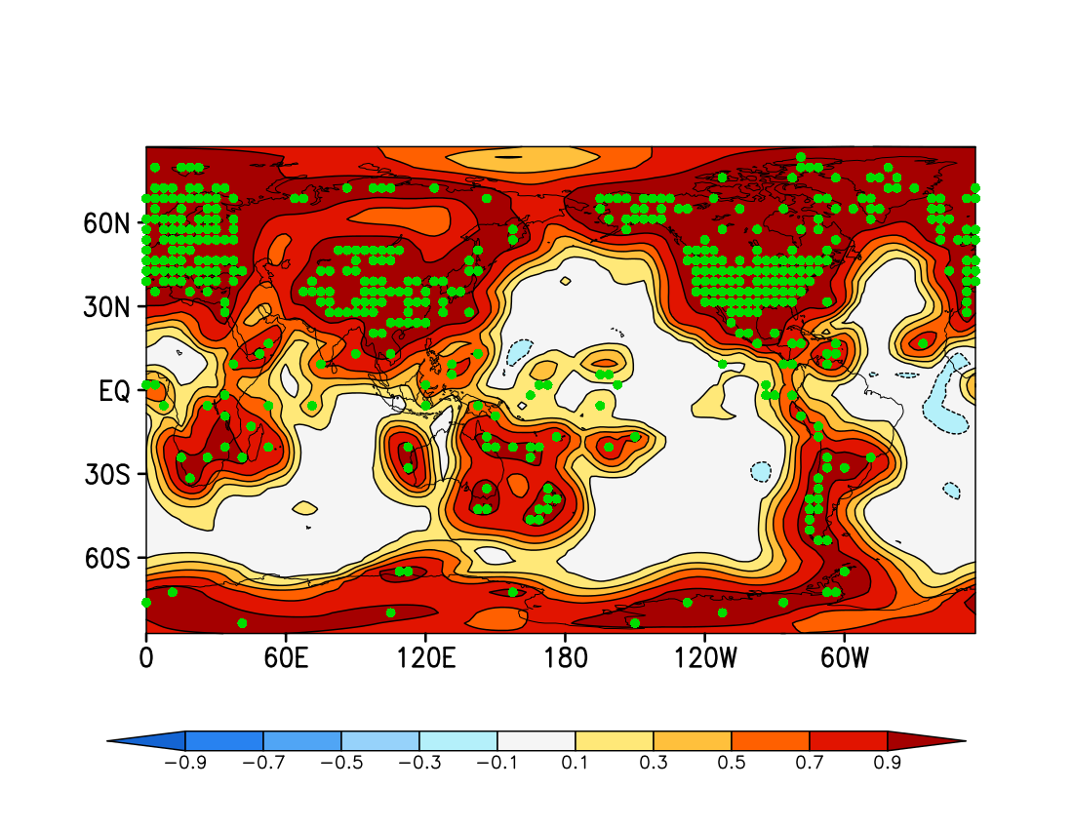
Correlation for T (1mo)
IAU
Offline

Slide 20
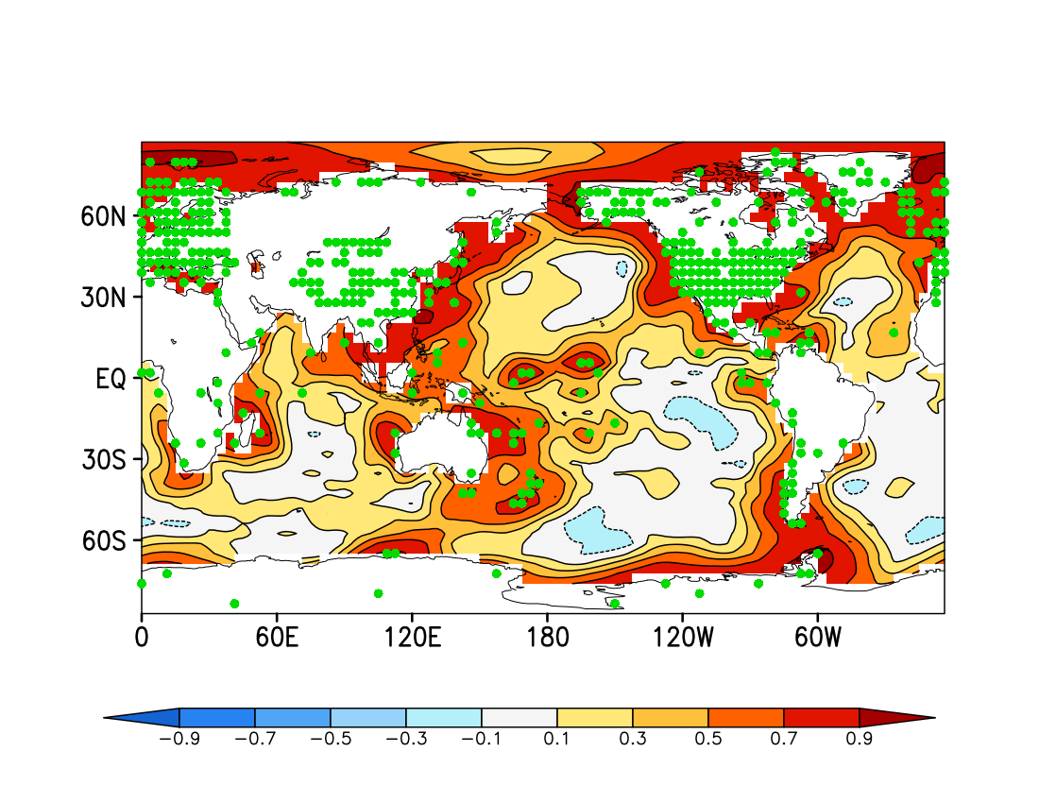
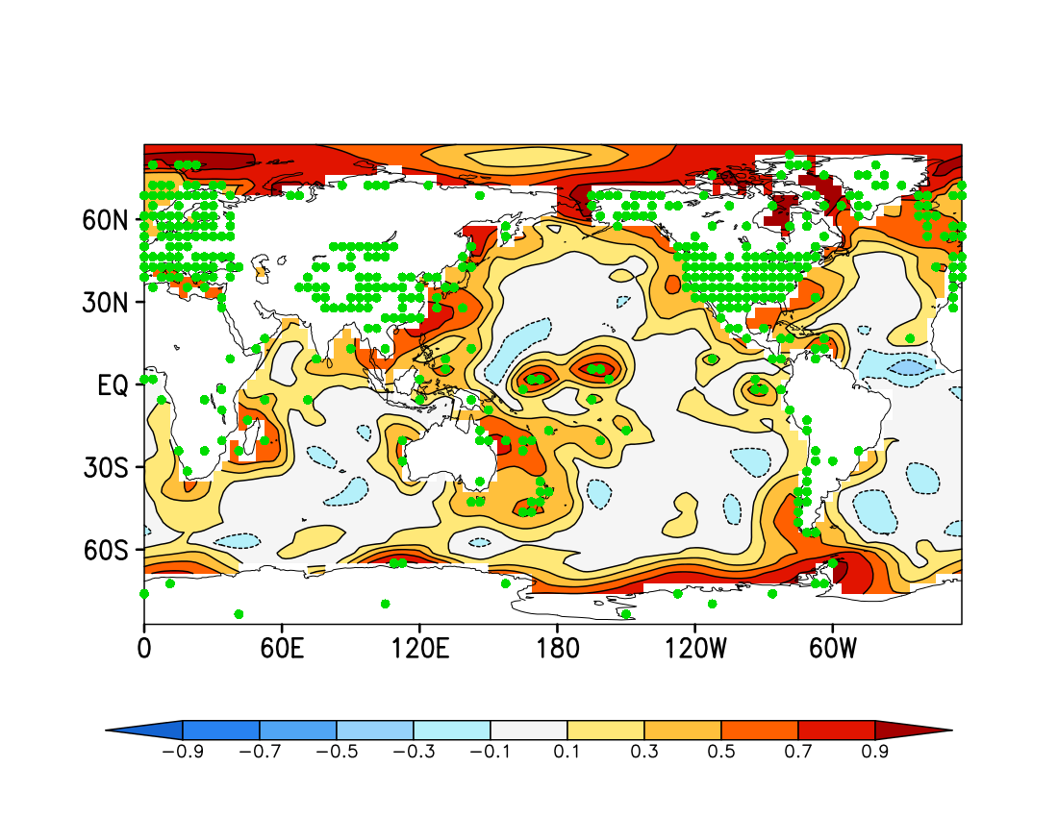
Correlation for SST (1mo)
IAU
Offline

Slide 21
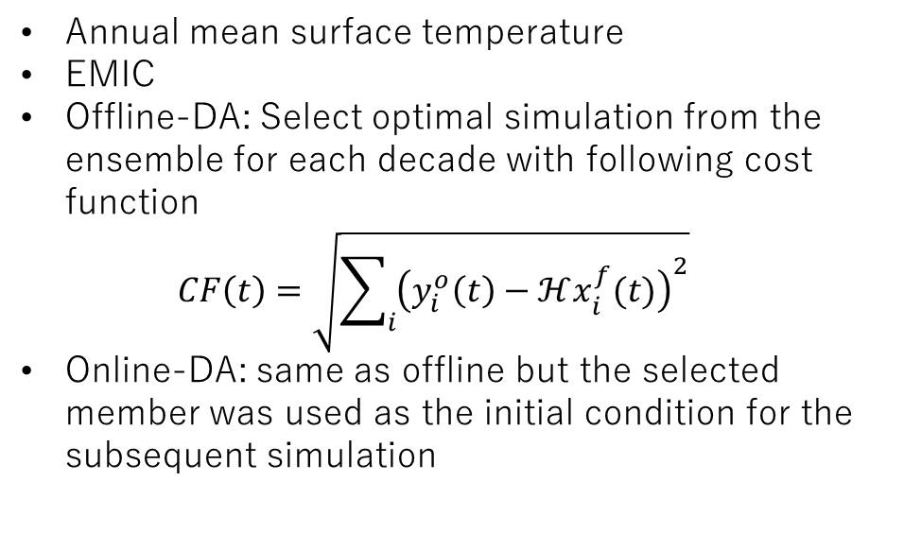
Online or Offline?
Annual mean surface temperature
EMIC
Offline-DA: Select optimal simulation from the ensemble for each decade with following cost function
$CF\left(t\right)=\sqrt{\sum_{i}{{\left(y_{i}^{o}\left(t\right)−ℋx_{i}^{f}(t)\right)}^{2}}}$
Online-DA: same as offline but the selected member was used as the initial condition for the subsequent simulation
Offline
Is better
Matsikaris, A., Widmann, M., Jungclaus, J., On-line and off-line data assimilation in palaeoclimatology: a case study, Clim. Past, 11, 81-93, 2015.
Online
is better

Slide 22

Material and Method: ensemble simulation
Model: AGCM SPEEDY (Molteni, 2003)
SST from CMIP5
y1850
y1850
y1860
Reference Run
Ensemble Size
100 member
$$⋮$$
Molteni, F., Atmospheric simulations using a GCM with simplified physical parameterizations, Clim. Dyn., 20, 2, 175-191, 2003.
Mann, M. E., Zhang, Z., Hughes, M. K., Bradley, R. S., Miller, S. K., Rutherford, S., Ni, F., Proxy-based reconstructions of hemispheric and global surface temperature variations over the past two millennia, PNAS, 105, 13242-13257, 2008.

Slide 23
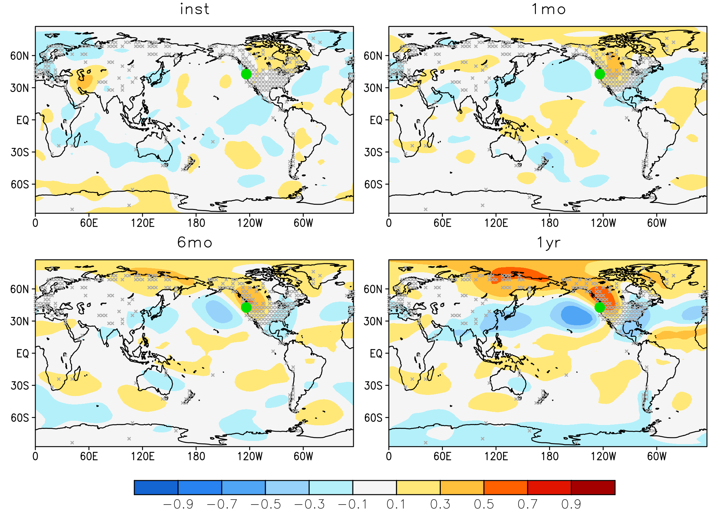




Ensemble Correlation b/w $ℋ\left(X\right)$ and $X$
Annual mean
surface temperature
Instantaneous, 1mon, 6mon, and
1yr mean GPH@500hPa
Temporal representativeness
00U00TC
1Jan1859
00U00TC
1Jan1860
$$ℋ\left(X\right)$$
$$X$$
Inst
1mon
6mon
1yr
● $ℋ(X)$
Notes:
Observation equivalent amount and model state
There is a persistent pattern up to at least monthly scale.
That is there is a pattern which is captured by linear relation throughout the year

Slide 24

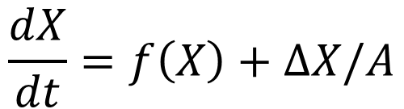
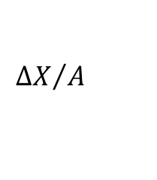
New Algorithm
Incremental Analysis Update (IAU)
First guess
$${ΔX}/A$$
$$ΔX$$
Analysis
Time-mean analysis
$$\frac{dX}{dt}=f\left(X\right)+ΔX/A$$
Time-averaged observation
T
← ΔT=e.g.1yr →
Bloom, S. C., Takacs, L. L., Da Silva, A. M., and Levina, D., Data assimilation using incremental analysis updates, Mon. Weather Rev., 124, 1256-1271, 1996.
Notes:
This and next slides explain how to assimilate time-averaged data.
Lets say we have observation which represents the average of this period.
In online data assimilation, firstly simulate that period and take average, and then create time-averaged analysis.
After that the increment is added to the first guess, and the next simulation starts from that.
To create analysis, EnKF is basically used.

Slide 25
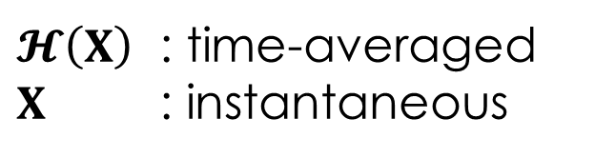
New Algorithm
Naive online data assimilation
First guess
analysis
$𝓗\left(X\right)$ : time-averaged
$X$ : instantaneous
Time-averaged observation
T
Notes:
The other method is naïve online data assimilation, which does not have any background.

Slide 26
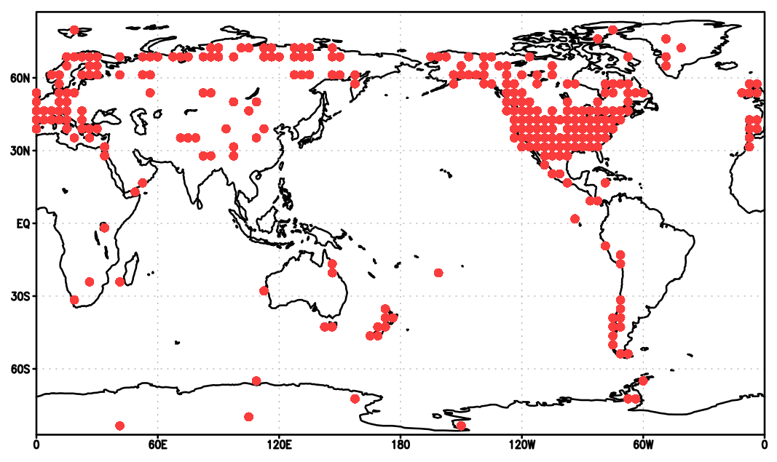

Material and Method: DA
Observation distribution (N=283)
Observation:
Annual mean surface Temp.
Model: AGCM SPEEDY
Observation network: Mann et al. (2008)
Run 2-cycle with
  NoDA, naïve, TAU, and IAU DA
y1850
y1851
y1855
y1856
y1857
SST from CMIP5
Observation
+Noise ~N(0,1)
Nature Run
Ensemble run
100 member
$$⋮$$
Analysis
Analysis
Spin-up
Forecast
Forecast

Slide 27
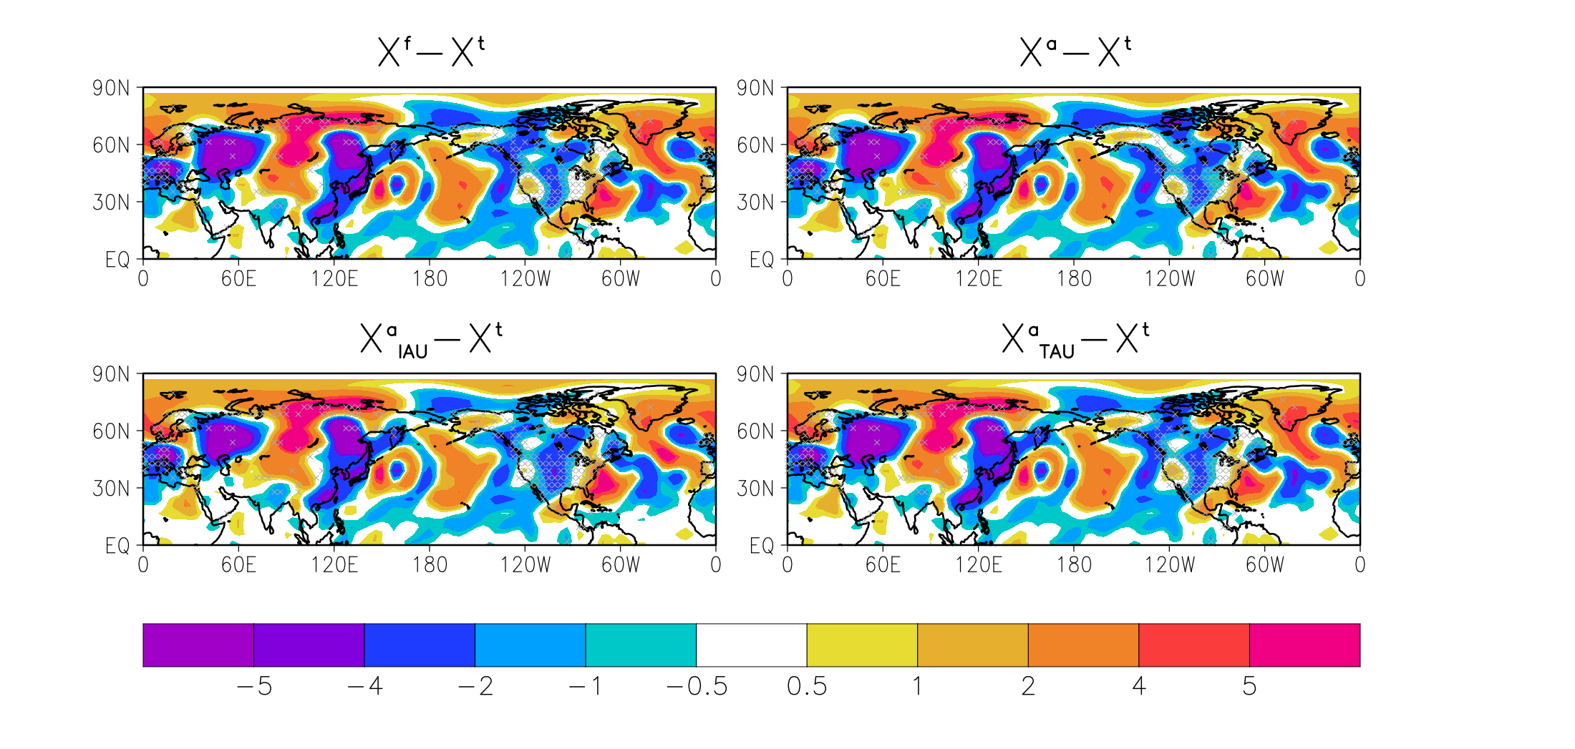
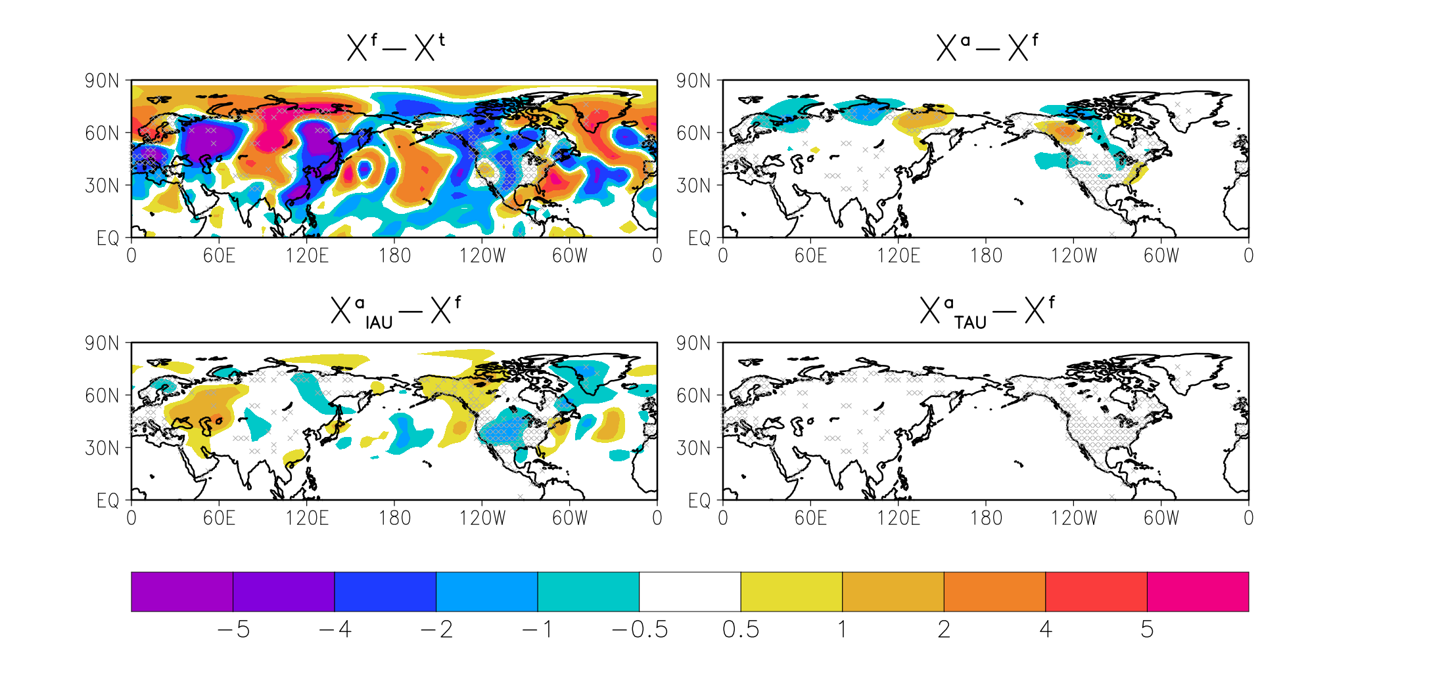







Instantaneous Analysis @0000UTC 1Jan 1856
0000UTC
1Jan1857
$$\overline{X_{NoDA}^{f}}−X^{t}$$
0000UTC
1Jan1856
$$\overline{X_{NoDA}^{f}}−X^{t}$$
$$\overline{X_{Naive}^{a}}−\overline{X_{NoDA}^{f}}$$
$$\overline{X_{Naive}^{a}}−X^{t}$$
NoDA
Naive
$$\overline{X_{IAU}^{a}}−\overline{X_{NoDA}^{f}}$$
$$\overline{X_{TAU}^{a}}−\overline{X_{NoDA}^{f}}$$
$$\overline{X_{IAU}^{a}}−X^{t}$$
$$\overline{X_{TAU}^{a}}−X^{t}$$
TAU
IAU
Temperature @925 hPa [K]
Notes:
The figures compare the difference from the truth. It is hard to find difference among the panels.
So I changed the point of view.
The figures compare the difference from the forecast. Thus, the figures show how changed from the forecast.
In these figures, if the color is opposite to the first figure, the analysis mitigate the bias in the forecast.

Slide 28
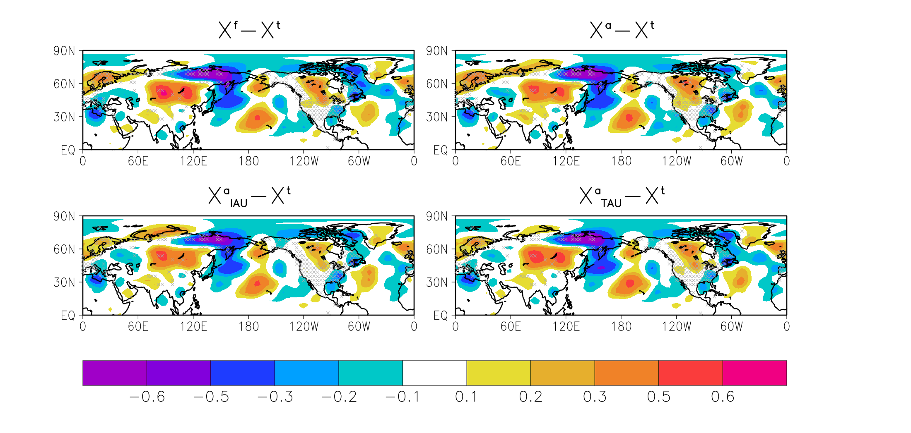
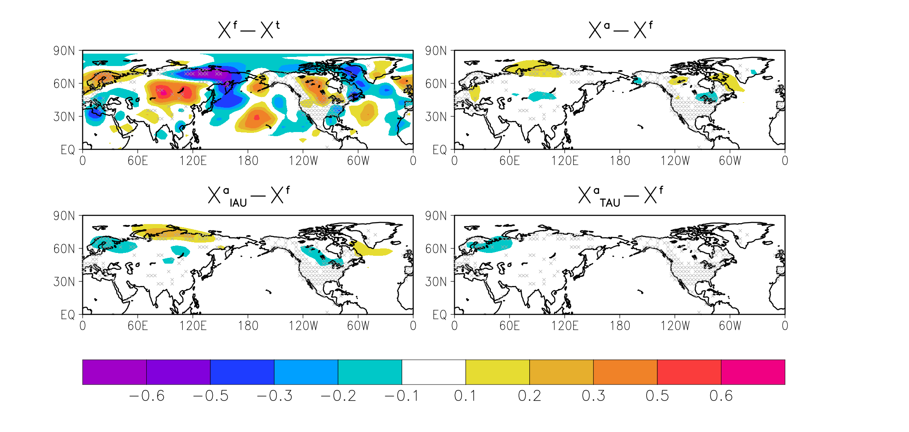








Time-Averaged Forecast (1Jan – 31Dec1856)
0000UTC
1Jan1856
0000UTC
1Jan1857
$$\overline{X_{NoDA}^{f}}−X^{t}$$
$$\overline{X_{Naive}^{f}}−\overline{X_{NoDA}^{f}}$$
$$\overline{X_{NoDA}^{f}}−X^{t}$$
$$\overline{X_{Naive}^{f}}−X^{t}$$
NoDA
Naive
$$\overline{X_{IAU}^{f}}−\overline{X_{NoDA}^{f}}$$
$$\overline{X_{TAU}^{f}}−\overline{X_{NoDA}^{f}}$$
$$\overline{X_{IAU}^{f}}−X^{t}$$
$$\overline{X_{TAU}^{f}}−X^{t}$$
TAU
IAU
Temperature @925 hPa [K]
Notes:
瞬時値の比較。AOなどの比較。

Slide 29
Skill comparison
手法ごと、観測resolutionごとのrmse
棒グラフ
例示として時系列のRMSEを示すと良いかも
Anomaly correlation

Slide 30
