Slide 1
Localization methods for assimilating dense observations in a global LETKF
The 8th EnKF Data Assimilation Workshop, Montreal, Canada, May 9, 2018
Yoichiro Ota
(Numerical Prediction Division/
Japan Meteorological Agency)

Slide 2
Motivations
There are growing number of observations available for data assimilation (DA).
For global DA, satellite radiance observations such as hyper spectral sounders have a lot of information.
Some challenges specific to the EnKF
The EnKF has a limitation on utilizing the information from large number of observations due to the limited ensemble size K.
DFS (Degrees of Freedom for Signal) is at most K-1 in the EnKF (localized domain).
Observation space localization is problematic for non-local observations such as satellite radiance.
There is no trivial “observed location”.
Model space localization may mitigate the issue.
Questions from operational NWP
Which determines the optimal localization scale, S/N ratio of ensemble-based B or number of observations in localized domain?
Can model space vertical localization be implemented at reasonable cost? Does it improve the EnKF analysis?

Slide 3
JMA Global EPS (GEPS)
 | Global EPS (GEPS)
Main targets | Typhoon forecast, One-week to One-month forecast
Frequency | 4 times a day when TC exists, 2 times a day otherwise
Forecast range | 5.5 days (06,18UTC), 18 days (00,12UTC)* 34 days (00,12UTC on Tue. and Wed.)
Ensemble size | 27 upto 11 days, 13 afterwards
Resolution | TL479L100 (Model top: 0.01hPa) upto 18 days, TL319L100 afterwards
Initial perturbations | SV (NH, TR and SH) + LETKF
Model ensemble | Stochastically Perturbed Physics Tendency (SPPT)
Boundary perturbations | Perturbations on SST
* Only on Tuesday, Wednesday, Saturday and Sunday and 11 days for other days at this point.
Global EPS covers from short-range to sub-seasonal forecast.
It has unified three operational EPSs known as Typhoon EPS, One-week EPS and One-month EPS on March 2017.
Perturbations from LETKF are introduced to represent the uncertainty on initial conditions better.

Slide 4
Specifications of LETKF in JMA GEPS
Model: TL319L100 (approx. 55km, model top 0.01hPa) version of operational GSM
LETKF with 50 member ensembles
Localization: see next slide
Adaptive multiplicative inflation (based on A-B and O-B statistics)
Initialization based on Hamrud et al. (2015)
Assimilate observations 6 hourly using the same set of observations as the JMA global early analysis
Except for hyper-spectral IR sounders (AIRS, IASI and CrIS)
The same bias correction is applied as the deterministic analysis
Ensemble mean of the analysis is replaced with the deterministic (4D-Var) analysis.

Slide 5
Adaptive localization based on number of observations
Default localization settings
Observation space localization based on the distance between analysis grid and observations.
Localization scale (1/sqrt(e)): 400 km in horizontal, 0.4 (0.8 for surface obs.) scale height in vertical, 3 hours in temporal
For satellite radiance, maximum of normalized weighting function and gaussian function with e-holding scale of 0.8 scale heights is used as vertical localization function*.
* Normalized weighting function is used for operational LETKF
Localization tested
Horizontal localization scale is adjusted to limit the number of observations p_{l} in local analysis for each observation type
Shorter localization scale is applied to the dense observations.
p_{l} is tuned so that sum of the localization function in local analysis becomes approximately half of the default setting (that is equivalent to set the horizontal localization scale to 300 km uniformly).
Vertical and temporal localization functions are the same as the default settings.

Slide 6
Experimental settings
Model: TL319L100 (approx. 55km, model top 0.01hPa) version of operational GSM
LETKF with 50 member ensembles
Adaptive multiplicative inflation (based on A-B and O-B statistics)
Initialization based on Hamrud et al. (2015)
Assimilate observations 6 hourly using the same set of observations as the JMA global cycle analysis (without hyper spectral sounders)
Experiments
CNTL: default localization settings
ADAP: adaptive localization scale
H300: horizontal localization scale is set to 300 km
Period: From July 10, 2016 to September 11, 2016 (Forecasts are verified for August 2016)
Bias correction coefficients of 4DVar (VarBC) are used, but the analysis ensemble mean is not replaced with the 4DVar analysis.

Slide 7
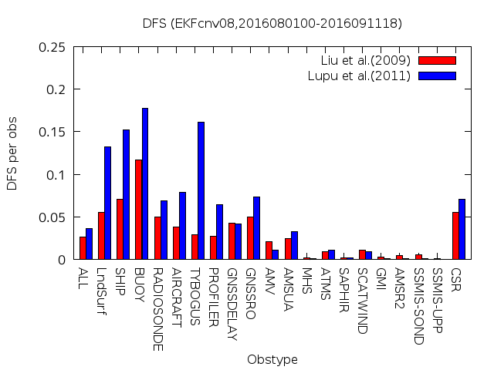
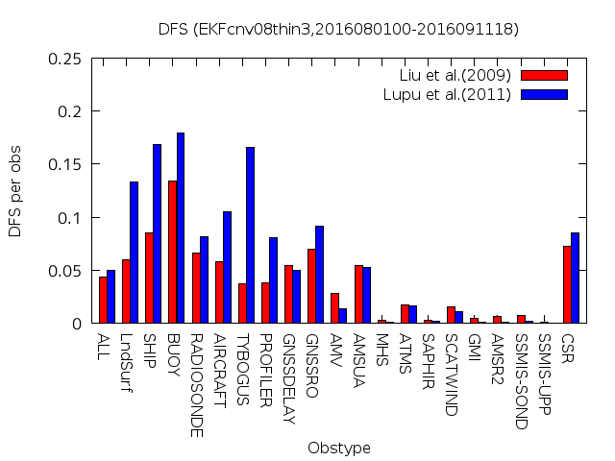
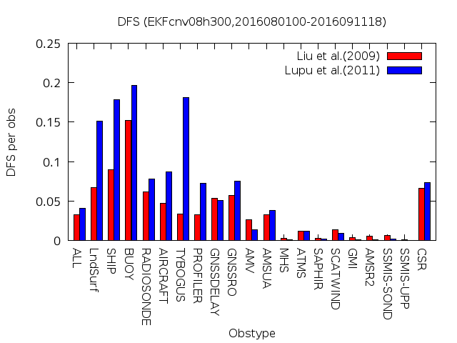
DFS (Degrees of Freedom for Signal)
Period
August 2016
CNTL
ADAP
Ensemble-based DFS by Liu et al. (2009)
$$trace\left[HAH^{T}R^{−1}\right]/p$$
H300
DFS by Lupu et al. (2011)
$$trace\left[\left(d^{a−b}d^{o−aT}\right)R^{−1}\right]/p$$
DFS statistics by two different methods are mostly consistent.
DFS values of both ADAP and H300 are larger than that of CNTL. → More information is extracted from the observations

Slide 8
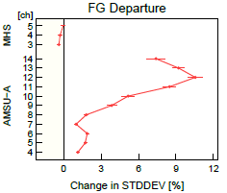
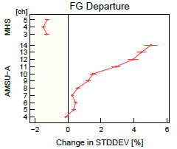
O-B statistics
MHS
Relative changes [%] in standard deviation of O-B for AMSU-A and MHS.
AMSU-A
0
12%
0
6%
ADAP-CNTL
H300-CNTL
O-B of H300 is smaller than that of ADAP.
Localization scale adjustment based on observation numbers is not better than simple uniform localization scale change.
O-B of H300 and ADAP for AMSU-A are larger than that of CNTL. On the other hand, O-B of H300 for MHS is smaller than that of CNTL.
Suggesting optimal localization scale for MHS (humidity sensitive ch) is shorter than that for AMSU-A (temperature sensitive ch).
For AMSU-A, O-B of H300 and ADAP are degraded especially on stratosphere which suggests wider horizontal localization is preferable in the stratosphere.

Slide 9
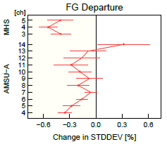
O-B statistics (cont.)
Relative changes [%] in standard deviation of O-B for AMSU-A and MHS.
MHS
AMSU-A
* Humidity sensitive observations: MHS, ATMS (ch18-22), SSMIS (ch9-11), GMI, AMSR2, SAPHIR, CSR, RH (radiosonde)
Q300-CNTL
When horizontal localization scale of humidity sensitive observations* is set to 300 km (Q300), O-B of both AMSU-A and MHS are decreased.
One possibility is that the ensemble-based B of humidity is noisier than those of other variables. Thus, shorter horizontal localization scale is preferable.
Optimal localization scale is likely determined by the S/N ratio of ensemble-based background error covariance, not by the observation density (at least with current observation coverage).
Notes:
Thinning intervals for satellite radiance observations
AMSU-A, ATMS: 250 km
CSR: 220 km
MW imager (GMI, AMSR2 and SSMIS), Hyper spectral IR sounders: 200 km
MW sounders (MHS, SAPHIR and SSMIS-UPP): 180 km

Slide 10
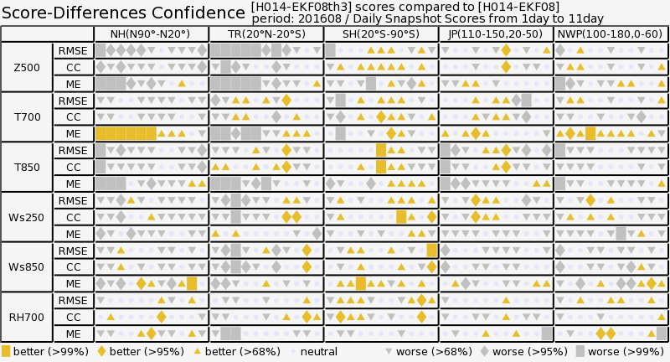
Score cards against radiosonde
NH
Tropics
SH
Japan
NW Pacific
Forecast score of ADAP is significantly degraded for short-range forecasts.
Orange: ADAP is statistically better than CNTL
Gray: ADAP is statistically worse than CNTL

Slide 11
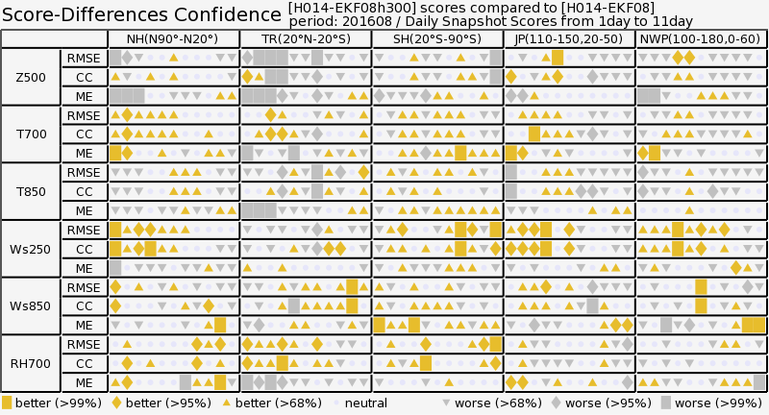
Score cards against radiosonde
NH
Tropics
SH
Japan
NW Pacific
Forecast score of H300 is improved in some elements on extra-tropics.
Short-range forecast score in tropics is still worse than CNTL.
Orange: H300 is statistically better than CNTL
Gray: H300 is statistically worse than CNTL

Slide 12
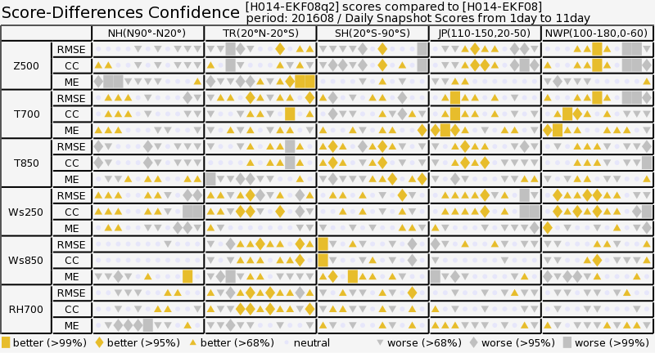
Score cards against radiosonde
NH
Tropics
SH
Japan
NW Pacific
Forecast score of Q300 is mostly neutral compared to CNTL.
Orange: Q300 is statistically better than CNTL
Gray: Q300 is statistically worse than CNTL

Slide 13
Model space localization based on modulated ensembles (Bishop et al. 2017) 1/2
Localized background error covariance $B_{loc}$ is constructed as
o:schur product
Where, B_{ens} is raw ensemble-based B, F is localization matrix applied to B and
and
Z is modulated ensemble perturbation which has K x L members
ETKF analysis with modulated perturbations Z is equivalent to the LETKF using model space localization.
To do the analysis cycle, the gain form of ETKF is used to construct K members of analysis perturbations instead of K x L members.

Slide 14
Model space localization based on modulated ensembles (Bishop et al. 2017) 2/2
Original form of ETKF using modulated ensembles
…(1)
$$Z_{a}=Z[C{\left(Γ+I\right)}^{−\frac{1}{2}}C^{T}]$$
$$=Z−C\left[{I−\left(Γ+I\right)}^{−\frac{1}{2}}\right]Γ^{−1}C^{T}{\left(HZ\right)}^{T}R^{−1}(HZ)$$
…(2)
← Gain form
Where $C$ and $Γ$ are eigen-vectors and diagonal matrix with eigen-values of ${\left(HZ\right)}^{T}R^{−1}(HZ)$. H is observation operator, R is observation error covariance, $x_{a}$and $x_{f}$are the analysis and the first guess and overbar represents ensemble mean.
Using the second line of (2), K member analysis perturbations are approximated with
$$X_{a}=X_{f}−αC\left[{I−\left(Γ+I\right)}^{−\frac{1}{2}}\right]Γ^{−1}C^{T}{\left(HZ\right)}^{T}R^{−1}(HX_{f})$$
…(3)
$a$is inherent inflation parameter to compensate the underestimation of analysis variance by using K member ensembles not K x L member ensembles.
This factor is not considered at this point ($α$=1).

Slide 15
Key aspects for implementing model space vertical localization
Model space localization is applied to the vertical localization.
Horizontal (and temporal) localization is not changed
Computational costs
Memory: require L (number of eigen-modes) times memory space compared to observation space localization.
Computation: require O(L²)~O(L³) times of computation on ETKF update
However, whole vertical column can be updated at once so that total computation is reduced by 1/N (number of vertical layers).
Number of eigen-modes that represents the vertical localization matrix is a key for the computational cost.

Slide 16
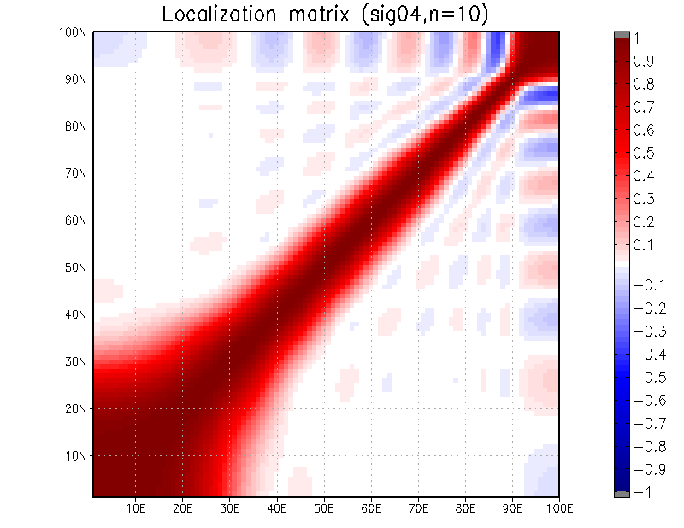
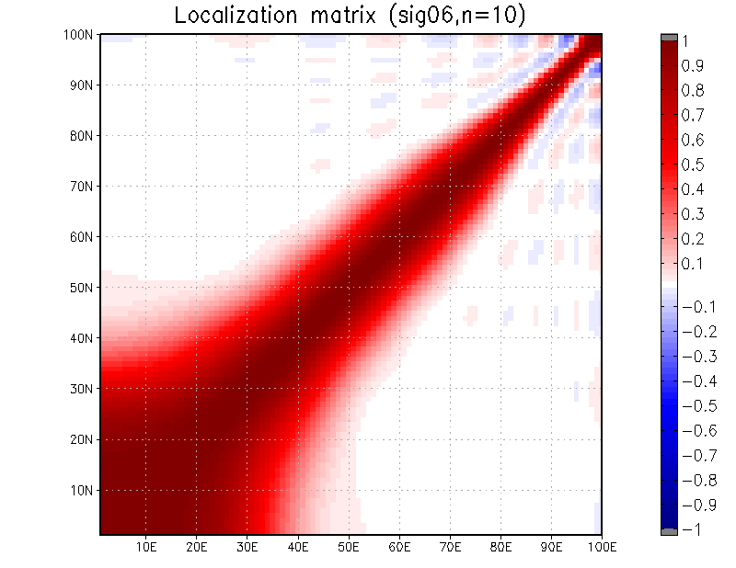
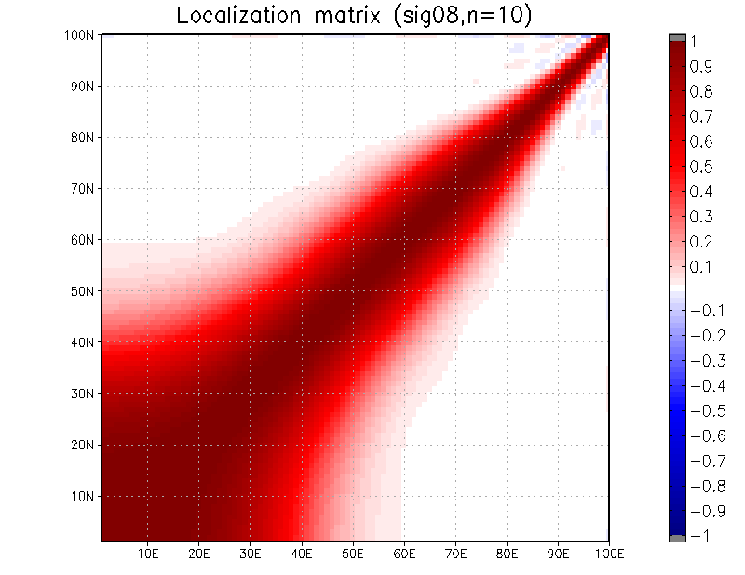
Approximation of localization matrix
$σ$=0.4 scale heights
$σ$=0.6 scale heights
Reconstructed localization matrices with L=10 eigen-modes.
$σ$=0.8 scale heights
Wider the localization, less eigen-modes are required.
Following experiments use L=10 and $σ$ = 0.6 scale heights.

Slide 17
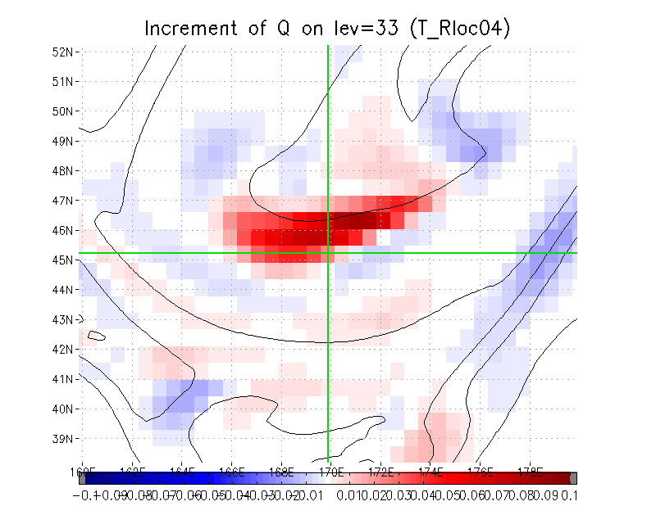
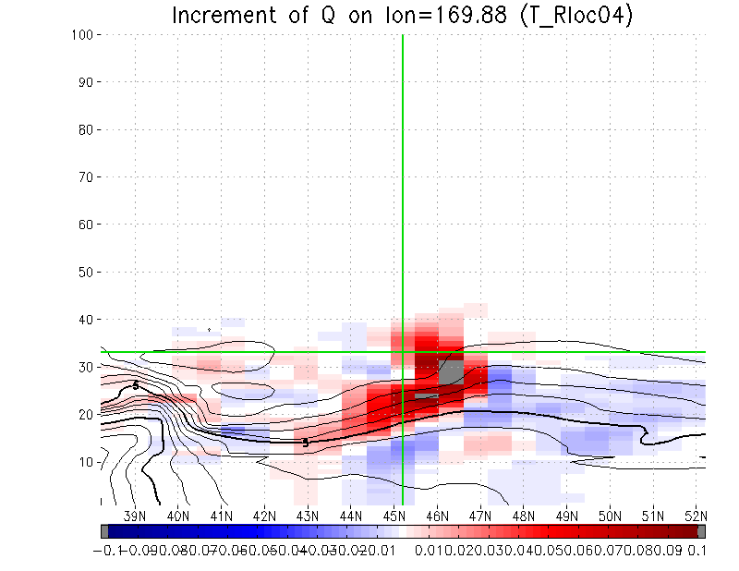
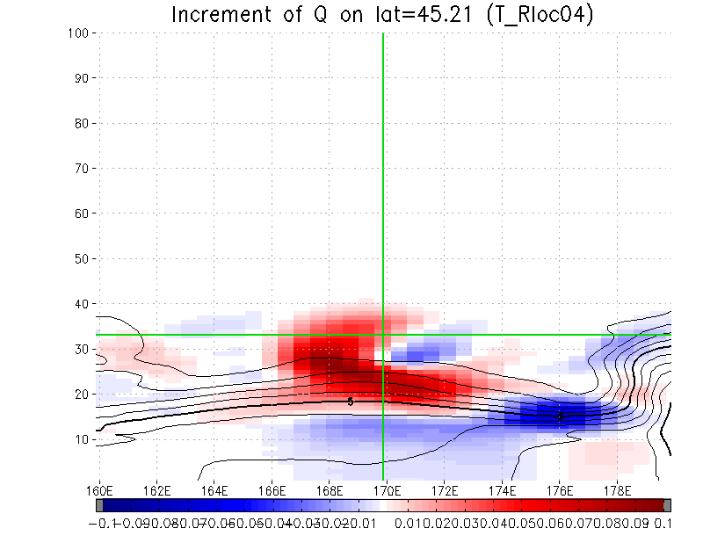
Q increment with assimilation of T obs on level 33 (observation space localization)
45.21N, 169.88E, O-B=1.0K, error=1.0K
Time=0h
Observed point
North
Upper left: horizontal map on level 33 (~500 hPa)
Upper right: latitude-vertical section
Lower left: longitude-vertical section
Color: analysis increment
Contour: the first guess
Increment pattern is very similar and only the vertical extent has been changed.
East

Slide 18
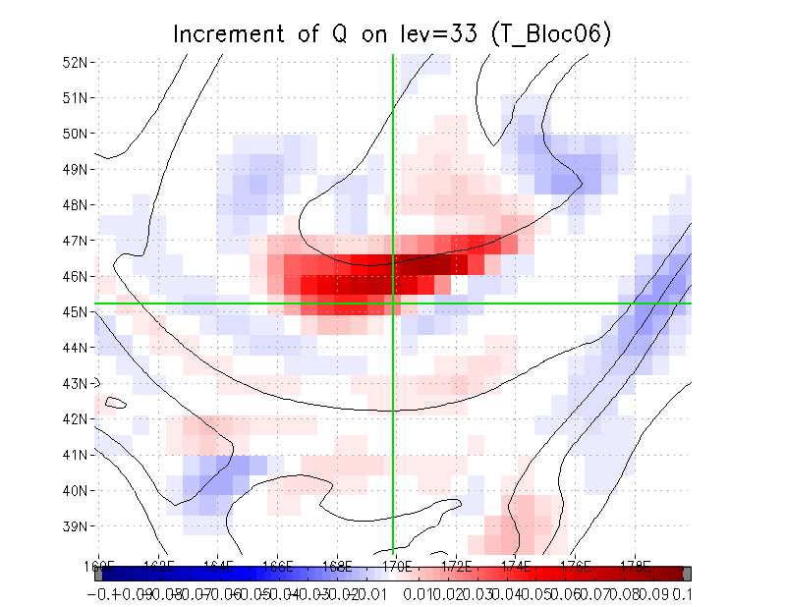
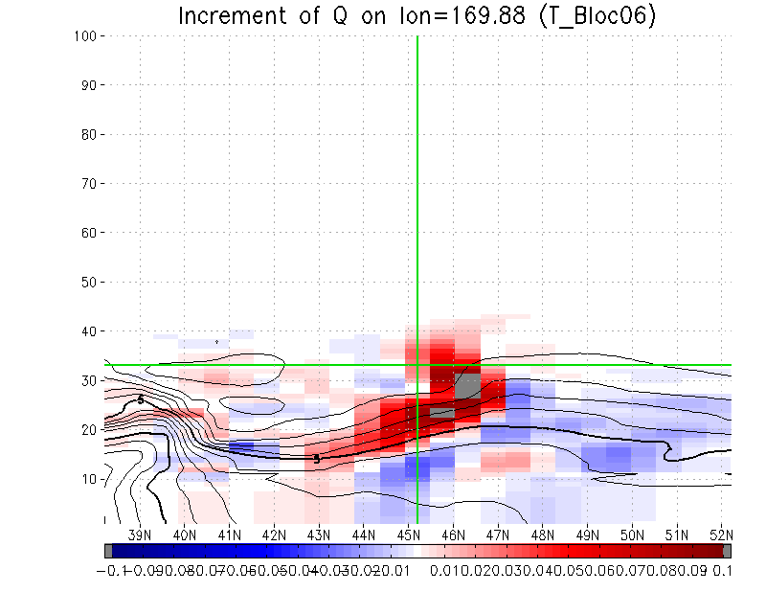
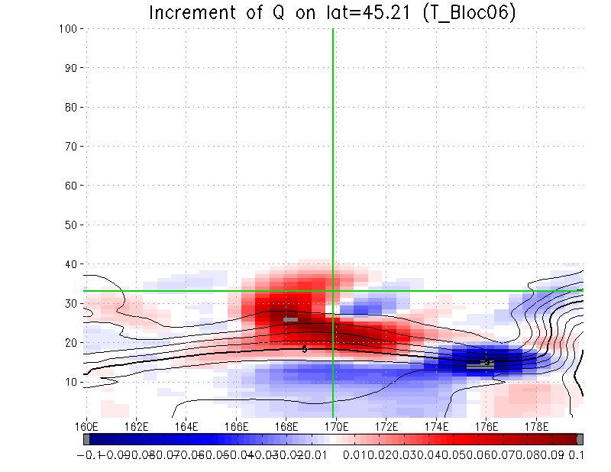
Q increment with assimilation of T obs on level 33 (model space localization)
45.21N, 169.88E, O-B=1.0K, error=1.0K
Time=0h
Observed point
North
Upper left: horizontal map on level 33 (~500 hPa)
Upper right: latitude-vertical section
Lower left: longitude-vertical section
Color: analysis increment
Contour: the first guess
Increment pattern is very similar and only the vertical extent has been changed.
East

Slide 19
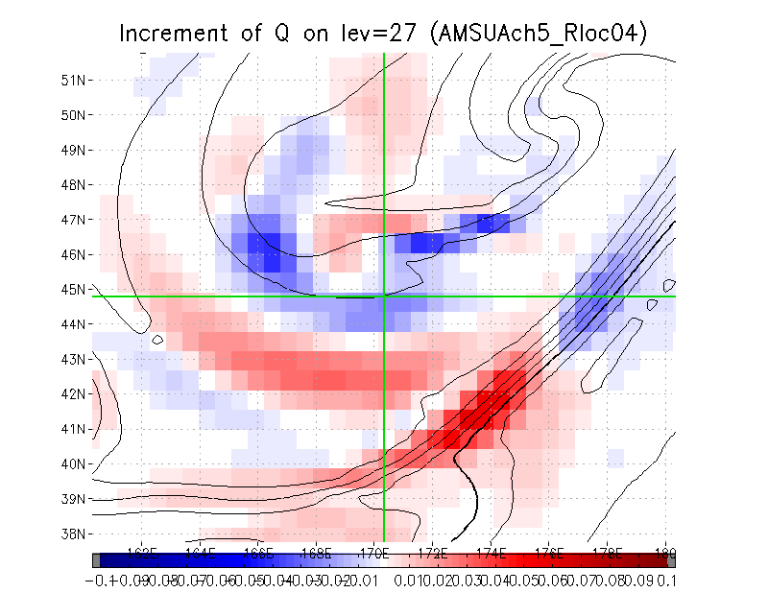
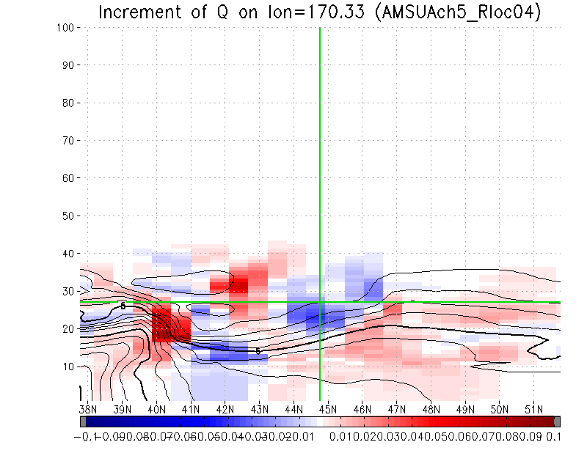
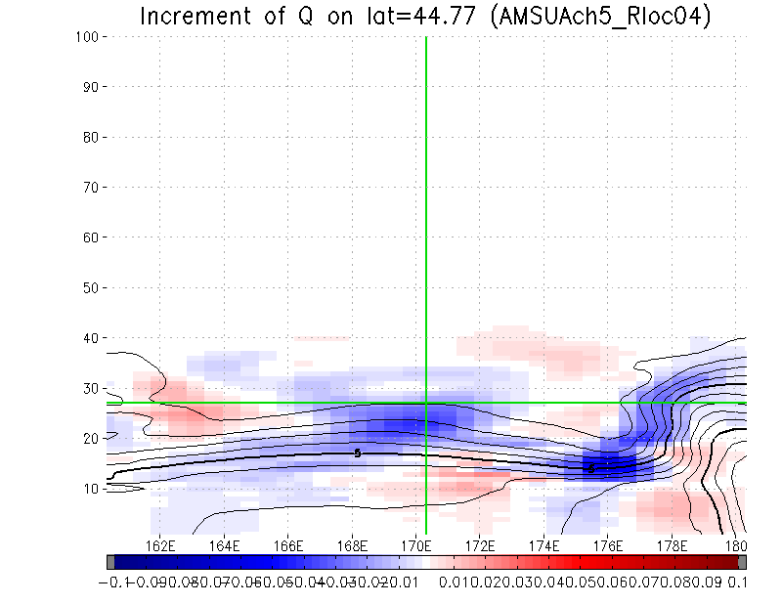
Q increment with assimilation of AMSU-A ch5 (observation space localization)
44.77N, 170.33E, O-B=0.39K, error=0.2K
Time=-3h
Observed point
North
Upper left: horizontal map on level 28 (~610 hPa)
Upper right: latitude-vertical section
Lower left: longitude-vertical section
Color: analysis increment
Contour: the first guess
In some part, increment pattern has been changed by applying model space vertical localization.
Assimilation of vertically non-local observations is affected by this change.
East

Slide 20
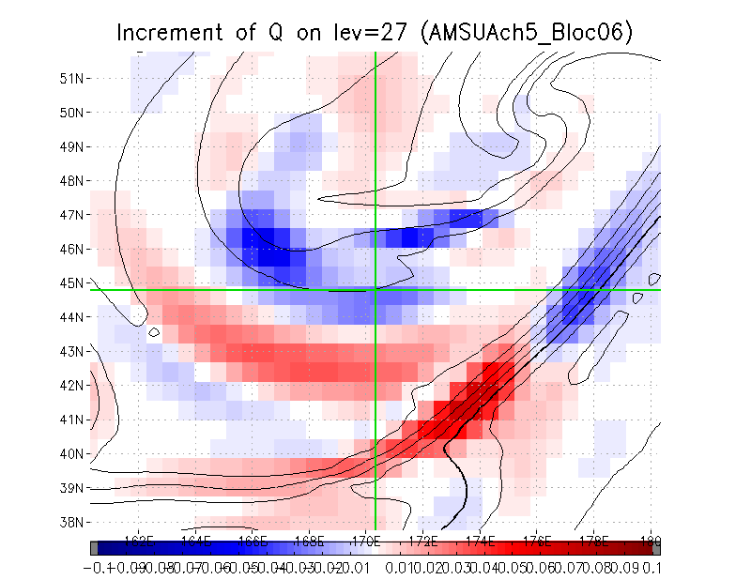
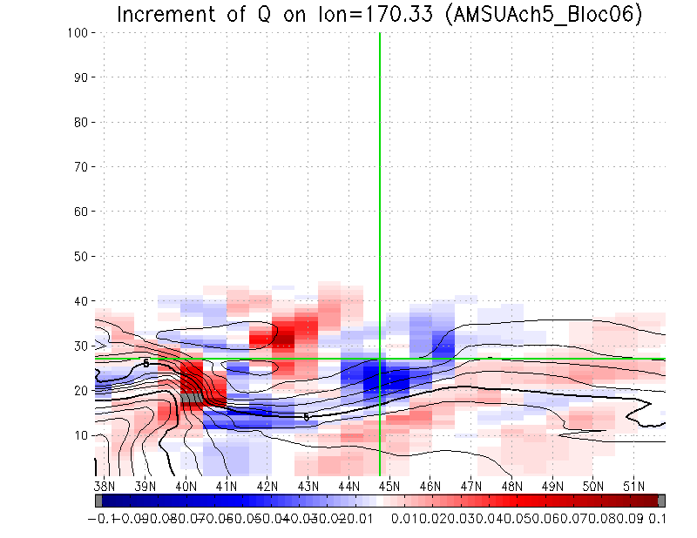
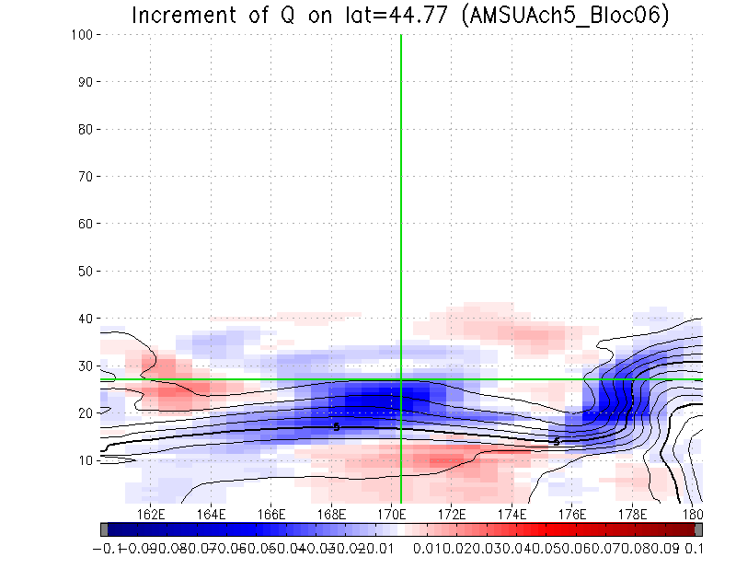
Q increment with assimilation of AMSU-A ch5 (model space localization)
44.77N, 170.33E, O-B=0.39K, error=0.2K
Time=-3h
Observed point
North
Upper left: horizontal map on level 28 (~610 hPa)
Upper right: latitude-vertical section
Lower left: longitude-vertical section
Color: analysis increment
Contour: the first guess
In some part, increment pattern has been changed by applying model space vertical localization.
Assimilation of vertically non-local observations is affected by this change.
East

Slide 21
Experimental settings
Model: TL319L100 (approx. 55km, model top 0.01hPa) version of operational GSM
LETKF with 50 member ensembles
Adaptive multiplicative inflation
Initialization based on Hamrud et al. (2015)
Assimilate observations 6 hourly using the same set of observations as the JMA global cycle analysis (without hyper spectral sounders)
Experiments
CNTL: observation space vertical localization, horizontal localization scale of humidity sensitive observations is 300 km.
BLOC: CNTL + model space vertical localization with localization scale of 0.6 scale heights and 10 eigen-modes
Period: From July 10, 2016 to September 11, 2016 (Forecasts are verified for August 2016)
Bias correction coefficients of 4DVar (VarBC) are used, but the analysis ensemble mean is not replaced with the 4DVar analysis.

Slide 22
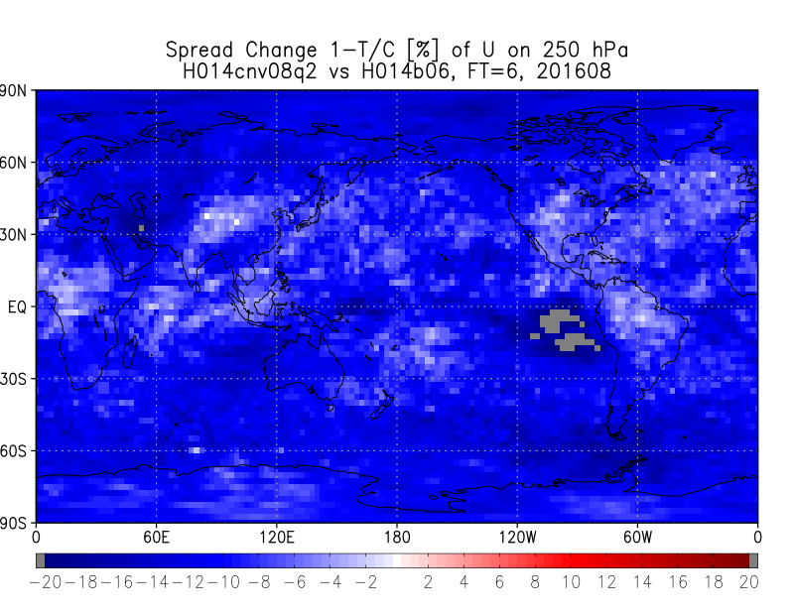
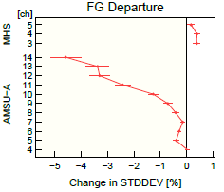
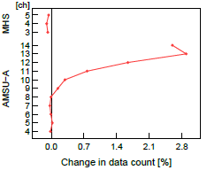
Analysis changes
← Relative change [%] of the first guess spread of U on 250 hPa (BLOC compared to CNTL)
MHS
Relative changes [%] in standard deviation of O-B for AMSU-A and MHS.→
AMSU-A
-5%
0
-20%
+20%
Relative changes [%] in number of used observations for AMSU-A and MHS.→
MHS
The first guess spread has been decreased by 10-20% in most layers.
O-B of observations on stratosphere has been decreased and more observations are assimilated.
Reduction of the first guess spread seems too large compared to the reduction of O-B.
AMSU-A
0
+2.8%
The first guess on stratosphere seems to be improved by model space vertical localization.
O-A is mostly increased (not shown) suggesting the reduction of B is too large.

Slide 23
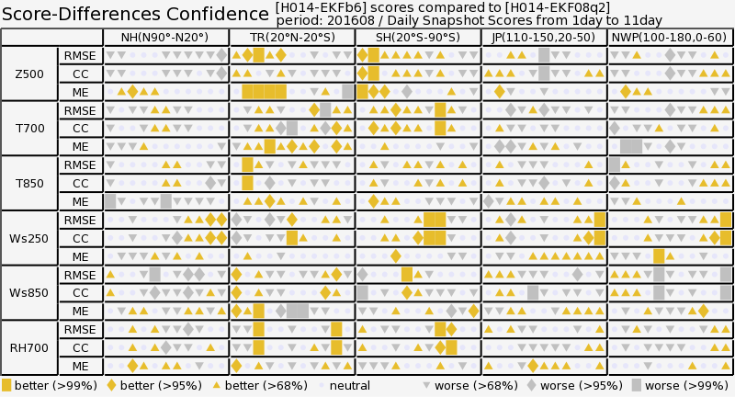
Score cards against radiosonde
NH
Tropics
SH
Japan
NW Pacific
Forecast score of BLOC is better than CNTL in Tropics and Southern hemisphere.
The impact is relatively moderate.
Orange: BLOC is statistically better than CNTL
Gray: BLOC is statistically worse than CNTL

Slide 24
Summary
Optimal localization scale
It is likely determined by the S/N ratio of ensemble-based covariance, rather than the number of assimilated observations.
Good news for the EnKF developers
This may depend on the system, though.
Model space vertical localization
It can be implemented with a reasonable cost but still increasing the computational cost by the factor of O(10).
Large benefit is required to justify the increased computational cost.
Preliminary result shows positive impact, but it seems to be moderate.
More benefits are required for operational implementation. Further investigations are necessary.
In part, this may be caused by too small B. Especially, adaptive covariance inflation with modulated ensembles needs to be carefully investigated. Should the “inherent inflation” be considered in addition to the current adaptive inflation approach (based on O-B and A-B statistics)?

Slide 25
References
Bishop, C. H., J. S. Whitaker and L. Lei, 2017: Gain form of the Ensemble Transform Kalman Filter and its relevance to satellite data assimilation with model space ensemble covariance localization. Mon. Wea. Rev., 145, 4575-4592.
Hamrud, M., M. Monavita and L. Isaksen, 2015: EnKF and hybrid gain ensemble data assimilation. Part I: EnKF implementation. Mon. Wea. Rev., 143, 4847-4864.
Liu, J., E. Kalnay, T. Miyoshi and C. Cardinali, 2009: Analysis sensitivity calculation in an ensemble Kalman filter. Q. J. R. Meteorol. Soc., 135, 1842-1851.
Lupu, C., P. Gauthier and S. Laroche, 2011: Evaluation of the Impact of Observations on Analyses in 3D- and 4D-Var Based on Information Content. Mon. Wea. Rev., 139, 726-737.

Slide 26
Backups

Slide 27
Adaptive inflation
In the LETKF, inflation coefficient is estimated on each grid based on A-B and O-B statistics. With model space vertical localization, whole vertical column is updated at once, so additional treatment is necessary to estimate the coefficient on each vertical layers.
A-B can be computed with
Weighting with the observation error variance like in the current LETKF,
With model space vertical localization, localization function $ρ$ includes horizontal and temporal localization only. For the estimation of inflation coefficient, observation space vertical localization is applied to this weighting as well.

