Slide 1
Assimilating GOES-16 ABI all-sky IR radiance using EnKF for convection-permitting severe thunderstorm predictions
Yunji Zhang, Fuqing Zhang, David J. Stensrud
Center for Advanced Data Assimilation and Predictability Techniques,
Department of Meteorology and Atmospheric Science,
Pennsylvania State University
Acknowledgements:
Eugene Claothiaux, Masashi Minamide, Scott Sieron (PSU)
Christopher Velden (CIMSS), Tim Schmit (NOAA/NESDIS)
The 8th EnKF Workshop
Montréal, 9 May 2018

Slide 2
Recent Progresses: EnKF & All-Sky Radiance
Tropical cyclone applications
GOES-13 for hurricane Karl (2010) (Zhang et al. 2016 GRL)
GOES-13 for hurricane Patricia (2015) (Presentation on Thu. by R. Nystrom)
Himawari-8 for typhoon Soudelor (2015) (Minamide & Zhang 2018 MWR, Honda et al. 2018 MWR)
GOES-16 for hurricane Harvey (2017) (Minamide & Zhang 2018 QJRMS)
Heavy rainfall applications
Himawari-8 for flood in Sep 2015 (Honda et al. 2018 JGR)
Assimilation techniques
Adaptive observation error inflation (AOEI) (Minamide & Zhang 2017 MWR)
Adaptive background error inflation (ABEI) (Minamide & Zhang 2018 MWR)
High-resolution, frequent assimilation on a tornadic thunderstorm event

Slide 3
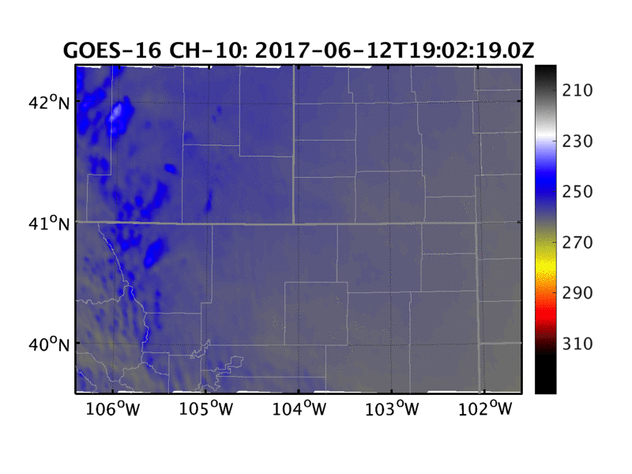
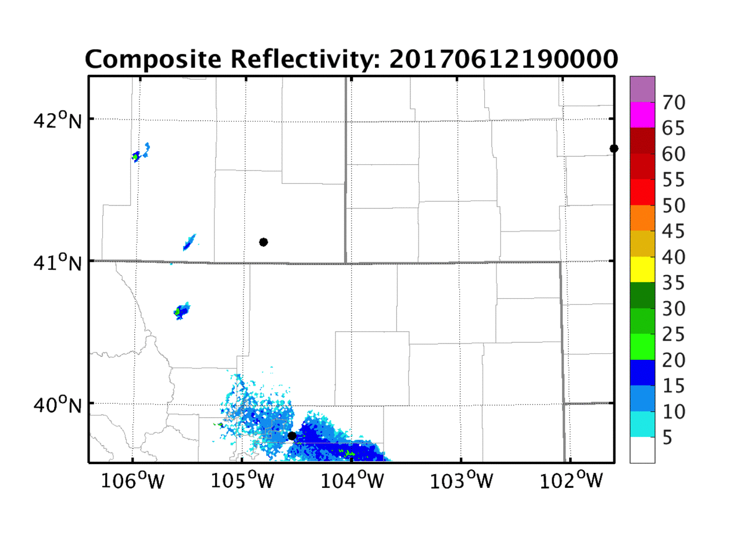
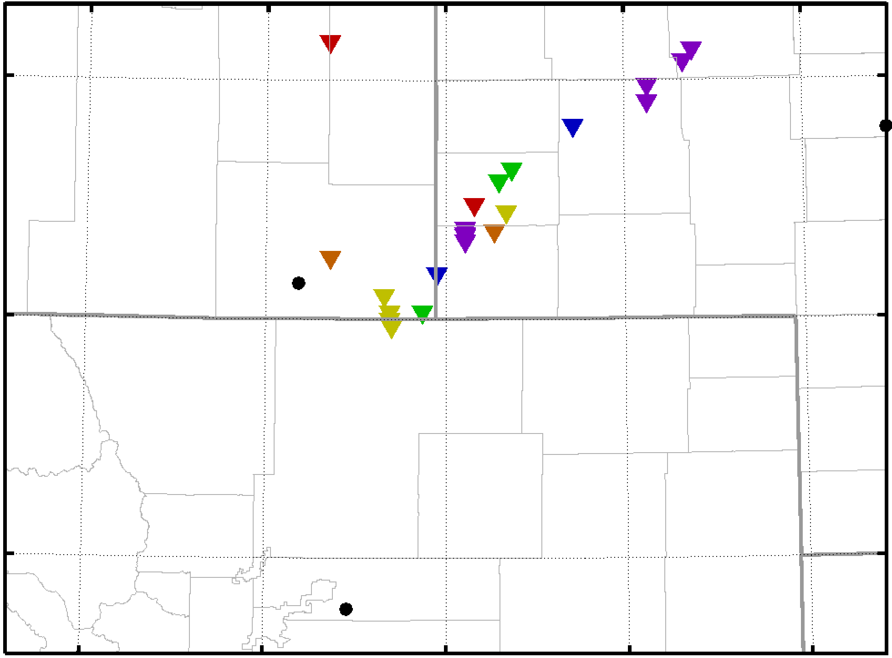
Even Overview: 12 June 2017

Slide 4
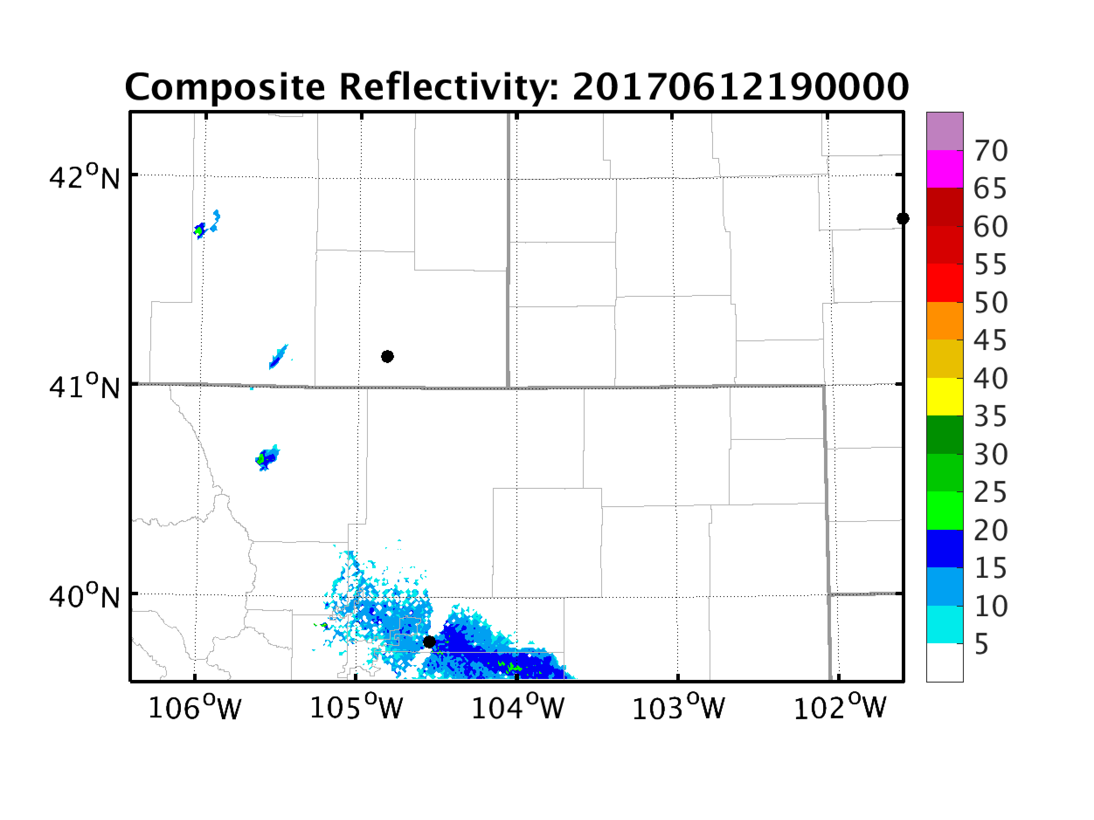
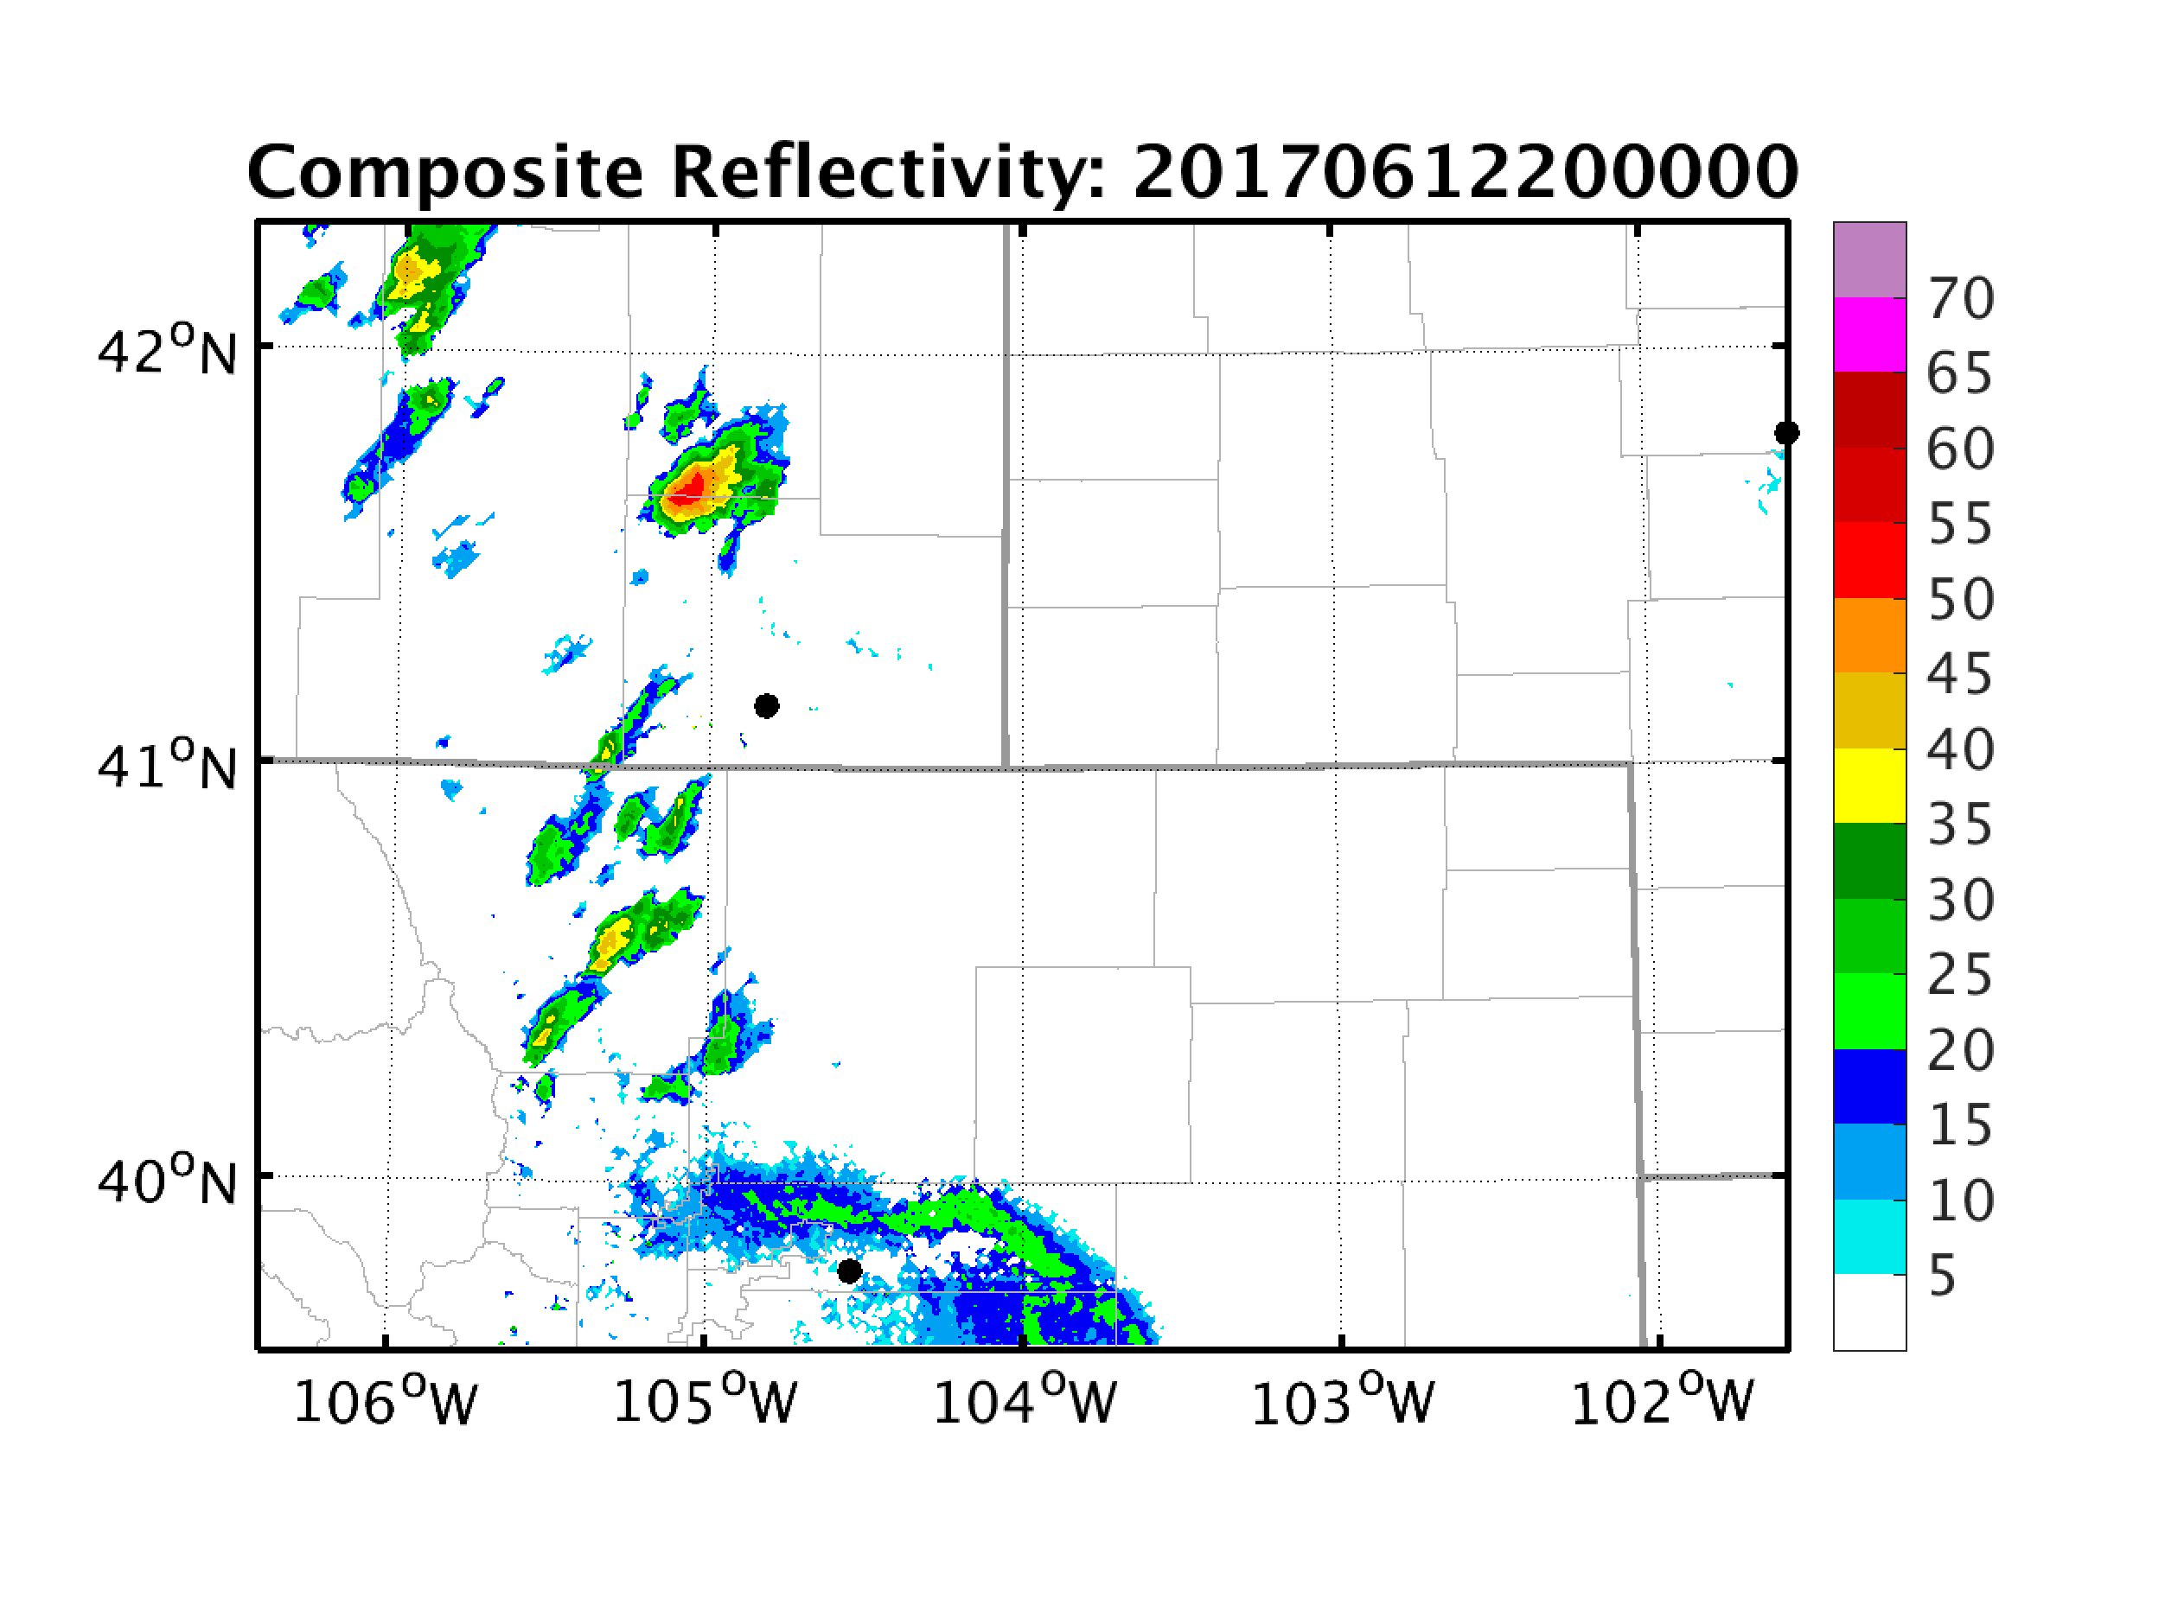
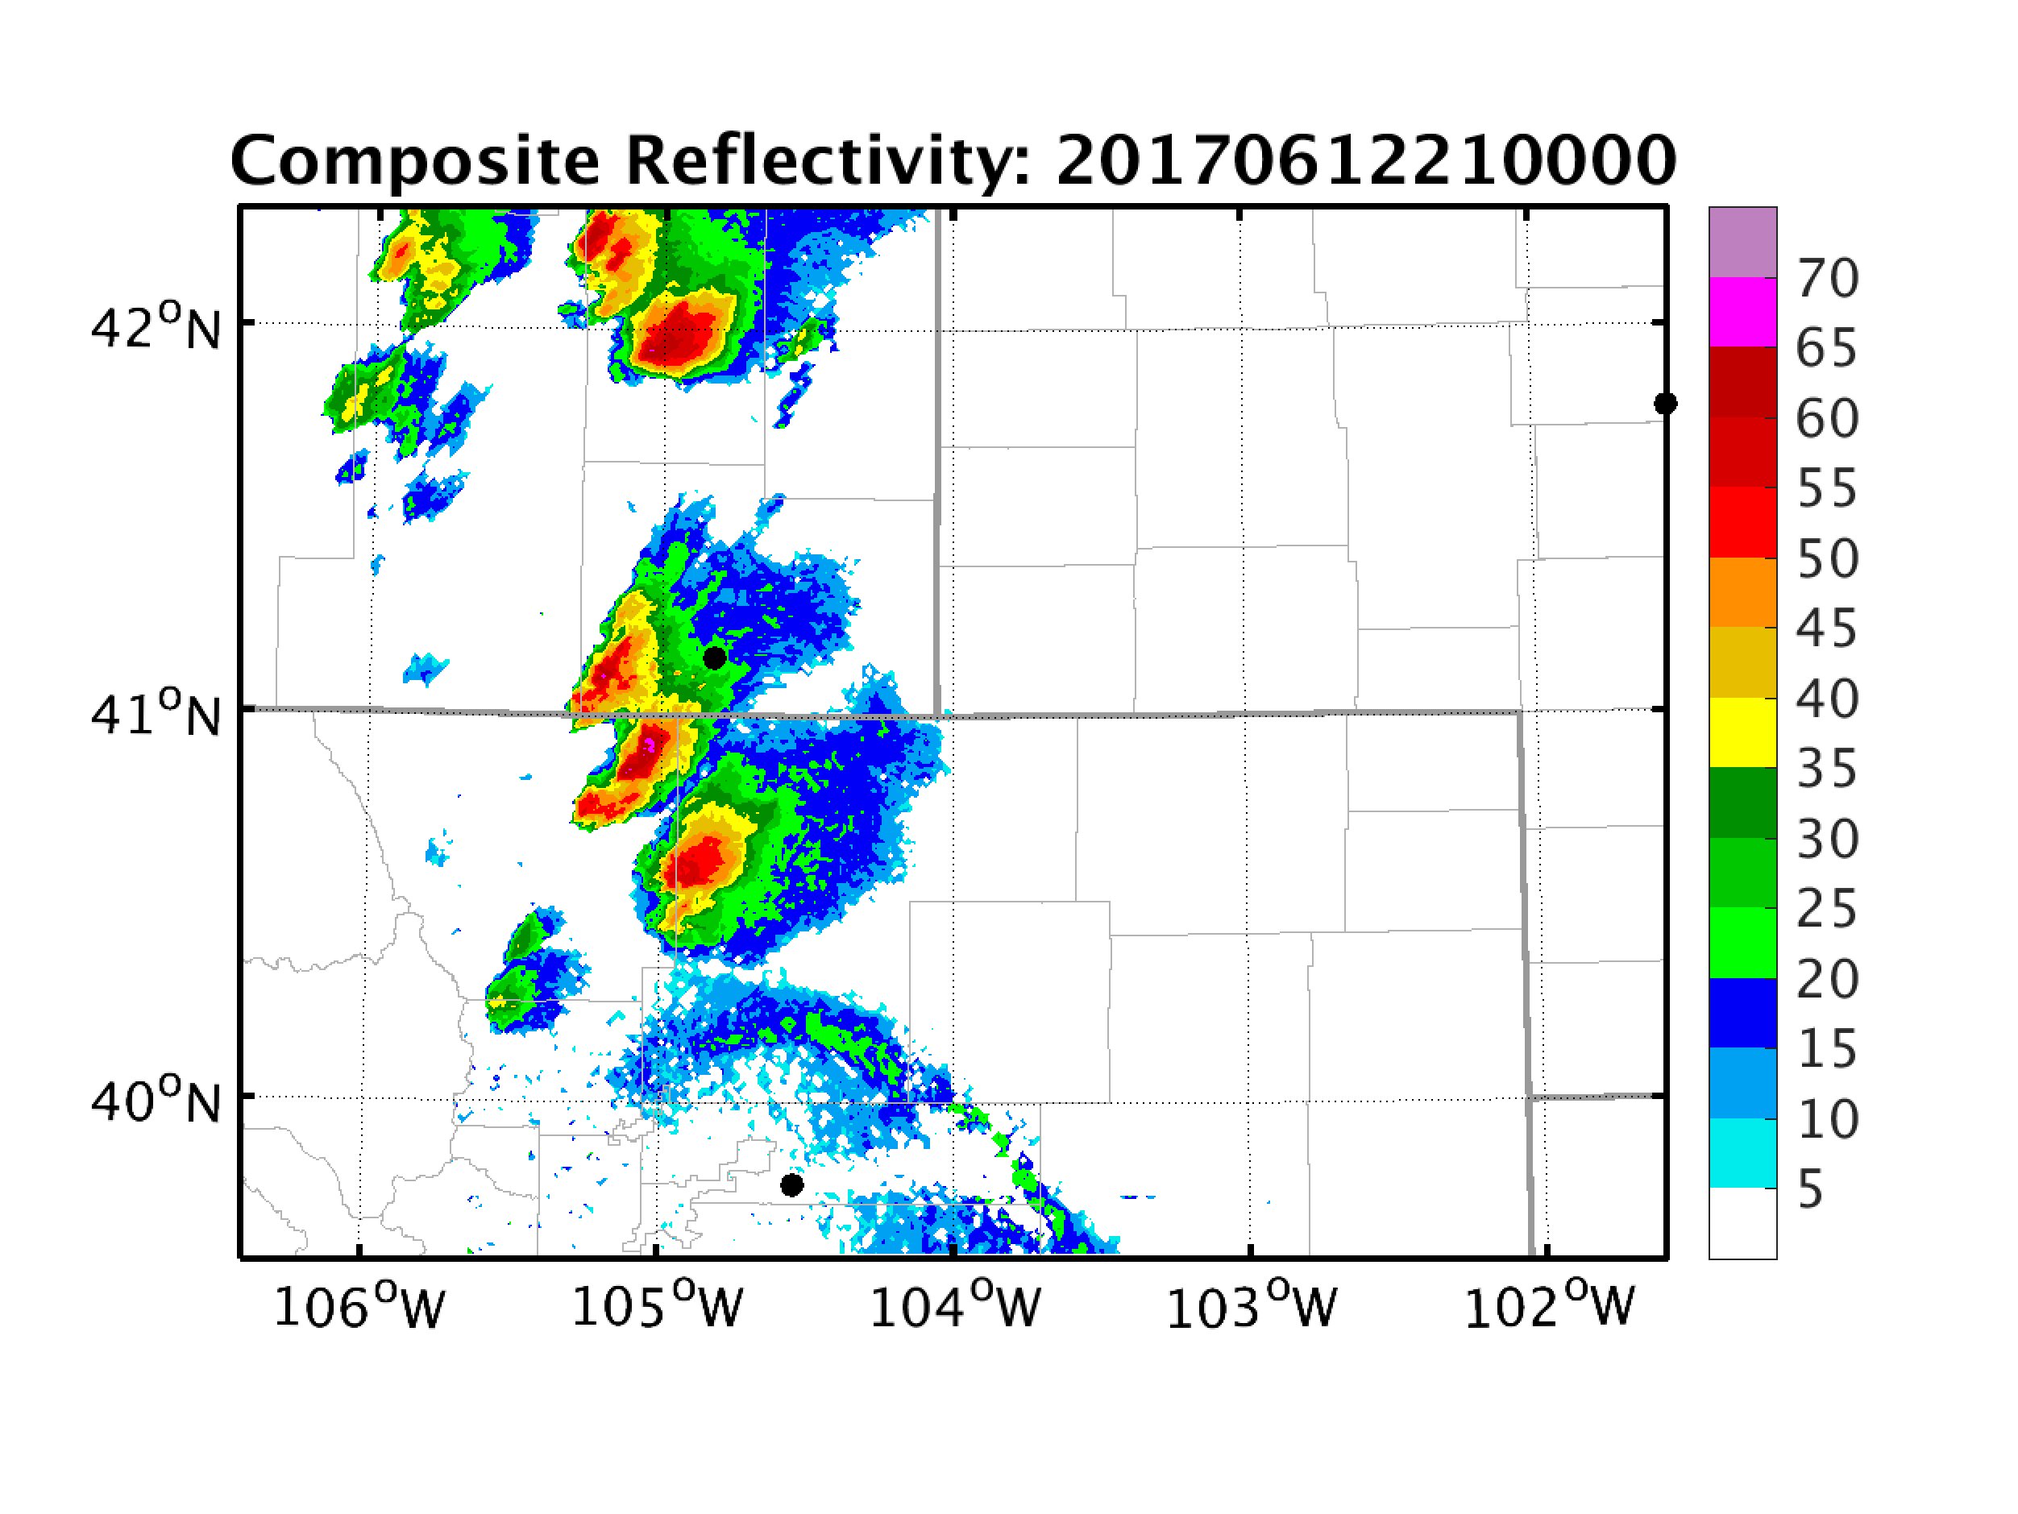
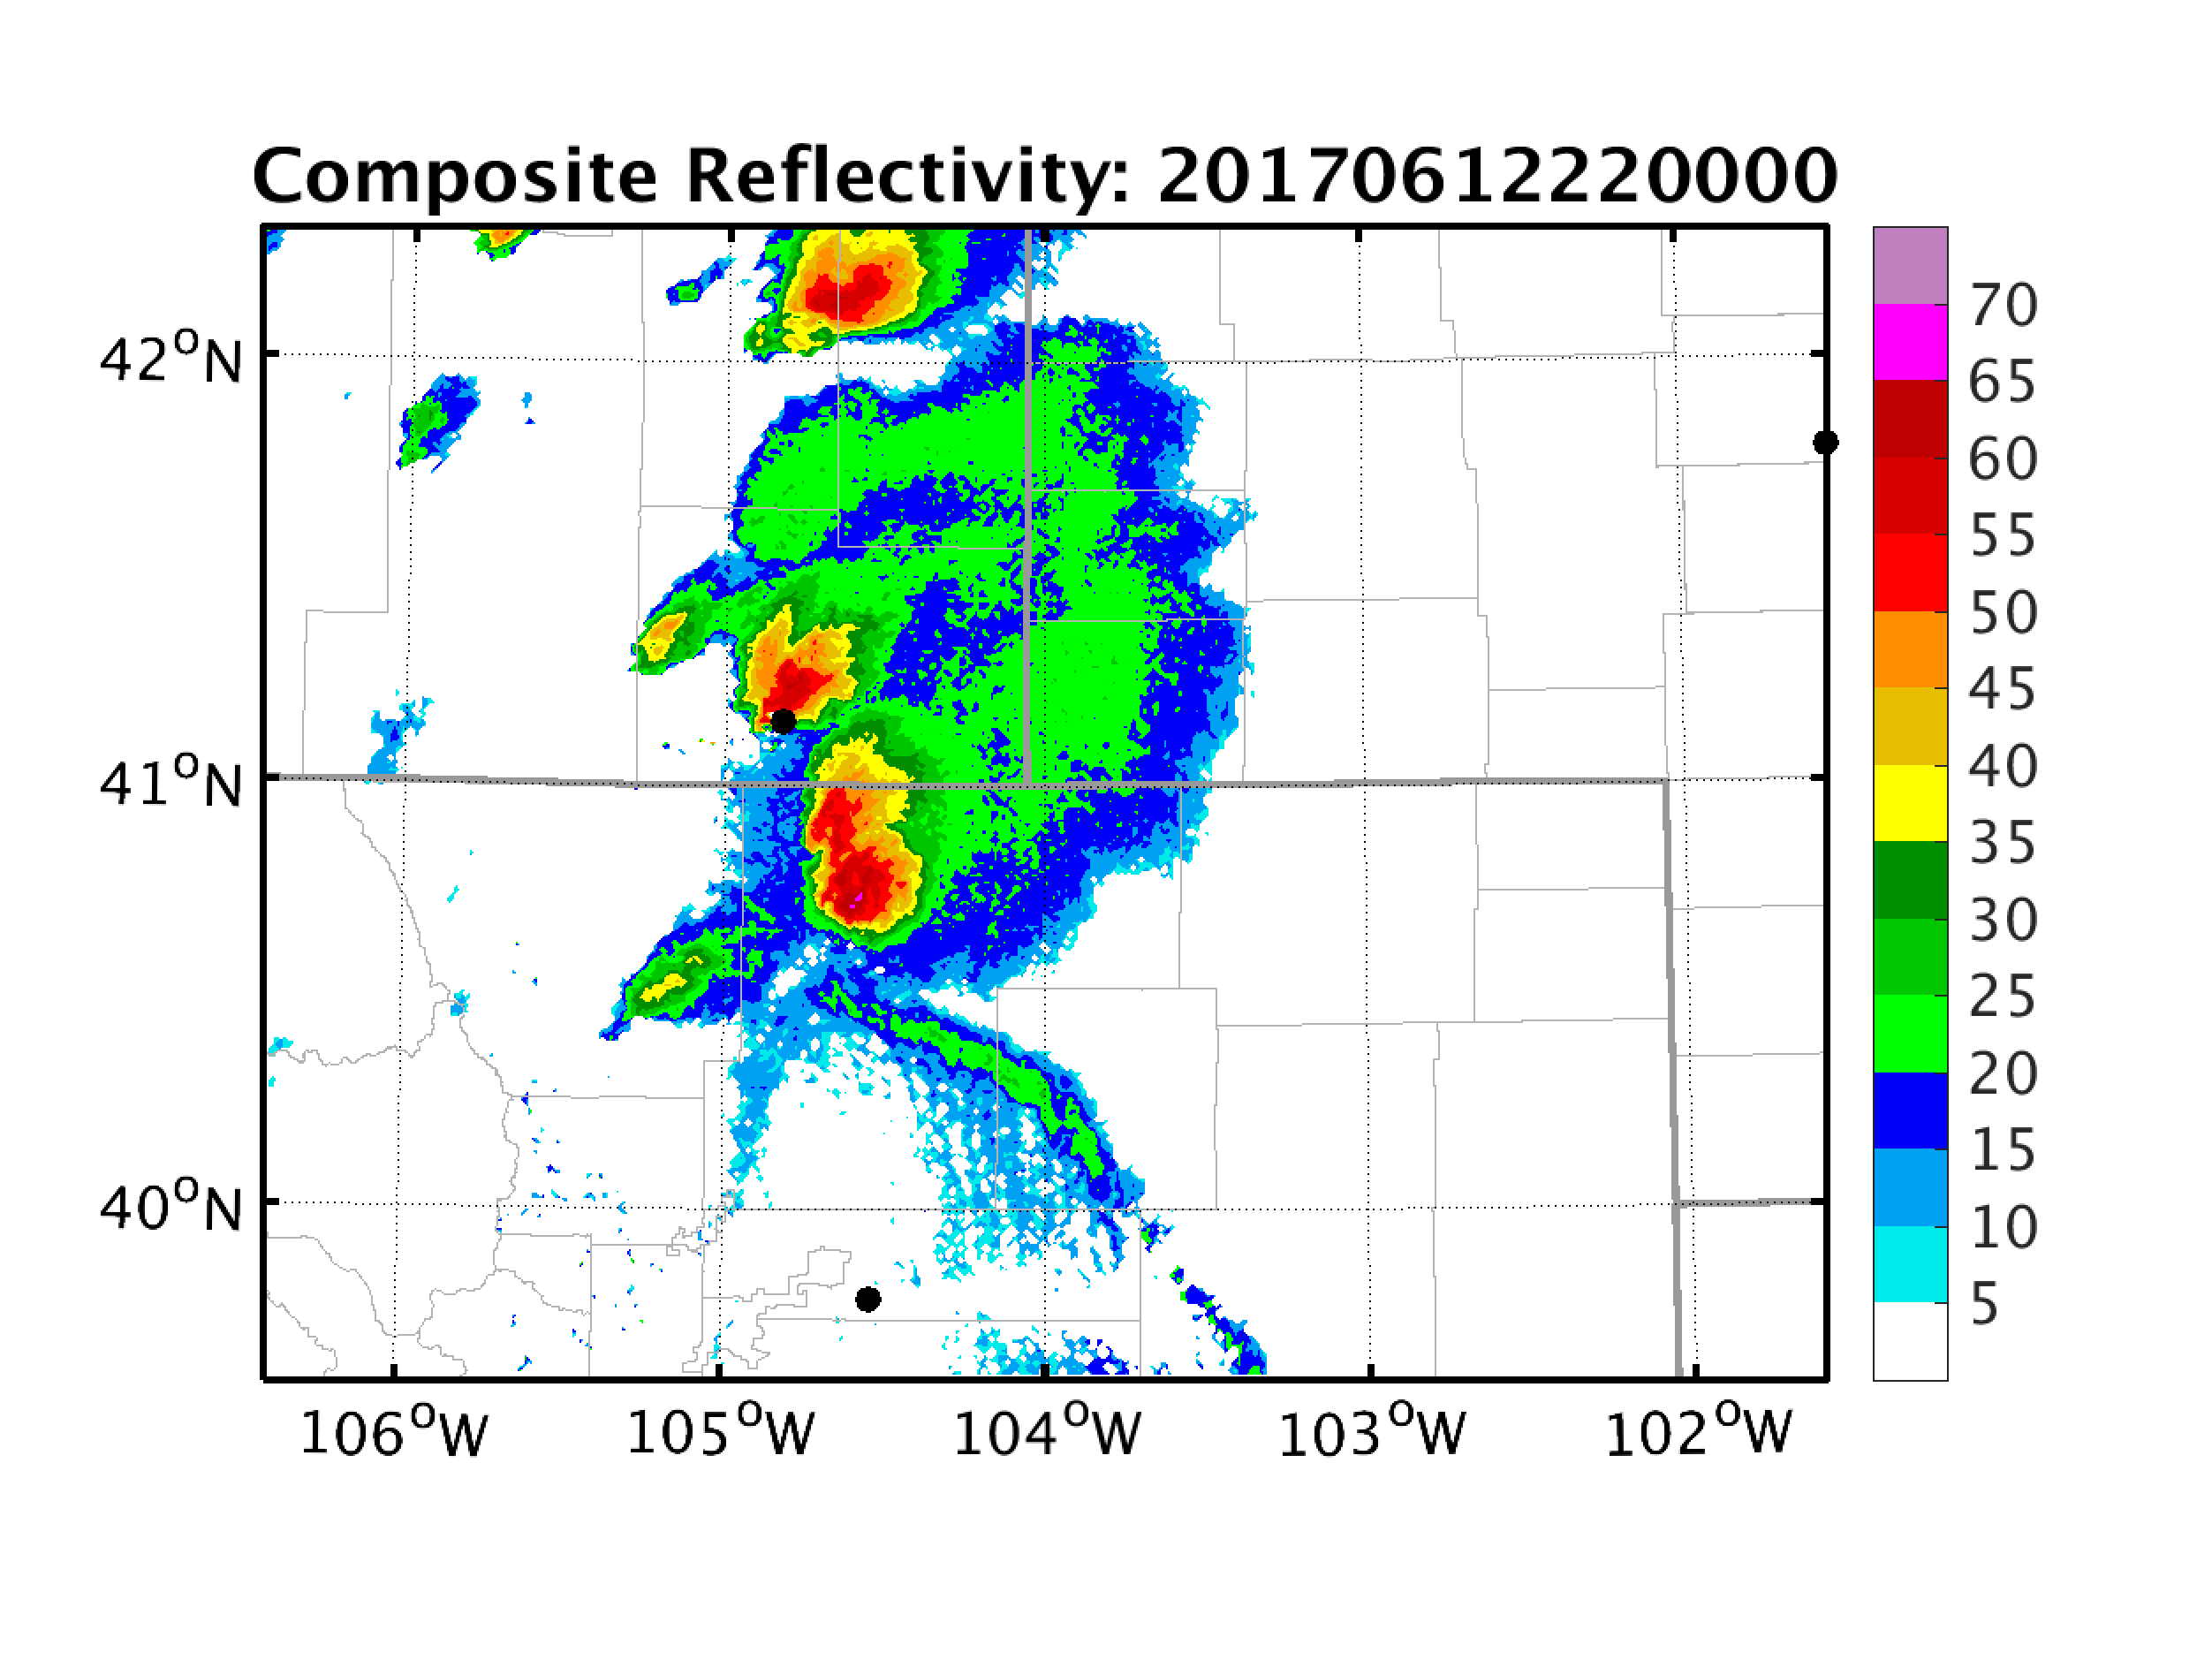
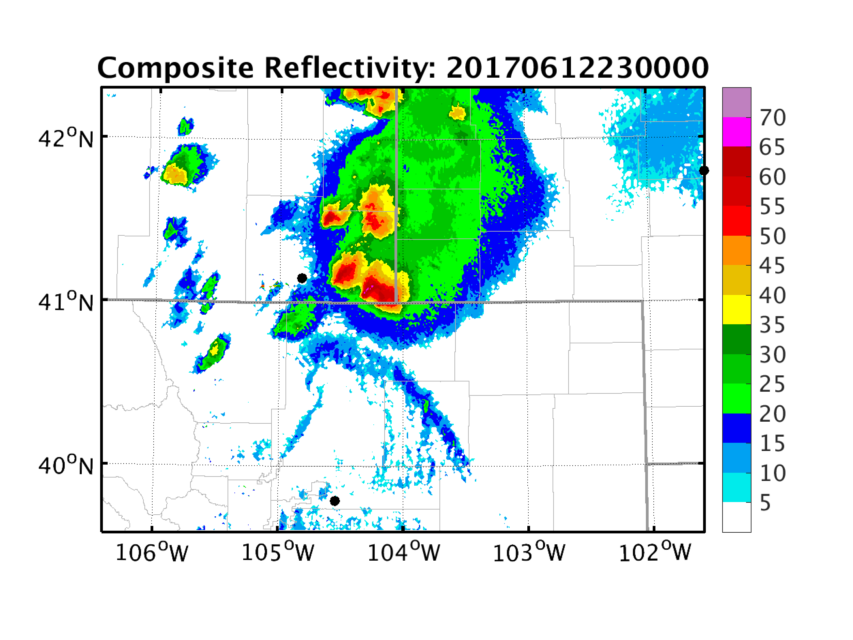
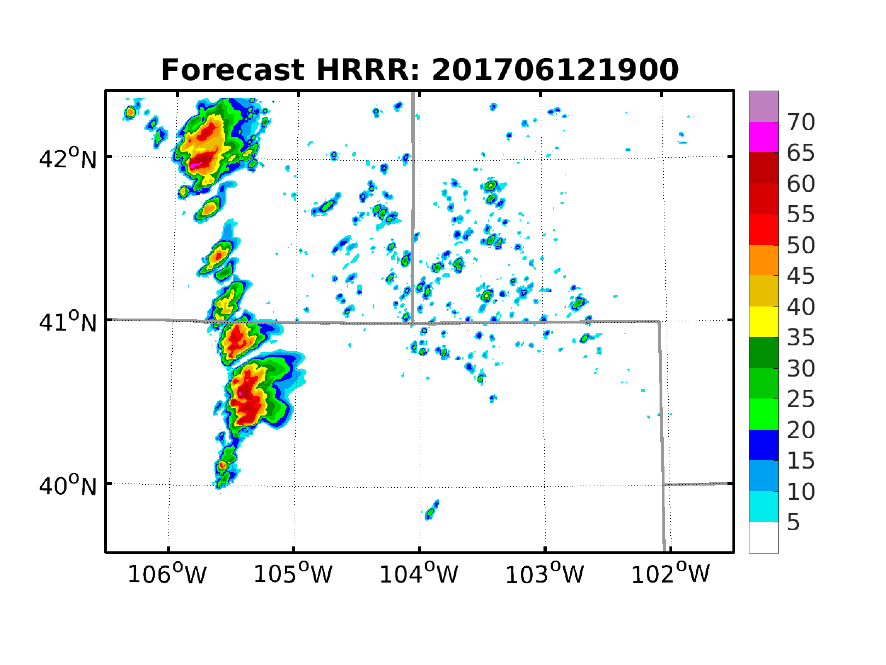
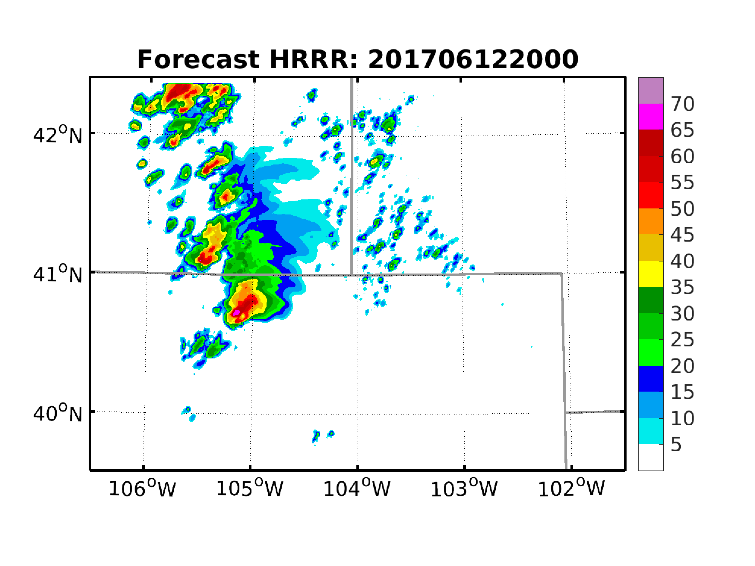
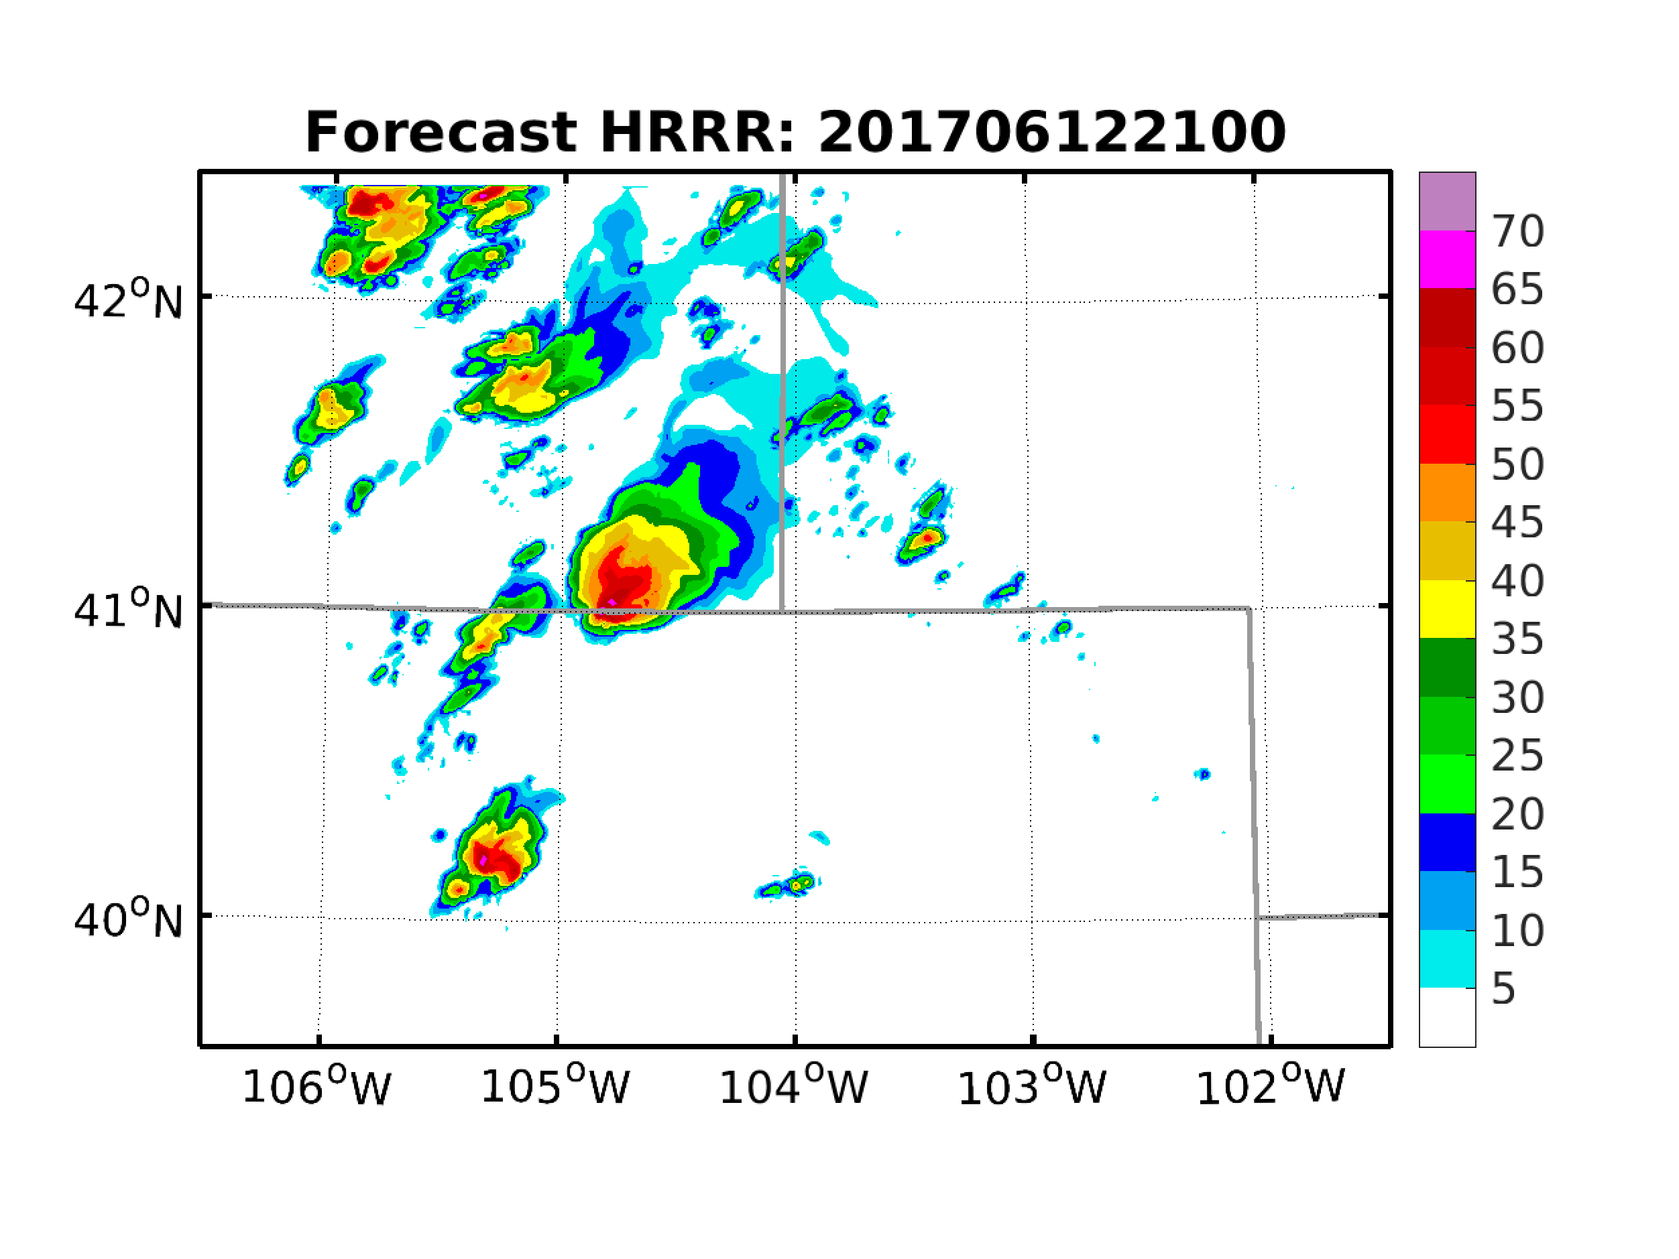
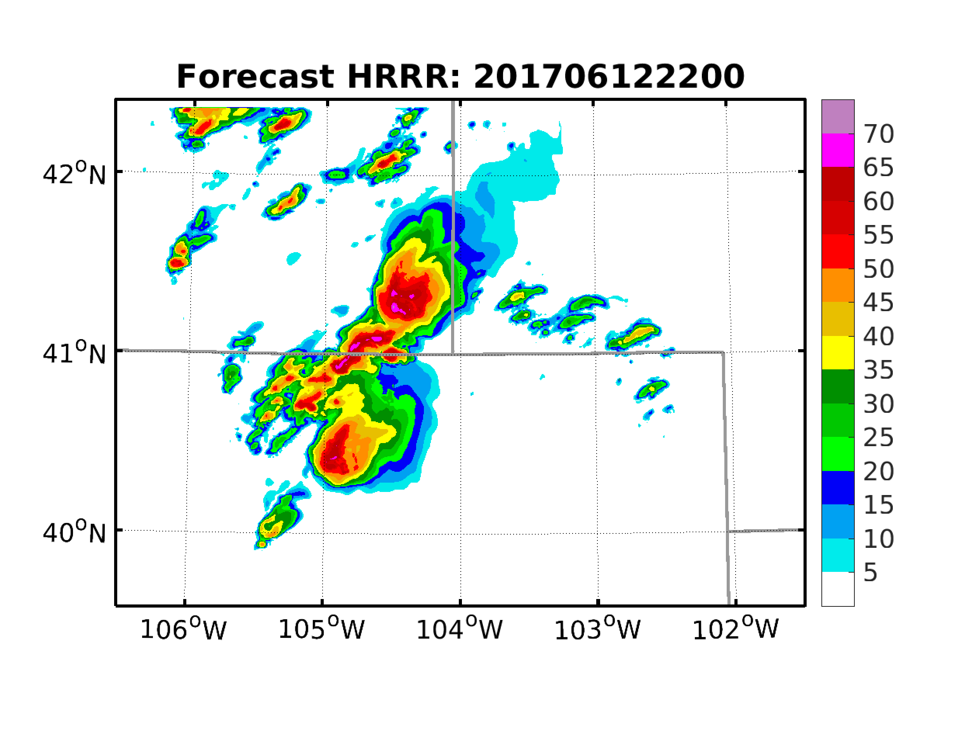
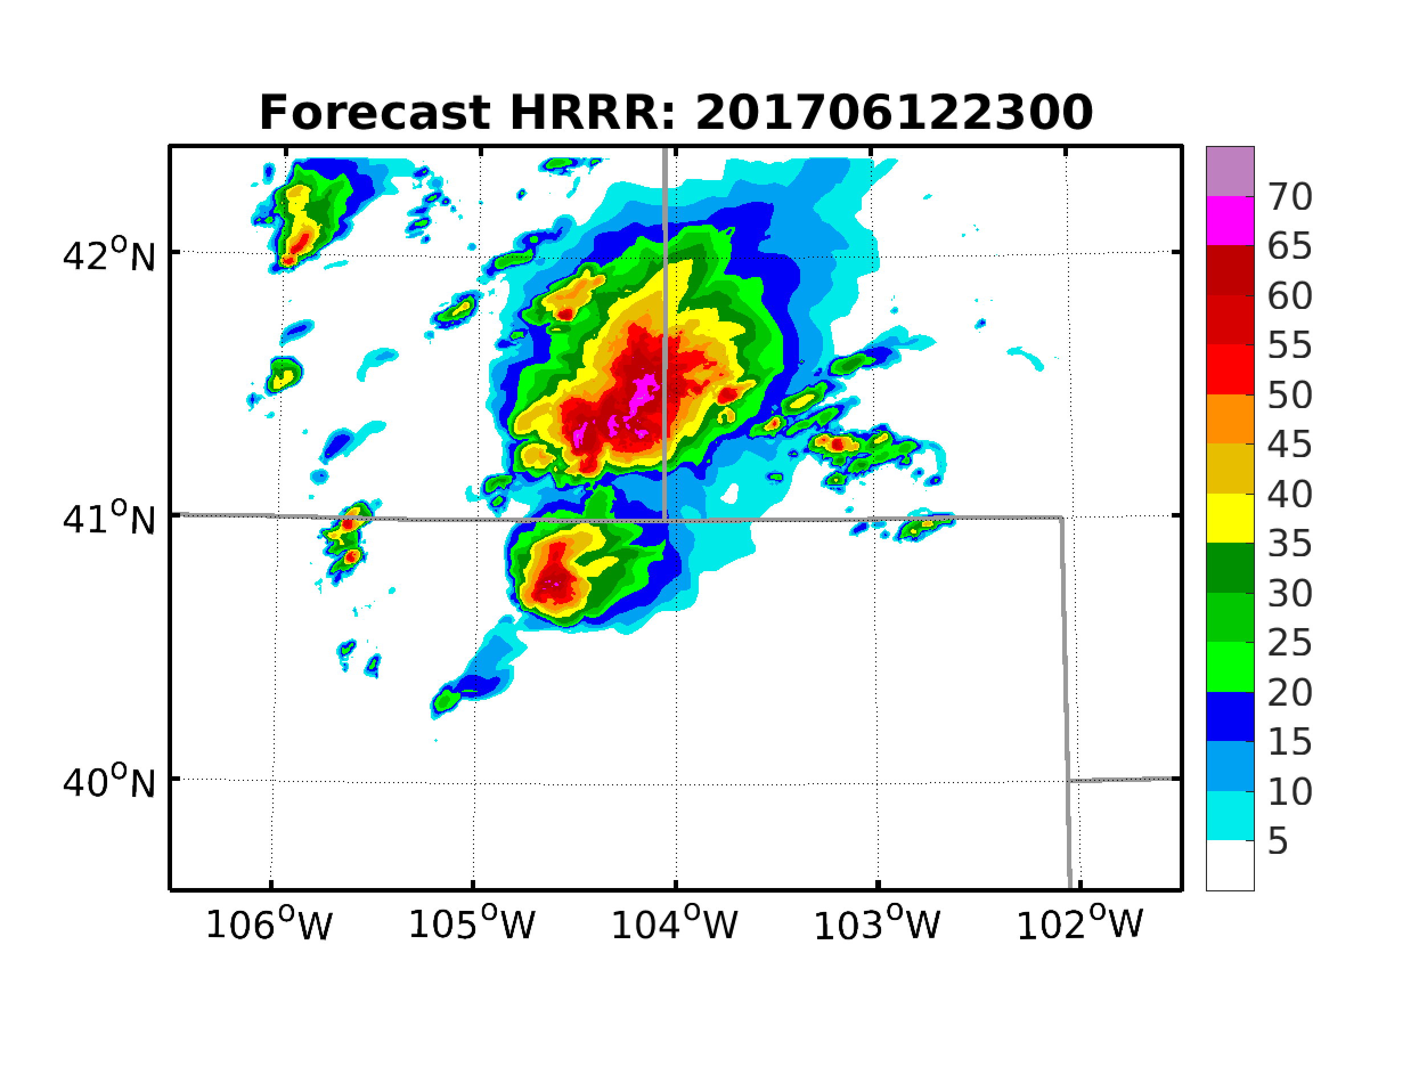
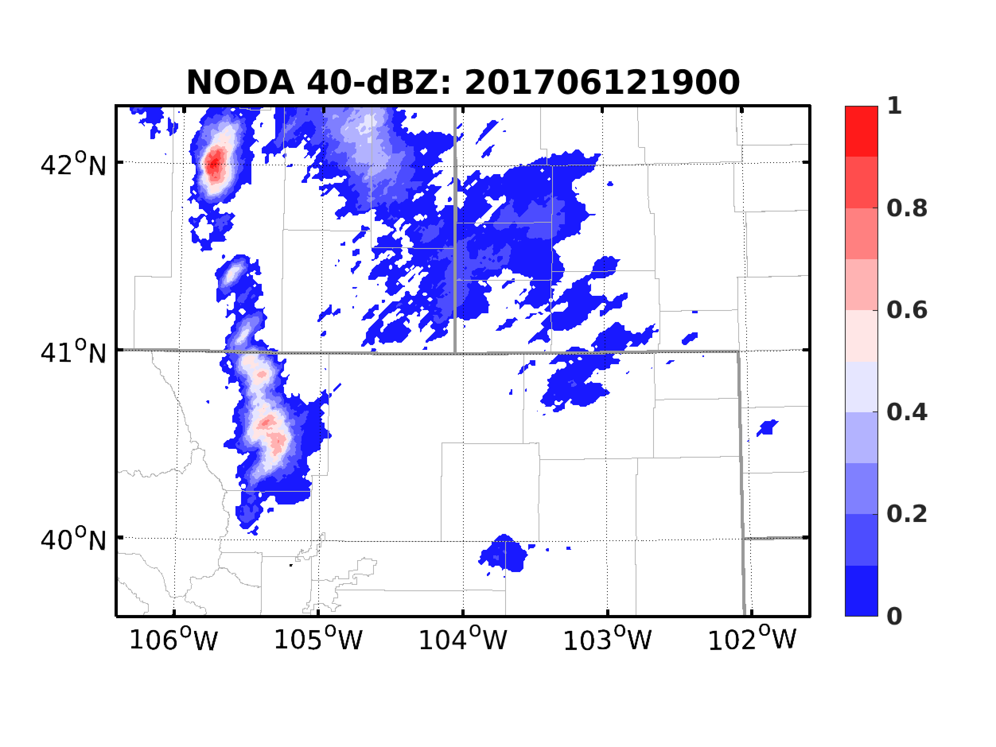
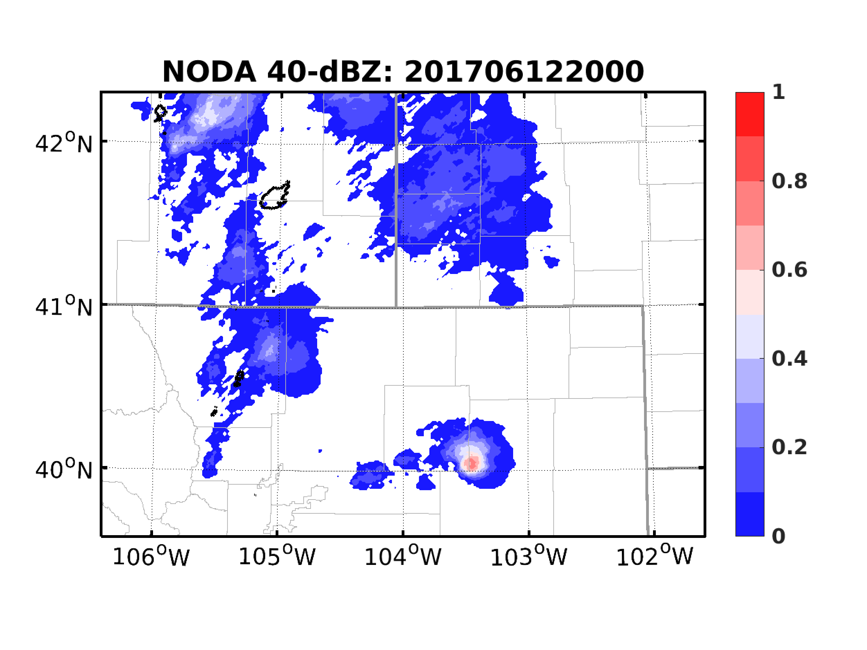
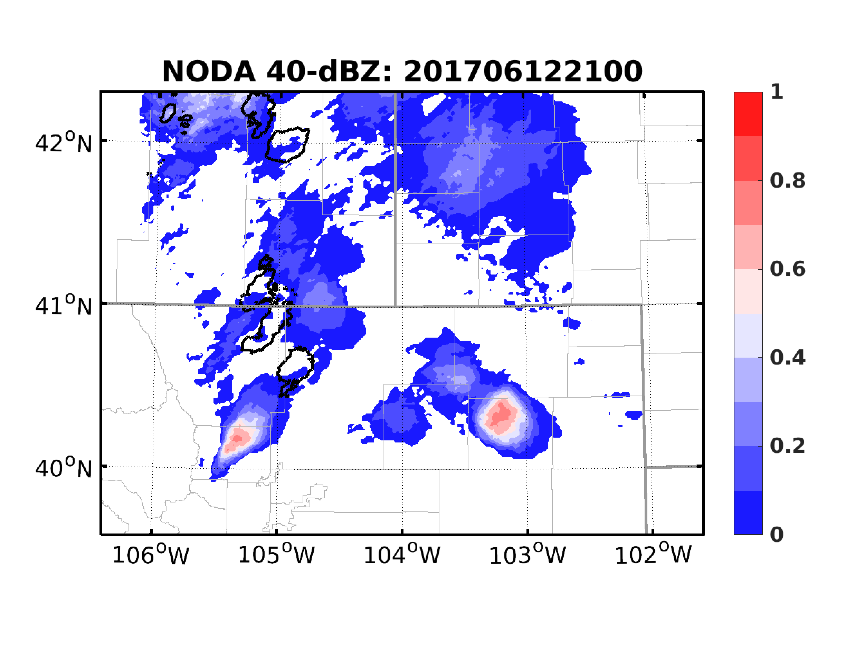
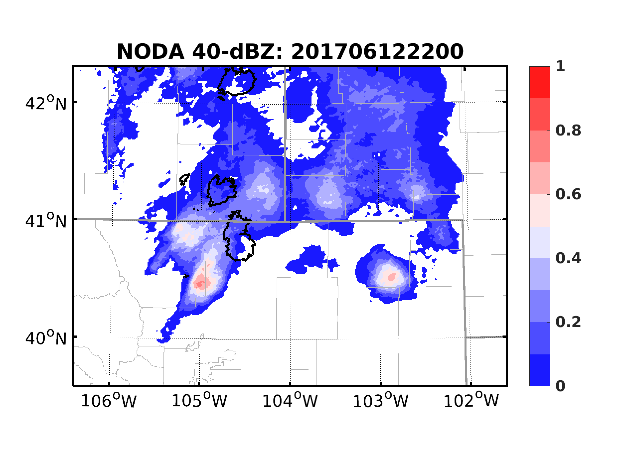
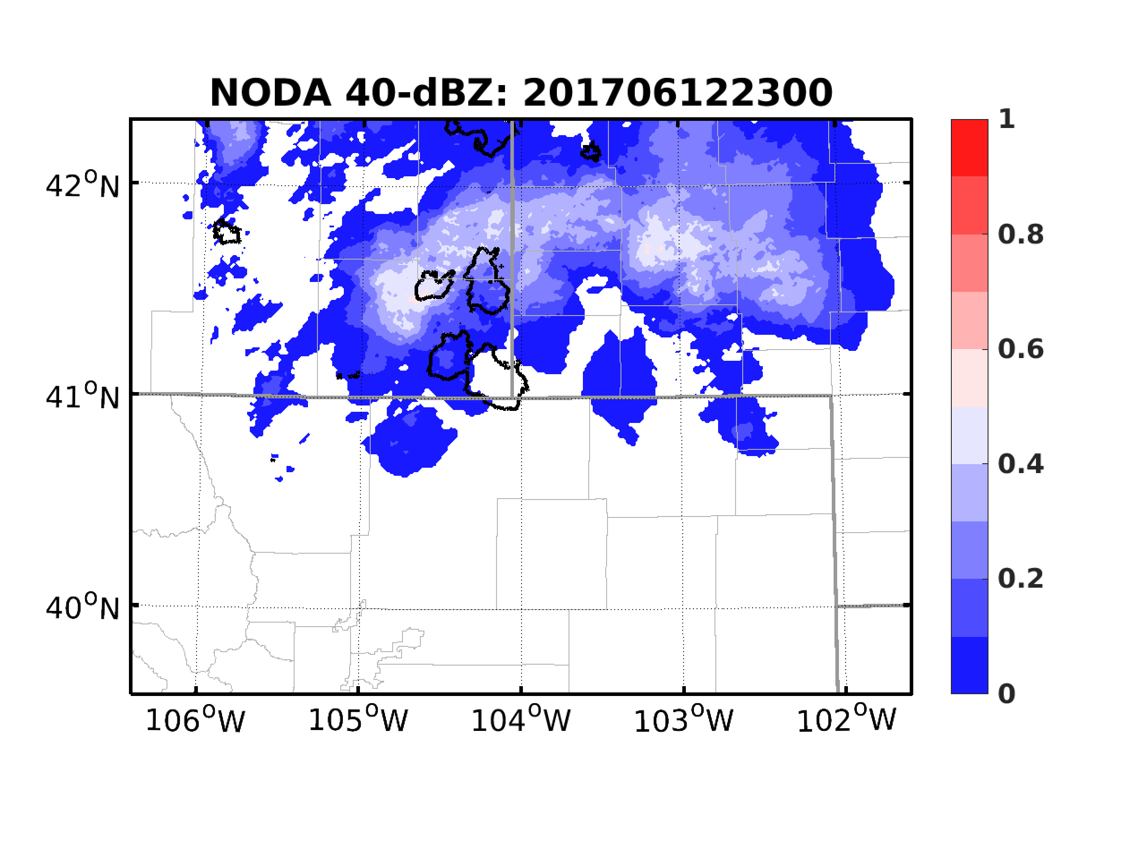
Forecasts w/o Data Assimilation
1900
2000
2100
2200
2300
WSR-88D
Fcst from HRRR
HRRR + GEFS Pert
1-km WRF V3.8.1deterministic forecast from 1800 to 0000 from HRRR analysis
1-km 40-member ensemble forecast from HRRR analysis with GEFS perturbations

Slide 5
Experiment Design
Cycling EnSRF every 5 minutes from 1900 to 2040 UTC
Assimilate GOES-16 ABI brightness temperature only
Channel 10 (7.3 µm) -- lower-tropospheric water vapor channel
Raw BT observations with resolution of ~2.5 km at targeted region
Use AOEI to implicitly account for the spatially correlated errors
Assign vertical location of 620/250 hPa for cloudy/clear-sky observations
Vertical ROI 5x altitude, horizontal ROI 30 km
RTPP 80%
Forecasts from EnKF analysis:
Deterministic forecasts from 1930, 2000 and 2040 UTC analysis mean
Ensemble forecasts from 1930, 2000 and 2040 UTC analysis ensemble

Slide 6
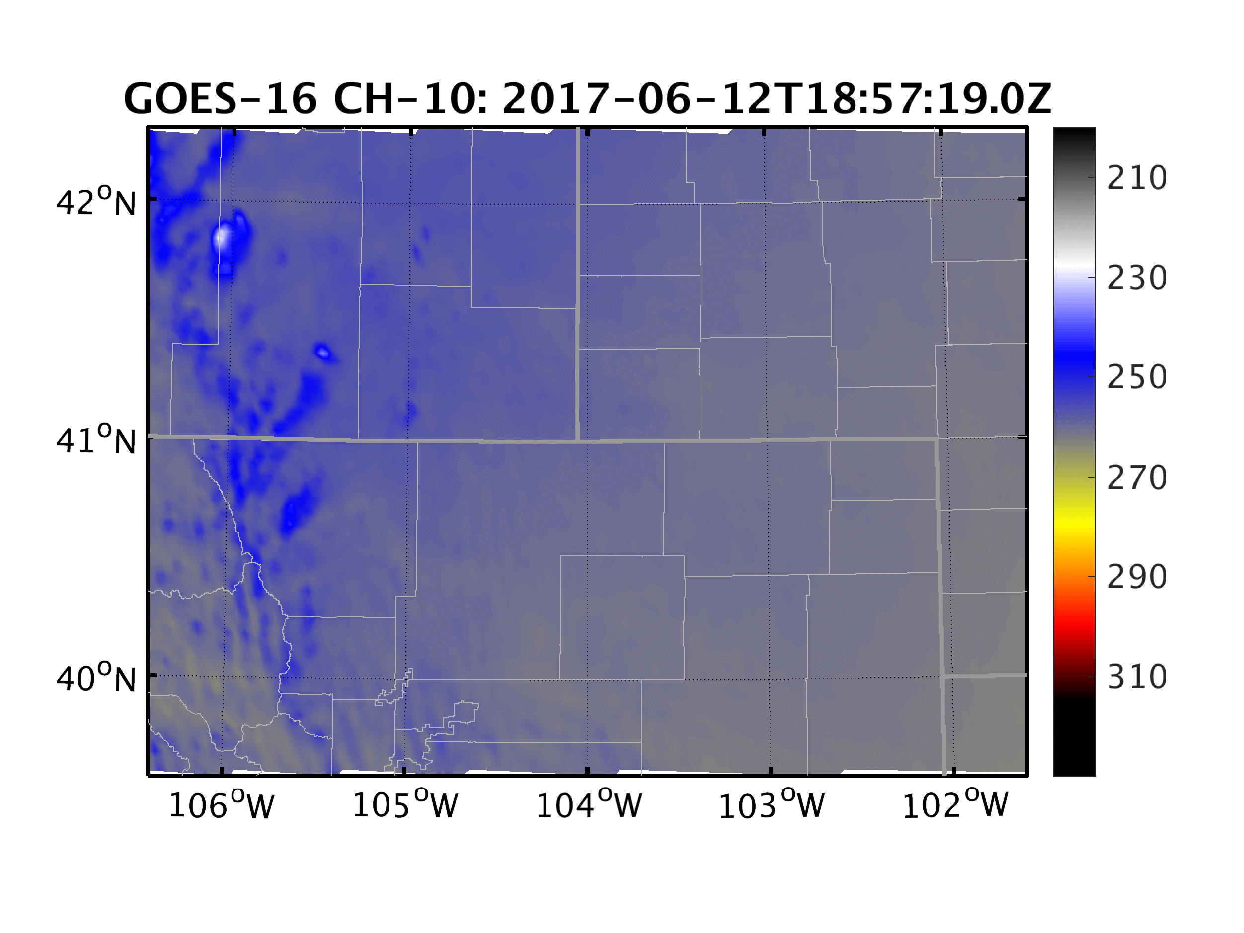
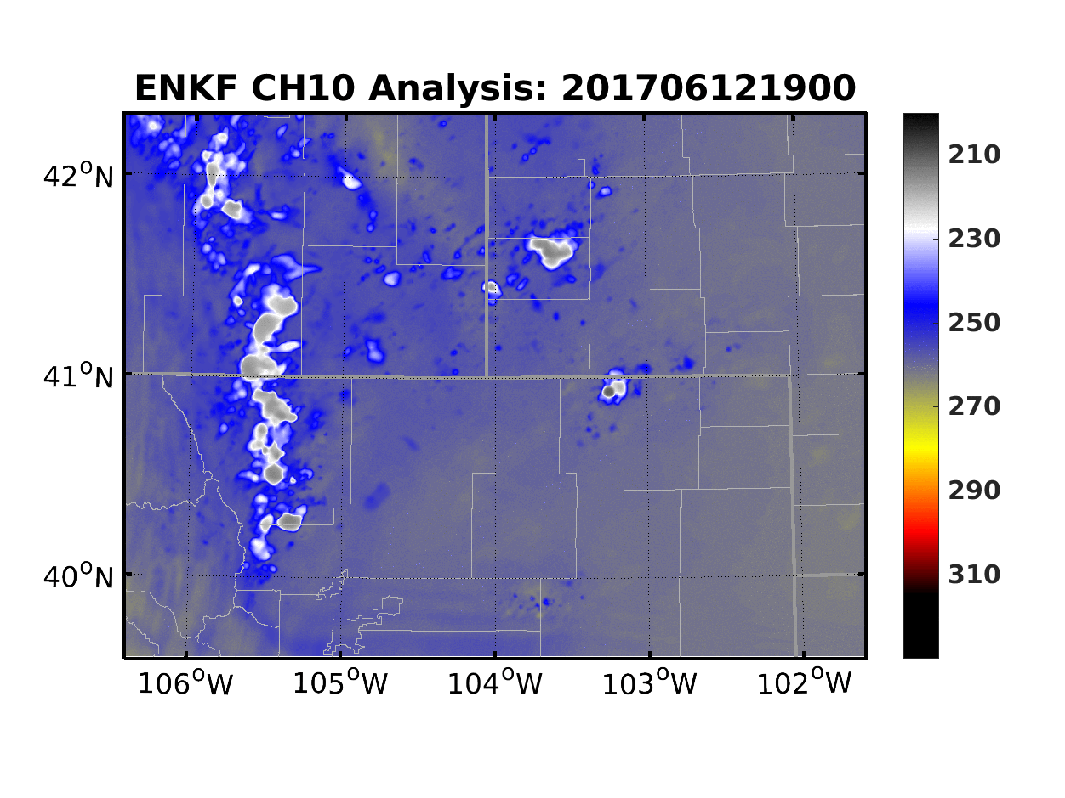
EnKF: Analysis Results
ABI CH-10
EnKF analysis mean

Slide 7
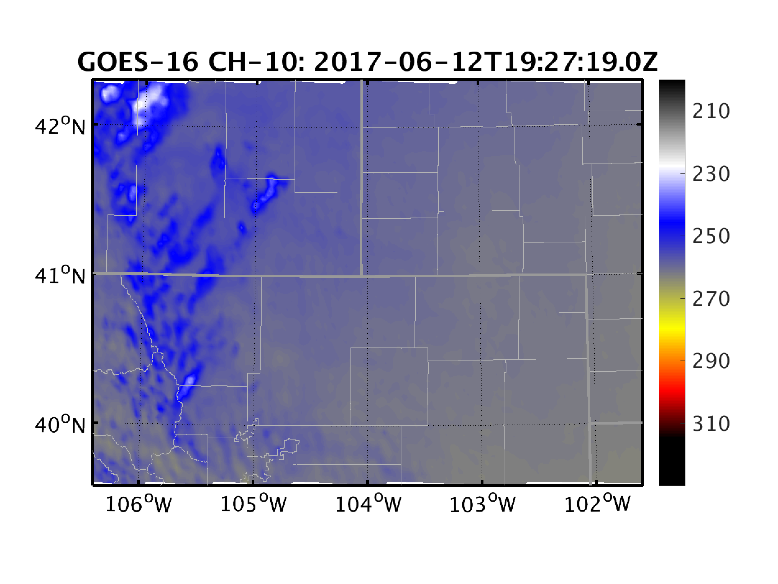
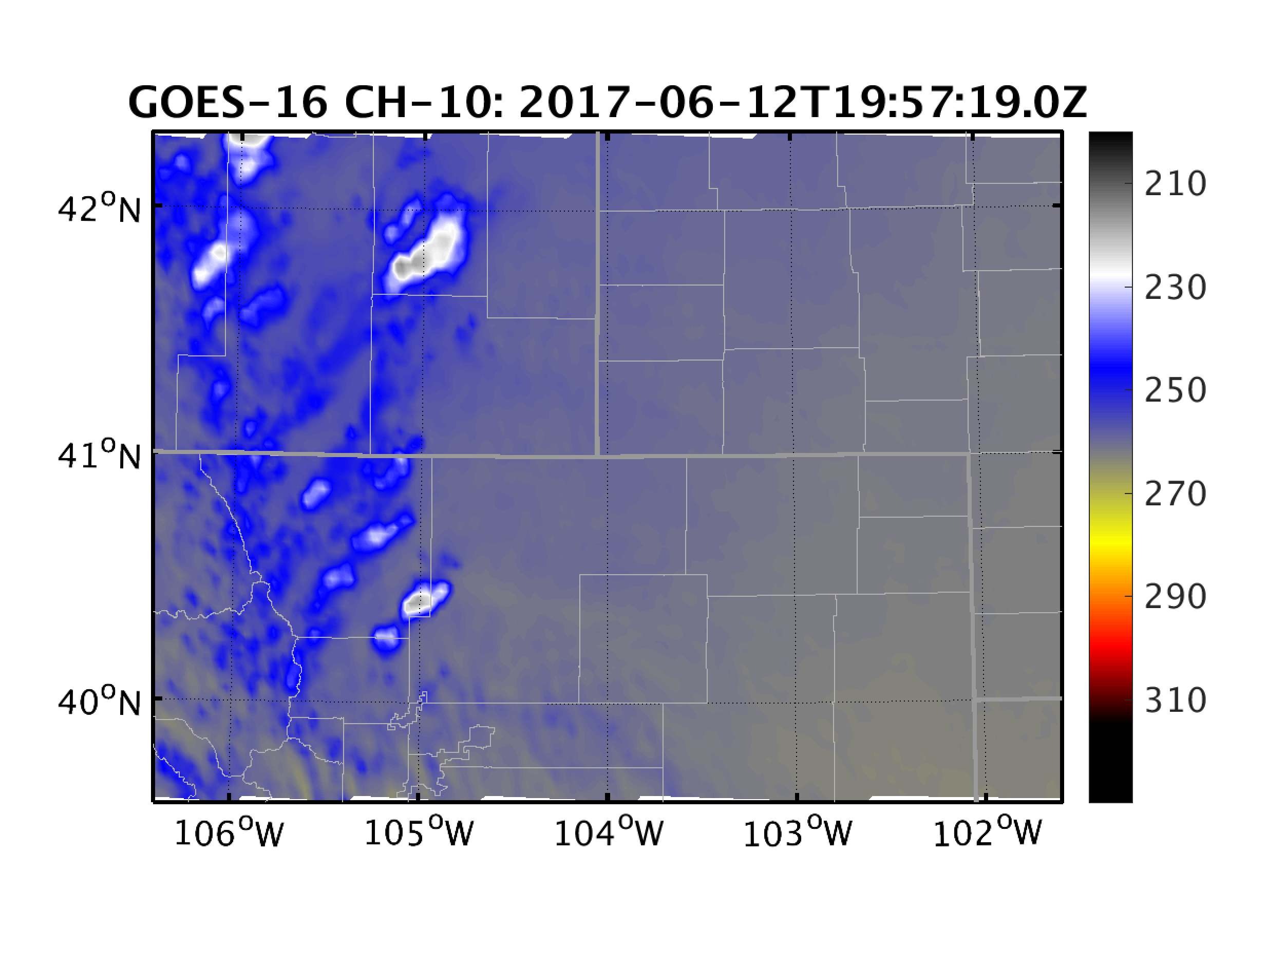
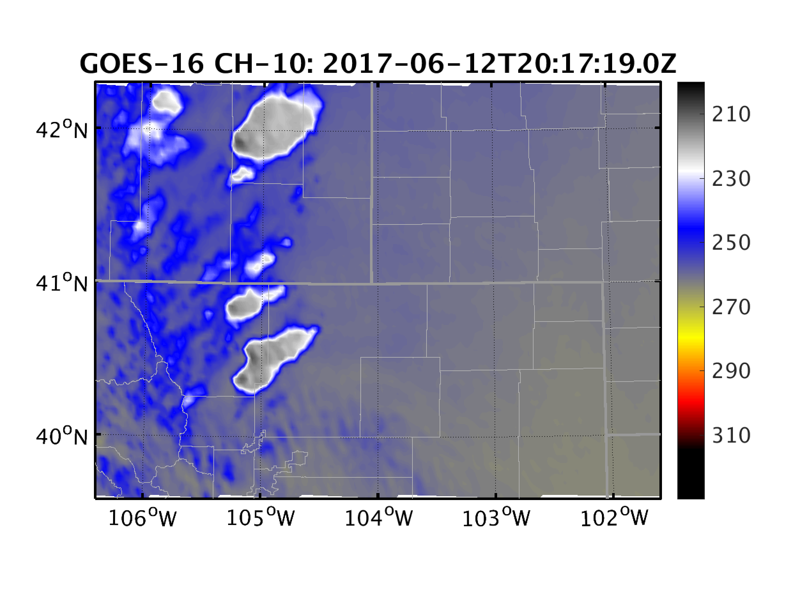
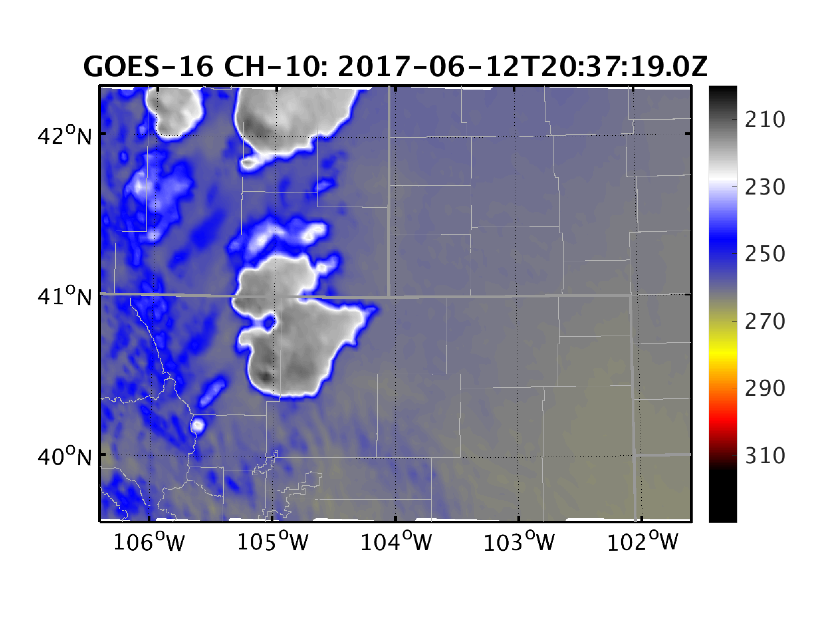
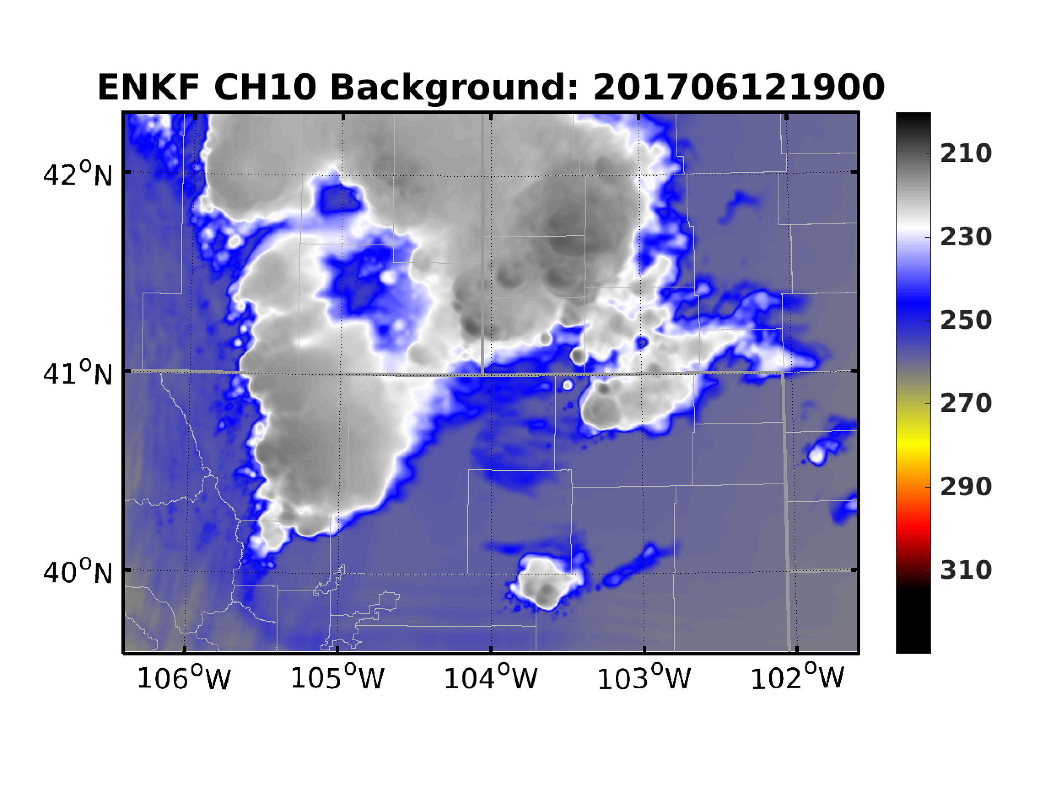
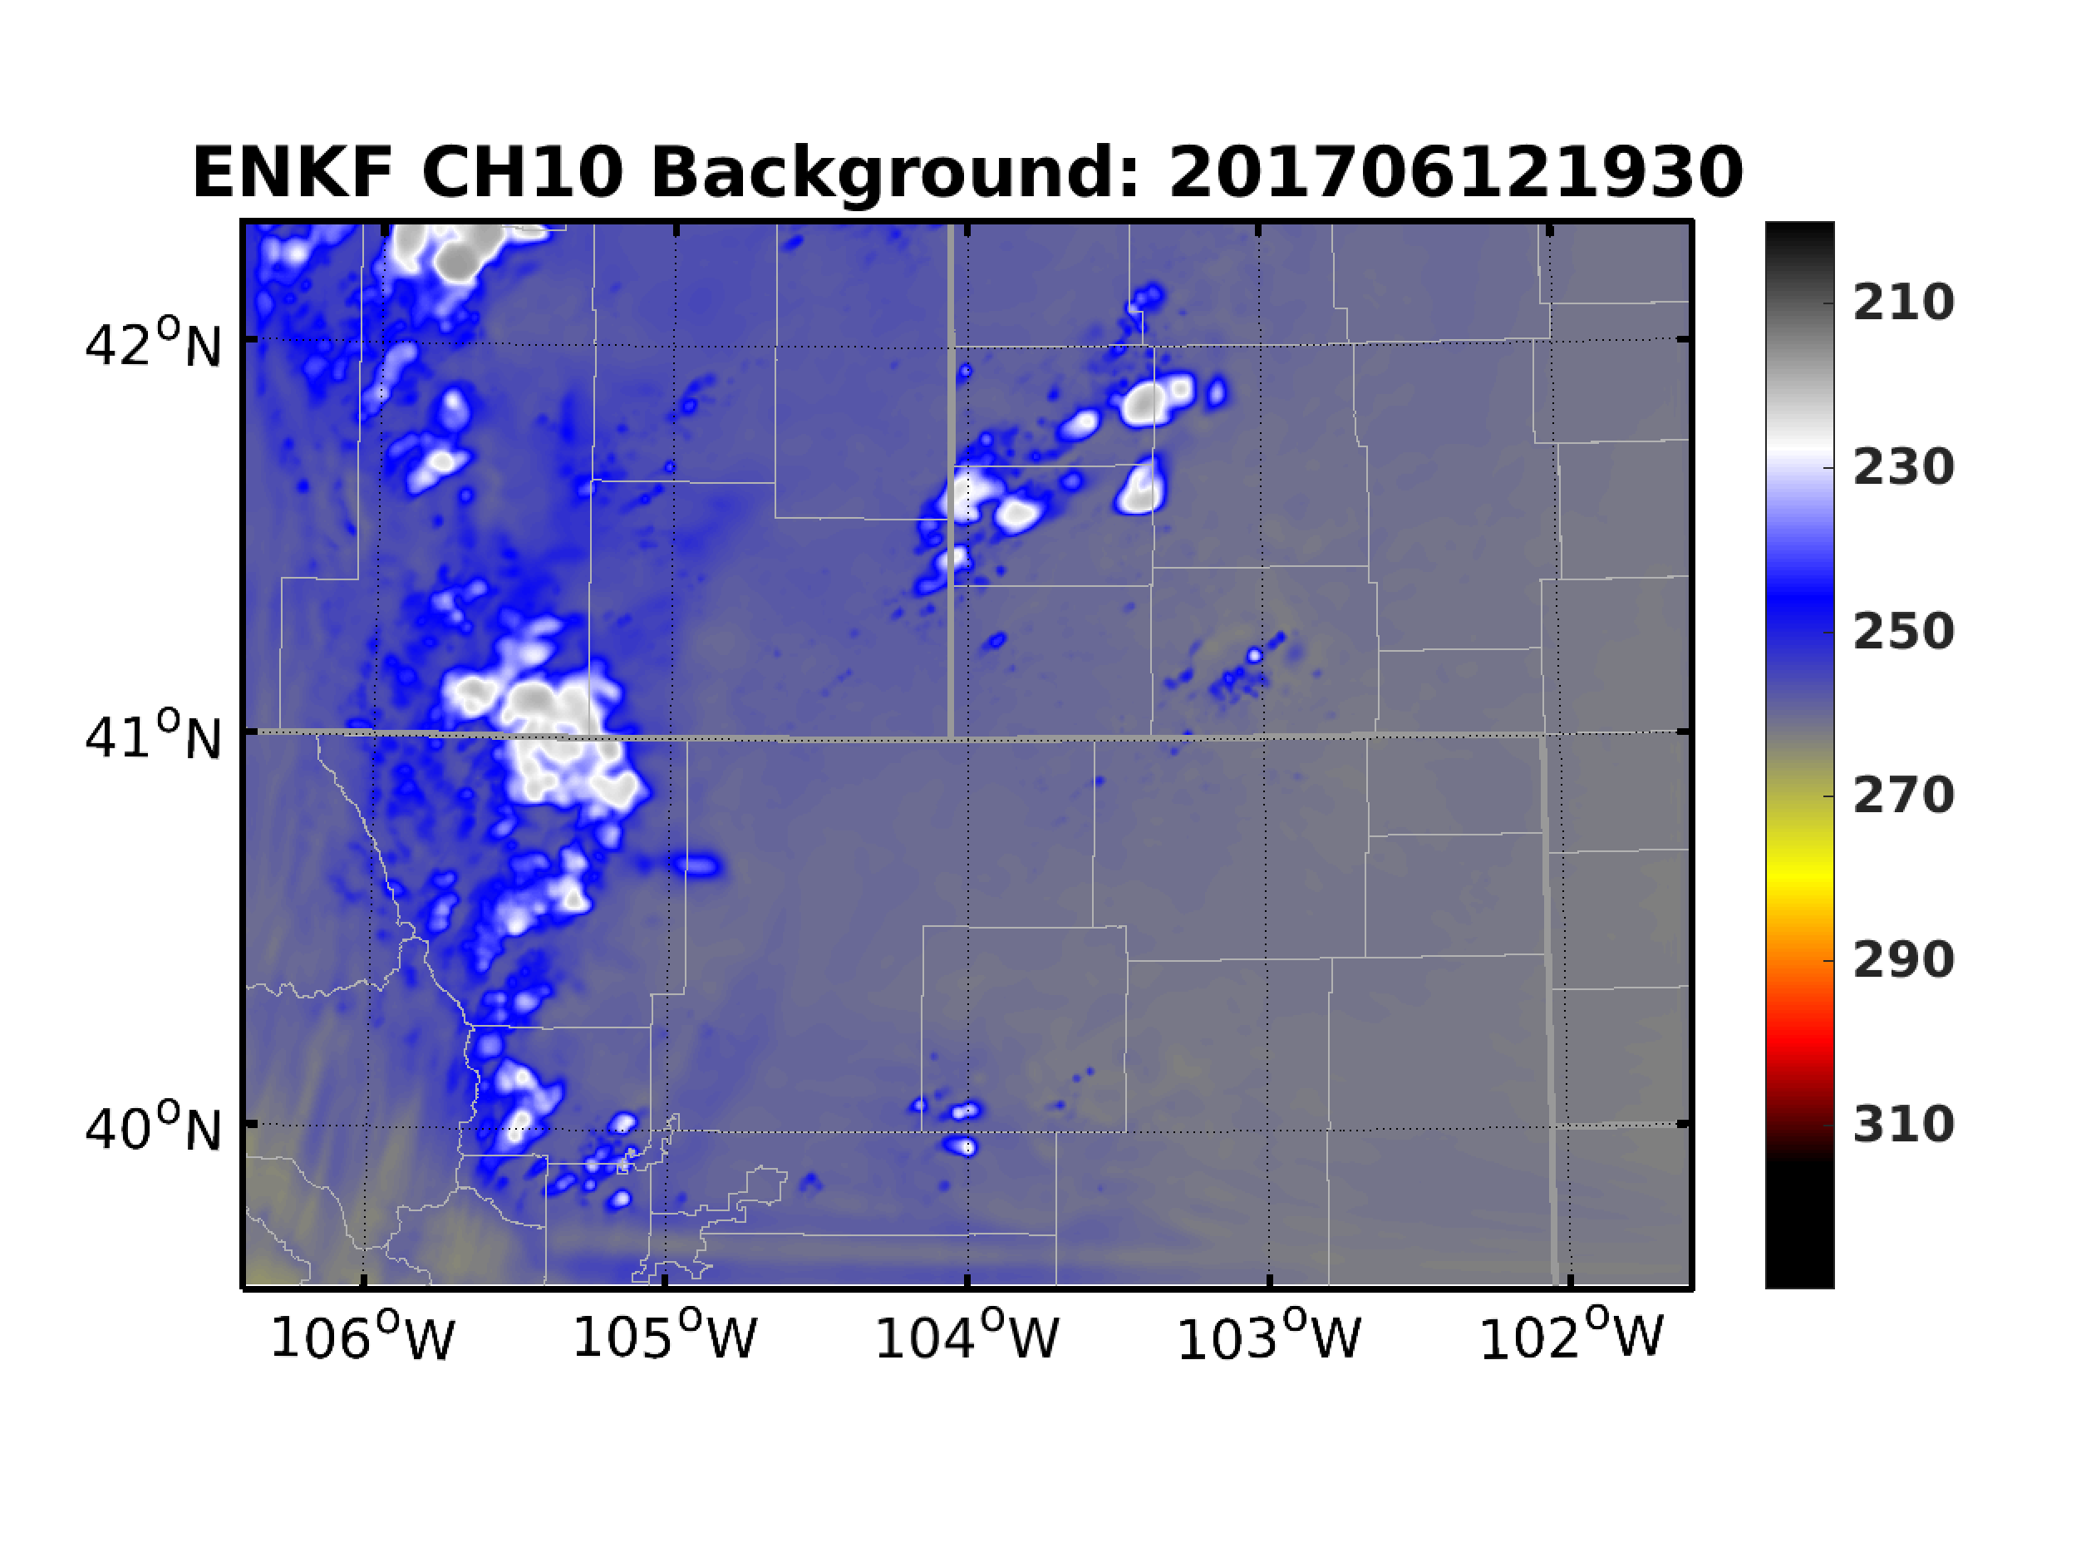
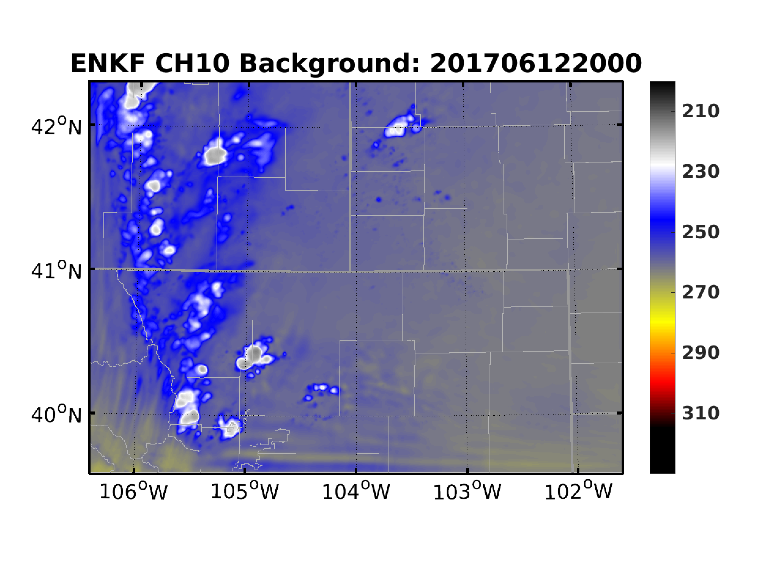
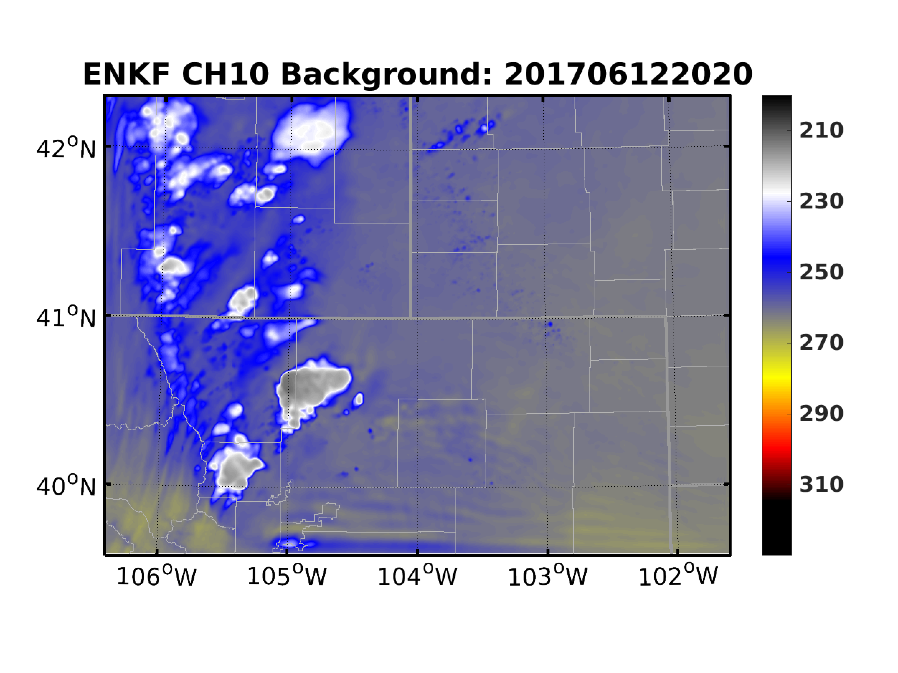
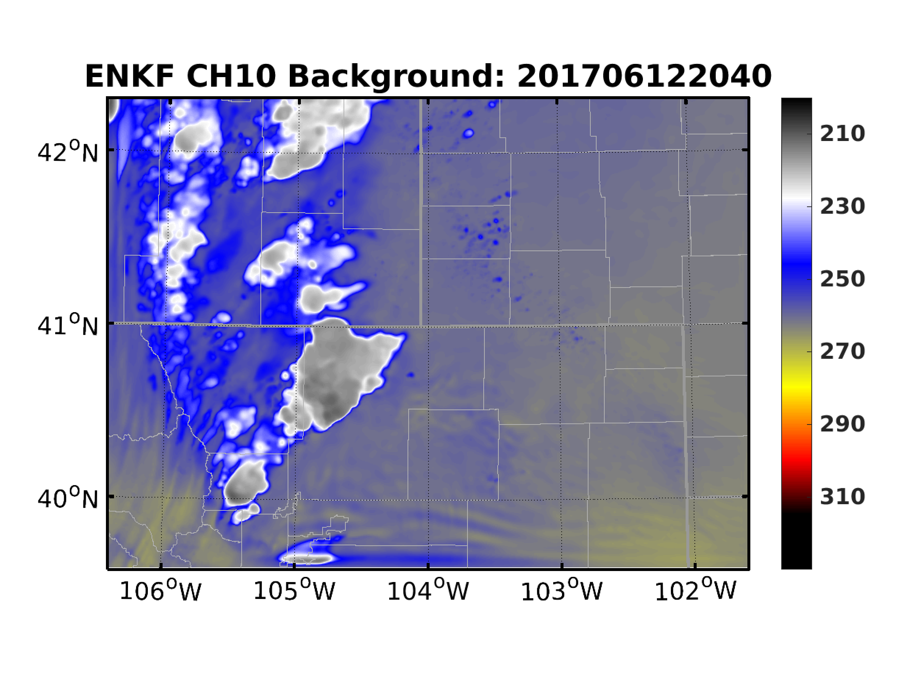
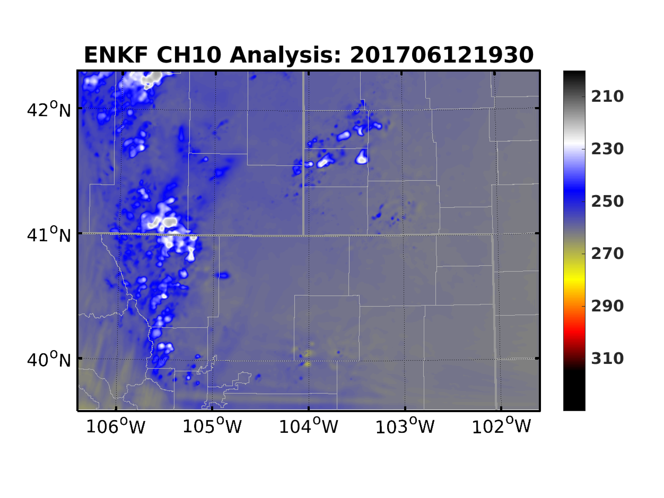
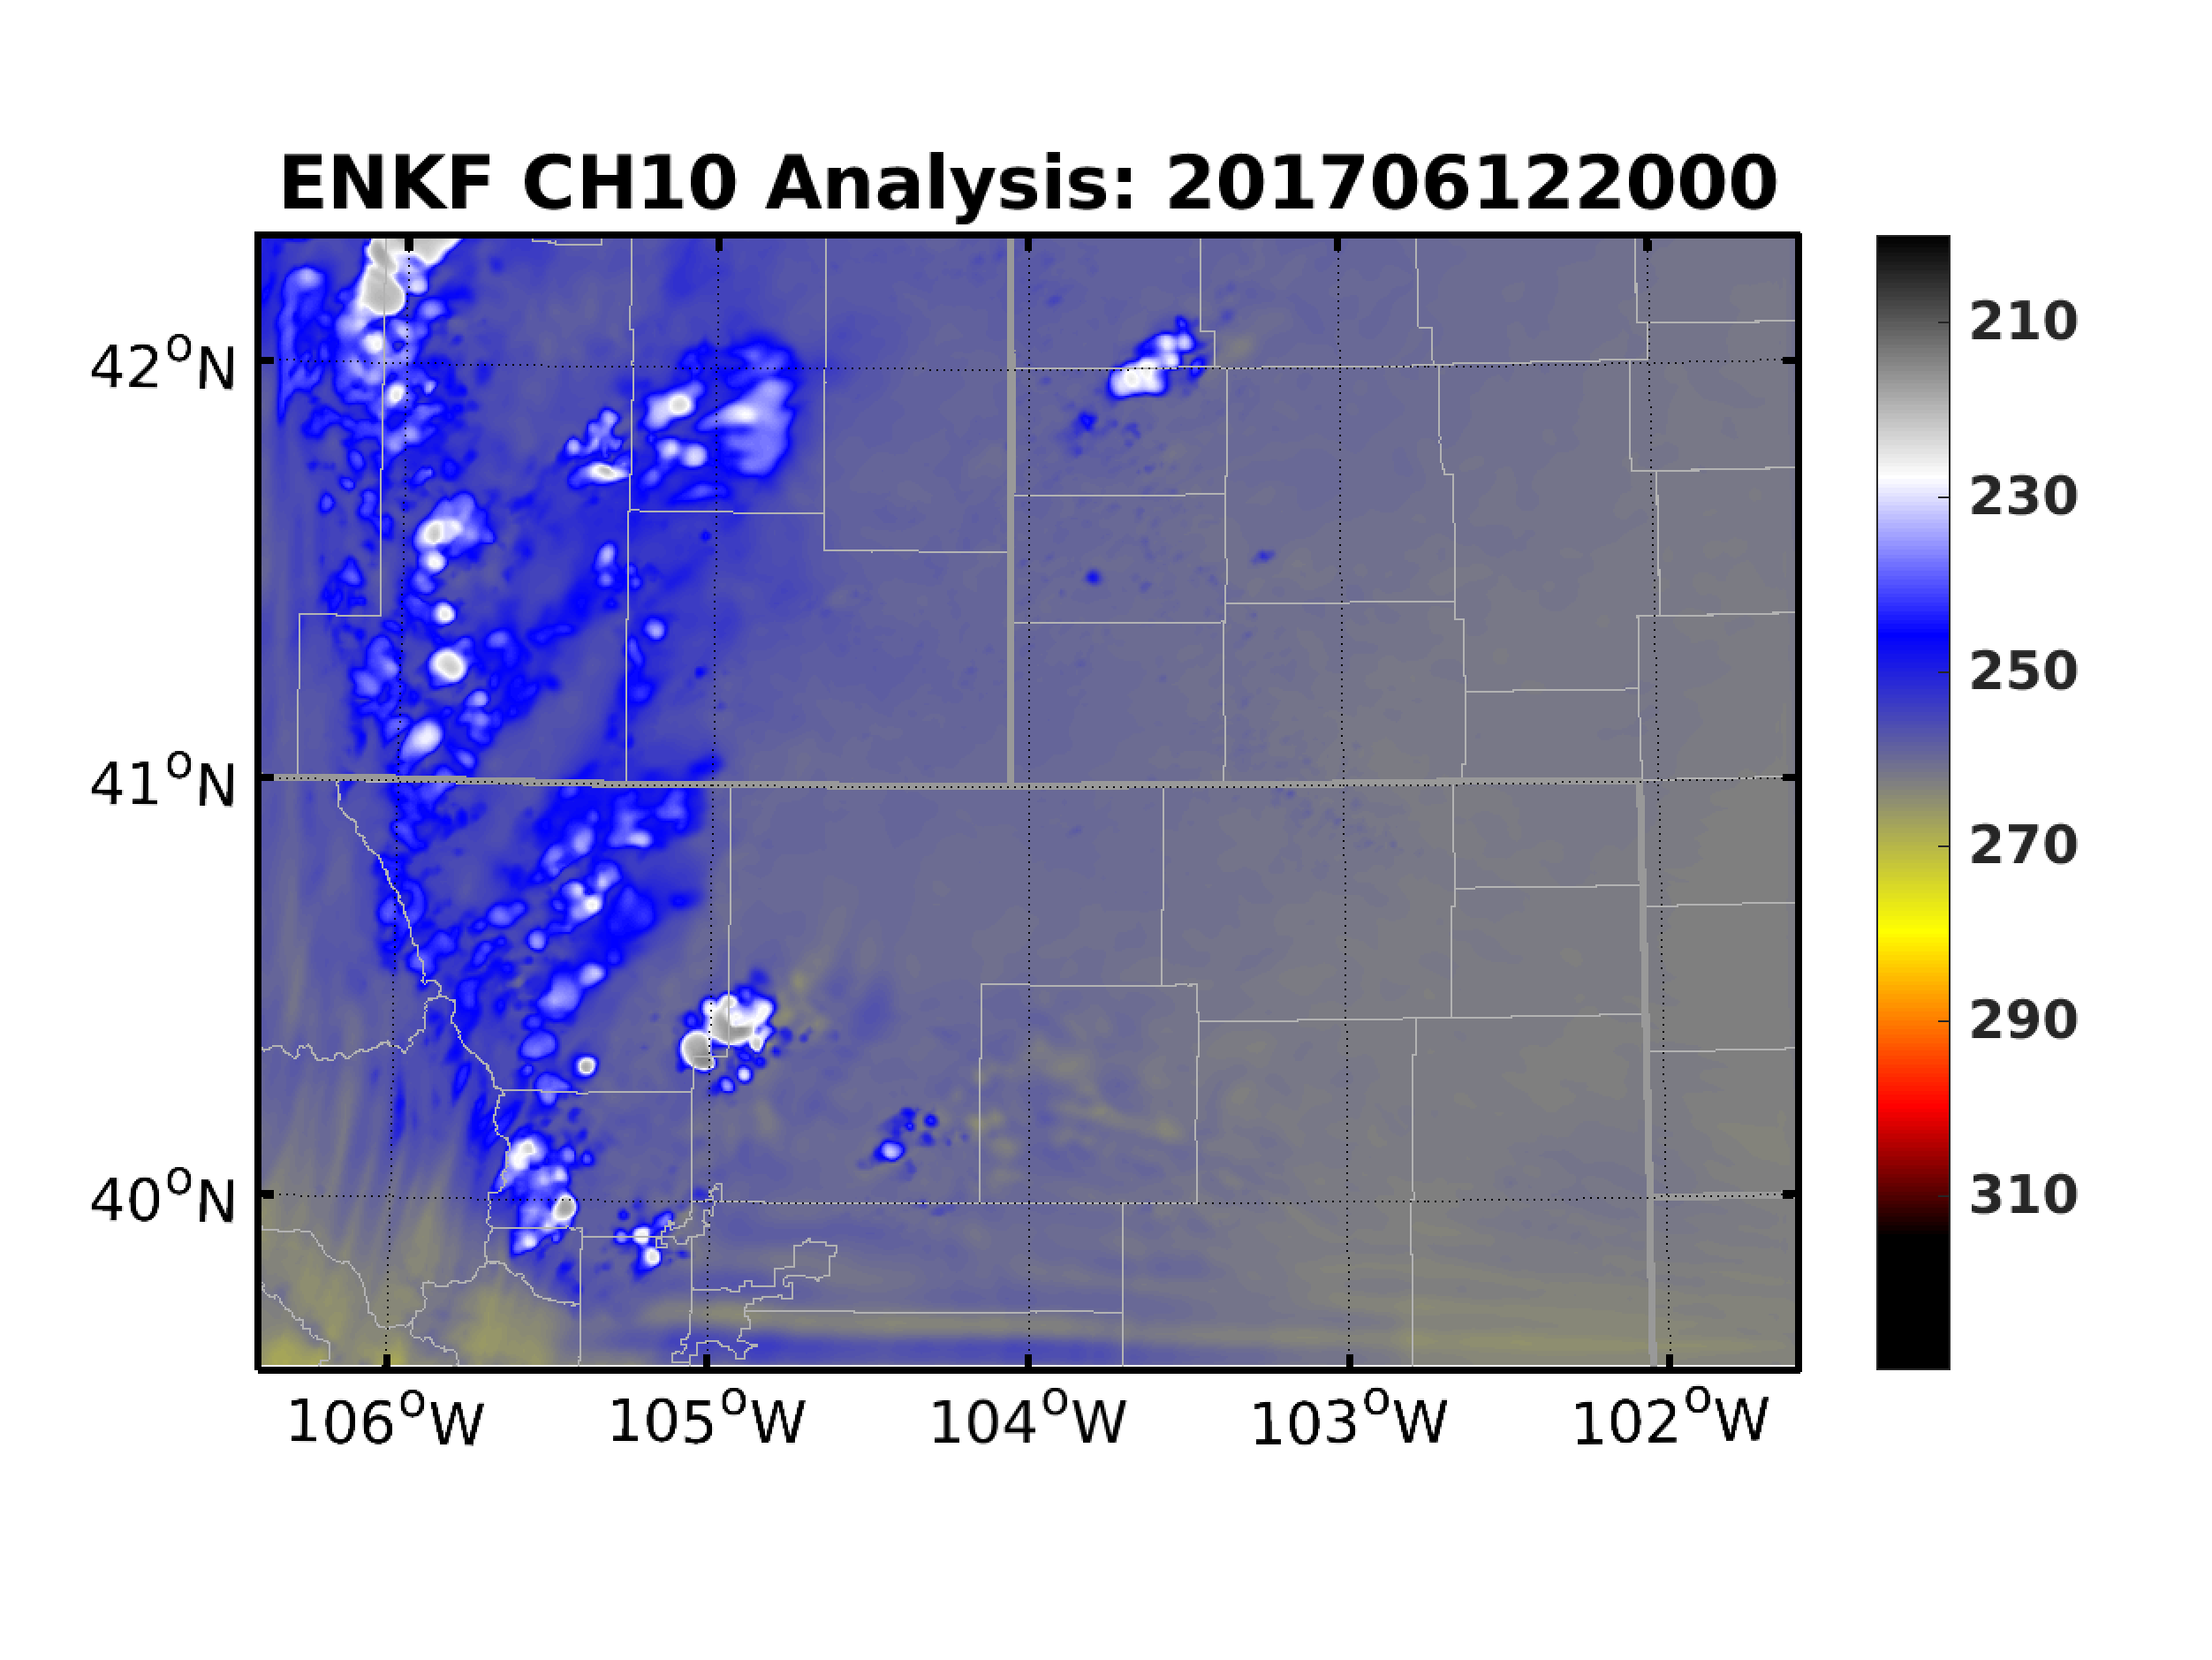
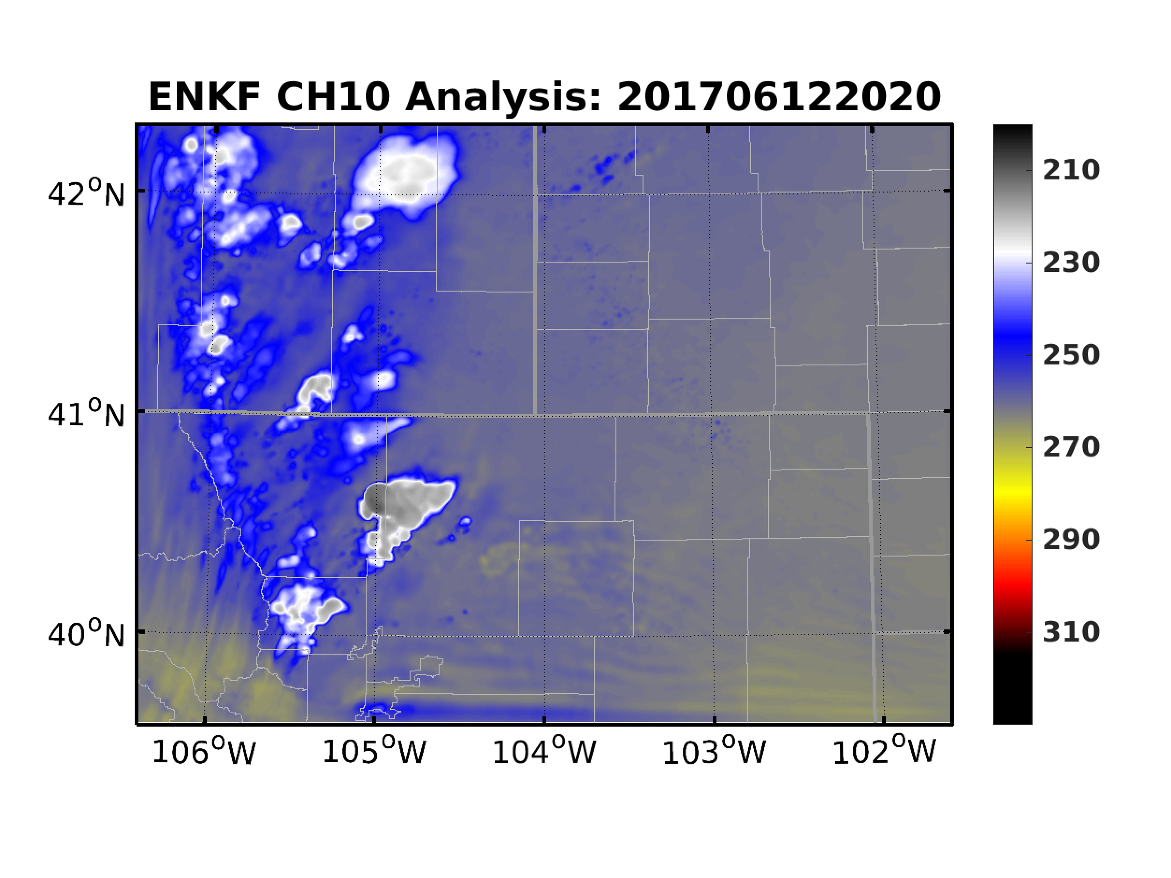
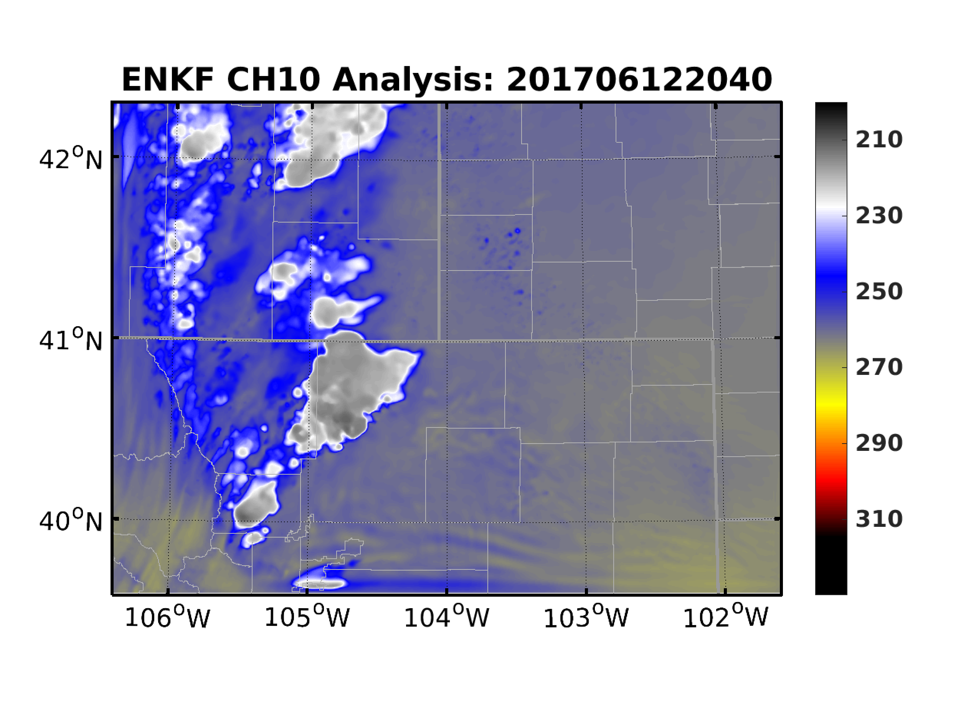
EnKF: Comparison with Observed BT
ABI CH-10
EnKF Background
EnKF Analysis

Slide 8
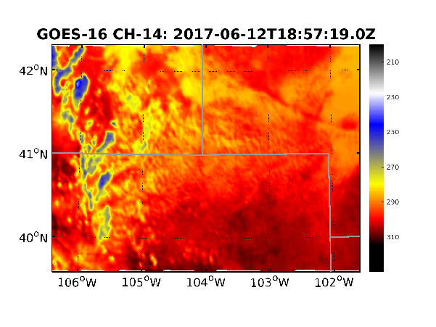
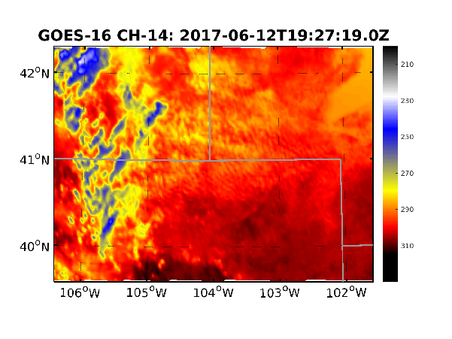
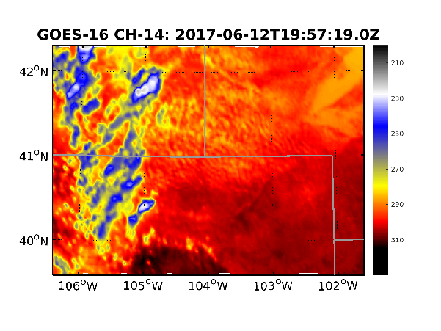
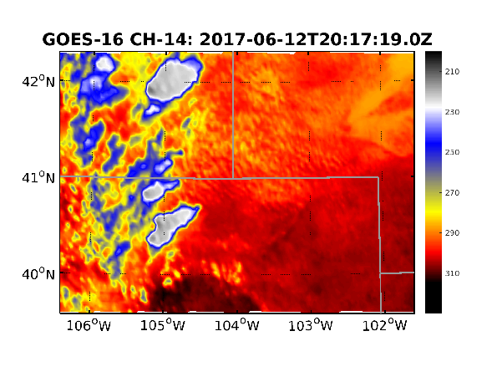
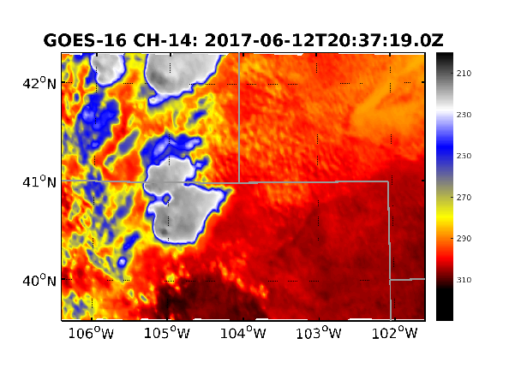
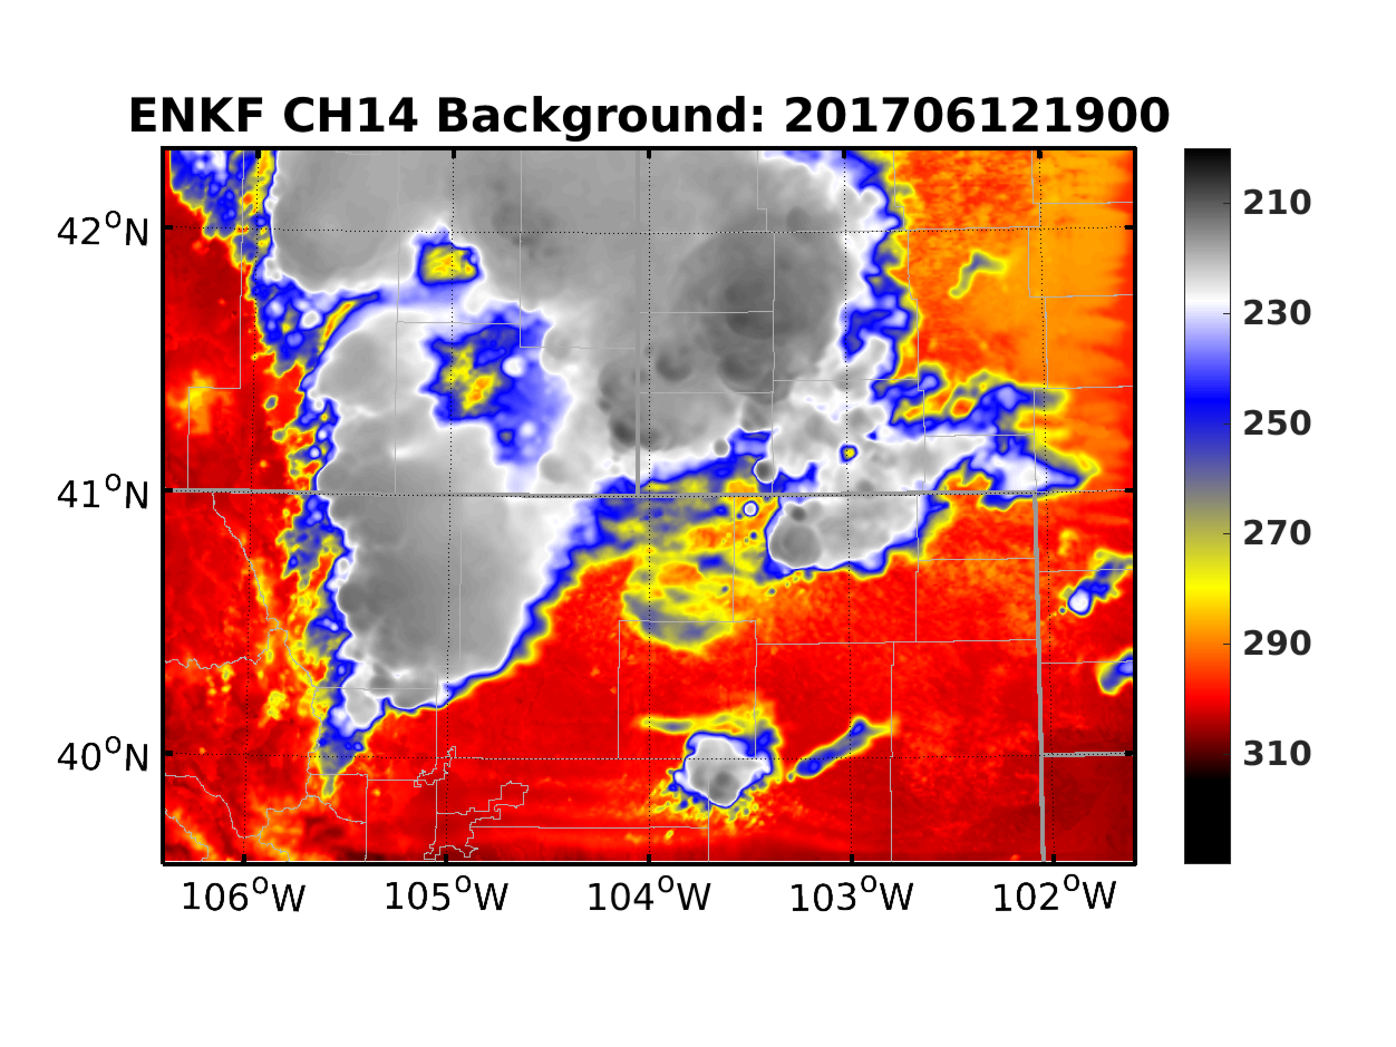
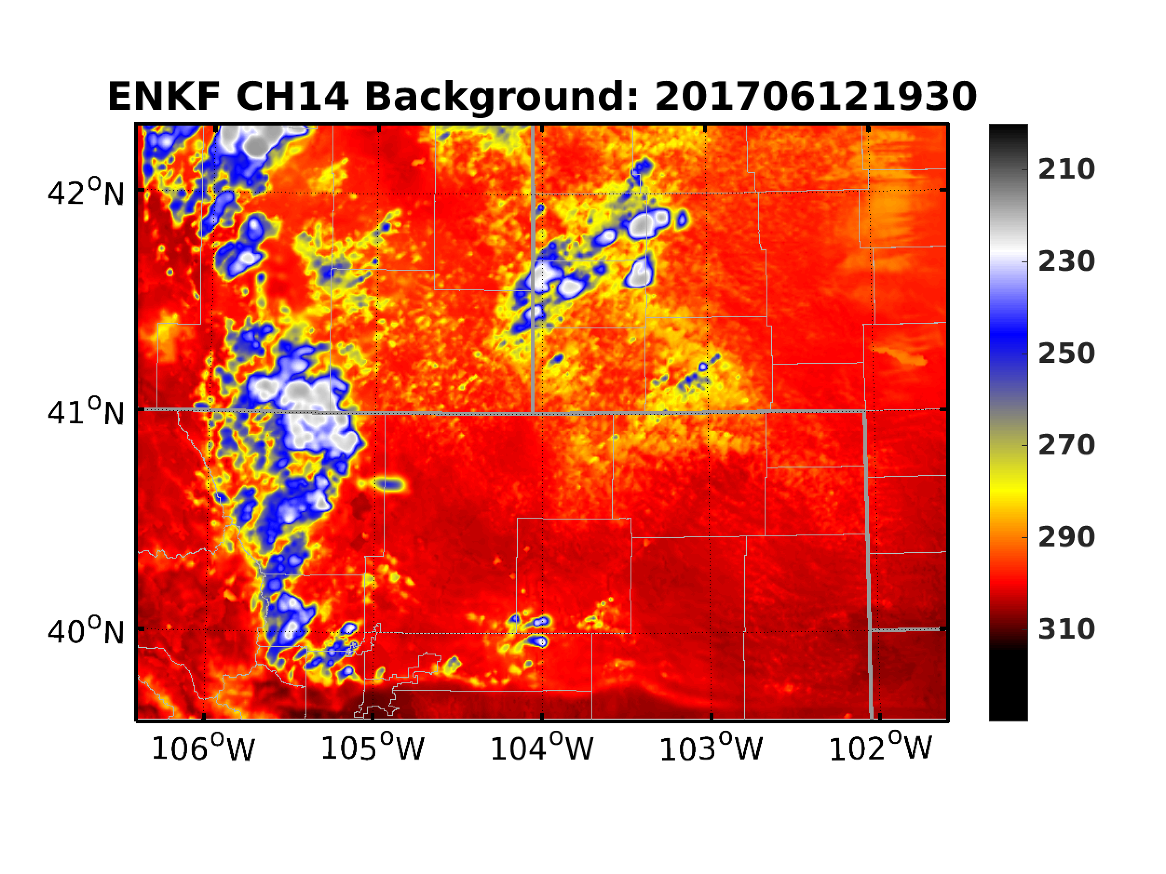
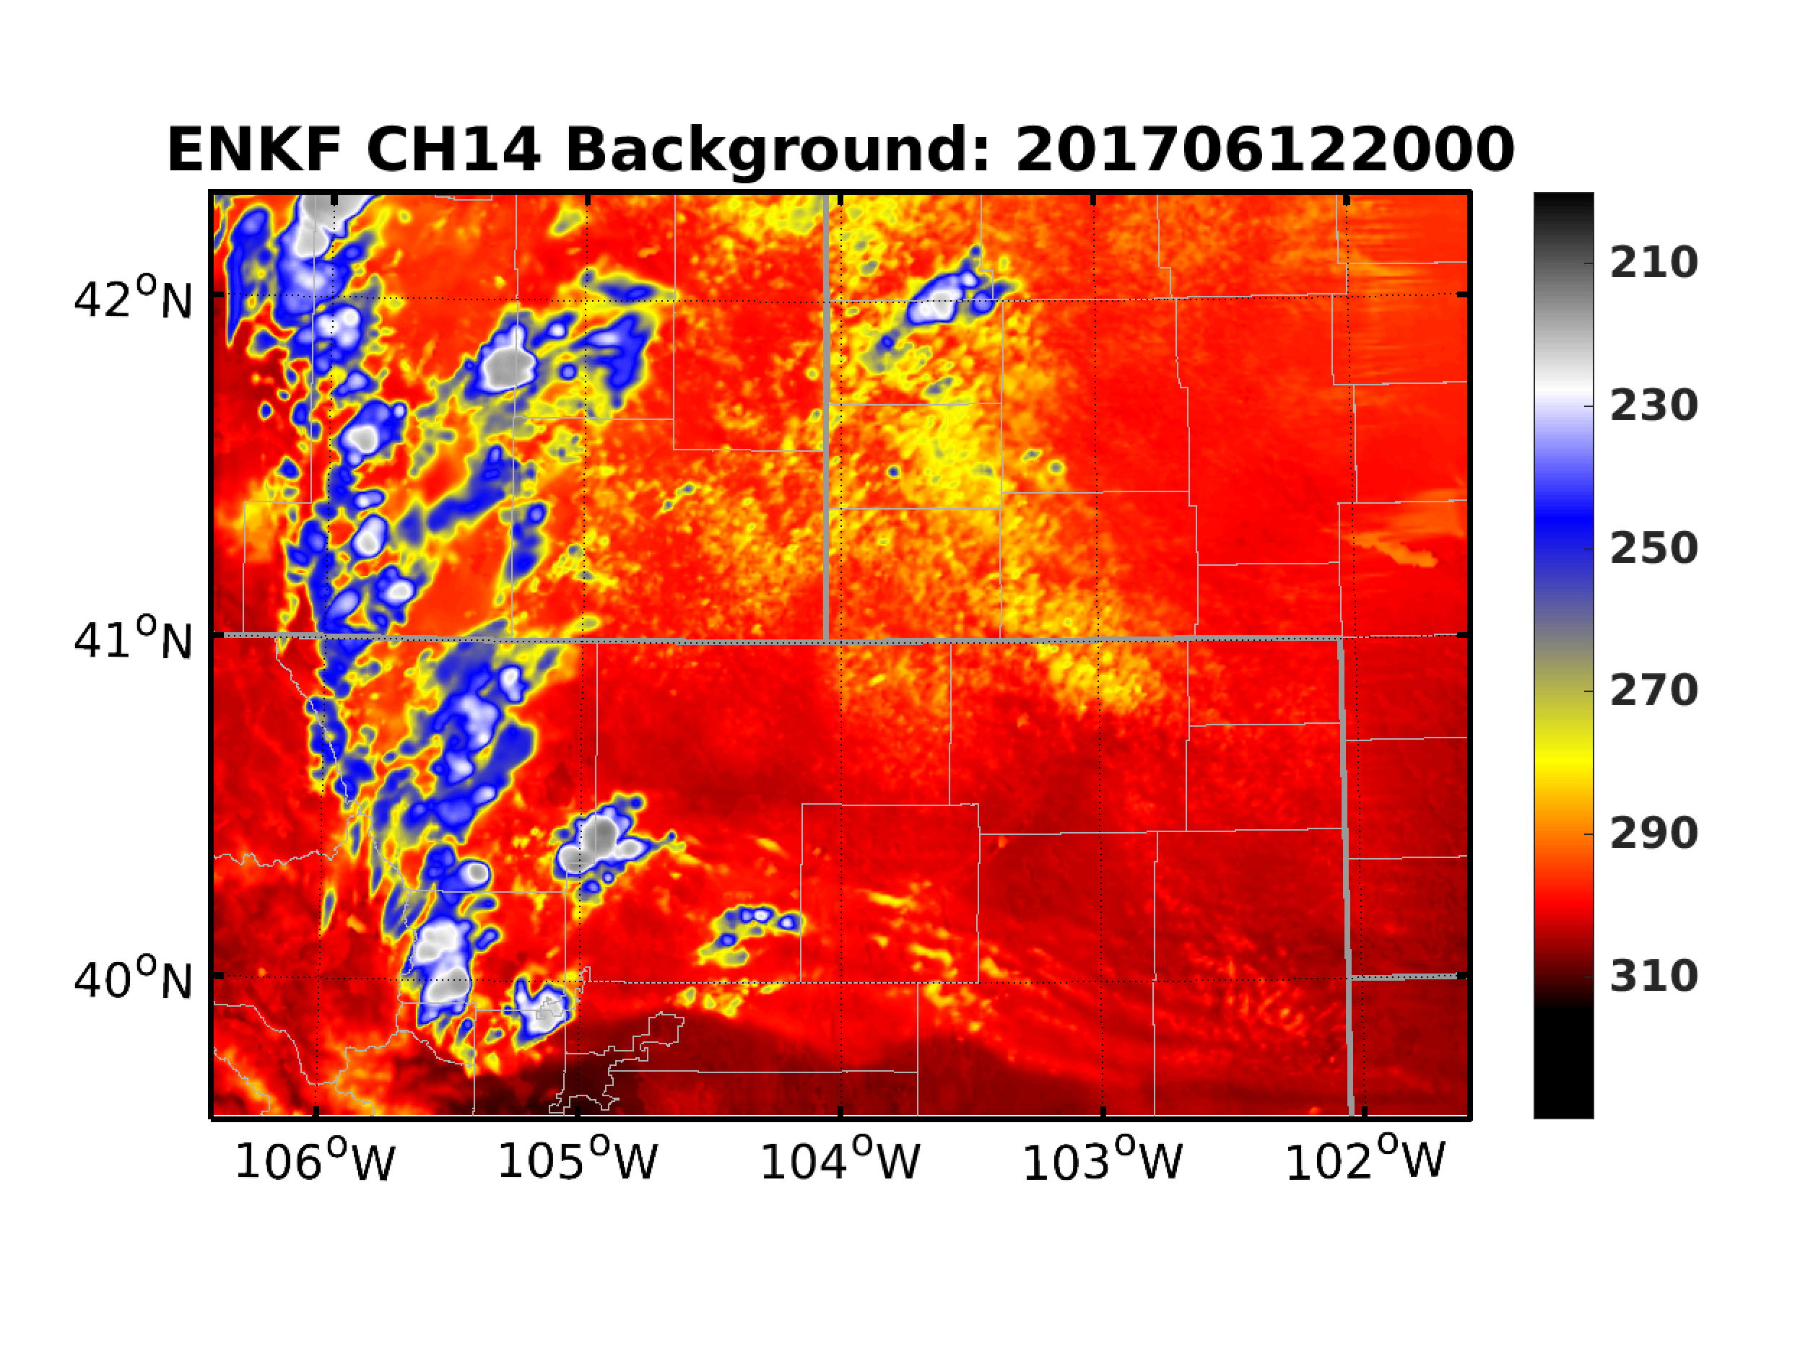
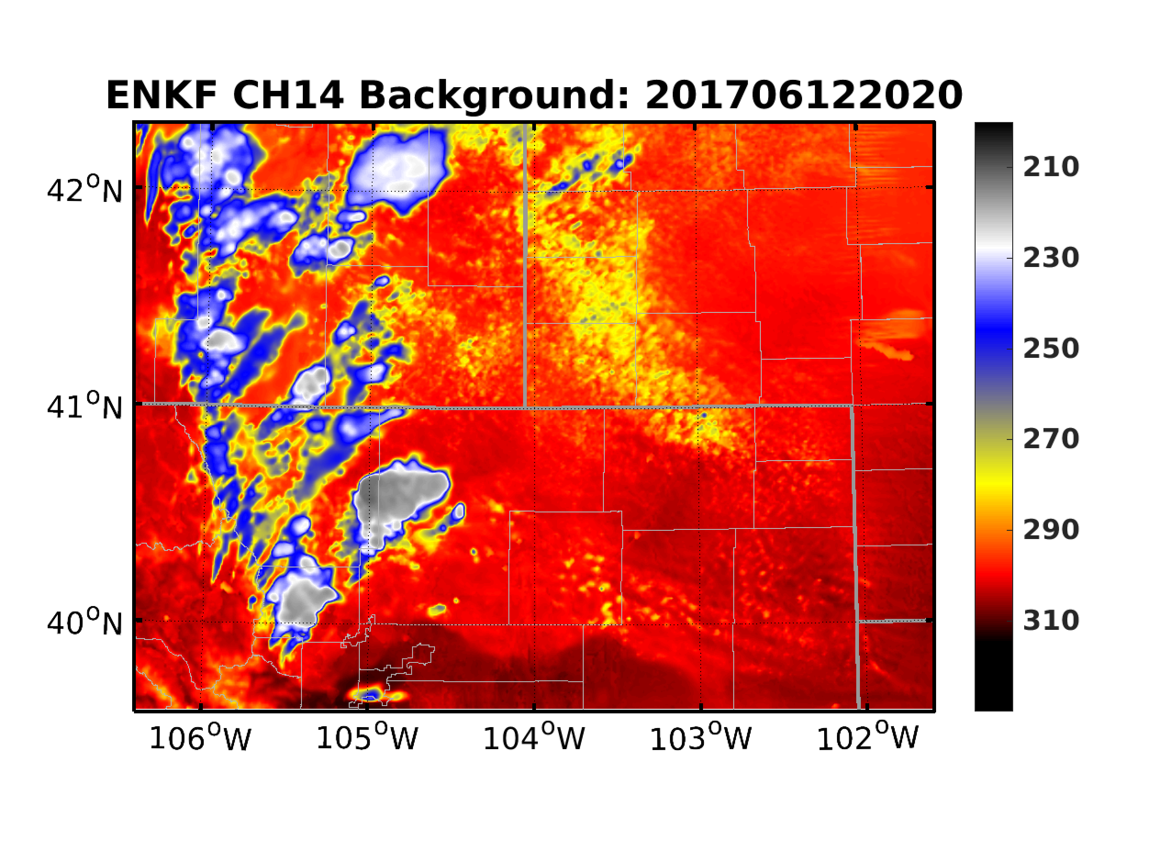
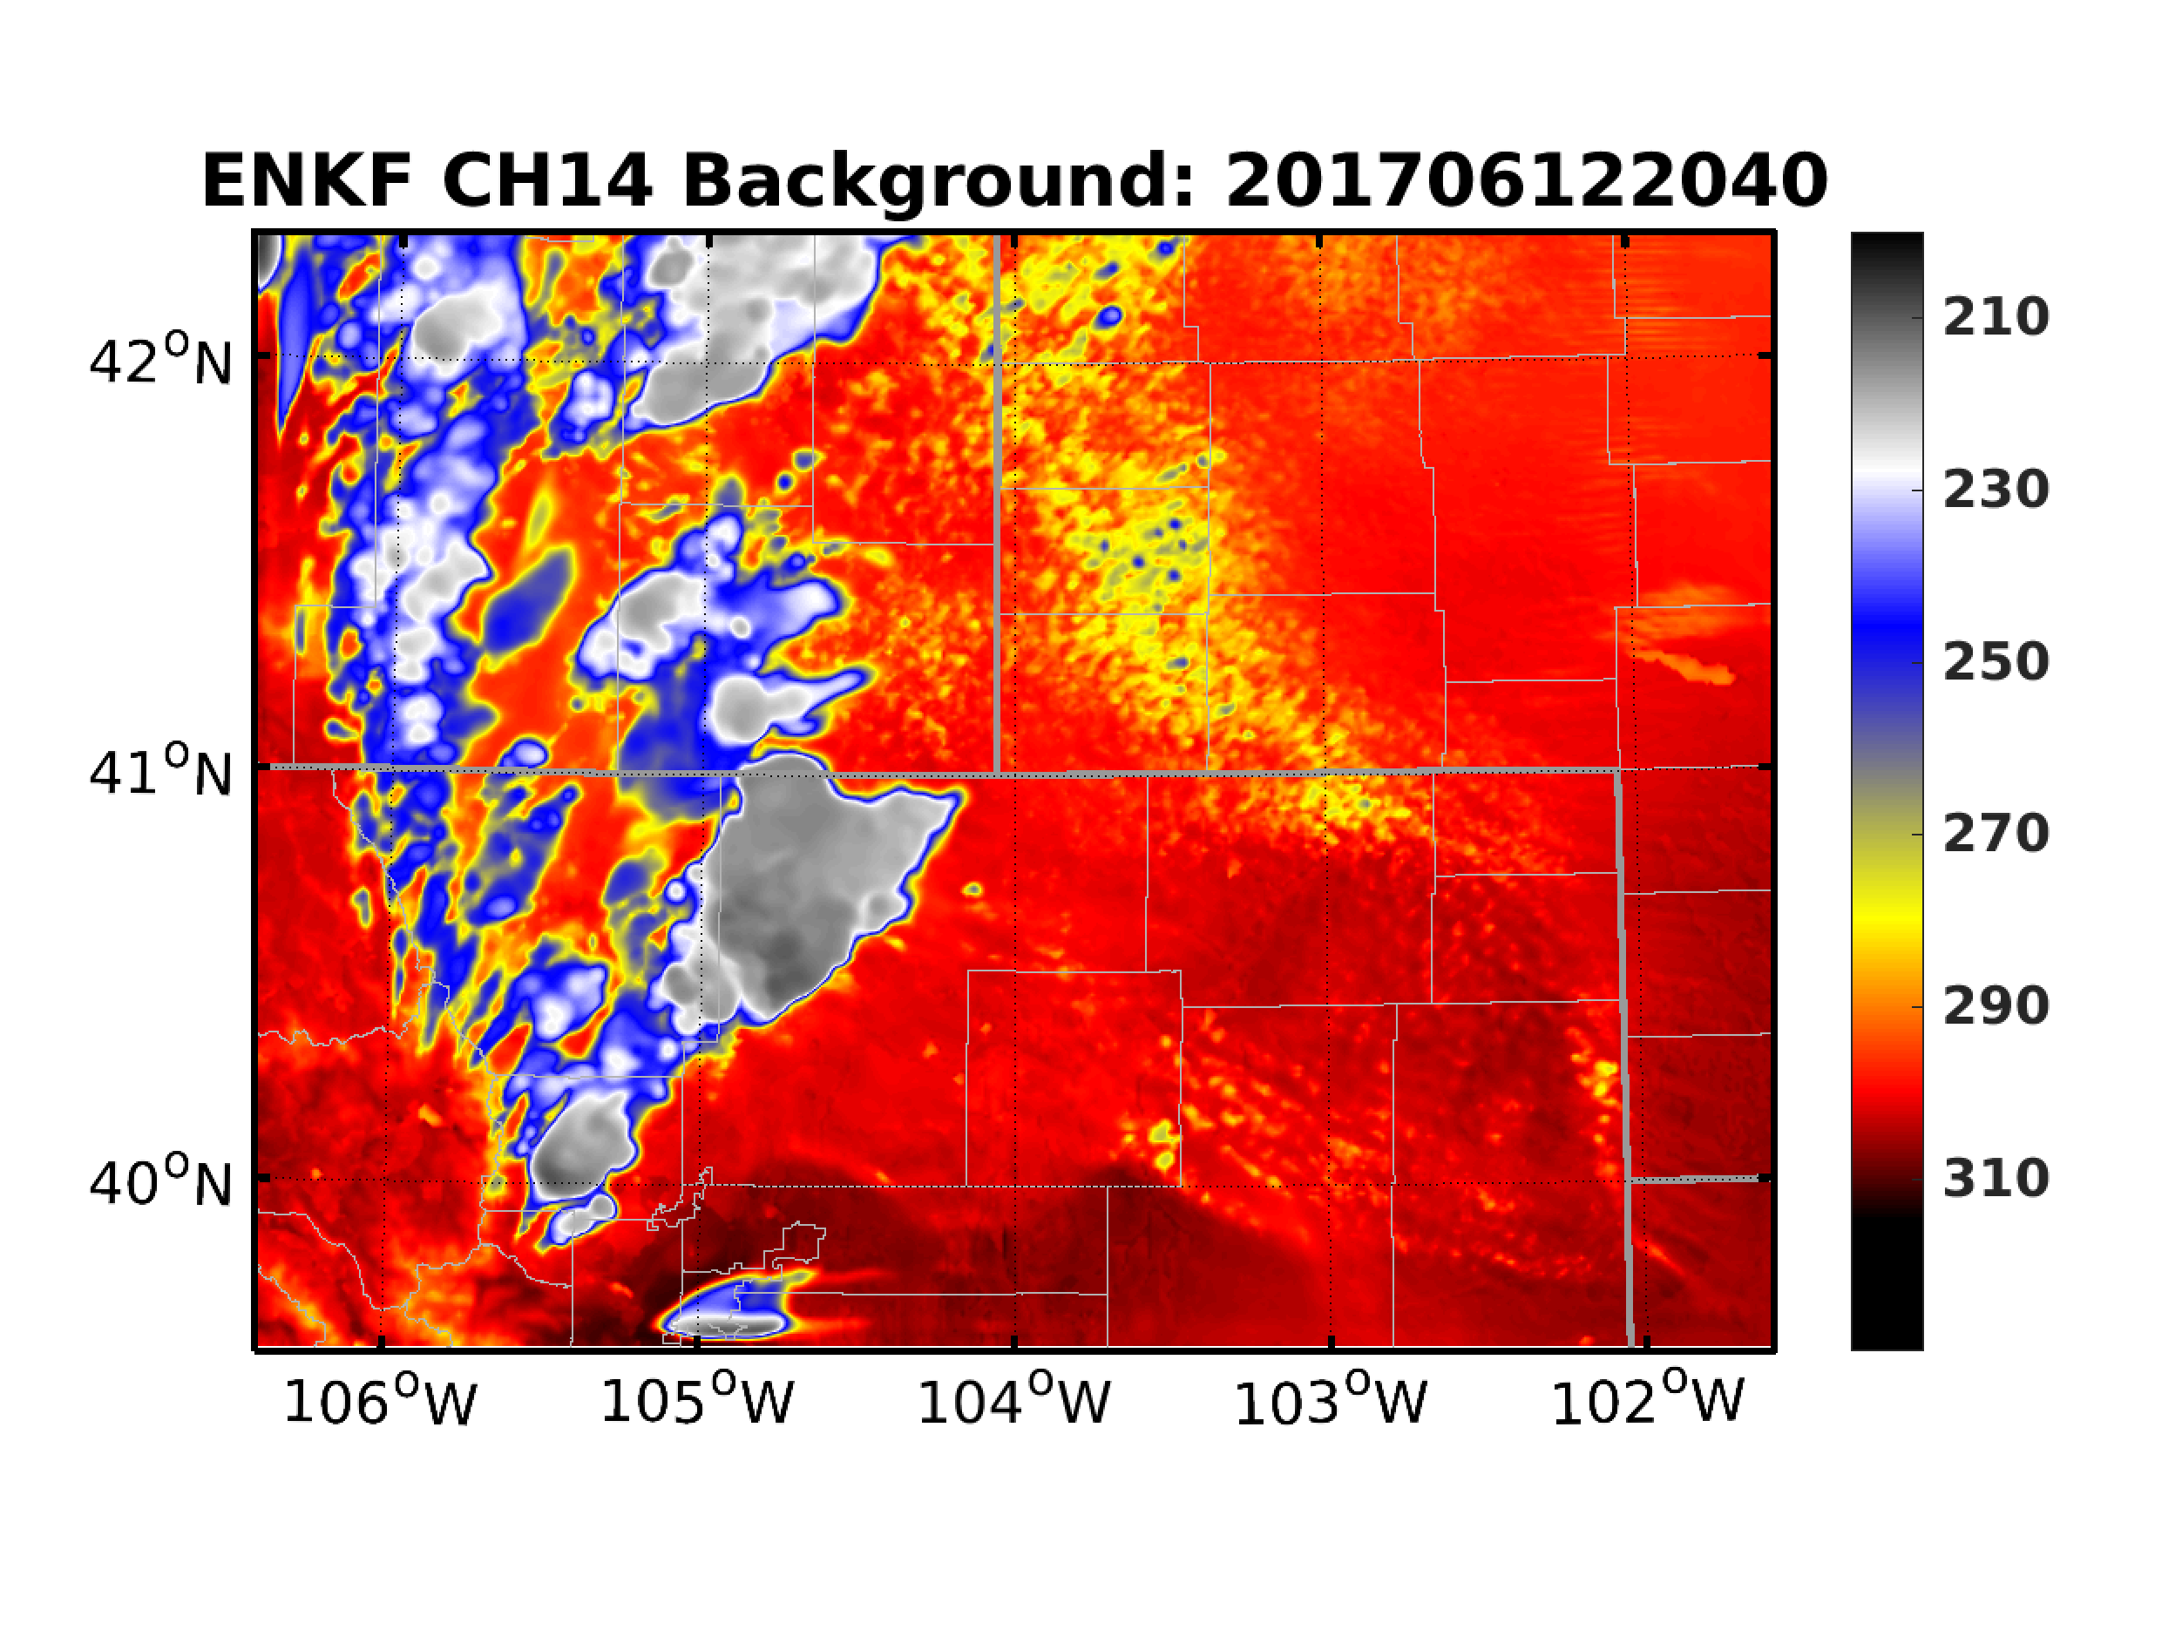
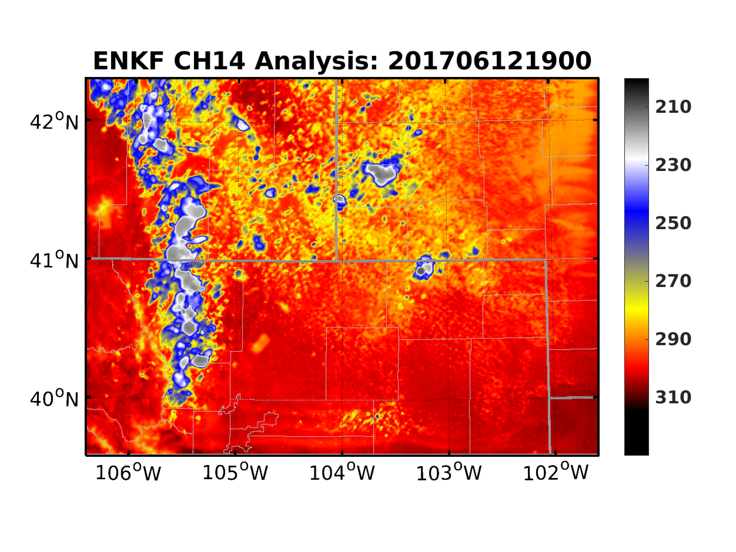
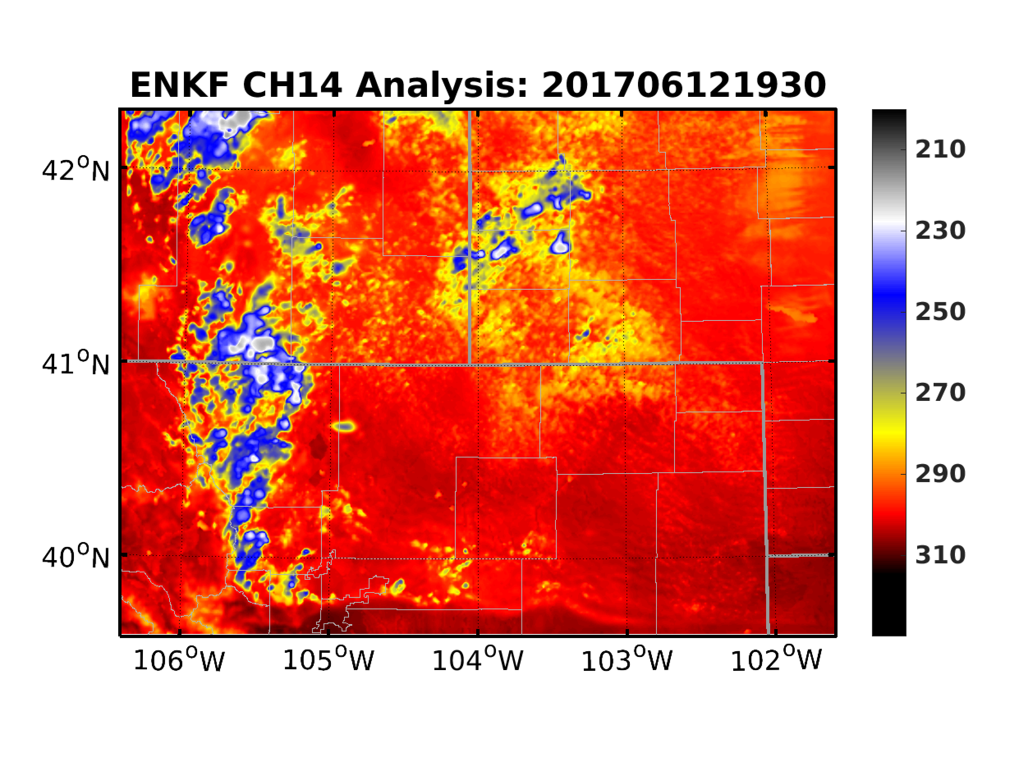
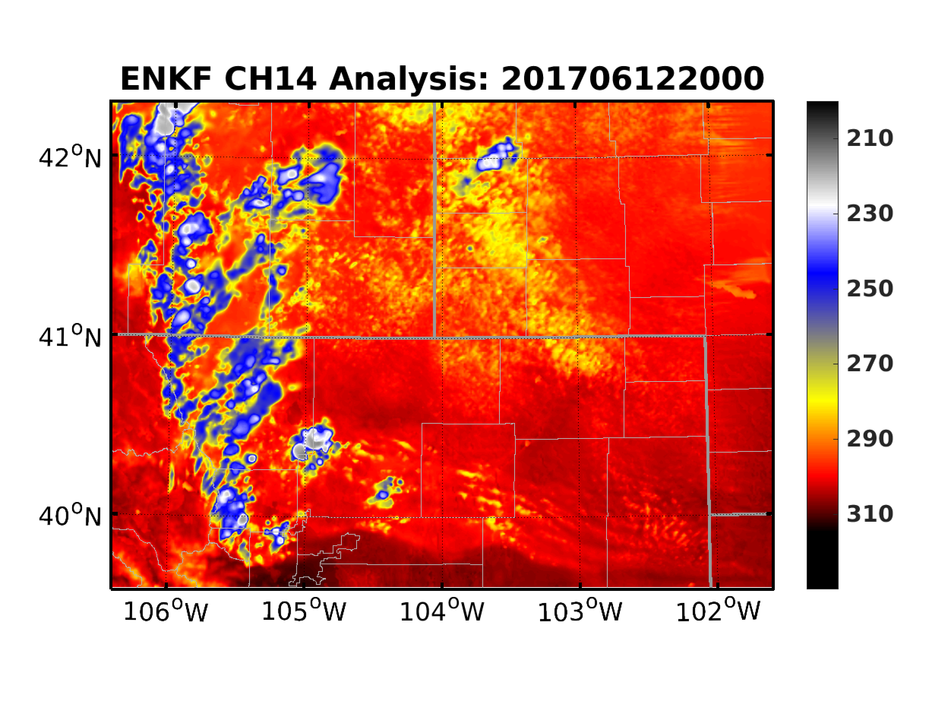
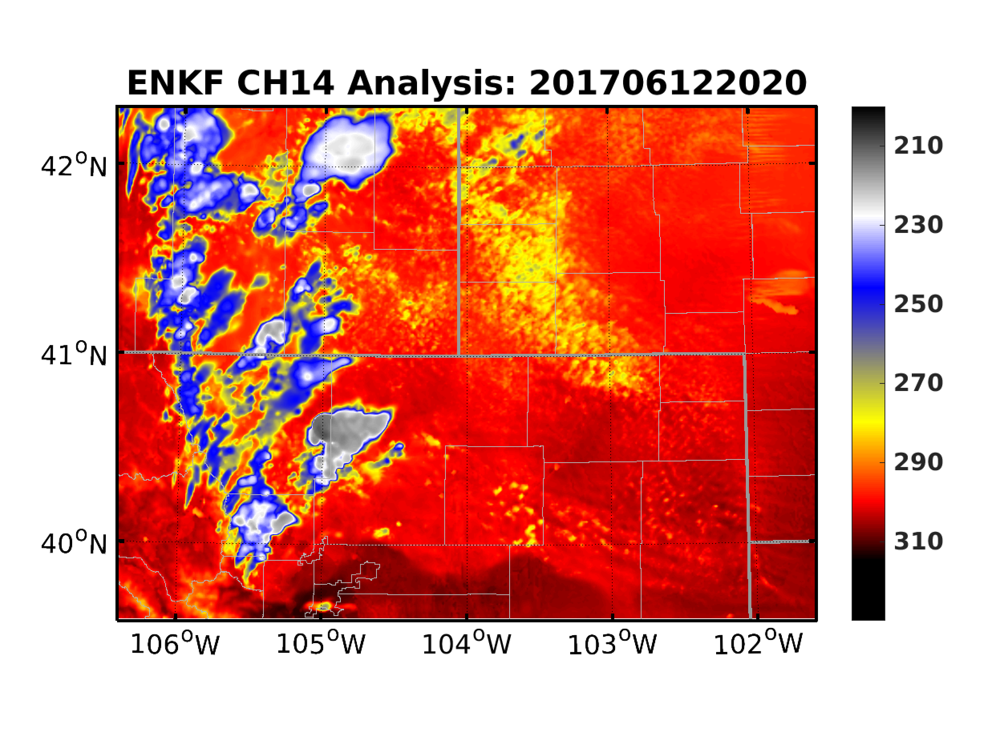
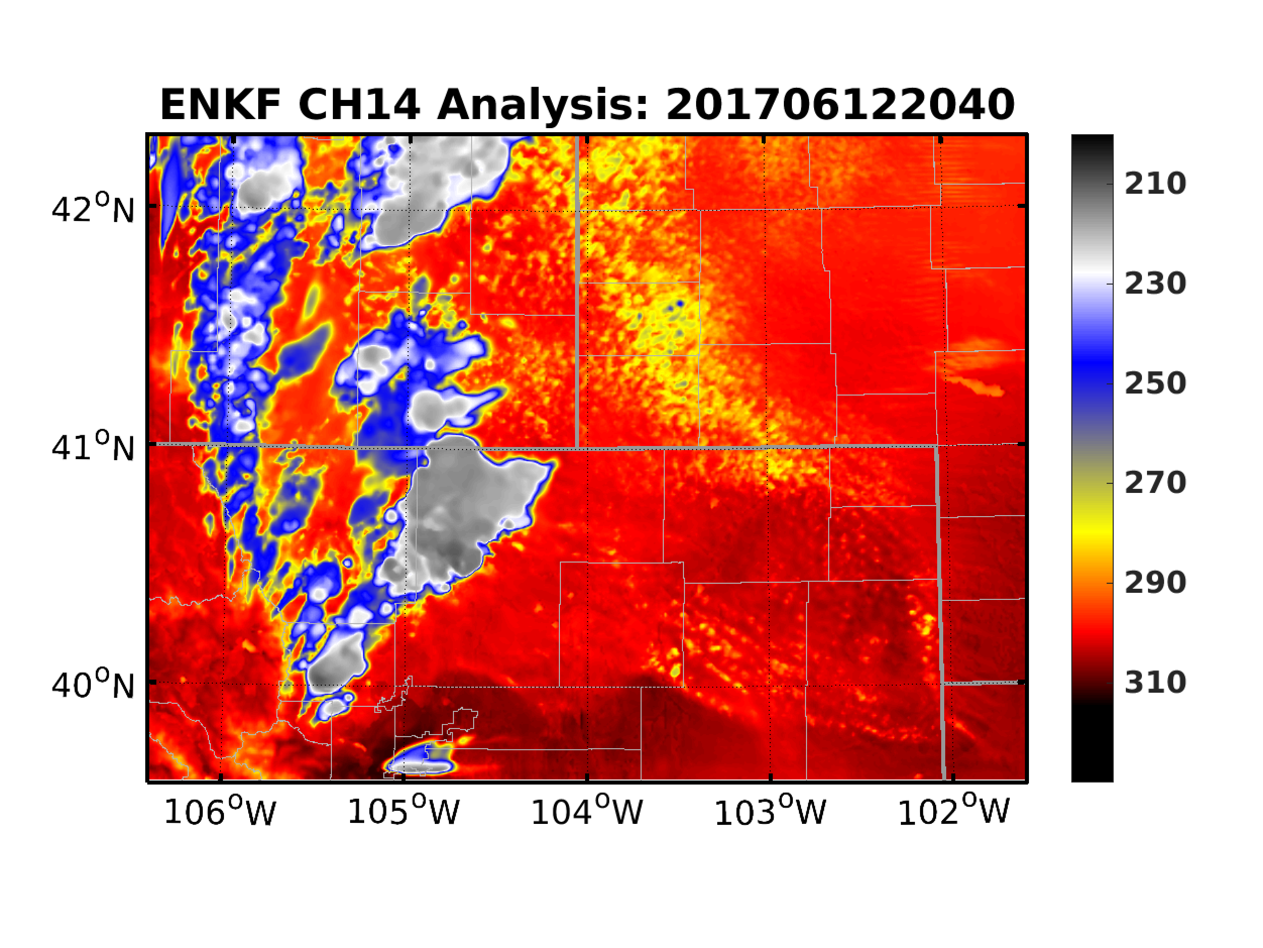
EnKF: Comparison with Independent BT
ABI CH-14
EnKF Background
EnKF Analysis

Slide 9
EnKF: Influence on Hydrometeors
Qc+Qr
Qi+Qs+Qg

Slide 10
EnKF: Influence on Hydrometeors

Slide 11
EnKF: Influence on Hydrometeors

Slide 12
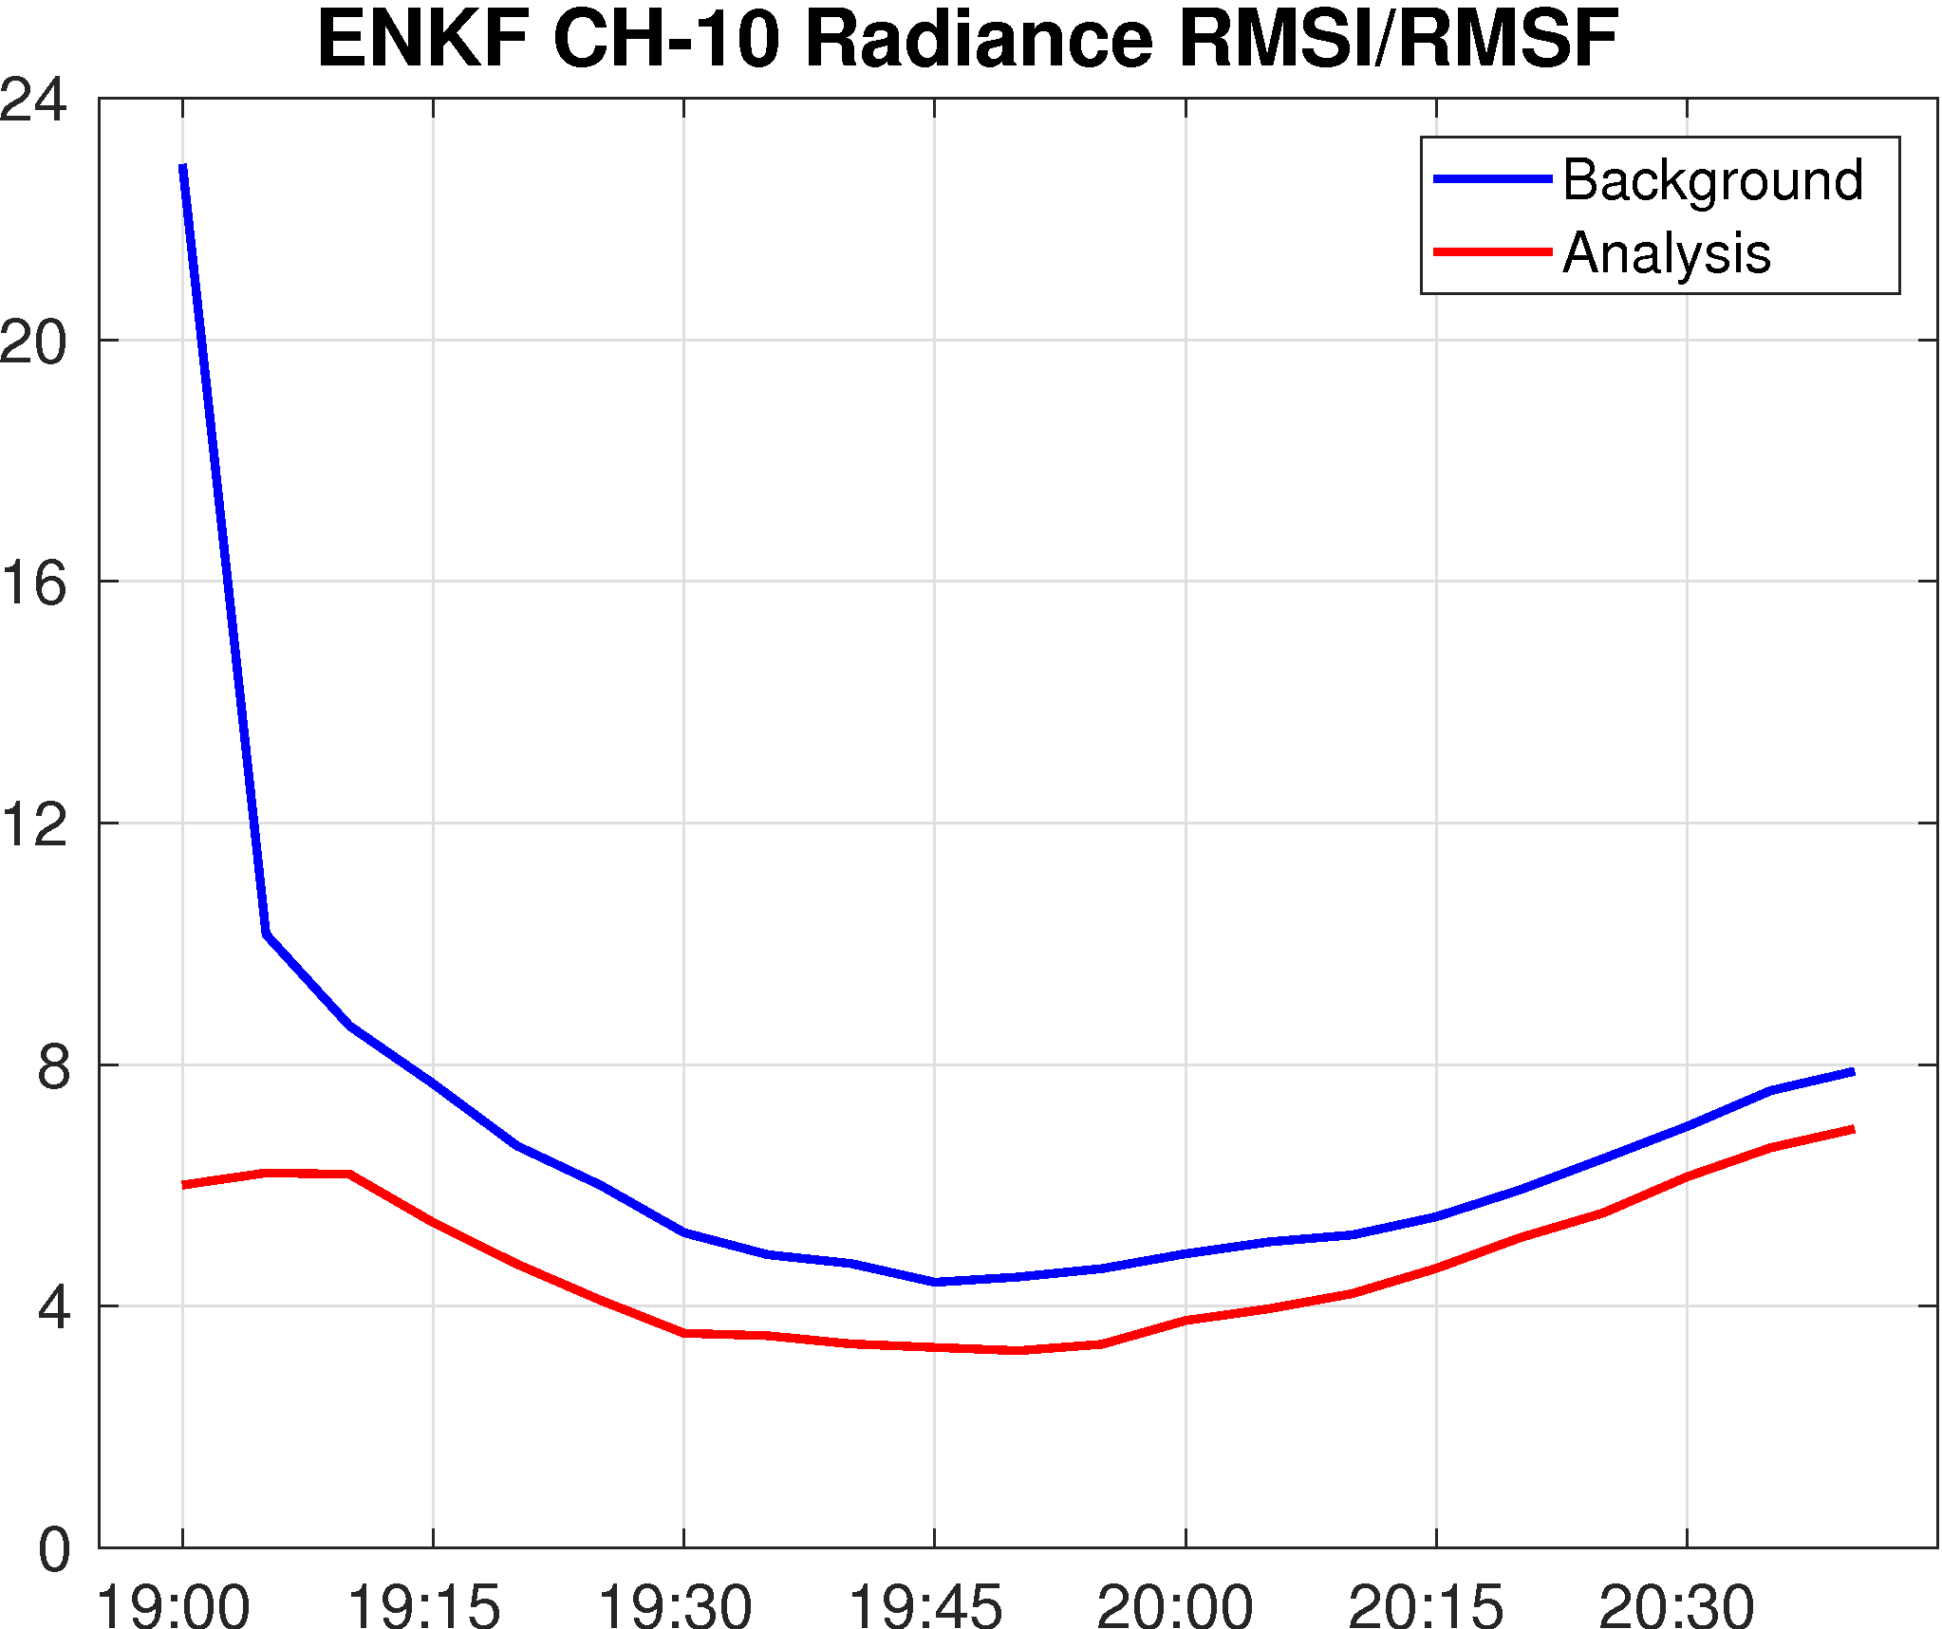
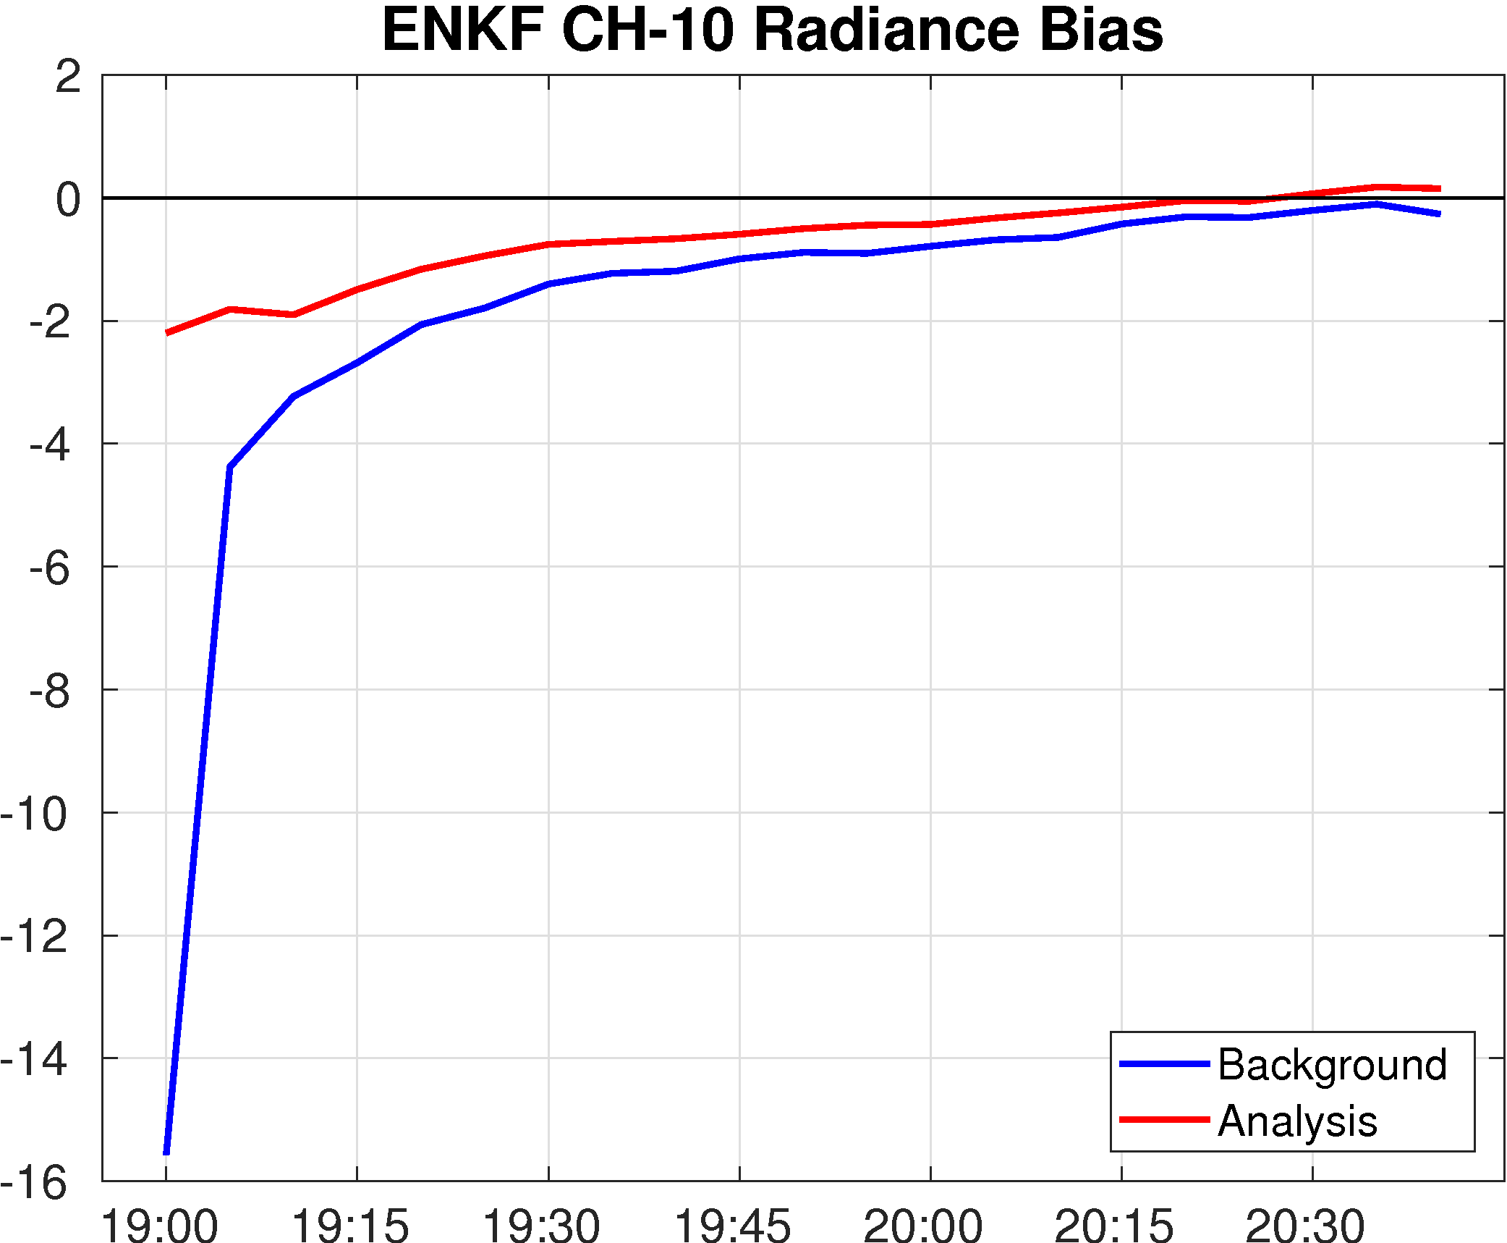
EnKF: Observation-Space Verifications

Slide 13
Deterministic Forecasts: Reflectivity
2000
2100
2200
2300
0000
WSR-88D
Fcst1930
Fcst2000
Fcst2030

Slide 14
Deterministic Forecasts: UH and Vorticity
2–5-km Updraft Helicity
0–1-km Max Vertical Vorticity

Slide 15
Probabilistic Forecasts: Reflectivity
2000
2100
2200
2300
0000
EF1930
EF2000
EF2040

Slide 16
Probabilistic Forecasts: UH and Vorticity
2–5-km Updraft Helicity
0–1-km Max Vertical Vorticity

Slide 17
Concluding Remarks
Assimilating infrared BT observations from GOES-16 ABI can improve analysis and prediction of a severe thunderstorm event
Effective removal of spurious clouds before CI
Better constraints on hydrometeors (especially ice particles)
Enhanced mid-level mesocyclone and low-level rotation forecasts
How to better utilize BT to initialize clouds?
ABEI (Minamide & Zhang 2018 MWR)
Simultaneous assimilation of BT and radar observations

