Slide 1
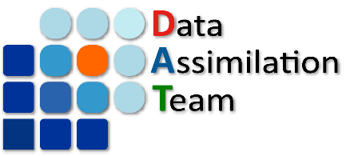
Ensemble Forecast Sensitivity to Observations Verified with Multiple References
S. Kotsuki, K. Kurosawa, T. Miyoshi
RIKEN
Center for Computational Science
8th EnKF-WS, May. 9, 2018 @ Montreal, Canada
Notes:
45分質疑込み

Slide 2
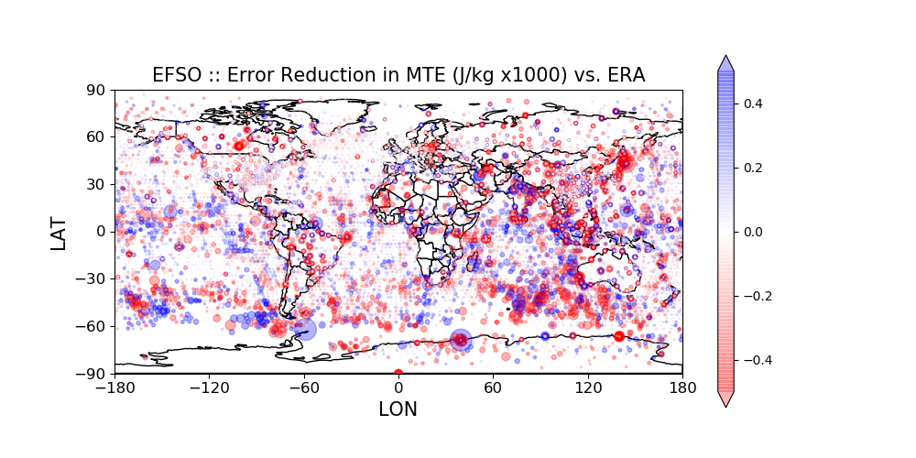
Estimated Obs Impact by EFSO
● Beneficial observation
● Detrimental observation
2014/07/11/00UTC; vs. ERA interim

Slide 3
Outline
EFSO with NICAM-LETKF
Denying detrimental obs w/ EFSO (L96)

Slide 4
EFSO with NICAM-LETKF

Slide 5
FSO: Forecast Sensitivity to Observation
analysis time
verification time
model space
truth state
(unknown)
reference
-6
0
t
time (hr)

Slide 6
FSO: Forecast Sensitivity to Observation
analysis time
verification time
model space
AN incr.
By DA
truth state
(unknown)
reference
-6
0
t
time (hr)

Slide 7
FSO: Forecast Sensitivity to Observation
analysis time
verification time
model space
FCST Error
Reduced by DA
AN incr.
By DA
truth state
(unknown)
reference
-6
0
t
time (hr)

Slide 8
FSO: Forecast Sensitivity to Observation
analysis time
verification time
model space
FCST Error
Reduced by DA
AN incr.
By DA
truth state
(unknown)
reference
-6
0
t
time (hr)
Moist Total Energy for Error Norm

Slide 9
FSO: Forecast Sensitivity to Observation
analysis time
verification time
model space
FCST Error
Reduced by DA
AN incr.
By DA
truth state
(unknown)
reference
-6
0
t
time (hr)
Moist Total Energy for Error Norm
Normalized Obs. Departure for Error Norm

Slide 10
Ensemble FSO (EFSO)
Moist Total Energy for Error Norm (Kalnay et al. 2012)
obs-minus-FG
AN ptb
in obs space
FCST ptb
Normalized Obs. Departure for Error Norm (Sommer and Weissmann 2016)
obs-minus-FG
AN ptb
in obs space
FCST ptb

Slide 11
EFSO: FCST MTE Error Reduction (2014/07)
vs. NICAM-LETKF
vs. ERA Interim
Positive Impact
(improving 6-hr FCST)
■ME : Moist Energy
■PE : Potential Energy
■KE : Kinetic Energy
Monthly average in July 2014; FT 06hr

Slide 12
EFSO: FCST NOD Error Reduction (2014/07)
OthConv
Monthly average in July 2014; FT 12hr

Slide 13
EFSO: FCST NOD Error Reduction (2014/07)
-1.15x10⁻³
-32.6x10⁻³
-1.11x10⁻³
-0.02x10⁻³
OthConv
Monthly average in July 2014; FT 12hr

Slide 14
EFSO: FCST NOD Error Reduction (2014/07)
-1.15x10⁻³
-32.6x10⁻³
-1.11x10⁻³
-0.02x10⁻³
Each type of observations mainly contributes
to the improvement of the observed variable!
Monthly average in July 2014; FT 12hr

Slide 15
Beneficial Observation Rate

Slide 16
FCST Error Reduction per Obs (2014/07/11/00)
vs. ERA
FCST degraded
FT 06hr
FCST improved

Slide 17
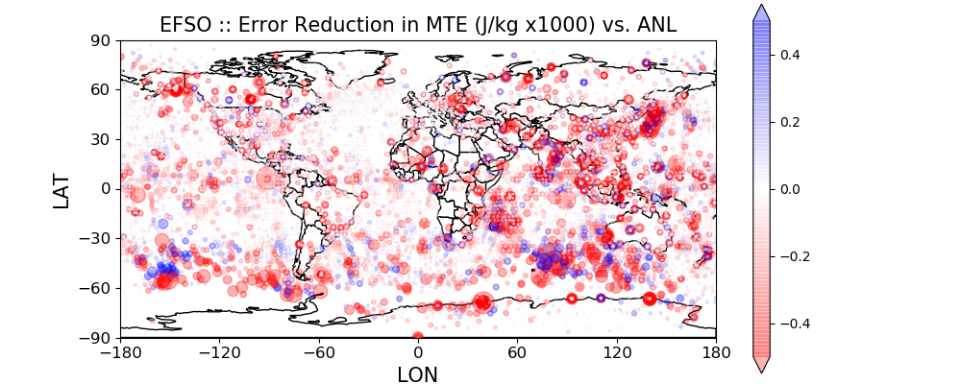
FCST Error Reduction per Obs (2014/07/11/00)
vs. ERA
FCST degraded
FT 06hr
FCST improved
vs.
NICAM
-LETKF
FCST degraded
FT 06hr
FCST improved

Slide 18
FSO: Forecast Sensitivity to Observation
analysis time
verification time
model space
FCST Error
Reduced by DA
AN incr.
By DA
truth state
(unknown)
reference
-6
0
t
time (hr)
FSO assumes no error correlation

Slide 19
Fraction of beneficial observations (ave. 2014/07)
Ref. | Subseq. AN | ERA Interim | AMSU-A
FT 06hr | 58.8 % | 55.4 % | 53.1 %
FT 12hr | 56.1 % | 54.2 % | 53.2 %
FSO may overestimate observational impact
with subsequent analyses for verification reference.

Slide 20
Denying detrimental obs with EFSO
Many thanks: Daisuke Hotta (JMA),
Tse-Chun Chen (UMD), Eugenia Kalnay (UMD)

Slide 21
EFSO with Lorenz-96
Serial EnSRF (Whitaker and Hamill 2001)
Ensemble size : 8
# of observations : 40
Adaptive multiplicative inflation (Miyoshi 2011)
Assimilation order
1. Random
2. From worse to better impacts based on EFSO
3. From better to worse impacts based on EFSO
cf. Kotsuki et al. (2017, MWR); POSTER #8

Slide 22
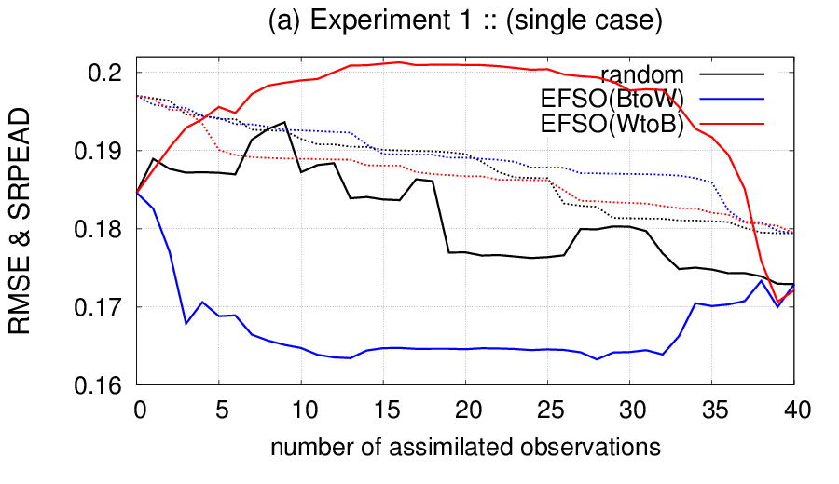
RMSE during serial assimilation (one case)
ー RMSE
--- SPRD
FG
AN
－: random order
－: EFSO better → worse obs.
－: EFSO worse → better obs.

Slide 23
RMSE during serial assimilation (one case)
ー RMSE
--- SPRD
Can we stop
assimilating here?
FG
AN
－: random order
－: EFSO better → worse obs.
－: EFSO worse → better obs.

Slide 24
Quick Review
Denying detrimental obs w/ EFSO (EFSO-DN)
(similar to proactive QC)
motivated by Hotta et al. (2017; MWR)
PQC in GFS w/ MODIS winds
works for L96 when denying top 10% bad obs
Chen et al., personal communications
was not successful for L96 when denying all bad obs
Our study
Two kinds of detrimental obs
・ flawed (e.g. biased, w/ non-Gaussian error)
・ unflawed

Slide 25
Filter
Filter
time
time
0
0
(1) DA: AN @ t=0
(2) Nonlinear FCST
: FG
: OB
: AN

Slide 26
Denying Obs w/ EFSO
Filter w/
EFSO-DN
Target
AN
Reference
AN
time
time
0
T
0
T
(1) DA-cycle by t=T
(2) EFSO to evaluate
OBS at t=0
time
0
T
0
(3) Deny detrimental OBS
& DA: AN @ t=0
(4) Nonlinear FCST
: FG
: OB
: AN

Slide 27
Smoother
EFSO-DN uses future obs
➔ considered as a smoother
Smoother
※ different due to
model nonlinearity
time window
※ should be excluded
for smoother cycles
time
time
0
T
0
DA: AN @ t=0
w/ OBS in window
(2) Nonlinear FCST
: FG
: OB
: AN

Slide 28
Motivation
When denying all bad obs (in our L96 study)
DA cycle was not successful
This study conducts non-cycled experiments
LETKF cycle
FG
FG
FG
FG
FG
DA & FCST
DA & FCST
DA & FCST
DA & FCST
DA & FCST
DA methods
NoDA | LETKF (Filter) | LETKF-DN (w/ EFSO-DN) | LETKS (Smoother)

Slide 29
Non-cycled Experiments w/ L96
Experimental setting
# Ensemble | 8
# Observation | 40
Localization scale | 5 grids (manually tuned)
Advection of localization | 0.6 grids / day (Kalnay et al. 2012)

Slide 30
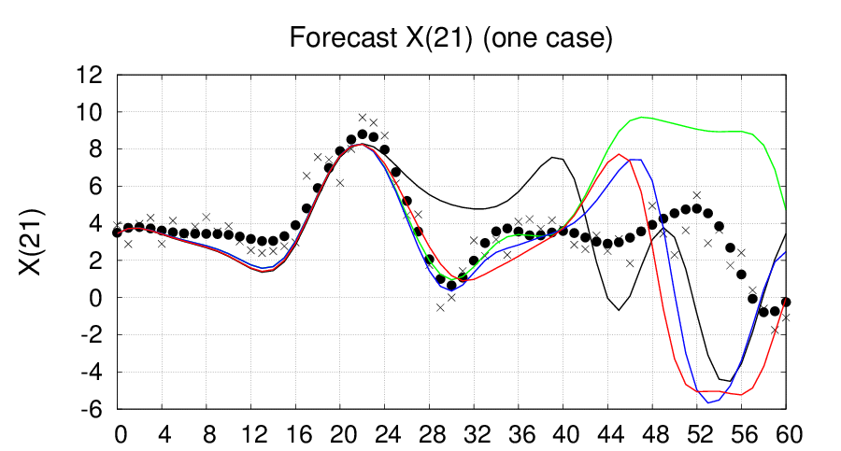
An Example :: LETKF w/wo EFSO-DN (1 step ≈ 6h)
Improved up to
FT 40
➔ FT
LETKF
EFSO
LETKF-DN (EFSO@FT08)
EFSO
LETKF-DN (EFSO@FT16)
EFSO
LETKF-DN (EFSO@FT24)

Slide 31
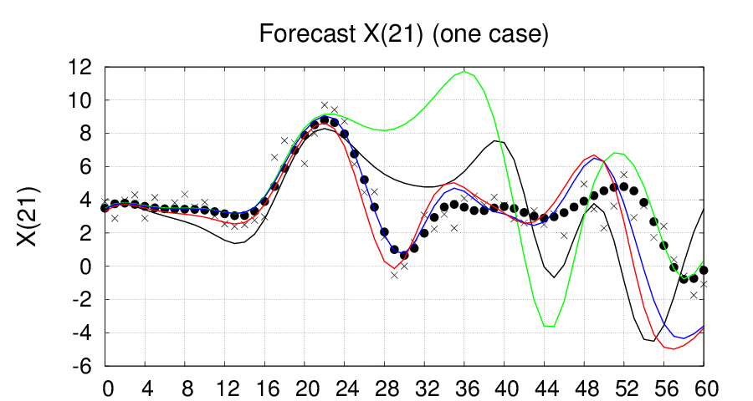
An Example :: LETKF vs. LETKS (1 step ≈ 6h)
Improved up to FT 44
➔ FT
LETKF (no-window)
window
LETKS (08-window)
window
LETKS (16-window)
window
LETKS (24-window)

Slide 32
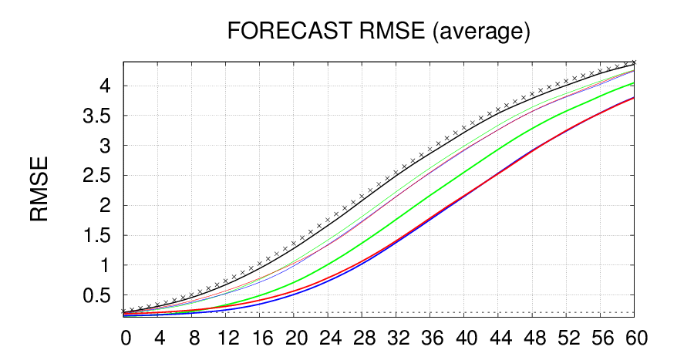
Mean RMSE (average of 1800 cases)
➔ FT
LETKF-DN ≤ LETKF
LETKS ≤ LETKF-DN

Slide 33
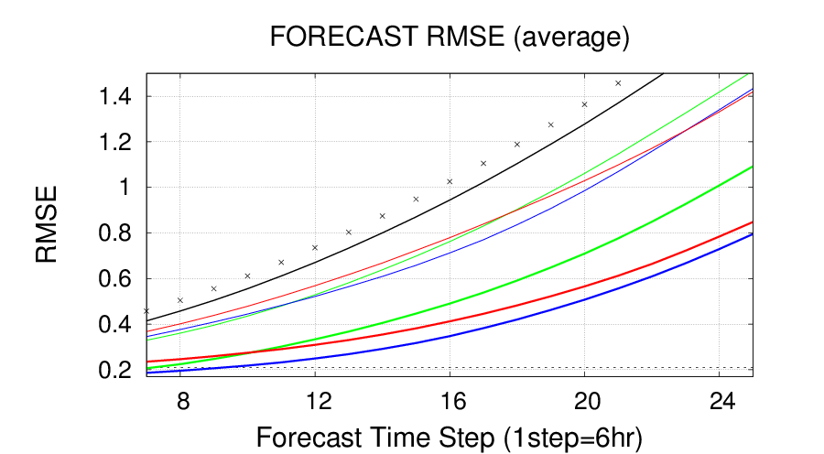
Mean RMSE (average of 1800 cases)
EFSO@FT16
is the best
EFSO@FT24
is the best
EFSO@FT08
is the best
➔ FT
LETKF-DN works as designed!!!

Slide 34
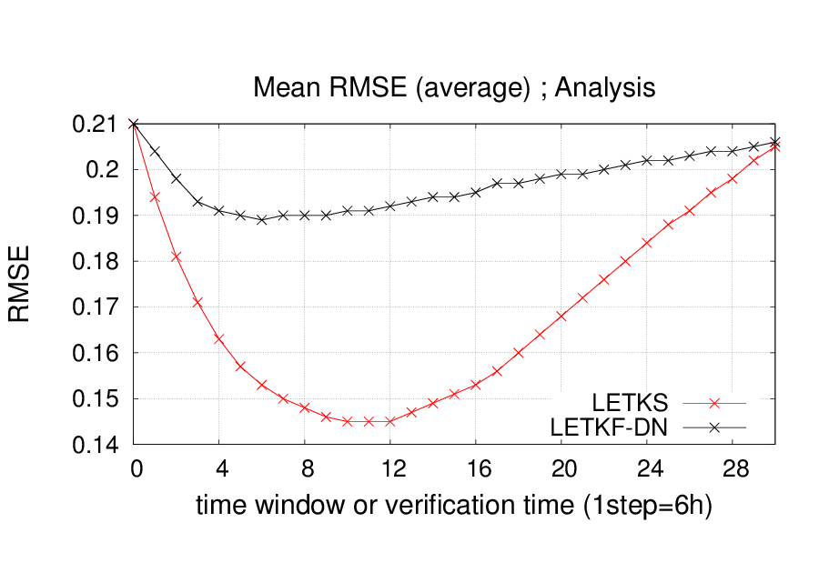
Mean Analysis RMSE (average of 1800 cases)
LETKF
LETKS ≤ LETKF-DN
Limitations for window & verification time
due to linear error growth approximation

Slide 35
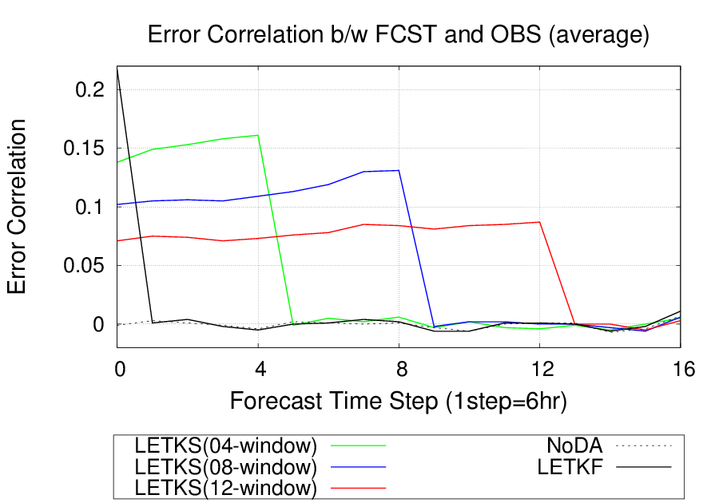
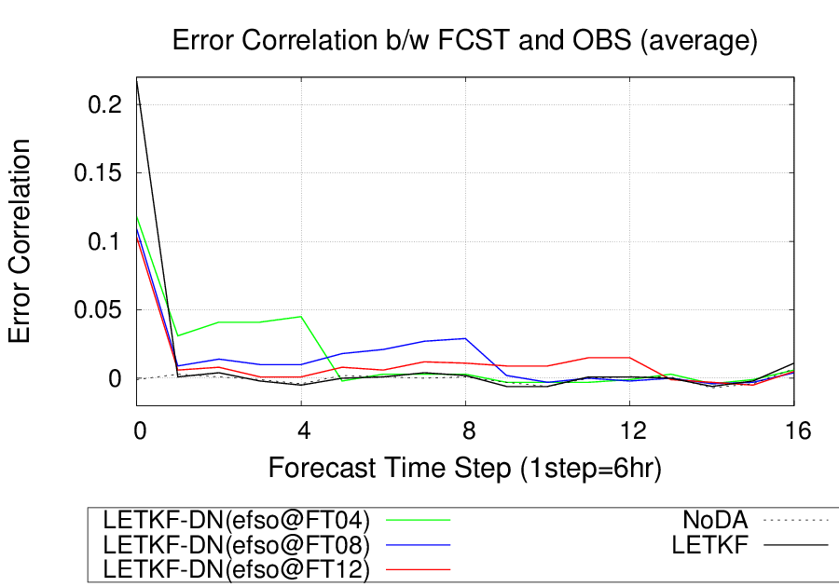
Interpretation of EFSO-DN
Smoother
LETKF-DN
time window
Reference
AN
time
time
using future obs directly
using future obs indirectly
Sample: 1800*40
Sample: 1800*40

Slide 36
Results and discussion based on non-cycled exp.
Reasons EFSO-DN did not work for cycled exp.
Overdispersive analysis ensemble
More accurate analysis, but larger spread due to fewer obs
OMB-OMB based adaptive inflation does not work
<dd^{T}>=HBH^{T} + R - <εº(Hε^{b})^{T}> - <Hε^{b}(εº) ^{T}>
Remarks for cycled DA
Variational methods would not have those issues
Denying partially (e.g. only top 10% detrimental obs), or, manually-tuned inflation would mitigate those issues
However, mathematical approaches need to be developed to assimilate partially-used obs
Smoother is better than the EFSO-DN
Both using the same future obs
Remarks:
PQC has advantage to deny flawed obs.

Slide 37
Summary
NICAM-LETKF
OBS impacts are estimated vs. AN and OBS
Each type of observations mainly contributes to the improvement of the observed variable
FSO may overestimate observational impact w/ subsequent analyses for verification reference
L96: EFSO-DN ⬅➔ Smoother
Non-cycled experiments are conducted
Smoother is better than the EFSO-DN
EFSO-DN uses future OBS indirectly
Kotsuki et al. (in prep.)
Kotsuki et al. (in prep.)

Slide 38
APPENDIX

Slide 39
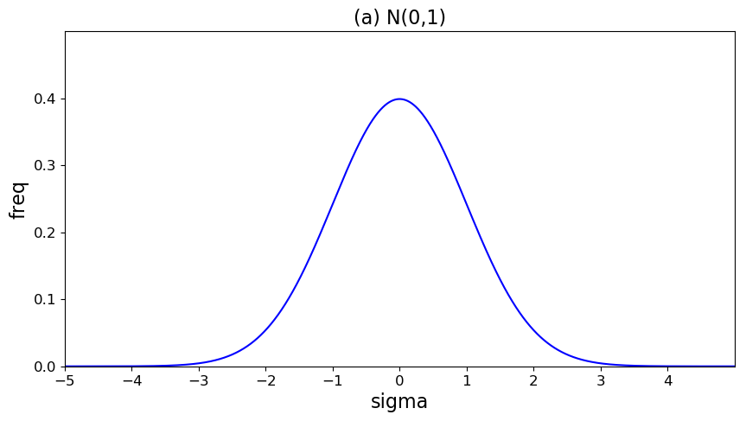
beneficial & detrimental obs
Truth

Slide 40
beneficial & detrimental obs
Truth
FG

Slide 41
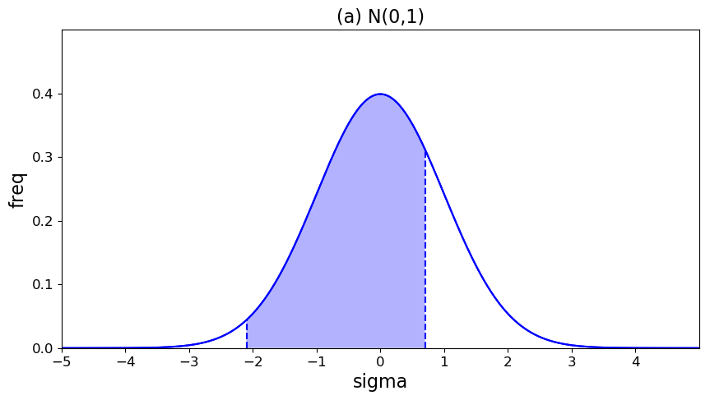
beneficial & detrimental obs
Beneficial obs
Truth
FG
See Lorenc and Mariott (2014) for more detailed discussion

Slide 42
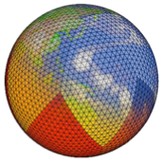
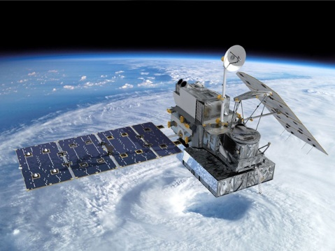
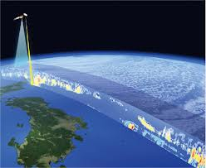
Project Overview
GPM
NICAM
LETKF
(JAXA)
Local Ensemble Transform Kalman Filter (Hunt et al. 2007)
Goal: Look for most effective use of GPM precipitation measurements.

Slide 43
NICAM-LETKF (NWP) system
System developed (Terasaki et al. 2014, SOLA)
AMSU-A assimilated (Terasaki and Miyoshi 2018, JMSJ)
MHS assimilated (Terasaki et al., in prep.)
GSMaP assimilated (Kotsuki et al. 2017, JGR-A)
GPM/DPR assimilated (Poster #9)
Model parameter DA w/ GSMaP (Kotsuki et al., in revision)
Adaptive-RTPP&RTPS (Kotsuki et al. 2017, QJRMS)
Accounting for correlated R (Terasaki et al., in prep.)
EFSO implemented (Kotsuki et al., in prep.)
System accelerated (Yashiro et al. 2016, GMD)
10,000-member DA (Miyoshi et al. 2015, Computer)
This talk

Slide 45
Interpretation of Positive Obs. Rate

Slide 46
Interpretation of Positive Obs. Rate
FG
(e.g., x=0.7, σ=1.0)

Slide 47
Interpretation of Positive Obs. Rate
FG
(e.g., x=0.7, σ=1.0)

Slide 48
Interpretation of Positive Obs. Rate

Slide 50
Derivation
These two variables should be
consistent with Kalman gain
① liner error growth approximation
② ensemble error covariance approximation

Slide 51
Error Norms
L2 norm for Toy models (e.g. L63, L96)
Moist Total Energy norm for the atmosphere
KE: kinetic energy
PE: potential energy
ME: moist energy
cf. Ota et al. (2013, Tellus)

Slide 52
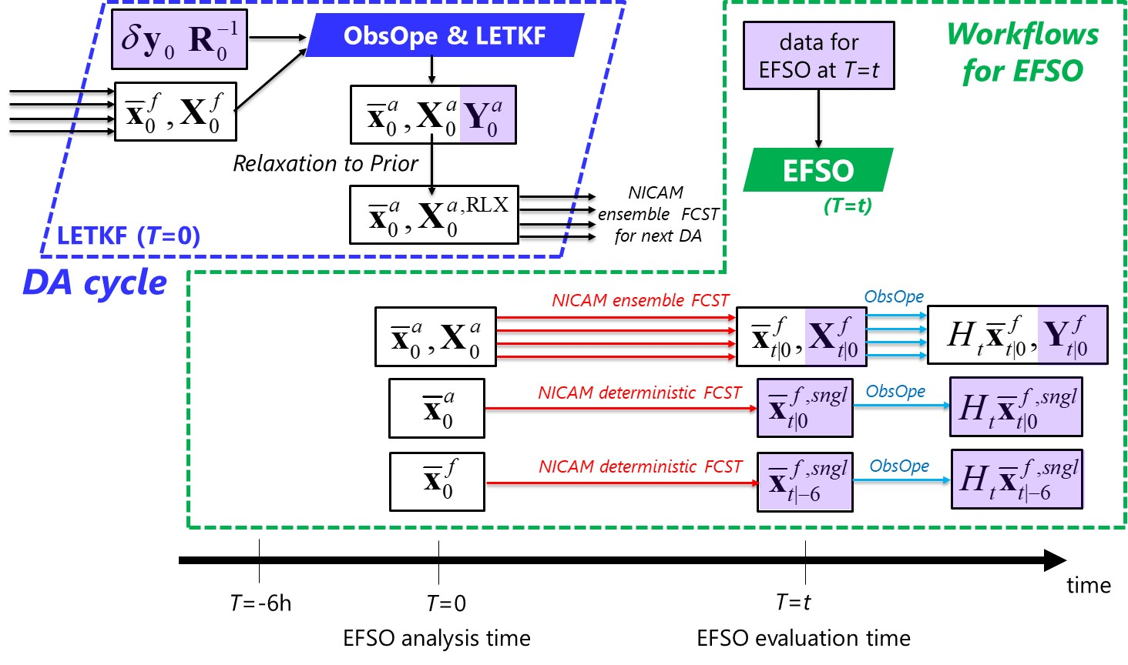
EFSO with NICAM-LETKF

Slide 53
EFSO with NICAM-LETKF

Slide 54
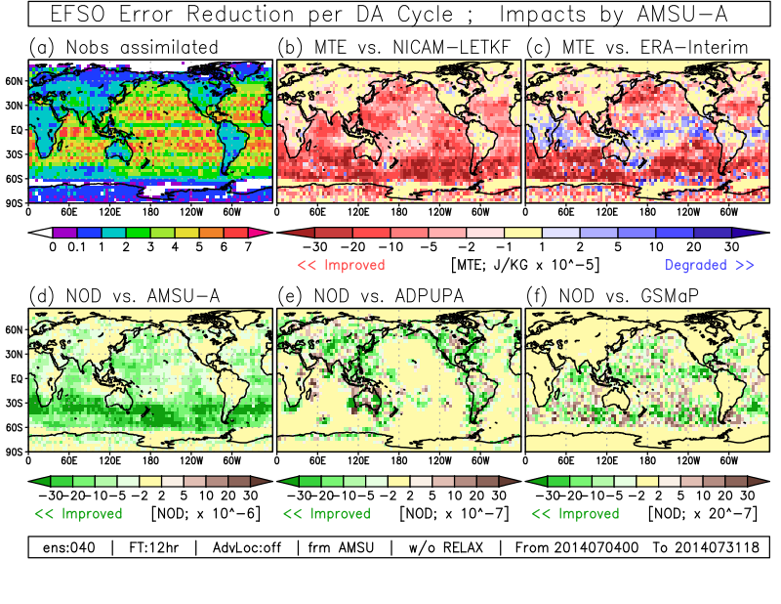
Spatial Pattern of AMSU-A impacts

Slide 55
Spatial Pattern of AMSU-A impacts

Slide 56
Impact of AMSU-A radiances
(a) w/ AMSU-A (500hPa)
(b) w/o AMSU-A(500hPa)

Slide 57
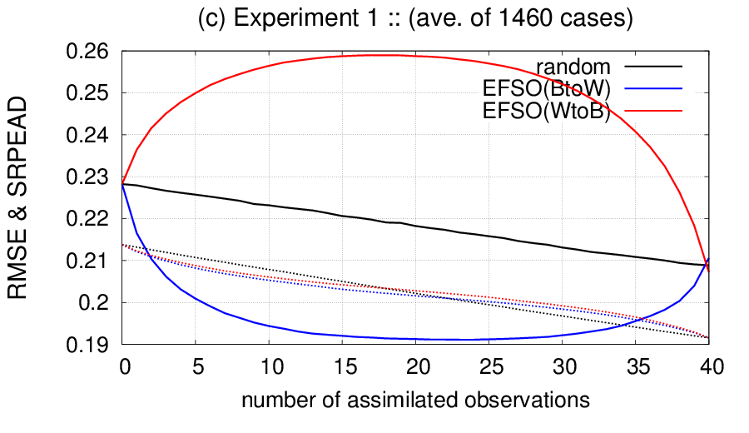
RMSE during serial assimilation (ave of 1460 cases)
ー RMSE
--- SPRD
FG
AN
－: random order
－: EFSO better → worse obs.
－: EFSO worse → better obs.

Slide 58
Question
ー RMSE
--- SPRD
Can we stop
assimilating here?
FG
AN
－: random order
－: EFSO better → worse obs.
－: EFSO worse → better obs.

