Slide 1
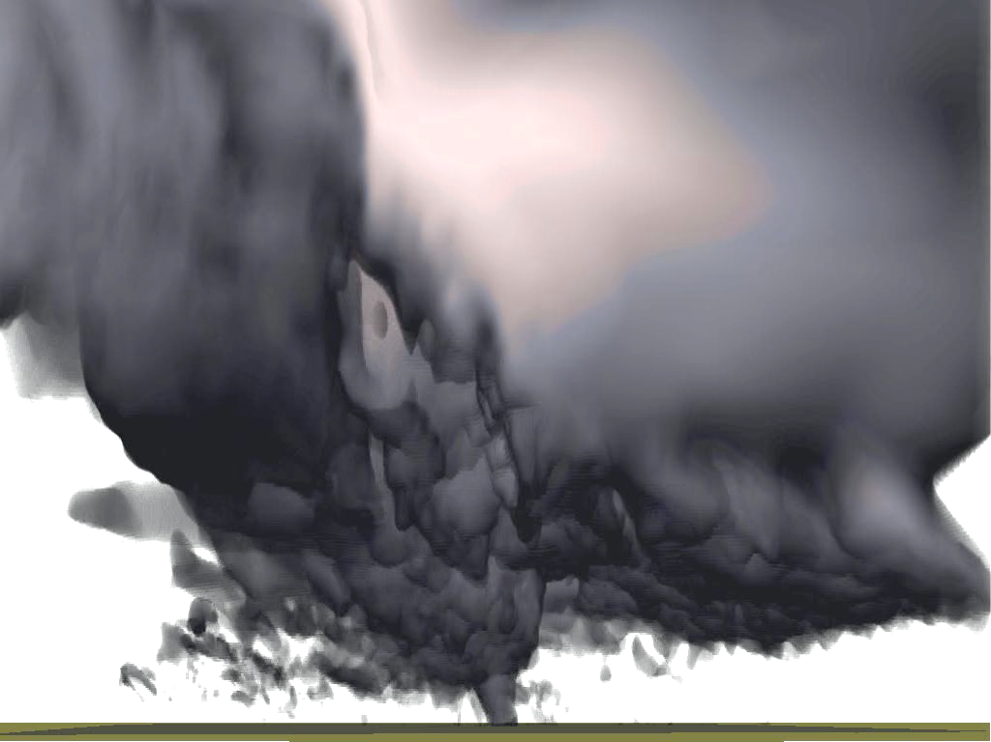
CAPS Real-time Storm-Scale EnKF Data Assimilation and Forecasts for the NOAA Hazardous Weather Testbed Spring Forecasting Experiments: Towards the Goal of Operational Ensemble-Variational Data Assimilation for Convection-Permitting Models
Presented by Youngsun Jung
Center for Analysis and Prediction of Storms
Rong Kong, Chengsi, Liu, Jingyao Luo, Ming Xue, Gang Zhao
Acknowledgement: real-time HWT team
May 7, 2018
youngsun.jung@ou.edu

Slide 2
Real-time DA and NWP
CAPS/OU has been producing 3-km (previously 4-km) CONUS-domain ensemble forecasts for evaluation at NOAA HWT since 2007 and HMT since 2017.
Goals: To determine the optimal design, configurations, and post-processing of storm-scale ensemble prediction, and to provide the products for evaluation by forecasters and researchers, and test storm-scale data assimilation methods.
Part of the Community Leveraged Unified Ensemble (CLUE) since 2017.
A distinct feature of the CAPS SSEFs: the assimilation of full-volume radial velocity and reflectivity data from the WSR-88D network.
To gain understanding to optimize and further calibrate a short-term probabilistic forecast system to support WoF

Slide 3
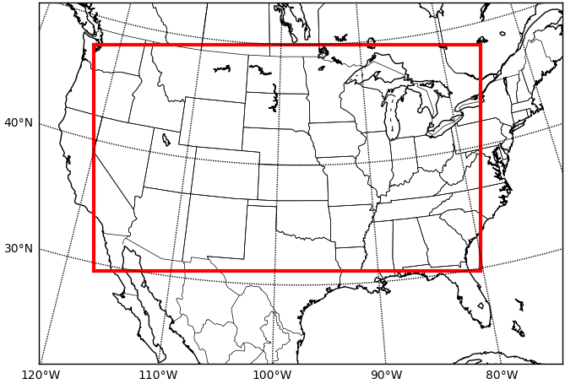
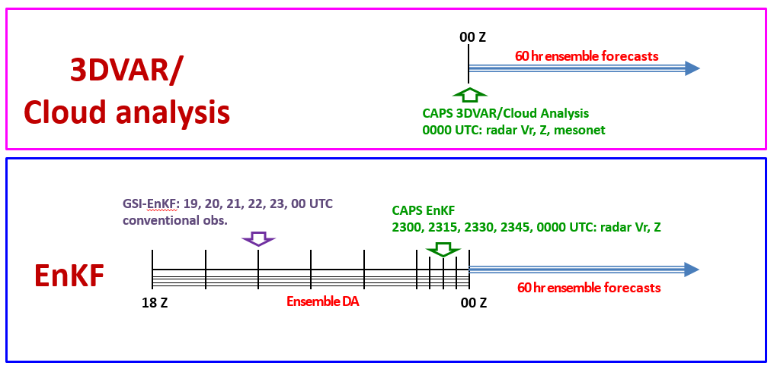
2017 HWT Model and Configuration
Forecast model: WRF-ARW v3.8.1 (2017)
DA systems: CAPS 3DVAR/cloud analysis, GSI-EnKF, CAPS EnKF
3-km horizontal grid spacing, 51 vertical levels
http://www.caps.ou.edu/~fkong/sub_atm/spring17-enkf.html
Verification domain
Forecast domain
(1160 X 1120)

Slide 4
Computing Resource (EnKF Ensemble)
PSC Bridges (21,056 cores)
Two Intel Haswell (E5-2695 v3) 14-core CPUs, 2.3-3.3 GHz
CAPS HWT Spring Experiment
Using 205 nodes (205*28 = 5740 cores)
Data archive: ~ 1 TB/day (not all data is archived)
Performance statistics: 26 April 2018 case
Conventional observation assimilation: < 3 minutes
Radar data assimilation: ~ 5 min (20x56 = 1120 cores)
radar reflectivity: ~ 1 millions radial velocity: ~ 60 K (from 139 sites)

Slide 5
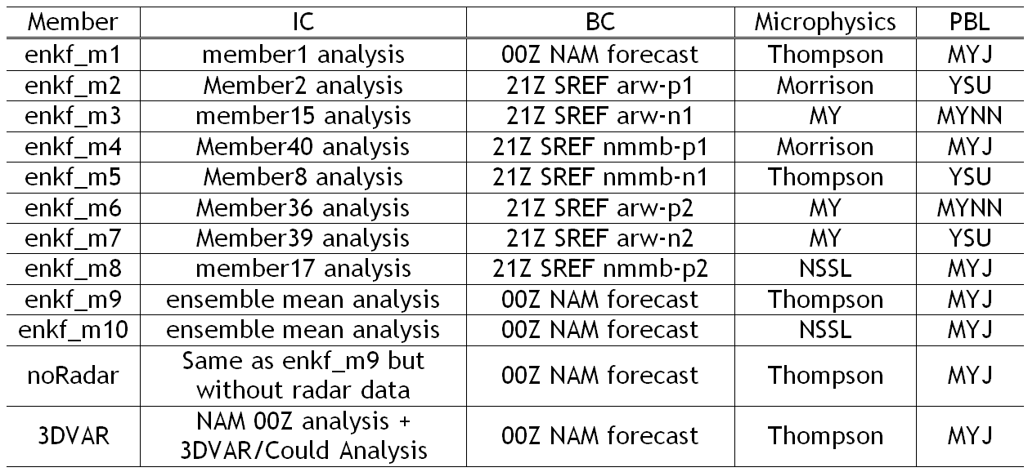
Configuration for the EnKF Ensemble Forecasts

Slide 6
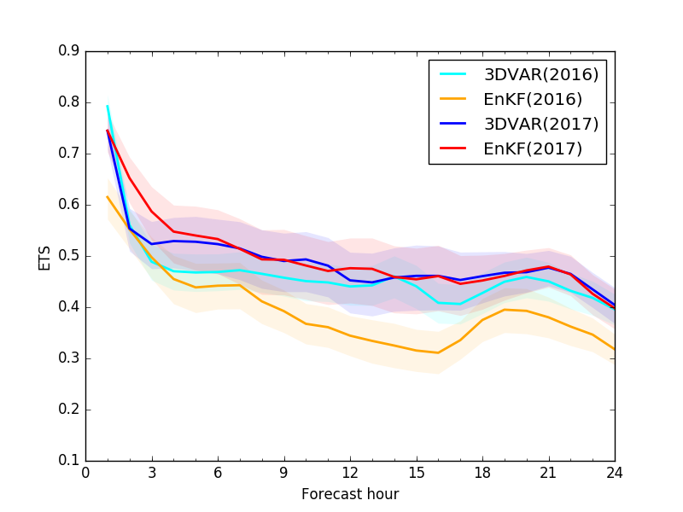
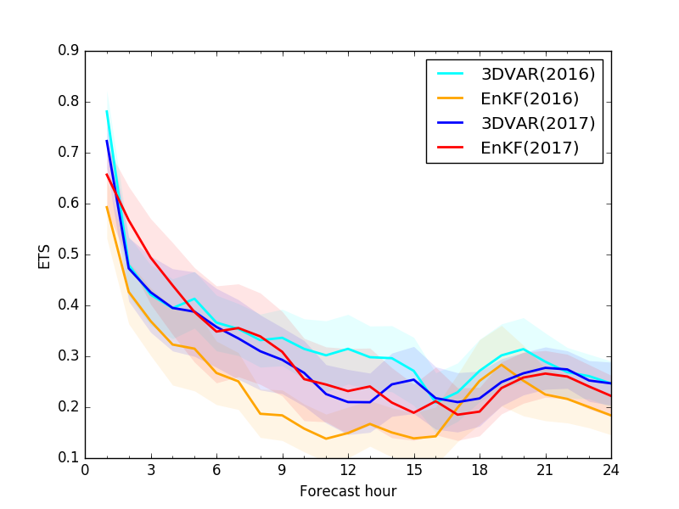
Neighborhood ETS of 1-hour rainfall
(R=15km)
a) ≥ 1.27 mm
b) ≥ 6.35 mm
Experiment (number of cases):
3DVar_2016 (18), EnKF_2016 (16), 3DVar_2017 (22), EnKF_2017 (21)

Slide 7
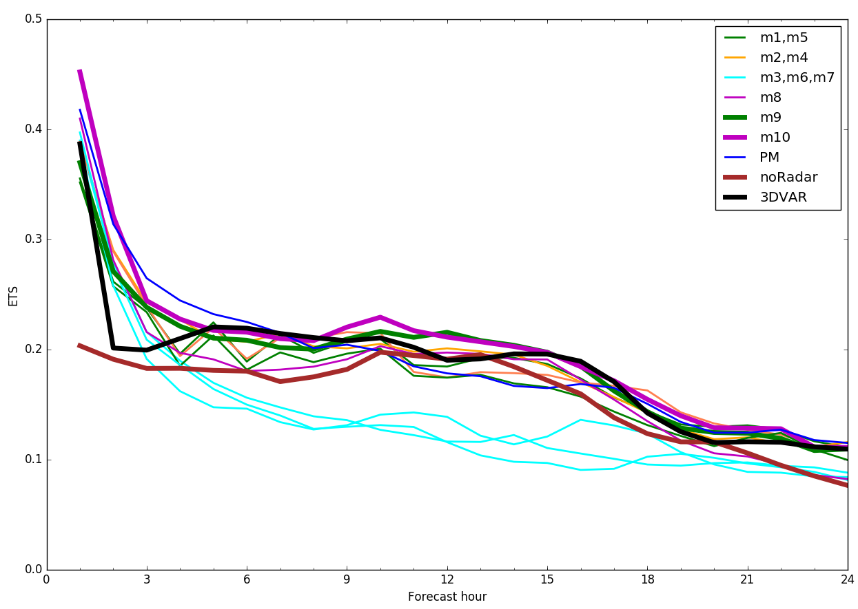
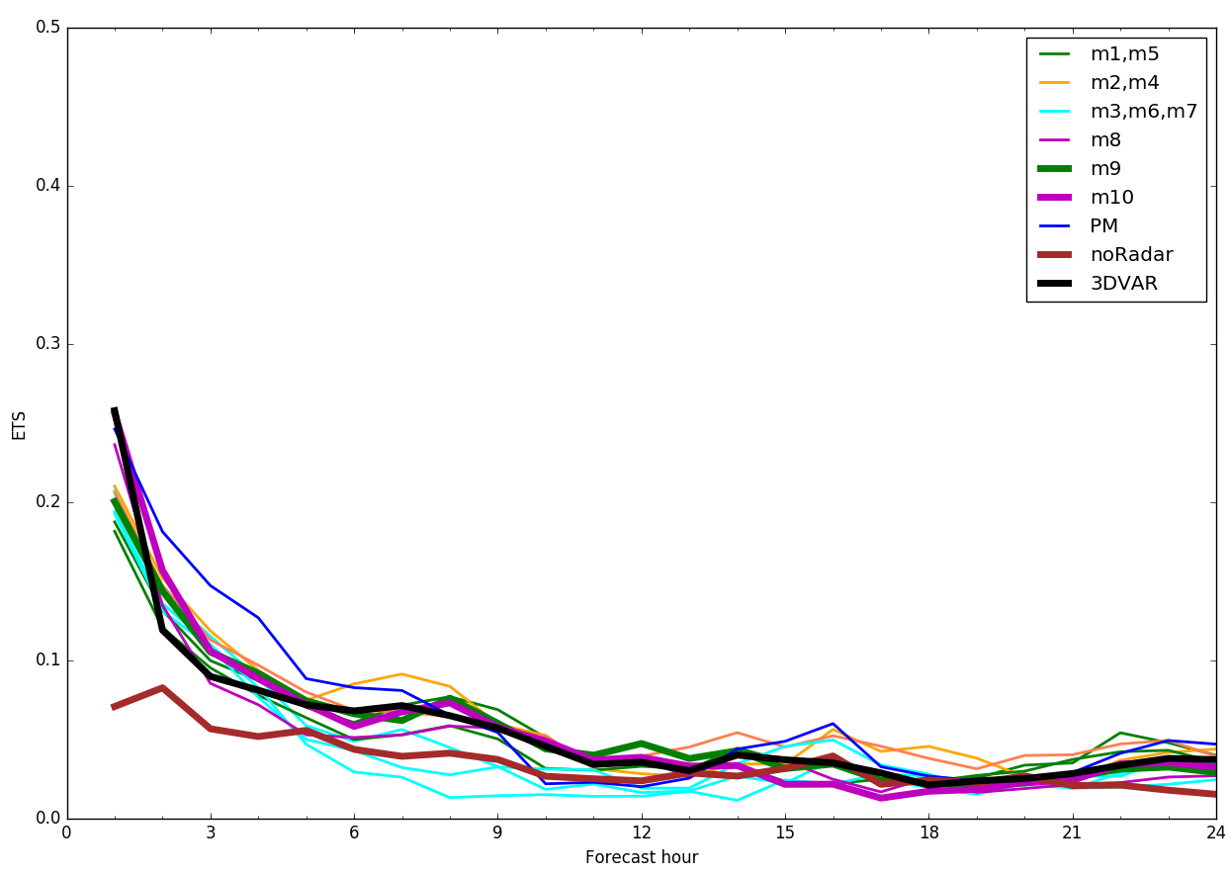
ETSs of 1-hour rainfall accumulations
a) ≥ 0.05 in
b) ≥ 0.25 in
Green: Thompson (m1: 23, m5: 23, m9: 20 days) Black: 3DVAR (22 days)
Cyan: MY (m3: 16, m6: 16, m7: 18 days) Brown: noRadar (11 days)
Orange: Morrison (m2: 22, m4: 23 days) Blue: PM (23 days)
Purple: NSSL (m8: 20, m10: 20 days)

Slide 8
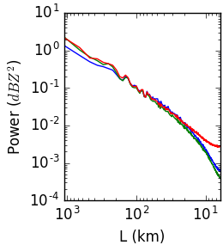
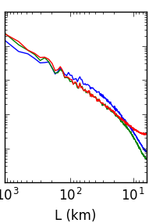
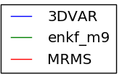
14 day averaged Composite Reflectivity Power Spectra (dBZ²)
a) 0015 UTC
b) 0100 UTC
6∆x
6∆x

Slide 9
0000 UTC
MRMS Cloud-analysis EnKF
5/17/2017
5/26/2017
5/29/2017
5/30/2017

Slide 10
0006 UTC
MRMS Cloud-analysis EnKF
5/17/2017
5/26/2017
5/29/2017
5/30/2017

Slide 11
0012 UTC
MRMS Cloud-analysis EnKF
5/17/2017
5/26/2017
5/29/2017
5/30/2017

Slide 12
0030 UTC
MRMS Cloud-analysis EnKF
5/17/2017
5/26/2017
5/29/2017
5/30/2017

Slide 13
0100 UTC
MRMS Cloud-analysis EnKF
5/17/2017
5/26/2017
5/29/2017
5/30/2017

Slide 14
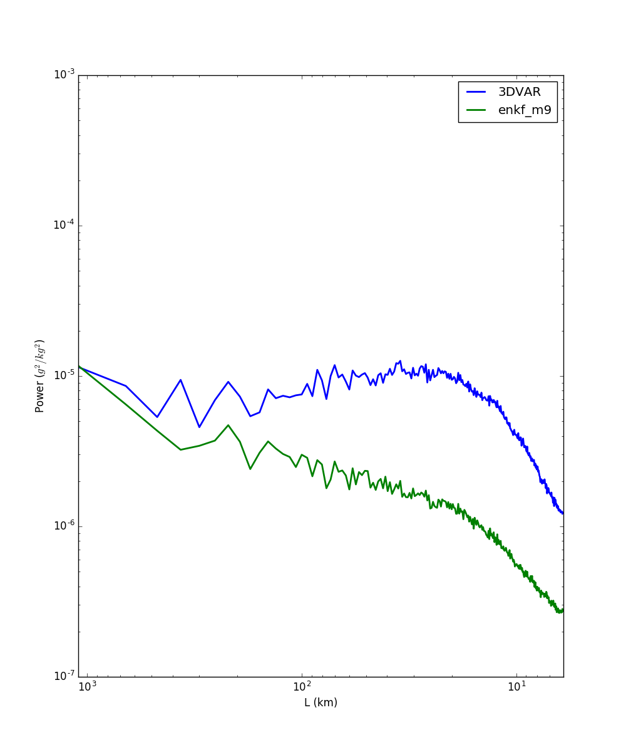
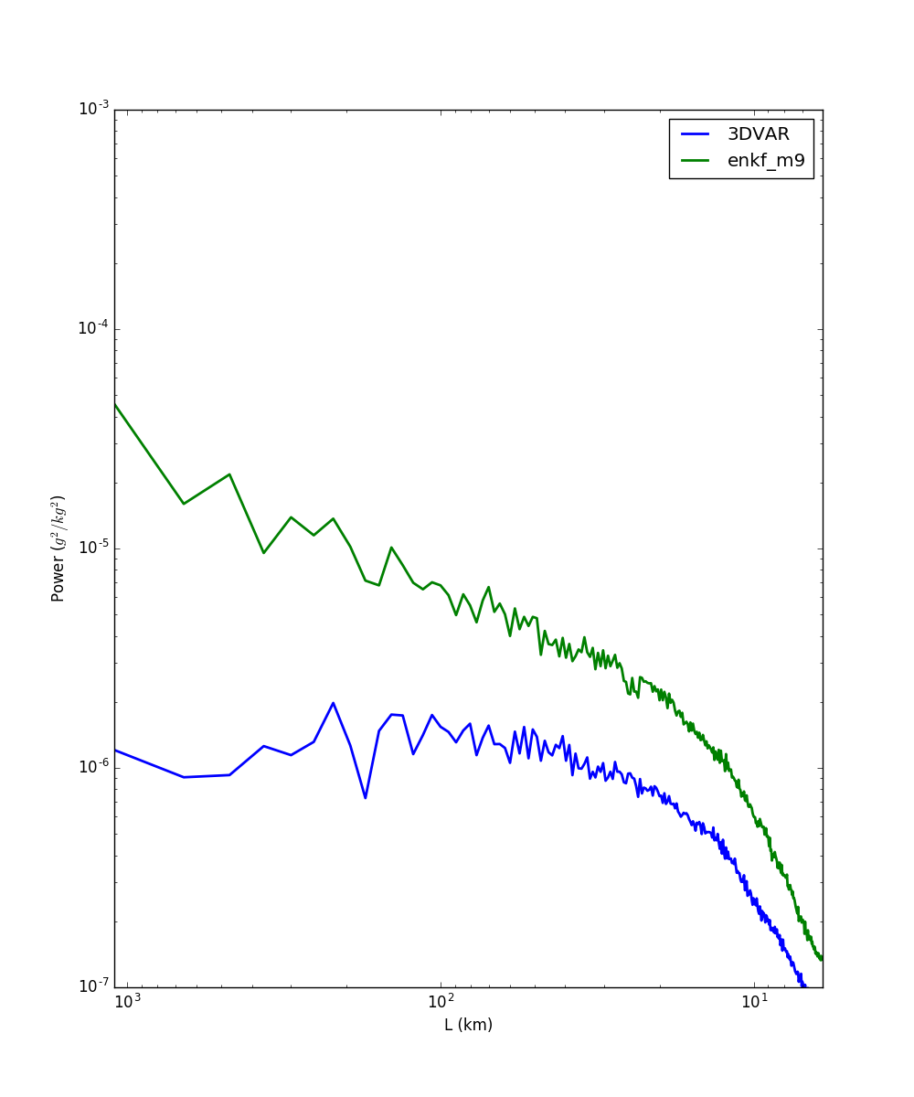
Mixing Ratio Power Spectra
0000 UTC
Graupel mixing ratio (k=25)
Rain mixing ratio (k=2)
10⁻³
10-⁴
10⁻⁵
10⁻⁶
10⁻⁷
10⁻³
10-⁴
10⁻⁵
10⁻⁶
10⁻⁷
Power (kg²/kg²)
10³ 10² 10¹
L (km)
10³ 10² 10¹
L (km)

Slide 15
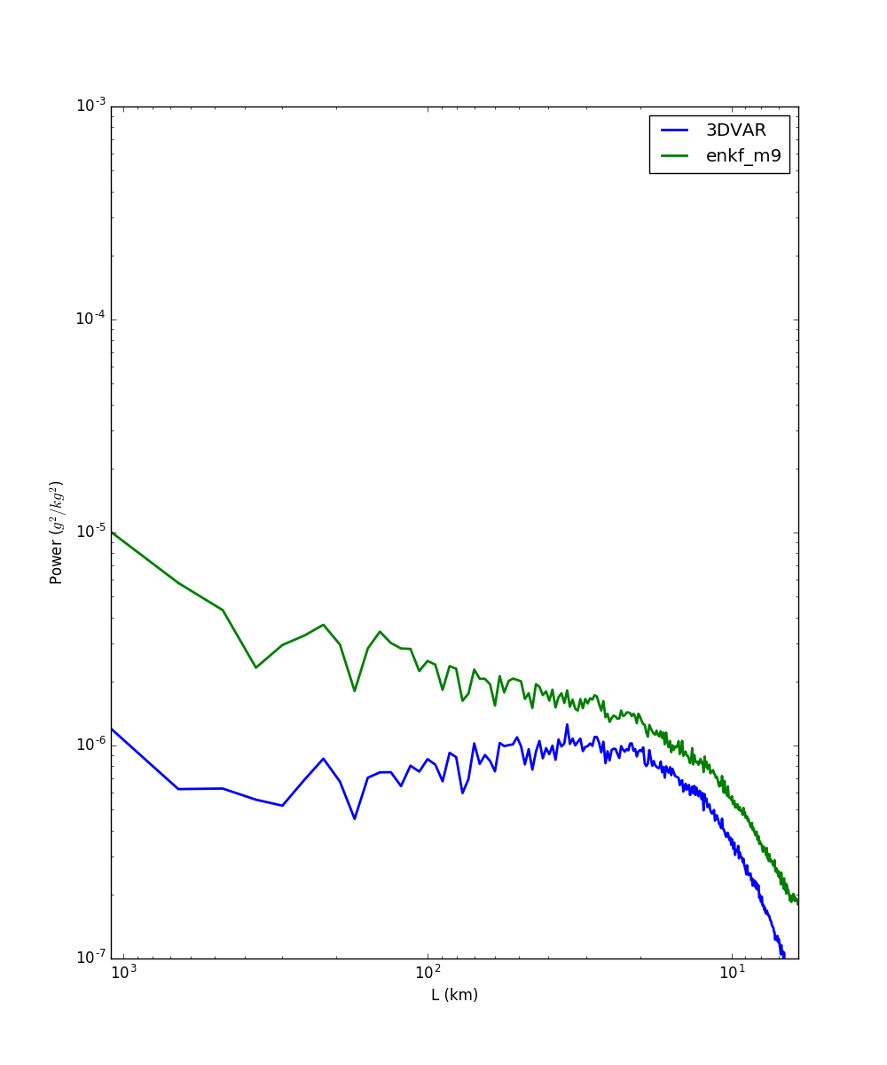
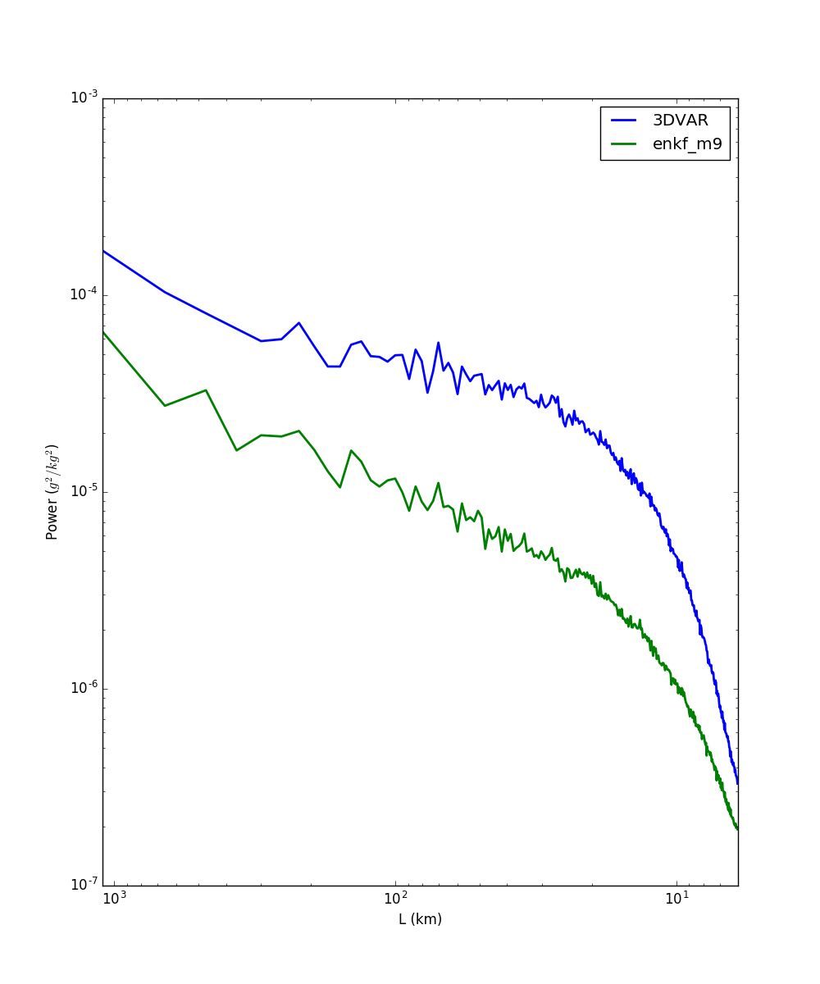
Mixing Ratio Power Spectra
0006 UTC
Graupel mixing ratio (k=25)
Rain mixing ratio (k=2)
10⁻³
10-⁴
10⁻⁵
10⁻⁶
10⁻⁷
10⁻³
10-⁴
10⁻⁵
10⁻⁶
10⁻⁷
Power (kg²/kg²)
10³ 10² 10¹
L (km)
10³ 10² 10¹
L (km)

Slide 16
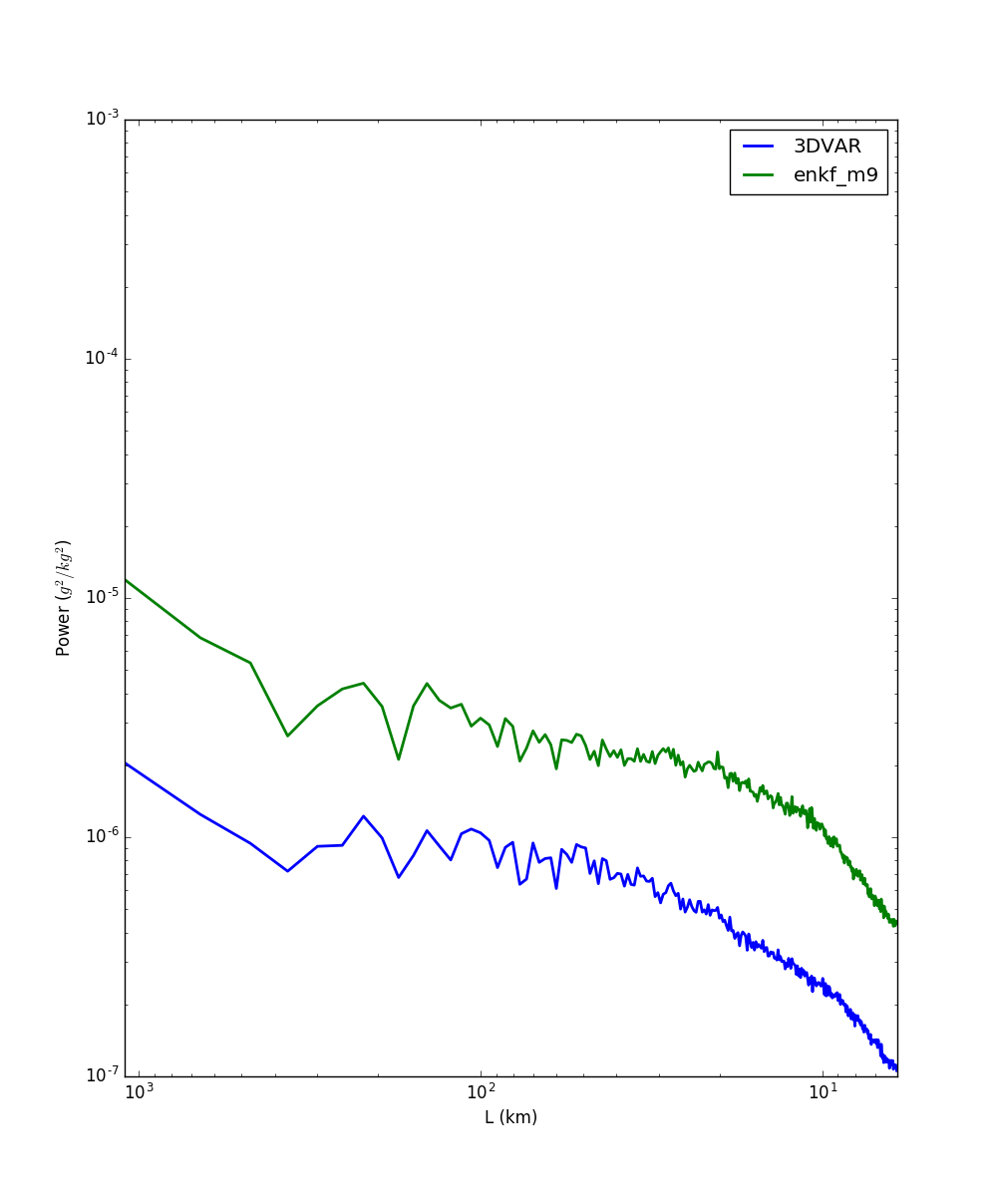
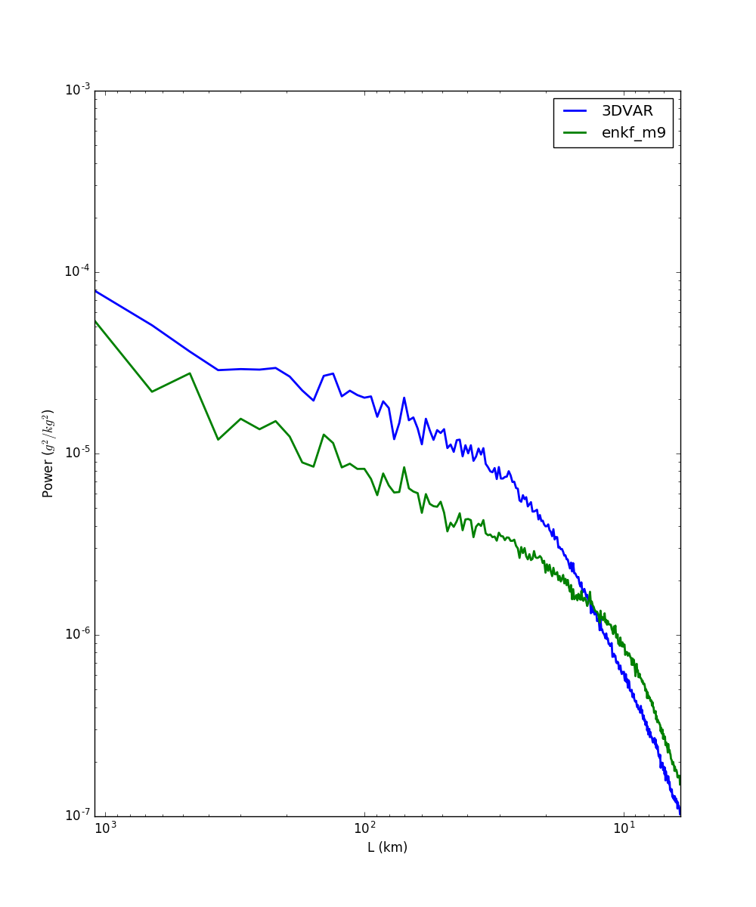
Mixing Ratio Power Spectra
0012 UTC
Graupel mixing ratio (k=25)
Rain mixing ratio (k=2)
10⁻³
10-⁴
10⁻⁵
10⁻⁶
10⁻⁷
10⁻³
10-⁴
10⁻⁵
10⁻⁶
10⁻⁷
Power (kg²/kg²)
10³ 10² 10¹
L (km)
10³ 10² 10¹
L (km)

Slide 17
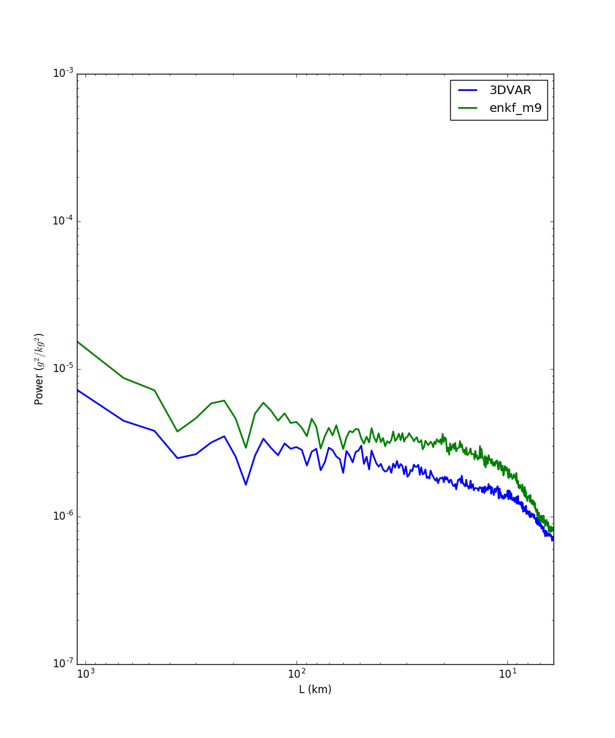
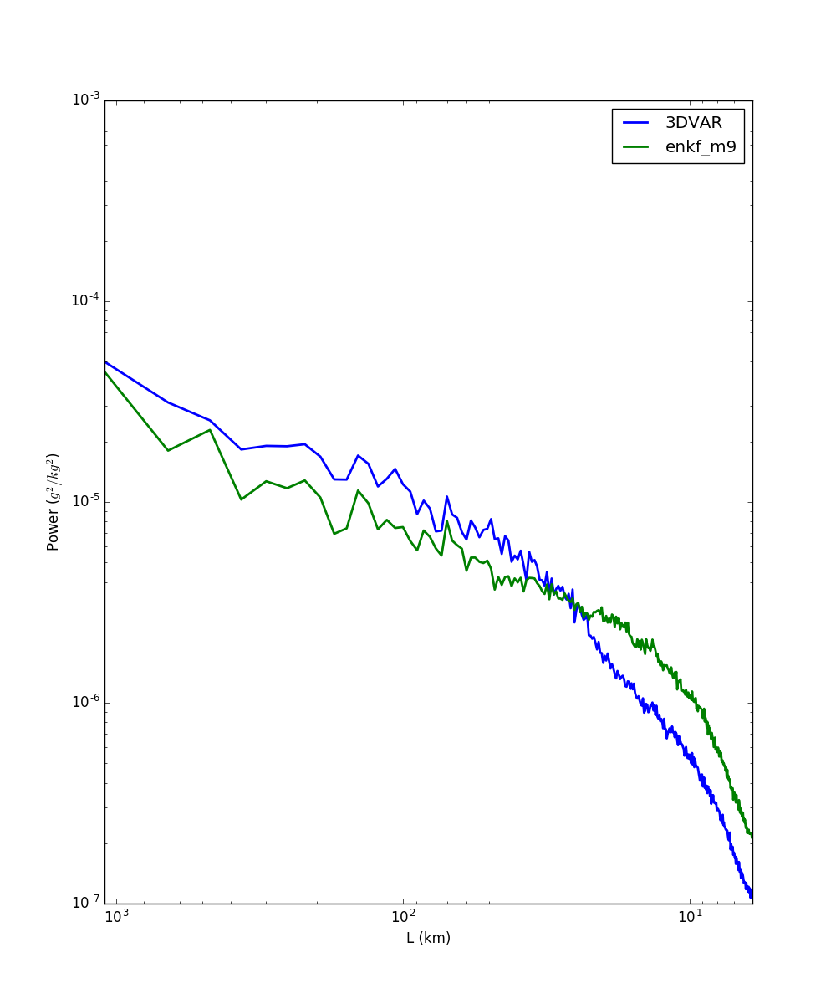
Mixing Ratio Power Spectra
0018 UTC
Graupel mixing ratio (k=25)
Rain mixing ratio (k=2)
10⁻³
10-⁴
10⁻⁵
10⁻⁶
10⁻⁷
10⁻³
10-⁴
10⁻⁵
10⁻⁶
10⁻⁷
Power (kg²/kg²)
10³ 10² 10¹
L (km)
10³ 10² 10¹
L (km)

Slide 18
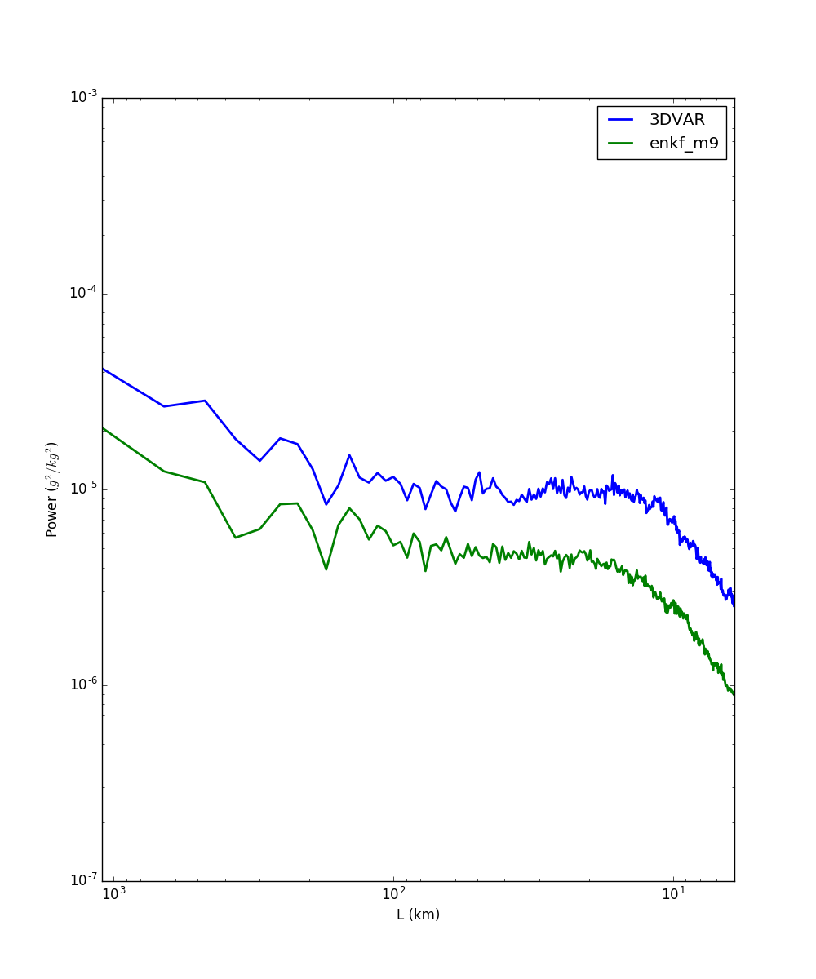
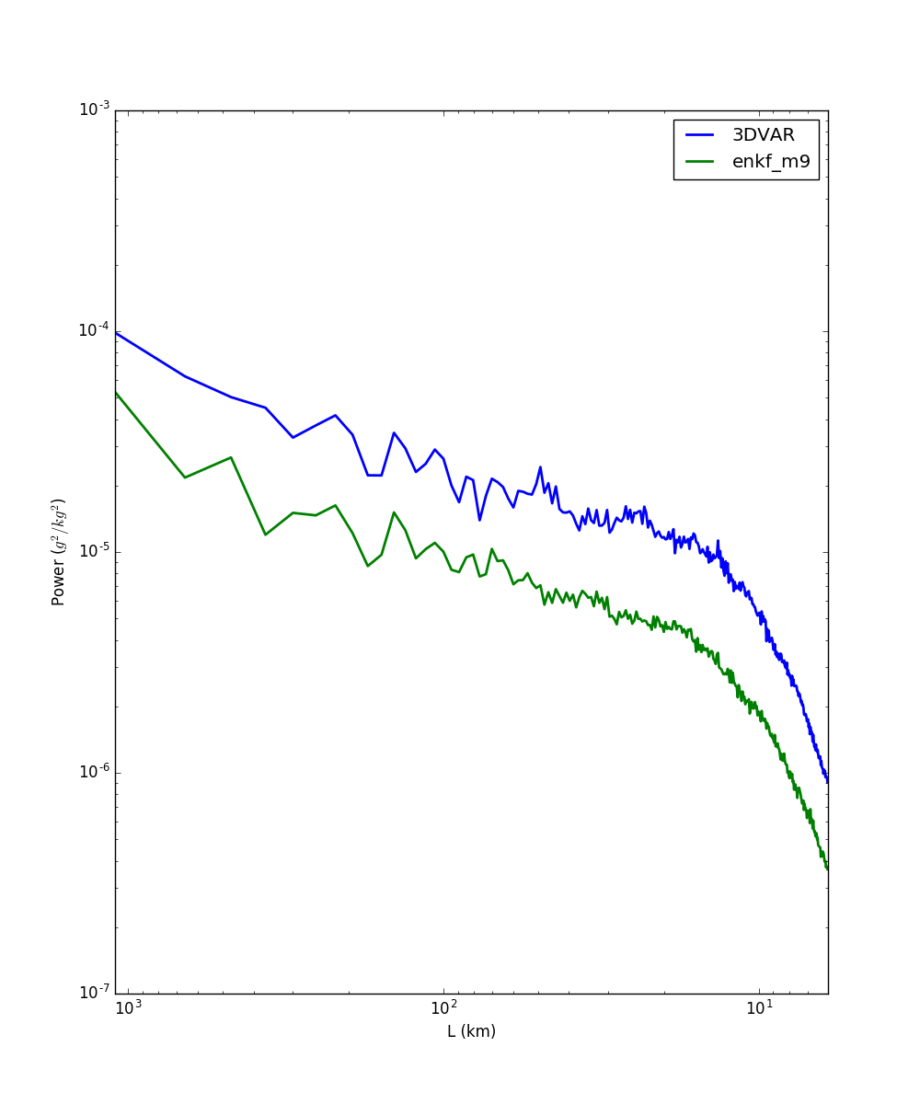
Mixing Ratio Power Spectra
0030 UTC
Graupel mixing ratio (k=25)
Rain mixing ratio (k=2)
10⁻³
10-⁴
10⁻⁵
10⁻⁶
10⁻⁷
10⁻³
10-⁴
10⁻⁵
10⁻⁶
10⁻⁷
Power (kg²/kg²)
10³ 10² 10¹
L (km)
10³ 10² 10¹
L (km)

Slide 19
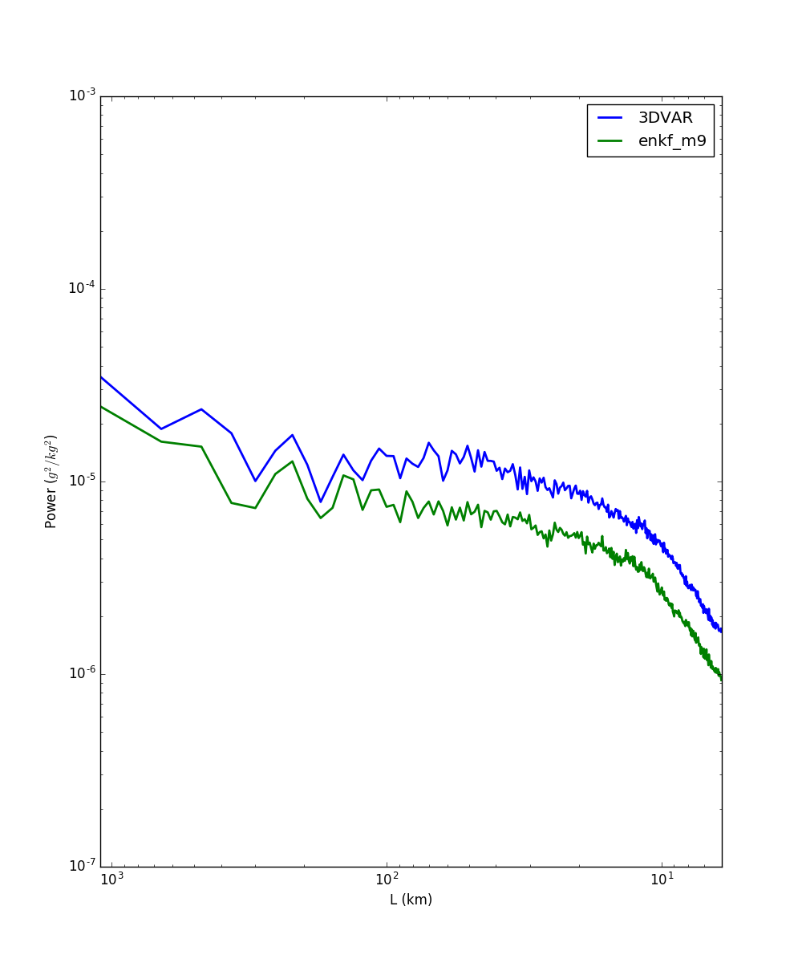
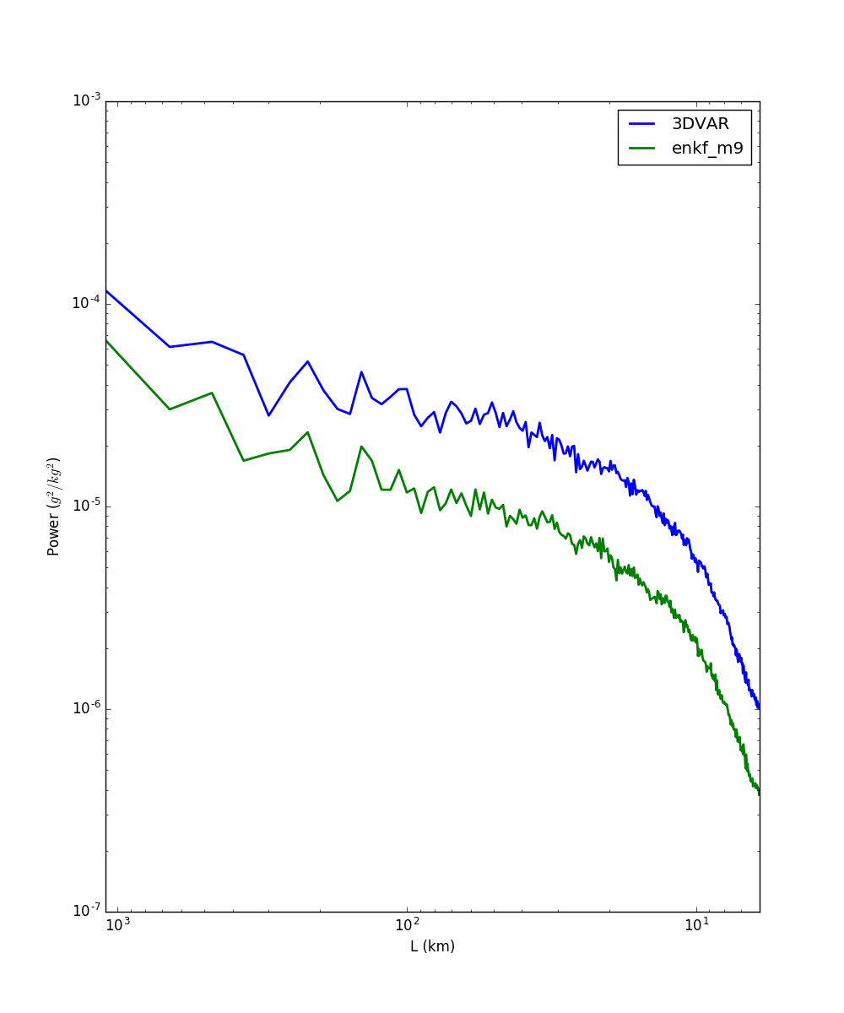
Mixing Ratio Power Spectra
0100 UTC
Graupel mixing ratio (k=25)
Rain mixing ratio (k=2)
10⁻³
10-⁴
10⁻⁵
10⁻⁶
10⁻⁷
10⁻³
10-⁴
10⁻⁵
10⁻⁶
10⁻⁷
Power (kg²/kg²)
10³ 10² 10¹
L (km)
10³ 10² 10¹
L (km)

Slide 20
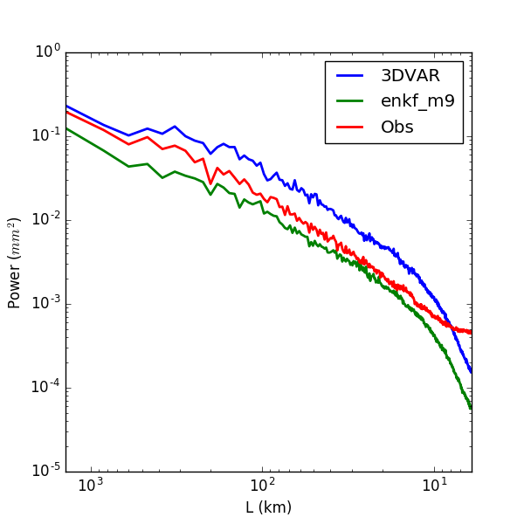
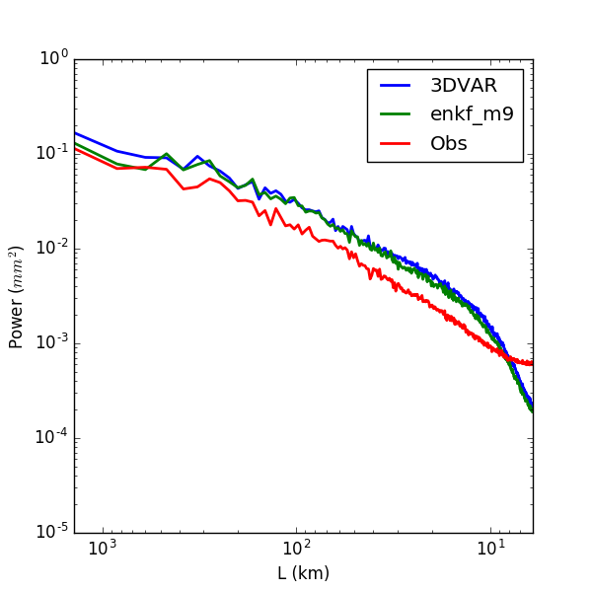
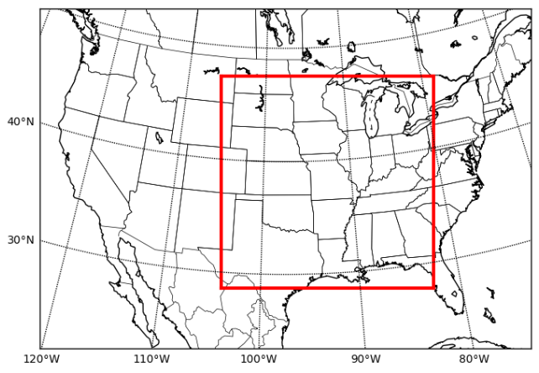
Power Spectra (3-hr rainfall)
00-03 UTC
21-00 UTC
3-hour accumulated rainfall (mm) averaged over 18 days. The inner box shows the spectral domain.

Slide 21
Summary of Real-time EnKF DA
A convective-scale EnKF DA system that assimilates full volume radar data has been developed and is running in real-time.
The precipitation forecasts show large sensitivity to the choice of microphysics schemes.
The EnKF forecasts are able to maintain the storm structure throughout the first forecast hour, suggesting that the EnKF analysis is well balanced.
Optimization of EnKF-En3DVar hybrid DA system for real-time applications is underway.

Slide 22
GSI-based 3DVar, EnKF, EnVar, and En3DVar Hybrid System
Optimization of the 3-km-grid-spacing EnKF-En3DVAR hybrid DA system for radar DA
EnKF: Thompson
3DVar, EnVar, EnKF-En3DVar hybrid: LFO (1983)
Special treatments to improve analysis and convergence rate are developed.
Limited by parallel efficiency and memory requirement

Slide 23
GSI EnKF Radar DA (Z+Vr)
Cycle1 (23:00)
observation
Forecast
Analysis
Jingyao Luo

Slide 24
GSI EnKF Radar DA (Z+Vr)
Cycle3 (23:30)
observation
Forecast
Analysis
Jingyao Luo

Slide 25
GSI EnKF Radar DA (Z+Vr)
Cycle5 (00:00)
observation
Forecast
Analysis
Jingyao Luo

Slide 26
GSI EnVar Radar DA (Z+Vr)
Cycle3 (23:30)
observation
Forecast
Analysis
Rong Kong

Slide 27
GSI 3DVAR, EnKF, En3DVar hybrid Assimilation of Z: 5th cycle after 1 hr radar DA
OBS H(xb) 3DVar H(xb)_EnKF H(xb) Hybrid 50% B
OBS H(xa) 3DVar H(xa)_EnKF H(xa) Hybrid 50% B
Rong Kong

Slide 28
Summary
EnKF can produce well-balanced model state variables while under-dispersion hampers quality of analysis.
Clear benefit of static BEC in EnVar hybrid
Special treatments for Z assimilation are necessary in the variational framework
q vs log(q), non-zero lower limits to variables, etc.
Liu et al. (2018, in review)

Slide 29
Research Projects
EnKF-EnVar hybrid system – Rong Kong (Tue. 11:20 am)
Warn-on-Forecast (WoF)
Phased-array radar DA – Tim Supinie (Tue. 2:10 pm)
Analysis and forecast sensitivity to the microphysics scheme with EnKF DA – Jon Labriola (Tue. 11: 40 am)
Key points:
Continuous rapid update (≤ 5 min), cycled storm-scale ensemble DA and forecasts
High-resolution (≤ 1 km) ensemble forecasts
Dual-polarization, phased array radar DA

