Slide 1
Using ensembles to estimate the forecast impact of observations within the Canadian 4D-EnVar
8th EnKF Workshop
7-10 May 2018
Mark Buehner¹ and Ping Du²
¹Data Assimilation and Satellite Meteorology Research Section
²Data Assimilation and Quality Control Development Section

Slide 2
FSOI adapted for EnVar: Motivation
4DVar for both global and regional DA replaced by 4D-EnVar (November 2014) at ECCC
Development/support essentially discontinued of tangent linear and adjoint of forecast model
Therefore, to perform FSOI in context of 4D-EnVar, requires adapting approach to avoid use of adjoint of forecast model
Pure ensemble approach (EFSOI) exists (e.g. as used at NCEP), but can only give impact of observations assimilated in EnKF
At ECCC, less observations assimilated in EnKF than in 4D-EnVar, affecting the relative impacts of each observation type
New Hybrid-FSOI (HFSOI) approach combines elements of standard adjoint approach (for analysis) and pure ensemble approach (for forecast propagation)

Slide 3
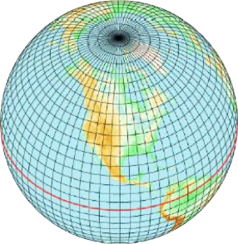
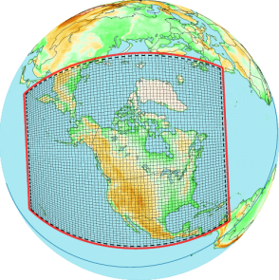
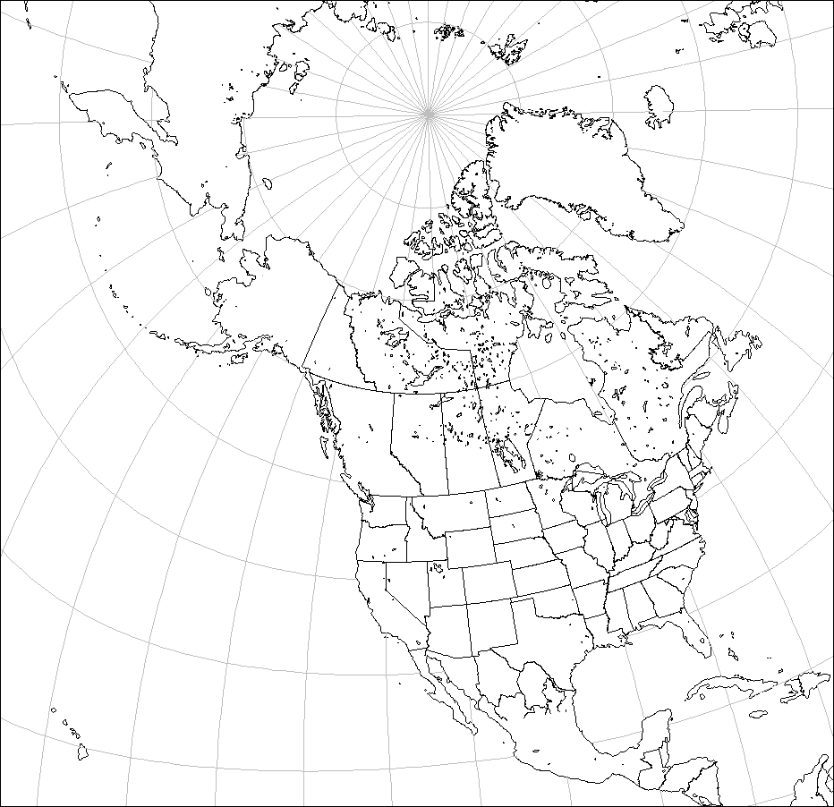
ECCC's operational NWP systems
Deterministic
Ensemble
GDPS
GEPS
EnKF
256-member
Global
4DEnVar
x 20
x 20
Δx=25km
Δx=50km
RDPS
REPS
Regional
4DEnVar
x 20
x 20
Δx=10km
Δx=15km
HRDPS
Convective-scale
Δx=2.5km

Slide 4
Basic idea of FSOI
Goal is to partition, with respect to arbitrary subsets of observations, the forecast error reduction from assimilating these observations:
$$∆e^{2}= {\left(e_{t+∆t}^{fa}\right)}^{T}C\left(e_{t+∆t}^{fa}\right)−{\left(e_{t+∆t}^{fb}\right)}^{T}C\left(e_{t+∆t}^{fb}\right)$$
Scalar measure of forecast error
$$e_{t+∆t}^{fb}=M\left(x_{t}^{b}\right)−x_{t+∆t}^{a}$$
Assimilation of obs
$$e_{t+∆t}^{fa}=M\left(x_{t}^{a}\right)−x_{t+∆t}^{a}$$
Forecast Error
$$x_{t}^{b}→x_{t}^{a}$$
Verifying analysis
t-6h
t
Time
t+∆t

Slide 5
FSOI general approach
Forecast error reduction from assimilating all observations:
This can be rewritten as a sum of contributions from each observation, allowing the calculation of contribution from any subset of obs:
Where the sensitivity of the change in forecast error to each observation can be written as (using the chain rule):
$$∆e^{2}= {\left(e_{t+∆t}^{fa}\right)}^{T}C\left(e_{t+∆t}^{fa}\right)−{\left(e_{t+∆t}^{fb}\right)}^{T}C\left(e_{t+∆t}^{fb}\right)$$
$$∆e^{2}≈\sum_{i}{{\left(y^{o}−H\left(x^{b}\right)\right)}_{i} ∂∆e^{2}/∂{y_{i}^{}}^{o}}$$
$$\frac{∂∆e^{2}}{∂y^{o}}=\left(\frac{∂x_{t}}{∂y^{o}}\right)\left(\frac{∂x_{t+∆t}}{∂x_{t}}\right)\left(\frac{∂∆e^{2}}{∂x_{t+∆t}}\right)$$
=(
)
(
Adjoint of Fcst
)
(
Sens. wrt fcst.
Sens. wrt obs
Adjoint of DA
)

Slide 6
New FSOI approach (Idea from A. Lorenc working paper) Forecast step uses ensemble, DA step like variational approach
Instead of using adjoint of forecast model, sensitivities propagated to analysis time using extended background ensemble forecasts → requires use of 100% ensemble B in analysis step
The analysis increment is a (spatially varying) linear combination of the background ensemble*, the propagated increment is assumed to be the same linear combination of the ensemble* at the forecast time
Adjoint of analysis step uses standard variational approach
*actually the deviations
of the ensemble
members from the
ensemble mean state
Assimilation of obs
Atmospheric State
$$x_{t}^{b}→x_{t}^{a}$$
=(
)
(
Adjoint of Fcst
)
(
Sens. wrt fcst.
Sens. wrt obs
Adjoint of DA
)
t-6h
t
Time
t+∆t

Slide 7
Formulation (Idea from A. Lorenc working paper)
Change in forecast error at time t (with respect to norm $C$) is given by:
$$∆e^{2}= {\left(e_{t}^{fa}\right)}^{T}C\left(e_{t}^{fa}\right)−{\left(e_{t}^{fb}\right)}^{T}C\left(e_{t}^{fb}\right)$$
Denote gradient of this with respect to any quantity as: $\hat{\left(∙\right)}=∂∆e^{2}$ / $∂\left(∙\right)$
Write $∆e^{2}$ as a sum of contributions from each obs:
$∆e^{2}≈{\left(y^{o}−H\left(x^{b}\right)\right)}^{T}\left({\hat{y}}^{o}\right)$
Where:
$${\hat{y}}^{o}=R^{−1}HB^{1/2}\hat{a}$$
$$\hat{v}=B_{t}^{T/2}\hat{δx_{t}}$$
$$\hat{δx_{t}}=C\left(e_{t}^{fa}+e_{t}^{fb}\right)$$
And $\hat{a}$ is obtained by minimizing the cost function (very similar to EnVar):
$$J\left(\hat{a}\right)=\frac{1}{2}{(\hat{a}−\hat{v})}^{T}(\hat{a}−\hat{v})+\frac{1}{2}{\left(HB_{0}^{1/2}\hat{a}\right)}^{T}R^{−1}\left(HB_{0}^{1/2}\hat{a}\right)$$
Based on extended ensemble at forecast time, replaces $B_{0}^{T/2}MT$
→sensitivity wrt observations
→sensitivity wrt control vector
→sensitivity wrt forecast

Slide 8
Conclusions from previous study (Buehner et al. 2018, MWR)
Results with Hybrid-FSOI approach adapted for use with EnVar are promising and qualitatively similar to results using adjoint model
Introducing a simple flow-following covariance localization increases apparent impact and improves similarity with adjoint model results
Significant differences remain for some obs types (e.g. in-situ sfc):
At least partially due to vertical ensemble localization
Due to nonlinear ensemble vs. linear adjoint propagation:
incomplete simplified physics and no surface sensitivities in adjoint model
use of multi-physics approach and independently evolving surface fields in ensemble
Current approach (formally) limited to EnVar with 100% ensemble B

Slide 9
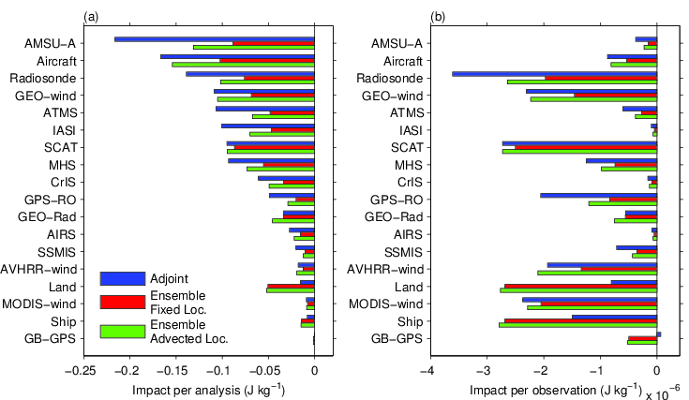
Results Average impact per analysis on 0Z+6Z 24h forecasts
Ordered by Adjoint-FSOI
Overall, similar results between using ensemble or adjoint model
Advection always increases apparent impact, especially for Aircraft, Raob, AMSU-A, AMV
In-situ surface obs have larger apparent impact when using ensemble
Radiances, Raob and GPS-RO have lower impact with ensemble than adjoint
8

Slide 10
Similarity with EFSOI approach (Ota et al. 2013)
Hybrid FSOI approach (HFSOI):
$${\hat{y}}^{o}=R^{−1}HB_{0}^{1/2}\tilde{A}B_{t}^{T/2}C\left(e_{t}^{fa}+e_{t}^{fb}\right)$$
where $\tilde{A}$ is $P_{a}$ in control vector space:$P_{a}=B_{0}^{1/2}\tilde{A}B_{0}^{T/2}={P_{a}}^{1/2}{P_{a}}^{T/2}$
multiplication by $\tilde{A}$ implemented by minimizing a cost function
EFSOI approach obtained by combining these equations:
$${\hat{y}}^{o}=R^{−1}H{P_{a}}^{1/2}P_{a,t}^{T/2}C\left(e_{t}^{fa}+e_{t}^{fb}\right)$$
Note that the ensemble valid at forecast time differs in the two formulations:
HFSOI: forecasts initialized with the background ensemble, $B_{t}^{T/2}$
EFSOI: forecasts initialized with the analysis ensemble, $P_{a,t}^{T/2}$
Starting with code for HFSOI, EFSOI implemented by simply reading appropriate analysis-based ensembles and removing the minimization

Slide 11
Comparison of impacts from HFSOI and EFSOI
Performed EnVar data assimilation experiment similar to operational configuration, but with 100% ensemble B, same resolution (39km) and observations as EnKF
Evaluated FSOI 4x/day between Sept 1 – Oct 16, 2016 (NAWDEX period) for 24h deterministic forecasts
Forecast error measured with dry global energy norm up to 100hPa relative to analyses
For EFSOI, computed FSOI using analysis ensemble both w/ and w/o additive inflation at initial time, but forecast ensemble only available from inflated analyses
For both approaches, localization is advected between forecast and analysis time (0.75 × wind)
In hindsight, for EFSOI it does not make sense to use analysis and forecast ensembles with additive inflation, since inflation is applied after the EnKF analysis step and these ensembles appear in the formulation due to their relationship to K:
$${K^{T}M^{T}=R}^{−1}HP_{a}^{}M^{T}$$

Slide 12
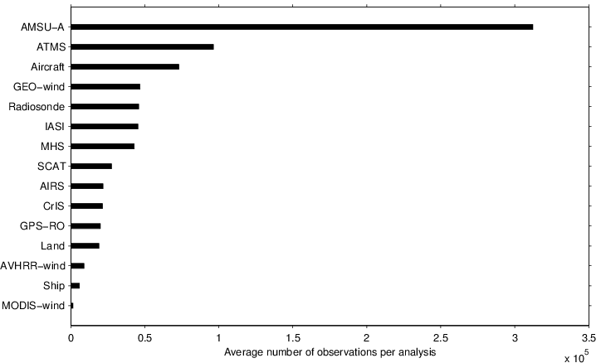
Results Number of assimilated observations
AMSU-A is dominant observation type due to reduced use of IR radiances in the EnKF (relative to operational EnVar configuration)

Slide 13
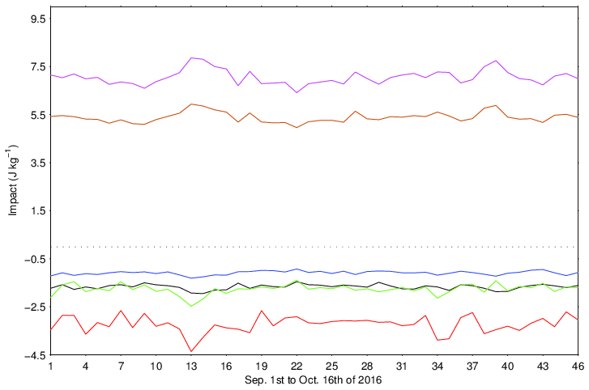
Results Averaged total impact per day for 24h forecasts
Fcst from x_{b}
Fcst from x_{a}
0.0
HFSOI
True reduction
EFSOI anl. w/o pert.
EFSOI anl. w/ pert.
EFSOI using analyses with additive inflation overestimates impact by ~ 2x
EFSOI using analyses w/o perturbations gives best estimate of total impact
HFSOI underestimates total impact
8

Slide 14
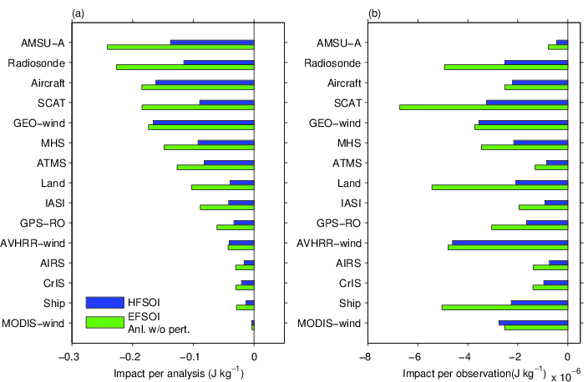
Results Average impact per analysis for 24h forecasts
Ordered by EFSOI
Radiances, Radiosonde, GPS-RO and surface obs have larger apparent impact with EFSOI
Due to using ens forecasts initialized with inflated analysis ens?
8

Slide 15
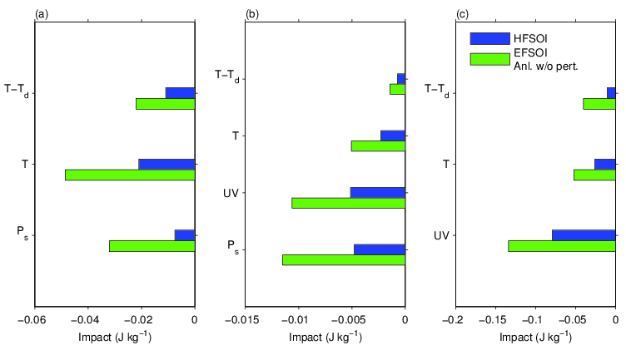
Results: 24h forecasts Average impact of In situ surface observations
Land
Ship (+buoy)
humidity
humidity
temperature
temperature
wind components
surface pressure
surface pressure

Slide 16
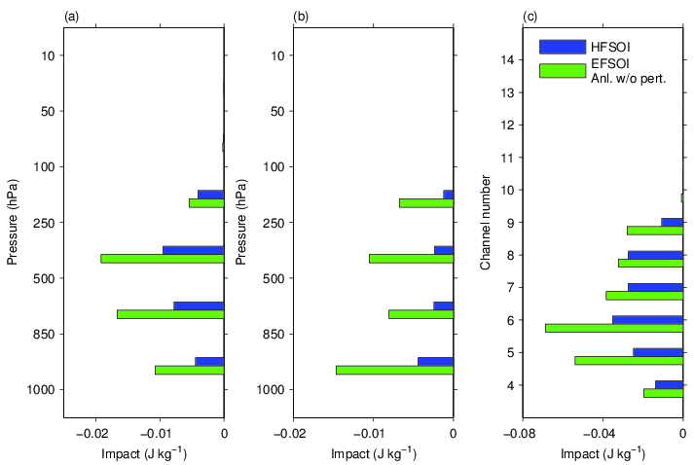
Results: 24h forecasts Vertical distribution: Impact of Raob and AMSU-A
Raob
Temperature
Raob
Humidity
AMSU-A

Slide 17
Conclusions
Results with HFSOI and EFSOI (w/o additive inflation) give qualitatively similar results, but differences for some obs types
Current EFSOI results use analysis ensemble without additive inflation, but forecasts initialized from inflated analyses
Additional EFSOI tests to be done using forecasts initialized from uninflated analyses - inflation likely artificially boosts obs impact
For HFSOI approach, must use background and forecast ensembles initialized with inflated analyses since background ensembles must be the same as those used for EnVar analysis
Also, investigate effect of using single model configuration in 24h ensemble forecasts for FSOI (now multi-physics)
Plan to apply FSOI to evaluate impact of supplementary observations during NAWDEX and YOPP in combination with OSE's
Starting preparations for operational implementation of HFSOI

