Slide 1
Improving Background-Error Covariances in a 3DEnVar Data Assimilation System for Convective Scale NWP
Jean-François Caronª, Yann Michel^{b} , Thibaut Montmerle^{b} and Étienne Arbogast^{b}
ªECCC
^{b}CNRM/Météo-France

Slide 2
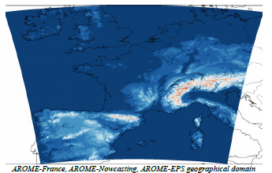
Introduction
1.3 km
3DVar
Hourly cycling
06h forecasts 24x day
42h forecasts 05x day
AROME
Météo-France is moving towards 4D Ensemble-Variational (EnVar) approaches for both ARPEGE (global) and AROME (local) data assimilation systems.
(Some) Recent results suggest that blending homogeneous and isotropic B with an ensemble-derived B (B_{ens}) brings no benefit in high resolution DA.
Different approaches to improve B_{ens} were examined without modifying the ensemble of background generation strategy.

Slide 3
Introduction
  Tested approaches to improve B_{ens} [similar to Lorenc (2017, QJRMS) in a global context]
  Two flavors of Scale-Dependent Localization (SDL)
  Increasing the effective ensemble size using lagged forecasts
  The combination of the above techniques
  AROME 3DEnVar-based system (R&D version; Montmerle et al., 2018, QJRMS)
25 ensemble members @ 3.8km (ensemble of 3DVar)
Localization in spectral (bi-Fourrier) or gridpoint (recursive filter) space
3-hourly cycling (instead for hourly)
Deterministic forecast @ 3.8 km (instead for 1.3 km)

Slide 4
[1] Scale-Dependent Localisation (SDL)
Definition: Simultaneously apply appropriate (i.e. different) localization to different range of scales.
The approach can be applied to both horizontal and vertical localization but this presentation will only focus on horizontal-scale-dependent horizontal localization.
Pros:
  Horizontal-scale-dependent horizontal localization leads to implicit vertical-level-dependent, variable-dependent and location-dependent horizontal localization (Caron and Buehner, 2018, MWR).
Cons:
  Adds more parameters to tune.
  Increases the cost of the analysis step (at least in our formulation).

Slide 5
[1] SDL formulations
Usual (one-size-fits-all) approach
Analysis increment computed from control vector (B^{1/2} preconditioning) using:
k: member index
SDL (Buehner and Shlyaeva, 2015, Tellus)
Varying amounts of smoothing applied to same set of amplitudes for a given member
j: scale index
SDL with spectral localisation (SDLwSL; Buehner 2012, MWR)
Varying amounts of smoothing applied to different set of amplitudes for a given member

Slide 6
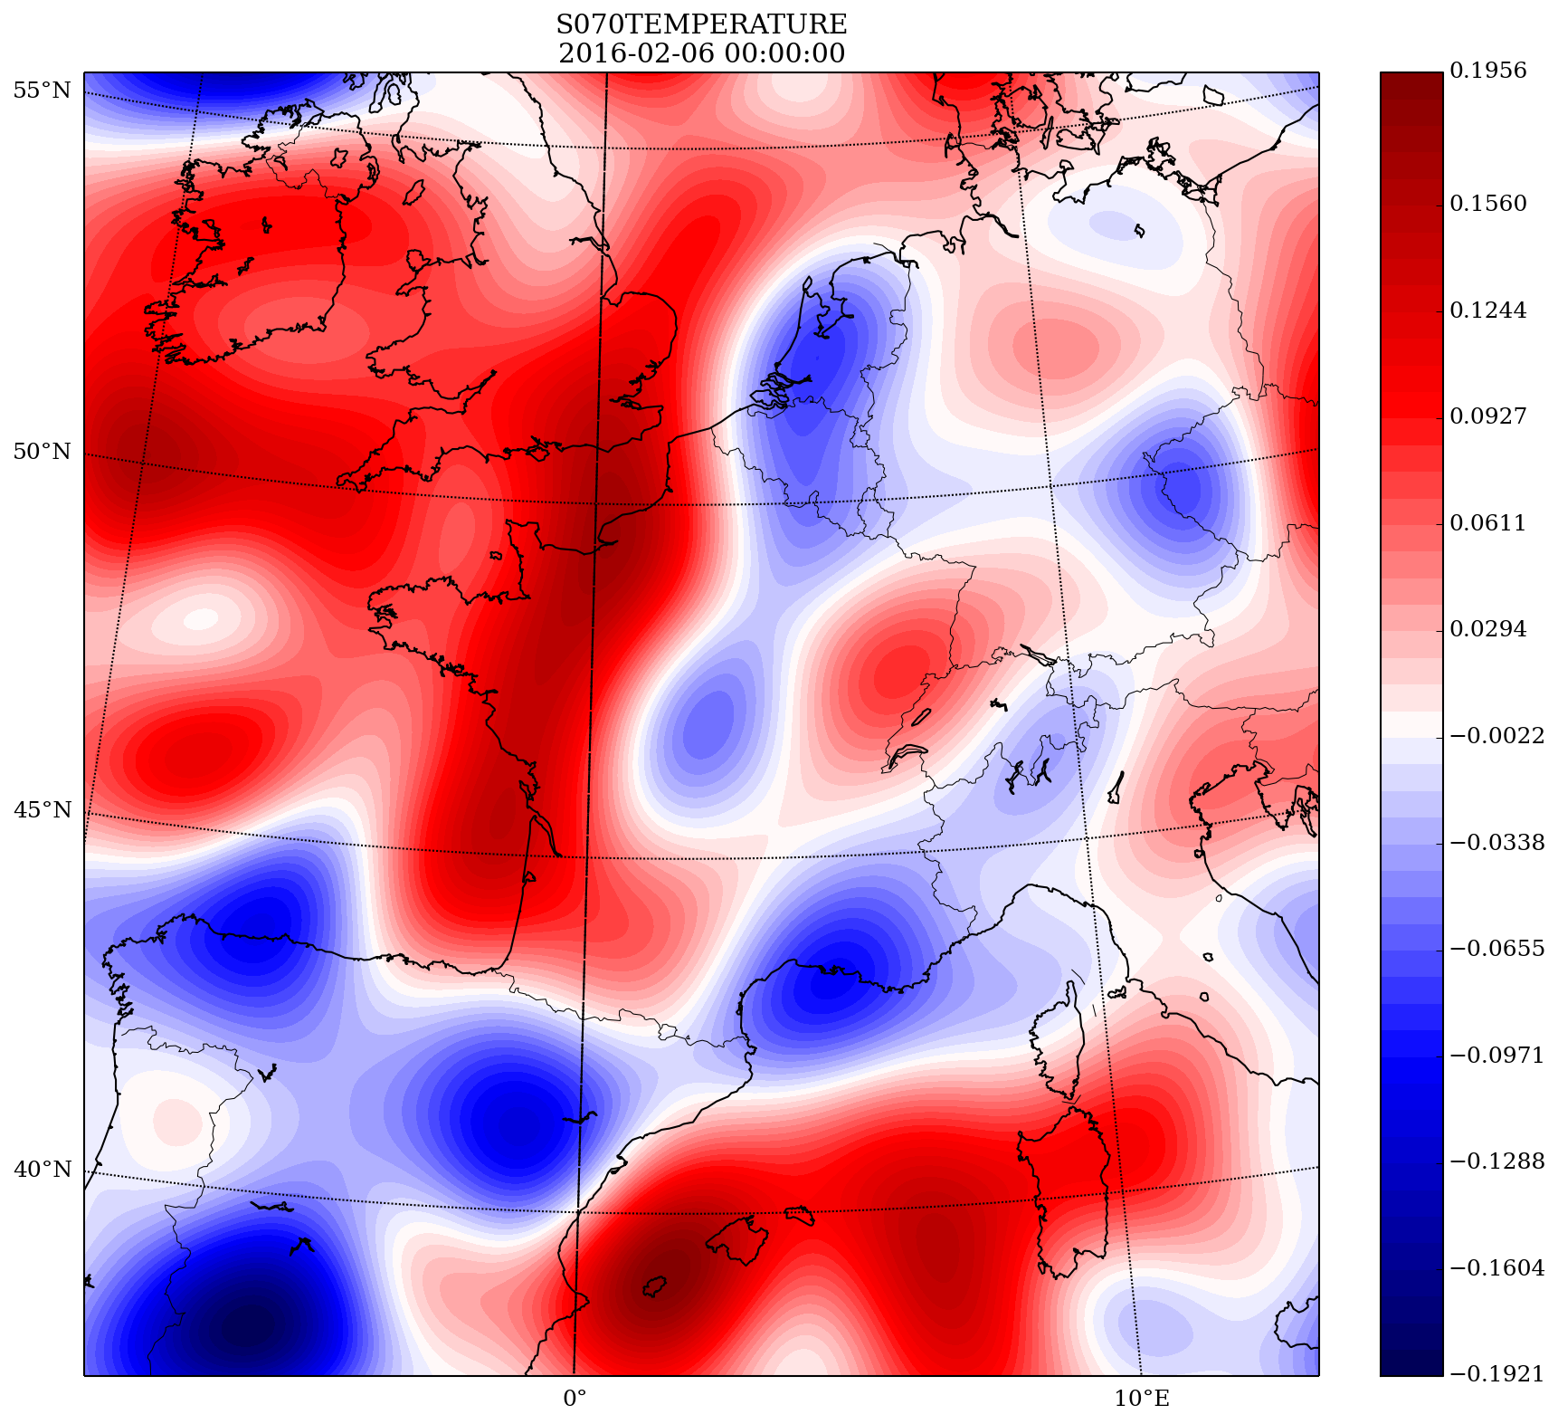
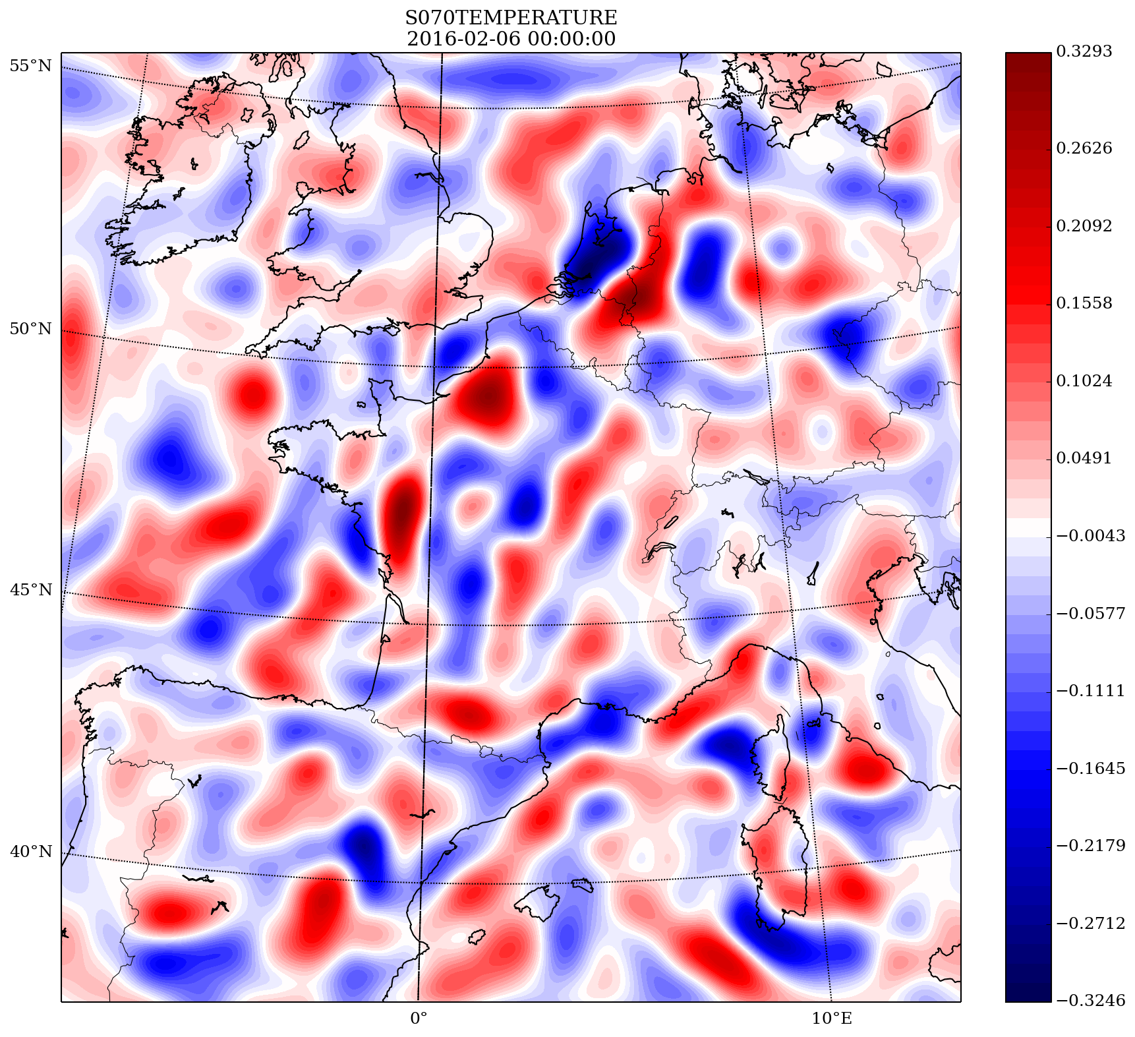
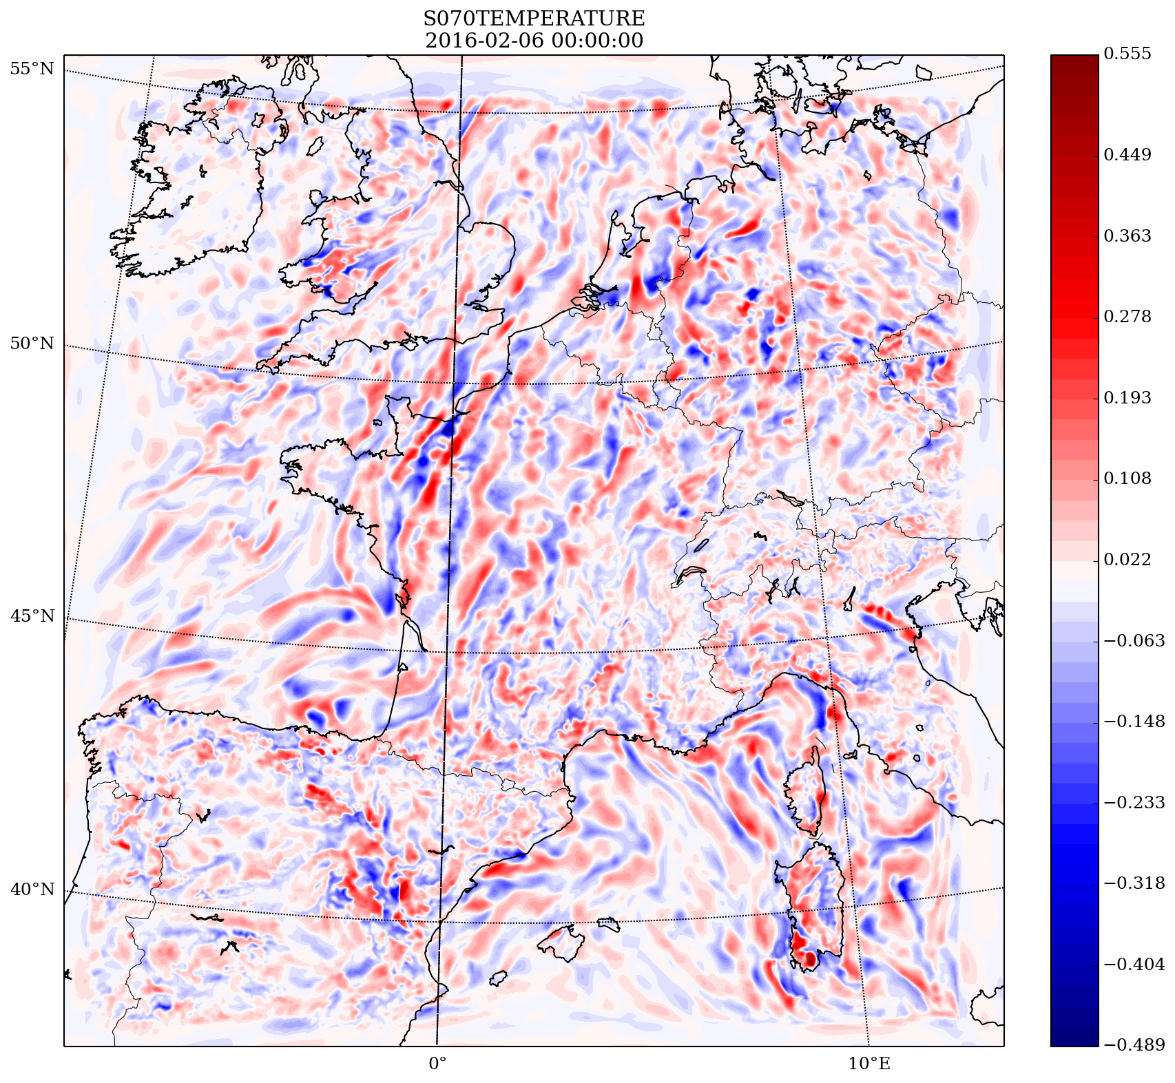
[1] Adopted 3 waveband decomposition
F: filtering step
j: scale index
Temperature perturbations near 950 hPa from member #1. 3-h forecast valid on 06 February 2016 at 0000 UTC.

Slide 7
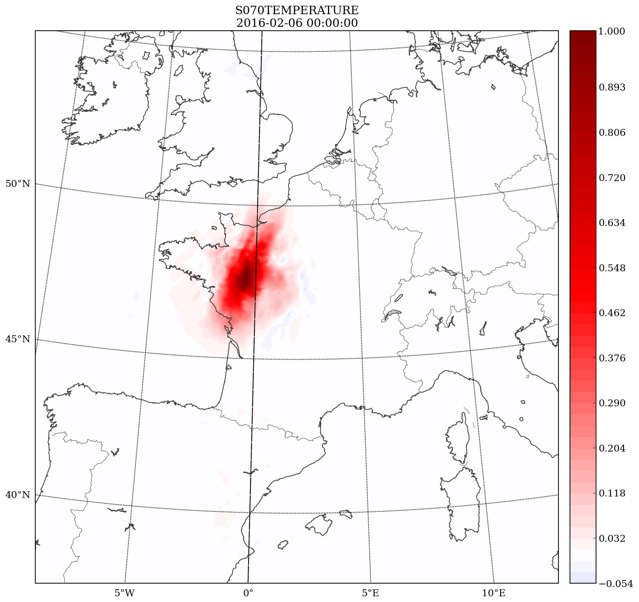
[1] Single-obs: Frontal case
250km (one-size-fits-all)

Slide 8
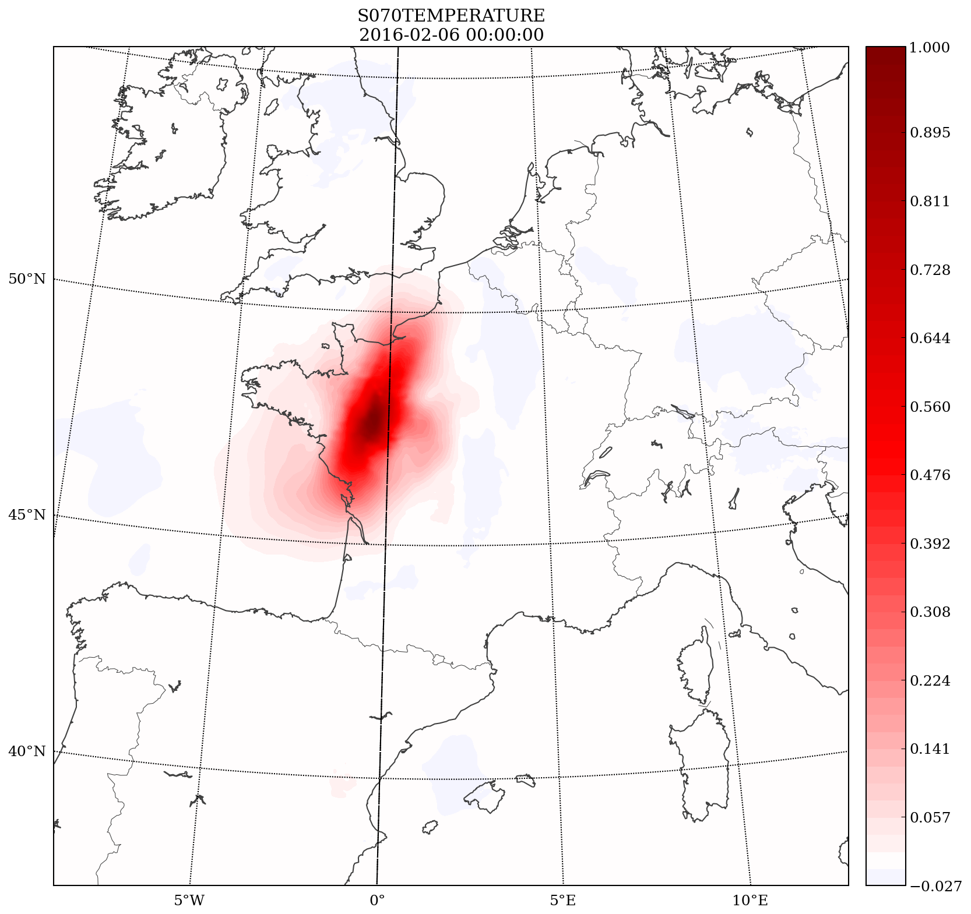
[1] Single-obs: Frontal case
SDL 080/250/500km

Slide 9
[1] Single-obs: Frontal case
SDL 250/250/250km
Identical to 250 km one-size-fits-all

Slide 10
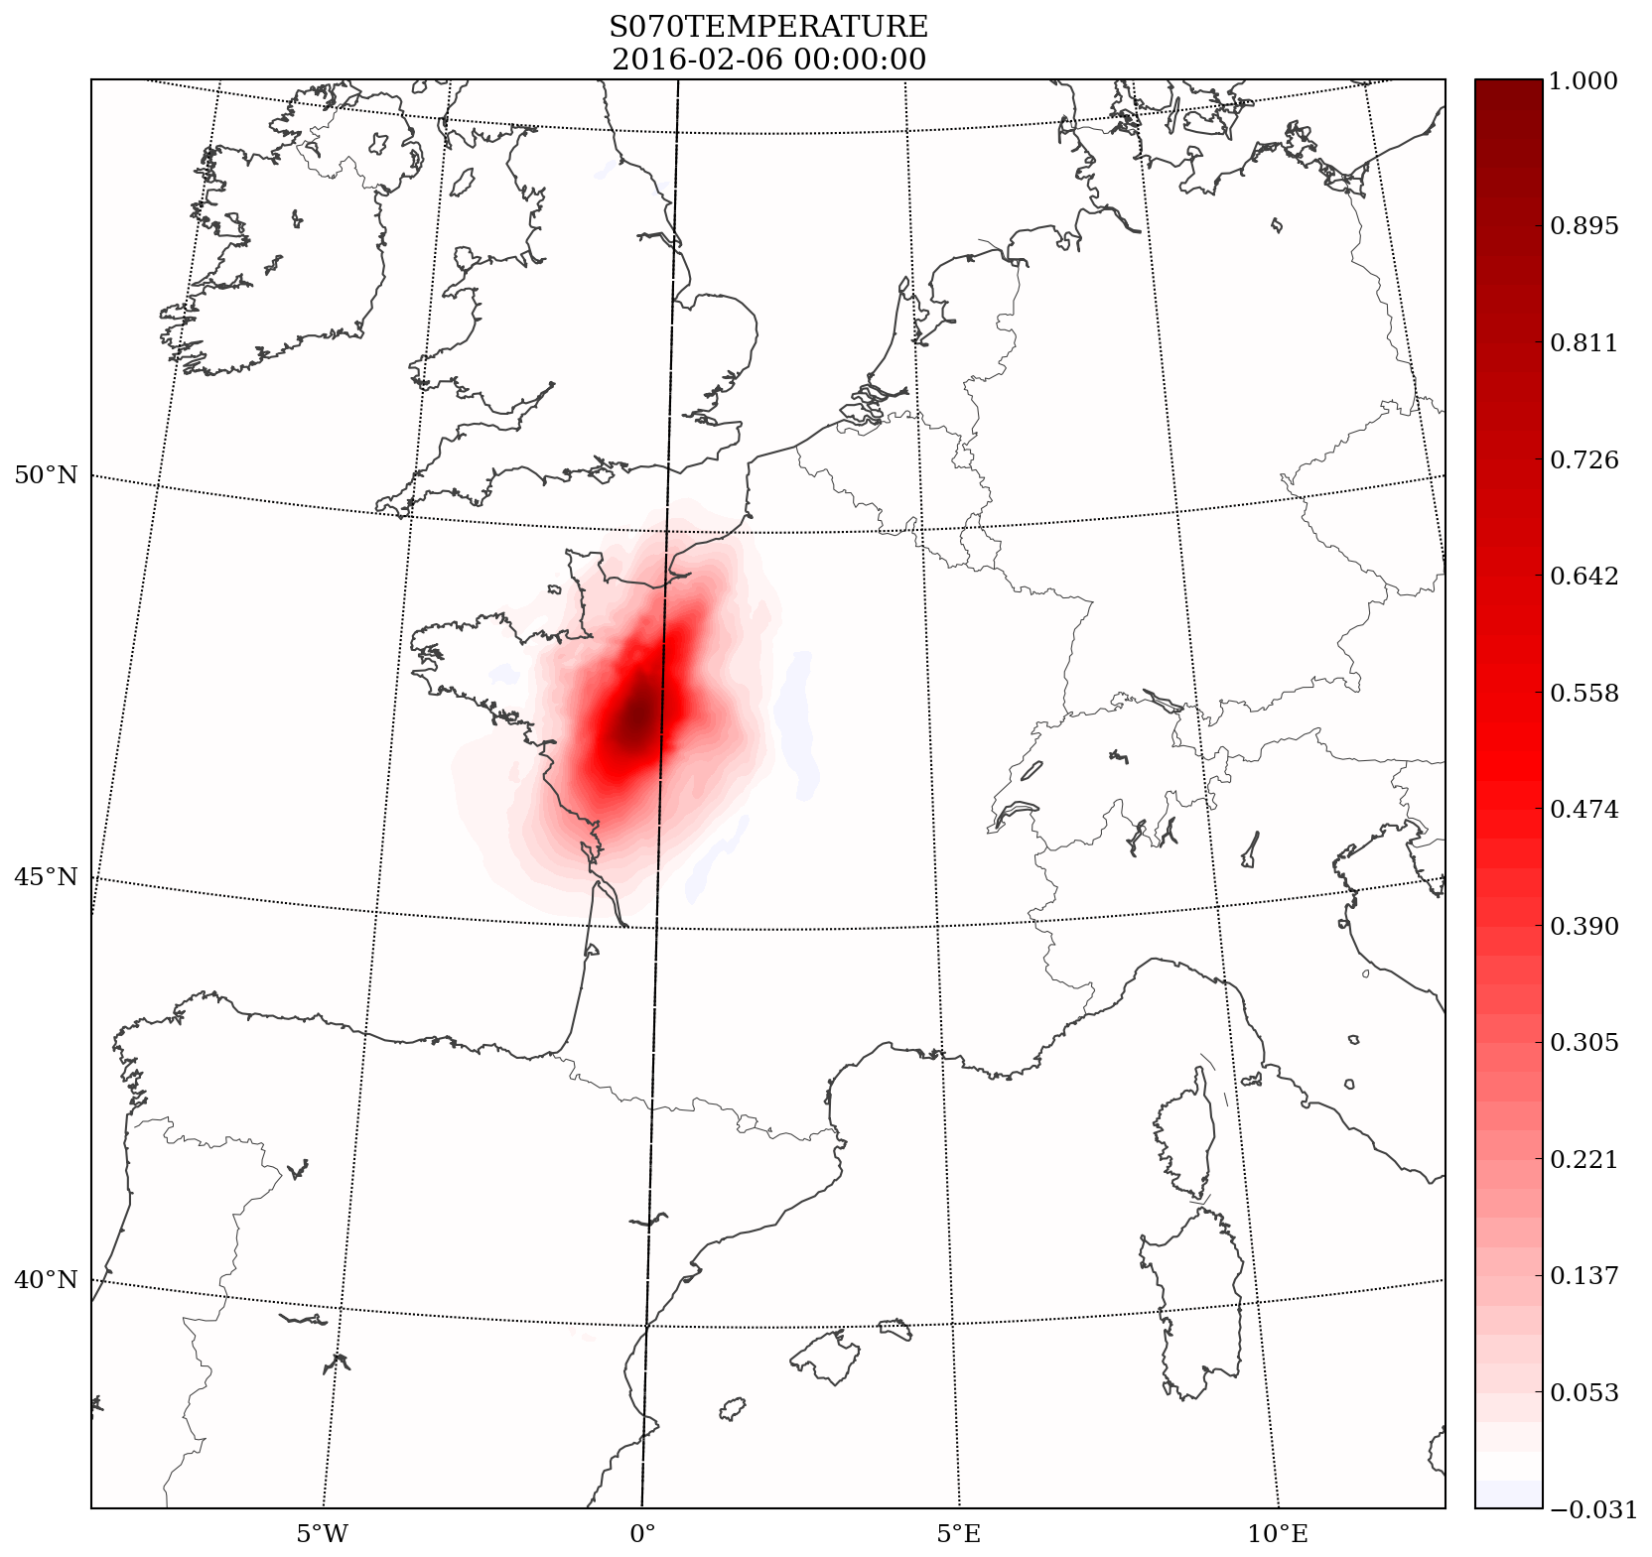
[1] Single-obs: Frontal case
SDLwSL 250/250/250km

Slide 11
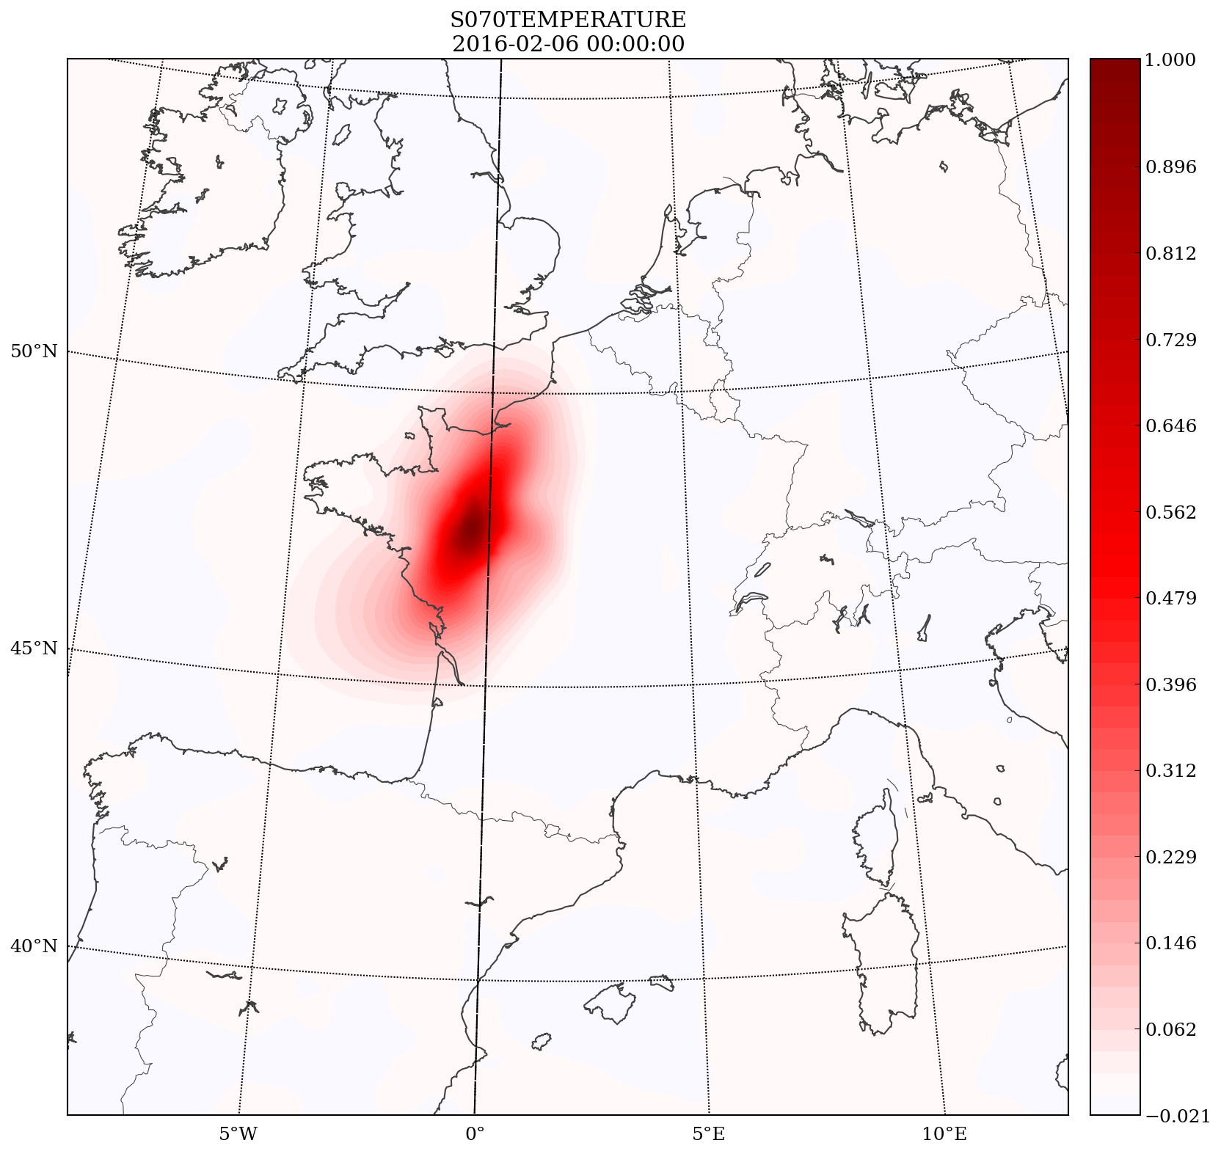
[1] Single-obs: Frontal case
SDLwSL 080/250/500km

Slide 12
[1] Performed DA and forecast cycles
2 weeks trialling (February 2016) were used testing many horizontal localization length scale for both SDL and ‘one-size-fits-all’ approaches.
Extension to 1 month for both the control experiment and the best performing SDL configurations
The same horizontal-scale decomposition (3 wavebands) was used in all the SDL experiments.
30-hour forecasts issued from 00, 06, 12 and18 UTC

Slide 13
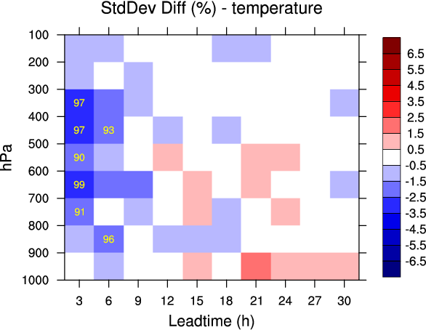
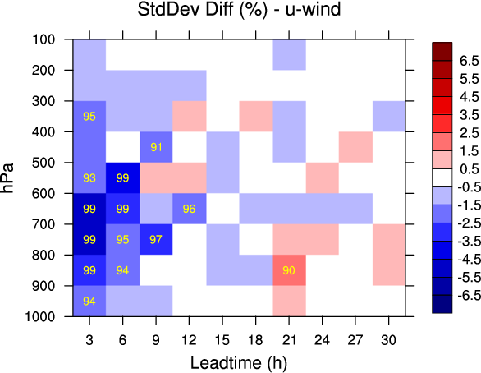
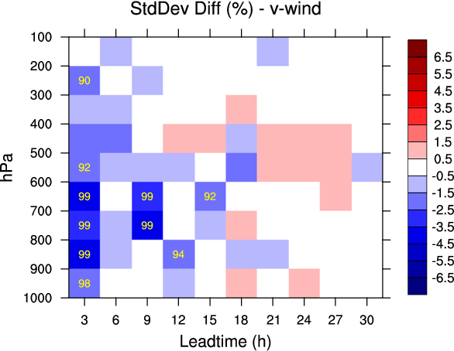
[1] Verification against aircraft(+3 to +30h, 3h)
2 weeks
SDL 075/150/300km
vs
250km

Slide 14
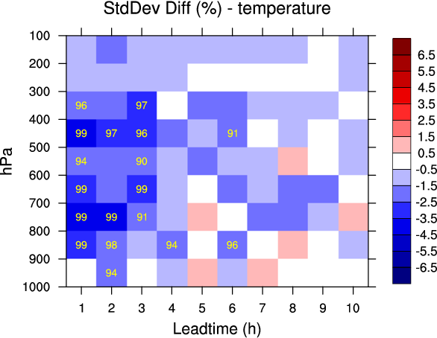
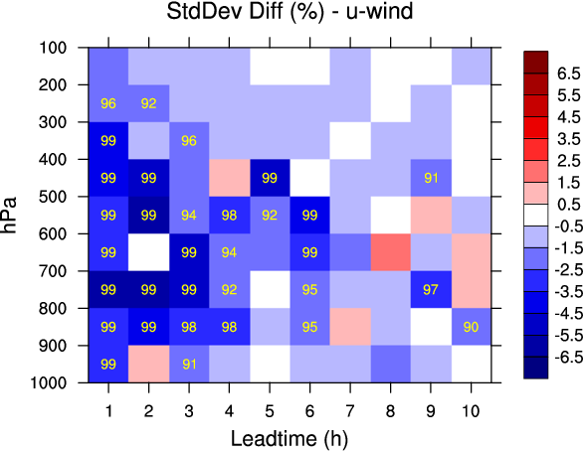
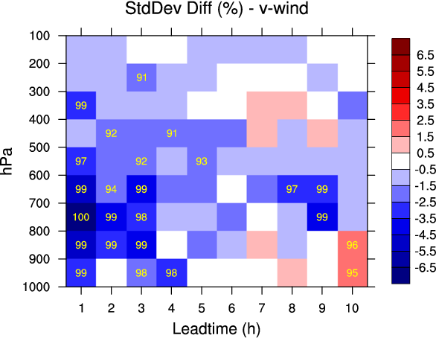
[1] Verification against aircraft (+1 to +10h, 1h)
2 weeks
SDL 075/150/300km
vs
250km

Slide 15
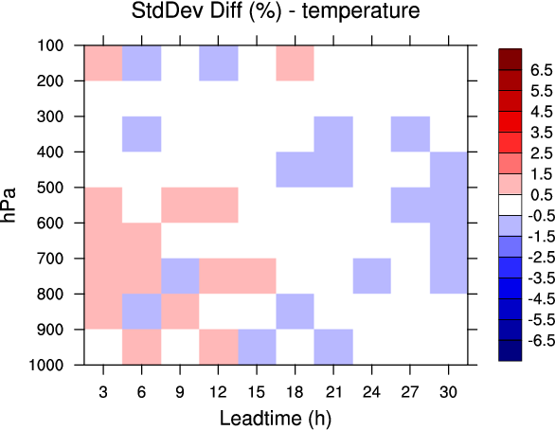
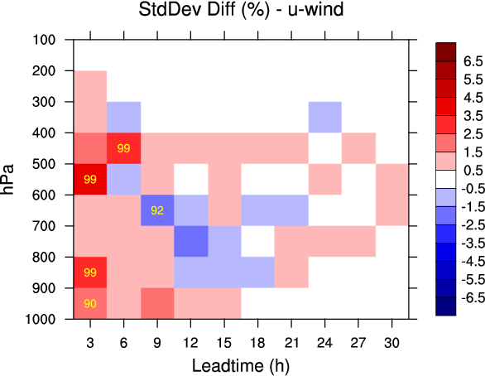
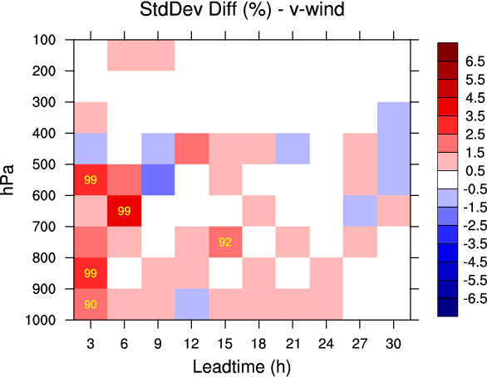
[1] Verification against aircraft (+3 to +30h, 3h)
2 weeks
300km
vs
250km

Slide 16
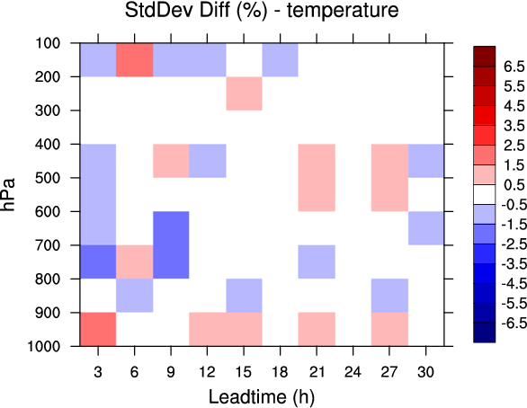
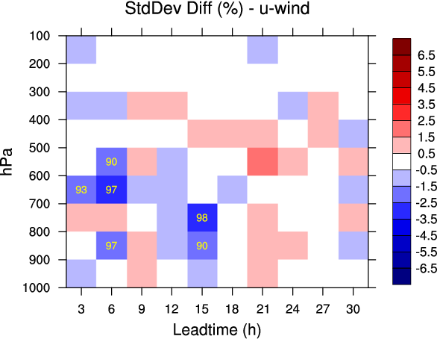
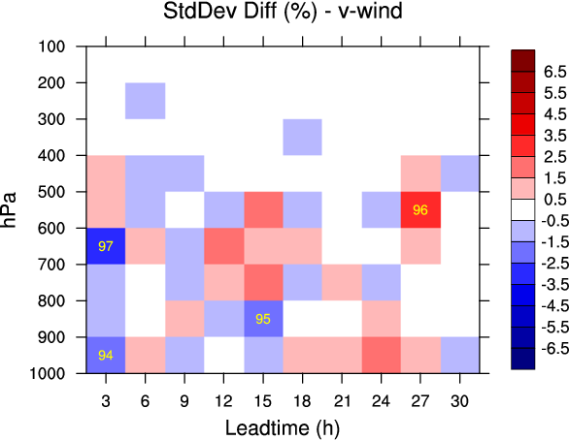
[1] Verification against aircraft (+3 to +30h, 3h)
2 weeks
200km
vs
250km

Slide 17
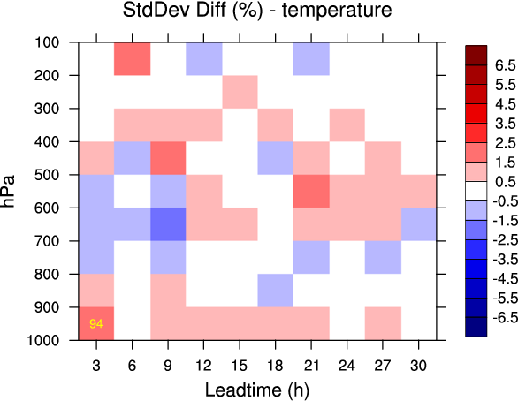
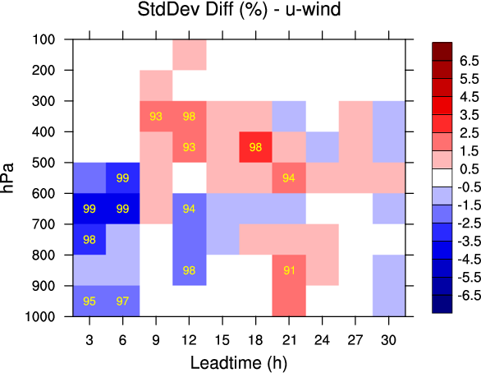
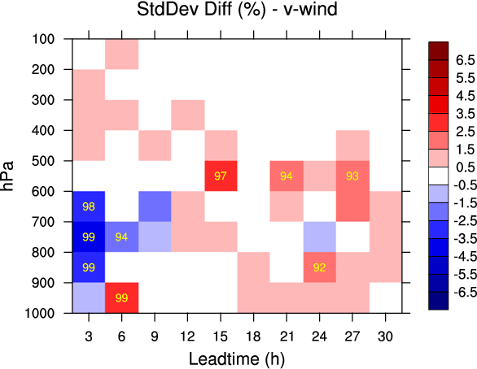
[1] Verification against aircraft (+3 to +30h, 3h)
2 weeks
150km
vs
250km

Slide 18
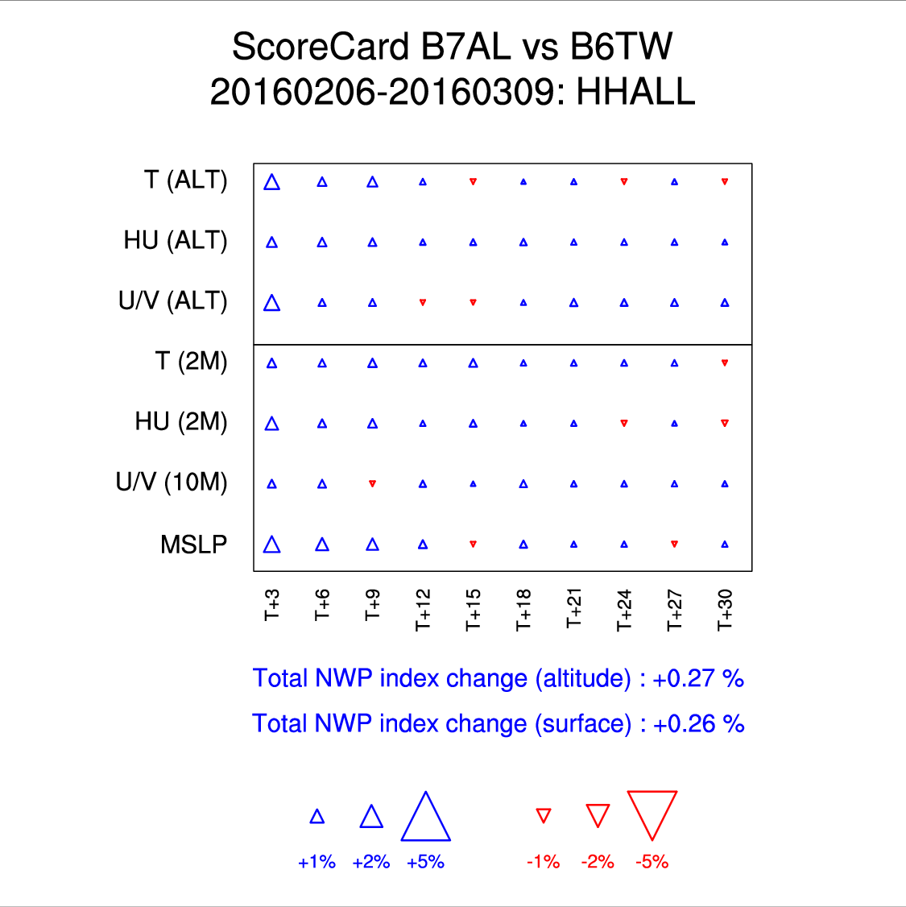
[1] Full verification (+3 to +30h, 3h)
1 month
SDL 075/150/300km
vs
250km

Slide 19
[1] Changes in NWP index (+3 to +30h, 3h)
1 month
Reference : one-size-fits-all 250km
Configuration | Total NWP index change
 | Altitude | Surface
SDL 75/150/300 km | +0.27 | +0.26
SDLwSL 250/250/250 km | +0.36 | +0.26
SDLwSL 84/224/448 km | +0.46 | +0.34

Slide 20
[2] Lagged ensemble
Combine forecasts of different length, valid at the analysis time, to create a larger ensemble (Lorenc, 2017, QJRMS)
The forecasts from the ensemble of 3DVar for AROME where extended to t+9h making possible the following experiments:
  50member-L3: 25 t+3h forecasts + 25 t+6h forecasts
  75member-L3&6: 50member-L3 + 25 t+9h forecasts
We used lagged ensemble forecasts and not lagged ensemble perturbations (i.e., each sub-ensemble mean was not removed)

Slide 21
[2] Changes in NWP index (+3 to +30h, 3h)
1 month
Reference : one-size-fits-all 250km
Configuration | Total NWP index change
 | Altitude | Surface
SDLwSL 84/224/448 km | +0.46 | +0.34
50member-L3 250 km | +0.50 | +0.54
75member-L3&6 250 km | +0.70 | +0.68

Slide 22
[3] SDL / SDLwSL + lagging

Slide 23
[3] Changes in NWP index (+3 to +30h, 3h)
1 month
Reference : one-size-fits-all 250km
Configuration | Total NWP index change
 | Altitude | Surface
75member-L3&6 250 km | +0.70 | +0.68
75member-L3&6 SDL | +0.92 | +0.90
75member-L3&6 SDLwSL | +1.01 | +0.76

Slide 24
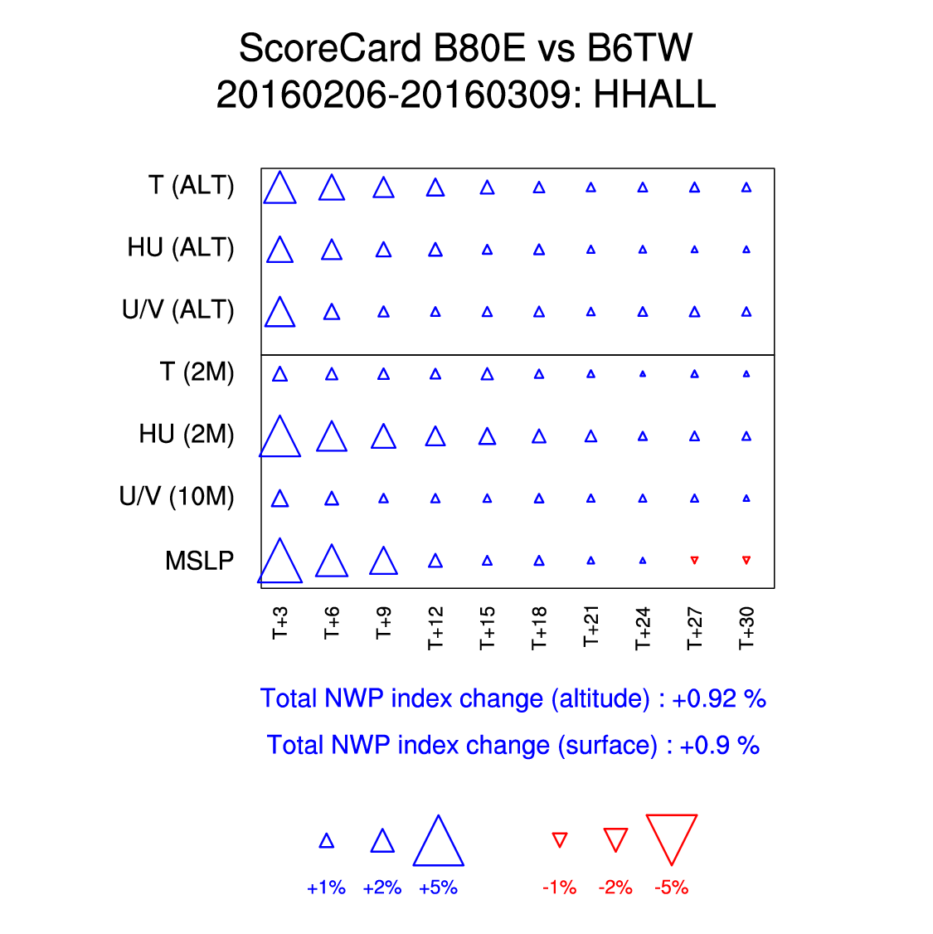
[3] Full verification (+3 to +30h, 3h)
1 month
Lagging (25x3) + SDL
075/150/300km
vs
25-member
250km

Slide 25
Summary and conclusion
In the context of AROME 3DEnVar…
  The SDL formulation of Buehner (2012), which assumes that the covariance between the scales are zero, performs better than the more recent formulation of Buehner and Shlyaeva (2015), that avoids the complete removal of the between-scale covariances, when B_{ens} is derived from the most recent 25-member ensemble forecasts.
  When increasing the effective ensemble size to 75 members with time-lagged forecasts, the two scale-dependent formulations provide similar forecast improvements overall.
  It was also found that the lagged ensemble forecasts approach outperforms scale-dependent localization on its own.
  The largest forecast improvements are obtained when combining the two approaches.

Slide 26
Future work at ECCC
  In the context of ensemble forecasts with O(100) members, we plan to keep using the SDL formulation of Buehner and Shlyaeva (2015) as tested in a global context by Caron and Buehner (2018, MWR).
  SDL is now being tested in a 4D context for a potential implementation in our operational forecasting systems in 2019.
  Lagrangian advection of the localization will soon be examined in our 4DEnVar systems, with and without SDL, using the computationally efficient approach proposed by Desroziers et al. (2016, QJRMS).

Slide 27
Extra

Slide 28
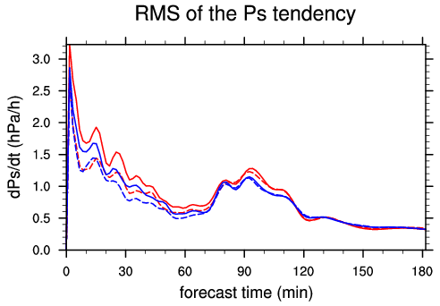
Impact on balance: Convective Scale
RF-SDL
RF
SP-SDL
SP

