Slide 1


Predicting Hurricane Intensity of Hurricane Harvey, Irma and Maria: The Real-Time Forecast Experiment with Assimilation of Airborne Doppler Radar Observations
Xingchao Chen and Fuqing Zhang
Department of Meteorology and Atmospheric Science, and Center for Advanced Data Assimilation and Predictability Techniques, The Pennsylvania State University, University Park, Pennsylvania

Slide 2
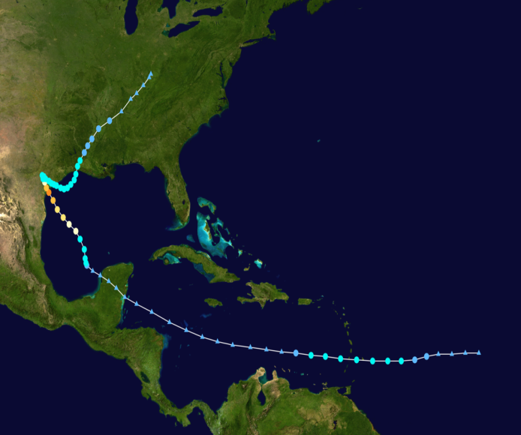
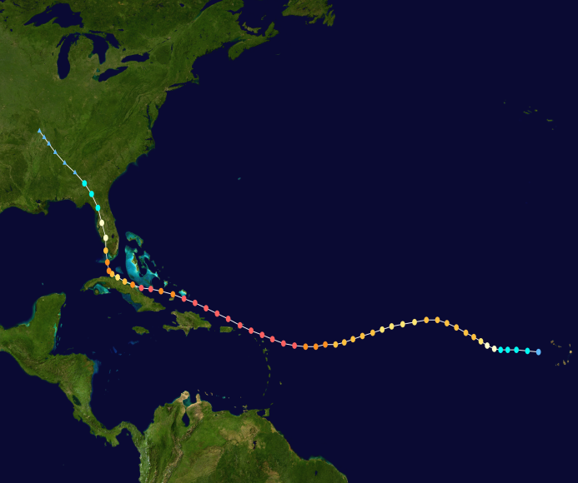
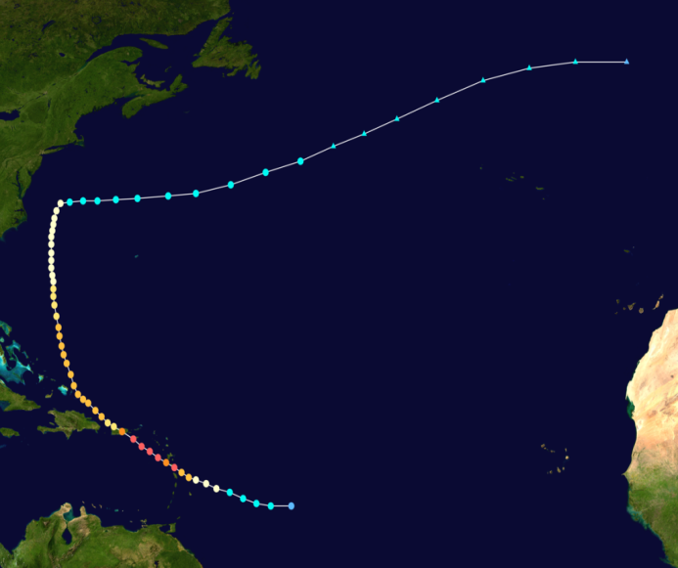
2017 Hurricane Season
Total depressions | 18
Total storms | 17
Hurricanes | 10
Major hurricanes | 6
7th most intense Atlantic hurricane seasons since 1850
Costliest tropical cyclone season on record! (≥ $368.66 billion) , nearly all of which was due to three of the season's major hurricanes: Harvey, Irma, and Maria.
Hurricane Harvey
Category 4 major hurricane
Hurricane Irma
Category 5 major hurricane
Hurricane Maria
Category 5 major hurricane
Damage: 125 billion
Damage: 64.76 billion
Damage: 91.61 billion

Slide 3
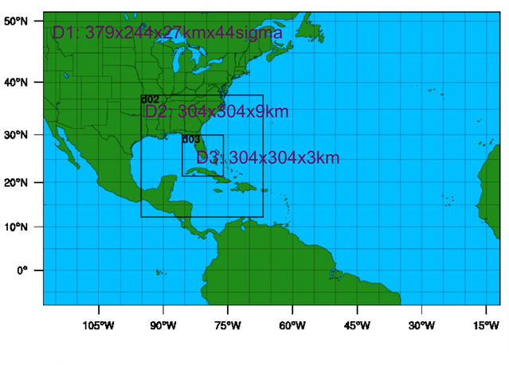
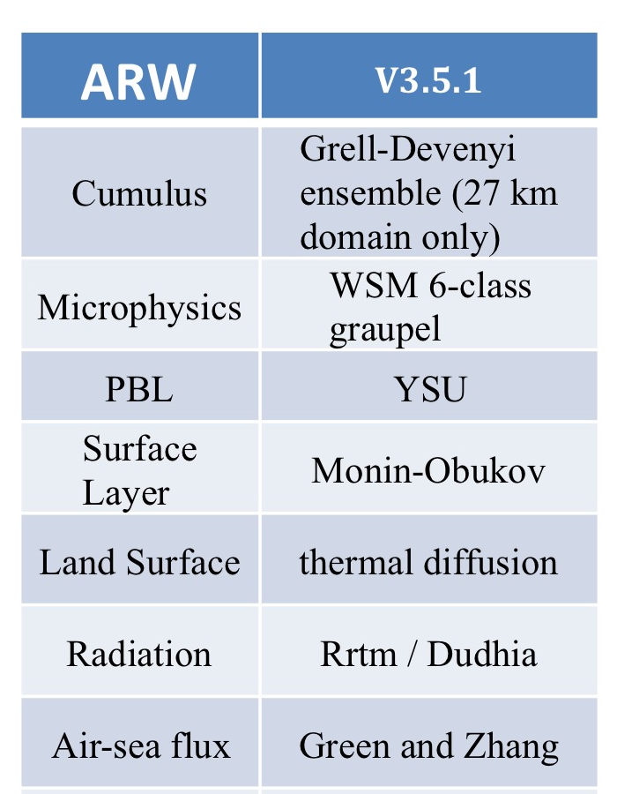
PSU WRF/EnKF Real-time System
D2 and D3 are “vortex following”—moving throughout the forecast such that the storm center is always in the middle of these inner domains.
60-member ensemble, IC and BC: GFS using 3DVAR background uncertainty

Slide 4
PSU WRF/EnKF Real-time System
Splitting the original file into one-sweep files
Creating a volume
Dividing the volume into smaller bins
Observation selection
Quality control
Creating super-observations
(Weng and Zhang, 2011)
These procedures have since been implemented operationally on the NOAA hurricane aircraft that allows for more efficient real-time transmission of airborne radar observations
Notes:
Hurricanes spend most of their lifetimes over the ocean, where an insufficient number of conventional observations are available for resolving inner-core structures. Airborne Doppler radar observations may well cover the inner-core areas and can be used to initialize hurricanes.

Slide 5
PSU WRF/EnKF Real-time System
The covariance relaxation method (Zhang et al. 2004)
(xª_{new})′ = (1 − α)(xª)′ + α(x^{f})′
Where α = 0.6, preventing filter divergence
The successive covariance localization (SCL) method
(Zhang et al. 2009)
1/9 of the total observations are randomly chosen and assimilated with a horizontal localization radius of influence (ROI) of 1215 km in all three domains in order to capture the large-scale background flow.
Then another 2/9 of the observations are assimilated with an ROI of 405 km in the 9 and 3 km domains.
Finally, the other 6/9 of observations are assimilated using a ROI of 135 km in the inner 3 km domain.
Notes:
Our use of (5), which overestimates the uncertainty in the analysis, is motivated by the tendency for the EnKF to underestimate the uncertainty of the analysis (Burgers et al. 1998; van Leeuwen 1999) if the ensemble size is small or if the initial estimate is poor (i.e., ensemble mean error is greater than the spread).
The SCL technique is designed to assimilate dense observations such as from radars that contain multiscale information of the atmosphere (Z09), and to reduce computational costs and sampling errors. It uses a different ROI for different groups of observations by random sampling.
The use of SCL is partially motivated by the fact that with serial observation processing of the EnKF, the error correlation length scale decreases as the previously assimilated observations better define the large scales; hence, later observations should be assimilated with tighter localization

Slide 6
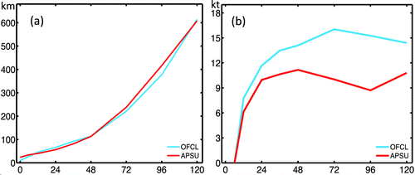
PSU WRF/EnKF Real-time System
Track
Intensity
(top) The mean absolute forecast errors of (a) track and (b) intensity at different forecast lead times (verified against poststorm best-track observations estimated by NHC) for the PSU WRF-EnKF system (red) and the NHC official forecasts (cyan) averaged over all applicable P3 Doppler missions during 2008–12.

Slide 7
Hurricane Irma

Slide 8
Hurricane Irma
Pmin
Vmax

Slide 9
Hurricane Maria

Slide 10
Hurricane Maria
Pmin
Vmax

Slide 11
Hurricane Harvey

Slide 12
Hurricane Harvey
Pmin
Vmax

Slide 13
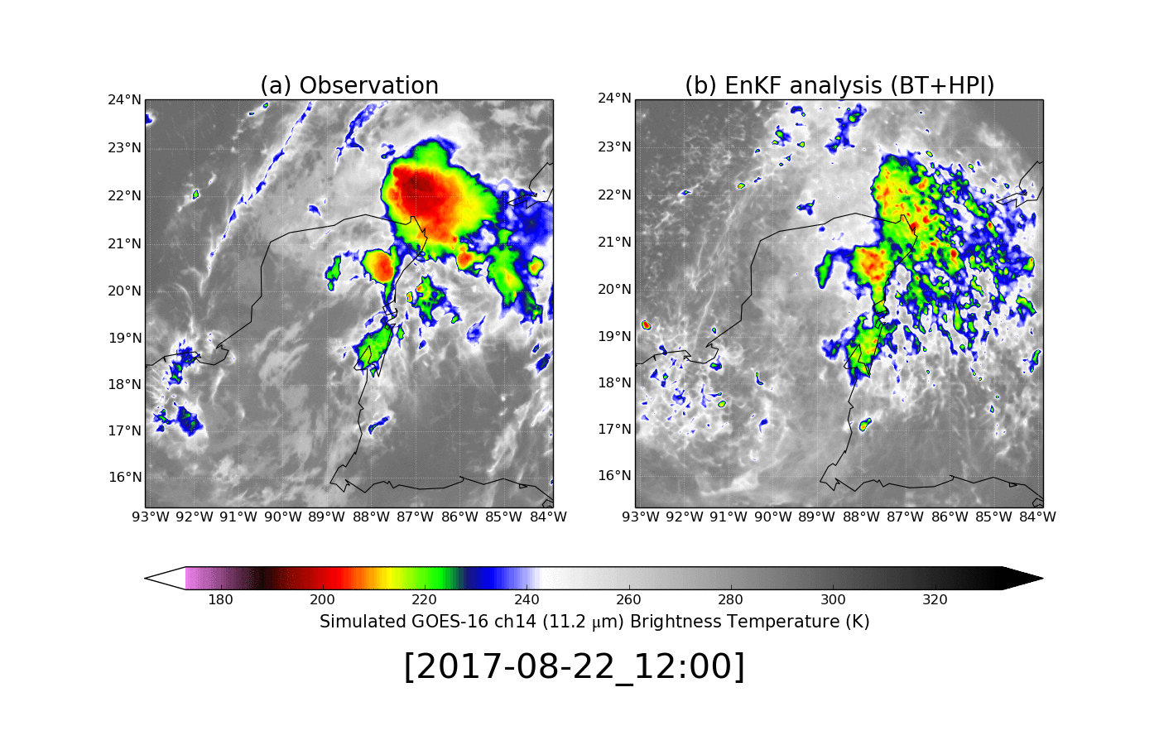
EnKF Performance Assimilating GOES-16 all-sky BT
Hurricane Harvey
Observation
EnKF analysis
Minamide and Zhang, 2018, in prep

Slide 14
Hurricane Harvey
Satellite Data Assimilation
Comparison of Harvey’s position and intensity forecasts by regional models

Slide 15
Hurricane Harvey
FV3
Comparison of Harvey’s position and intensity forecasts by global models
Zhang et al. (2018), submitted to BAMS
Notes:
Our fvGFS simulations use a globally uniform 13-km grid mesh together with a two-way interactive 3-km cloud-resolving nested domain, centered at 92.5°W, 21.5°N in the Gulf of Mexico.
The vortex initialization in fvGFS is the interpolated PSU WRF-EnKF analysis within a 600-km radius of the initial Harvey vortex center but will be linearly hybrid with the operational GFS analysis with weights decreased from 1.0 at the 600-km radius to 0.0 at the 900-km radius, beyond which only the GFS analysis is used.

Slide 16
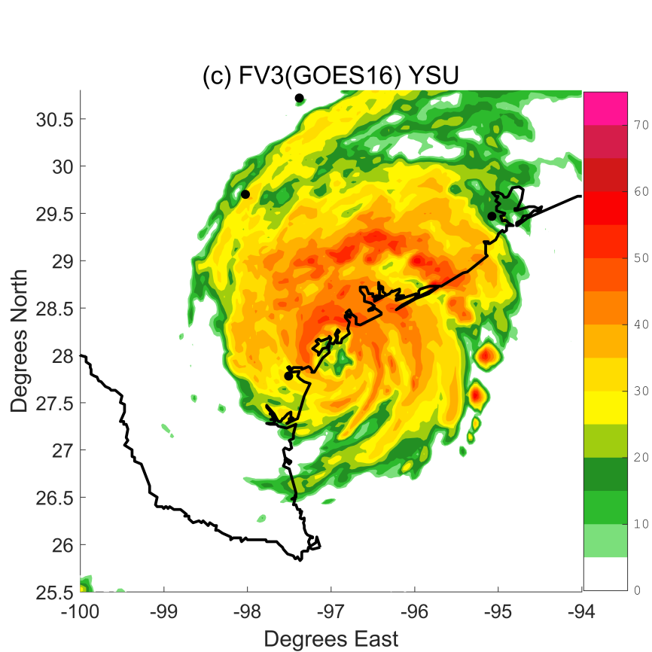
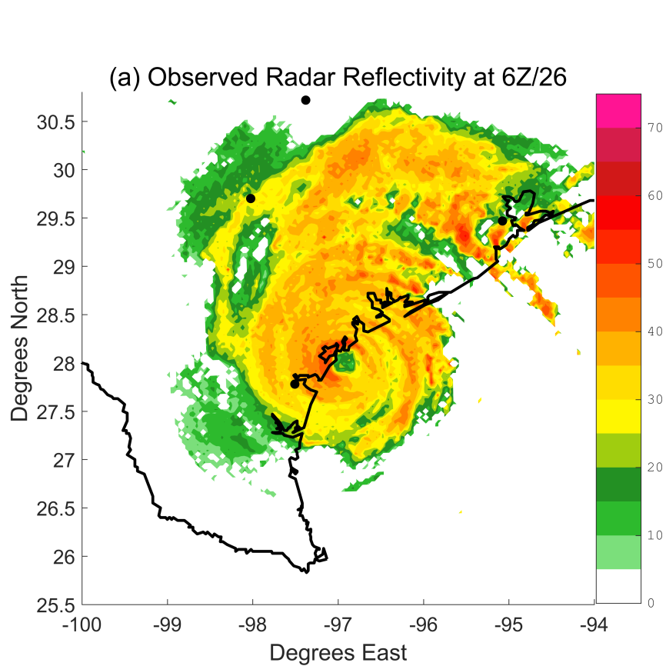
Hurricane Harvey
FV3
FV3 forecast of hurricane structure

Slide 17
Hurricane Harvey
FV3
FV3 forecast of event total rainfall

Slide 18
Conclusion
The deterministic forecast of PSU Real-Time System shows better track forecast for Hurricane Irma.
The deterministic forecast of PSU Real-Time System shows both better track and better intensity forecasts for Hurricane Maria.
The track forecast of Hurricane Harvey in PSU Real-Time System is worse than HWRF and NHC official forecast, while better track and intensity forecast of Harvey can be archived through using next-generation global model and assimilating all-sky radiance observations

