Slide 1
2018 EnKF Workshop Development and Testing of a High-Resolution Rapid Refresh Ensemble (HRRRE)
David Dowell, Trevor Alcott, Curtis Alexander, Jeff Beck, Stan Benjamin,
John Brown, Jeff Duda, Guoqing Ge, Jeff Hamilton, Ming Hu, Eric James,
Brian Jamison, Isidora Jankov, Terra Ladwig, Steve Weygandt
NOAA/ESRL/Global Systems Division
Glen Romine, Craig Schwartz, Kate Fossell, May Wong
National Center for Atmospheric Research
Kent Knopfmeier, Pat Skinner, Lou Wicker
National Severe Storms Laboratory
Xuguang Wang, Yongming Wang
University of Oklahoma
Geoff Manikin, Jacob Carley
NOAA/NWS/NCEP/EMC

Slide 2
NOAA Convective-Allowing Ensemble Forecasting
Today: High-Resolution Ensemble Forecast (HREFv2)
“Ensemble of opportunity” assembled from 8 regional deterministic forecasts (Δx=3 km)
4 with ARW dynamic core, 4 with NMM dynamic core
Initialization from global model, cycled DA on 3-km grid for short period
Hybrid DA using a global (not convective-allowing) background ensemble
Skillful severe weather forecasts
HREF Updraft Helicity
(rotating updrafts)
0-24 h forecast
8 members
tornado, hail, and wind reports shown on right
graphics from Brett Roberts
Hazardous Weather Testbed

Slide 3
NOAA Convective-Allowing Ensemble Forecasting
Near Future Plans (2018-2025)
Simplified model suite: transition to a single model (FV3) for global and regional applications
Ensemble / hybrid DA with a convective-allowing (Δx~3 km) background ensemble
Formal ensemble forecast system (HREF → single-model system)
Comparable skill and spread to existing multi-model HREF system
Regional initially → global eventually
“Warn on Forecast” (high resolution, on demand)
Grid spacing < 1 km, sub-hourly DA, sub-hourly ensemble forecasting
Research and Development at GSD: High-Resolution Rapid Refresh Ensemble (HRRRE)
Testbed for developing convective-allowing ensemble DA and forecasting capabilities, toward the goal of an operational formal ensemble system
Shared code and scripts with HRRR deterministic analysis and forecasting system
Collaboration with NCAR, NSSL, OU, EMC to guide design choices
Notes:
HREF baseline for comparison
HRRRE developing components of a potential operational system

Slide 4
Convective-Allowing Ensemble Configurations
Attribute | HRRRE | NCAR Ensemble | HREF
Dynamic Core | ARW | ARW | ARW and NMMB
Physics | RAP/HRRR Suite | RAP/HRRR Suite | Mixed
Initial Condition Atmos | GFS + GDAS once-daily restart | Continuous cycle | RAP and NAM
Initial Condition Soil | RAP/HRRR soil + perturbations | Continuous cycle | RAP and NAM
Hourly DA Cycling | EnKF w/posterior inflation | EnKF w/posterior inflation | 3D EnVar
Lateral Boundary | Perturbations | Perturbations | RAP and NAM
Stochastic Physics | None (or LSM, PBL, MP, Cu) | None | None
Number of DA Members | 36 | 80 | None
Number of Fcst Members | 9 | 10 | 8 (4 time-lagged)
Notes:
HREF mix of dynamic cores and initialization methods; short cycling period, with coarse ensemble background from global system

Slide 5
Convective-Allowing Ensemble Configurations
Attribute | HRRRE | NCAR Ensemble | HREF
Dynamic Core | ARW | ARW | ARW and NMMB
Physics | RAP/HRRR Suite | RAP/HRRR Suite | Mixed
Initial Condition Atmos | GFS + GDAS once-daily restart | Continuous cycle | RAP and NAM
Initial Condition Soil | RAP/HRRR soil + perturbations | Continuous cycle | RAP and NAM
Hourly DA Cycling | EnKF w/posterior inflation | EnKF w/posterior inflation | 3D EnVar (global)
Lateral Boundary | Perturbations | Perturbations | RAP and NAM
Stochastic Physics | None (or LSM, PBL, MP, Cu) | None | None
Number of DA Members | 36 | 80 | None
Number of Fcst Members | 9 | 10 | 8 (4 time-lagged)
Notes:
Continuous cycling: model biases easier to detect and potentially correct; but, don’t inherit large-scale analyses from global model
Daily restart: global model provides best large-scale analysis; but DA and forecasting then occurs during transition period from global model attractor to regional model attractor
Ensemble size

Slide 6
HRRRE Analysis System
Nested 15-km and 3-km WRF-ARW domains
36 members initialized daily at 0300 UTC
Initial mean from GFS (atmos.) and RAP-HRRR (soil)
Atmospheric perturbations from GFS DA ensemble (GDAS)
Random soil-moisture perturbations
Boundary-condition perturbations
Ensemble and domain size limited by computational resources
Simultaneous runs of NCAR Ensemble testing larger ensemble and continuous cycling
Notes:
Development driven by convective-scale forecasting for aviation and severe weather
Full CONUS this fall? Increased computing resources or 4-km grid spacing

Slide 7
HRRRE Analysis and Forecast System
Hourly cycling 0300 – 0000 UTC (21 hours)
Conventional observations both domains
Radar reflectivity observations 3-km domain only
GSI for ob preprocessing and ensemble priors
Two options for assimilation software: DART (EAKF) or NOAA EnKF (EnSRF)
Analysis variables: U, V, PH, T, MU, QVAPOR, QCLOUD, QICE, QRAIN, QSNOW
Localization radius 18 km / 300 km for radar obs / conventional obs (small ensemble)
Relaxation to prior spread
Ensemble forecasts
9 members out to ~36 hours
0000 UTC, 1200 UTC, and other selected times
Graphics for 3-km domain only
https://rapidrefresh.noaa.gov/hrrr/HRRRE/

Slide 8
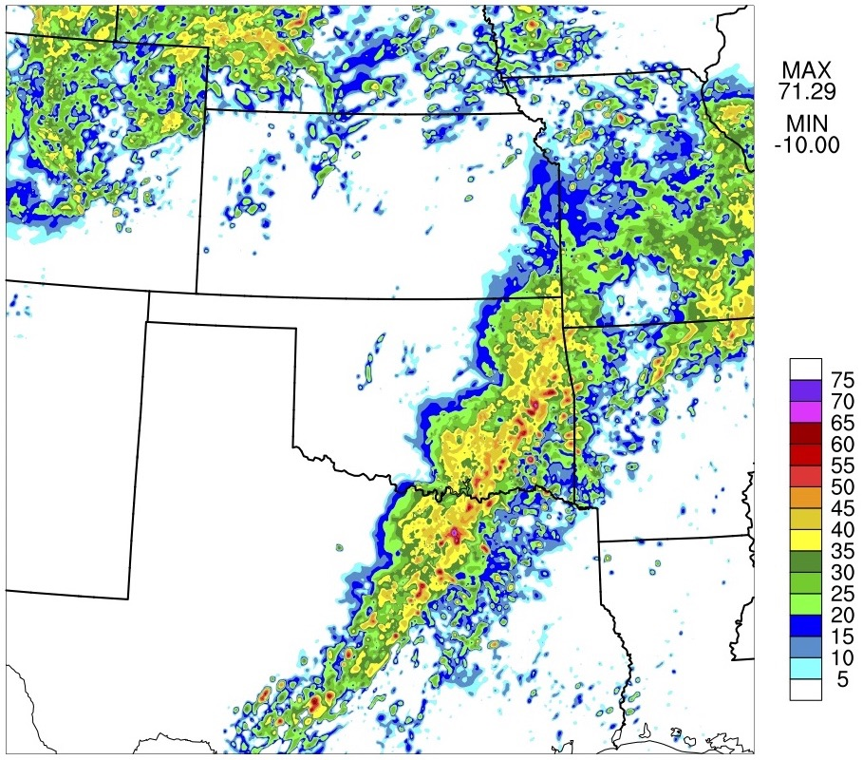
EnKF Radar Reflectivity Assimilation
Analysis Composite Reflectivity (dBZ)
Analysis increments associated with radar reflectivity DA are noisy.
non-Gaussian prior distributions
non-linear observation operator
But, reflectivity DA improves the forecast….
Notes:
One membrer

Slide 9
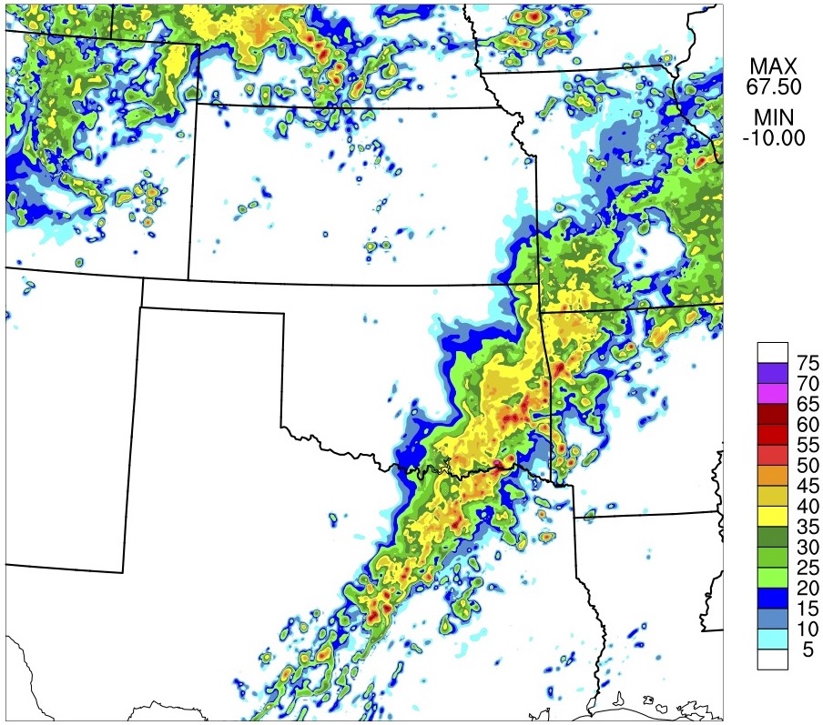
EnKF Radar Reflectivity Assimilation
1-h Forecast Composite Reflectivity (dBZ)
Analysis increments associated with radar reflectivity DA are noisy.
non-Gaussian prior distributions
non-linear observation operator
But, reflectivity DA improves the forecast….

Slide 10
HRRR and HRRRE Reflectivity Forecast Skill
CSI (20 km)
Eastern US
15 Mar – 5 May 2018
HRRR
reflectivity-based T tend. during 1-h model spinup
hydrometeor specification
HRRRE members 1, 2, 3
EnKF reflectivity assimilation
all times
30-dBZ threshold
0000 UTC initial time
20-dBZ threshold

Slide 11
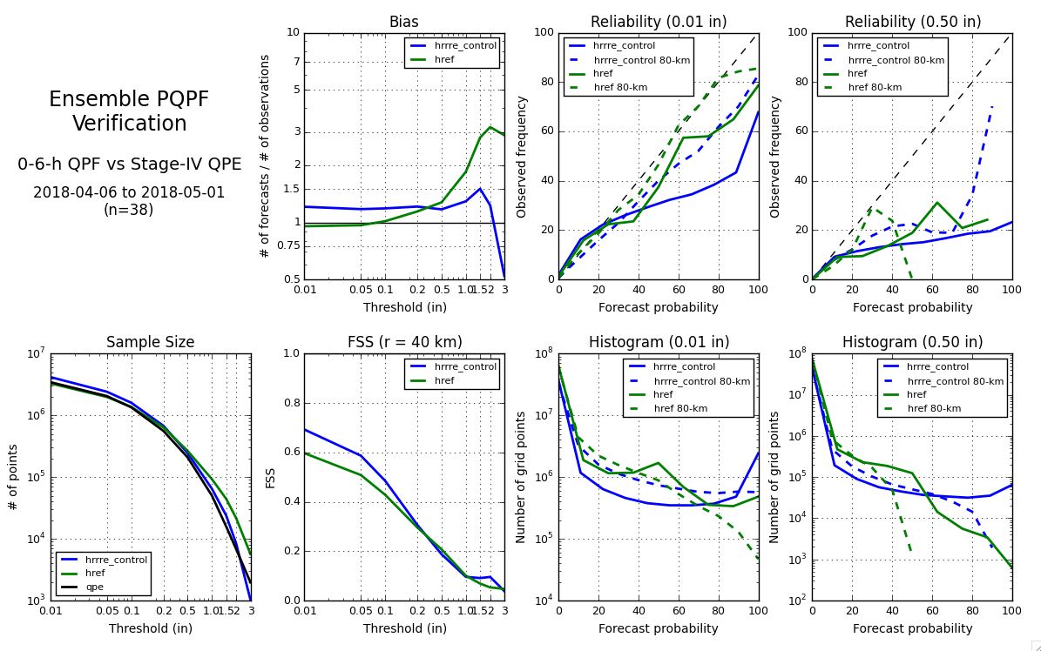
Probabilistic Verification: 0-6 h Precipitation
HRRRE: single-model system
HREF: multi-model system

Slide 12
Probabilistic Verification: 0-6 h Precipitation
HRRRE: single-model system
HREF: multi-model system

Slide 13
Probabilistic Verification: 0-6 h Precipitation
HRRRE: single-model system
HREF: multi-model system

Slide 14
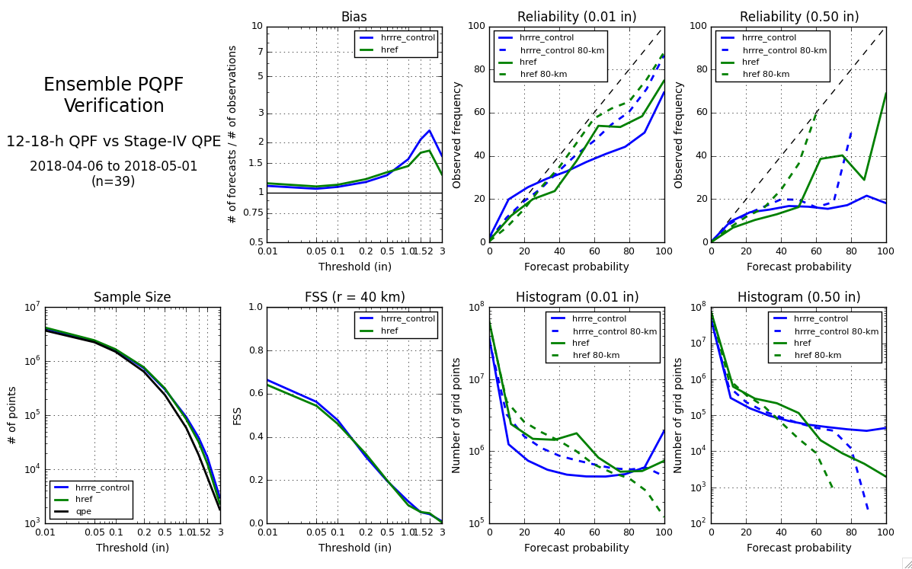
Probabilistic Verification: 12-18 h Precipitation
HRRRE: single-model system
HREF: multi-model system

Slide 15
Probabilistic Verification: 12-18 h Precipitation
HRRRE: single-model system
HREF: multi-model system

Slide 16
Probabilistic Verification: 12-18 h Precipitation
HRRRE: single-model system
HREF: multi-model system

Slide 17
Real-time Demos Spring 2018
Forecasts from HREF, HRRRE, NCAR Ensemble, CAPS EnKF, and OU (MAP) are being evaluated during ongoing Hazardous Weather Testbed “Spring Experiment”.
HREF: multi-model system
HRRRE: single-model system
HREF (left)
HRRRE (right)
Updraft Helicity
0-24 h forecast
8 members
tornado, hail,
and wind reports
graphics from Brett Roberts
Hazardous Weather Testbed

Slide 18
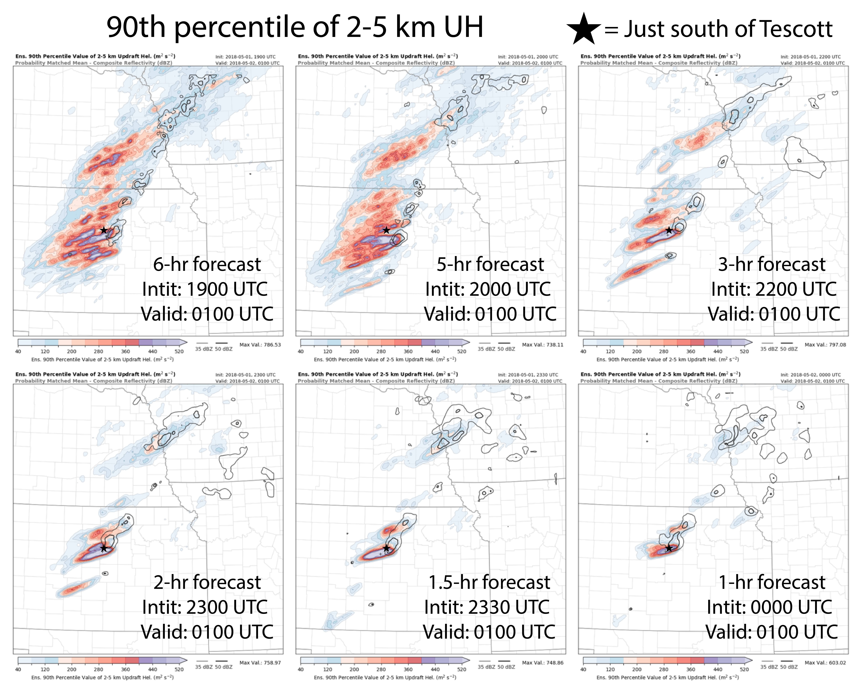
“Warn on Forecast”
Project led by National Severe Storms Laboratory
Sub-hourly EnKF DA and ensemble forecasting
“On demand” domain in region of anticipated hazardous weather
Nesting within fixed, hourly-updated ensemble system (HRRRE)
Coarse resolution currently, but eventually horizontal grid spacing < 1 km
graphics from Pat Skinner
and Jessie Choate
Notes:
also part of real-time demo this spring

Slide 19
Results and Discussion Items
Deterministic convective 1-6 h forecasts are better in HRRRE members (EnKF w/ high-res ensemble) than in HRRR (3D EnVar assimilation with coarse global ensemble).
Ensemble forecast spread is an ongoing challenge.
Useful guidance of where severe weather will occur from both HRRRE and HREF, but higher probability of detection in HREF (multi-model system)
Overconfidence in precip. forecasts indicated by probabilistic verification
Ongoing work to develop stochastic physics in HRRRE (not shown today)
We welcome collaboration on the following topics, and more.
Ensemble forecast spread
Hybrid DA
Cloud analysis
Optimizing ensemble DA for small ensembles
Optimizing ensemble DA for non-Gaussian prior distributions

Slide 21
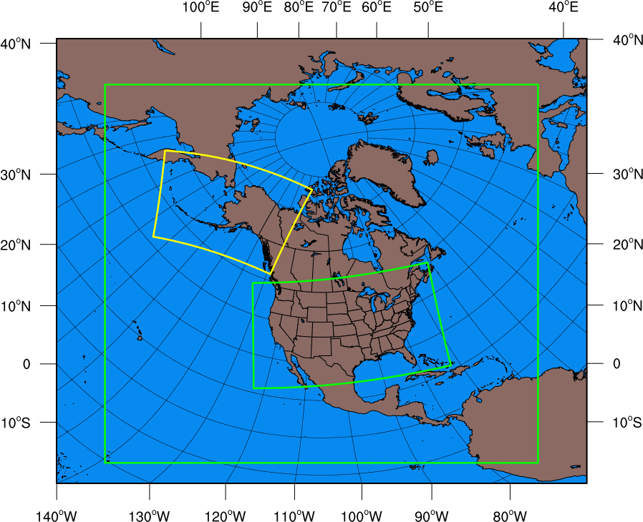
RAP/HRRR: Hourly-Updating Weather Forecast Suite
13-km Rapid Refresh (RAPv4) – to 39h (June 2018)
Initial & Lateral Boundary Conditions
Initial & Lateral Boundary Conditions
3-km High-Resolution Rapid Refresh Alaska (HRRR-AK) 36 hr (June 2018)
3-km High-Resolution Rapid Refresh (HRRRv3) – to 36h (June 2018)

