Slide 1
Using an EnKF to Update Bulk Microphysical Variables and Improve Hail Forecasts
Jonathan Labriola^{1,2}, Nathan Snook², Youngsun Jung², and Ming Xue^{1,2}
¹University of Oklahoma School of Meteorology
²Center for the Analysis and Prediction of Storms
8 May 2018
8th EnKF Data Assimilation Workshop, Sainte-Adèle, Québec, Canada

Slide 2
To begin, a quote:
"We been through every kind of rain there is. Little bitty stingin’ rain … and big ol’ fat rain. Rain that flew in sideways…"

Slide 3
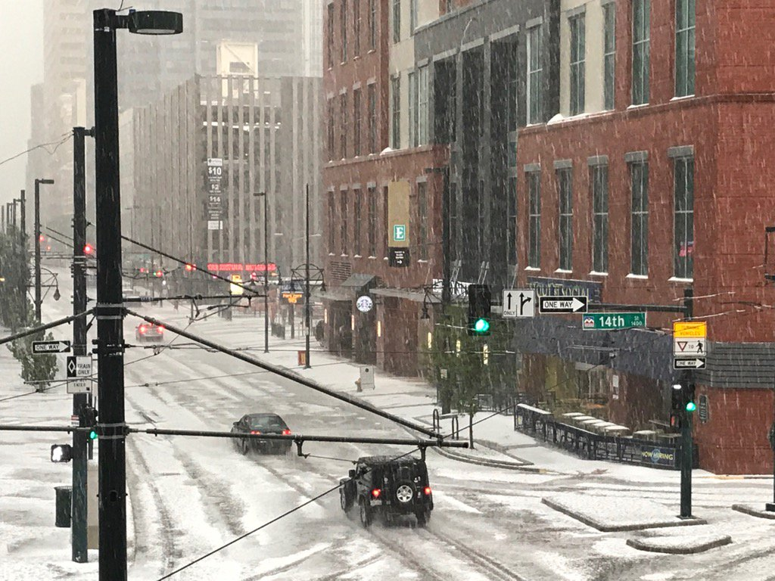
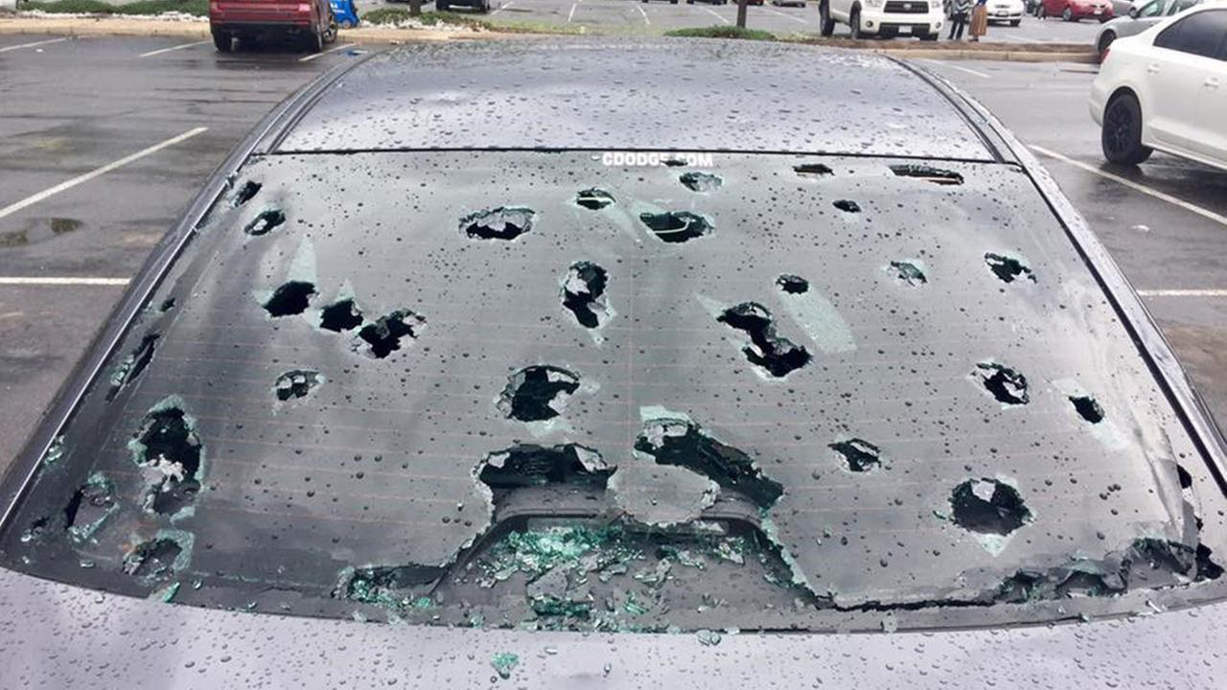
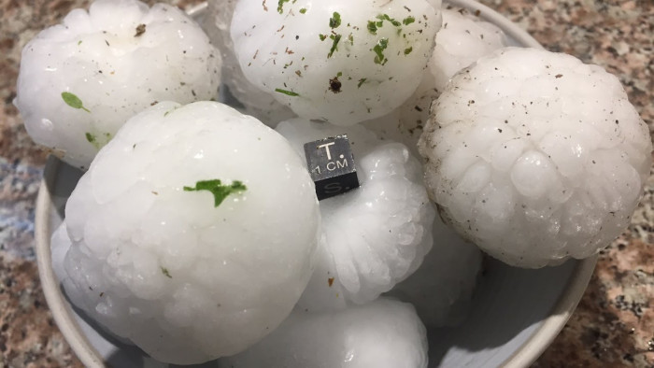
Colorado Hail Event
8 May 2017
Hailstorms over the Denver metro area caused $1.4 billion in damages
Most expensive natural disaster in Colorado state history

Slide 4
Explicit Hail Prediction
High-resolution convective scale forecasts can provide skillful hail predictions with substantial lead-time, allowing vulnerable industries/individuals to mitigate hail damage
Output from bulk microphysics (BMP) schemes can diagnose hail size, quantity
Several advanced, multi-moment BMP schemes are now available
Treatment of rimed ice varies significantly between BMP scheme, impacts forecast
Multi-moment schemes are significantly under-constrained with radar observations
Can EnKF retrieve all the predicted microphysical variables?
What is the best DA configuration for both model stability and accuracy?

Slide 5
DA with Multi-Moment BMP Schemes
BMP schemes predict many microphysical variables
Z is the only microphysical observation
Microphysical variables behave differently between BMP schemes
Determines model covariance structure
Z and microphysical variables have complex relationships
Z is not monotonically related to N_{tx} nor q_{x} in multi-moment schemes, it depends on the combination of N_{tx} and q_{x}.
NSSL
q_{i}, q_{s}, q_{r}, q_{c}, q_{g}, q_{h}
v_{g,} v_{h}
N_{ti}, N_{ts}, N_{tr}, N_{tc}, N_{tg}, N_{th}
N_{CCN}
15 Variables
Updated by Z

Slide 6
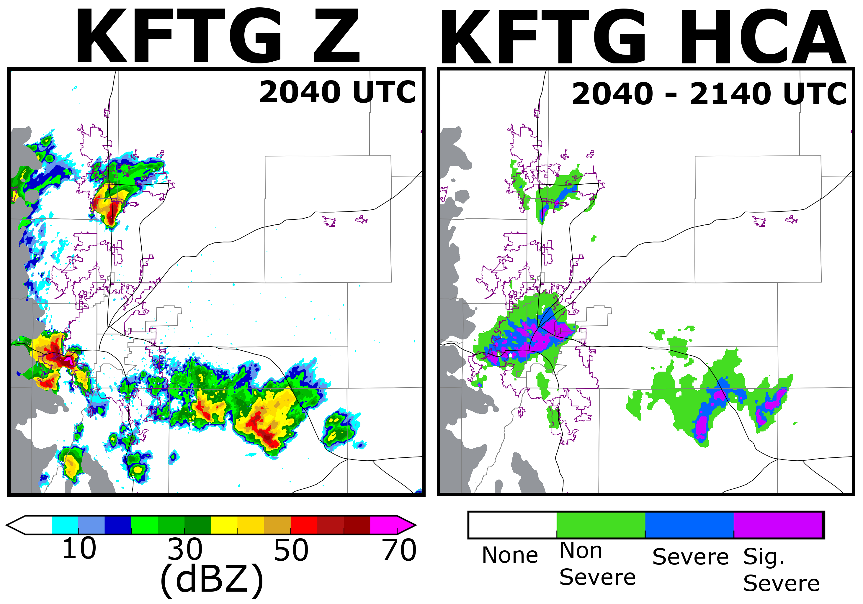
Ft. Collins
Elevation > 2.5 km Masked
Denver

Slide 7
Elevation > 2.5 km Masked
Notes:
Talk about the convective set-up. Discrete storms produced via upslope flow creates west and north of Denver. Multi-cellular storms formed along a weak frontal boundary just south of Denver

Slide 8
DA Configuration
Systems | DA: CAPS EnKF (Xue et al. 2006) / Forecast: ARPS (Xue et al. 2000,2001)
Observations | Surface (u, v, pt, q_{v}), KFTG S-Band radar (Z, v_{r})
Inflation | Initial perturbation: u,v = 2 m s⁻¹ pt = 2 k q_{v}= 1e-4 kg kg⁻¹ Inflation to prior spread: 95% (Whitaker and Hamil 2012)
Radar Forward Operator | T-Matrix scattering (Jung et al. 2010; Putnam et al. 2015)
Updated Fields | Update dynamic fields, q_{v} and microphysical variables
Background Ensemble
Initial Perturbations
Forecast to 2140 UTC
1900
UTC
1915
UTC
1930 UTC
1945 UTC
2000 UTC
2015 UTC
2030 UTC
2045 UTC
2100 UTC
60 Minute Spin-up period
5 min. DA cycles (SFC, Radar)
Forecast to 2320 UTC

Slide 9
Analyzed BMP Schemes
4 Experiments
Milbrandt and Yau (2005; MY) scheme (2-Moment; 12 variables)
Many small hail stones
Hail produced from frozen rain
Mansell et al. (2010; NSSL) scheme (2-Moment; 15 variables)
Variable density rimed ice
Fewer, larger hail particles
Hail produced from dense graupel
Z Updates Only q_{x} | Z Updates All Microphysical Variables
MY-Q | MY-ALL (q_{x}, N_{tx})
NSSL-Q | NSSL-ALL (q_{x}, N_{tx}, v_{g,h})

Slide 10
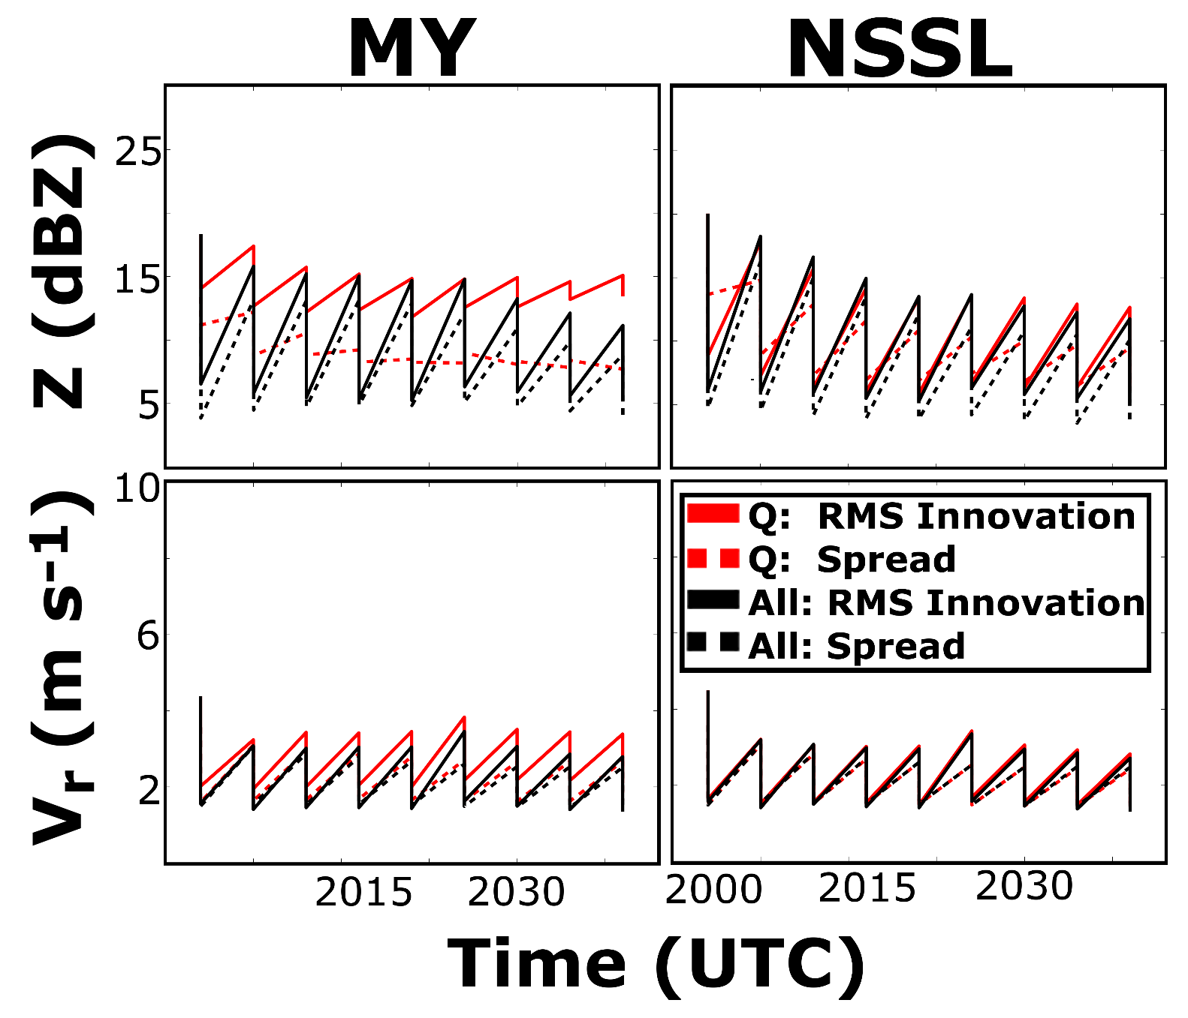
Data Assimilation
Updating all microphysical variables improves analysis
MY-Q has large RMSI
NSSL-Q more similar to NSSL-ALL

Slide 11
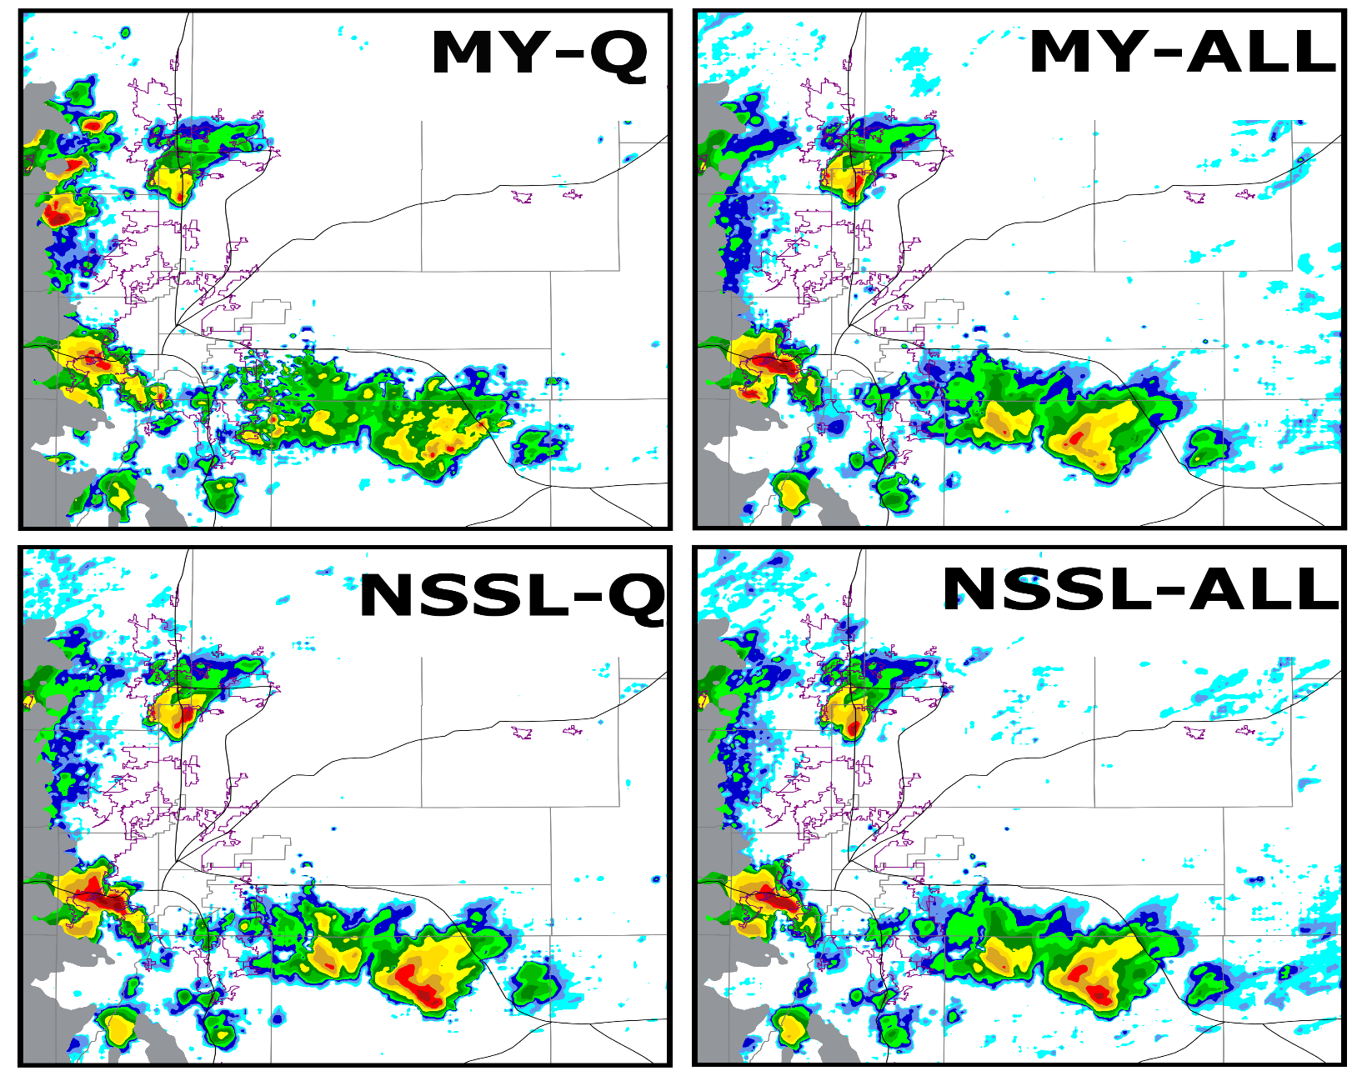
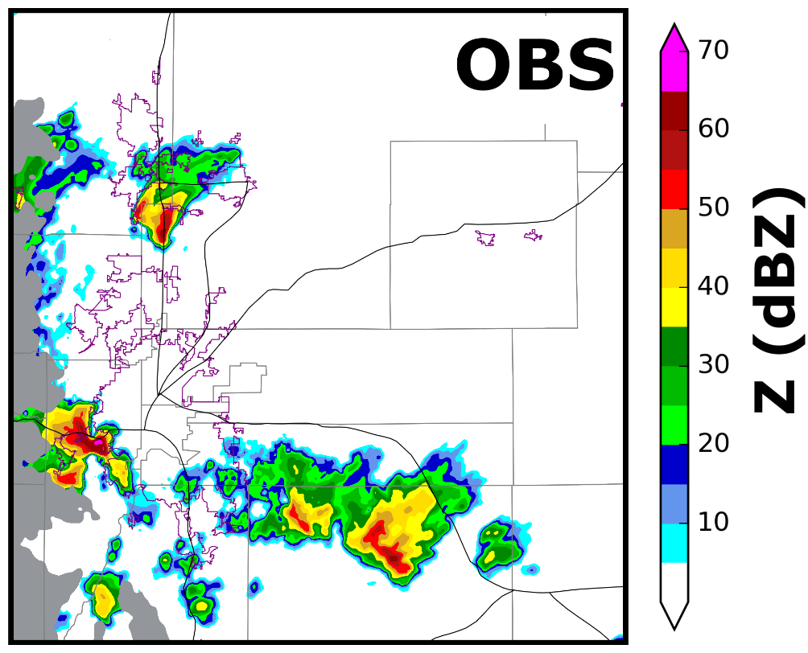
Final Analysis 2040 UTC
Notes:
Analyses all closely resemble the Observations except for MY-Q, this is where we will start
MY-Q has a lot of spurious storms present within the analysis

Slide 12
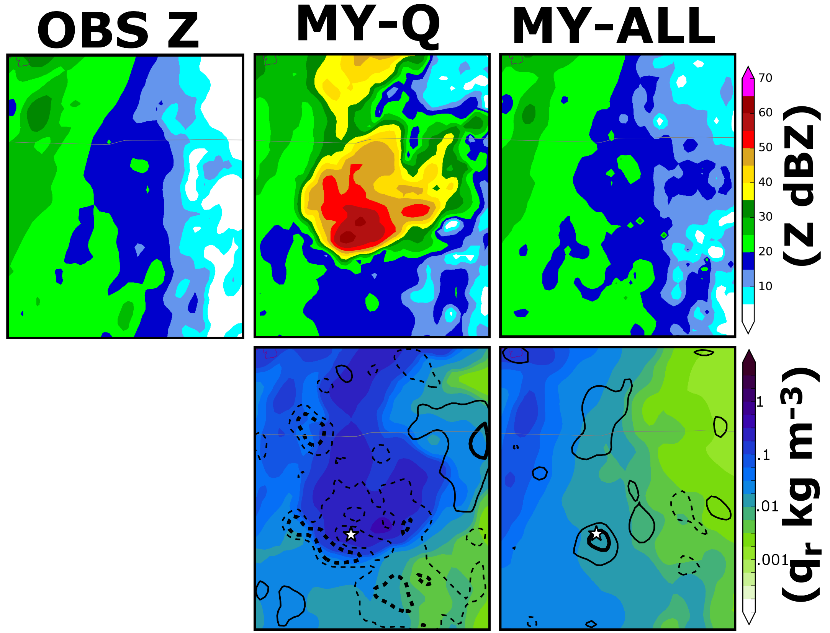
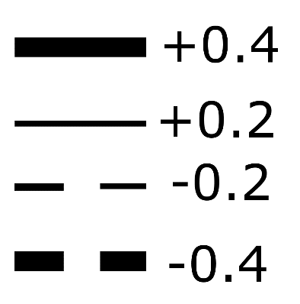
Unreliable MY-Q covariance structure
Correlation (COR) between Z, q_{r} negative
EnKF increases q_{r} when decreasing Z
Problem most pronounced for MY-Q
COR(Z, q_{r})

Slide 13
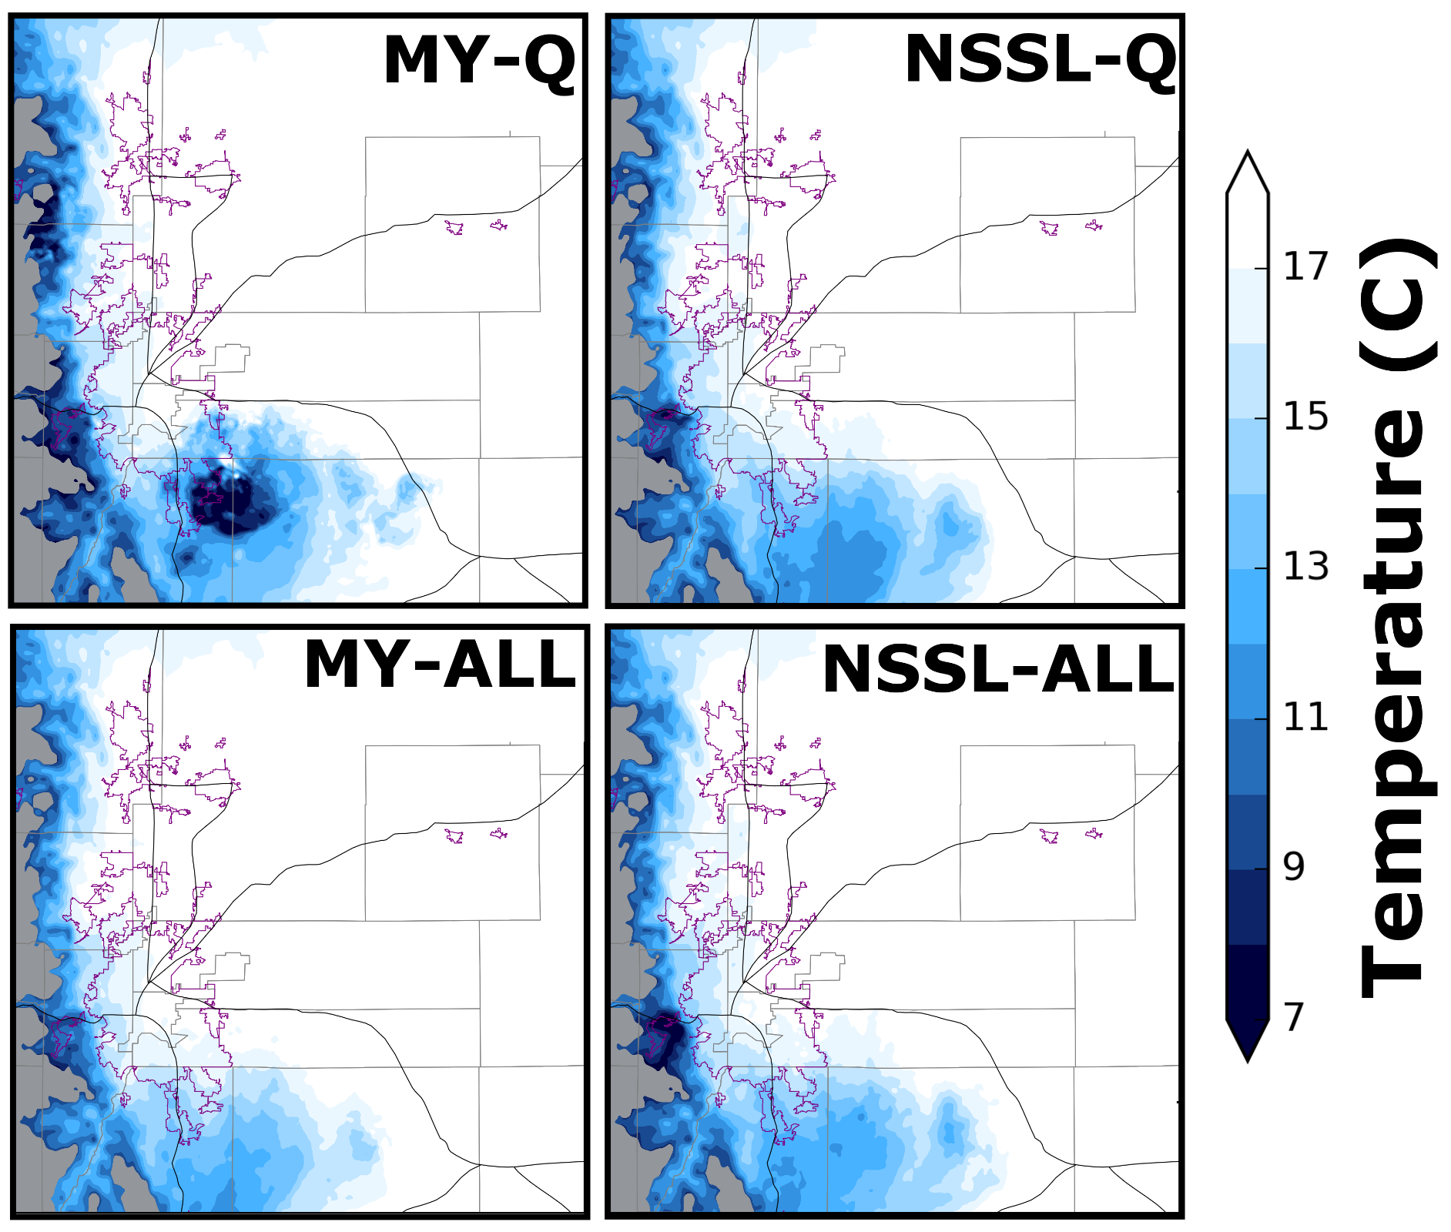
Cold Pool Intensity
MY-Q: Intense cold pools
Causes spurious convection
What causes this?
Cold pool intensifies during DA
MY-Q has large increase in q_{r}, intensifies cold pool
Strong cold pools lead to spurious convection
Notes:
DA introduces large quantities of rain into MY-Q, as a result the temperature decrease significantly during DA (continually adding more and more qr).

Slide 14
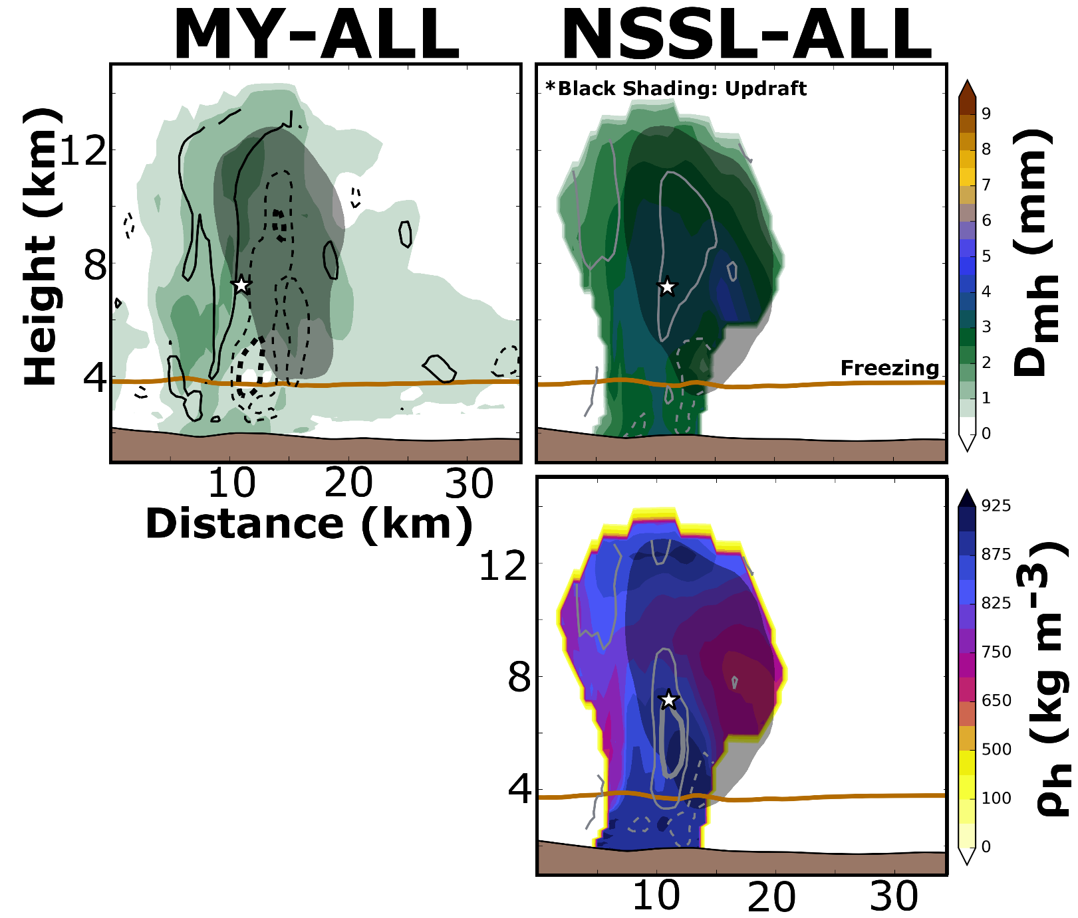
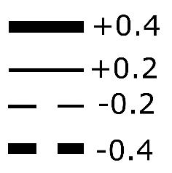
Updating Hail Fields
MY:
Continuous ingest of small hail in updraft, grows outside updraft
NSSL:
Increased hail size aloft (dry growth)
Hail densification near 0ºC isotherm (wet growth)
Updating NSSL v_{g,h} improves microphysical state of hail storm
COR(Z, field)
Notes:
NSSL dry growth: primary reason for why hail grows in size aloft. Hail wet growth: Water freezes more slowly for wet growth and fills in the crevices of the hailstone. This increase densification more instead of hail size (This is the justification for the correlation patterns seen above in the NSSL scheme.

Slide 15
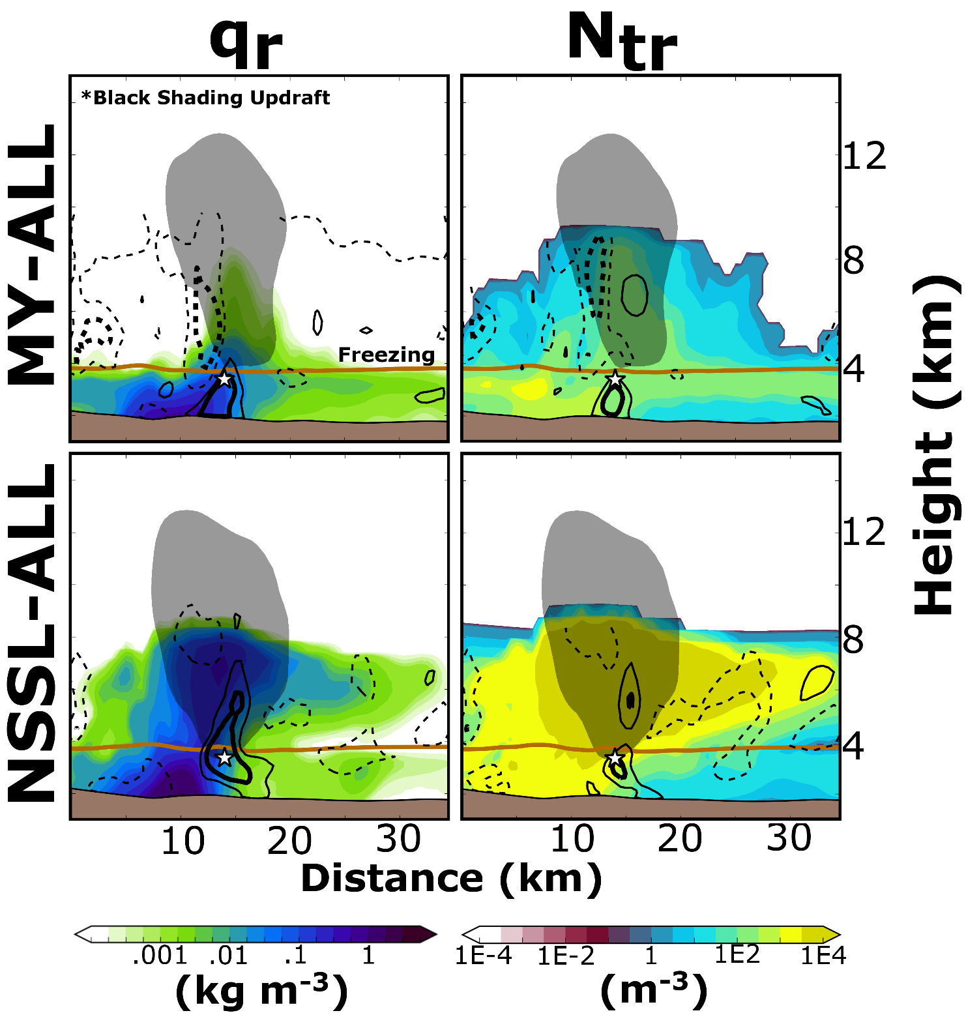
Updating Rain Fields
MY: Rain freezes, produces small hail
Limited super cooled rain
COR(Z, q_{r}) negative when T < 0 °C
NSSL: Only dense graupel creates hail
More rain aloft, accreted by hail
COR(Z, q_{r}) is positive deep into storm updraft
COR(Z, field)

Slide 16
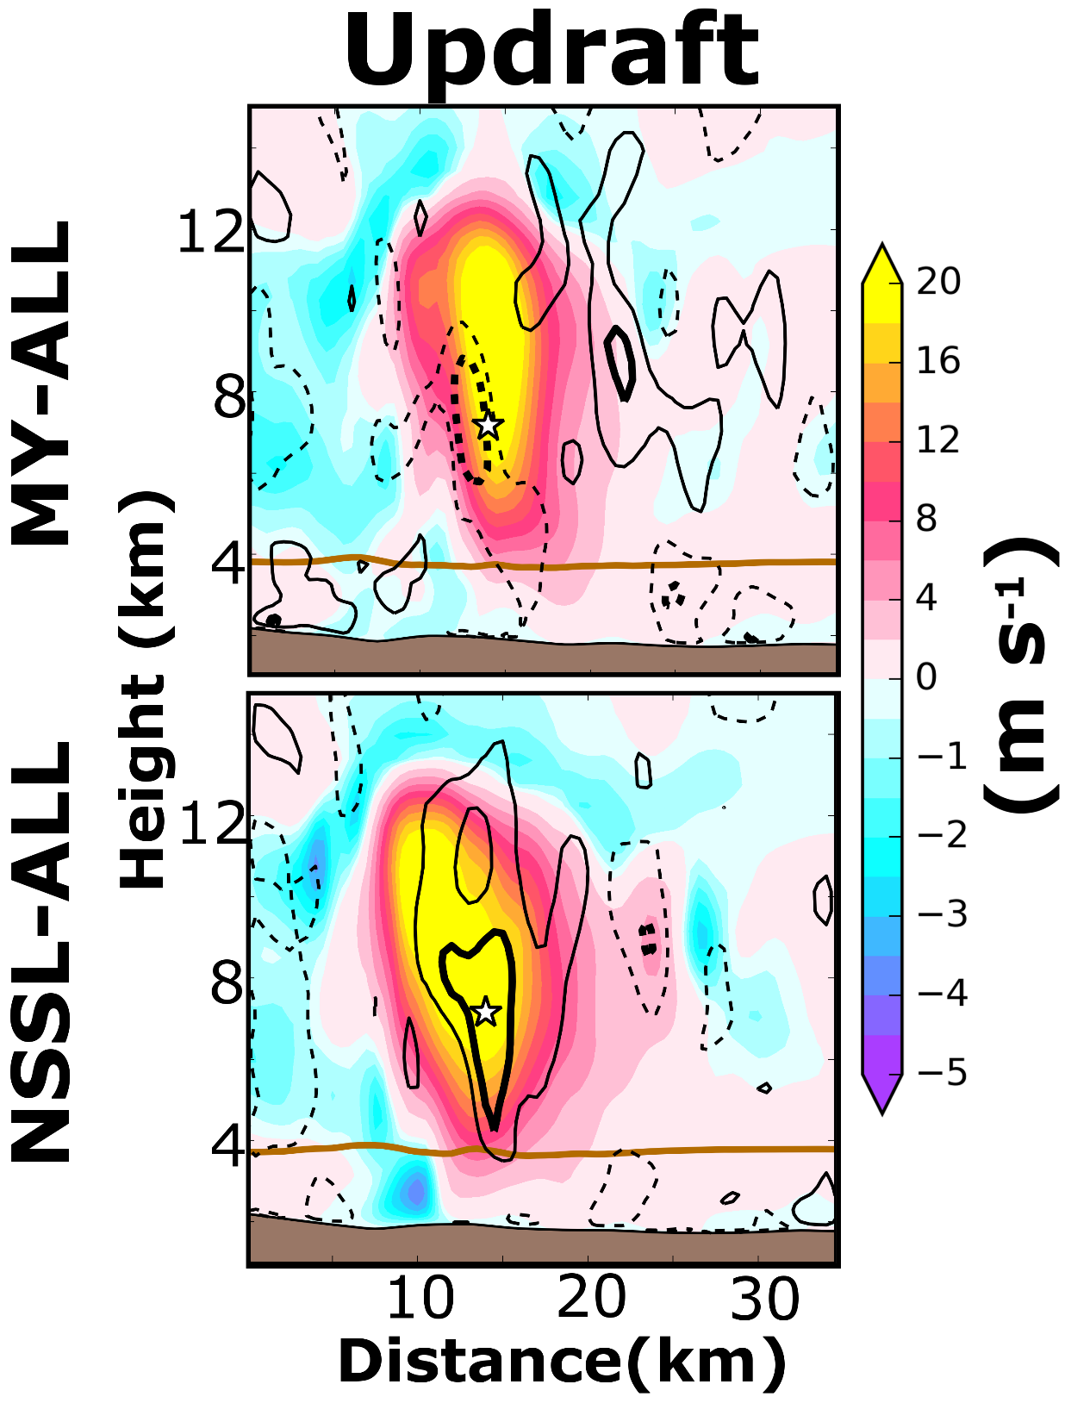
Updating Updraft Intensity
MY-ALL
COR(Z, w) is negative
Strong updrafts produce more small hail stones (reduces D_{mh})
NSSL-ALL
COR(Z, w) is positive
Rain particles are not converted to hail
Strong updrafts increase accretional growth of hail
COR(Z, w)

Slide 17
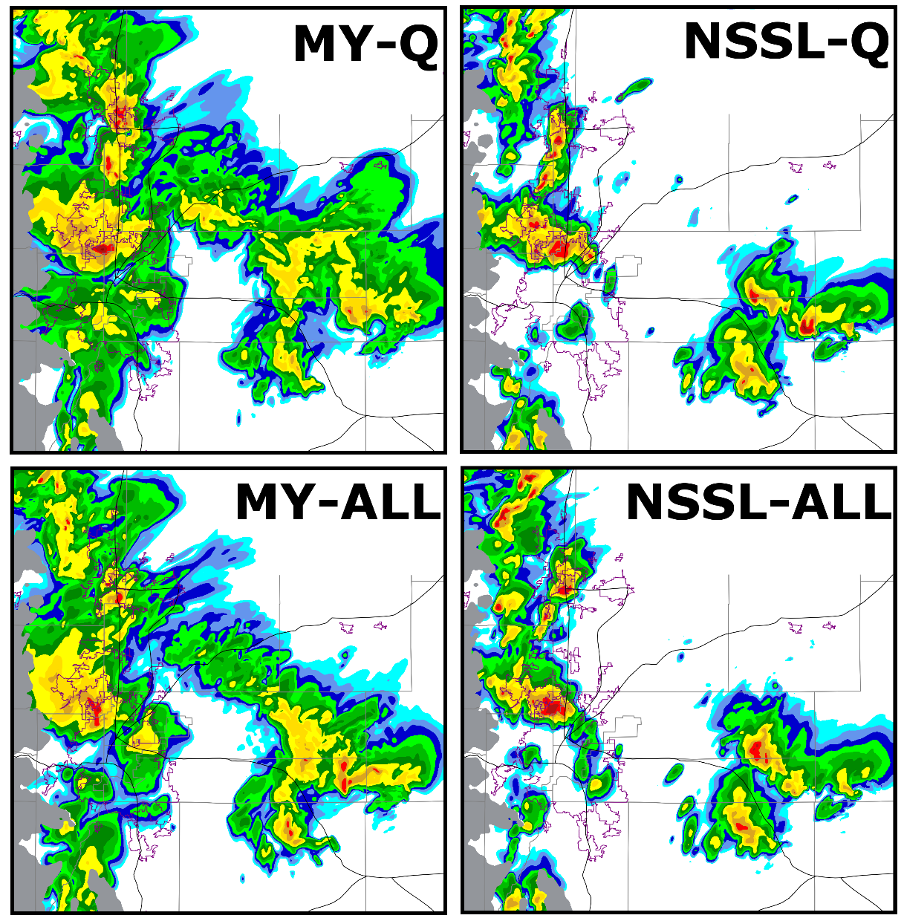
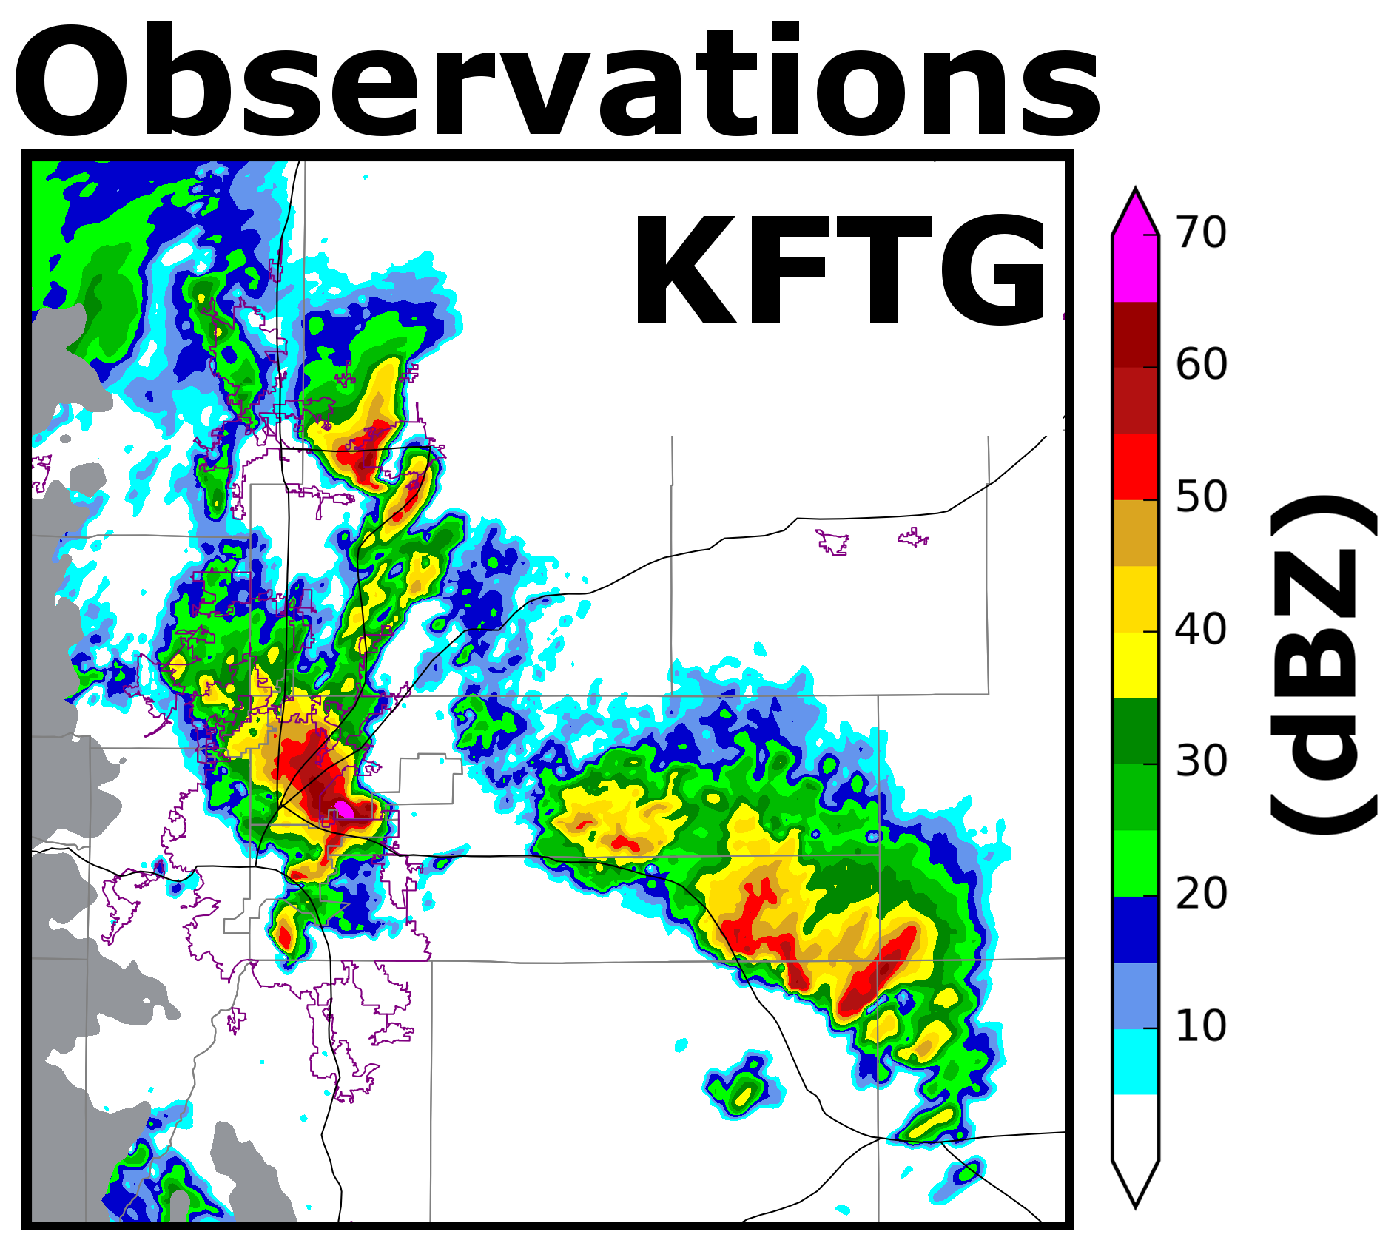
Forecast Reflectivity 2140 UTC

Slide 18
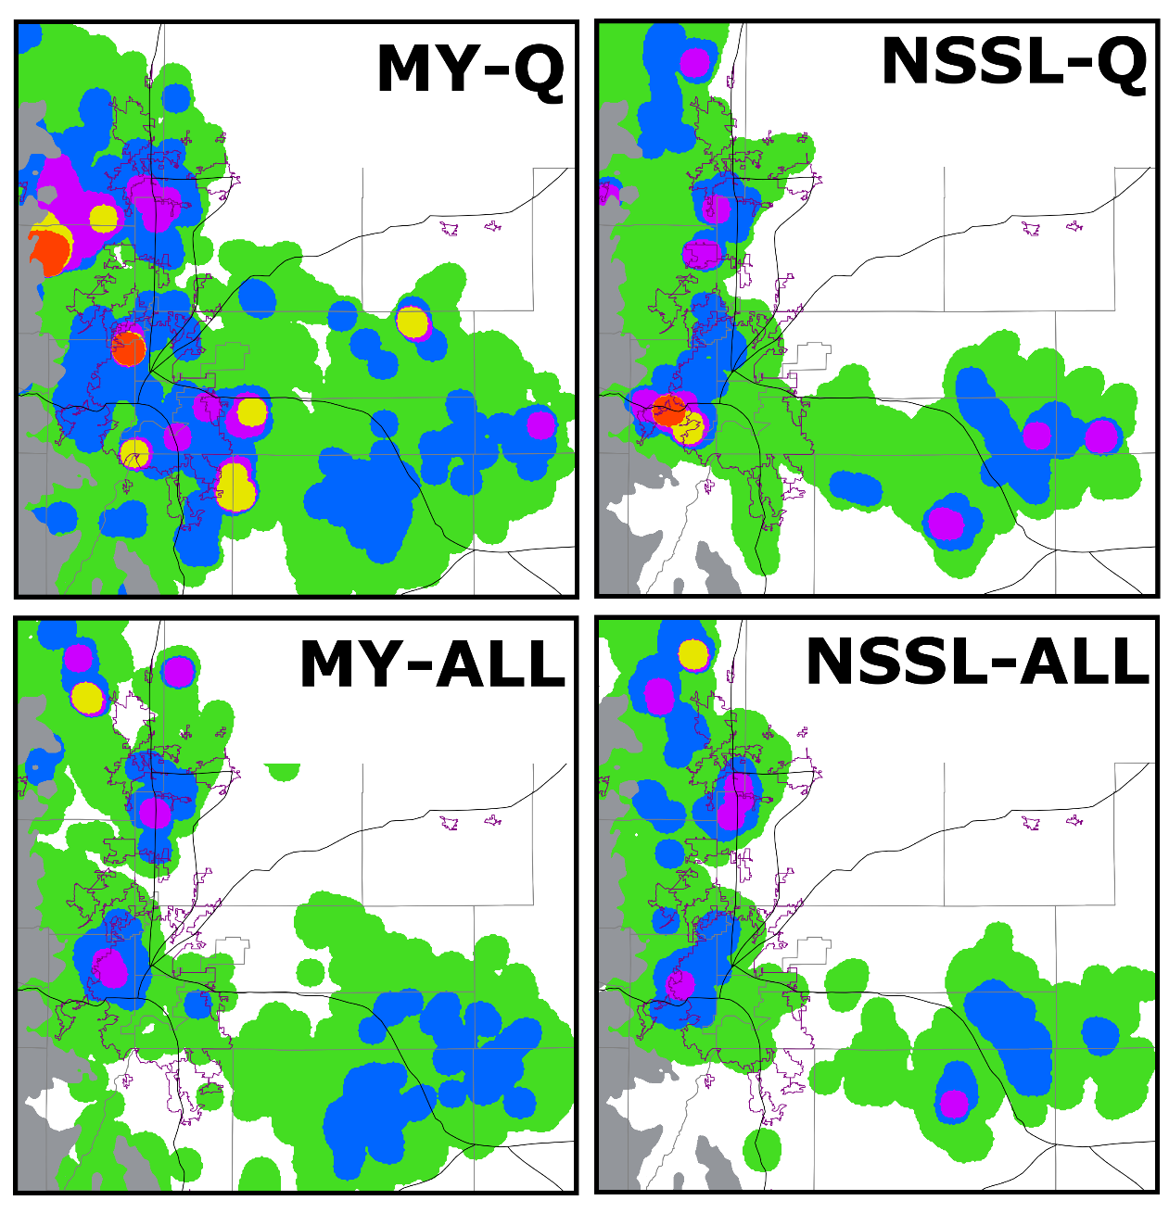
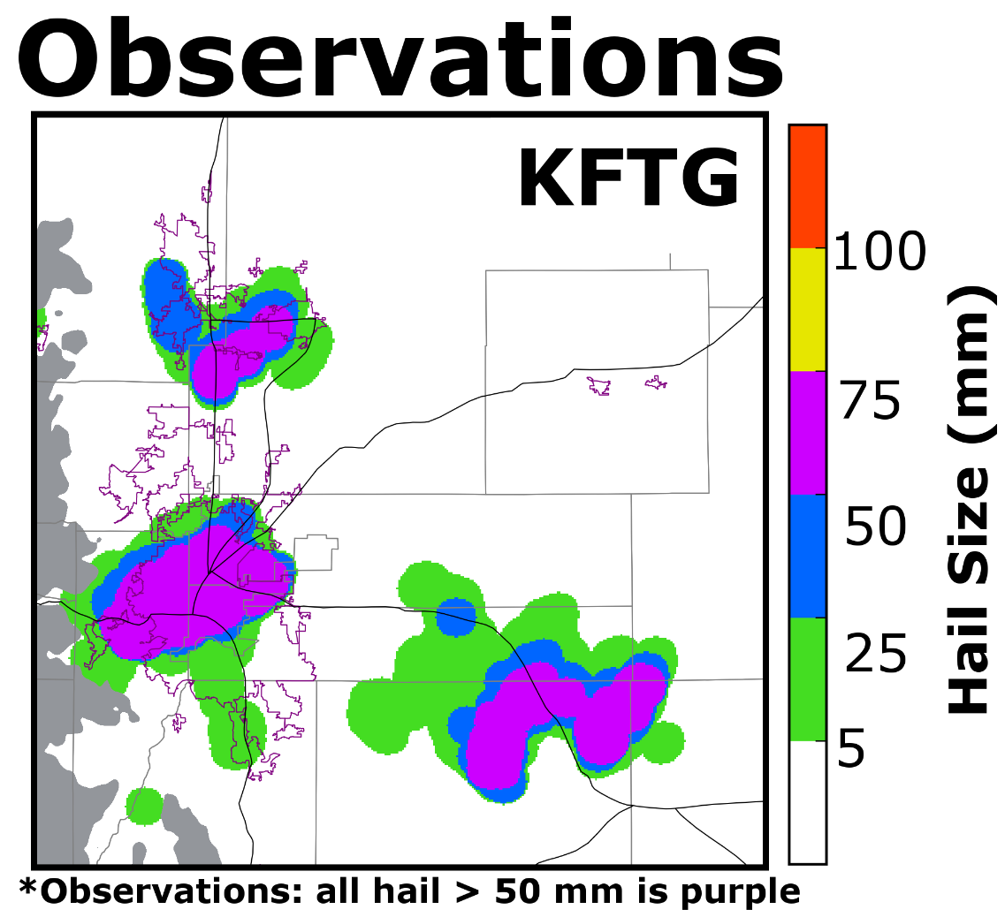
Maximum Hail Size Forecast 2040 – 2140 UTC

Slide 19
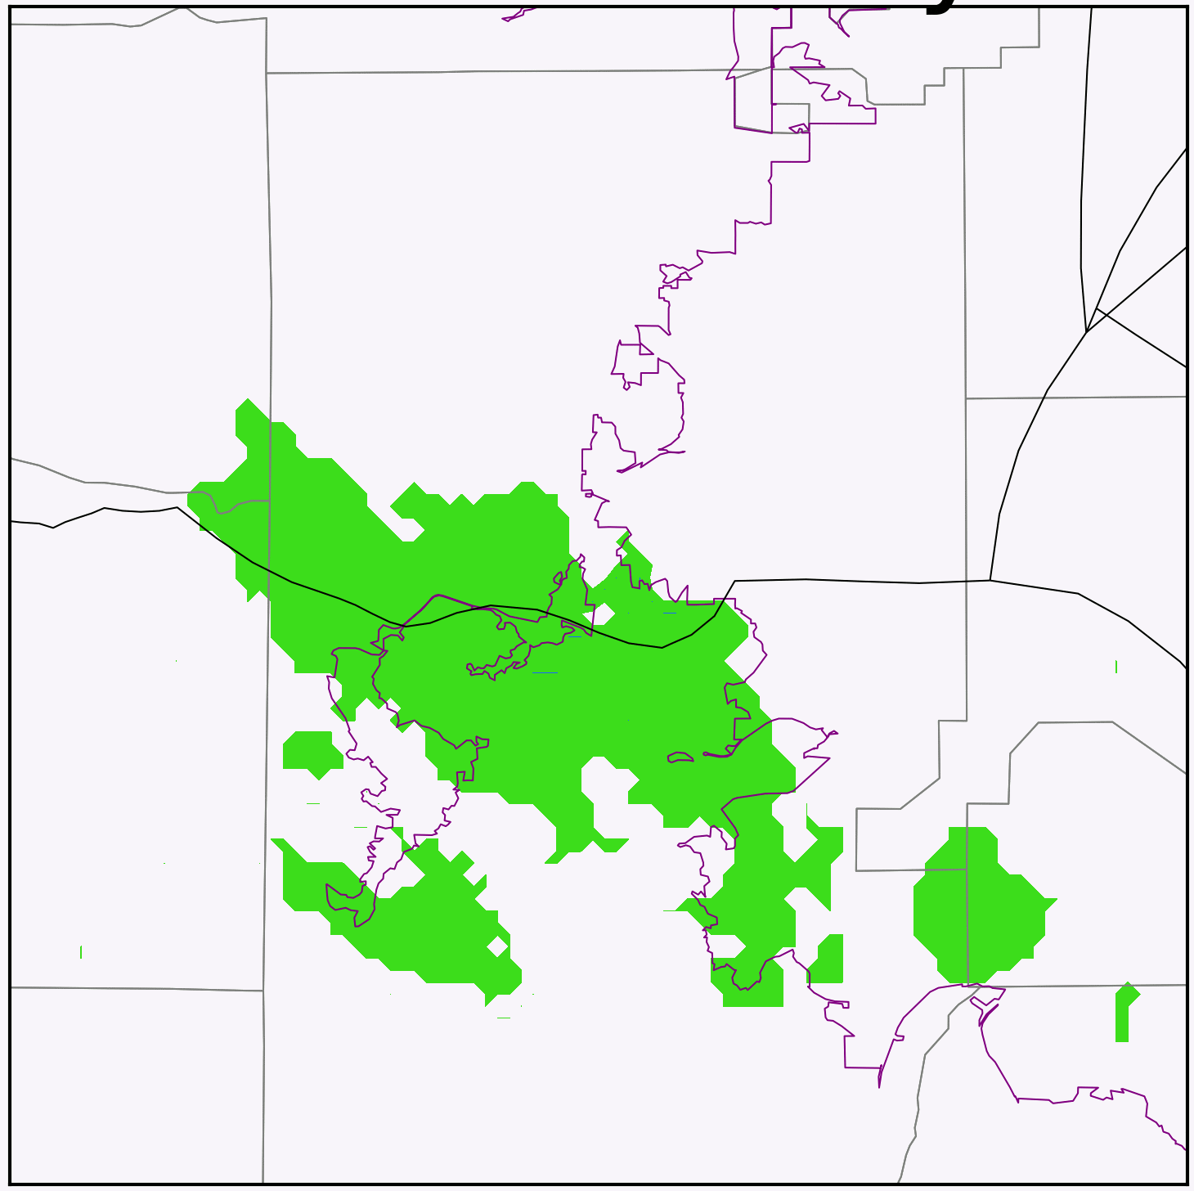
Predicting Hail Size
Updating only q_{x} causes large hail initially
Large hail falls out of storm within 5 minutes of analysis
Updating all variables initially decreases hail size
DA increases N_{th}, shrink hail size
NSSL-Q
Hail Size (mm)
NSSL-ALL

Slide 20
Conclusions
EnKF retrieves all microphysical variables relatively well
Update all microphysical variables during DA to improve microphysical state
Choice of BMP scheme is an important to consider for DA
Choice of BMP scheme impacts how microphysical and thermodynamic fields are updated
Unrealistic microphysical behaviors can degrade the analysis
NSSL BMP scheme is the optimal for this case study
Produces discrete, hail producing storms

Slide 21
Acknowledgments
Daniel Dawson – Implementing MY and NSSL schemes in ARPS
Kevin Thomas – Data management
Timothy Supinie – ARPS development and support
Bryan Putnam – EnKF support
Amy McGovern – Computing support
Questions? Email: j.labriola@ou.edu
This work is supported by the National Science Foundation (AGS-1261776). Any opinions, findings, conclusions, or recommendations expressed in this material are those of the authors and do not necessarily reflect those of the National Science Foundation

