Slide 1
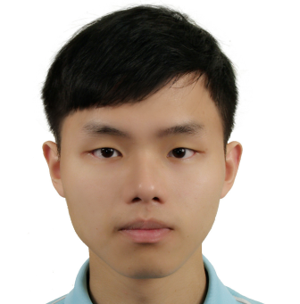



Impact of Assimilating Temperature and Humidity Information with Radar Data at Convective Scale:
An Observing System Simulation Experiments
Kao-Shen Chung, Ching-Yin Ke, Li-Hsin Chen
Acknowledgement: Profs. Yu-Chieng Liou & Shu-Chih Yang
Dept. of Atmospheric Sciences
National Central University
8th EnKF workshop, Montreal, QC, Canada
7 May – 10 May, 2018

Slide 2
Outline
Motivation
Examination of background error at convective scale
3. Results of OSSEs
(a)Analysis (B) Short-term forecast
4. Summary

Slide 3
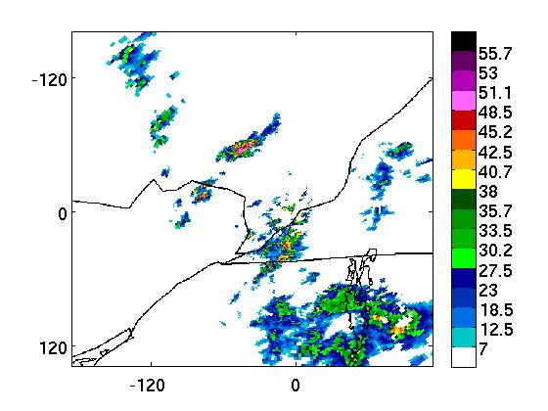
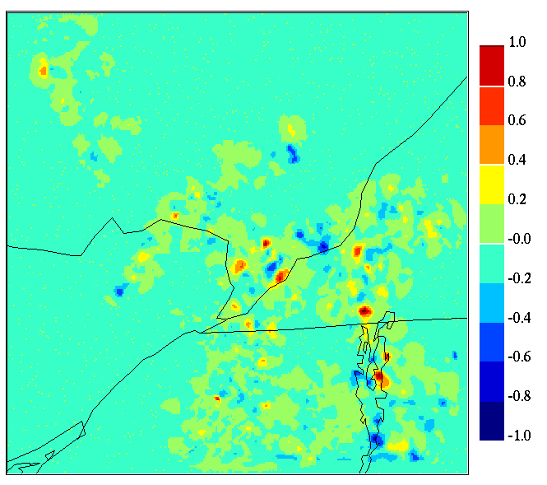
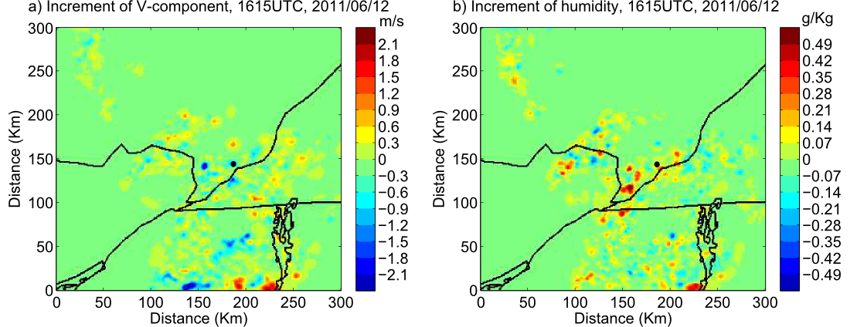
By using Canadian HREnKF and assimilating Vr from single Doppler radar
It is able to propagate information to other control variables.
Localized convection on June 12, 2011
(Chang et al. 2014 M.W.R.)
Obs Z
Temperature
V-wind
Humidity

Slide 4
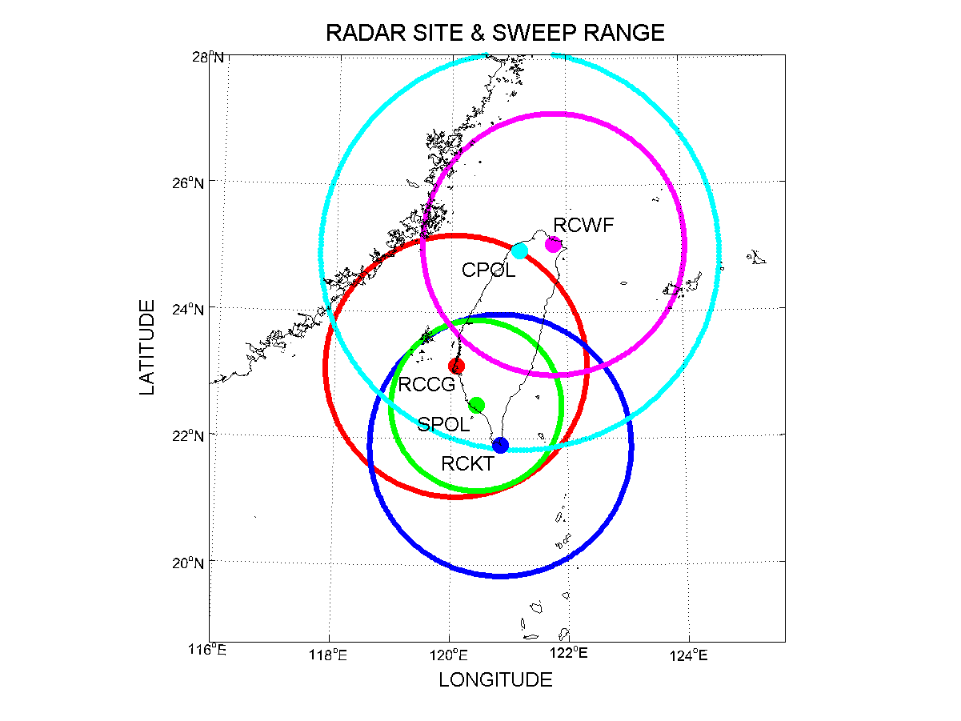
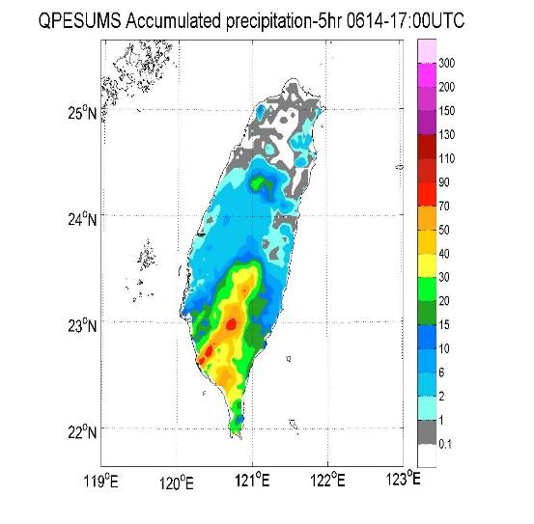
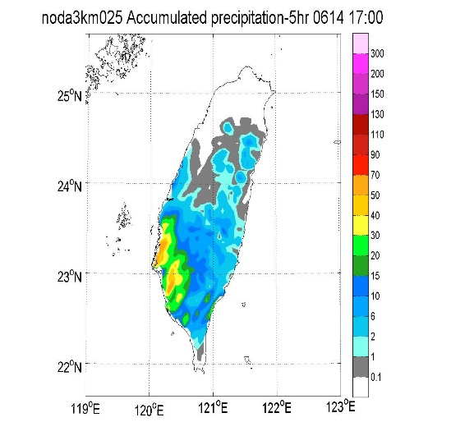
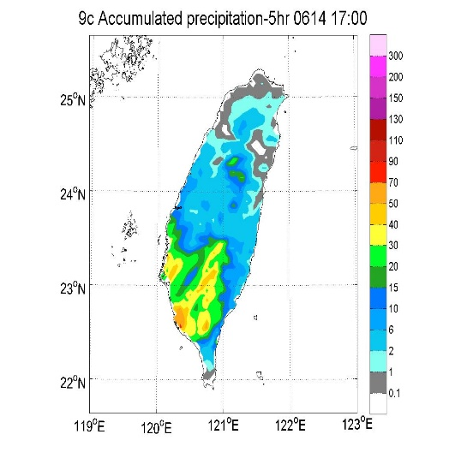
Assimilating observations of radar network in Taiwan [3-km]
WRF-LETKF Radar Assimilation System
WLRAS (Tsai et al 2014)
Assimilating both radial wind and reflectivity
Case study on 2008/06/14-15 SoWMEX
IOP8 (MCS)
~400km
QPF(0-5 hr accumulated precipitation)
observation
No DA
2-hr DA window
[Motivation]
1. By assimilating radial wind and reflectivity of radar network ,
why we still need more than 1-h assimilation window to improve QPF?
2. Are we able to reduce the cycling procedure for convective scale QPF?

Slide 5
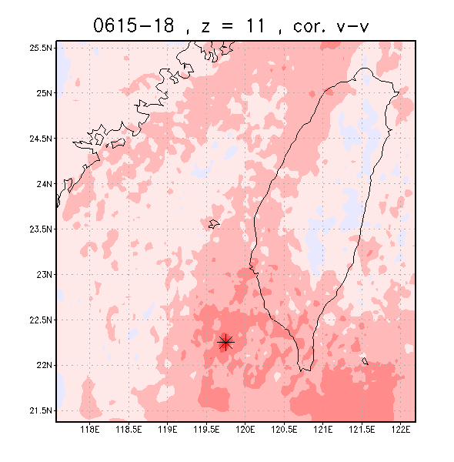
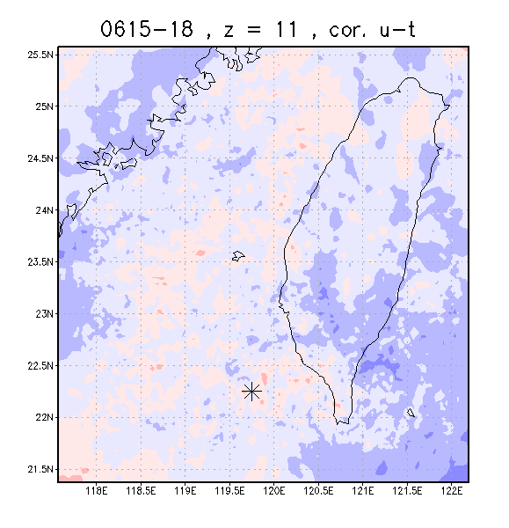
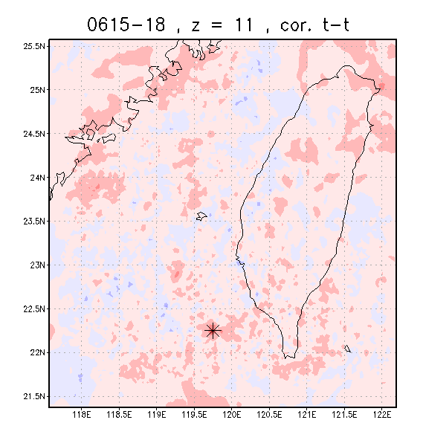
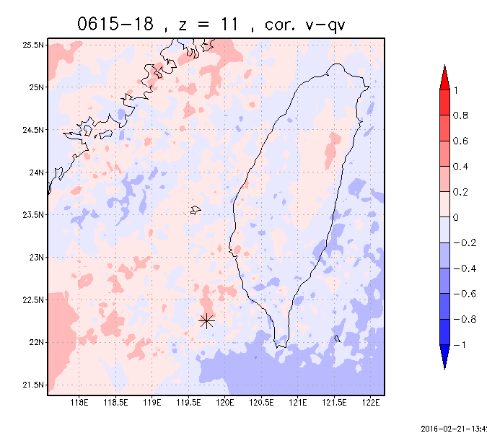
2. Examination of background error at convective scale
Convective scale error correlation (3-km resolution, ~700mb)
V-V
V-qv
T-T
U-T
Compared to Temperature, Wind has longer correlation length.
Less strong / very local correlations between state variables at convective scale

Slide 6
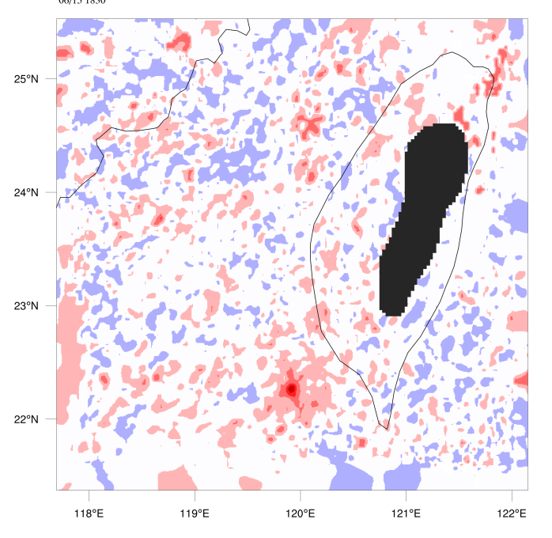
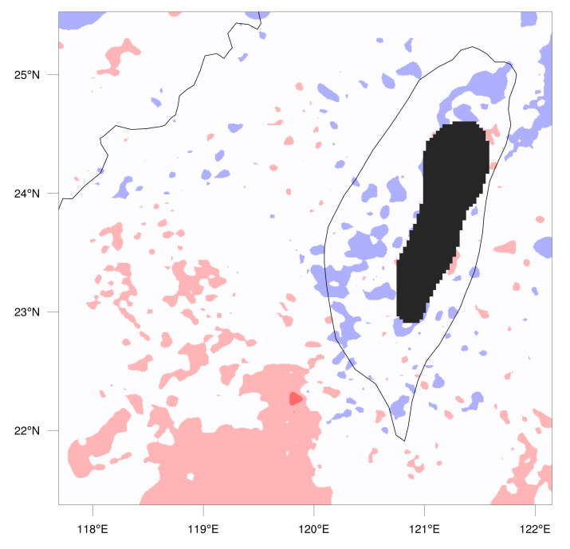
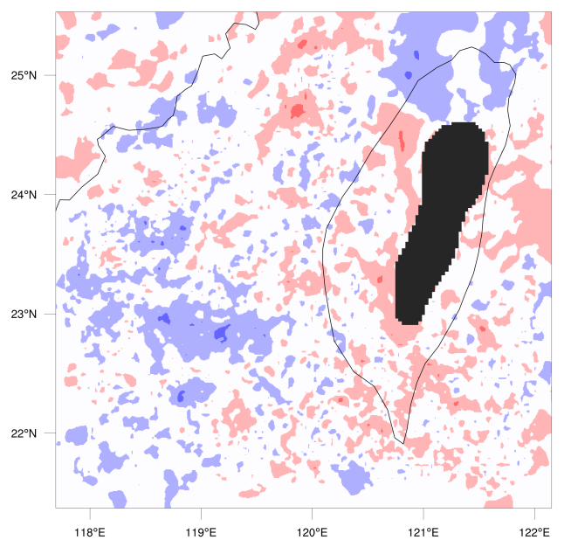
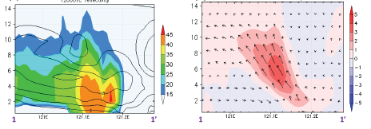
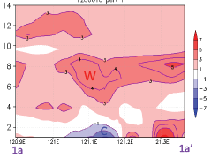
qr-qr auto-correlation
qr-U cross-correlation
qr-T cross-correlation
Explain why we may need
many cycles in radar DA to
obtain better analysis even
though with Radar network
Vr <-> u, v, w
Z <-> q_{r} , q_{s} , q_{g}
Z
Vr
T ??

Slide 7
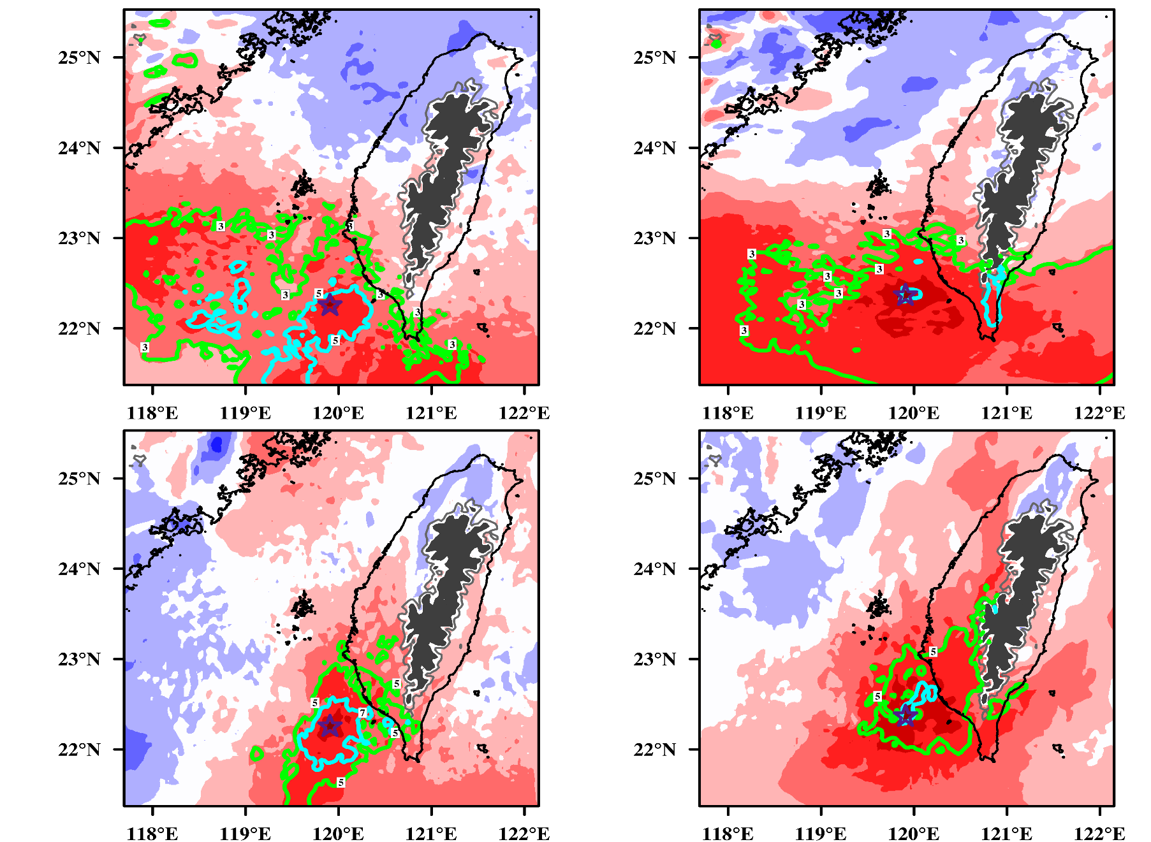
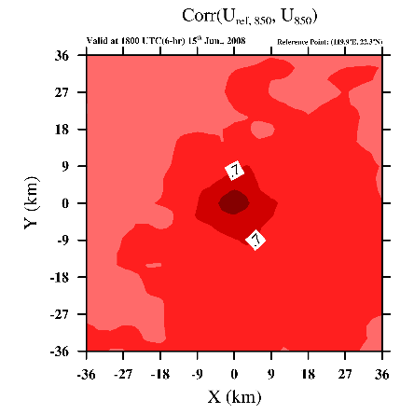
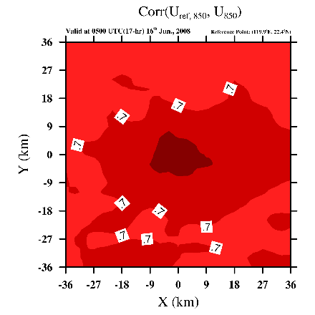
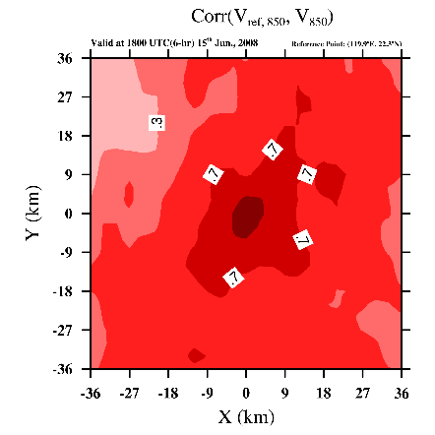
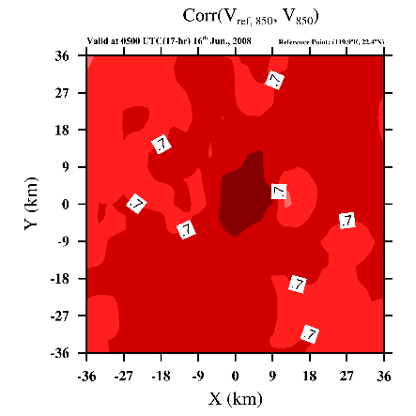
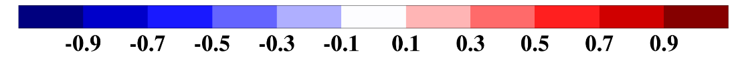
Convective
Error covariance at convective scale (I)
Stratiform
(a) Ucon-U
(b) Ustr-U
(c) Vcon-V
(d) Vstr-V

Slide 8
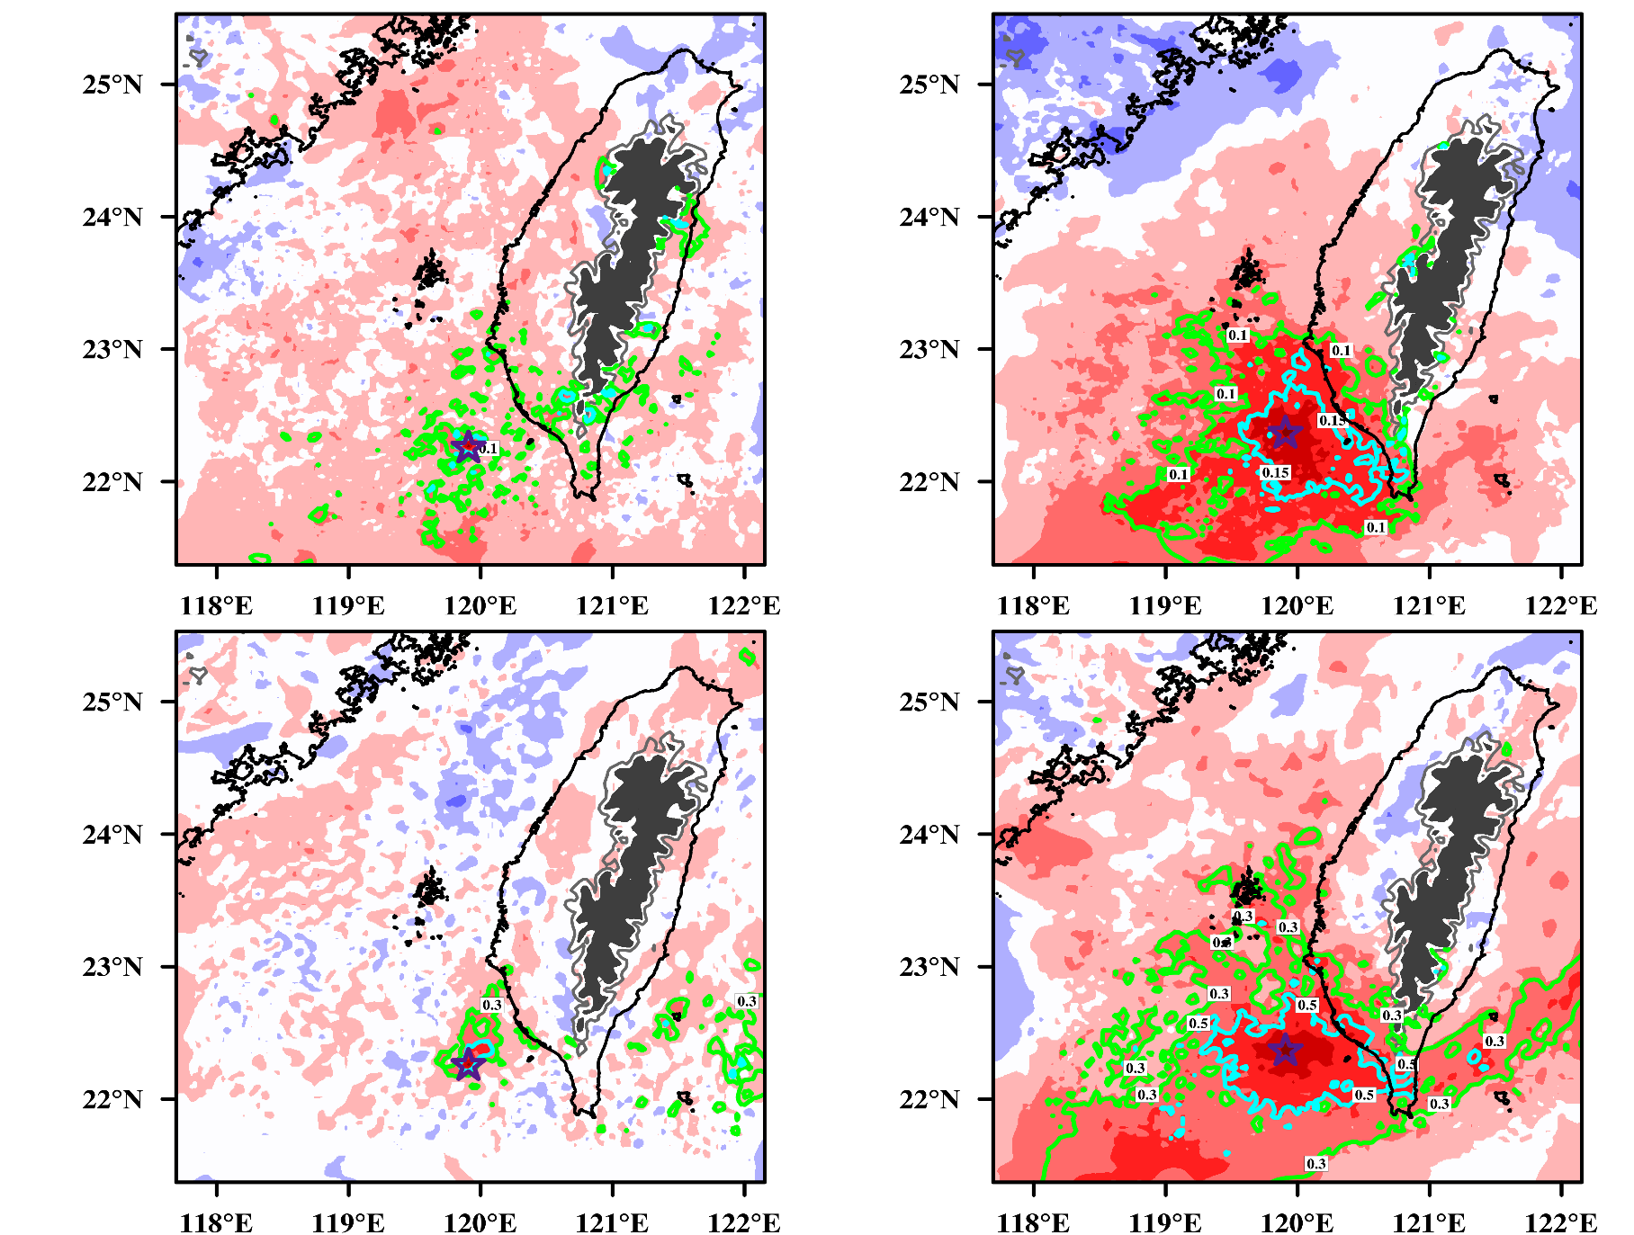
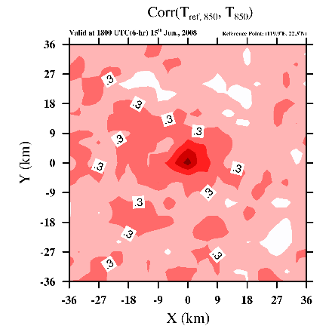
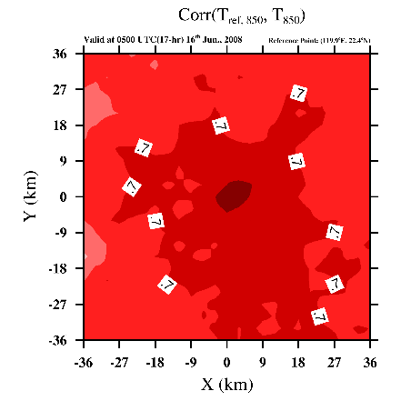
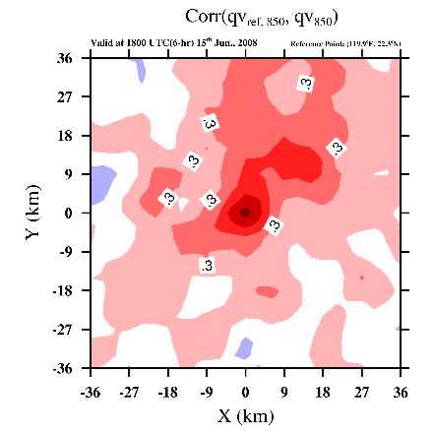
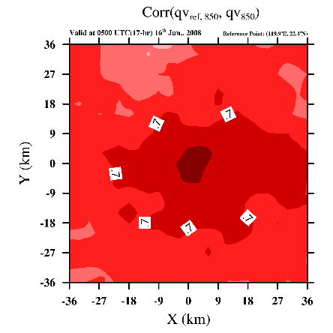
Convective
Error covariance at convective scale (II)
Stratiform
(a) Tcon-T
(b) Tstr-T
(c) qcon-q
(d) qstr-q

Slide 9
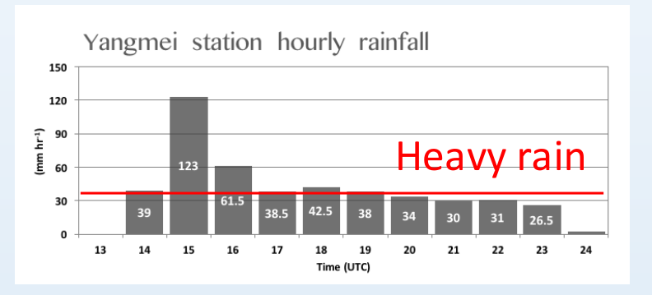
3. Impact Of Assimilating Temperature and Humidity
Are we able to reduce cycling procedure of DA at convective scale?
Setup of the OSSEs
WRF-LETKF Radar Assimilation System (WLRAS; Tsai et al., 2014)
Case study: Mesoscale convective system in Mei-Yu season on
11 June 2012
Radar sites: RCWF and NCU-CPOL
Extreme heavy rainfall
~130km

Slide 10
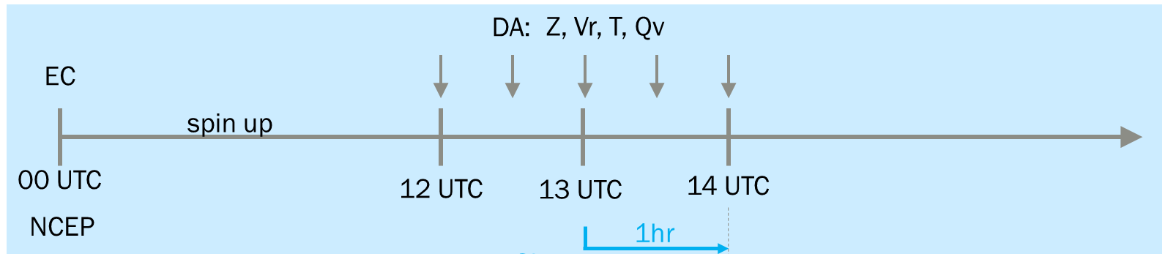
Experimental settings
Truth Run: I.C. and B.C. from EC-reanalysis (0611 0000UTC)
Background and DA Exps. : I.C. and B.C. from NCEP(0611 0000 UTC)
DA period : 1hour,every 15min
Observations : Reflectivity, Radial wind, Temperature, Water Vapor
Observation error : Z(3 dBZ), Vr(1 m/s), T(0.5K), Qv(0.5 g/kg)
Member size: 40 members
Experiments | Observation | Assimilation period (h)
NoDA | - | -
ZVr | Vr, Z | 1
ZVrT | Vr, Z, T | 1
ZVrQv | Vr, Z, Qv | 1
ZVrTQv | Vr, Z, T, Qv | 1
Forecast for 3-h

Slide 11
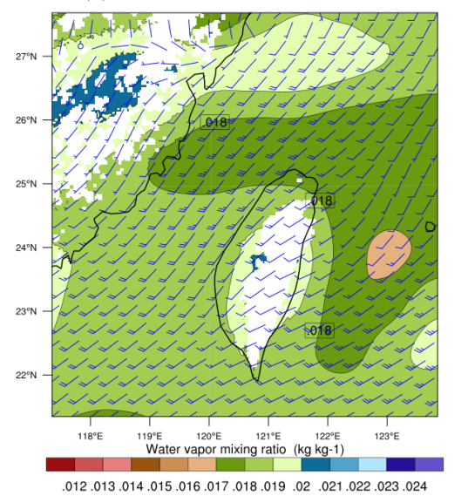
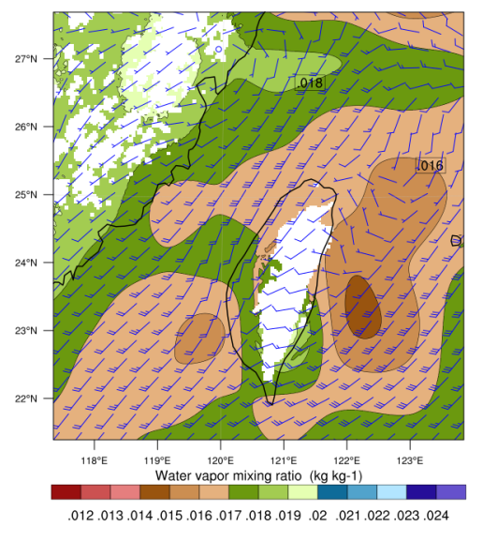
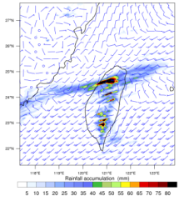
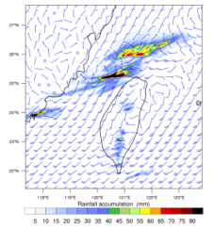
EC (truth)
NCEP (NoDA)
Humidity
wetter
drier
False alarm
Precipitation
Position error

Slide 12
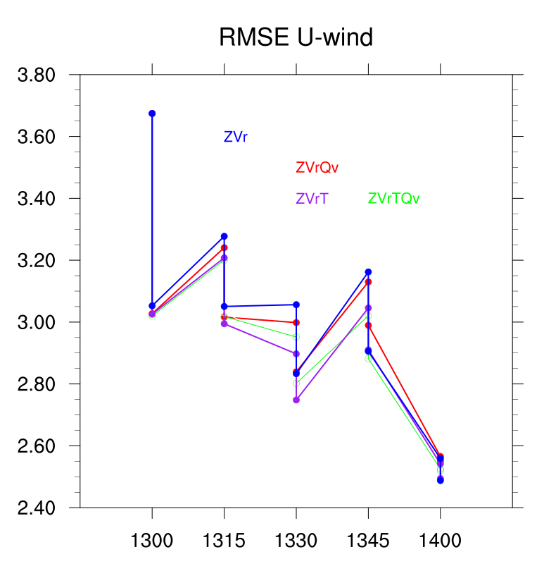
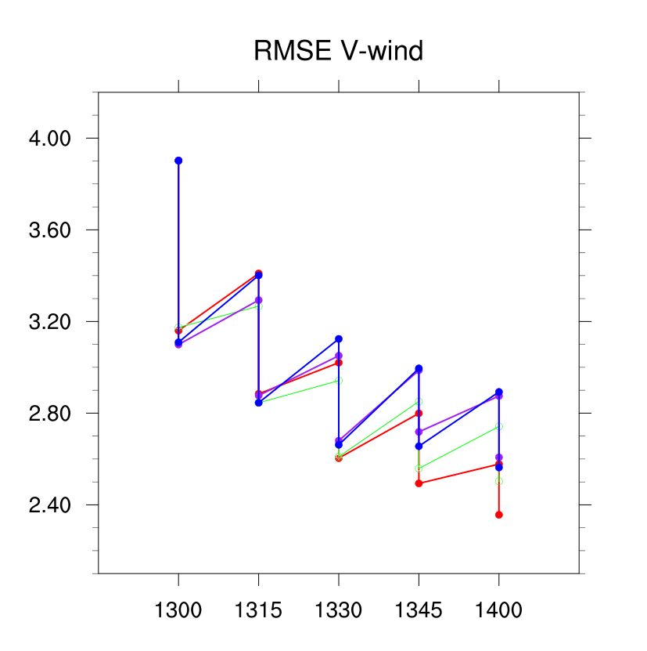
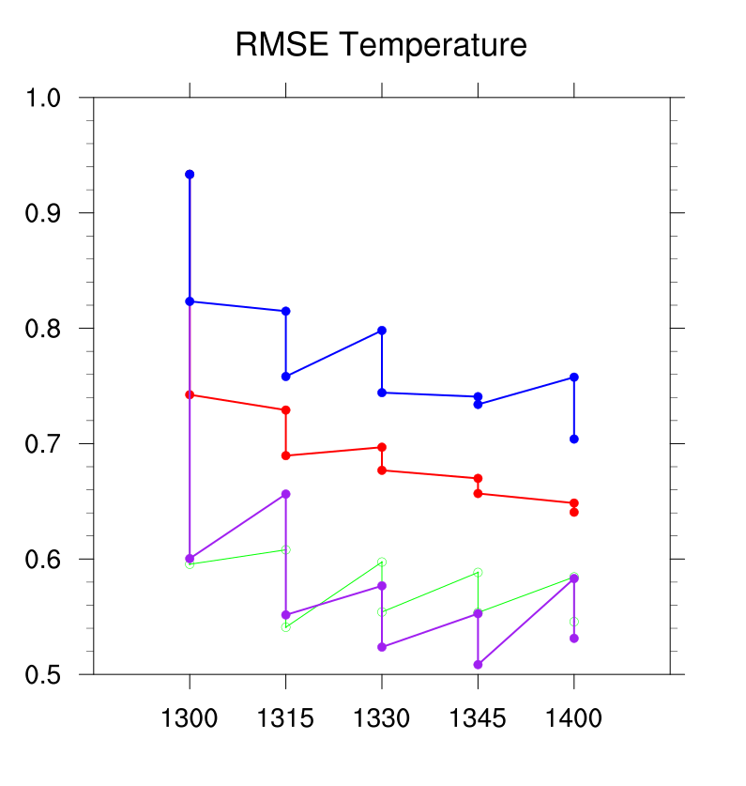
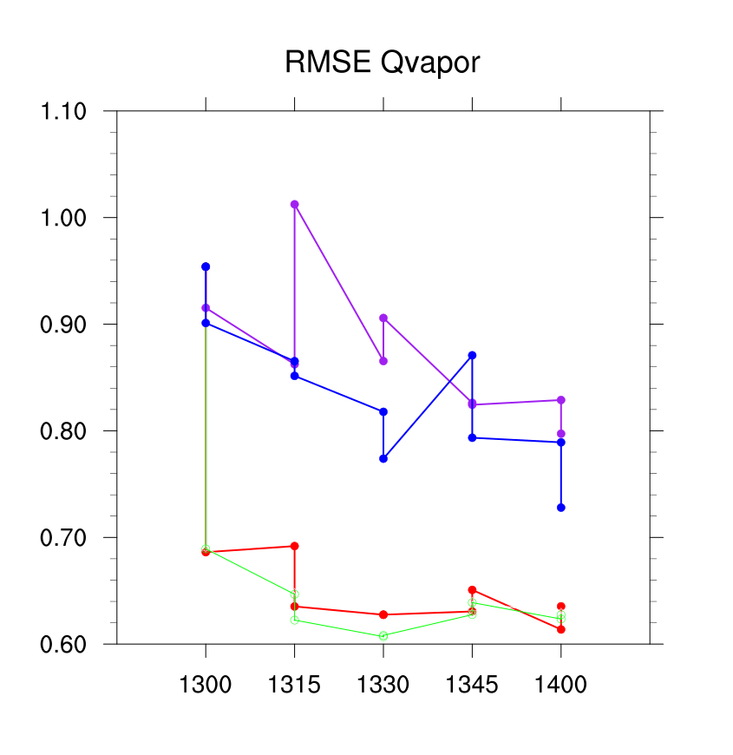
RMSE of A and P during 1-h assimilation cycles
- ZVr
- ZVrT
- ZVrQv
- ZVrTQv
Minor differences:
Assimilating Vr
Major differences

Slide 13
Convergence at 850mb
Dynamics (convergence):
Radar data (Z, Vr) is able to correct the position error.
Longer assimilation period (2-hr) captures better convergence line.
Exps. ZVrT and ZVrQv correct position error in shorter assimilation cycles.

Slide 14
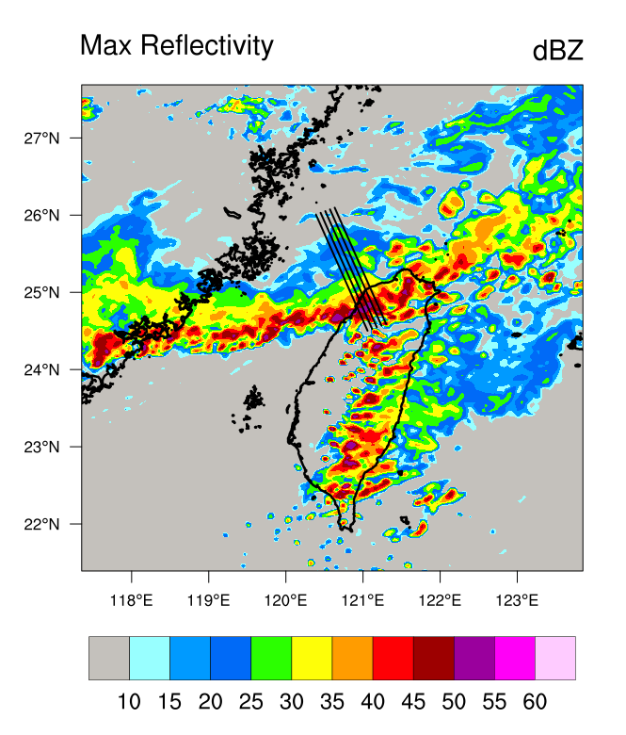
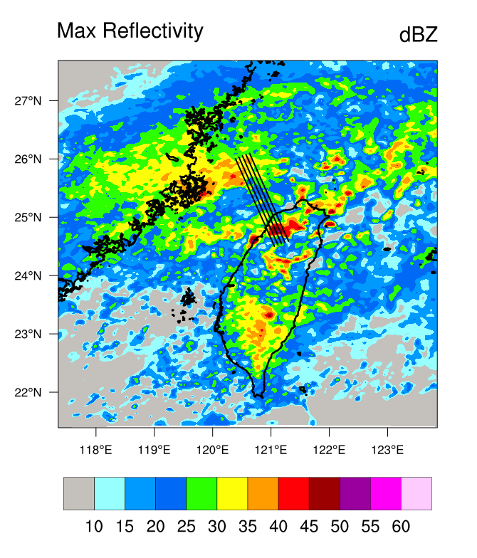
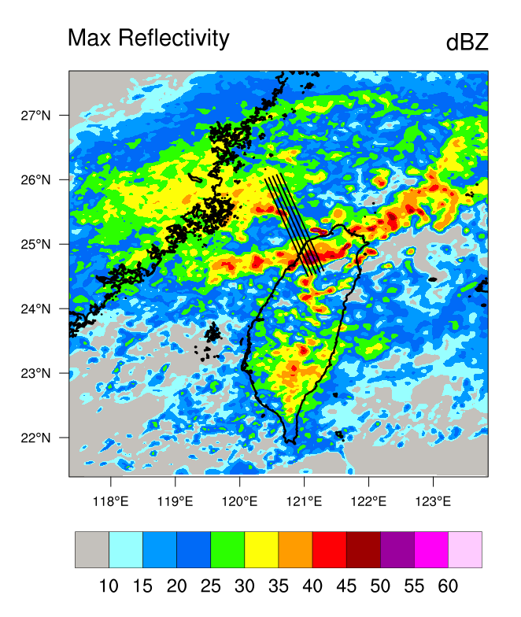
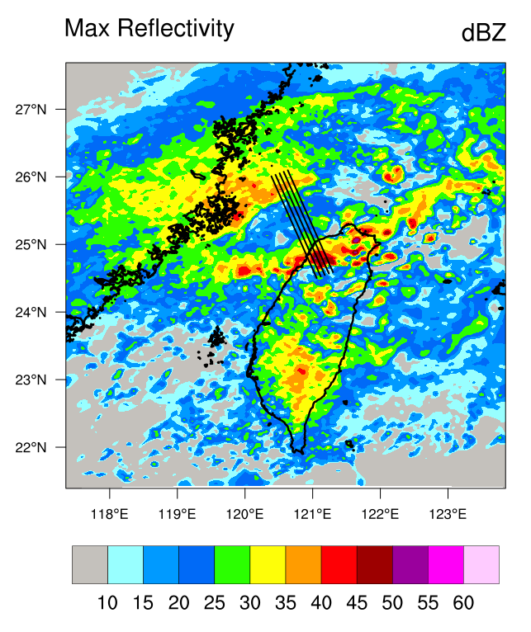
Truth
Analysis -
VrZ
Analysis -
VrZT
Analysis -
VrZ2h

Slide 15
Vertical structure of temperature and W
Thermodyancmis (T & W):
All Experiments show better results in the convective region.
Results of Exp. ZVrT and ZVrQv show better vertical structure both in temperature and vertical velocity in the stratiform area.

Slide 16
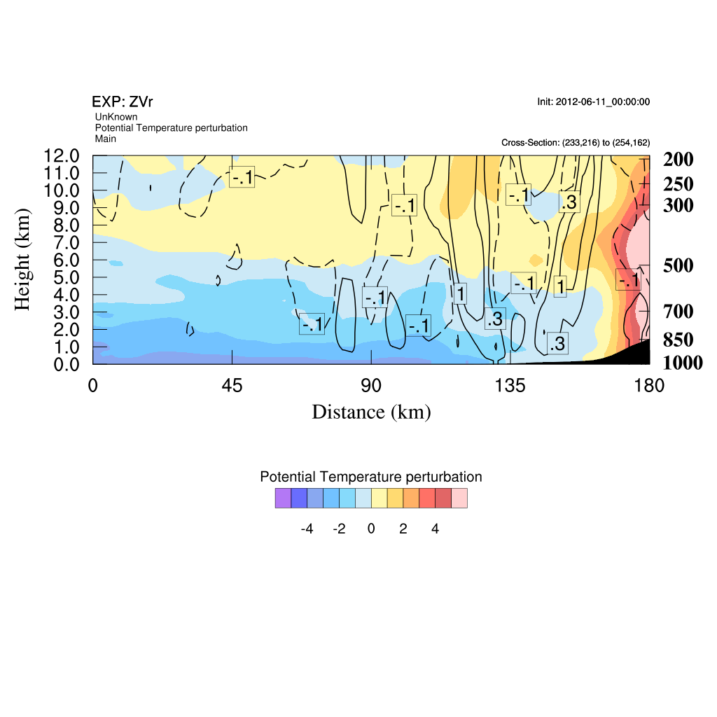
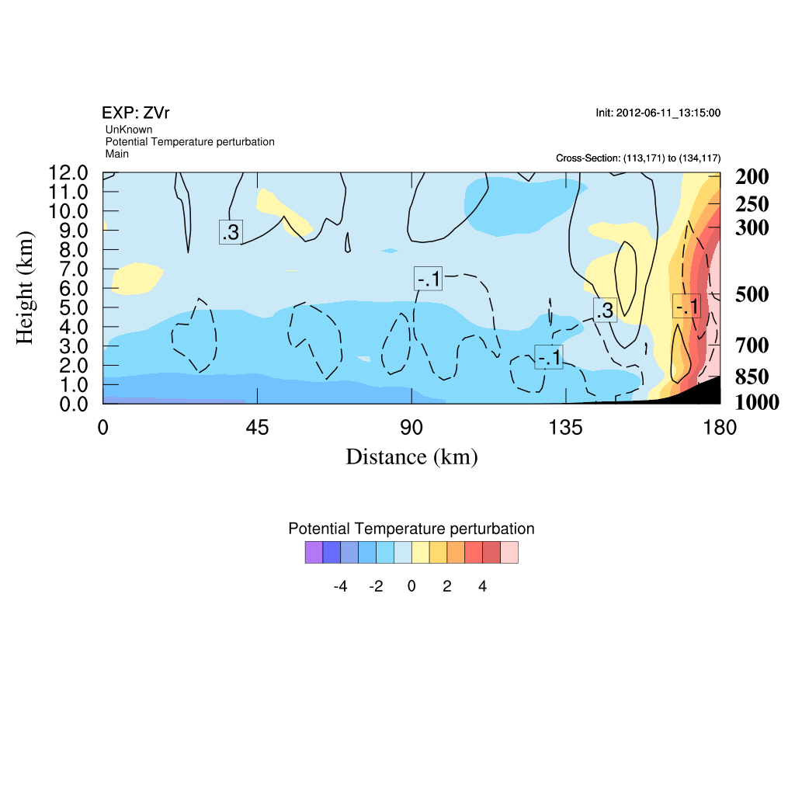
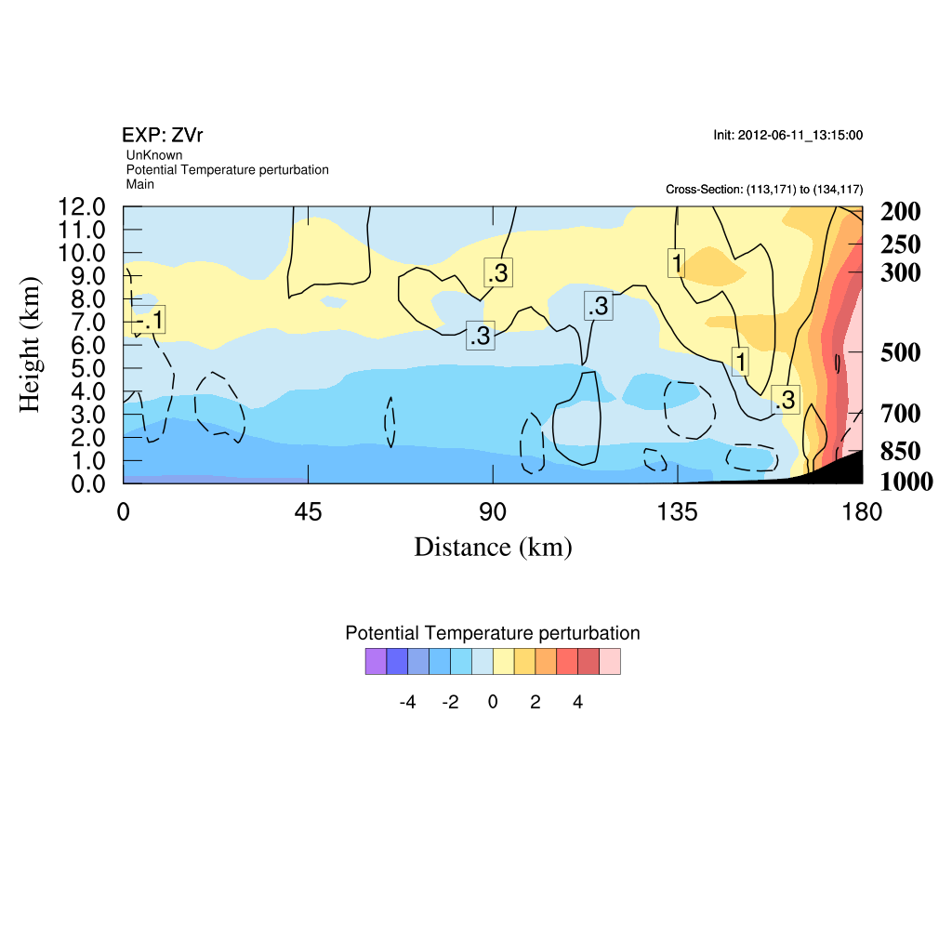
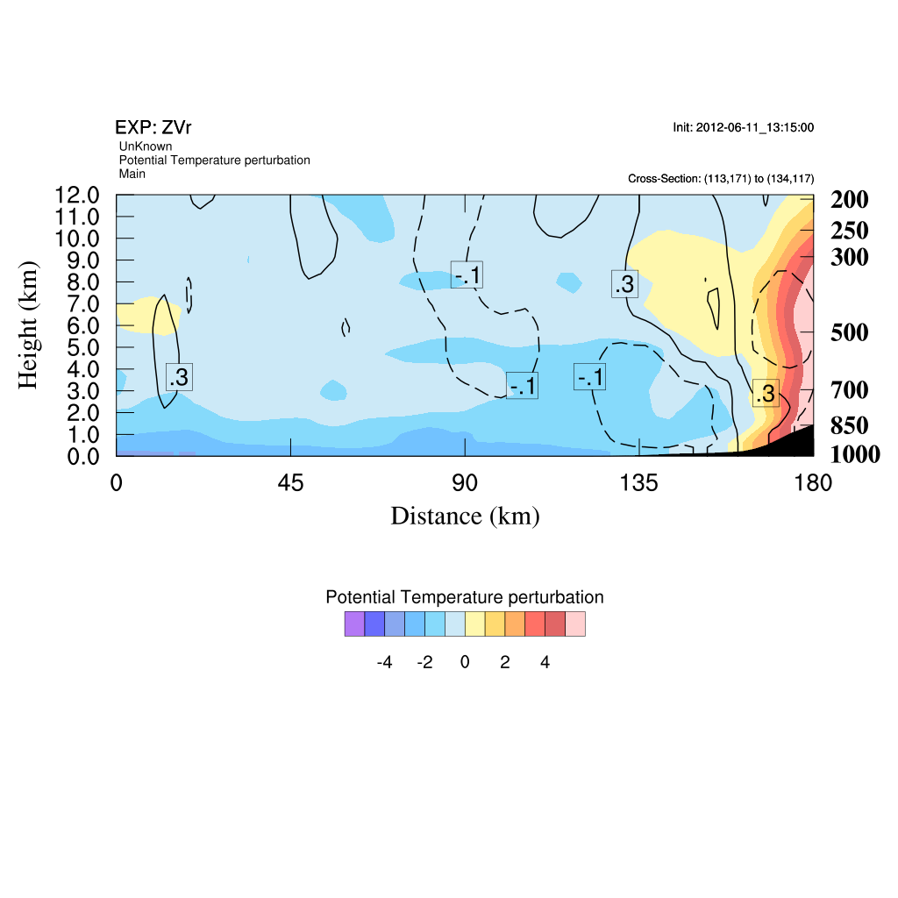
Analysis at 3rd cycle-
VrZ
Truth at 1330 UTC
Analysis at 3rd cycle-
VrZT
Analysis at 3rd cycle-
VrZ2h

Slide 17
Results of short-term forecast(3-h accumulated rainfall)
NoDA shows the problem of position error in model simulation all the time.
ZVrT and ZVrQv improve the rainfall location and intensity even better than ZVr and ZVr2h.

Slide 18
4. Summary
The examination of background errors at convective scale shows
1) less strong or very localized correlation between state variables
→ it explains why we need many cycles with radar network
2) error covariance has different structures at convective and
stratiform area for state variables
Results of OSSEs show that
1) one is able to reduce the cycling procedure and obtain better
analysis if it is able to assimilate temperature or humidity;
2) To correct position error of precipitation: assimilating radial wind
and reflectivity may not be enough.
→ Info. of temperature or humidity is needed at convective scale;
3) To improve the QPF for longer time: information of humidity is
the key.
How to obtain the info ?
Retrieval from satellite (GPS-RO, etc) and radar refractivity &
scanning mesoscale radiometer (Humidity)

