Slide 1


A brief review of recent progress of GSI EnVar for convective scale radar data assimilation and Ensemble-based targeted observation technique applied to MPAR (Multi-function Phase Array Radar) data
Xuguang Wang, Yongming Wang, Jeff Duda, Chris Kerr
Multi-scale data Assimilation and Predictability (MAP) Laboratory
School of Meteorology, University of Oklahoma, Norman, OK
Jacob Carley (NCEP), David Dowell (ESRL), Lou Wicker (NSSL)
8th EnKF workshop, May 7-10, 2018, Montreal, CA

Slide 2


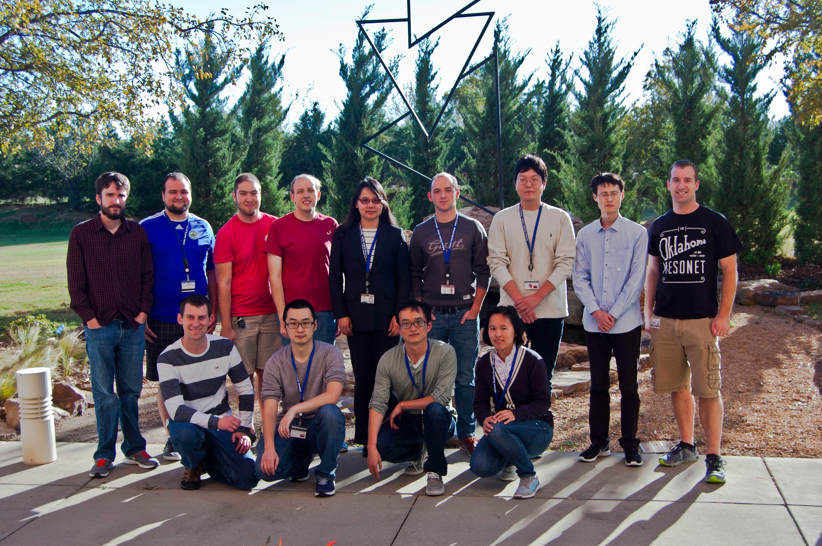
MAP Lab DA research and development
DA algorithm and system development
Global
MAP
Lab
Hurricane
Convective scale
R2O

Slide 3
MAP Lab DA research and development
DA algorithm and system development
GSI 3DEnVar:
Wang, Parrish, Kleist, Whitaker, 2013, MWR
GSI 4DEnVar:
Wang and Lei, 2014, MWR
GSI 3DEnVar and 4DEnVar became operational for US GFS since 2012 and 2016 respectively
Cost effective valid time shifting method to increase ensemble size in GSI EnVar:
Huang and Wang 2018, MWR
High rank ETKF (Huang Monday talk)
Multi-resolution/Multi-scale EnVar (Wed. Talk)
Global
MAP
Lab
Hurricane
Convective scale
R2O

Slide 4
MAP Lab DA research and development
DA algorithm and system development
Developed fully cycled GSI EnVar DA system for US operational convection allowing hurricane prediction system HWRF in collaboration with NOAA
Lu, Wang, Tong and Tallapragada, 2017, MWR
Lu, Wang, Li, Tong, Ma, 2016, QJRMS
The hybrid DA system for HWRF based on this became operational at NWS summer 2017
Improve the assimilation and study the impact of variety in-situ/remote sensing inner core observations (Lu and Wang 2018a)
Reveal model physics errors (Lu and Wang 2018b)
Understanding TC rapid intensification process (RI) (Feng and Wang 2018, Lyu and Wang 2018)
Global
MAP
Lab
Hurricane
Convective scale
R2O

Slide 5
MAP Lab DA research and development
DA algorithm and system development
Develop a new algorithm to assimilate radar reflectivity directly for the GSI EnVar (Wang and Wang 2017, MWR)
Implement direct radar assimilation for HRRR, NAM-CONUS, WoF contexts (Johnson et al. 2015, Wang and Wang 2017, Wang et al. 2018, Duda et al. 2018)
Understand the impact of using sub-kilometer analysis to initialize NWP model on tornadic supercell surface vorticity evolution prediction (Wang and Wang 2018)
Understand nocturnal convection (Chilpiski et al. 2018, Degelia et al. 2018)
Convective scale targeted observations (2nd half of this talk)
Global
MAP
Lab
Hurricane
Convective scale
R2O

Slide 6

PART I

Slide 7
GSI-based EnKF/EnVar DA system further developed for various US convection-allowing prediction systems with direct radar DA capability
Add direct radar DA capability
GSI-based Var/EnKF/3/4DEnVar/ Hybrid
WoF (<=1hr)
e.g. tornadic supercell
HRRR (<=18h)
Updated hourly
NAM CONUS (<=60h)
Updated 6-hourly
GSI: US operational data assimilation system
WoF: Warn on Forecast
HRRR: High Resolution Rapid Refresh
NAM CONUS: North American Mesoscale Forecast system - Continental US
In collaboration with NOAA EMC (Carley), GSD (Dowell) and NSSL (Wicker) colleagues

Slide 8
GSI-based EnKF/EnVar DA system further developed for various CONUS convection allowing prediction systems with direct radar DA capability
EnKF
Wang Y. et al. 2018
EnVar
Both the GSI EnKF and GSI EnVar components are extended
Instead of using the coarser resolution global ensemble in EnVar like the operational HRRR, the new EnVar system ingests convection allowing model’s own EnKF ensemble.

Slide 9
GSI-based EnKF/EnVar DA system further developed for various CONUS convection allowing prediction systems with direct radar DA capability
Direct radar (Vr and dBZ) DA capability is developed for GSI EnKF and GSI EnVar
Radial velocity and reflectivity observation operators are implemented.
The hydrometeor-related prognostic variables (rainwater, snow, graupel mixing ratios) are added as state variables.
The vertical velocity are added as state variables.
Direct reflectivity assimilation capability is developed (Wang and Wang 2017, MWR) as opposed to using the operational Cloud Analysis (CA) method, which is a separate and empirical approach.

Slide 10

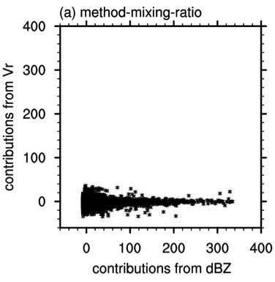
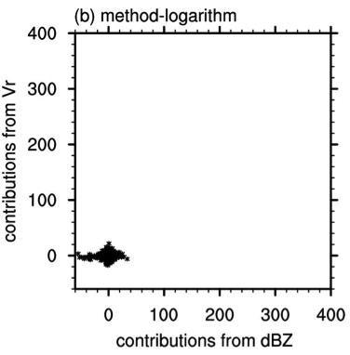
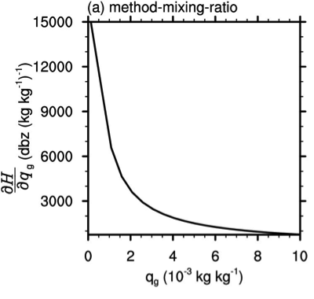
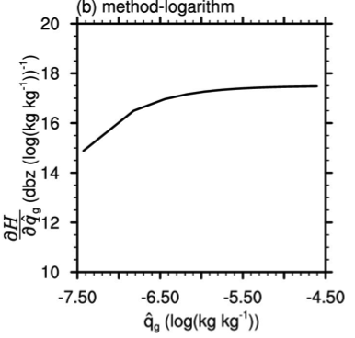
Issue with TL of nonlinear reflectivity operator in EnVar
Wang Y. and X. Wang 2017, MWR, 145, 1447-1471
When hydrometeor mixing ratio is used as state variables, large values of TL of the nonlinear reflectivity associated with the small hydrometeor mixing ratios lead to large differences of cost function gradients, which prevents efficient convergence and therefore under-estimates the hydrometeor increments.
This issue disallows simultaneous assimilation of Vr and Ref.
Using logarithm of hydrometeor mixing ratio as state variable fixes this issue, but incurs additional issues.

Slide 11
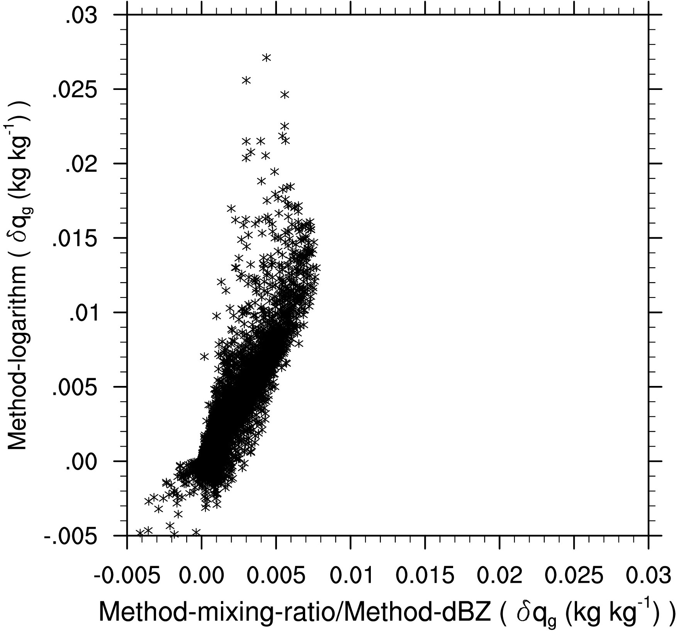
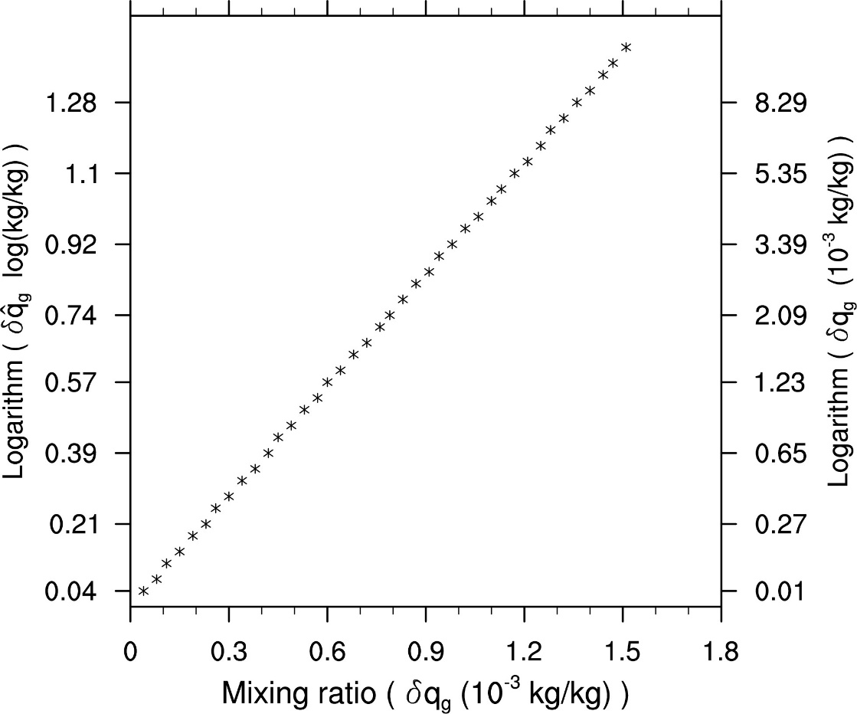
Issue with TL of nonlinear reflectivity operator in EnVar
Wang and Wang 2017, MWR
Use logarithm of hydrometeor mixing ratio as state variable
However, it produces anomalously large hydrometeor increment partly due to the transform to and from the logarithmic space
Ad hoc thresholding may help, however solution is fundamentally incorrect.

Slide 12
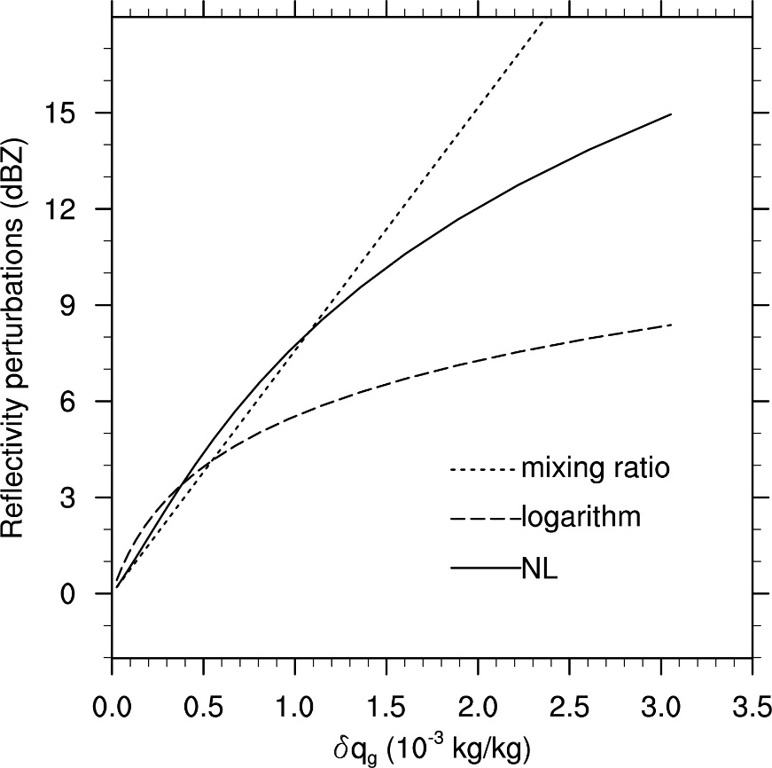
Issue with TL of nonlinear reflectivity operator in EnVar
Wang and Wang 2017, MWR
The underestimation and overestimation of hydrometeor increments are exacerbated by the TL assumption of the nonlinear reflectivity operator itself.

Slide 13
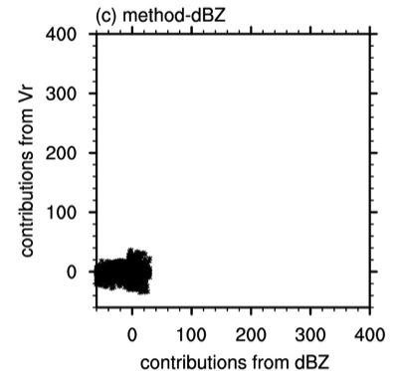
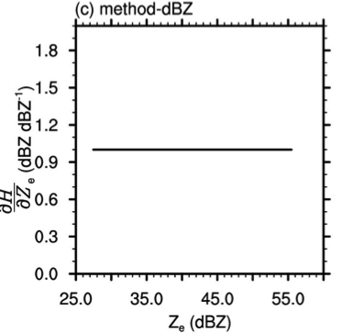
GSI-based EnVar without tangent linear (TL) and adjoint of the nonlinear reflectivity operator
Wang and Wang 2017, MWR
A new method extending state variables by directly including reflectivity as state variable is proposed:
No reflectivity operator appears in cost function or
Gradient issues fixed
In this method, no TL of the reflectivity operator exists . Hydrometeor is related to reflectivity following the nonlinear relationship.

Slide 14
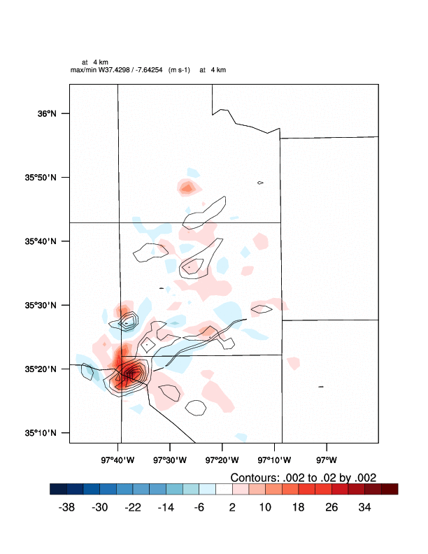
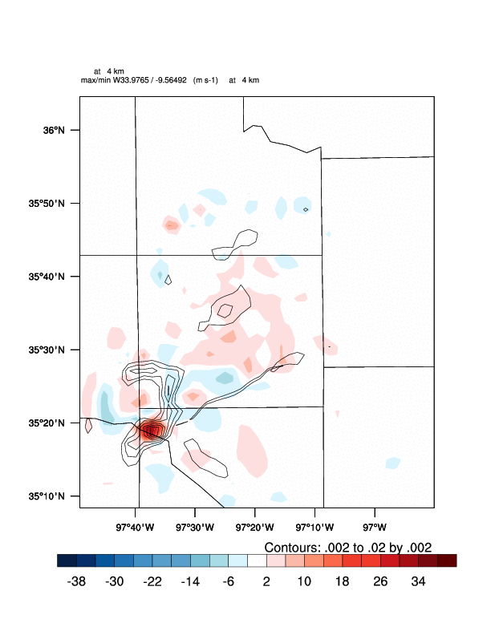
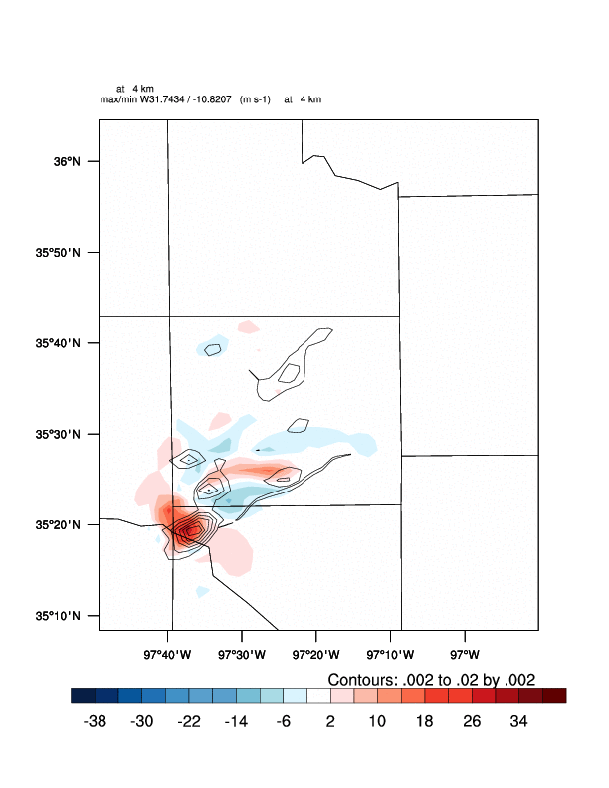
1 hour forecast of May 8th 2003 OKC tornadic supercell: w and vorticity at 4km
Wang and Wang 2017, MWR
New: extend state variable with reflectivity
Use log transform (q_hydrometeor) as state variable
Use
q_hydrometeor as state variable
New:
m/s
m/s
m/s

Slide 15
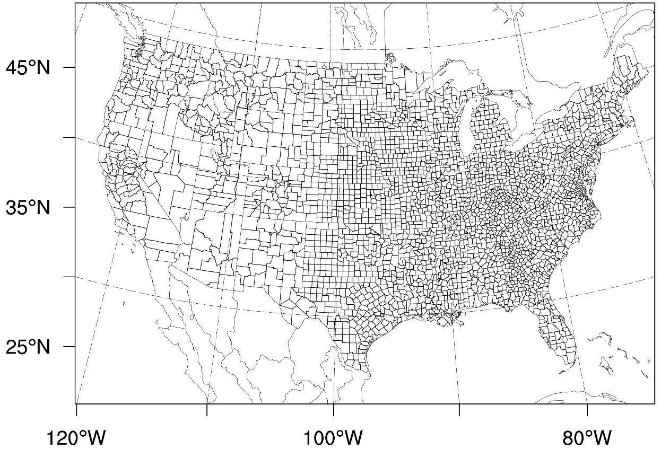
Implementation and experiment in operational HRRR/NAM CONUS contexts
Wang Y. et al. 2018, MWR
Domain:
Resolution: 3 km
Grid: 1621 X 1121 X 50
Large CONUS domain in operational HRRR context
Observations:
Conventional obs. are assimilated hourly for 6 hours
Radar data are assimilated sub-hourly/hourly
IC and LBC ensemble are provided by recentering GEFS (20) and SREF (20) perturbations to GFS-ctl

Slide 16
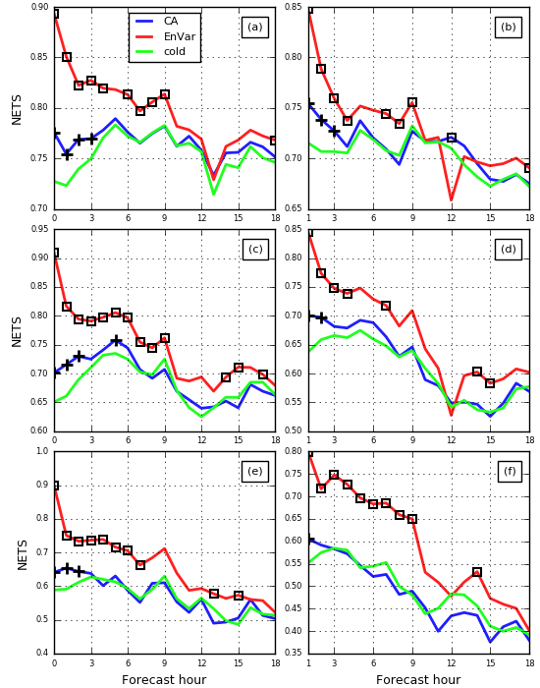
GSI-EnVar direct reflectivity assimilation vs cloud analysis (CA)
Duda, Wang, Wang, Carley, 2018a, MWR
EnVar overall verifies much better than CA.
CA does provide some benefit over not assimilating radar reflectivity at all, however, but only a few hours’ worth.
20dBz
0.254mm
30dBz
2.54mm
40dBz
12.7mm
NETS – neighborhood version of ETS using 50 km circular radius

Slide 17
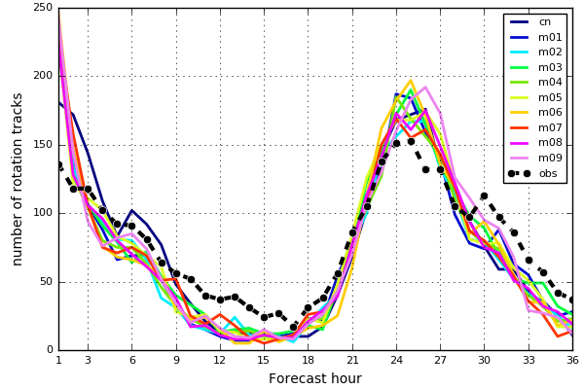
OU MAP 2017 HWT real time CONUS DA and ensemble
Duda, Wang, Wang, Carley, 2018b, MWR
New verification: Object based verification of rotation tracks
1-hr rotation tracks
OBS: MRMS RotationTrackML60min product (3-6 km AGL maximum azimuthal shear from Doppler velocity, measured in 10⁻³ s⁻¹), integrated over the past hour
FCST: hourly-maximum UH
Diurnal cycles of the number of rotation tracks verified well.
More tracks than observed at early lead times
Number of rotation tracks

Slide 18
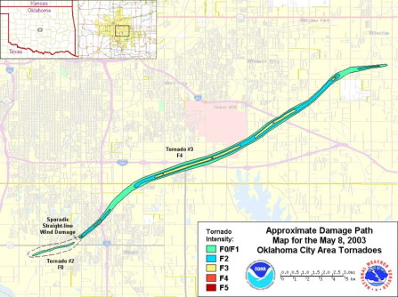
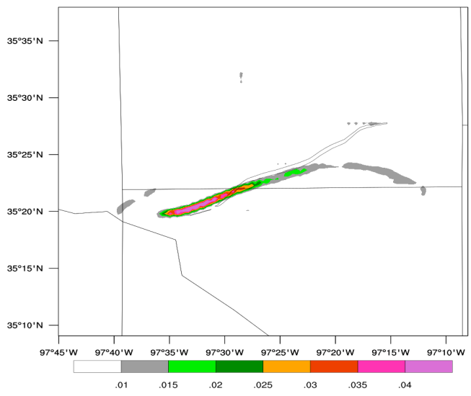
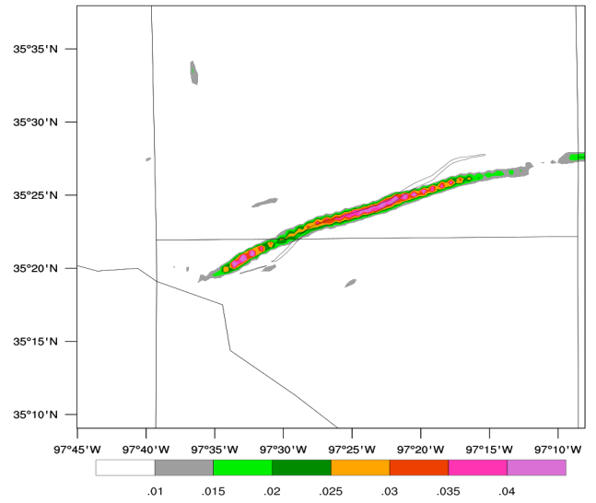
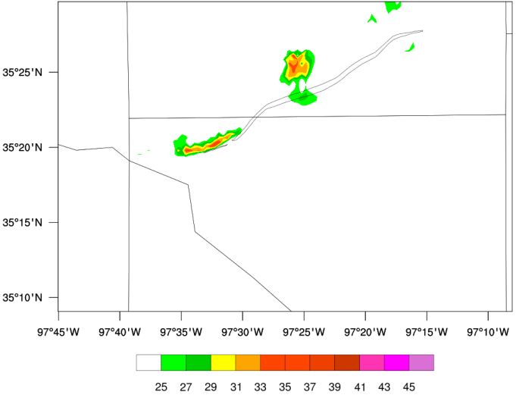
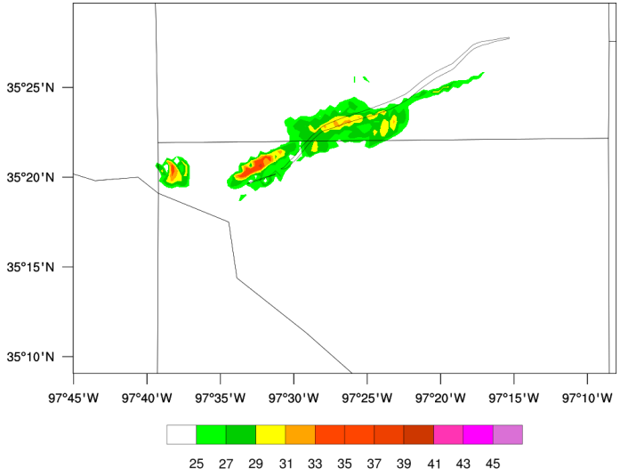

500m resolution analysis produced by dual resolution GSI EnVar improved sfc vorticity and 10-m wind for May 8th 2003 OKC tornadic supercell
Wang Y. et al. 2008
SR_2km
DR_500m
$≥$F2
Sfc
vorticity
F0/F1
Vorticity begins to decay at this time
The predicted vorticity is enhanced after 20-min forecast in DR. Its vorticity evolution is much more consistent with the reality than SR_2km.
DR is able to predict tornado strength sfc wind with longer duration and greater intensity (≥ EF1).
s⁻¹
SR_2km
DR_500m
10-m wind
U_{h} max=36.6 m/s (EF0)
U_{h} max=41.4 m/s (EF1)
m/s
EF0 ≥29 m/s
EF1 ≥38.4 m/s

Slide 19
PART II
Kerr and Wang 2018

Slide 20
Multi-function PAR and targeted observations
https://www.nssl.noaa.gov
Compared to the conventional, uniform scanning by WSR-88D radars, the flexibility inherent in MPAR enables “adaptive sampling” or alternatively termed as “targeted observations”
Convective scale targeting obs. pushes limit!

Slide 21
Background and Objectives
Targeted observation is the process of predicting the most optimal locations/strategy to observe before observations are collected and assimilated in real time in order to best improve a numerical forecast
Note this is different from traditional “data denial/addition” study through data assimilation.
optimal observation locations at t₁ estimated; targeting strategy determined
Desired time of observation collection and assimilation
Forecast time of interest
t₀
t₁
t₂
Criterion of optimal strategy at t1 determined at t0: If observations collected at t1 were assimilated, the optimal strategy would produce the largest error reduction for forecast valid at t2.

Slide 22
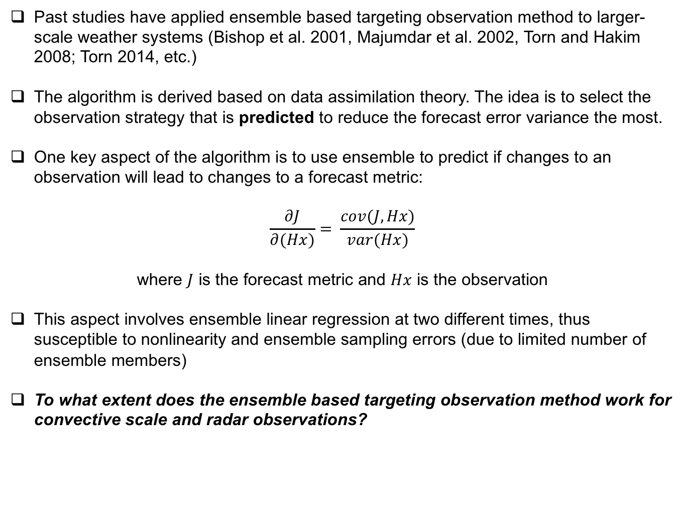
Background and Objectives
Past studies have applied ensemble based targeting observation method to larger-scale weather systems (Bishop et al. 2001, Majumdar et al. 2002, Torn and Hakim 2008; Torn 2014, etc.)
The algorithm is derived based on data assimilation theory. The idea is to select the observation strategy that is predicted to reduce the forecast error variance the most.
One key aspect of the algorithm is to use ensemble to predict if changes to an observation will lead to changes to a forecast metric:
$$\frac{∂J}{∂(Hx)}= \frac{cov(J,Hx)}{var(Hx)}$$
where $J$ is the forecast metric and $Hx$ is the observation
This aspect involves ensemble linear regression at two different times, thus susceptible to nonlinearity and ensemble sampling errors (due to limited number of ensemble members)
To what extent does the ensemble based targeting observation method work for convective scale and radar observations?

Slide 23
OSSE test-bed:
truth and synthetic obs.
An idealized splitting supercell thunderstorm is created using the Weather Research and Forecasting (WRF) model (Weisman and Klemp 1982; Skamarock et al. 2008)
2km horizontal grid spacing
Thompson et al. (2008) microphysics
Synthetic Doppler radial velocity and radar reflectivity observations are first harvested from this simulation every 5 minutes
Figure to right is simulation (“truth”) at 75 minutes
Radar location

Slide 24
OSSE test-bed: storm spin-up
EnKF approach is used for data assimilation. 50-member ensemble is created by perturbing the horizontal wind field of the truth run
Simulated doppler radial velocity and radar reflectivity observations are assimilated every 5 minutes for 75 minutes to allow sufficient storm spin-up
A free forecast is then initialized at 75 minutes; forecast metric of interest is 0-1 km updraft helicity (UH)
75 min (t0)
90 min (t1)
120 min (t2)
Testbed testing objectives

Slide 25
OSSE test-bed:
Three Scan Strategies
Would targeting algorithm be able to predict their impacts?
Full Volume
Low Level
Upper, maximum updraft intensity level

Slide 26
Actual Impact
Various sets of radar observations are assimilated independently before launching forecasts (partials and full volume)
Also independently assimilate observations at various times
Assess how the observations impact the forecasts at various lead times
Forecast time of interest (5 – 45 min. beyond t₁)
Single time of observation collection and assimilation (10-20 min. beyond 75 min.)
Forecast initialized
t0 (75 min.)
t₁
t₂

Slide 27
Actual Impact
This shows how various observation strategy affect the forecast metric, 0-1 km updraft helicity (“actual” error variance reduction)
Black: full scan
Blue: low levels
Green: max updraft intensity level

Slide 28
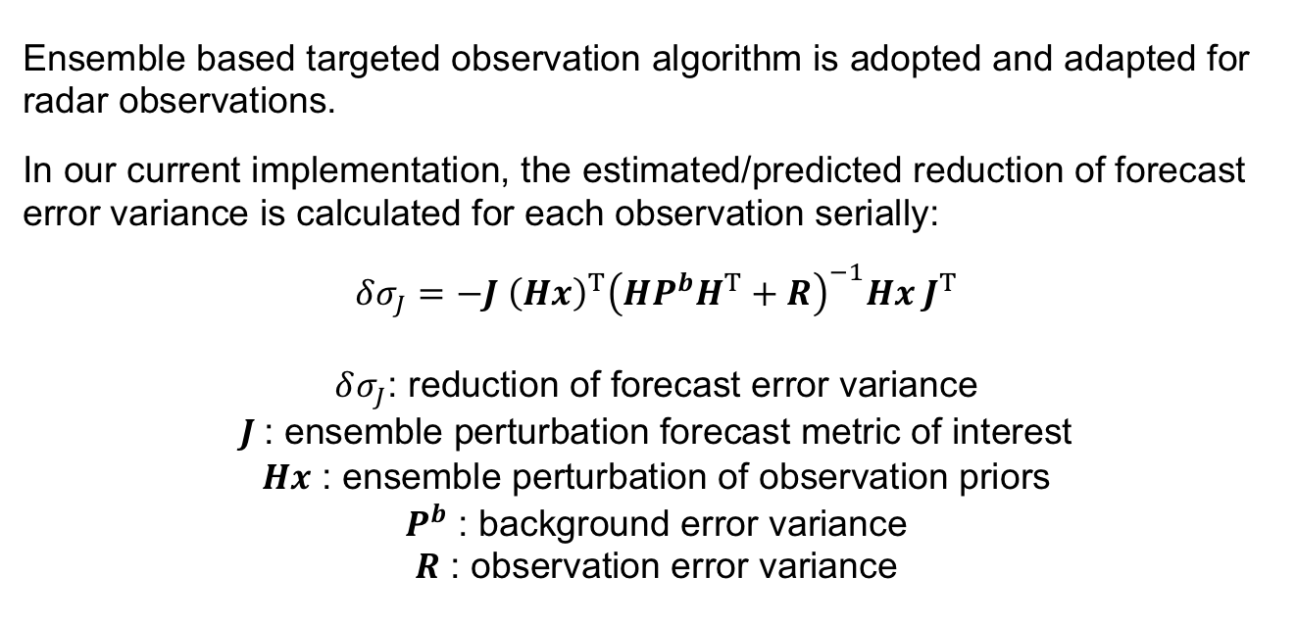
Implementation of targeted observation algorithm for radar observations
Ensemble based targeted observation algorithm is adopted and adapted for radar observations.
In our current implementation, the estimated/predicted reduction of forecast error variance is calculated for each observation serially:
$$δσ_{J}=−J {\left(Hx\right)}^{T}{\left(HP^{b}H^{T}+R\right)}^{−1}Hx J^{T}$$
$δσ_{J}$: reduction of forecast error variance
$J$: ensemble perturbation forecast metric of interest
$Hx$ : ensemble perturbation of observation priors
$P^{b}$ : background error variance
$R$ : observation error variance

Slide 29
How well does the targeting algorithm predict actual observation impacts?
At t₀, do we have an idea of these future observation impacts?
Black: full scan
Blue: low levels
Green: max updraft intensity level
Solid: actual
Dashed: estimated

Slide 30
How well does the targeting algorithm predict observation impacts?
Scatter plot illustrates trend in actual error reduction with estimated error variance reduction for various t₁ and t₂
Results suggest the targeting algorithm capable of distinguishing low impact strategy vs high impact strategy
Further testing parameters and increased sample size will hopefully further improve the results

Slide 31
Summary and Remarks
For direct reflectivity assimilation in EnVar, a method without tangent linear (TL) and adjoint of the nonlinear operator is developed to solve the issues associated with the TL of the reflectivity operator in EnVar.
With this approach, 4DEnVar is not only TLA free for forecast model, but also TLA free for nonlinear obs. operator.
Idea of extending state to include observed variables analogous to state augmentation of parallel implementation of serial EnKF but for addressing different issues.
Experiment with the May 8 tornadic supercell case (WoF context) shows that strong updraft and vorticity are better maintained using the new method than using hydrometeor mixing or log transformed hydrometer mixing ratio as state variables.
The method is implemented in operational HRRR and NAM-CONUS contexts and found to improve precipitation forecast as compared to the operational cloud analysis.
Sub-km analysis is found to be critical on the timing of weakening and re-intensification, and on the longevity and strength of the TLV for the May 8th OKC tornadic supercell case.
Ensemble targeting for convective scale is not impossible (the targeting algorithm shows promises on predicting the impact of radial velocity observations on forecasted 0-1 km UH out to 45 minutes)

Slide 32
References
Convective scale radar DA
Wang, Y. and X. Wang, 2017: Direct Assimilation of Radar Reflectivity without Tangent Linear and Adjoint of the Nonlinear Observation Operator in GSI-Based EnVar System: Methodology and Experiment with the 8 May 2003 Oklahoma City Tornadic Supercell, Mon. Wea. Rev., 145, 1447- 1471.
Wang Y., X. Wang, and J. Carley, 2018: GSI-based EnKF-Variational Hybrid Data Assimilation for NCEP NAMRR: System Development and Initial Testing. Mon. Wea. Rev. submitted.
Duda, J., X. Wang, Y. Wang and J. Carley, 2018: Comparing GSI-based ensemble-variational method for direct radar reflectivity assimilation with cloud analysis in convection-allowing forecasts over the continental US. Mon. Wea. Rev., submitted.
Duda, J., X. Wang, Y. Wang and J. Carley, 2018: Verification of a CONUS Storm-Scale Ensemble using an Ensemble-Variational Data Assimilation Scheme to directly assimilate multiscale in-situ and radar observations Participating in the 2017 Hazardous Weather Testbed Spring Forecasting Experiment. Mon. Wea. Rev., submitted
Wang Y., and X. Wang, 2018: Impact of the sub-kilometer resolution analysis on the prediction of tornado like vorticity and surface wind using the dual resolution GSI-based EnVar data assimilation system: methodology and experiment with the May 8th 2003 Oklahoma City tornado case. Mon. Wea. Rev., to be submitted.
Kerr, C. and X.Wang, 2018: Ensemble based targeting observation applied for multi-function phased array radar. Mon. Wea. Rev., to be submitted.

Slide 33
References
Hurricane DA
Lu, X., and X. Wang, M. Tong and V. Tallapragada, 2017: GSI-based, fully cycled, dual resolution hybrid ensemble-variational data assimilation system for HWRF: system description and experiment with Edouard (2014), Mon. Wea. Rev., 145, 4877-4898.
Lu, X., X. Wang, Y. Li, M. Tong and X. Ma, 2016: GSI-based ensemble-variational hybrid data assimilation for HWRF for hurricane initialization and prediction: impact of various error covariances for airborne radar observation assimilation. Q. J. R. Meteo. Soc., 143, 223-239.
Lu, X., and X. Wang, 2018a: Improving Hurricane Analyses and Predictions with TCI, IFEX Field Campaign Observations and CIMSS AMVs Using the Advanced Hybrid Data Assimilation system for HWRF. Part I: Why spin-down exists when HWRF is initialized with more realistic analysis during the prediction of Hurricane Patricia (2015)? Mon. Wea. Rev., submitted.
Lu, X. and X. Wang, 2018b: Improving Hurricane Analyses and Predictions with IFEX, TCI Field Campaign Observations and CIMSS AMVs Using the Advanced Hybrid Data Assimilation system for HWRF. Part II: Observations Impact on the Analyses and Predictions of Patricia (2015). Mon. Wea. Rev., submitted.
Feng, J. and X. Wang, 2018: Impact of assimilating outflow layer dropsonde observations collected during the TCI field campaign on the prediction
of intensity and structure of Hurricane Patricia (2015). Mon. Wea. Rev., submitted.
Lyu, X., and X. Wang, 2018: The Impact of HDOB and CIMSS AMV Observation Assimilation on the Analysis of Inner Core and Outflow Structures and the Prediction of Rapid Intensification of Hurricane Matthew (2016). Mon. Wea. Revi., submitted.

Slide 34
References
DA Algorithm and Global DA
Wang, X., 2010: Incorporating ensemble covariance in the Gridpoint Statistical Interpolation (GSI) variational minimization: a mathematical framework. Mon. Wea. Rev., 138, 2990-2995.
Wang, X., D. Parrish, D. Kleist, and J. Whitaker, 2013: GSI 3DVar-based ensemble-variational hybrid data assimilation for NCEP Global Forecast System: single resolution experiments. Mon. Wea. Rev., 141, 4098-4117.
Wang, X. and T. Lei, 2014: GSI-based four dimensional ensemble variational data assimilation (4DEnsVar): formulation and single resolution experiments with real data for NCEP GFS. Mon. Wea. Rev., 142, 3303-3325.
Huang, B., and X. Wang, 2018: On the use of cost effective valid time shifting ensembles to increase ensemble size in the GFS hybrid 4DEnVar system. Mon.Wea. Rev., submitted
Huang, B., X. Wang and C. H. Bishop: High rank ensemble transform Kalman filter. Mon. Wea. Rev., submitted

Slide 35
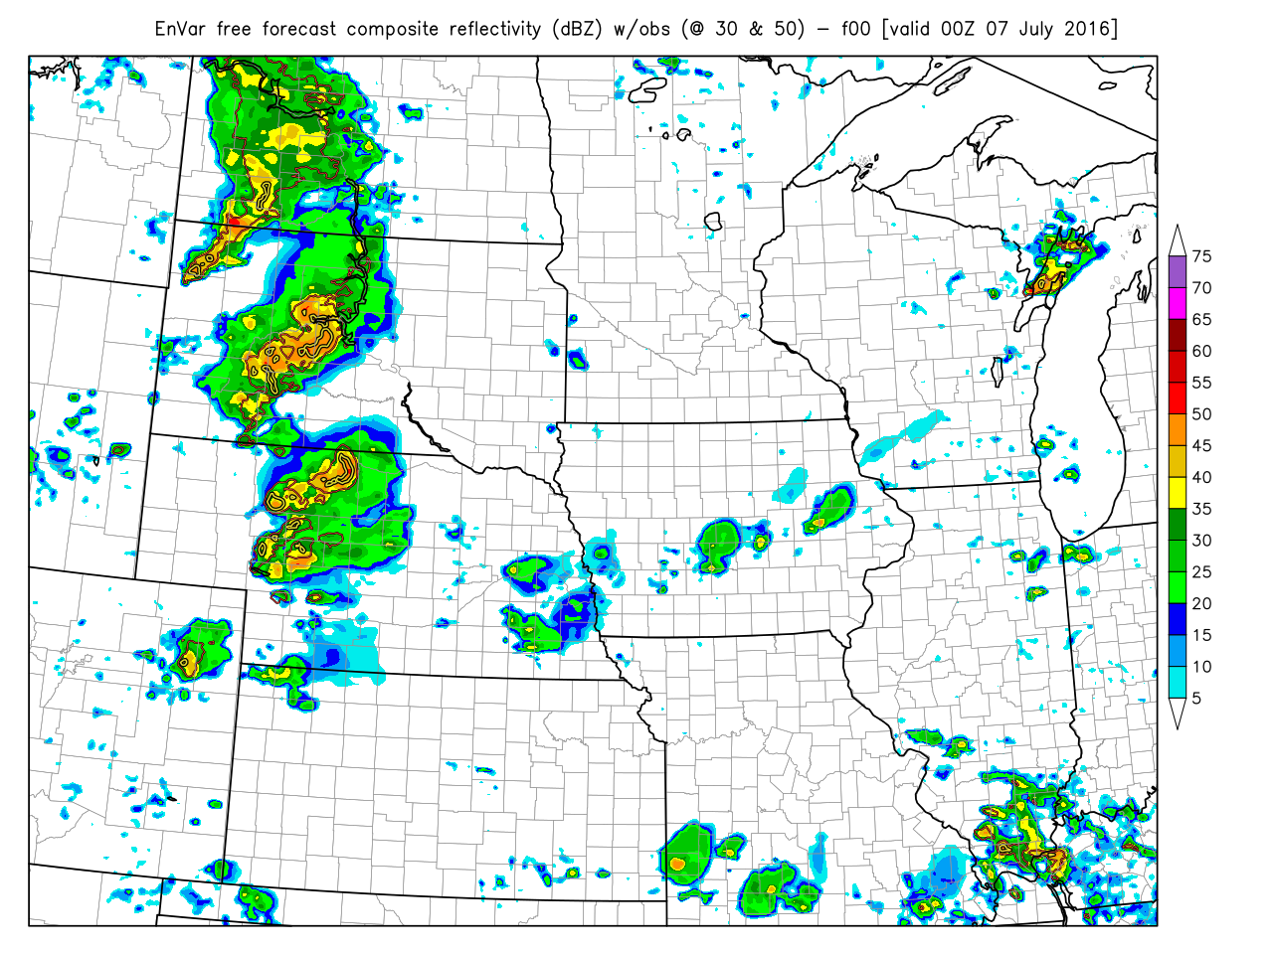
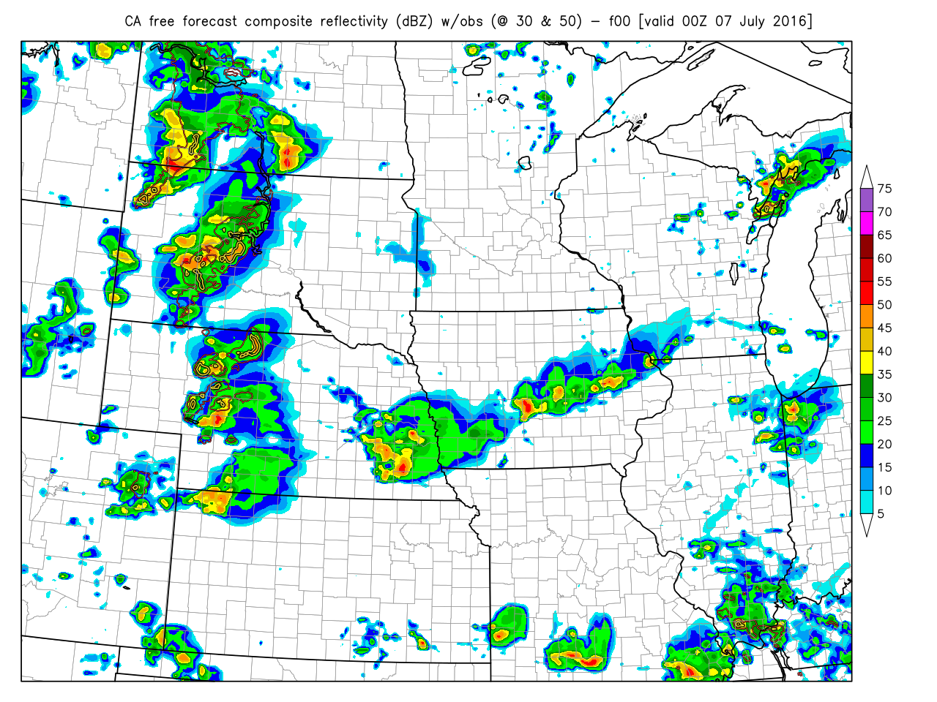
Why GSI EnVar is better than CA?
Duda, Wang, Wang, Carley 2018a, MWR
00 UTC 07 July 2016
EnVar (f00)
cloud analysis (f00)
obs. reflectivity key:
30 dBZ
50 dBZ
Spurious convection is better suppressed by the EnVar.

Slide 36
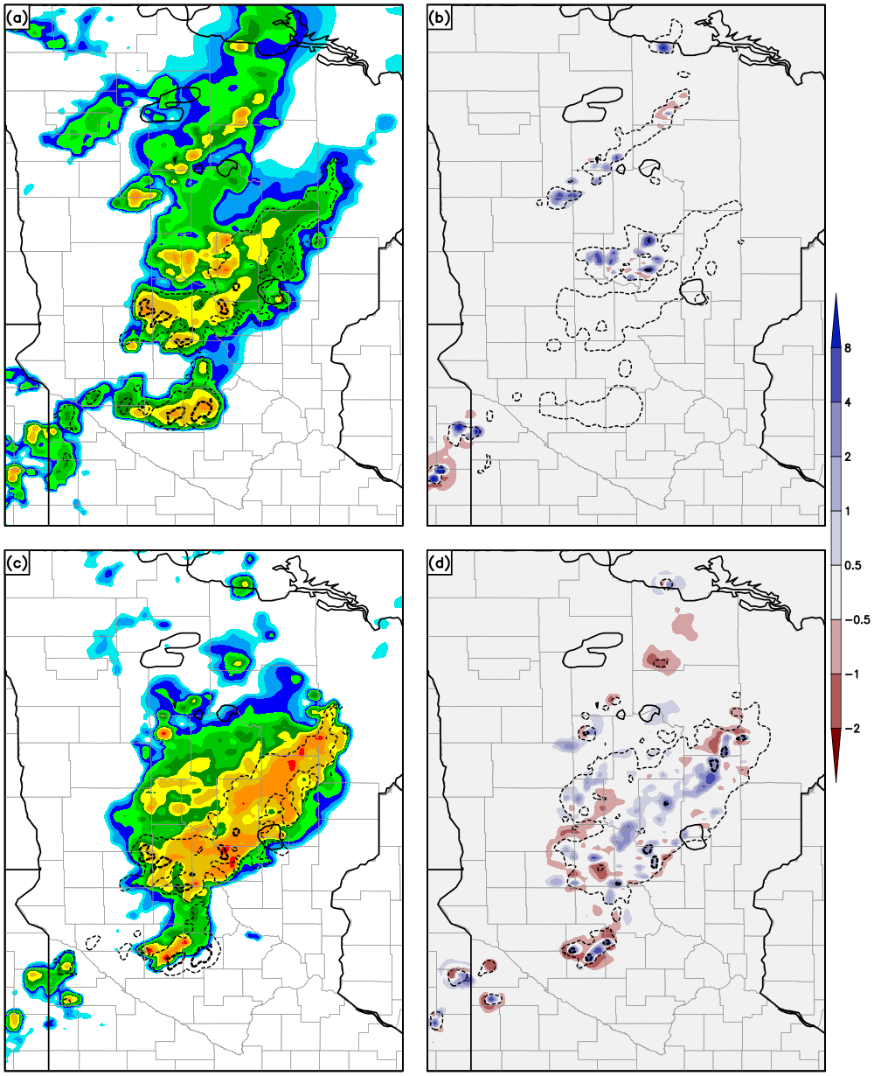
Why GSI EnVar is better than CA?
Duda, Wang, Wang, Carley 2018a, MWR
cloud analysis
17 June 2016
Weak vertical motion from CA
While CA is able to add reflectivity, it is incapable of providing a consistent update of the dynamical field (e.g., w) itself.
EnVar
EnVar can update other thermo/dynamical variables consistently through cross variable correlations

Slide 37
Use ensemble to predict if/how observations will impact a forecast metric
Blue dots represent locations of radial velocity observations from a max updraft velocity region scan that are predicteed impactful by the approach on a 30 minute 0-1 km UH forecast
Note how the observations are cluttered along the edges of the right mover updraft “tangential” to radar beam
Radar location
Black: Reflectivity > 20 dBZ
Green: Updraft > 5 m s⁻¹
Kerr and Wang 2018
Notes:
The error variance reduction calculation involves linear regression. But, the idea is not the same from the ensemble sensitivity shown in this slide. The key here is predict before obs are collected and assimilated.

Slide 38
max updraft speed height

