Slide 1
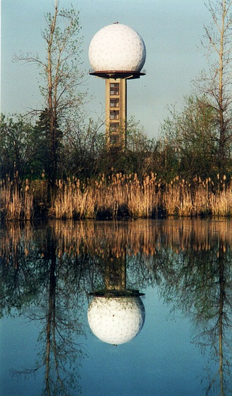
Reflection on the Challenges of Radar Data Assimilation at Meso-Convective Scales in an Ensemble Context
Frédéric Fabry
McGill University
8th EnKF workshop – Mont-Gabriel, QC, Canada – 7-10 May 2018
Notes:
Radar is our best instrument to observe storms; assimilation is our best technique to merge information; and numerical modelling is our best forecasting tool. So why are a) simple nowcasting approaches beating numerical forecasting for a couple of hours, b) the skill of numerical forecasting aided by radar data assimilation dropping so rapidly in the first forecast hour, and c) assimilated radar data showing positive effect for much shorter periods (e.g., about two hours) than other instruments (e.g., six hours for surface observations)? And how do we change this state of affairs?
In an attempt to answer these questions, a reflection on the challenges of radar data assimilation in the context of mesoscale and convective scale forecasting was undertaken. In particular, we wanted to understand what made the assimilation of radar data assimilation more challenging and limiting than that of other data sources. The rapid drop in the skill of radar data assimilation with forecast time suggests that radar data assimilation has difficulties affecting the fields that will shape storm development in the future. This arises because:
- Over 90+% of the troposphere, the only information available from radar is “no precipitation”, largely limiting innovation to areas where either the analysis or the observations have precipitation;
- The air feeding the storms and controlling their environment in a few hours largely come from regions of no precipitation; hence its properties are largely unconstrained directly by radar. Any innovation must hence come from distant correlations with precipitation areas.
- Though there is significant correlation between overall storm intensity and thermodynamic properties, the correlations computed at gridpoint scales are limited because the field of precipitation and its errors have much more energy at smaller unpredictable scales compared to other fields. Limited ensemble sizes and localization then prevent such weak long-distance correlations to be fully utilized. And as model resolution increases, this problem becomes worse.
As a result, the most successful methods for assimilating radar data are those that purposefully or accidently take advantage of the larger-scale relationships between storminess and thermodynamics such as LETKF, while those that use gridpoint-scale correlations are the least successful.
What this suggests is that special efforts should be made to take advantage of larger-scale correlations when assimilating radar data. And since many remote sensors so critical to forecast error reduction are largely blind in regions of critical meteorological activity that we want to constrain better (e.g., the lower troposphere under a cloudy developing storm), a case could be made that such an approach should also be used when assimilating other data.

Slide 2
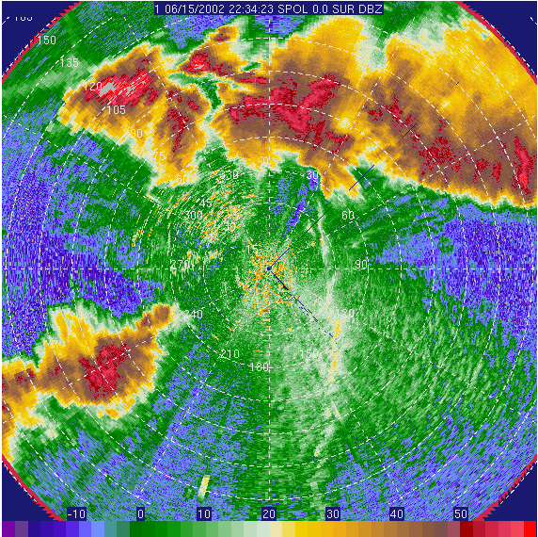
Radar Is our Best Tool to Monitor Convection…
250 km
Weak echoes
Strong echoes
Notes:
Radar is a powerful tool for storm monitoring and nowcasting because it provides the most detailed measurements on the current state (precipitation & winds) and the damaging aspects of the storm system.
But it is much weaker at constraining the future outcome, which is why radar nowcasting has had great difficulties in moving beyond the extrapolation of current threats (contrast the reviews from “Radar Meteorology” (Atlas 1991) and in “Weather Radar, Wind Profiler, Ionospheric Radar, and Other Advanced Applications” nowcasting chapter (Joe et al 2012).

Slide 3
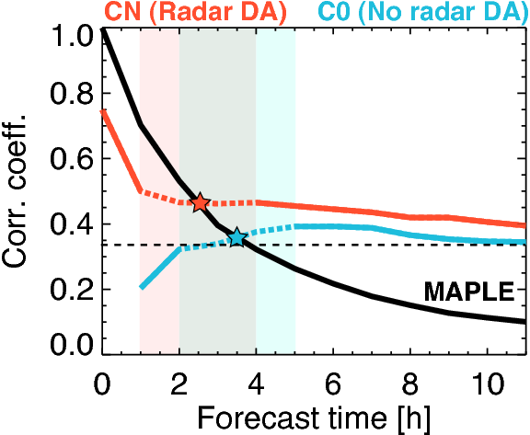
… But the Assimilation of its Data Is Difficult
Often, gains of assimilation (CN vs. C0) are short-lived (and with a rapid initial drop), more than for other data sets.
With radar DA
Without radar DA
Image courtesy of
Dr. Madalina Surcel,
McGill University
Skill of precipitation forecasts with (orange) and without (cyan) using radar data assimilation for the US Spring Experiment of 2008.
The skill of radar pattern extrapolation (black) is also shown.
Note the rapid skill drop in the first hour for forecasts using radar data assimilation.
Skill of forecast
Skill of precipitation forecast
Extrapolation
nowcast
Notes:
As a radar meteorologist, I find this state of affairs unexpected and puzzling → Drove my interest in this question

Slide 4
Symptoms and Ensuing Question
Symptoms:
- Significant gains achieved initially (at least for rain)
→ Hypothesis: The radar data are properly assimilated;
- Followed by a rapid loss of skill in the immediate future
→ Hypothesis: The gains from assimilation lose usefulness.
→ Rejection? Incompleteness or inconsequence of DA gains?
Question:
What is fundamentally/practically different between the data from radar and that of other sources that may affect their assimilation? [Context: convective-scale prediction]
What makes convective-scale DA difficult?

Slide 5
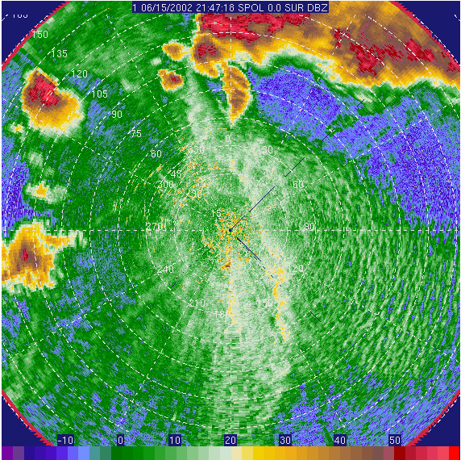
What Do Radars Measure?
1) Presence and strength of echoes
Source of echoes:
Precipitation (and some clouds);
Ground (generally filtered);
Insects, birds (may be filtered);
Refractive index gradients (strong temperature/humidity contrasts)
2) Other properties (in echoes only)
Radial component of target motion;
Some shape and time-of-travel information.

Slide 6
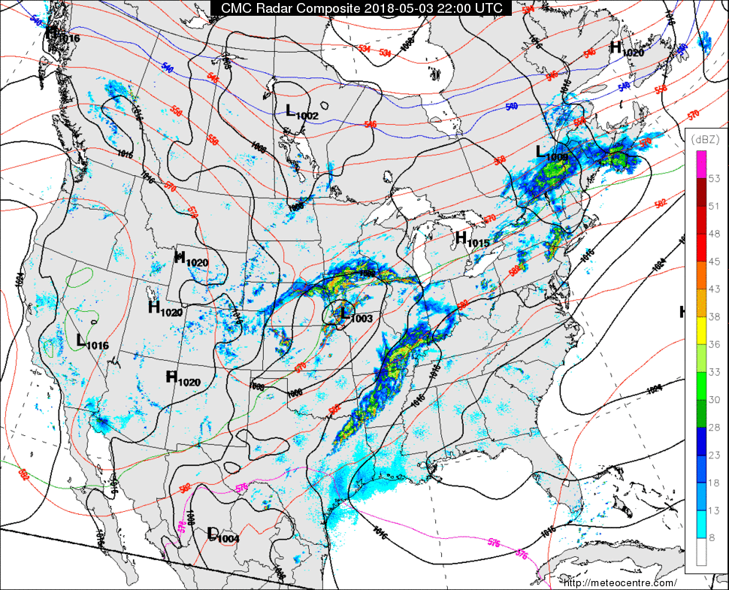
The Unusual Field of Precipitation Rate
Distribution of values:
- Mostly zeroes (~90%);
- Rest is near-normal in log(rain rate).
Often non-Gaussian errors.
Spatial structure:
- Less large-scale variability than other fields.
→ Smaller-scale (faster-evolving) errors dominate
Log-scale
Example of springtime sea-level pressure and radar reflectivity (mostly precipitation).
Contrast the spatial structure of these two fields.

Slide 7
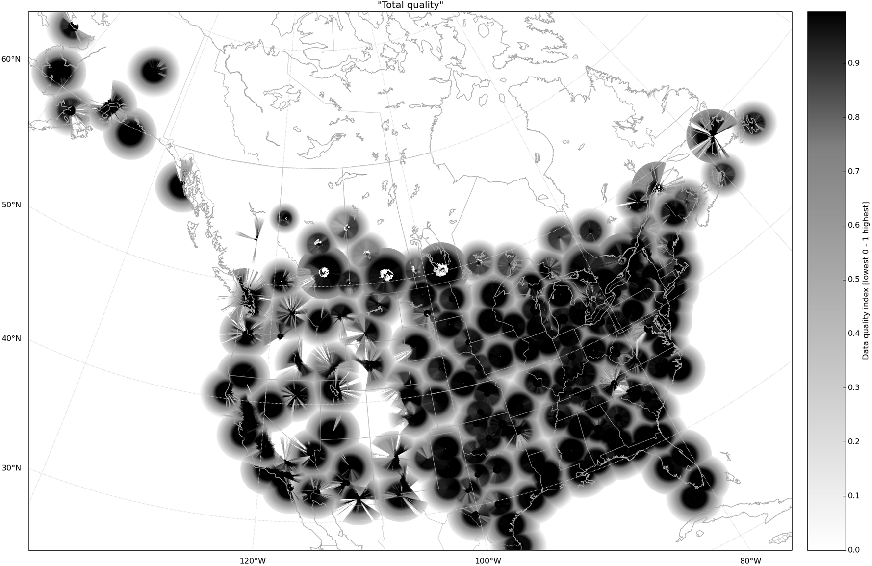
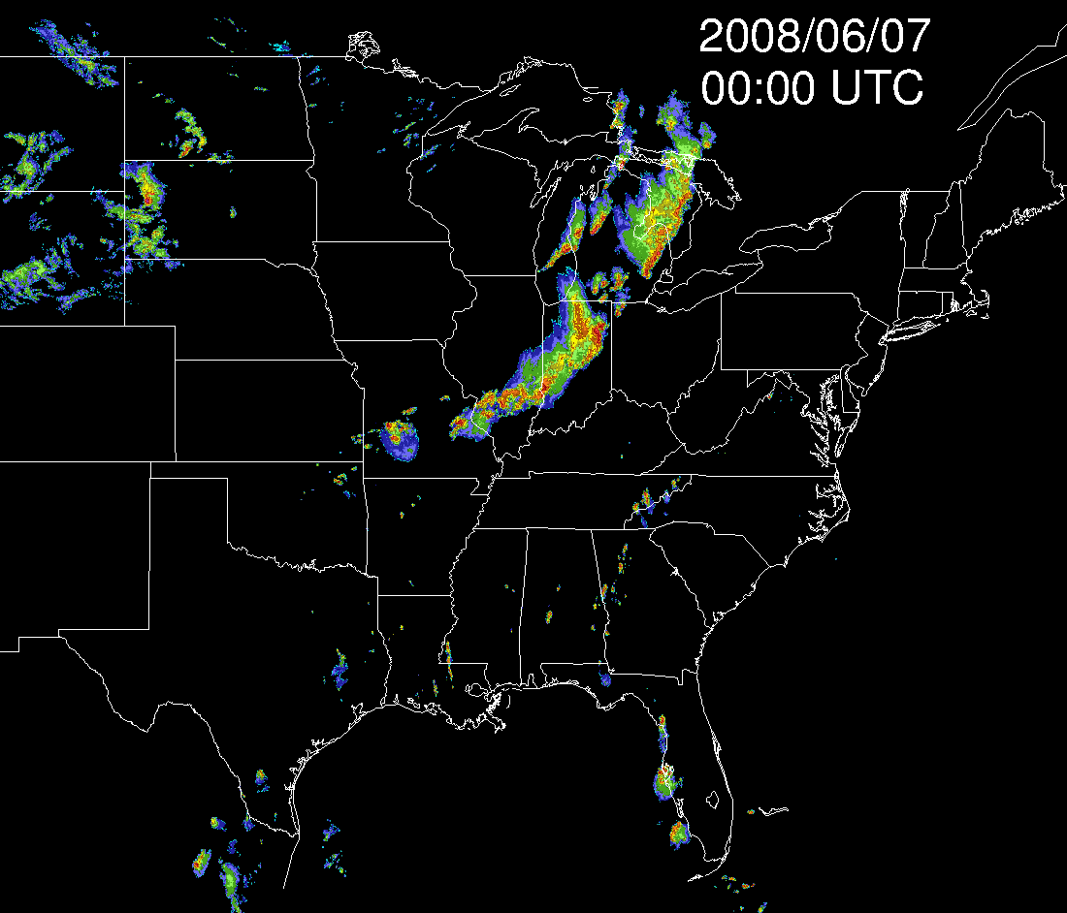
The Unusual Topology of Radar Constraints for DA
Quality index of radar data
(courtesy of D. Michelson ECCC)
Radar data are available over large areas…
… but their direct innovation is concentrated in a few regions with large gaps in between.
“Islands” of constraints within a “sea” of no-innovation
One day of radar data
in an active convection period

Slide 8
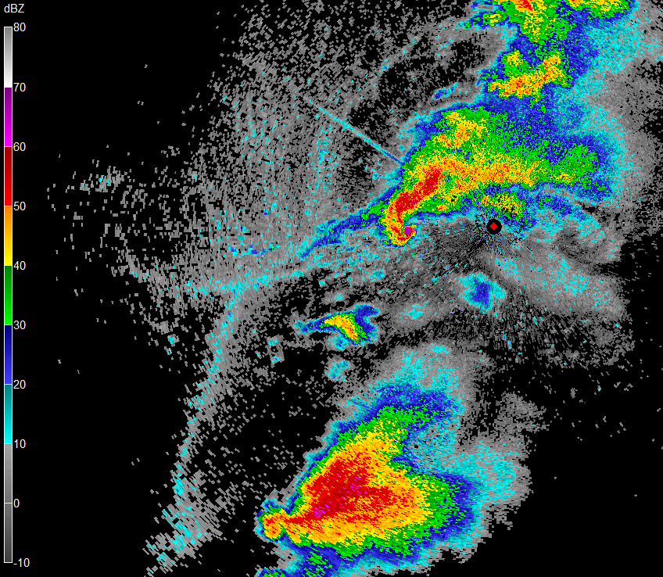
Topology of Radar Constraints for Convective DA
Moore (OK) 2013 tornado event, 20 May 2013
Illustration: a large tornadic supercell storm we aim to warn for.
Suppose we had tried to forecast this tornadic supercell storm an hour before.
50 km

Slide 9
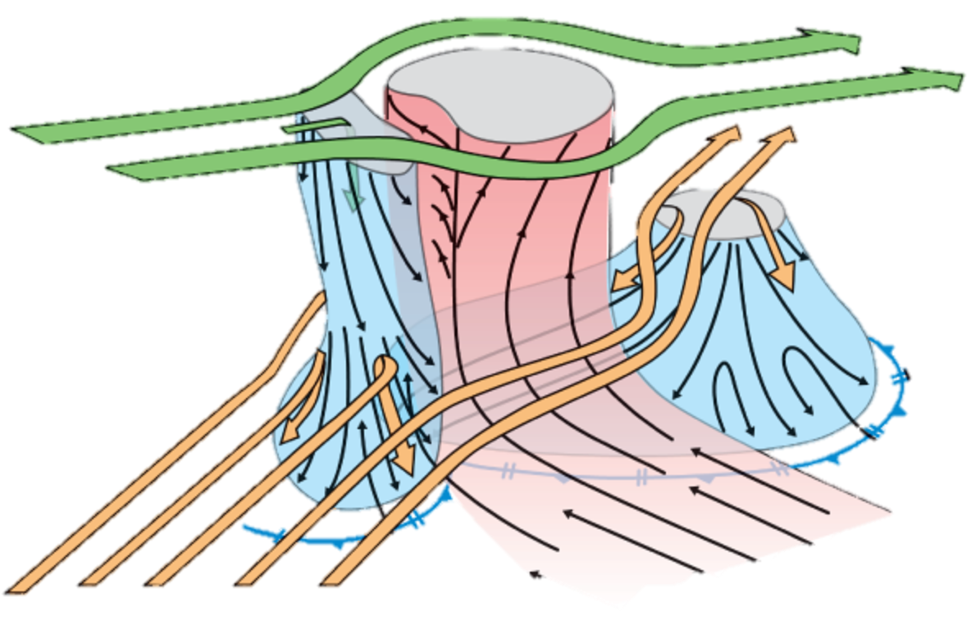
Topology of Radar Constraints for Convective DA
Moore (OK) 2013 tornado event, 20 May 2013
Let us first replace the storm echo by a cartoon…
(courtesy of Markowski and Richardson 2010’s book)
Updraft
E
B
Forward-flank
downdraft
9 km flow
Rear-flank
downdraft
D
C
A
Surface flow
4 km flow
50 km

Slide 10
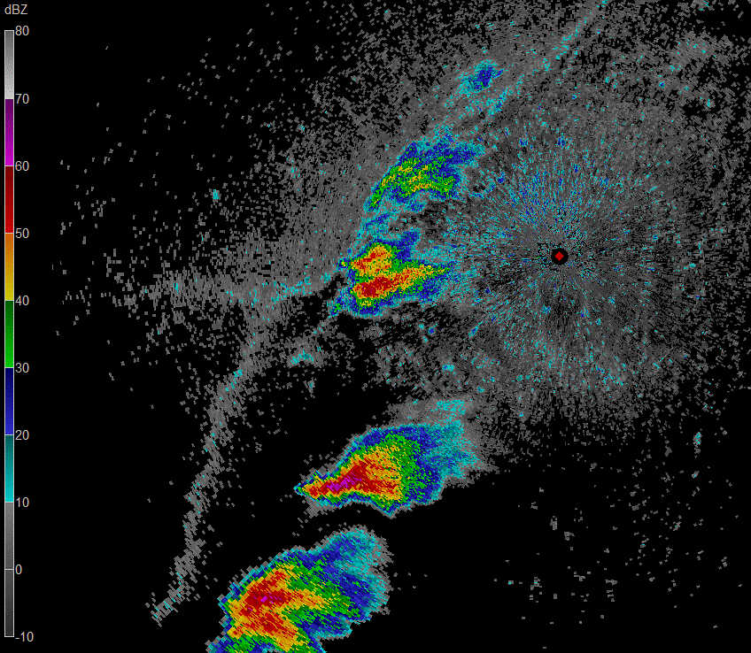
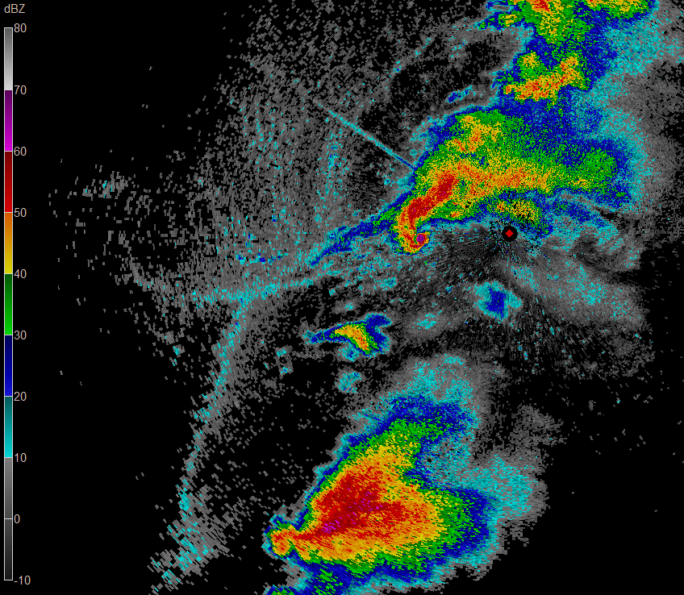
Topology of Radar Constraints for Convective DA
Moore (OK) 2013 tornado event, 20 May 2013
Let us first replace the storm echo by a cartoon, and then go back in time one hour.
Updraft
E
B
Forward-flank
downdraft
9 km flow
Rear-flank
downdraft
D
C
A
Q: What areas must be better constrained to improve the 1-hr forecast for that storm?
Surface flow
4 km flow
50 km

Slide 11
Topology of Radar Constraints for Convective DA
Moore (OK) 2013 tornado event, 20 May 2013
A: Many with no constraints besides “no precipitation”, an information largely known already by the background.
→ For radar to adjust those areas, innovation must come through distant relationships.
Updraft
E
B
Forward-flank
downdraft
9 km flow
Rear-flank
downdraft
D
C
A
E
Surface flow
4 km flow
B
A
D
C
50 km

Slide 12
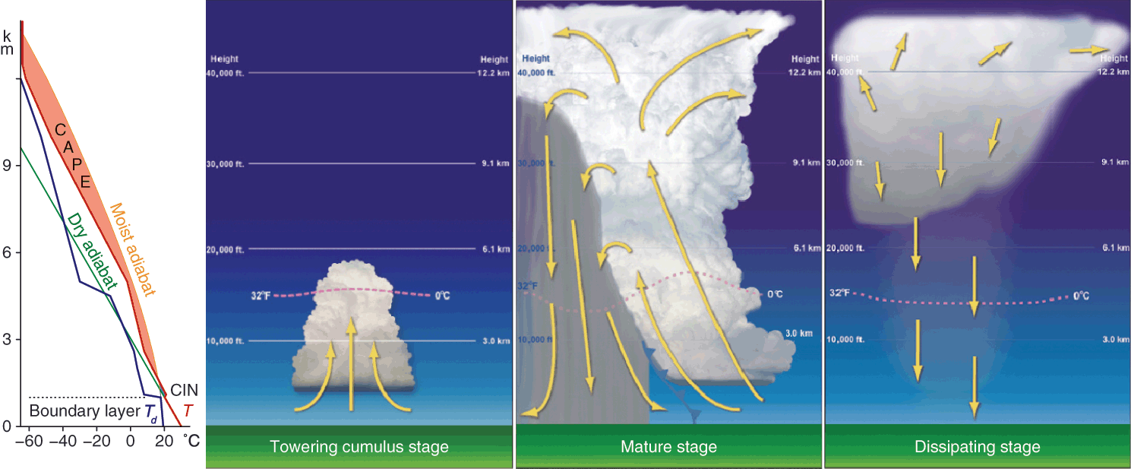
Radar-Measured Quantities vs. Causes of Storms
A TIME-SEQUENCE VIEW
Radar largely blind to these
Radar is best at observing those
Radar excels at monitoring the consequences and impacts of the storm formation process (precipitation, winds).
But it is largely blind to its causes (temperature/humidity forcing) → Causes must be inferred via error dependencies.
Notes:
See talk by Miyoshi (“Is 30-s update enough…”) for good illustrations of how late the radar capture the storm.

Slide 13
Radar-Measured Quantities vs. Causes of Storms
A PROPERTIES-AND-INTERACTIONS VIEW
Observed by radar
Drivers of storm evolution
1) Radar is much better at measuring the impacts of storms than their causes;
2) The best radar-measured property (precipitation) is the furthest from those causes and has limited feedback on them and is short-lived without support.
The equations of atmospheric interactions as a box and arrow diagram
Notes:
Tight feedbacks (and linear in derivative) in energy/dynamics cycle; looser connections (with threshold processes) in water cycle. Also note the many degrees of separation between what radar observes best (precipitation) and storm causes (shaded in orange)

Slide 14
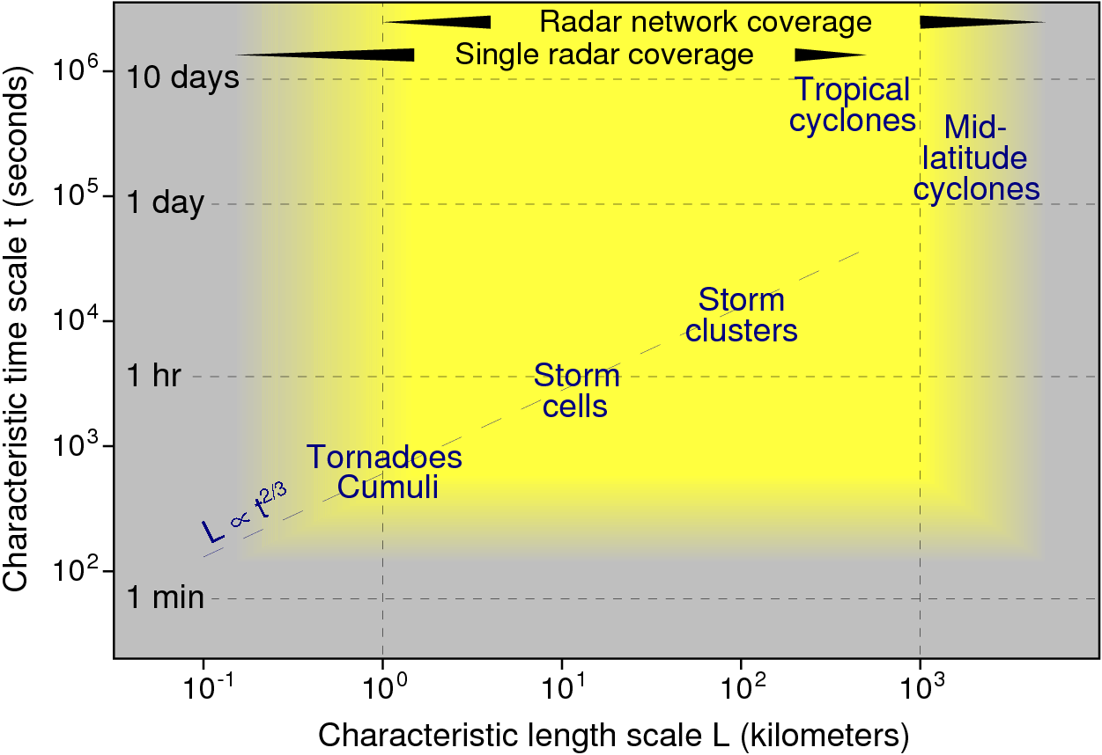
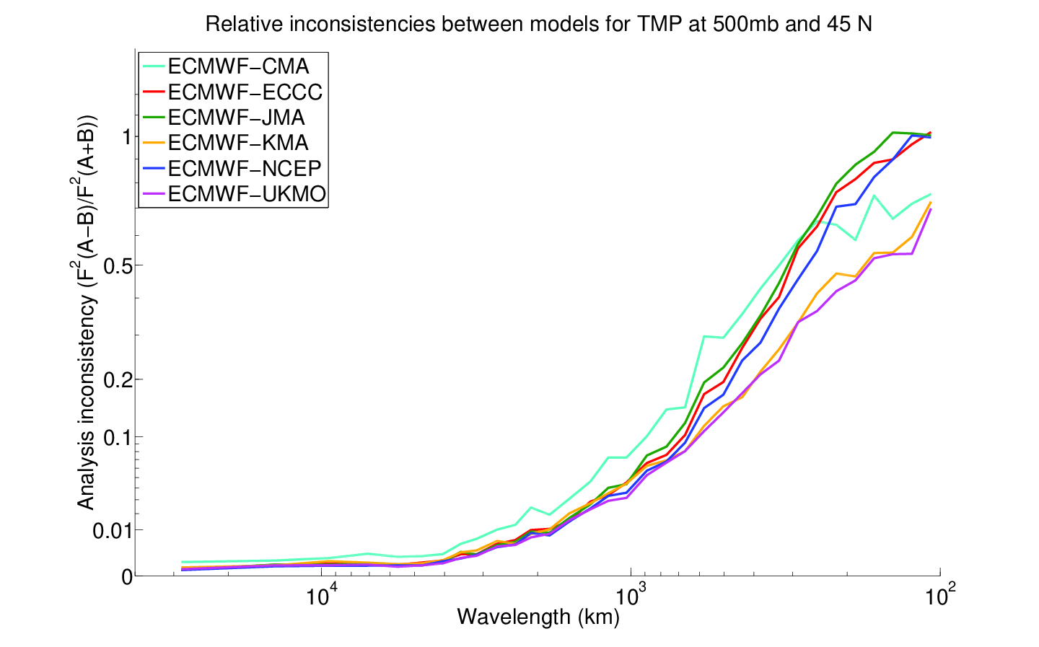
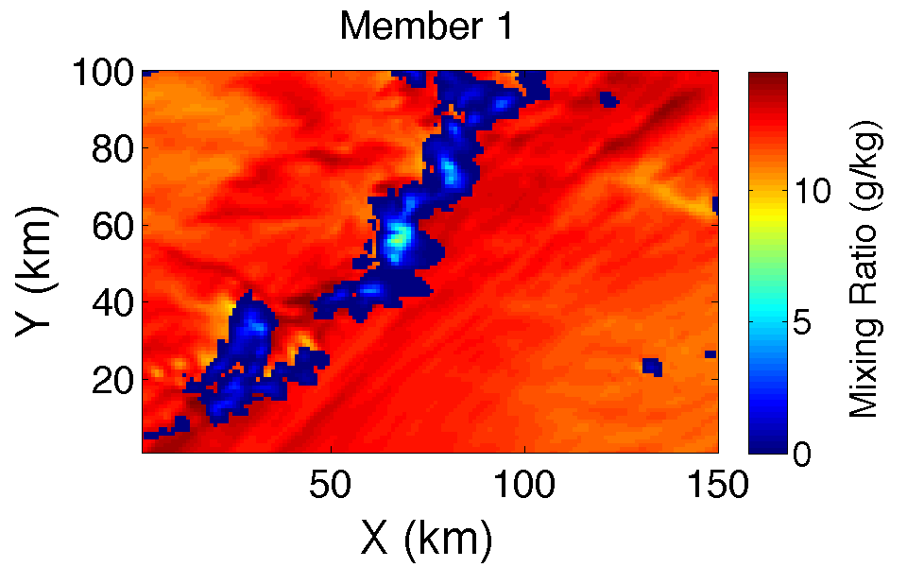
These Compound the “Usual” Additional Challenges of Convective-Scale DA
Fewer balances to rely on to fill missing information (geostrophy, hydrostatic balance…);
Faster evolution and error growth;
…
Analyses inconsistencies between models for T(500 mb, 45N)
October 2016
49-run average
1
14
50%
Vapor (g/kg)
Fractional inconsistency in spectra
6
20%
Rain
10%
1%
0
Km-scale ensemble from Jacques and Zawadzki (2015)
10,000 km
1,000 km
100 km

Slide 15
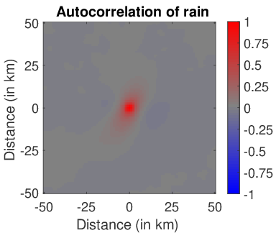
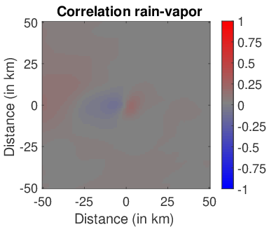
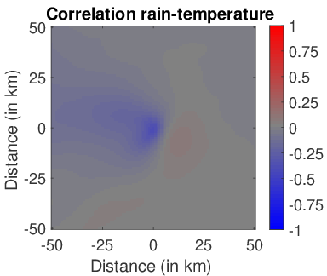
Impacts of the Many “Degrees of Separation” between Radar Data and Drivers of Weather
As a result, linear statistical relationships are often limited between rainfall and what controls the evolution of the storm in the present and in the future (assuming some members have precipitation).
Correlation between rainfall and other fields at 750-m altitude from the 1000-member ensemble from Jacques and Zawadzki (2015)
Not easy to project information tens of kilometers out;
Yet, it must be done to improve forecasts beyond a few minutes.

Slide 16
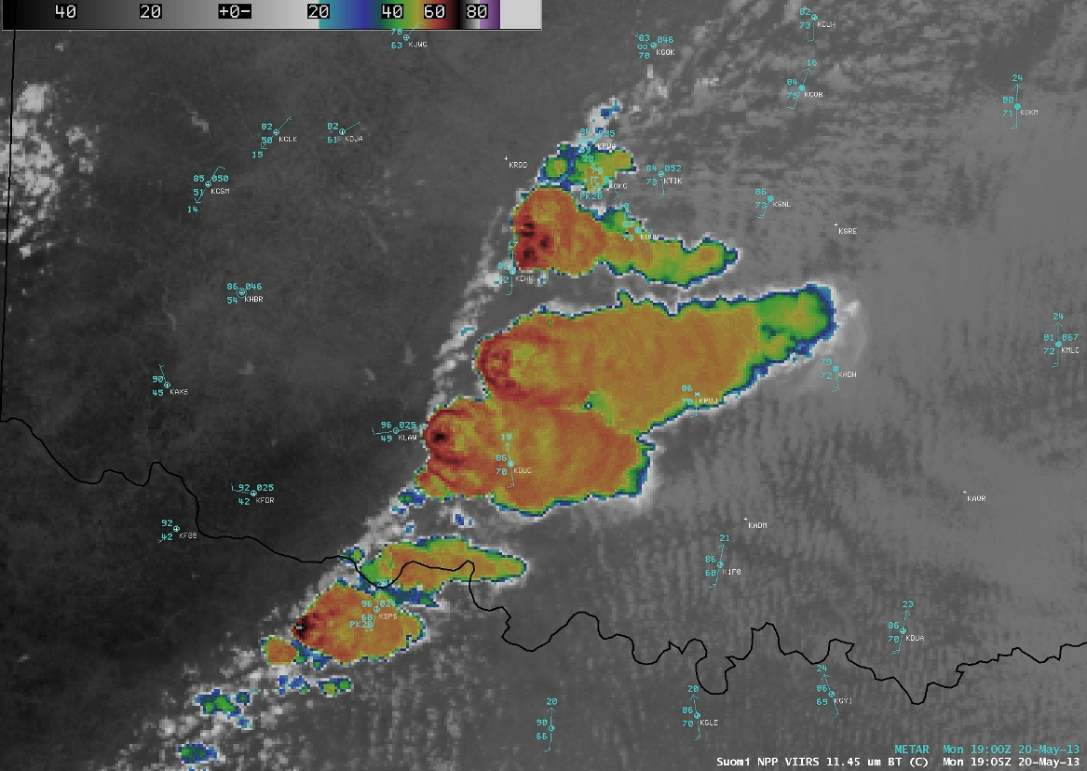
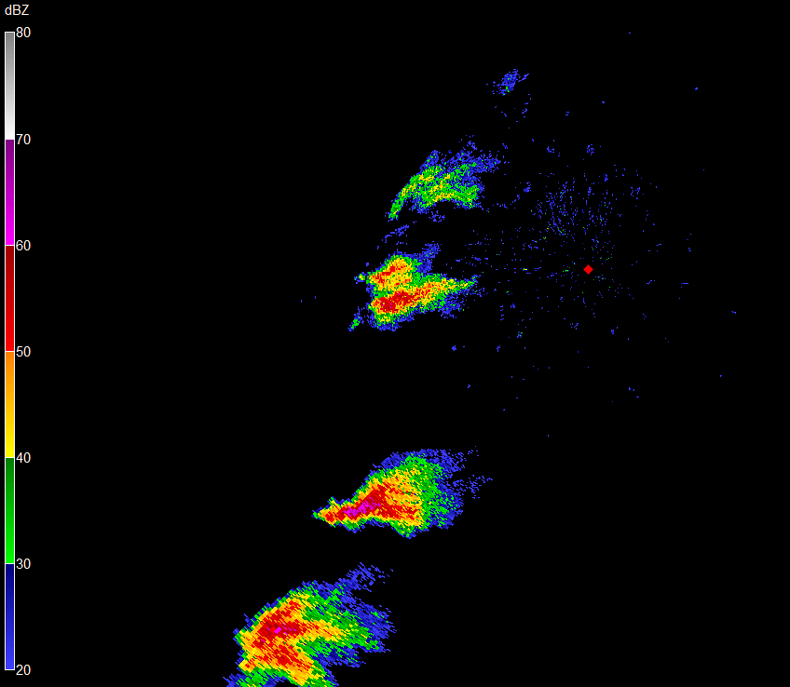
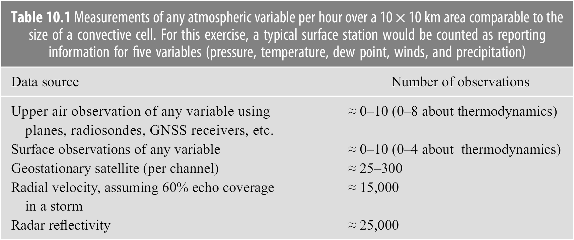
Convective Scales: No Good Alternative to Radar DA
Radars (and IR imagery) remain the dominant data source at these scales.
IR imagery, surface stations, and radar 1 hr before Moore tornado
1200 (largely from cloud top up)
in storms, near 0 outside
→ We have no choice but to try to make the best of radar.

Slide 17
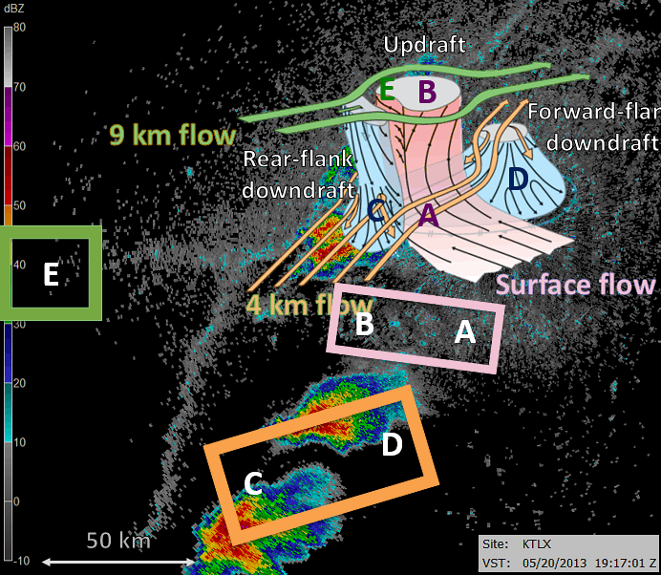
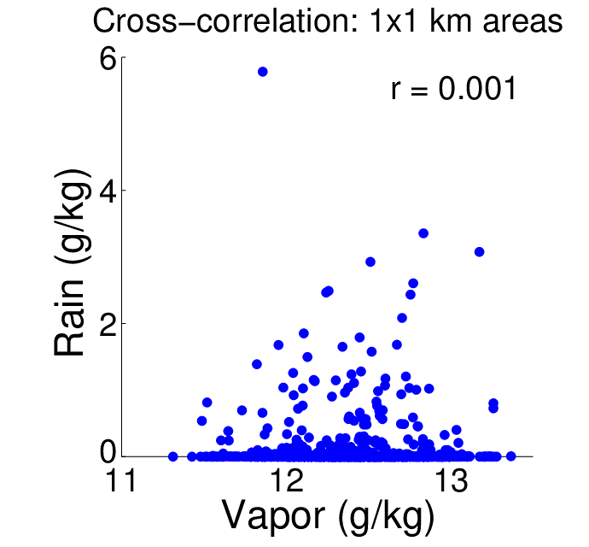
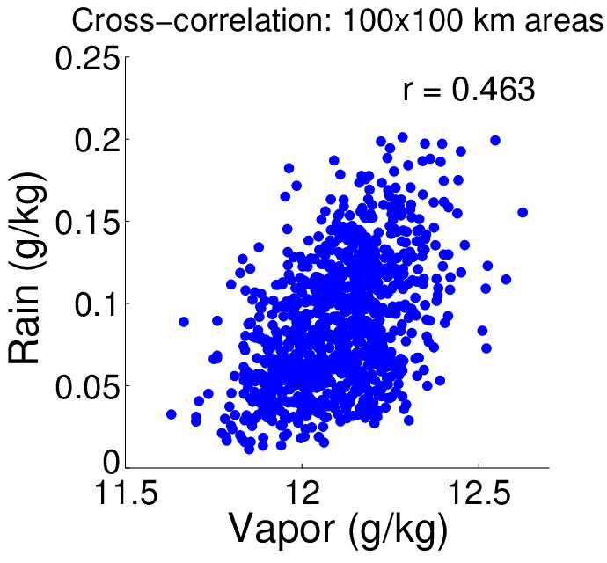
What Makes Radar Data Assimilation “Different”
Radar constraints are unusually distant both physically and process-wise from the drivers of future action.
→ To affect relevant fields, radar DA would benefit from approaches that forcefully project information far away:
Lower-resolution increments?
Lower-dimension approaches (e.g., Franken-states [see Perez])?
Or: Extend radar data (clear air, n)

