Slide 1




Practical Predictability of Supercells:
Exploring ensemble forecast sensitivity to EnKF analysis spread
Montgomery Flora , Corey Potvin and Louis Wicker

Slide 2

Why is storm-scale predictability an important topic to explore?
With CAMS in operational use, it is critical to understand storm-scale predictability
Evaluating and compare impacts of different forecast error sources
  e.g., IC uncertainty, coarse IC resolution, or model error
Warn-on-Forecast

Slide 3
How is this relate to a EnKF Workshop?
Past supercell predictability studies did not use fully flow-dependent initial condition (IC) errors
  Crucial since forecast errors grow both up- and down-scale ( e.g., Zhang et al. 2007, 2016; Durran and Gingrich 2014; Durran and Weyn 2016)
Initializing prior to convection initiation (CI) vs. post-CI
  Assimilating radar and satellite data and initializing post-CI leads to more realistic ICs

Slide 4
Description of the NEWS-e
ICs and BCs generated in real-time during 2016 Hazardous weather testbed using the NSSL Experimental Warn-on-Forecast System for ensembles (NEWS-e)
Nested in Experimental 3-km High-Resolution Rapid Refresh Ensemble (HRRRE; Dowell et al. 2016)
36 ensemble members with physical parameterization diversity
  3 PBL schemes, 2 Radiation schemes, and a single microphysics

Slide 5
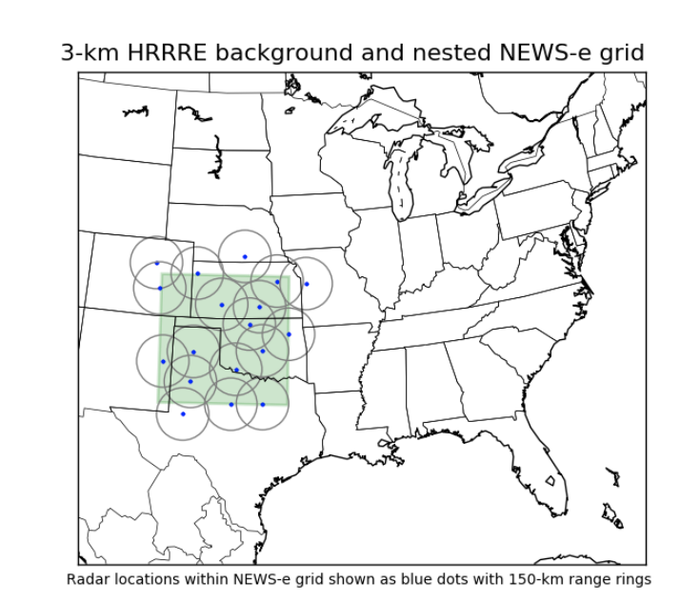
Description of the NEWS-e (cont.)
250 x 250 grid point domain with 3-km grid spacing
Ensemble Adjustment Kalman Filter from DART software
Radar, satellite, mesonet, and other conventional observations are assimilated every 15 min staring at 1800 UTC with forecasts launched from 1900 UTC to 0300 UTC.

Slide 6
Model Configuration
WRF-ARW v. 3.6.1
1-km grid nested inside the NEWS-e domain (case-dependent size)
  Based on computer resources, 1-km grid spacing sufficiently resolves the mid- and low-level mesocyclone ( Potvin and Flora 2015)
Perfect model assumption is adopted to isolate sensitivity of ensemble forecast spread to IC uncertainty
List of parameterizations
  Microphysics (Thompson), Boundary layer (MYNN 3.0), Radiation (RRTM and Dudhia), and Surface layer (MM5)
Model is integrated for 3 h with output every 5 min

Slide 7
Reducing Initial Condition Spread
Choose control member close to ensemble mean to be considered ‘Truth’
  Close to initial ensemble mean thermodynamic and kinematic variables
  Close to early ensemble mean evolution
  Storm remains relatively isolated and survives close to 3 h
Generate perturbations by subtracting control member from each ensemble member over the entire 3D domain for all state variables
Reduce perturbation magnitude (e.g., 50% and 25% of the original)
Add reduced perturbations onto the control member to generate new ensembles with reduced IC spread
Performed on 3-km grid then down-scaled to 1-km grid

Slide 8
Measuring Practical Predictability
Traditionally, atmospheric predictability is divided into two domains: intrinsic and practical
  Intrinsic predictability: extent to which prediction is possible given an optimal procedure and infinitesimal IC errors
  Practical predictability: “the time interval within which the errors in prediction do not exceed some prechosen magnitude” (Lornez 1969)
Ensemble forecast spread (standard deviation)
  Split into location and amplitude spread
Ensemble probability of exceedance
  Neighborhood maximum ensemble probability (NMEP; Schwartz and Sobash 2017)
  6 x 6 km neighborhood ( 3 grid point radius )
Bias
  Difference between control member and ensemble mean

Slide 9
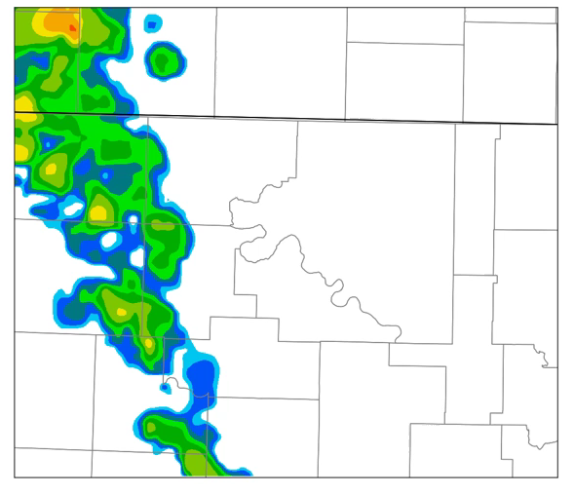
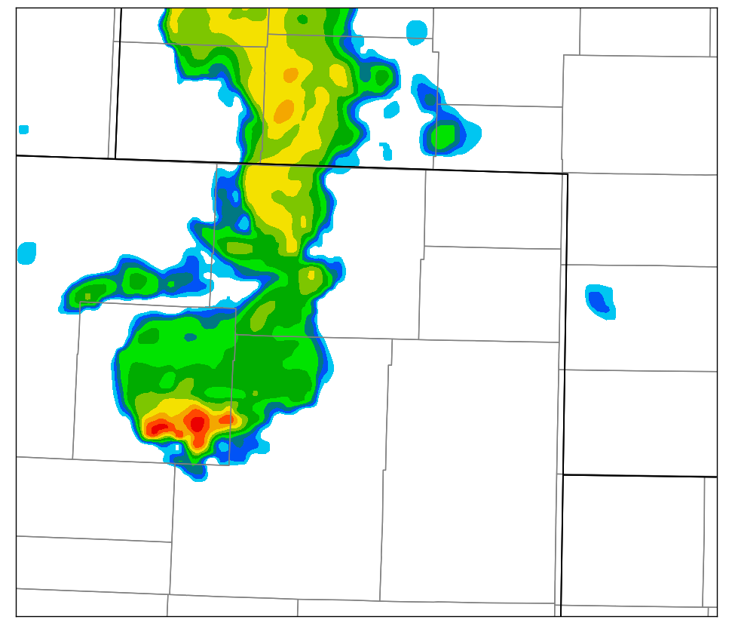
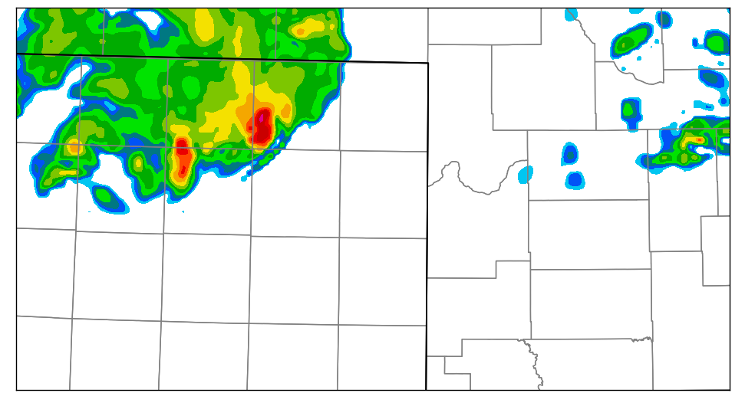
Three Supercell Cases
9 May 2016
Classic Right-Moving (RM) Supercell*
16 May 2016
Supercell growing upscale*
24 May 2016
Isolated RM Supercell*
*control member

Slide 10
Radar DA in the NEWS-e is not obviously underdispersive
Initialization time

Slide 11
How does updraft helicity NMEP improve by reducing IC spread?
Yellow Contour: Approx. forecast time
Blue Contour:
Control mem. UH = 300

Slide 12
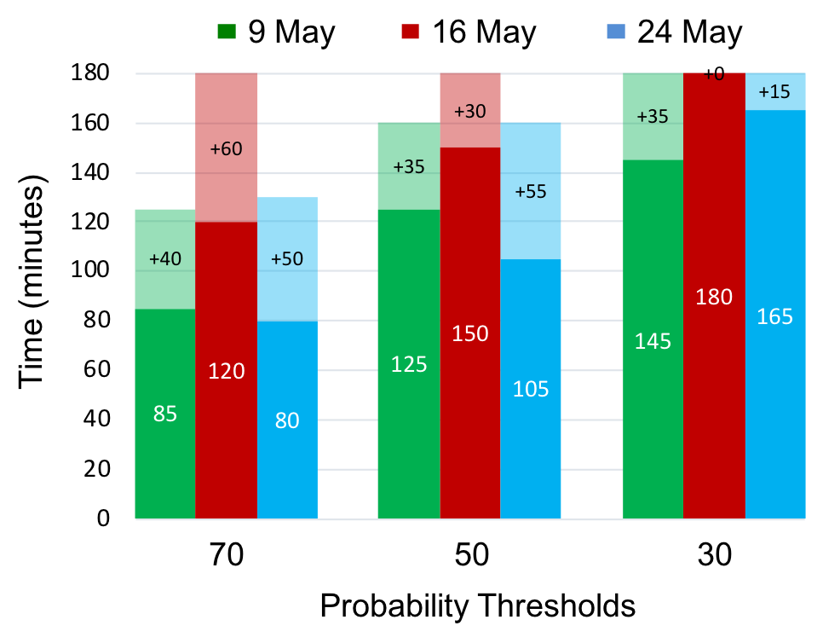
Practical predictability limit based on max NMEP of UH > 300 m²s⁻²
Shaded:
Additional time gained with 50% IC spread reduction
For the 70 & 50% thresholds, on average, the
lead time gained with a 50% IC spread reduction is 45 min
Solid:
Time when max NMEP falls below a given threshold

Slide 13
How predictable is storm location?
~95 min
~95 min
Average distance from ensemble mean storm location (based on max UH)
~125 min
+ 30 min
+ 30 min
Distance between control member and ensemble mean
storm location

Slide 14
How predictable is mid-level mesocyclone intensity?
~50 min
250
~90 min

Slide 15
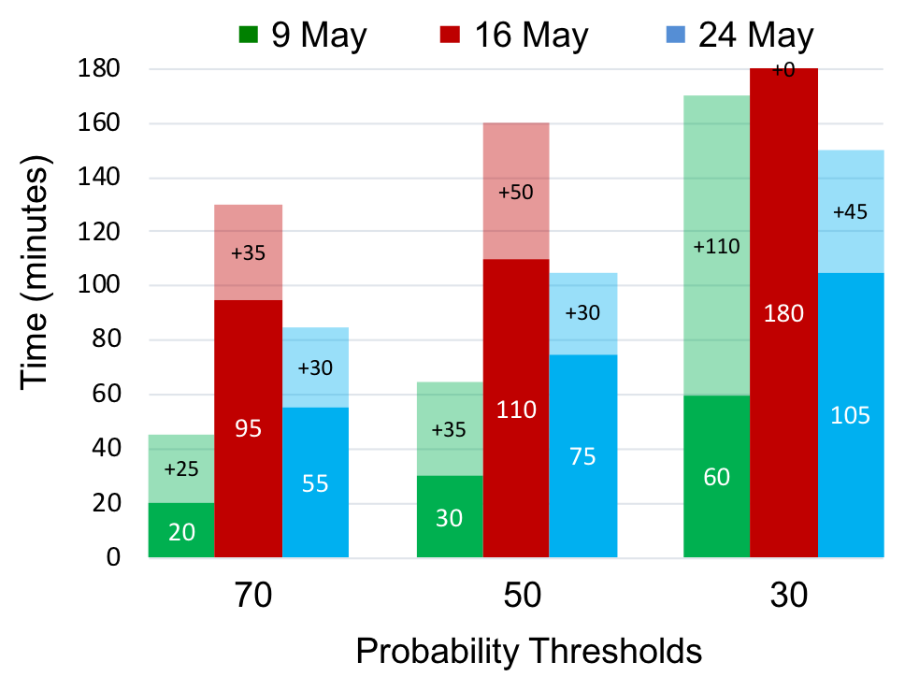
Practical predictability limit based on max NMEP of LLV > 0.015 s⁻¹
Extremely
case-dependent!
Times are slightly less than for
NMEP of UH
For the 70 & 50% thresholds, on average, the
lead time gained with a 50% IC spread reduction is 35 min

Slide 16
24 May illustrates that rainfall forecasts can suffer greatly from bias
Why is forecast uncertainty so high in the 100% experiment?
~0.4-0.5 in
~1.0 in
Large Forecast Bias!
Blue Contour:
Control mem = 0.75 in

Slide 17
Conclusions
Practical predictability of supercells is case- and feature-dependent
Storm location uncertainty and ensemble bifurcations in forecast storm intensity greatly limited practical predictability in the 100% experiments
Reducing IC spread by 50% produced substantial reductions in forecast spread for all evaluated supercell features.

Slide 18
Conclusions
Decreasing the IC spread by 75% produced additional reductions in forecast spread and bias in two of the three cases.
Practical predictability is substantially improved initializing post-CI
Rainfall predictability is impacted more by storm location uncertainty than the mid- and low-level mesocyclone predictability

Slide 19
Limitations and Future Work
More cases are needed!
  All cases from U.S. Central Great Plains
Synoptic –scale influences
  Large-scale organization and strongly forced storms may have inherited greater predictability from the larger scales
Missing other important supercell features
  Hail and the cold pool
See Flora et al. 2018 (in review) for more information!

Slide 20
Supplementary Slides

Slide 21
Is forecast bias also improved by reducing IC spread?
Bias:
Difference the control member and ensemble mean maximum UH
9 May has greatest difference between 25% and 100% experiments
Evolution of 50% and 25% are similar to each other, but distinct from 100% (unlike the other two cases)
In 16 and 24 May, bias is generally decreased by reducing IC spread
Magnitude of IC spread in the 9 May 100% experiment lead to a critical bifurcation (and premature storm demise)

Slide 22
Rainfall

Slide 23
What is already known about supercell predictability?
Cintineo and Stensrud JAS (2013) “Idealized / perturbed sounding”
  Predictability limit defined as probability of exceedance < 60%
  40 dBZ location was predictable out to 2 h, while mid-level mesocyclone location was only predictable out to 40 min
Potvin and Wicker WAF (2013) “Idealized / EnKF DA”
  Low-level rotation probabilistic guidance may be possible out to at least 30-60 min
Zhang et al MWR (2015) “May 20 2013 / full physics / perturbed deterministic ICs”
  Convection initiation (CI) is sensitive to diurnal PBL evolution and SW OK topography
Miglietta et al (2016, 2017) “Mediterranean Supercell / full physics / shifting initialization time”
  Predictability is sensitive to large-scale forcing and can be extended when CI is topographically-induced

Slide 24





How predictable is mid-level mesocyclone intensity?
$$UH= \int_{2 km}^{5 km}{w ζ dz}$$
~50 min
$$UH ∝\left(ζΔz\right)w$$
250
$$σ_{UH}∝\left(ζ Δz\right) σ_{w}$$
$σ_{w}$ = 15 – 20 m s⁻¹
~90 min
$σ_{UH}$ = 450 – 600 m² s⁻²

