Slide 1
Impact of the observational error in the assimilation of radar reflectivity volumes
Thomas Gastaldo, Virginia Poli, Chiara Marsigli
Tiziana Paccagnella, Pier Paolo Alberoni

Slide 2
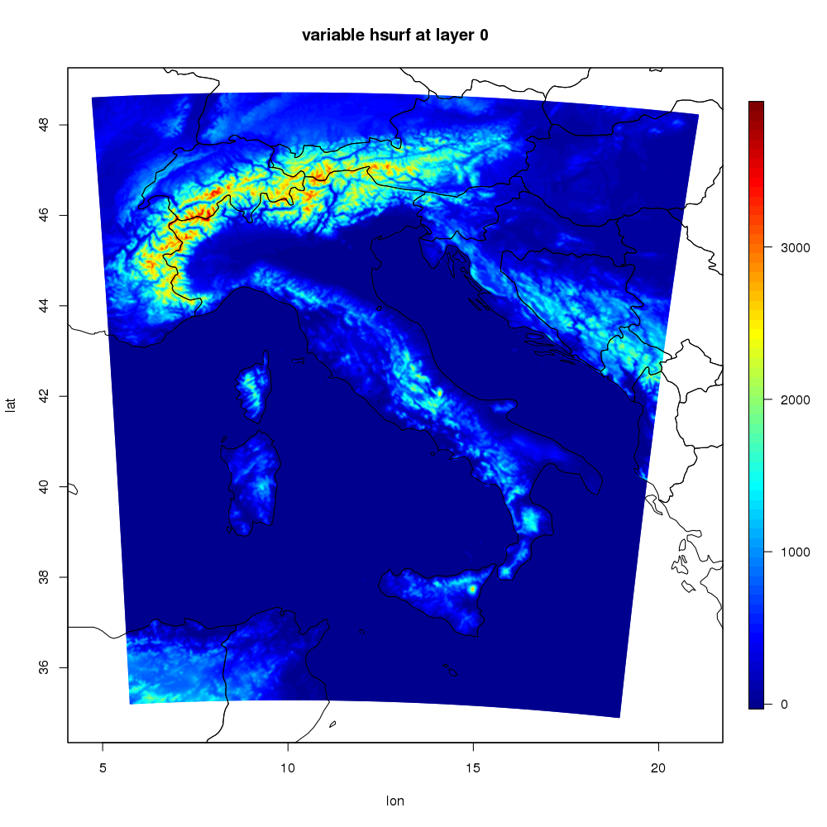
Introduction
COSMO-2I is the high resolution (2.2 km) convection-permitting model employed at Arpae, the Hydro-Meteo-Climate Service of the Emilia-Romagna region in Italy.
Initial conditions are provided by a data assimilation system (KENDA) based on a LETKF scheme. At present, only conventional data are employed.
Currently, tests are ongoing to evaluate the impact of the assimilation of radar reflectivity volumes from the Italian radar network.

Slide 3
KENDA – Operational set-up
00 UTC
03 UTC
03 UTC
06 UTC
CONVENTIONAL OBSERVATIONS
CONVENTIONAL OBSERVATIONS
RADAR SRI
RADAR SRI
ensemble
of analyses
ensemble
of forecasts
background
ensemble:
20 COSMO 2.2 runs
ANALYSIS
ensemble:
20 COSMO 2.2 runs
Deterministic run
innovation
observed value and model equivalent
LETKF
innovation
observed value and model equivalent
LETKF

Slide 4
KENDA – Experimental set-up
00 UTC
01 UTC
01 UTC
02 UTC
CONVENTIONAL OBSERVATIONS
CONVENTIONAL OBSERVATIONS
RADAR
VOLUMES
RADAR
VOLUMES
ensemble
of analyses
ensemble
of forecasts
background
ensemble:
20 COSMO 2.2 runs
ANALYSIS
ensemble:
20 COSMO 2.2 runs
Deterministic run
innovation
observed value and model equivalent
LETKF
innovation
observed value and model equivalent
LETKF

Slide 5
Reflectivity observational error (roe)
Observational error $ε_{o}$ is provided by the sum of 3 components
$$ε_{o}=y−y^{∗}=ε_{M}+ε_{R}+ε_{H}$$
$ε_{M}=$ instrumental error
$ε_{R}=$ representativity error
$ε_{H}=$ error introduced by the operator H
An estimation of the value of $ε_{o}$ can be obtained the statistics of Desroziers et al., 2005:
$$E\left[d_{a}^{o}{(d}_{b}^{o}\right)T]≅R$$
$d_{a}^{o}$ $=y −H(x_{a})$ $d_{b}^{o}$ $=y −H(x_{b})$
Applying this statistics to our case study, we got a reflectivity observational error (roe) equal to 5 dBZ. Results obtained employing this value are compared to those obtained using 10 dBZ (employed by Bick et. al, 2016).

Slide 6
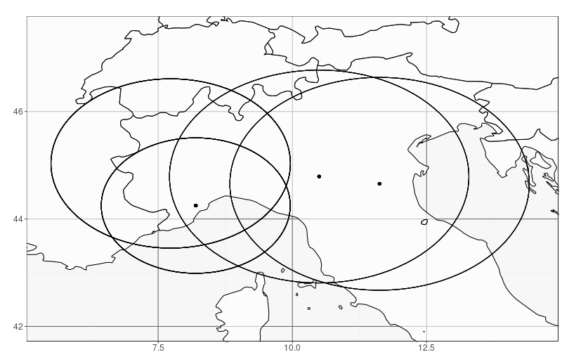
Case study – Set-up
From: 03/02/17 at 06 UTC
To: 07/02/17 at 00 UTC
Model: COSMO at 2.2 km hor. res.
KENDA: 20 members ensemble + deterministic
Experiments: a 60 min. window is employed in each trials and R matrix is diagonal.
noDA: no data assimilation
conv+LHN: assimilation of conventional data (SYNOP, TEMP, AIREP) and LHN of surface rainfall intensity from Italian radar composite.
roe5 and roe10: assimilation of conventional data and of reflectivity volumes from 4 radars of Northern Italy. A 10 km superobbing is applied on both observations and model and values lower than 5 dBZ are set equal to 5 dBZ. Value of roe is equal to 5 dBZ and 10 dBZ respectively.
A 24h forecast is initialized each 3h from 3 Feb. at 12 UTC to 6 Feb. at 06 UTC (23 forecasts for each experiment).

Slide 7
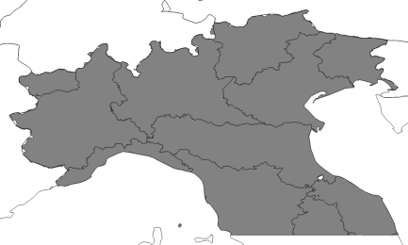
Verification: SAL
-2
0
+2
PERFECT
Structure
objects too small
or too peaked
objects too large
or too flat
Amplitude
average QPF
underestimated
average QPF
overestimated
Location
wrong location
of total center of mass
and/or objects relative
to center of mass
Wernli et al., 2008

Slide 8
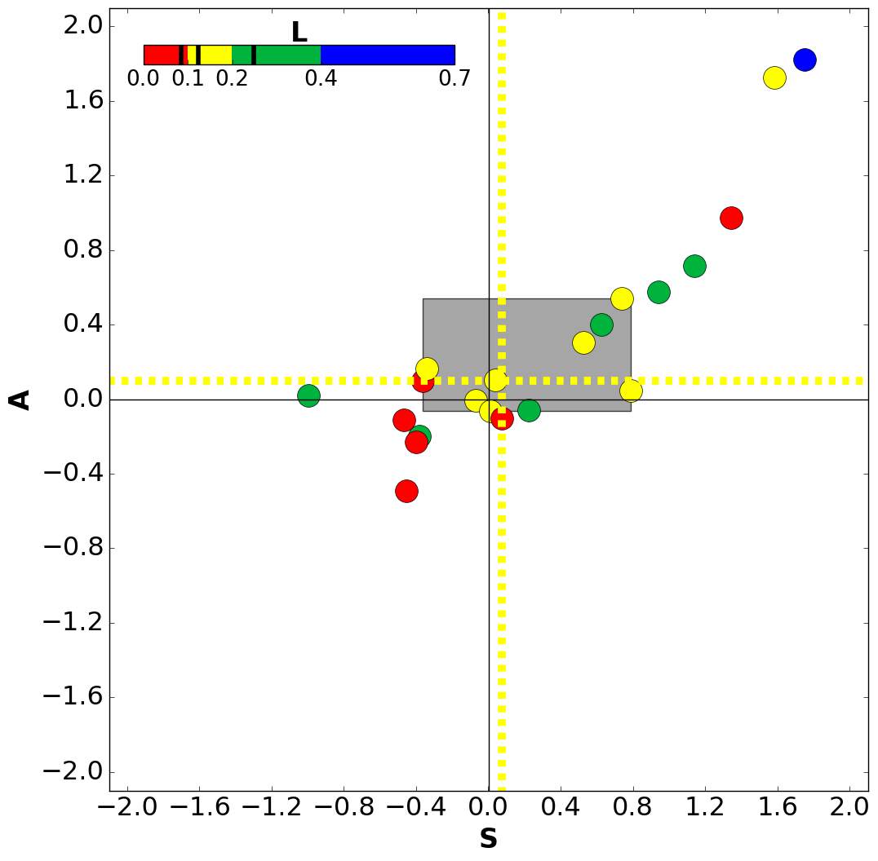
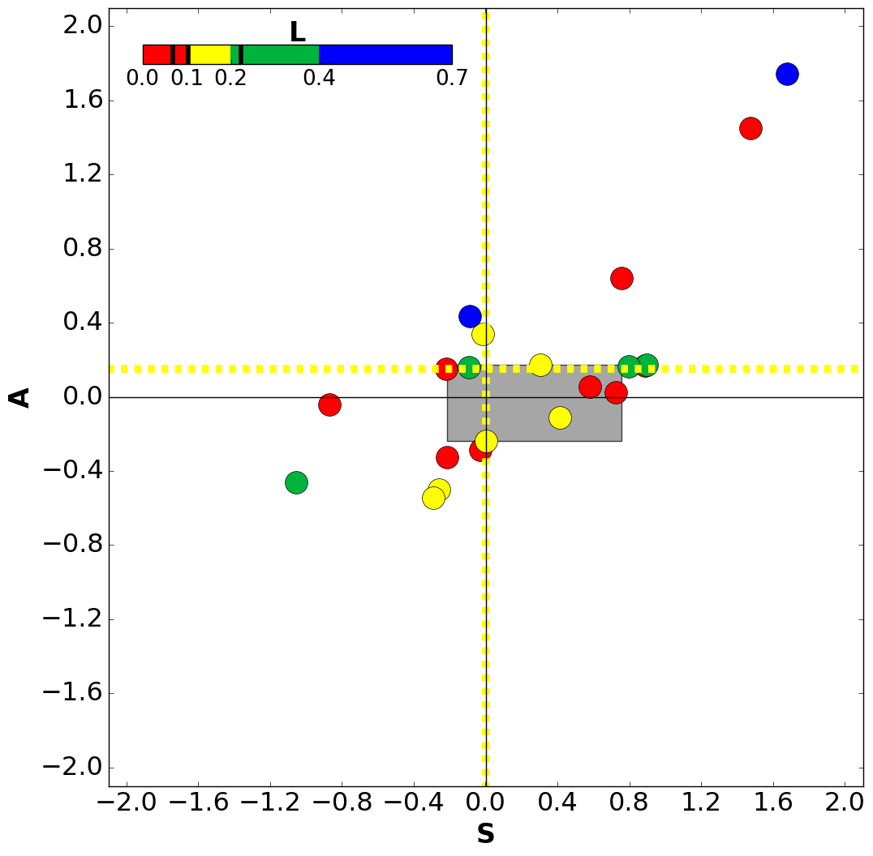
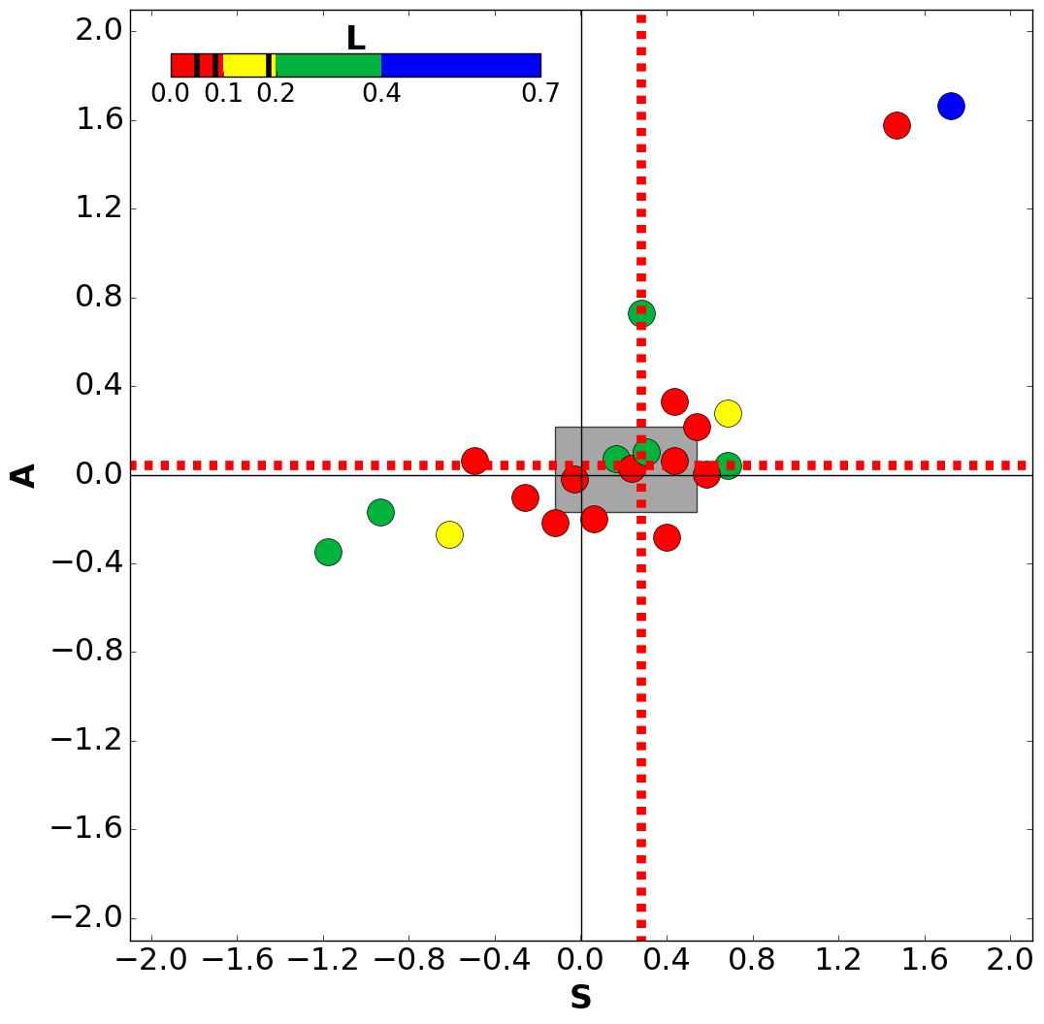
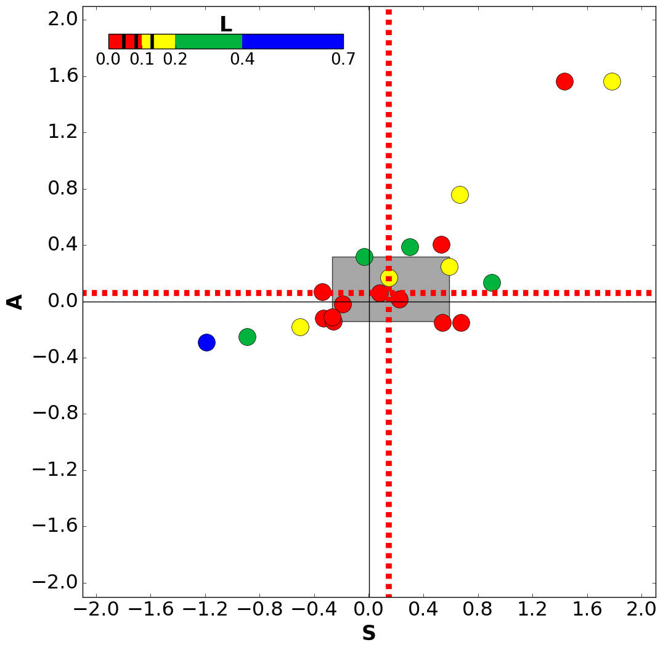
+3h
noDA
conv+LHN
roe 5
roe 10

Slide 9
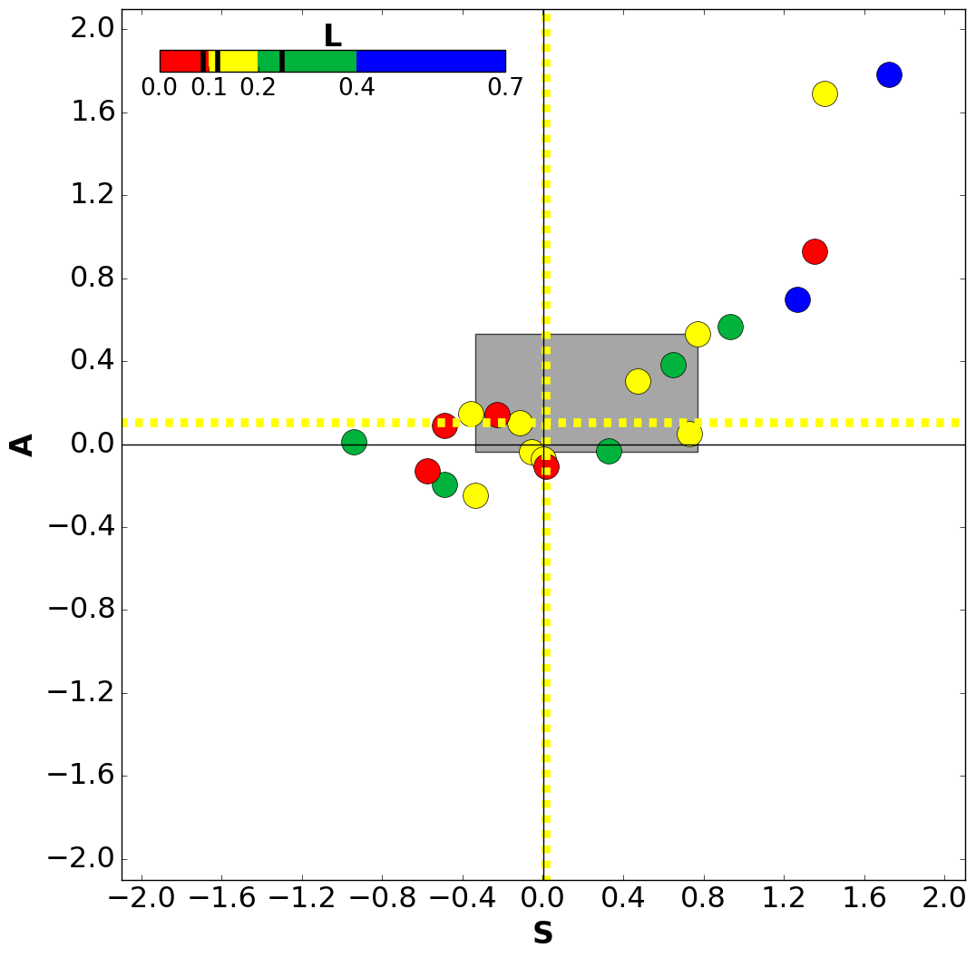
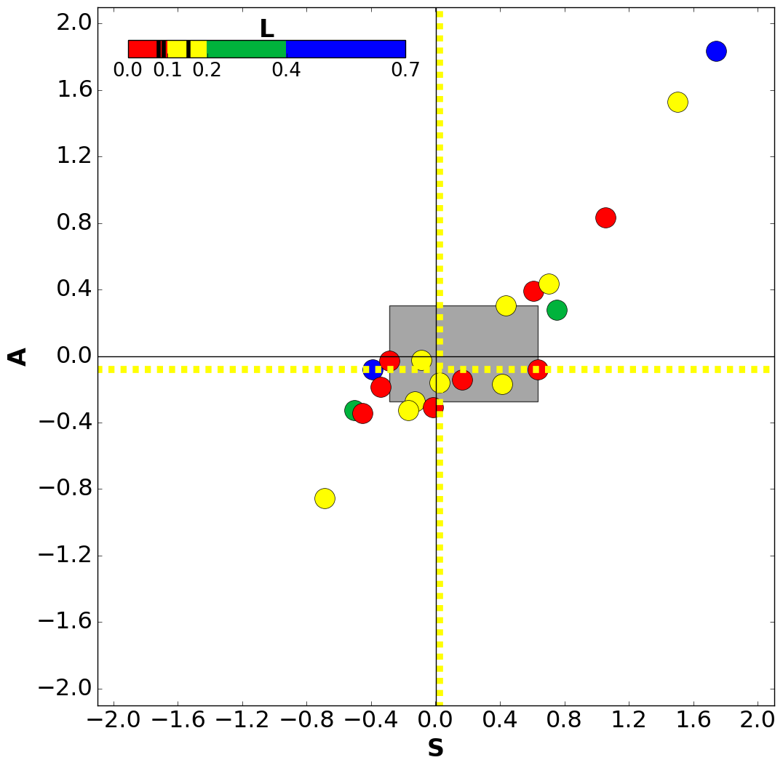
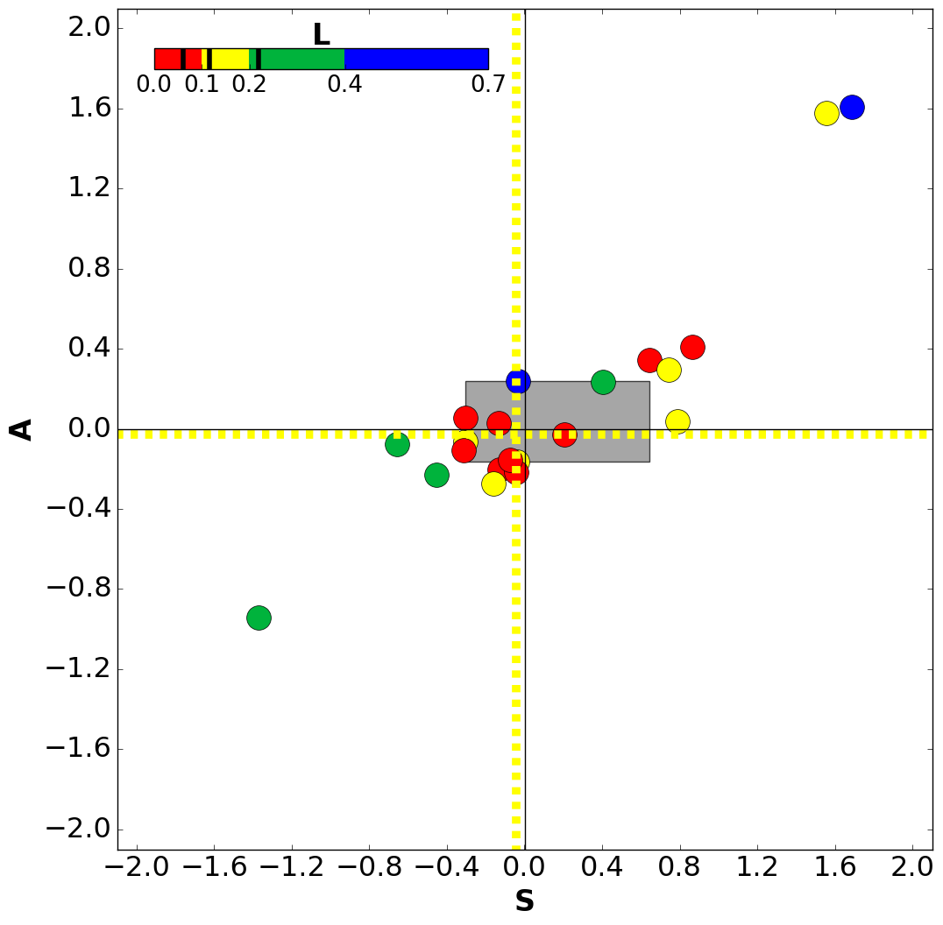
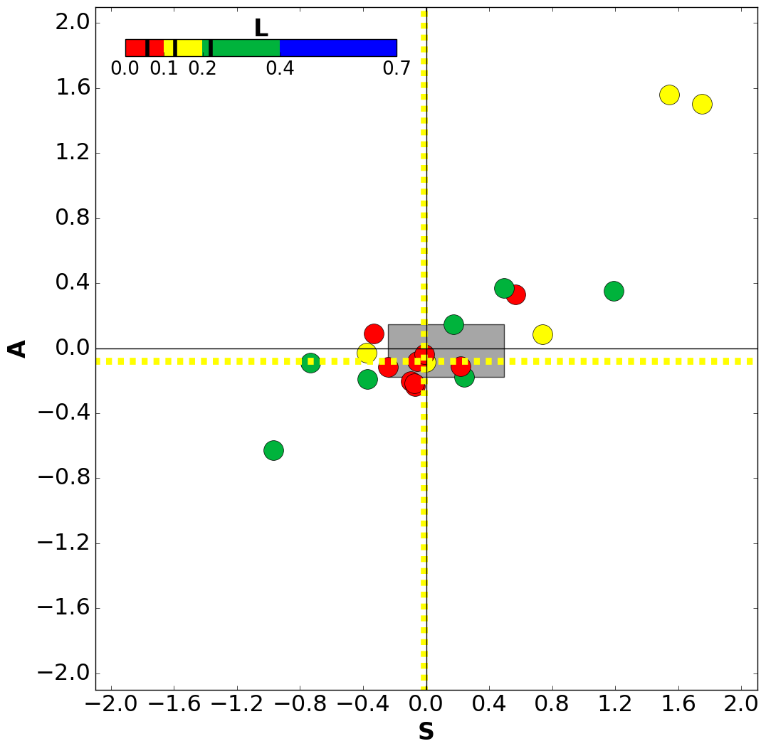
+6h
noDA
conv+LHN
roe 5
roe 10

Slide 10
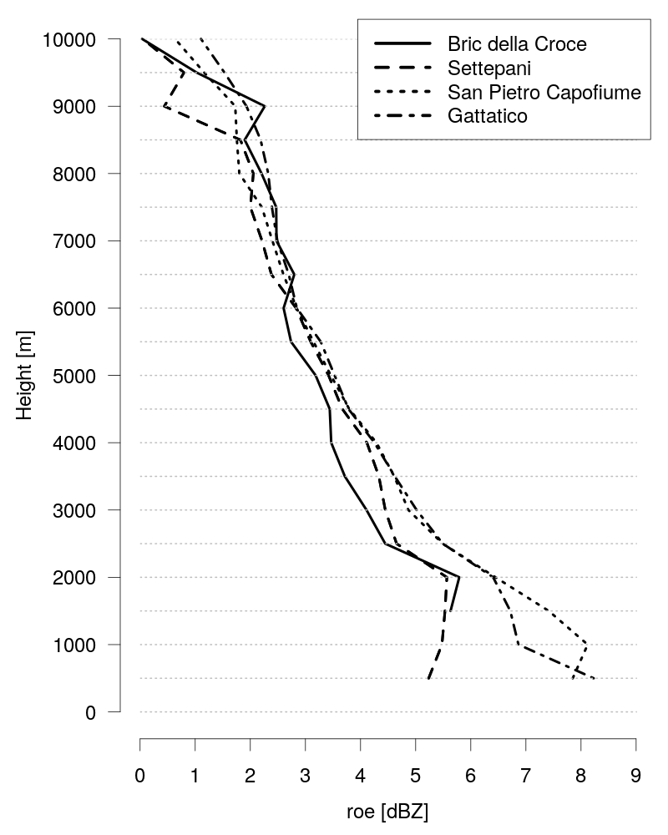
Reflectivity observational error (2)
The reflectivity observational error is strongly dependent on the radar station, especially at the lowest levels.
An average value for each radar station is computed. These values are employed in a new experiment (roevar) which set-up differs from that of roe5 and roe10 only due to the values of roe employed.
Two further experiments are performed multiplying roe value of each station by a factor 1.5 (roevar1.5) and by a factor 2 (roevar2).

Slide 11
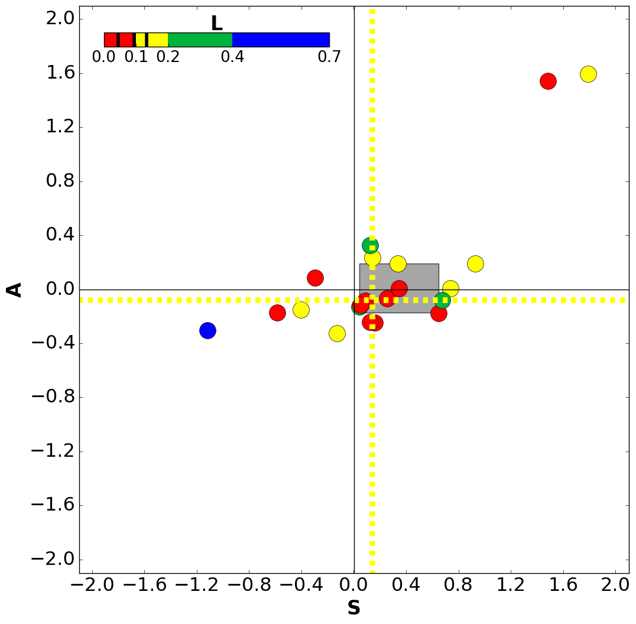
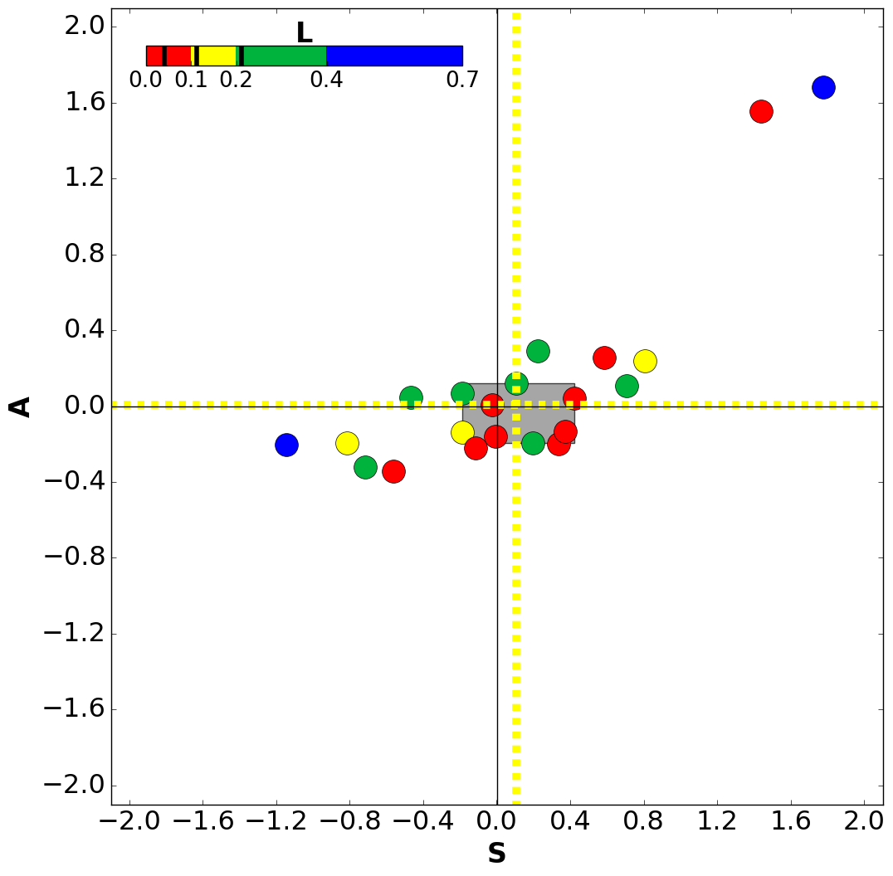
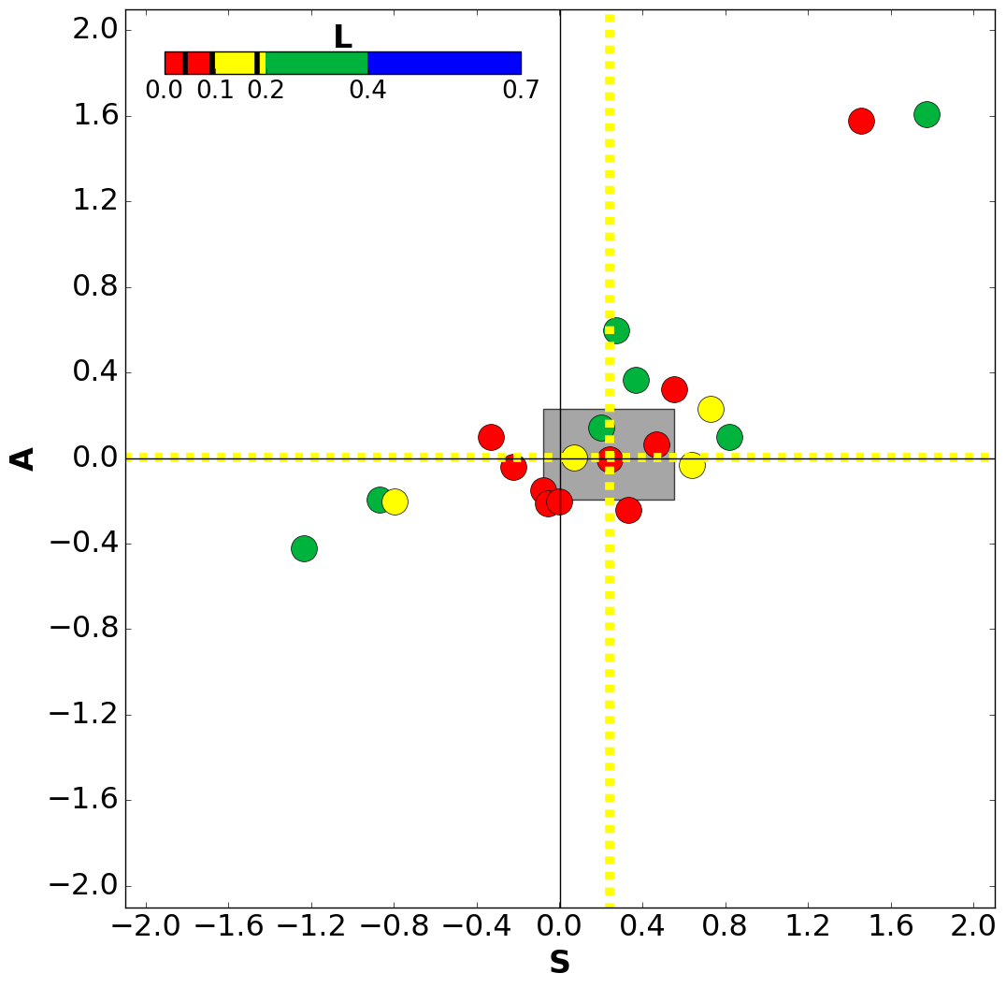
+3h
roe 10
roevar
roevar1.5
roevar2

Slide 12
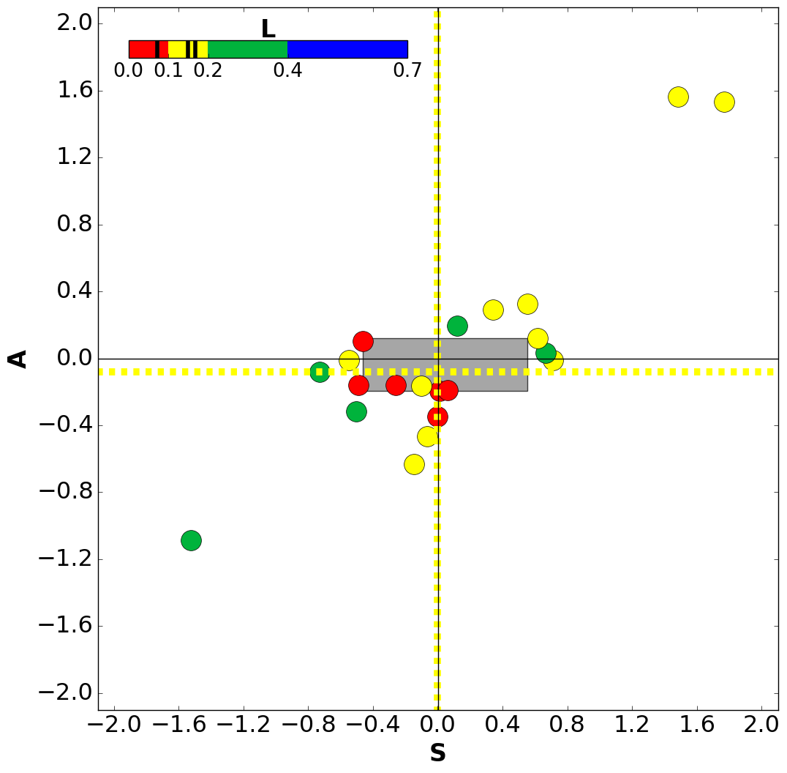
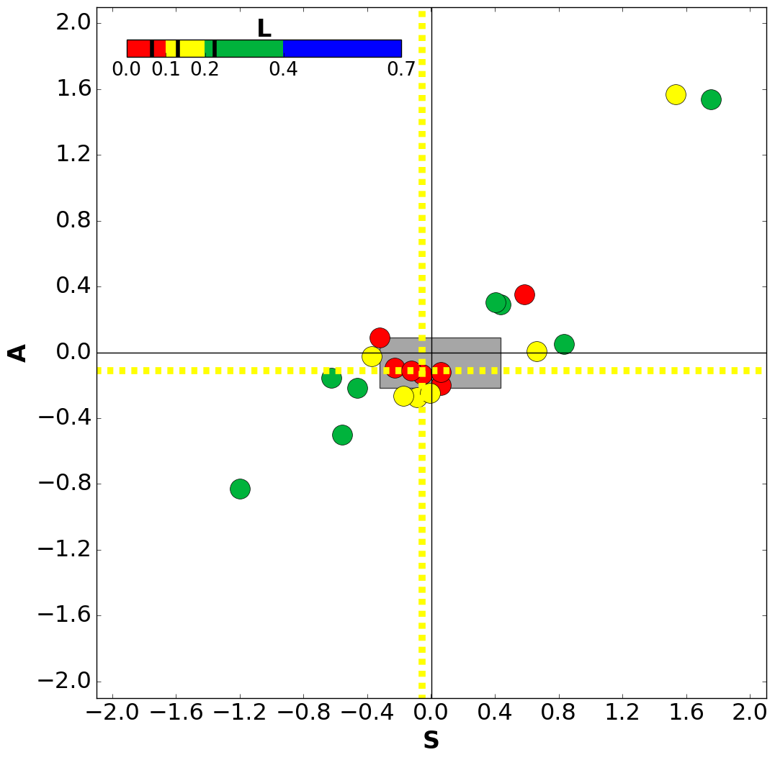
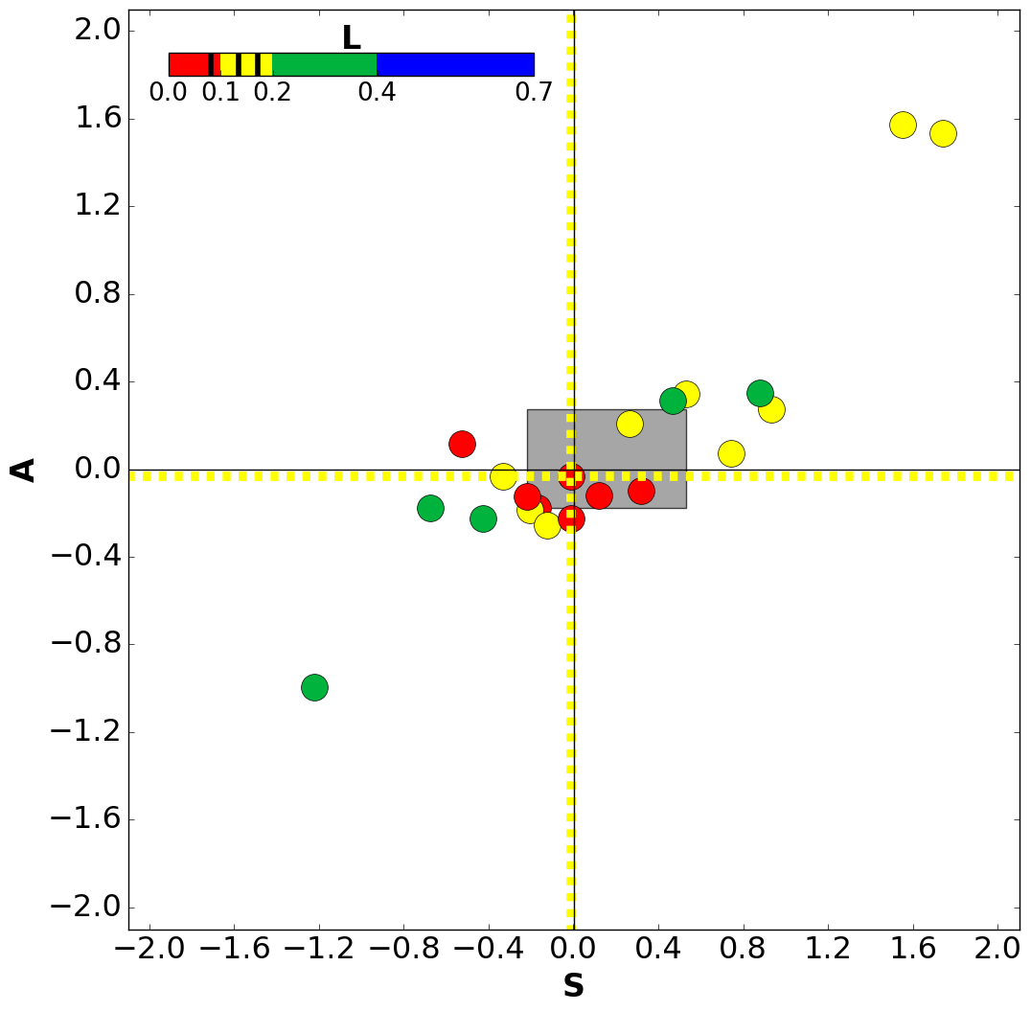
+6h
roe 10
roevar
roevar1.5
roevar2

Slide 13
Conclusions and future plans
Assimilation of reflectivity volumes has a great potential due to the high spatial and temporal density of this type of observations.
Tests are ongoing at Arpae and first results exhibit a slight improvement in forecast precipitation accuracy.
Employing a value of the observational error different for each radar is slightly beneficial, especially when values computed with the Desroziers statistics are multiplied by a factor of 1.5.
Further tests are needed to:
Improve observational error estimation (make it dependent on height, range, and weather regime).
Exploit correlation between neighboring observations.
Assimilate data from the whole Italian radar network

Slide 14
Thank you for your attention!

