Slide 1
Exploring the impacts of orthogonal updates in Hybrid Gain Data assimilation
8th EnKF workshop
Chih-Chien Chang¹
Stephen G. Penny^{2,3,4}
Shu-Chih Yang^{1,4}
¹Department of Atmospheric Sciences, National Central University, Taiwan
²Department of Atmospheric and Oceanic Science, University of Maryland College Park
³National Centers for Environmental Prediction (NCEP), College Park, MD, USA
⁴RIKEN Advanced Institute for Computational Science (AICS), Kobe, Japan.

Slide 2
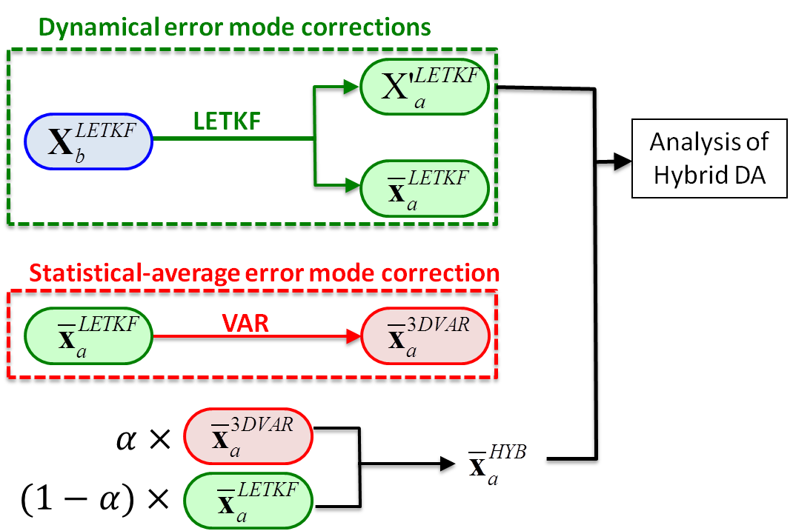
Hybrid-Gain DA algorithm
Two-Step updates!!
3DVar Error modes
Nature error modes
Dynamical error modes

Slide 3
Role of $α$ in hybrids
For HCDA:
Blending the covariance information.
$α_{1}+α_{2}+α_{3}+…+α_{n}=1$
For HGDA:
Adjust the analysis of VAR back toward the analysis ensemble mean state owing to the overestimated B.
Notes:
Matrix A has eigenvalue λ1…λn, the spectral radius $ρ$(A)=max(|λ1|…|λn|)
This can be regarded as the VAR trying to minimize the distance between analysis ensemble mean and observations through the assigned observation error covariance and background error covariance. In an ideal case when the ensemble size is sufficiently large and the model is unbiased, it is appropriate to use the analysis error covariance of EnKF instead of static background error covariance of VAR

Slide 4
Motivation
Can we find an optimal correction component and add it into the EnKF analysis directly without any degradation and without using the tunable parameter, $α$?
The VAR used in the HGDA aims to recover the missing growing modes of the EnKF, the useful correction should be outside the ensemble subspace. Hence, we extract the component, which is orthogonal to the ensemble subspace, from the VAR as the optimal correction.
QR-HGDA limits the VAR’s correction in the subspace that orthogonal to the ensemble space.

Slide 5
Experiment setup
EnKF DA
VAR DA
HGDA (2-step )
LETKF*α + VAR*(1-α)
α=0.5
QR decompose
Background
Orthogonal component
QR-HGDA
LETKF + orthogonal component
DO NOT NEED the α
EnKF DA
another HGDA version
VAR DA

Slide 6
Model setting
The quasi-geostrophic (QG) model (Rotunno and Bao, 1996) is used in this study.
The HGDA algorithm is implemented with the QG-3DVAR system (Morss ,1999) and the QG-LETKF system (Yang et. al., 2009).
Dimension: 65x33x7
Model variables:
potential temperatures at the bottom and top levels
potential vorticity at the interior levels.
Observations: 64 profiles of (u,v,t) (3% coverage)
Assimilation interval : 12 hrs

Slide 7
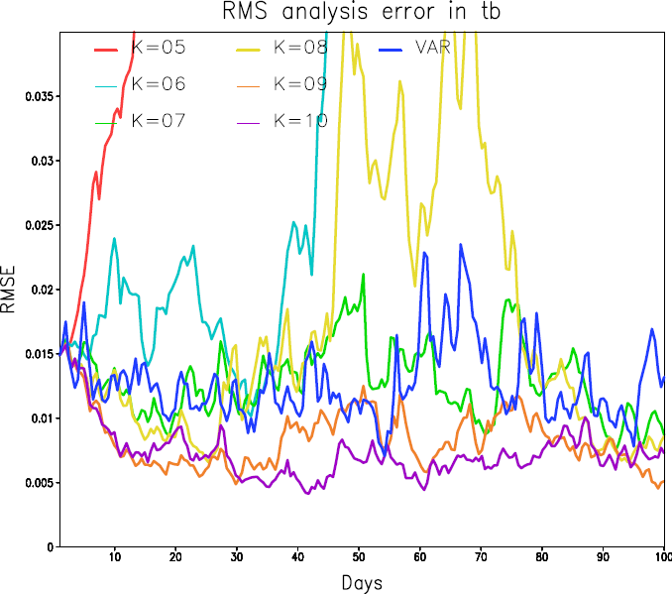
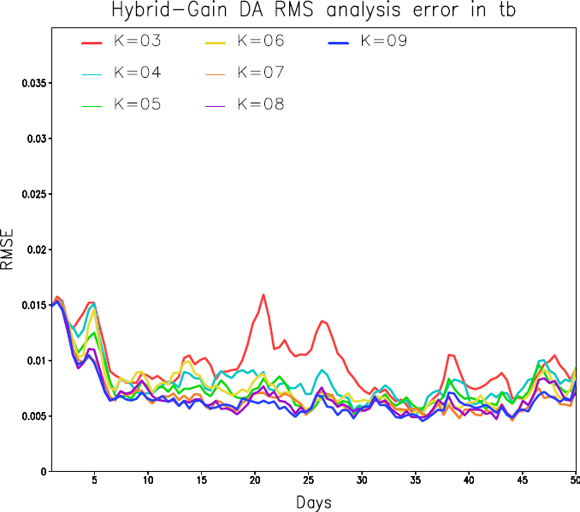
Time series RMSE for DA systems

Slide 8
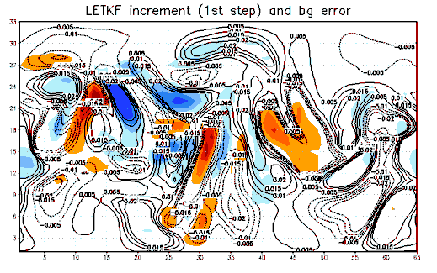
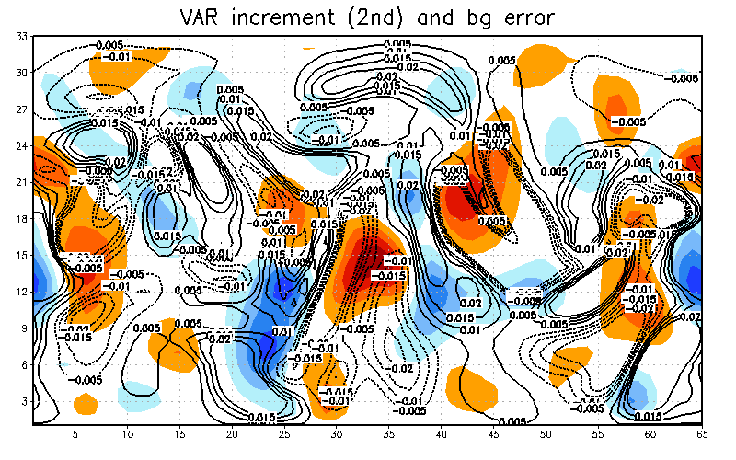
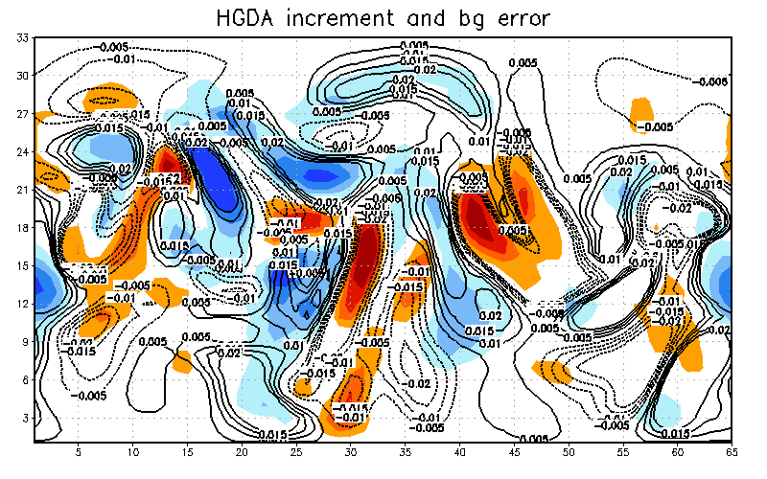
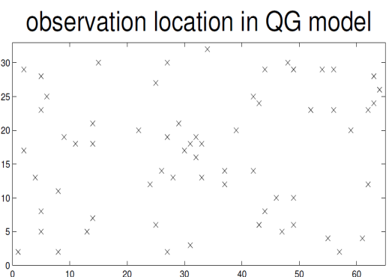
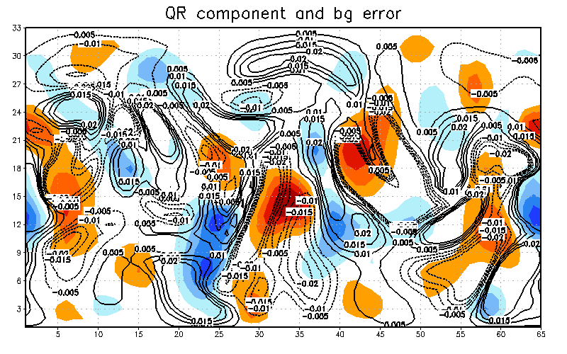
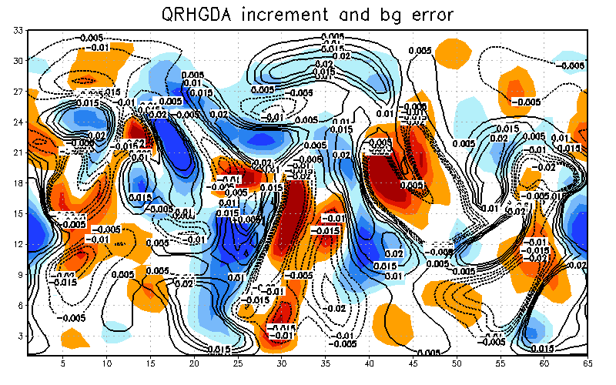
K=6 t=240
It seems that correction of VAR is quite independent to the LETKF
Shaded: increment
Contour: bg error

Slide 9
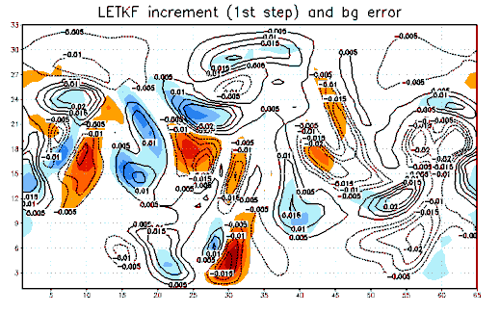
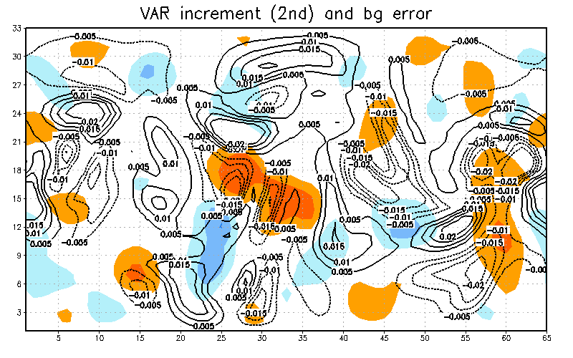
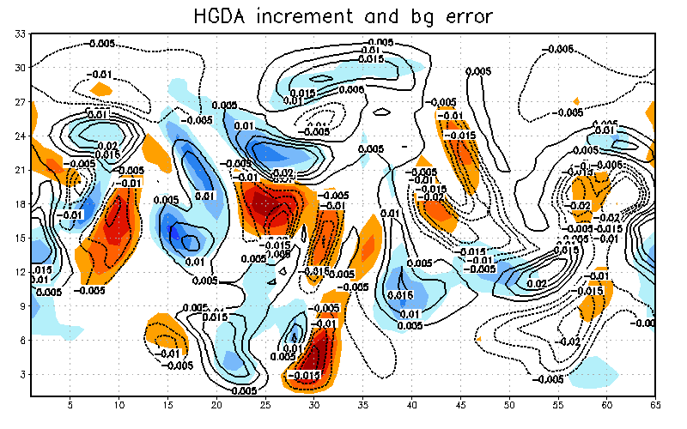
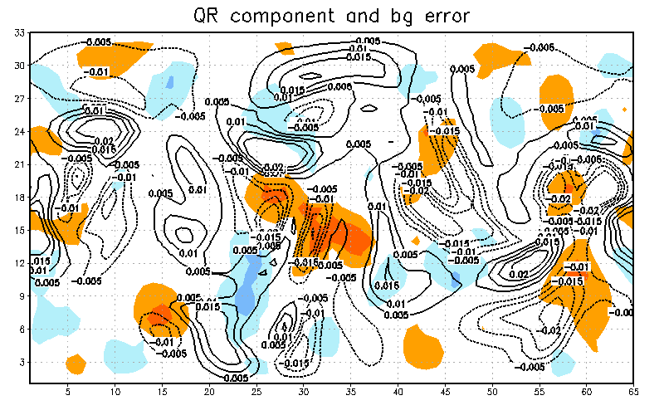
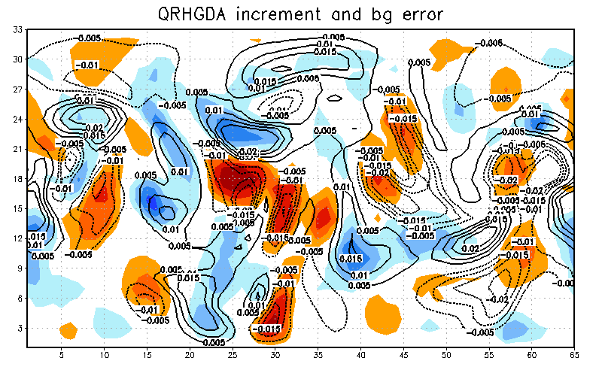
K=20 t=240
If VAR provides inaccurate correction, HGDA is able to smooth out the negative impact. But, QR-HGDA can not.
Shaded: increment
Contour: bg error
Notes:
Smooth out effect.

Slide 10
50 days averaged RMSE
50 days ave. | LETKF | HGDA | QR-HGDA
K=3 | 33.7622 | 0.959064 | 1.03286
K=4 | 28.7014 | 0.824849 | 0.987602
K=5 | 19.2092 | 0.756251 | 0.937539
K=6 | 2.23097 | 0.764848 | 0.920072
K=7 | 1.32713 | 0.674981 | 0.861488
K=8 | 1.44563 | 0.676689 | 0.884795
K=9 | 0.843722 | 0.656196 | 0.84605
K=10 | 0.766681 | 0.634474 | 0.820504
K=15 | 0.654865 | 0.614667 | 0.807201
K=20 | 0.543641 | 0.593387 | 0.773753
Notes:
LETKF can well-represent the error characterization. The information from VAR introduces negative impact on LETKF.
However, the combination weight smooth out such effect. But the QR-HGDA uses all inaccurate information.

Slide 11
Imperfect QG model
We impose a model bias by adjusting the amount of vertical eddy diffusion, which impacts the Ekman pumping effect in the QG model.
The vertical eddy diffusion coefficient is decreased from 5$m^{2}s^{−1}$ to 4.75 $m^{2}s^{−1}$.

Slide 12
Imperfect QG model
HGDA can reduce the model bias and outperforms the LETKF even with 20 members.
QR-HGDA shows some advantage as the ensemble size is small in compared with the HGDA.
When the complexity of model increases, HGDA is more sensitive to the combination weight.
50 days ave. | LETKF w/bias | HGDA w/bias | QRHGDA w/bias
K=3 | 33.6292 | 1.21368 | 1.19496
K=4 | 23.2106 | 1.1113 | 1.09363
K=5 | 16.6046 | 0.948225 | 1.053
K=6 | 2.92321 | 0.922558 | 1.01898
K=7 | 1.89699 | 0.828285 | 0.957123
K=8 | 2.58567 | 0.835325 | 0.969529
K=9 | 1.23684 | 0.800341 | 0.939857
K=10 | 1.10391 | 0.76631 | 0.896177
K=15 | 0.901885 | 0.737163 | 0.883974
K=20 | 0.774239 | 0.703089 | 0.861664
Notes:
(It will divergent for the small K cases when the weight favors EnKF)

Slide 13
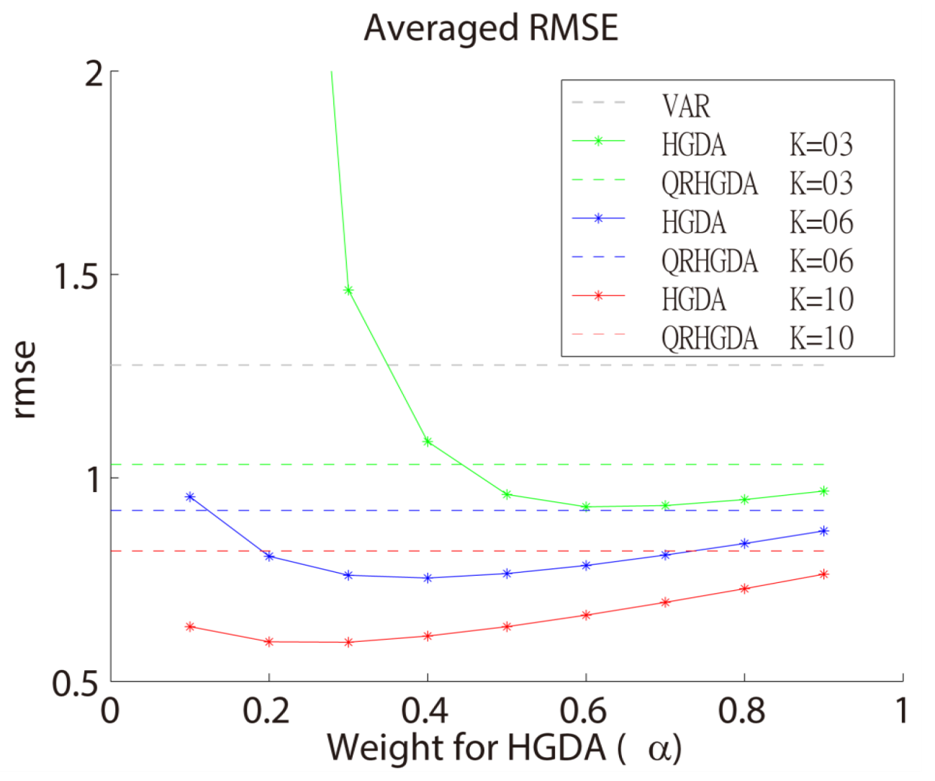
Imperfect QG model
When the ensemble size is relatively smaller than the model dimension, using a combination weight favors the EnKF in the HGDA may cause the filter divergence.
However, the QR-HGDA is still stable.

Slide 14
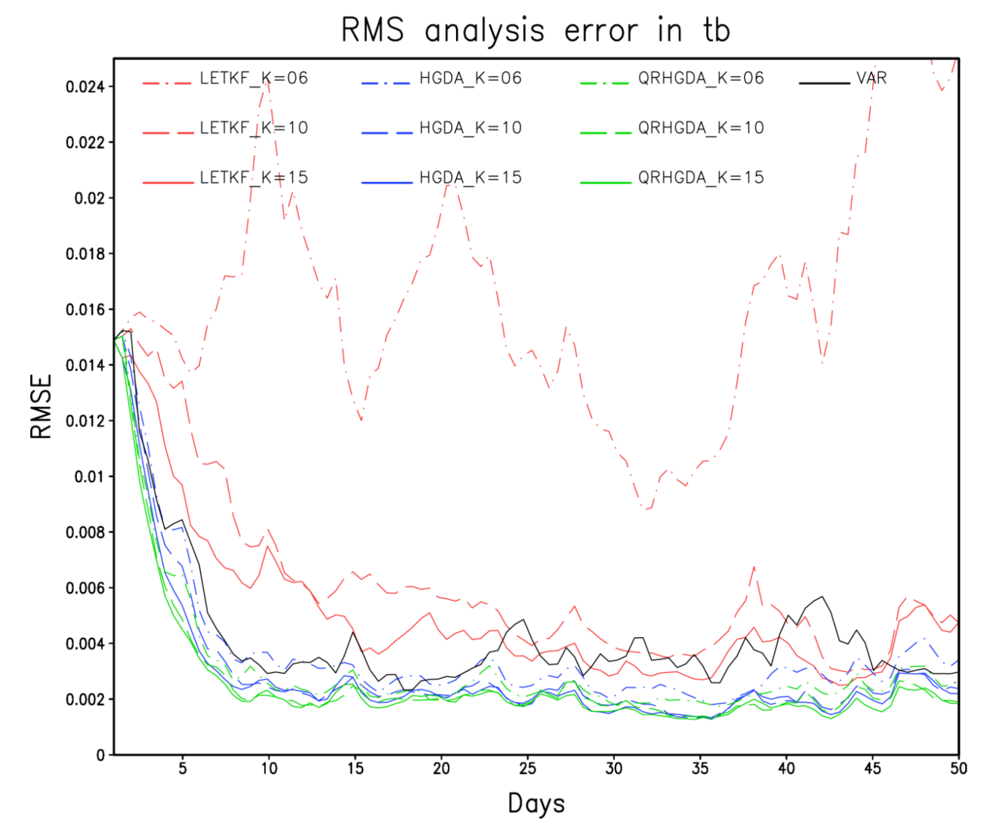
Role of observational noise
Keep the R matrix and the observational noise to zero in the DA system.
We want to mimic the situation of over-estimated observation error.
The QR-HGDA shows some advantage without the observation noise.

Slide 15
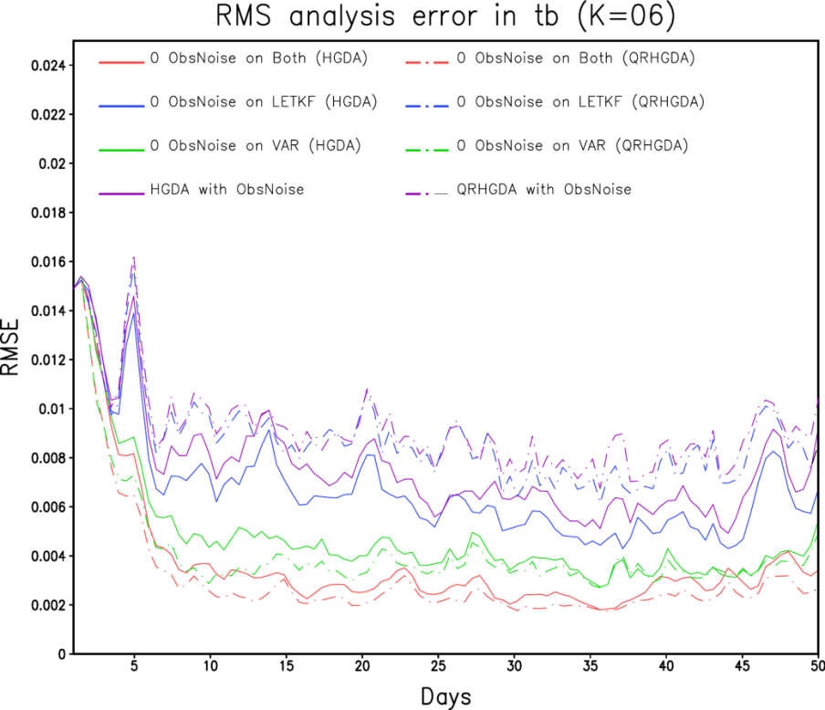
Role of observational noise
LETKF DA
VAR DA
HGDA (2-step )
K=6 | HGDA | QRHGDA
w/o ObsNoise_Both | 0.371652 | 0.312199
w/o ObsNoise_LETKF | 0.678356 | 0.876925
w/o ObsNoise_VAR | 0.477828 | 0.418371
w/ ObsNoise | 0.764848 | 0.920072
VAR seems to be sensitive to the observation noise in the HGDA and the QR-HGDA.
50 days average

Slide 16
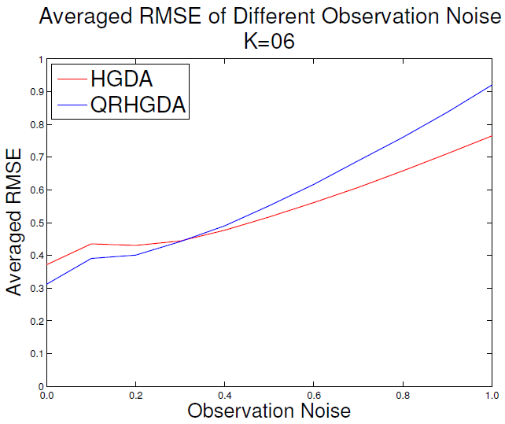
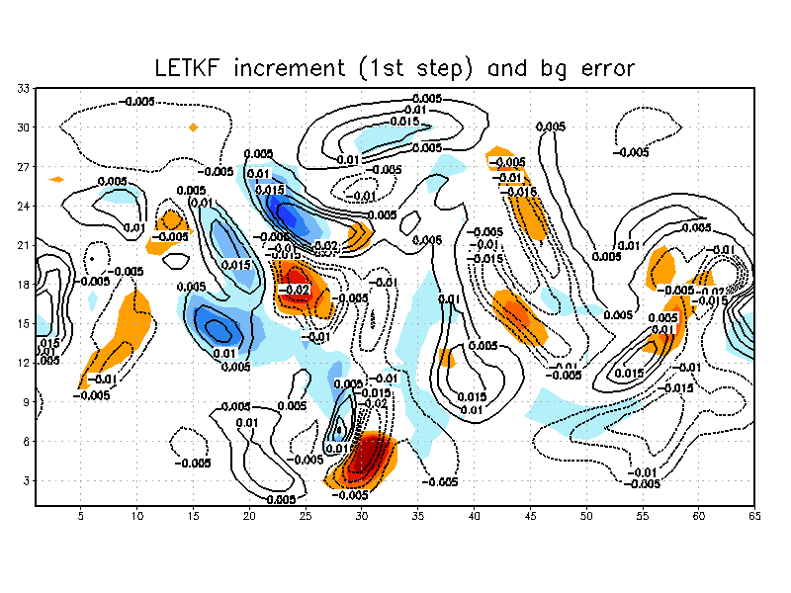
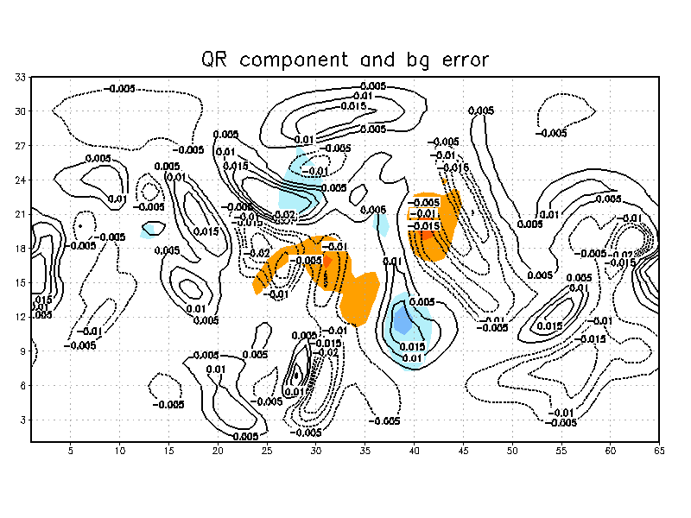
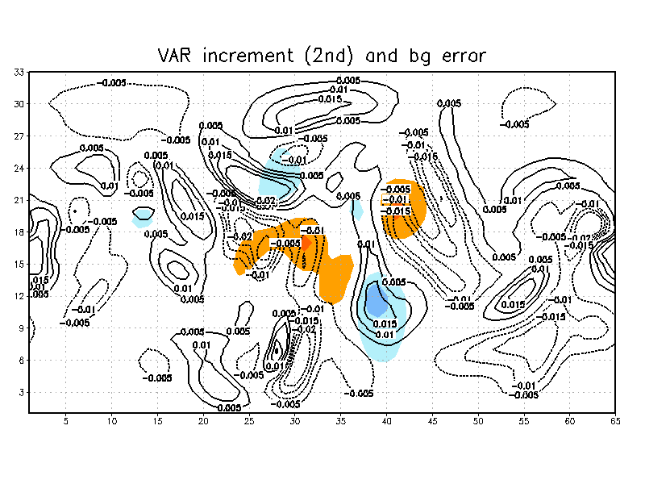
ObsNoise=0.0; K=06

Slide 17
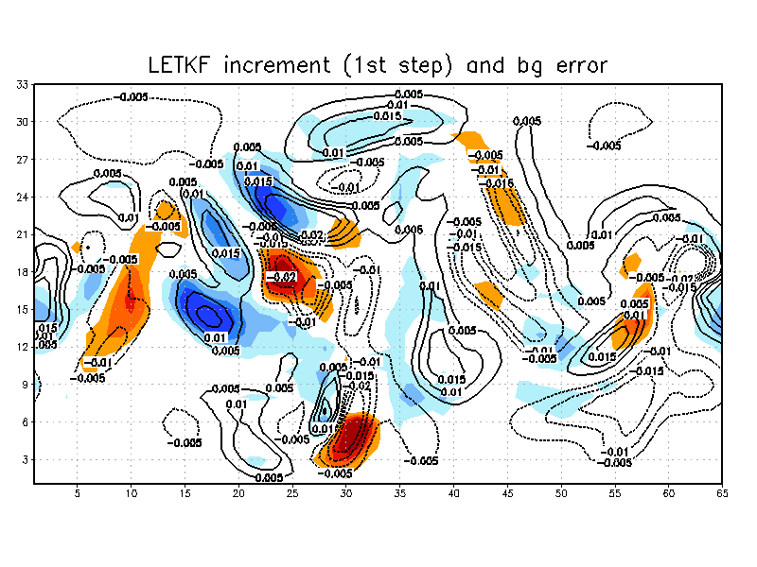
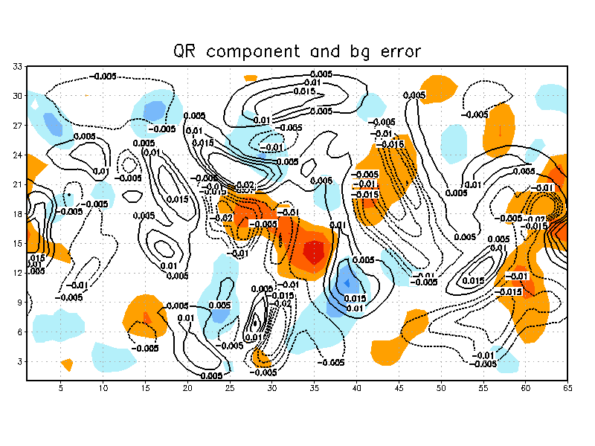
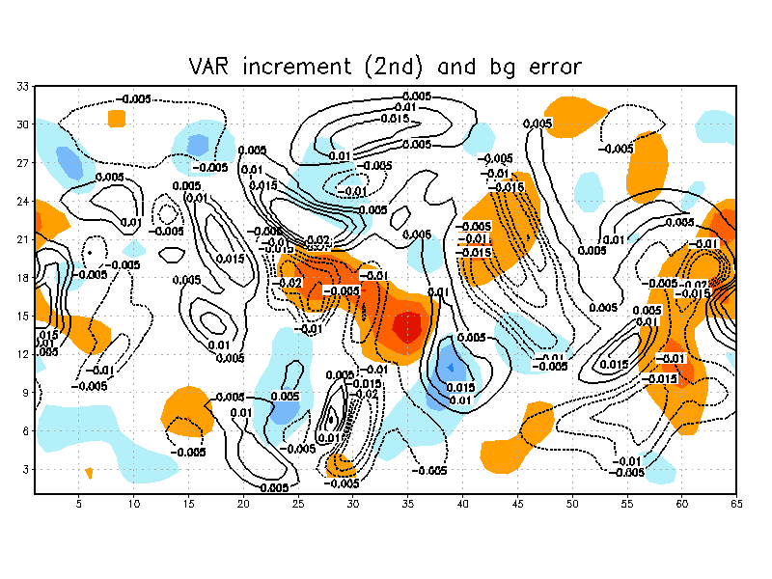
ObsNoise=1.0; K=06

Slide 18
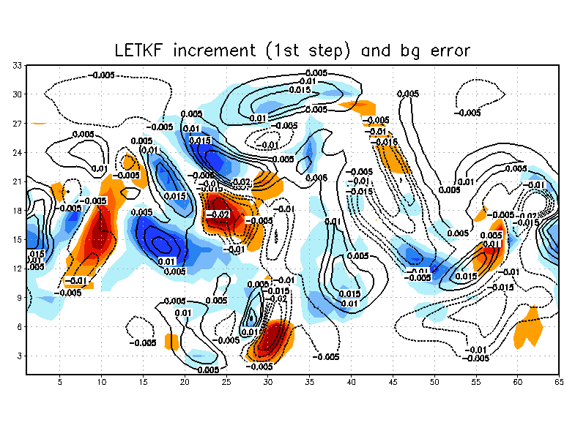
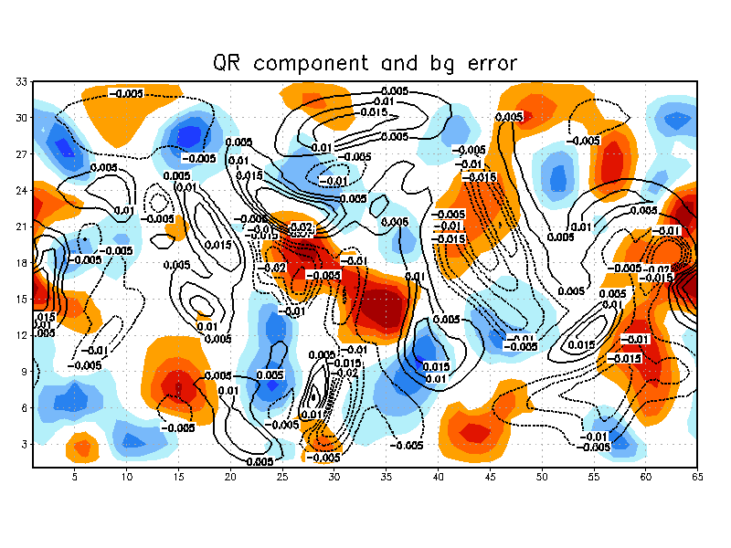
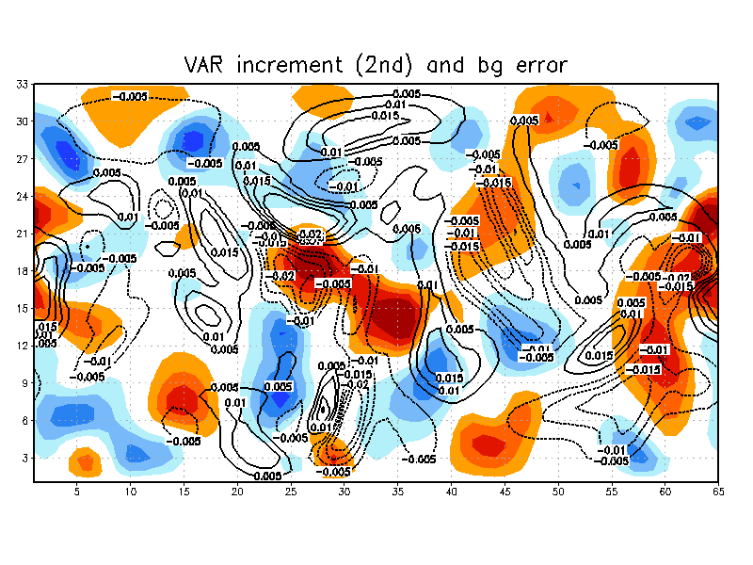
ObsNoise=2.0; K=06
Increasing the ObsNoise, the structure of LETKF increment are remain limited in particular region (direction).
But for the VAR or the orthogonal component, its increment structures become wider.

Slide 19
Conclusion
QR-HGDA is a different strategy of the HGDA update by the orthogonal component, without using the combination weight. Its performance is better than the LETKF and slightly worse than the two-step HGDA.
QR-HGDA provides corrections in the subspace orthogonal to the ensemble perturbations, accounting for unrepresented unstable and neutral modes in the EnKF.
The sensitive test implies that the observation noise plays an important role in the DA processes. When the negative effect of observation noise becomes unavoidable, HGDA can smooth out the errors introduced into EnKF due to the observation noise through the combination weight but the orthogonal correction of QR-HGDA does not adequately account for the effects of such noise.

Slide 21
The only limitation is the final gain matrix must generate a contraction, i.e. the spectral radius $ρ\left(I−KH\right)<1$.

Slide 22
Hybrid Gain algorithm
$$\hat{\overline{x_{a}}}=\left(1−α\right)\overline{x_{a}}+α\overline{{x_{a}}^{v}}$$
$\left(1−α\right) \overline{x_{a}} =\left(1−α\right)[\overline{x_{b}}+δ_{x}]$
$$+ α \overline{{x_{a}}^{v}} = α\left[(\overline{x_{b}}+δ_{x})+δ_{xv}\right]$$
-------------------------------------------------------
$=\left[\overline{x_{b}}+δ_{x}+δ_{xv}\right]$
$=[\overline{x_{b}} +\left(K_{LETKF}+K_{var}\right)∗innovation]$
Gain combination!!

Slide 23
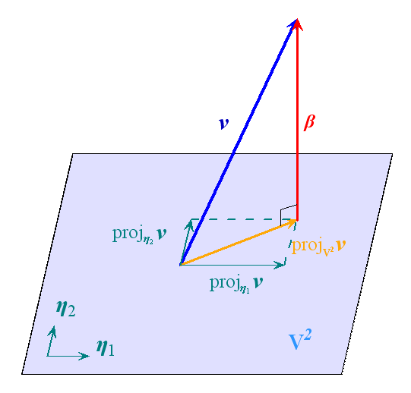
QR factorization
Gram-Schmidt orthogonalization
A=[member #1, member #2, … ,member #k, analysis of VAR]
Orthogonal component=last column of QR(A)

