Slide 1
Recent Developments in the Met Office Ensemble Prediction System MOGREPS-G
Mohamed Jardak (presenter), N.E. Bowler, A.M. Clayton, G.W. Inverarity, A.C. Lorenc, M.A. Wlasak and L. Anton
The 8th EnKF Data Assimilation Workshop. Sainte-Adèle, Québec Canada May 8th 2018
www.metoffice.gov.uk © Crown Copyright 2018, Met Office
Notes:
Always use a cover slide to start your presentation. There are three to choose from within the template.
If you require a bespoke image please email the studio design.studio@metoffice.gov.uk
Please allow 2 working days

Slide 2
ETKF Replacement Project
Replace ETKF with more sophisticated, sustainable update:
ETKF-based ensemble: transform ensemble perturbations using information from latest observations
Sophisticated adaptive inflation scheme
Simple localisation
4DEnVar-based ensemble: Perform data assimilation for each member using VAR code
Sophisticated localisation
Easier to maintain
Closer to DA system (hybrid covariances)
Cheaper than an ensemble of 4DVar

Slide 3
4DEnVar-based Ensemble: Key Design Features
Ensemble of data assimilations (En-4DEnVar step):
“Simple self-exclusion” method to prevent inbreeding
“Mean-pert” method to reduce computational cost
Inflation to account for data assimilation deficiencies:
RTPP: Relaxation to Prior Perturbations
RTPS: Relaxation to Prior Spread

Slide 4
4DEnVar-based Ensemble: Key Design Features
To account for model uncertainties:
Random parameters in physics
SKEB: Stochastic Kinetic Energy Backscatter
Additive inflation based on scaled historical analysis increments, plus bias corrections
To account for other uncertainties:
Random perturbations to SST, soil moisture and soil temperature

Slide 5
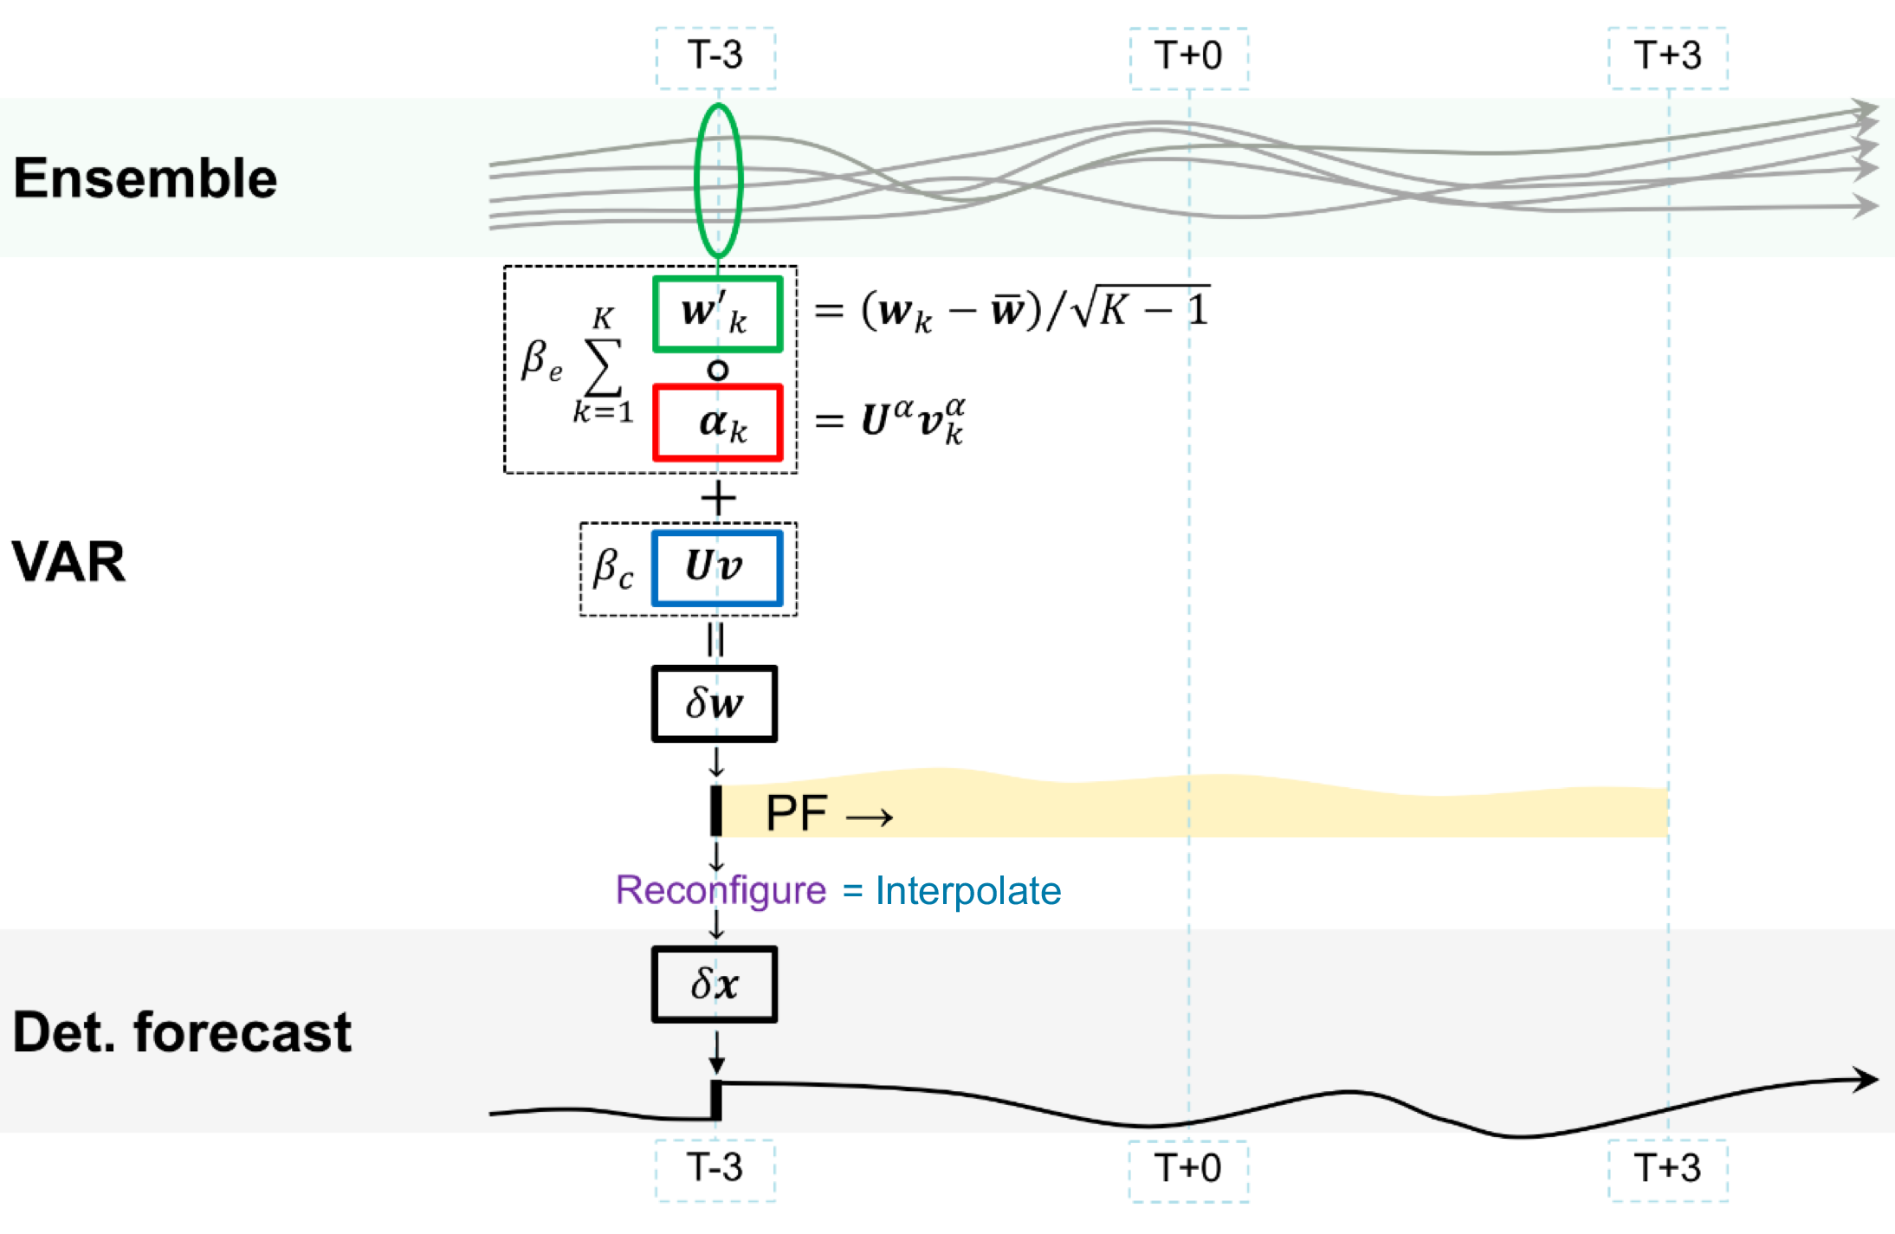
Hybrid-4DVar versus Hybrid-4DEnVar:
Hybrid-4DVar schematic
Details in: Clayton et al (2013) Q.J.R. Meteorol.,Soc., https://doi.org/10.1002/qj.2054

Slide 6
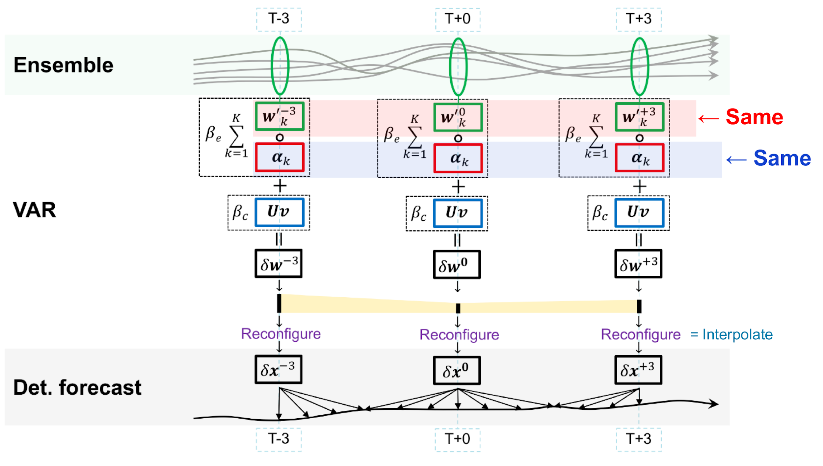
Hybrid-4DVar versus Hybrid-4DEnVar:
Hybrid-4DEnVar schematic
Details in: Clayton et al (2013) Q.J.R. Meteorol., Soc., https://doi.org/10.1002/qj.2054

Slide 7
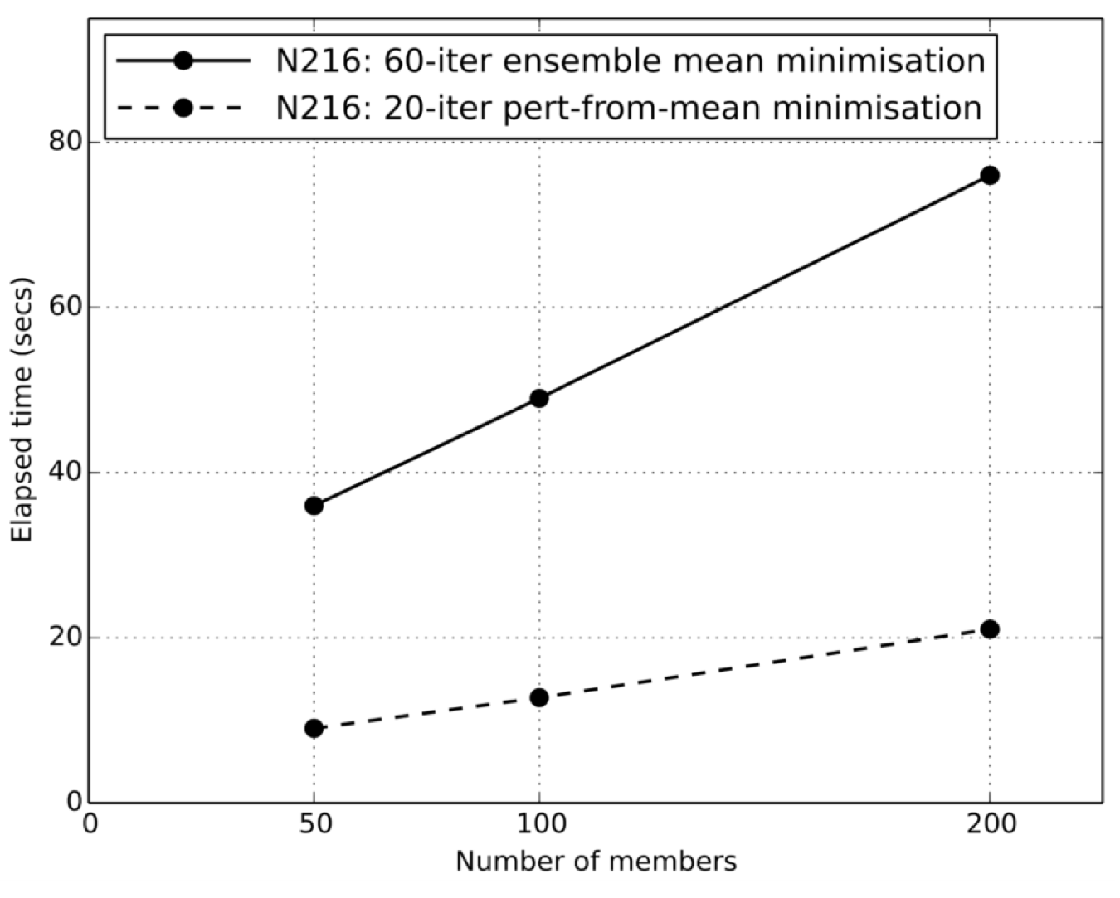
Mean-Pert Method: Reduce Computation Cost
Calculate ensemble mean analysis using fully nonlinear analysis equations
Calculate perturbations from mean analysis for each member, using linear equations and a reduced iteration count
Details in: Lorenc et al (2013) Q.J.R. Meteorol., Soc., https://doi.org/10.1002/qj.2965

Slide 8
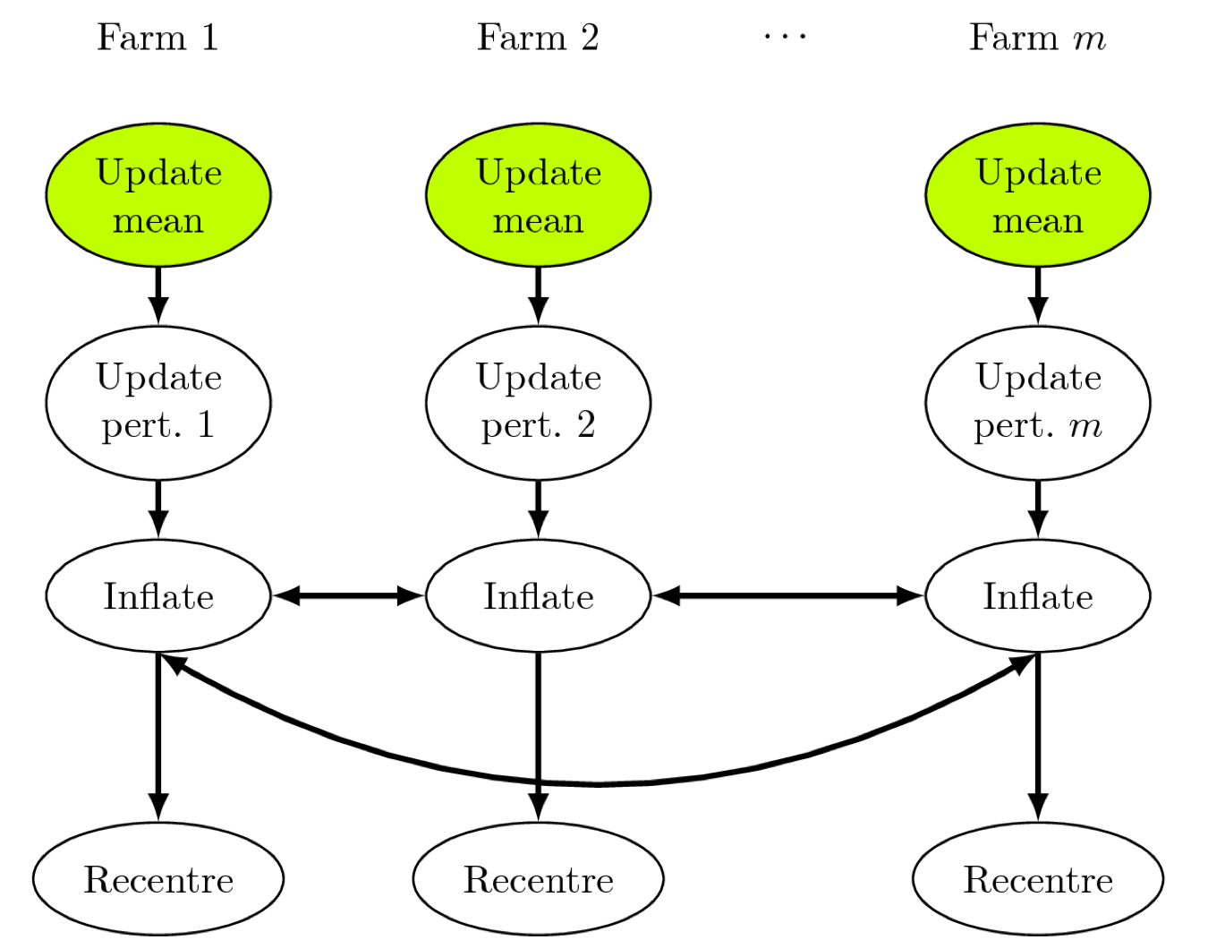
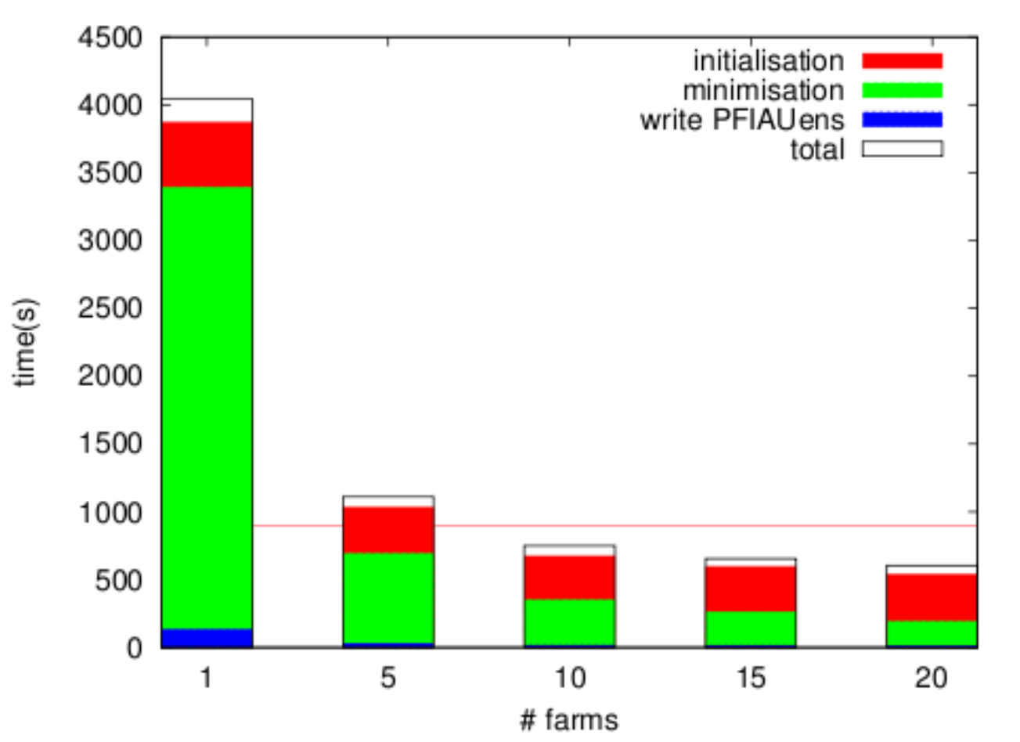
Mean-Pert Method: Reduce Run Time

Slide 9
4DEnVar-based Ensemble Design Features: Inflation
Inflation to account for DA deficiencies:
RTPP: Relaxation to Prior Perturbations - factor 0.5 mimic EnSRF/DEnKF
RTPP good at maintaining ensemble spread
Makes perturbations too large-scale and too balanced
RTPS: Relaxation to Prior Spread
More realistic effect on scale and balance of perturbations
Relatively poor at maintaining ensemble spread
Details in: Zhang et al. (2004) Mon. Weather Rev. https://doi.org/10.1175/15200493(2004)132%3C1238:IOIEAO$3E2.0.CO;2 and Whitaker and Hamill (2012), Mon. Weather Rev. https:/doi.org/10.1175/MWR-D-11-00276.1

Slide 10
4DEnVar-based Ensemble Design Features:
Model Uncertainties
To account for model uncertainties:
Random parameters in physics
SKEB: Stochastic Kinetic Energy Backscatter
Additive inflation based on scaled historical analysis increments plus bias correction
To account for other uncertainties:
Random perturbations to SST, soil moisture and soil temperature

Slide 11
Additive Inflation
Archive of analysis increments:
Average analysis increment:
Randomly select increments from the archive:
For each 6-hour window, add these increments to the analysis mean, removing the sample average:
Details in: Bowler et al. (2017). Q. J. R. Meteorol. Soc., https://doi.org/10.1002/qj.3004

Slide 12
Recentering versus No Recentering:
No recentering
full recentering
Partial recentering

Slide 13
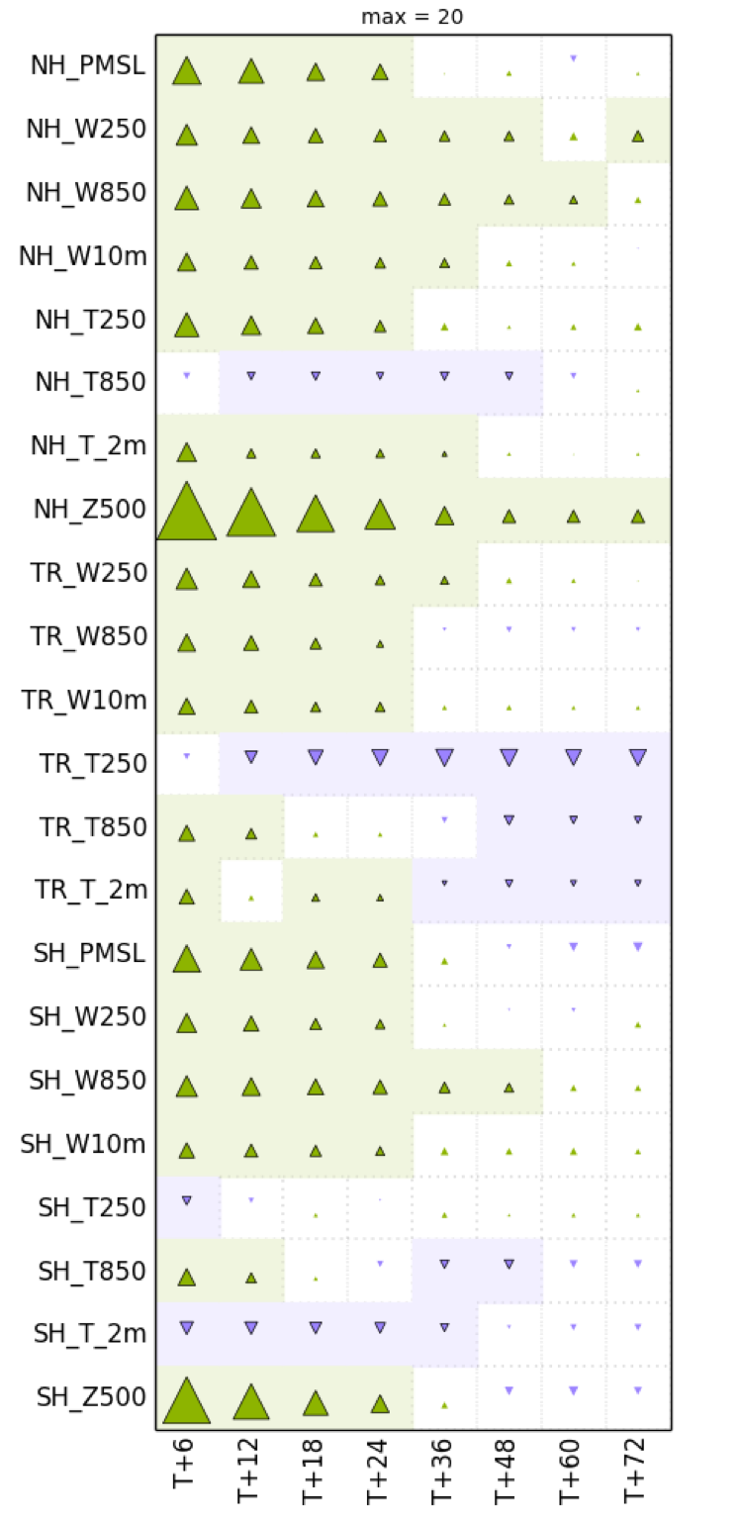
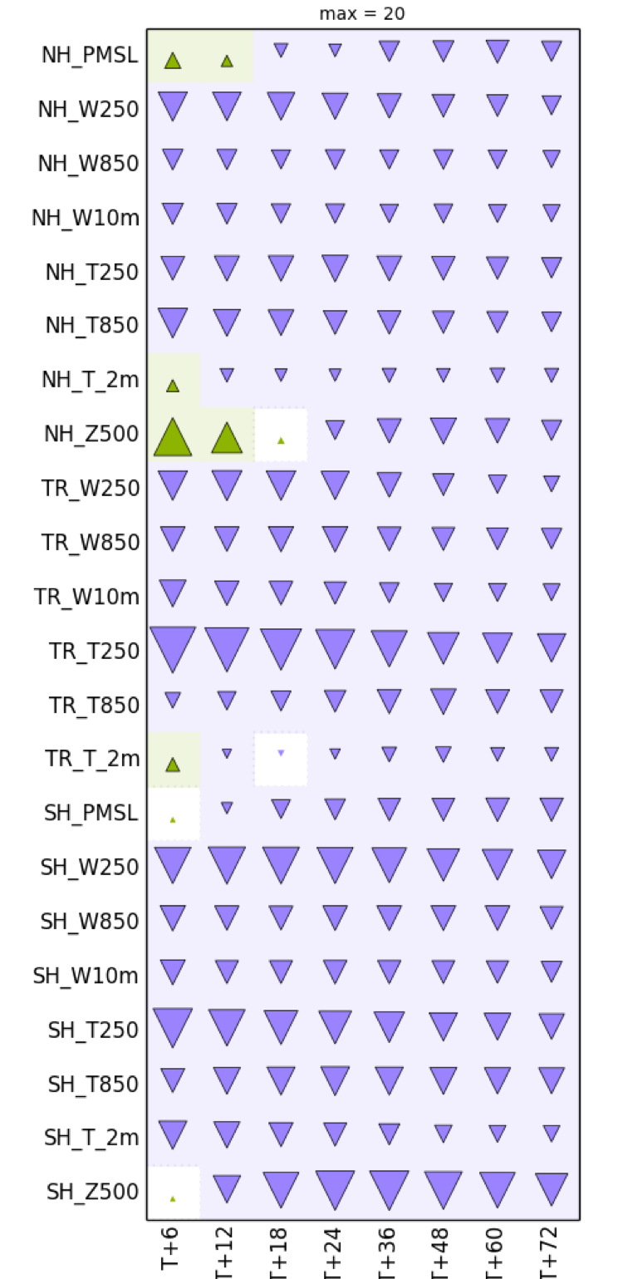
Recentering versus No Recentering:
% change in CRPS vs. ECMWF analyses:
Change 𑁛 Area of Triangle:
: at least 20% better
: statistically significant change

Slide 14
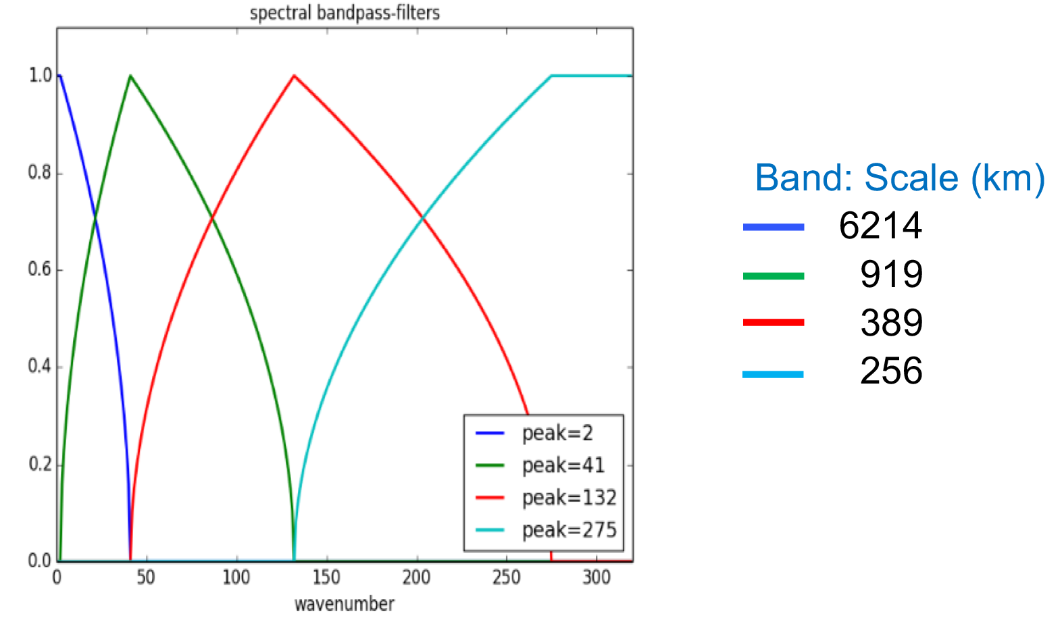
Improved Processing of Ensemble Data:
Horizontal Waveband Localisation
Correlations decrease with distance between horizontal wavenumbers, therefore split ensemble error modes into wavebands and assume they are uncorrelated
Apply shorter localisation scales to shorter scale bands
Details in: Buehner (2012). Mon. Weather Rev. https://doi.org/10.1175/MWR-D-10-05052.1

Slide 15
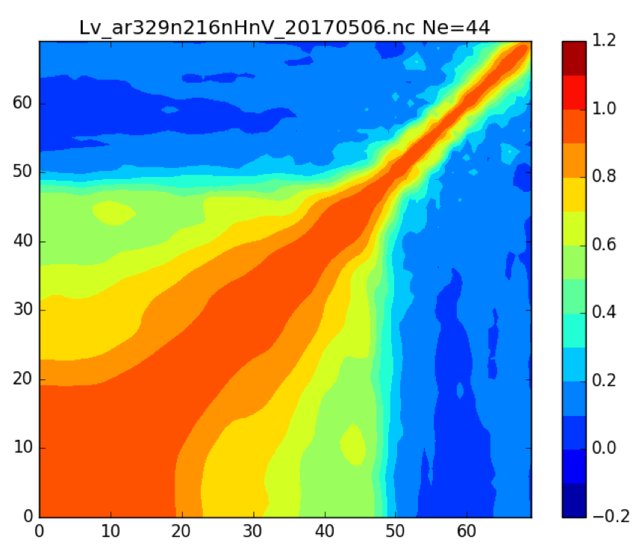
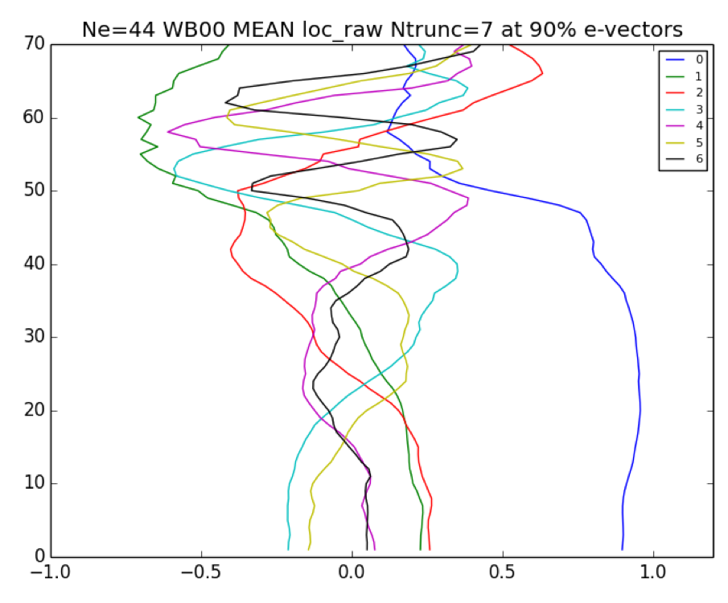
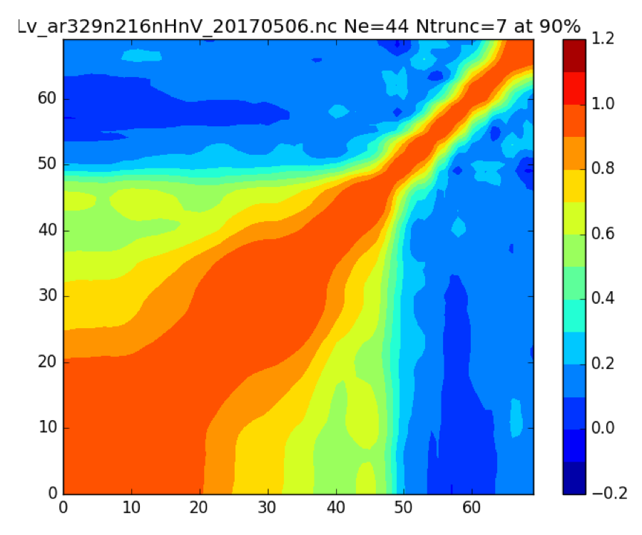
Improved Processing of Ensemble Data:
Hybrid_diag localisation
Software also used to diagnose a new vertical localisation matrix
Raw diagnosed localisations
Retained eigenvectors
Truncated & renormalized localisations
Details in: Lorenc (2017). Q.J.R. Meteorol. Soc., https://doi.org/10.1002/qj.2990 and Inverarity et al. (2018). https://www.metoffice.gov.uk/learning/library/publications/science/weather-science-technical-reports

Slide 16
4DEnVar-based Ensemble Design Features:
Trial Setup
44 and 100 perturbed members (12-minutes used to produce forecast for 44 perturbed members)
Experiments with N400L70 model at approximately 32 km grid spacing
Operational system used N64L70 model at approximately 21 km grid spacing and full recentering around the deterministic analysis
RTPP factor = 0.5 and RTPS factor = 0.7
Waveband horizontal localisation scales (6241,919,389,256) km
Ménétrier vertical localisation
Hybrid covariance weights

Slide 17
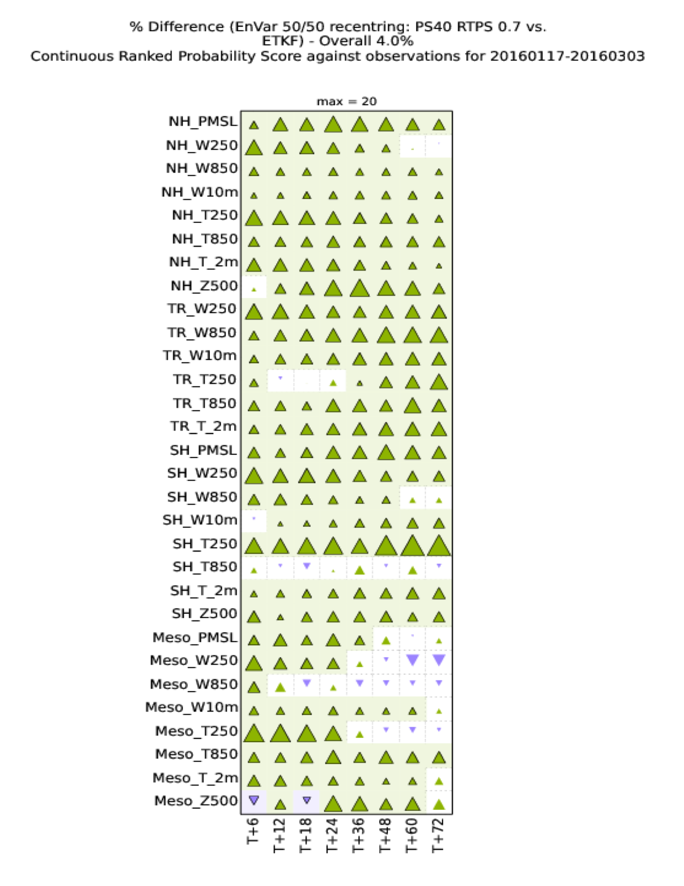
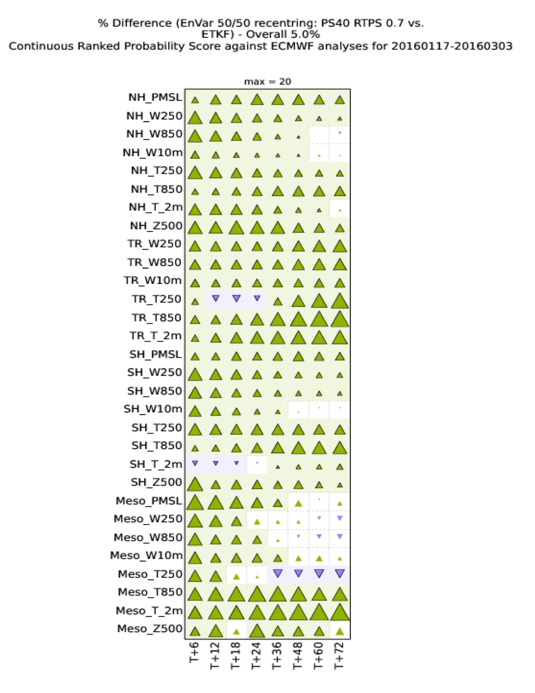
Results
January to March 2016:
Full recentred 44 member ETKF
versus
Half recentred 44 member En-4DEnVar

Slide 18
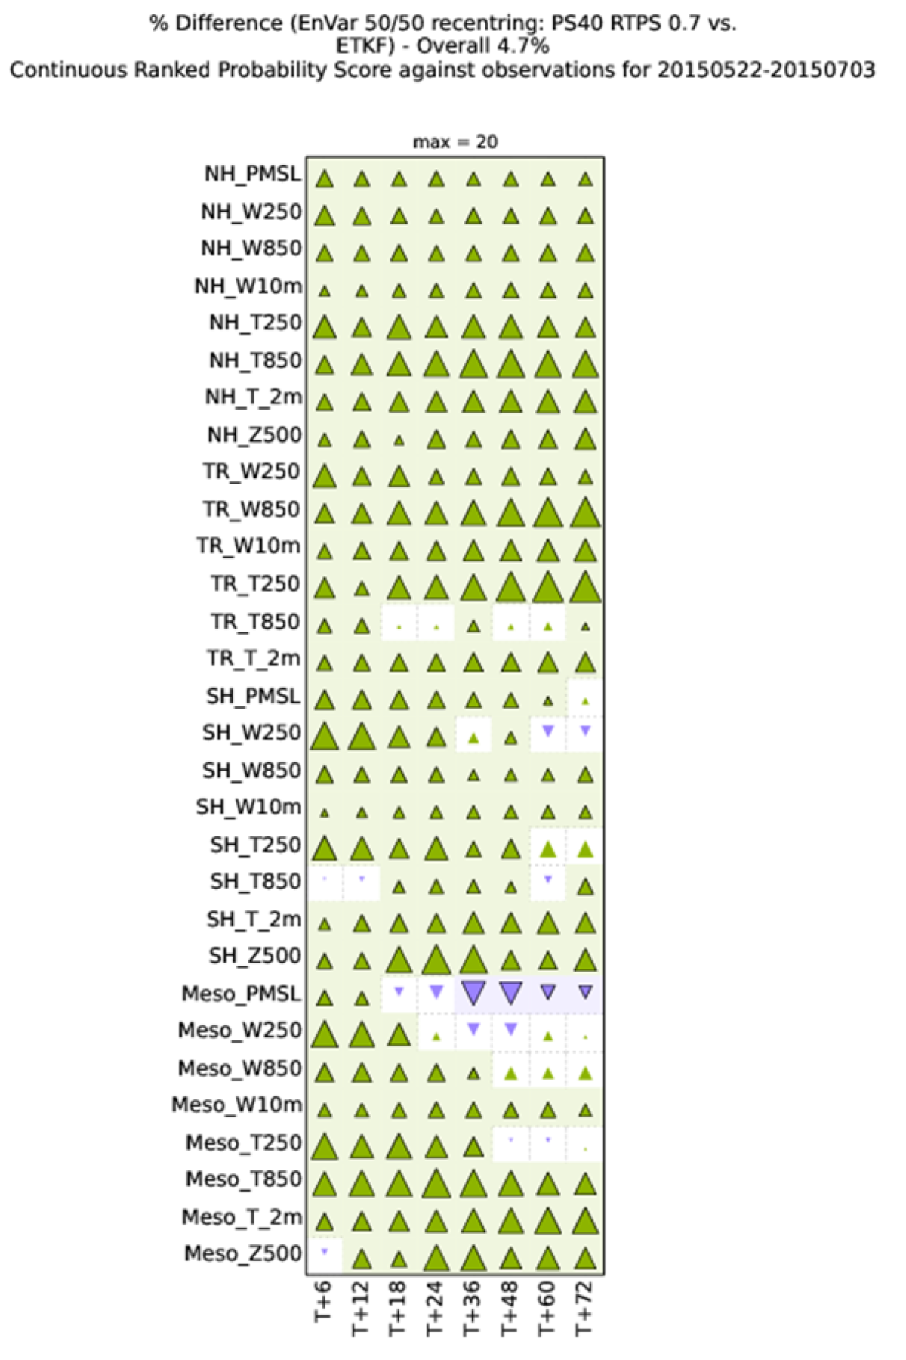
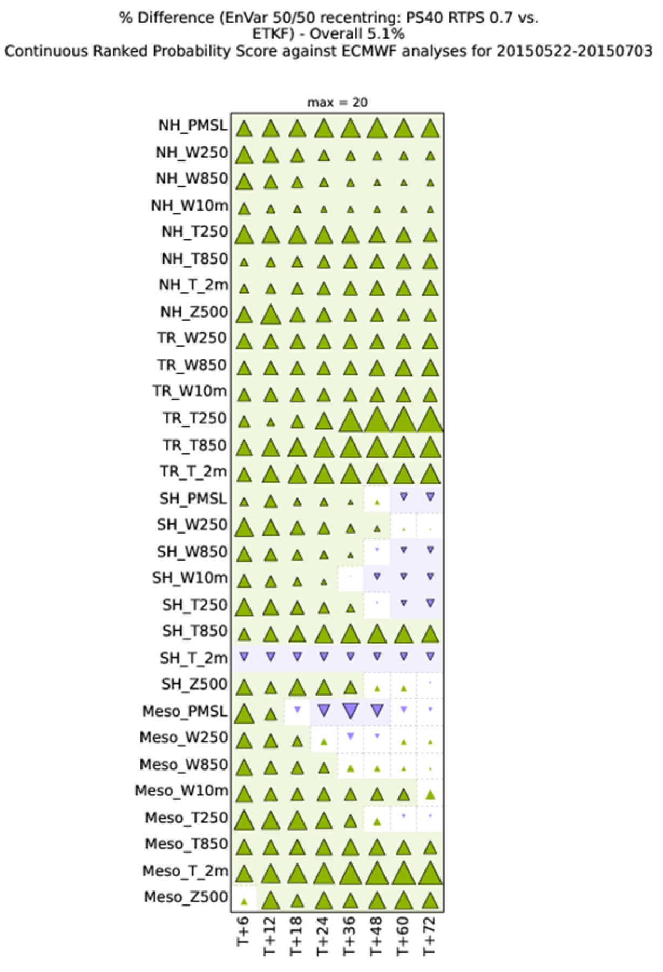
Results
May to July 2015:
Full recentred 44 member ETKF
versus
Half recentred 44 member En-4DEnVar

Slide 19
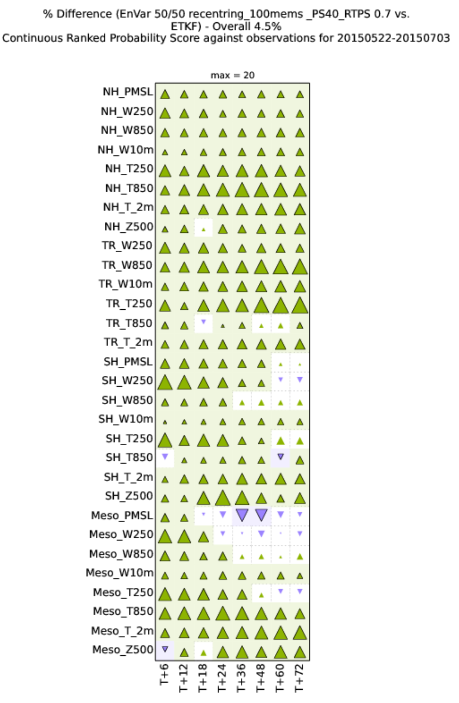
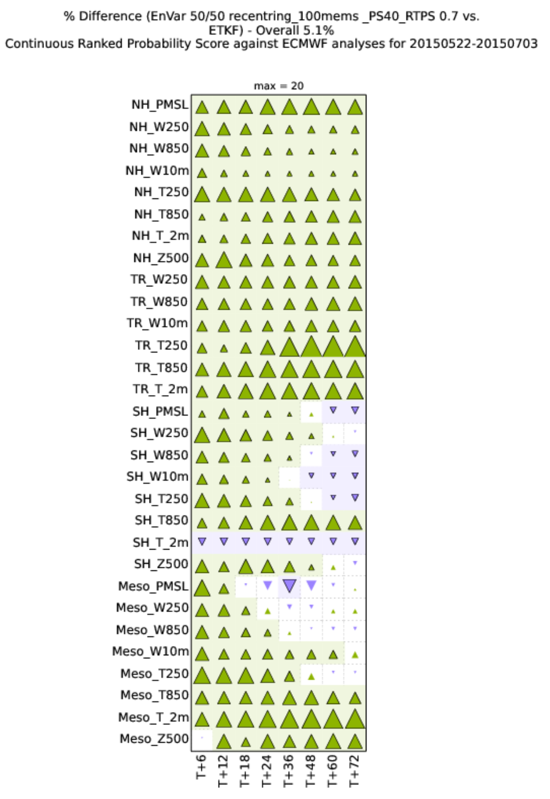
Results
May to July 2015:
Full recentred 44 member ETKF
versus
Half recentred 100 member En-4DEnVar

Slide 20
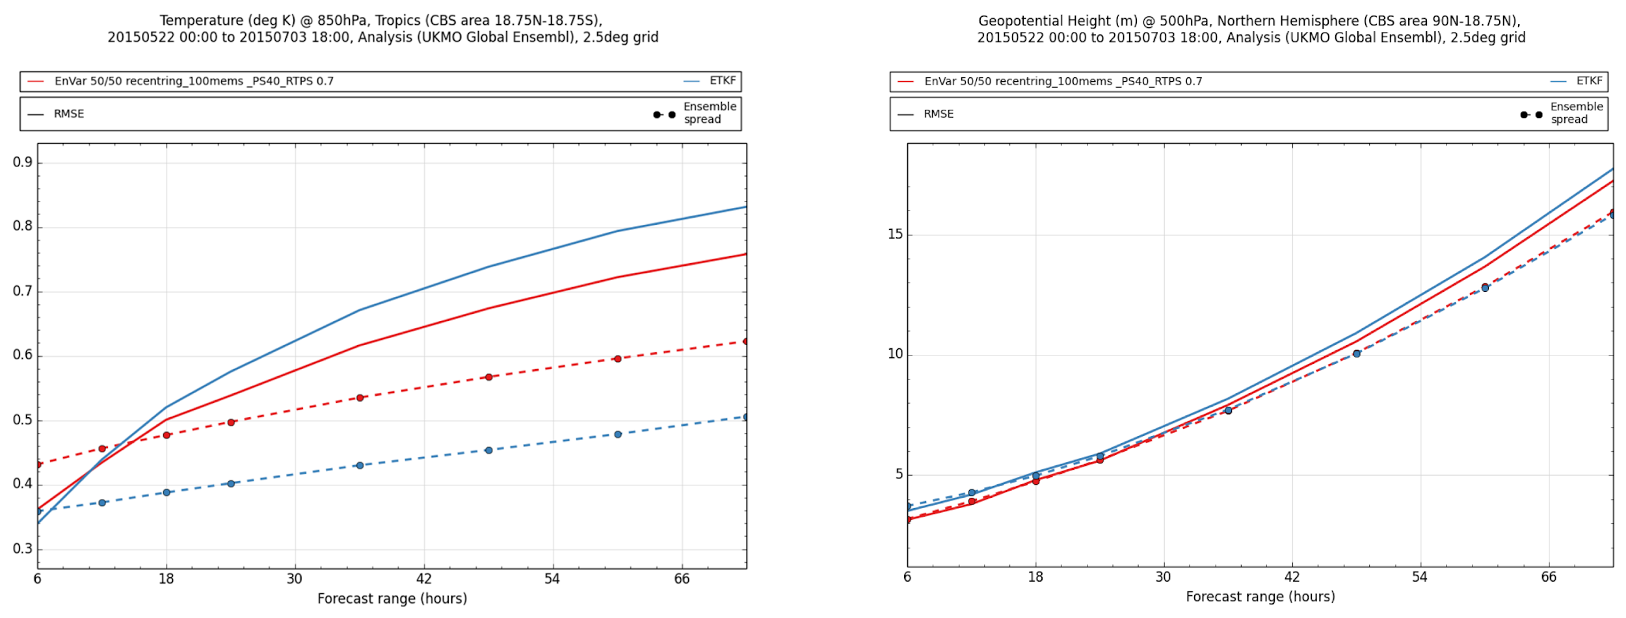
Results

Slide 21
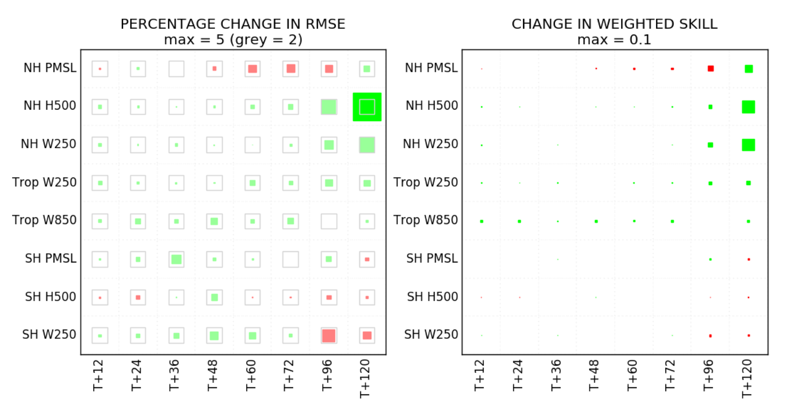
En-4DEnVar driving Hybrid 4DVar:
Verification Against Observations

Slide 22
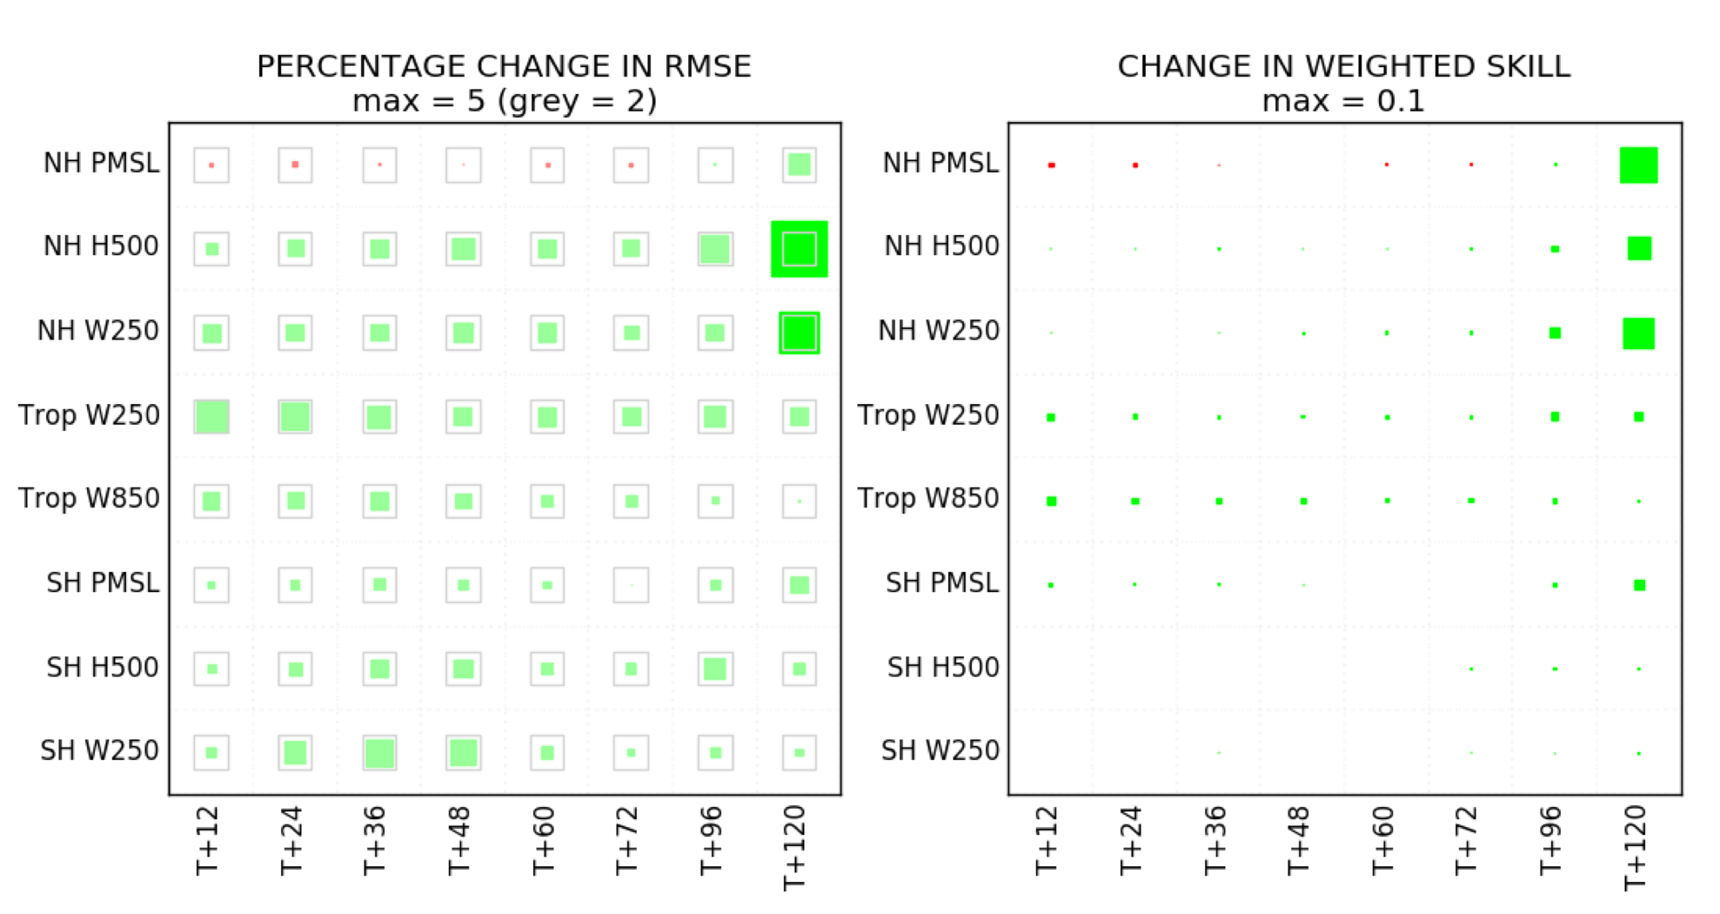
En-4DEnVar driving Hybrid 4DVar:
Verification Against ECMWF Analyses

Slide 23
Conclusions
En-4DEnVar performs much better than ETKF
Partially recentring around deterministic analysis gives small benefits
Additive inflation very effective
Horizontal localisation using wavebands gives big benefits
Vertical localisation gives little to no benefits
Aspire to implement operationally early 2019

Slide 24
References
Bowler NE, Clayton AM, Jardak M, Lee E, Lorenc AC, Piccolo C, Pring SR, Wlasak MA, Barker DM, Inverarity GW and Swinbank R (2017). Q. J. R. Meteorol. Soc., 143: 785-797. https://doi.org/10.1002/qj.3004
Buehner M (2012). Mon. Weather Rev., 140: 617–636. https://doi.org/10.1175/MWR-D-10-05052.1
Clayton AM, Lorenc AC and Barker DM (2013). Q. J. R. Meteorol, 139: 1445-1461 https://doi.org/10.1002/qj.2054
Inverarity, Wlasak, Jardak and Lorenc (2018) Forecasting Research Tech. Report 625, Met Office, Exeter, U.K. https://www.metoffice.gov.uk/learning/library/publications/science/weather-science-technical-reports
Lorenc AC, Jardak M, Payne T, Bowler NE and Wlasak MA (2017). Q. J. R. Meteorol. Soc, 143: 798-805 https://doi.org/10.1002/qj.2965
Lorenc AC(2017). Q. J . R. Meteorol. Soc., 143: 1062-1072 https://doi.org/10.1002/qj.2990
Ménétrier B and Auligné T (2015). Mon. Weather Rev., 143: 3931-3947 https://doi.org/10.1175/MWR-D-15-0057.1
Piccolo C and Cullen M (2016). Mon. Weather Rev., 144: 213-224 https://doi.org/10.1175/MWR-D-15-0270.1
Zhang F, Snyder C and Juanzhen S (2004). Mon. Weather Rev., 132: 1238–1253 https://doi.org/10.1175/1520-0493(2004)132%3C1238:IOIEAO%3E2.0.CO;2
Whitaker JS and Hamill TM (2012). Mon. Weather Rev., 140: 3078–3089 https://doi.org/10.1175/MWR-D-11-00276.1

Slide 25
Questions…
For more information please contact
www.metoffice.gov.uk
mohamed.jardak@metoffice.gov.uk
+44 01392 884065
www.metoffice.gov.uk
© Crown Copyright 2018, Met Office

Slide 26
Additional Slides

Slide 27
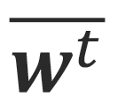
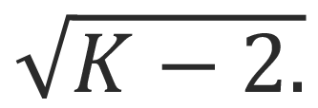
Simple Self-Exclusion Method: Prevent Inbreeding
Ensemble covariance used to analyse member includes the forecast from its own member
“In-breeding”:
Generally larger than
Analysis spread smaller than it should be
Should:
Remove index from the sum
Remove member from
Scale with
To fit in with Mean-Pert, we just do 1, neglecting 2 and 3
Details in: Bowler et al. (2017). Q.J.R. Meteorol. Soc., https://doi.org/10.1002/qj.3004

Slide 28
Additive Inflation
AddInfX: Randomly selected historical analysis increment (with scaling)
From 3-month archive for the same season, but from a different year
Also add in the 3-month mean increment, as a bias correction (with no scaling)
Details in: Bowler et al. (2017). Q.J.R. Meteorol. Soc., https://doi.org/10.1002/qj.3004 and Piccolo and Cullen (2016). Mon. weather Rev. https://doi.org/10.1175/MWR-D-15-0270.1

Slide 29
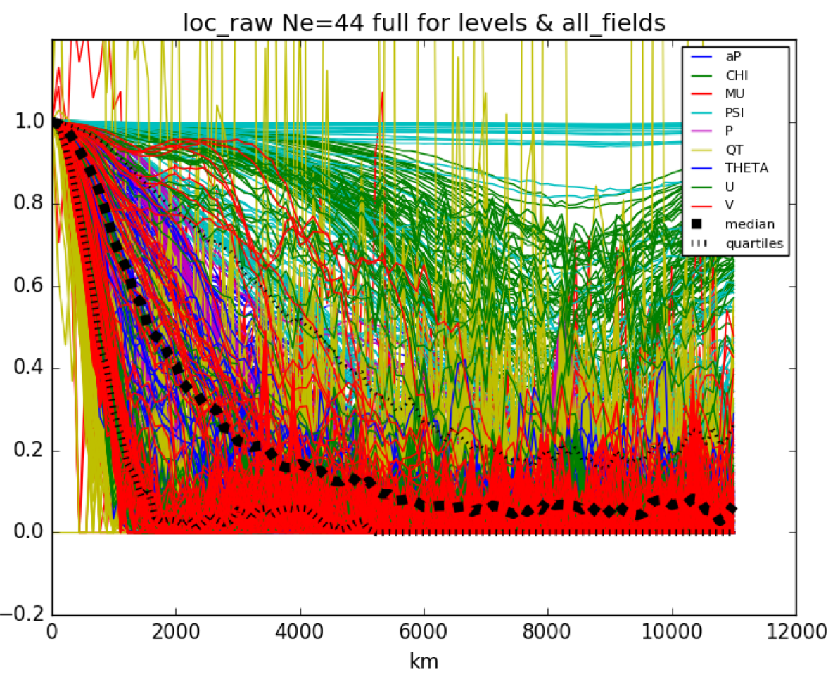
Improved Processing of Ensemble Data:
Hybrid_diag localisation
Diagnosed horizontal localisation functions differ between variables and model levels
Using wavebands, best results obtained by using means over all localised variables for a thinned set of model levels
Details in: Lorenc (2017). Q.J.R. Meteorol. Soc., https://doi.org/10.1002/qj.2990 and Ménétrier and Auligné https://doi.org/10.1175/MWR-D-15-0057.1

