Slide 1

Historic Rapid Intensification of Hurricane Patricia (2015): Challenges in Cloud-Resolving Ensemble Analysis and Prediction
Robert Nystrom and Fuqing Zhang
The Pennsylvania State University Department of Meteorology, Center for Advanced Data Assimilation and Predictability Techniques
Funding: NASA Earth and Space Science Fellowship Program (NESSF)
Computing: Texas Advanced Computing Center (TACC) and NOAA Jet

Slide 2
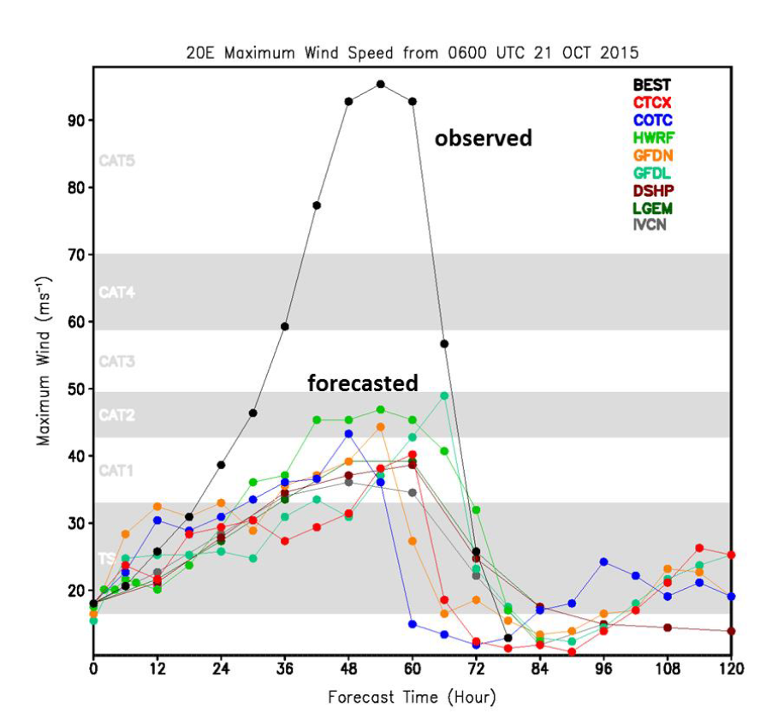
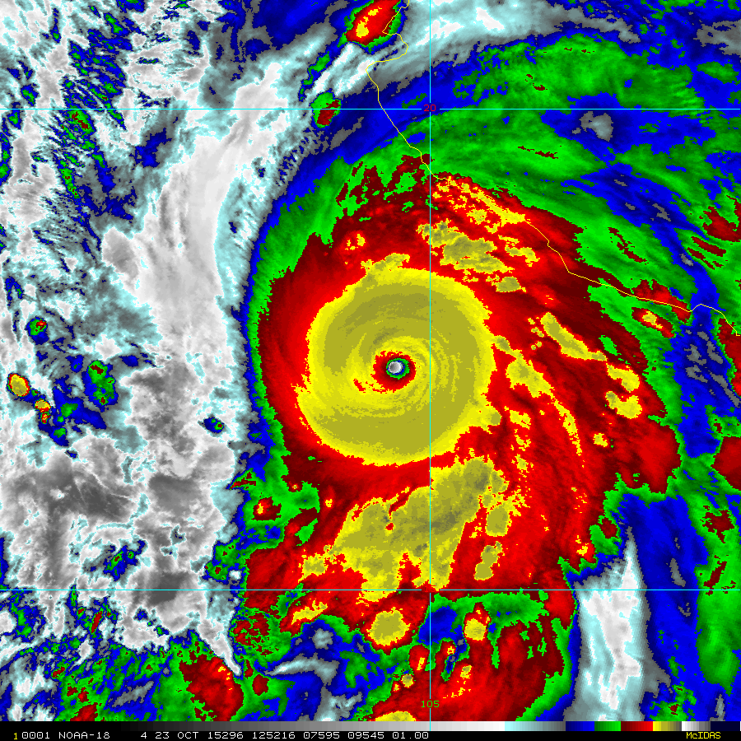
Patricia (2015)
Highest observed surface wind speed (measured by aircraft SFMR), 94 m s⁻¹
Most rapid intensification rate, 54 m s⁻¹ in 24 h
[Rogers et al., 2017]
Notes:
Well observed by TCI field campaign (high density dropsondes) and NOAA P-3

Slide 3
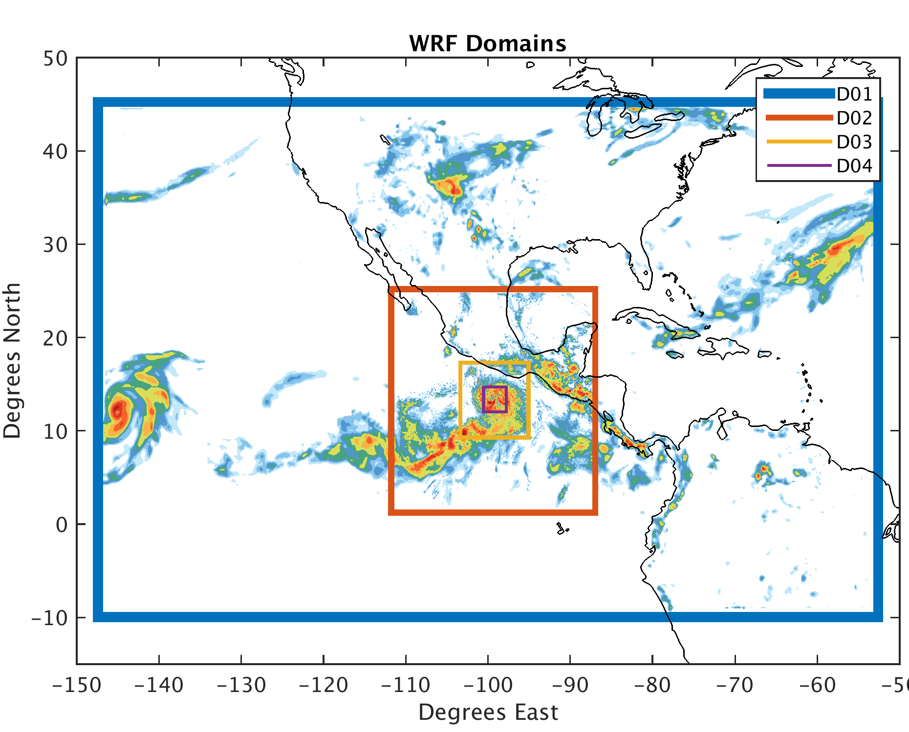
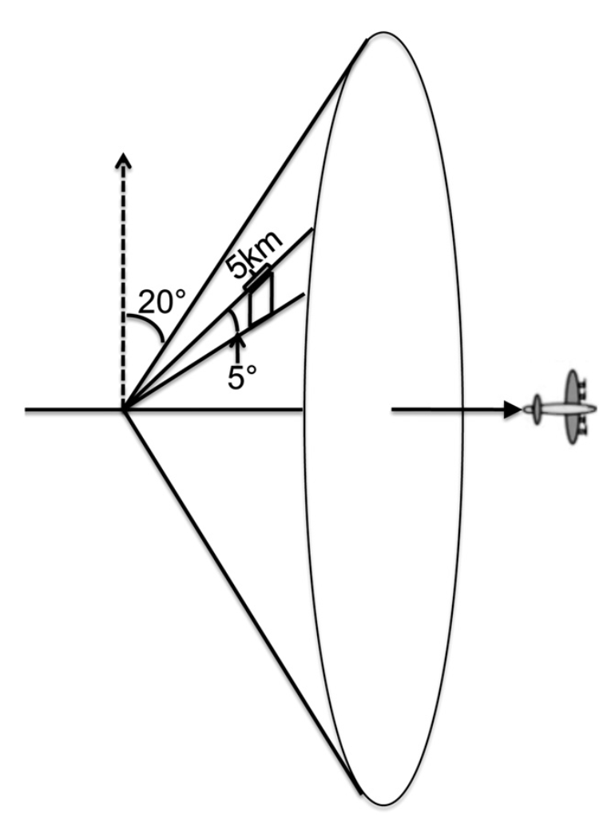
PSU WRF-EnKF Configuration for Patricia
60 member ensemble
1 hour continuous cycling EnKF
27/9/3/1 km grid spacing
IC/BCs provided by GFS
CV3 initial ensemble perturbations
Chen et al. (2016) surface flux scheme
Assimilated all conventional obs
and P-3 radial velocity SOs
[Weng and Zhang, 2012]
Notes:
Highlight specifications of PSU WRF-EnKF system
-WRF v3.5.1
-4 two-way nested domains
-Assimilate all conventional obs as well as aircraft radar (radial velocities)

Slide 4
Performance of cycling WRF-EnKF w/ modified C_{d} and 1 km horizontal grid spacing

Slide 5
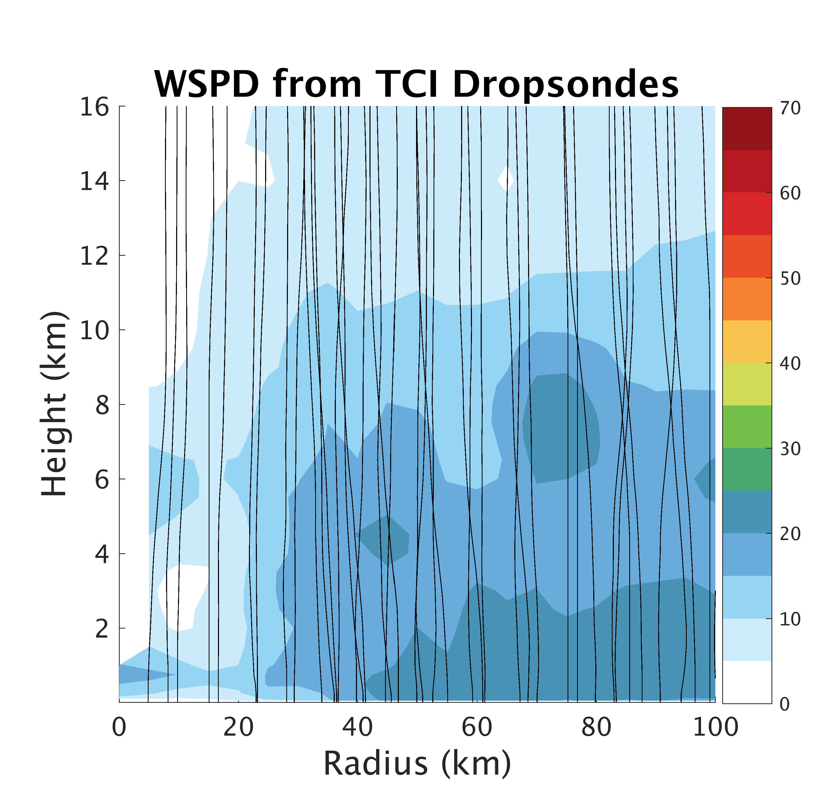
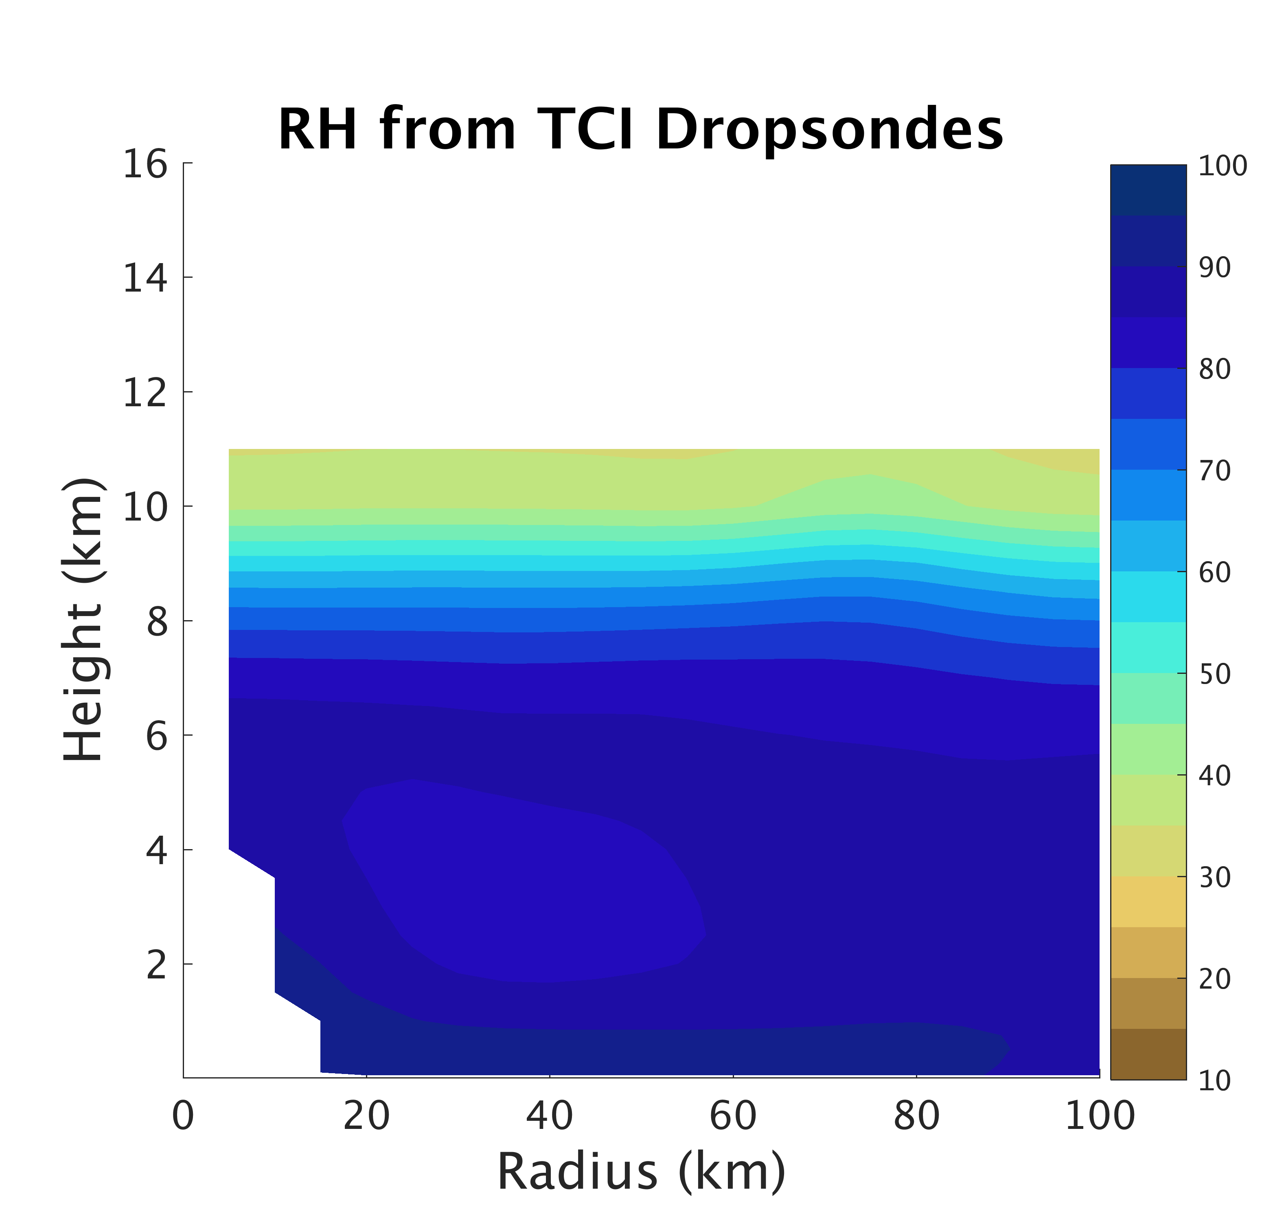
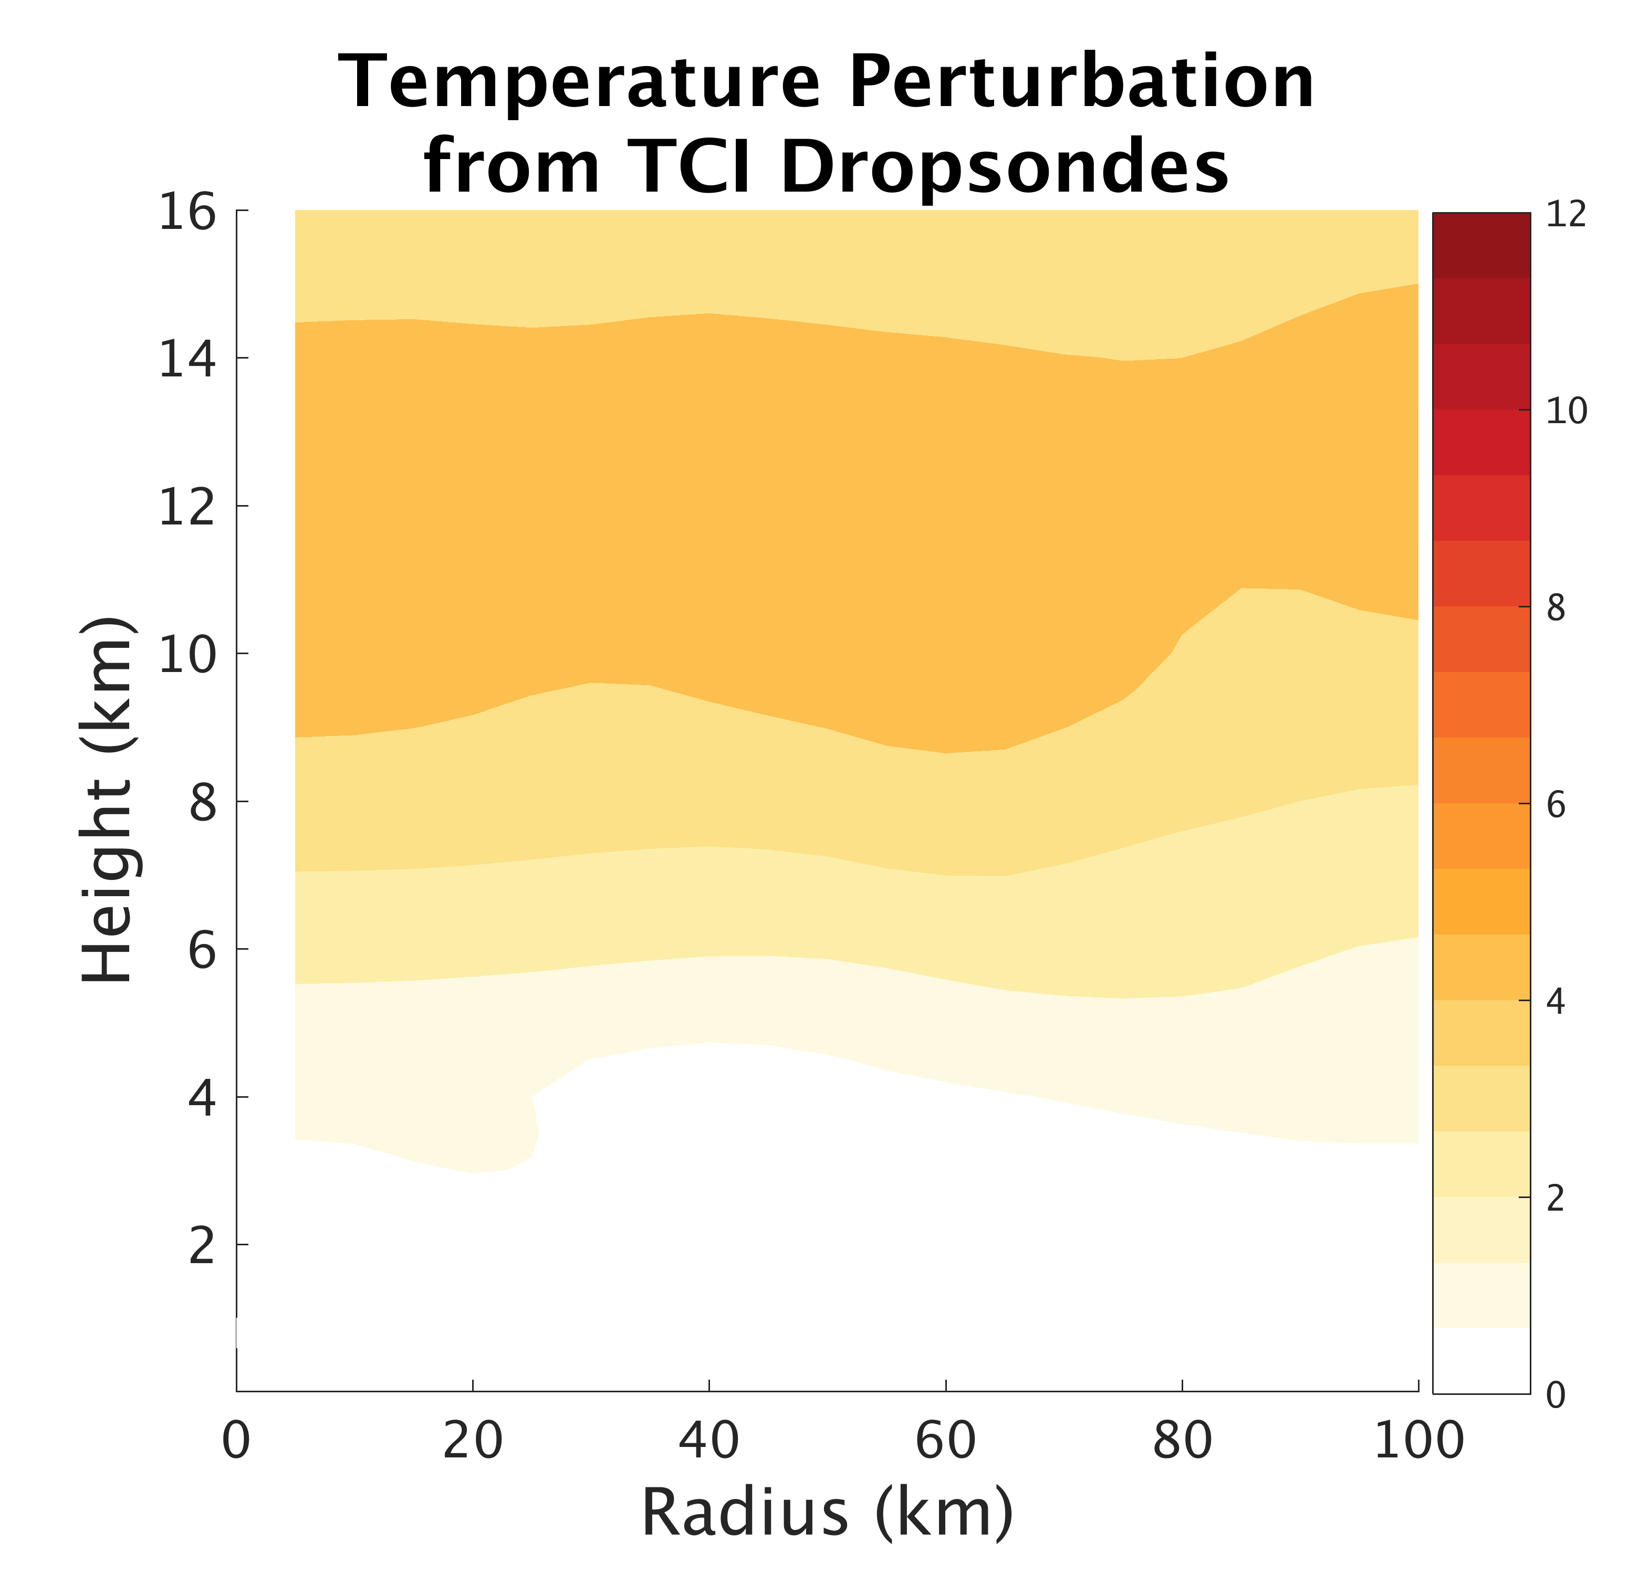
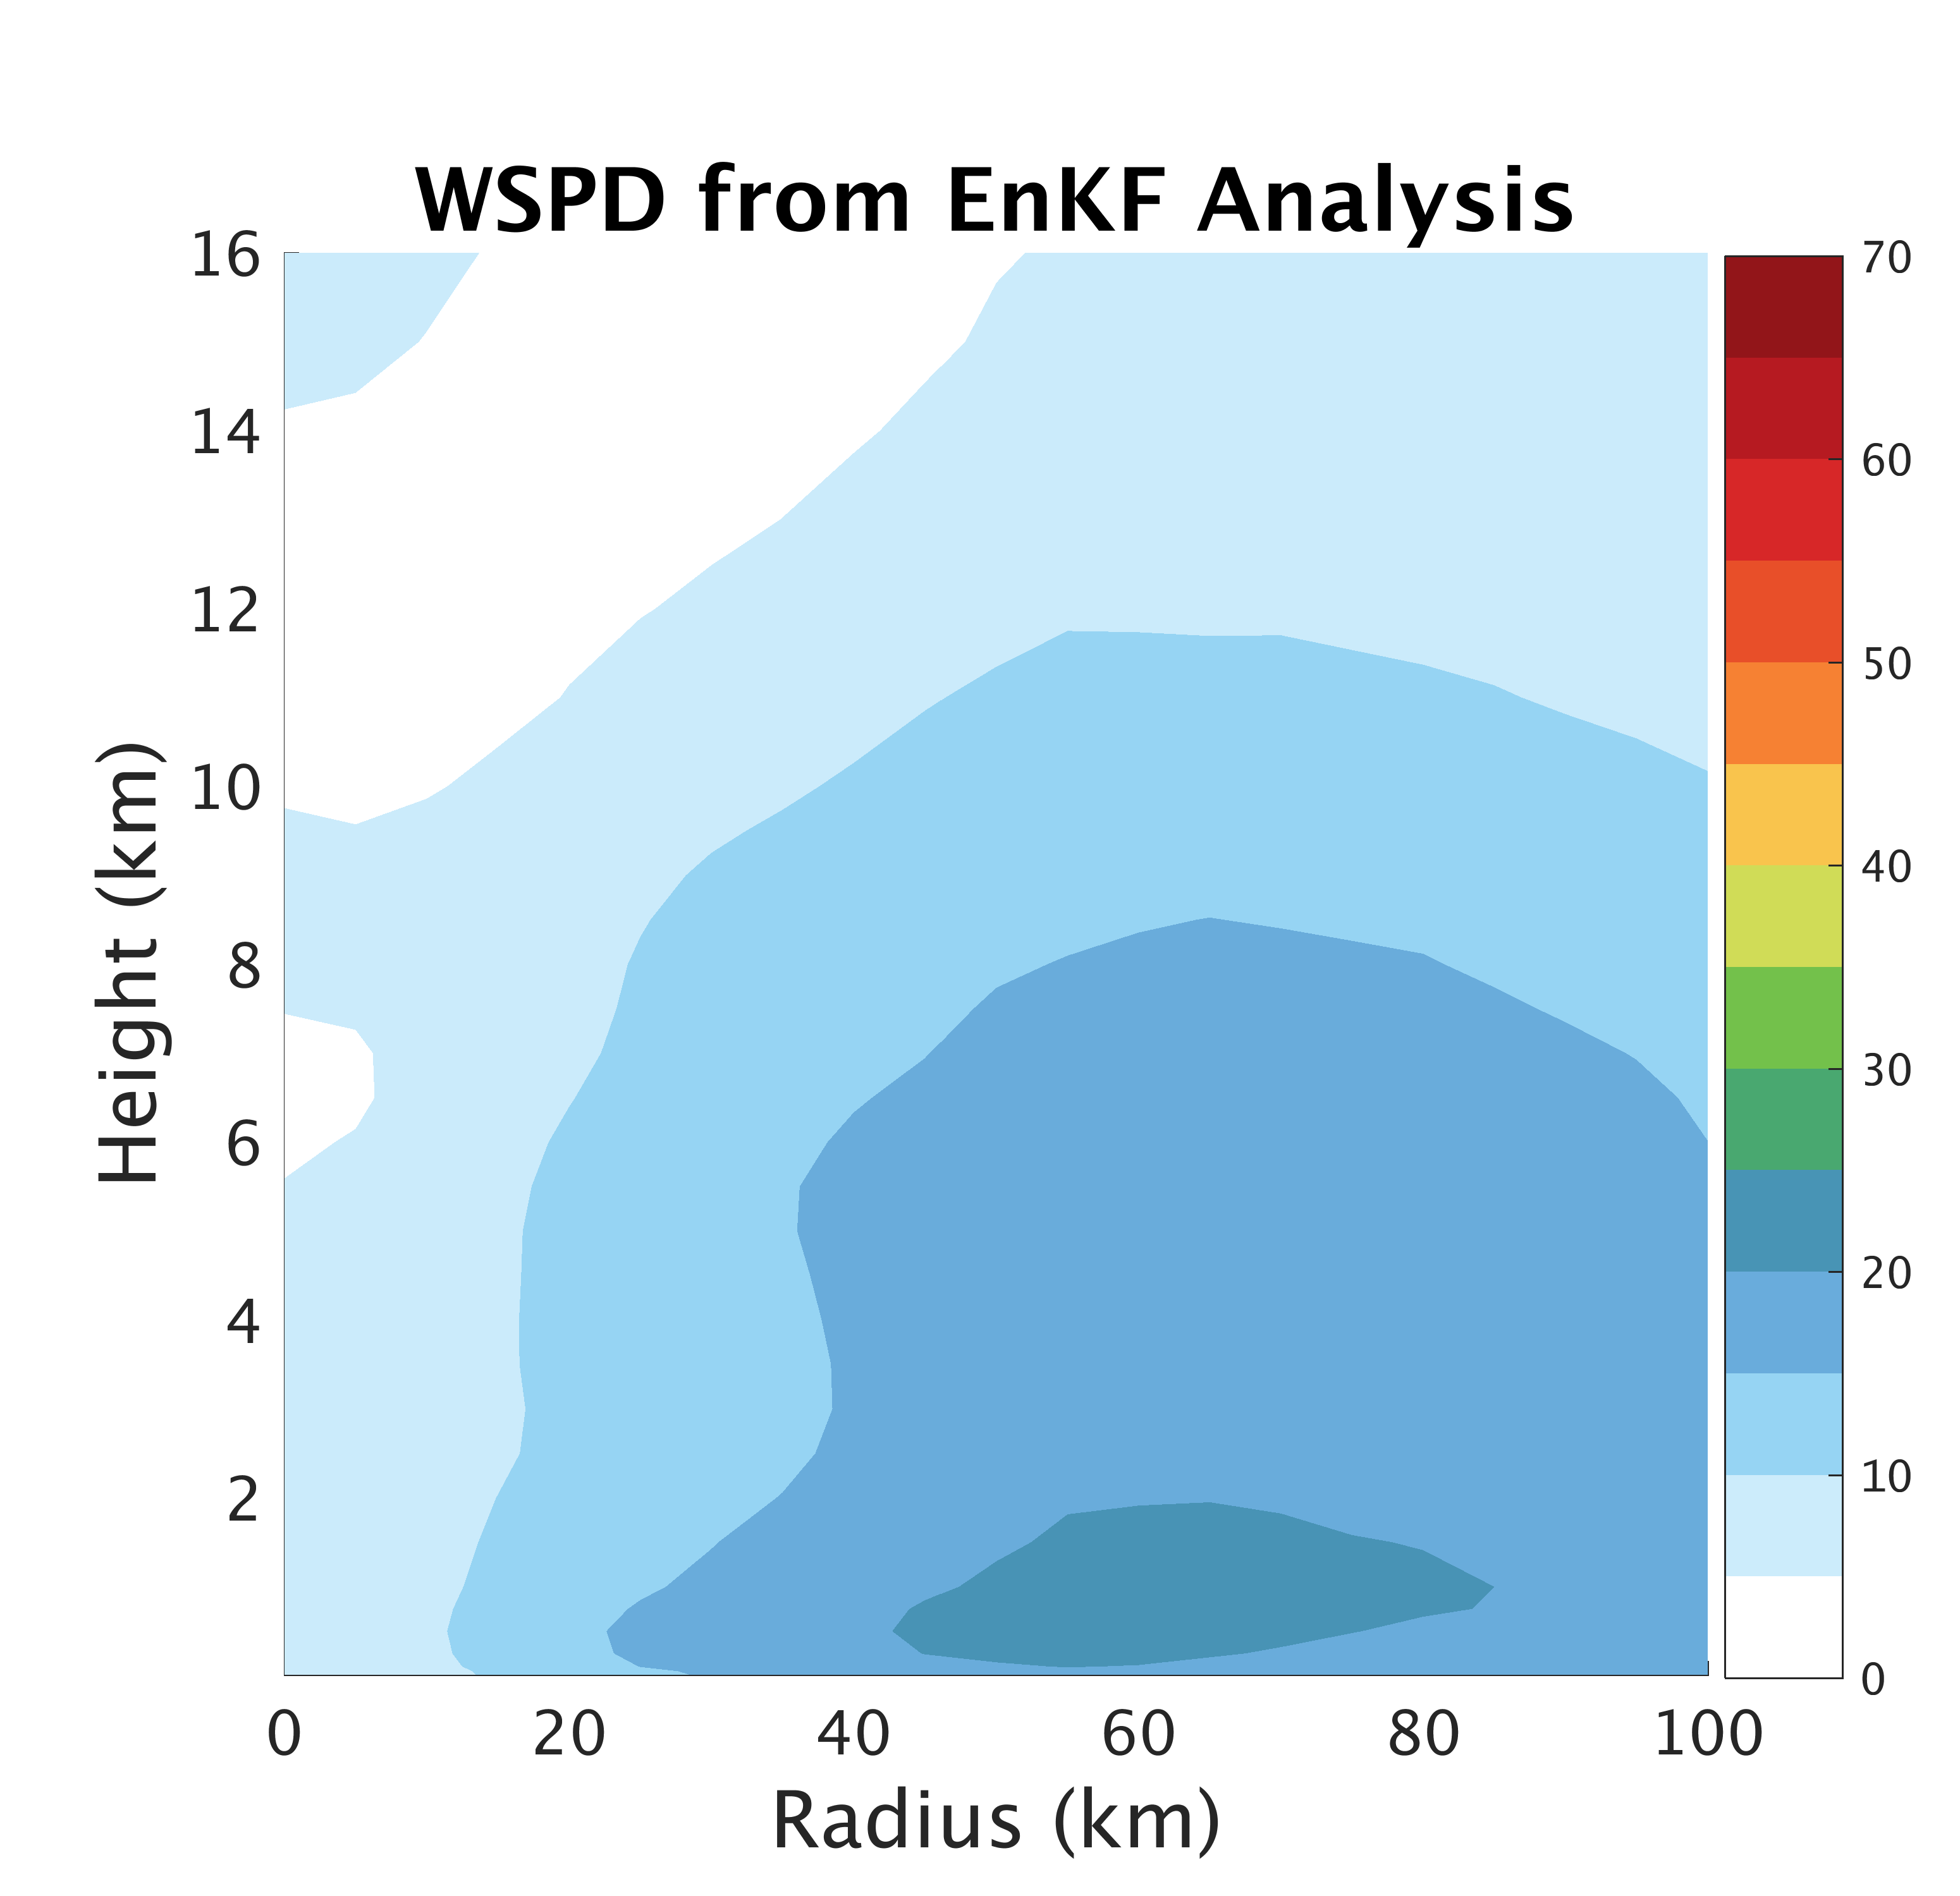
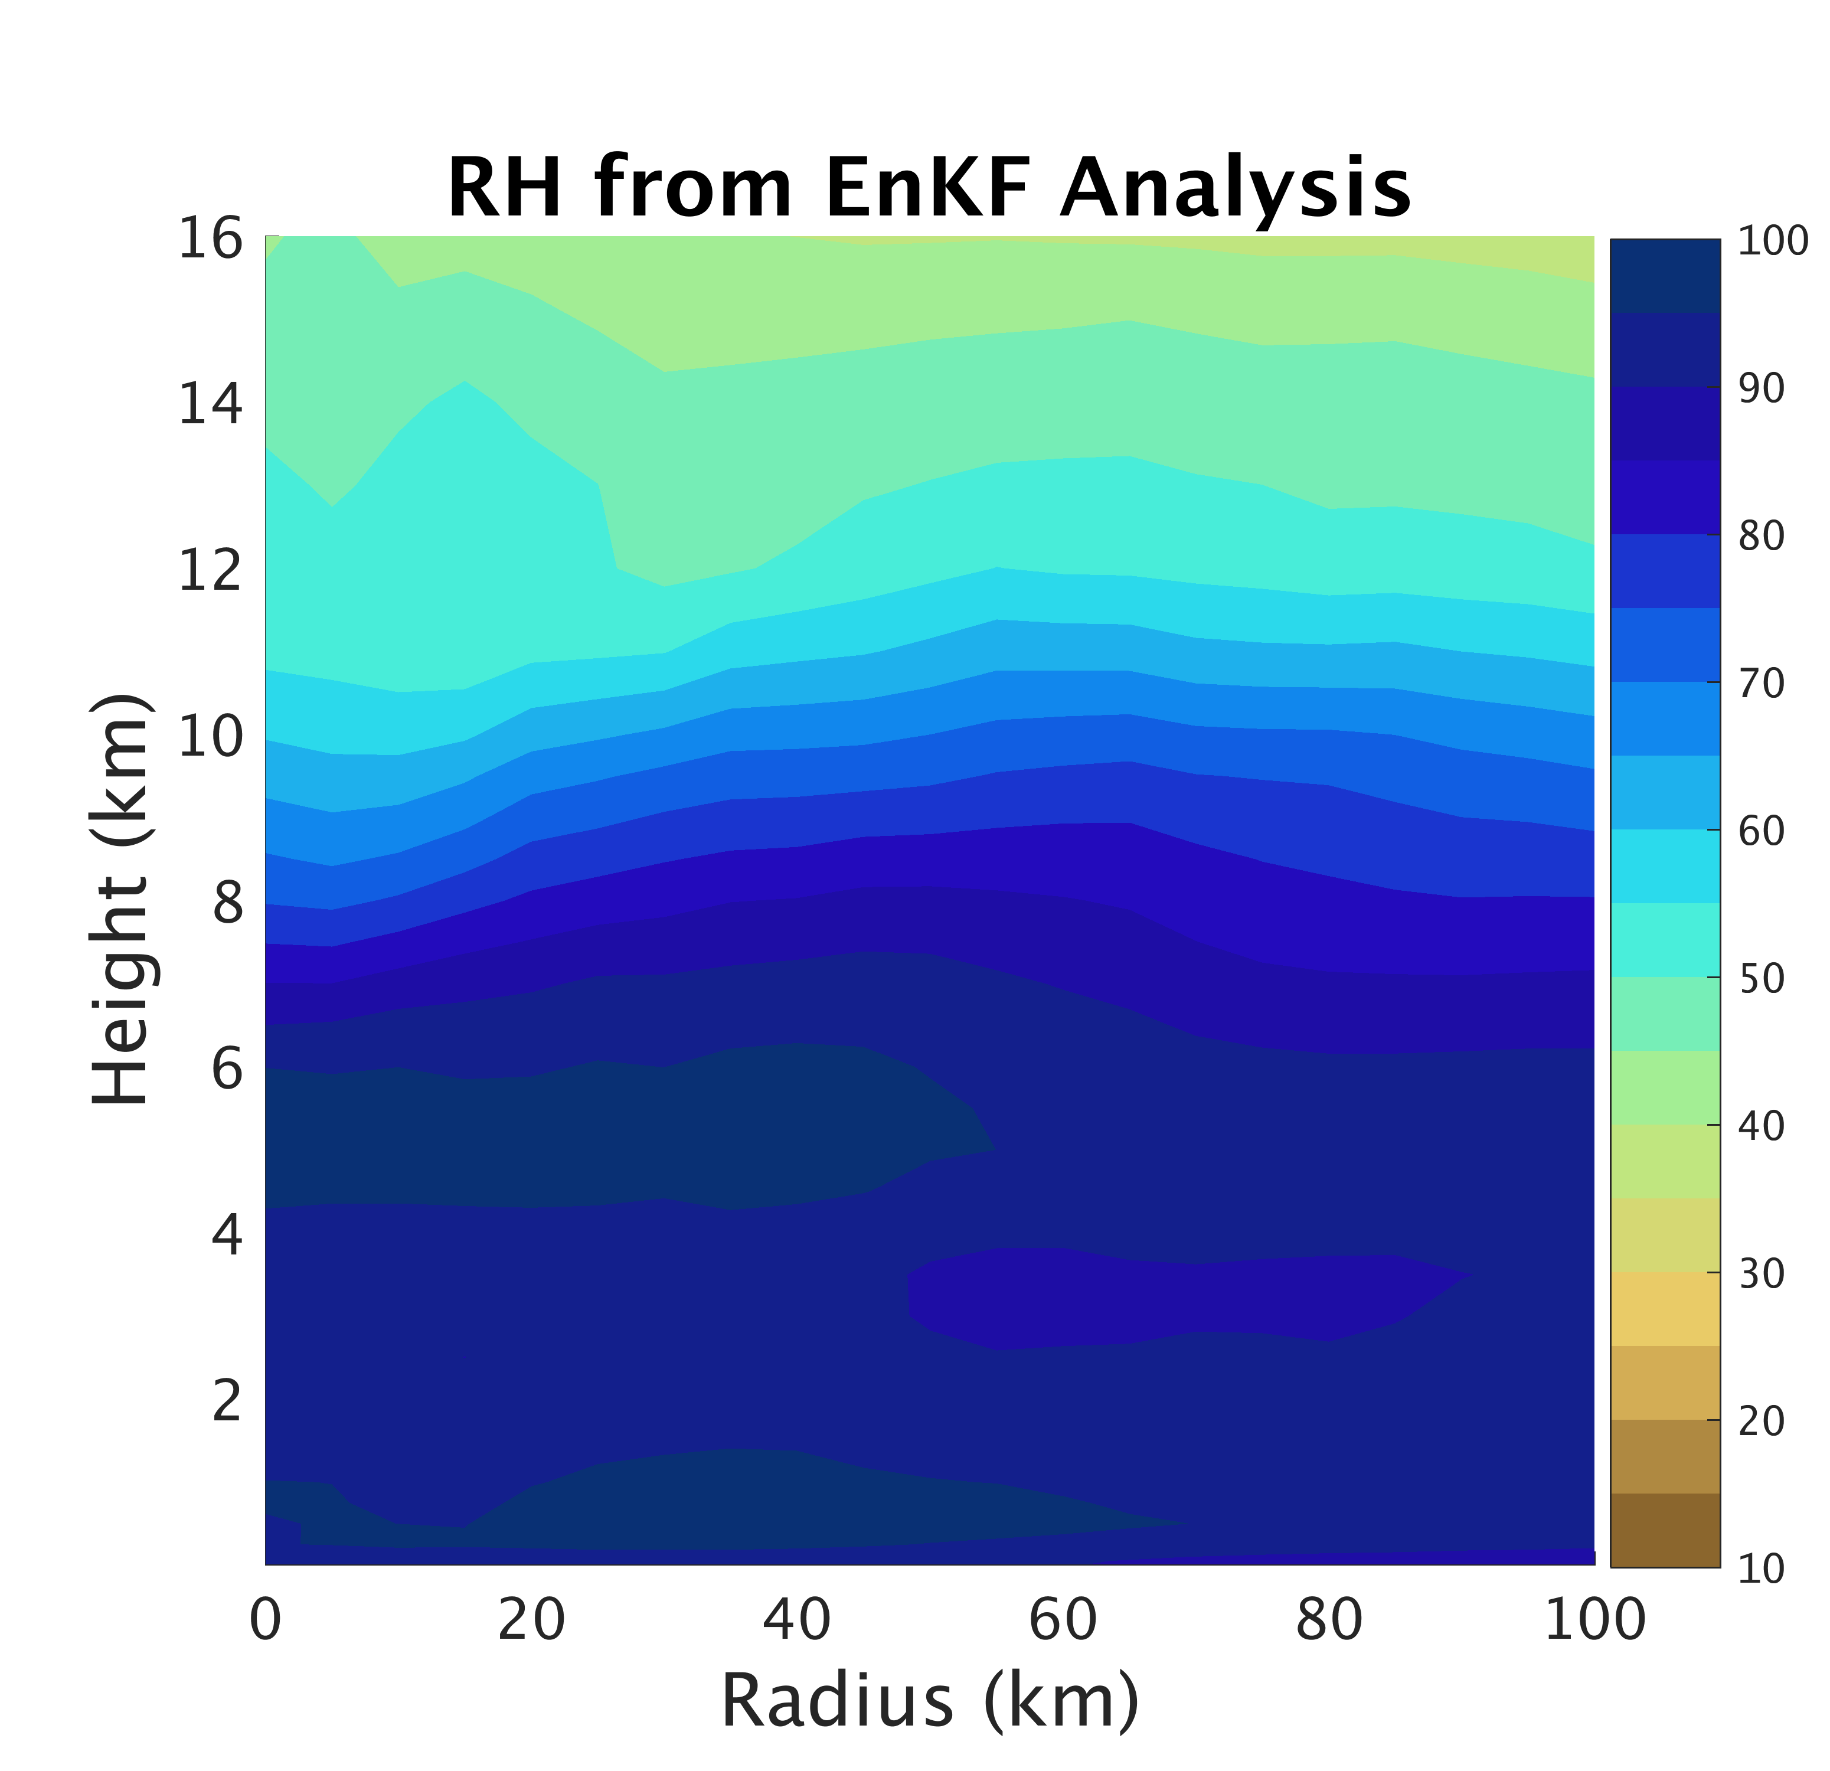
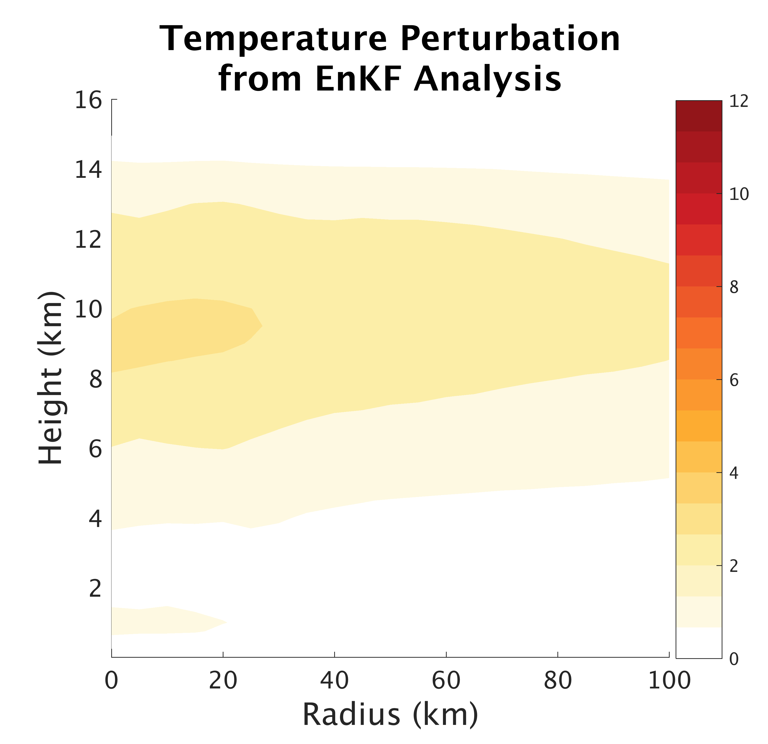
Good Agreement between EnKF Analysis
and TCI Dropsondes
a)
b)
c)
Observations
d)
e)
f)
Analysis 21st 21z
Notes:
Flight 1, 21st 19-21z compared with EnKF Analysis at 21z 21st
Dropsondes location relative to NOAA HRD wind center track

Slide 6
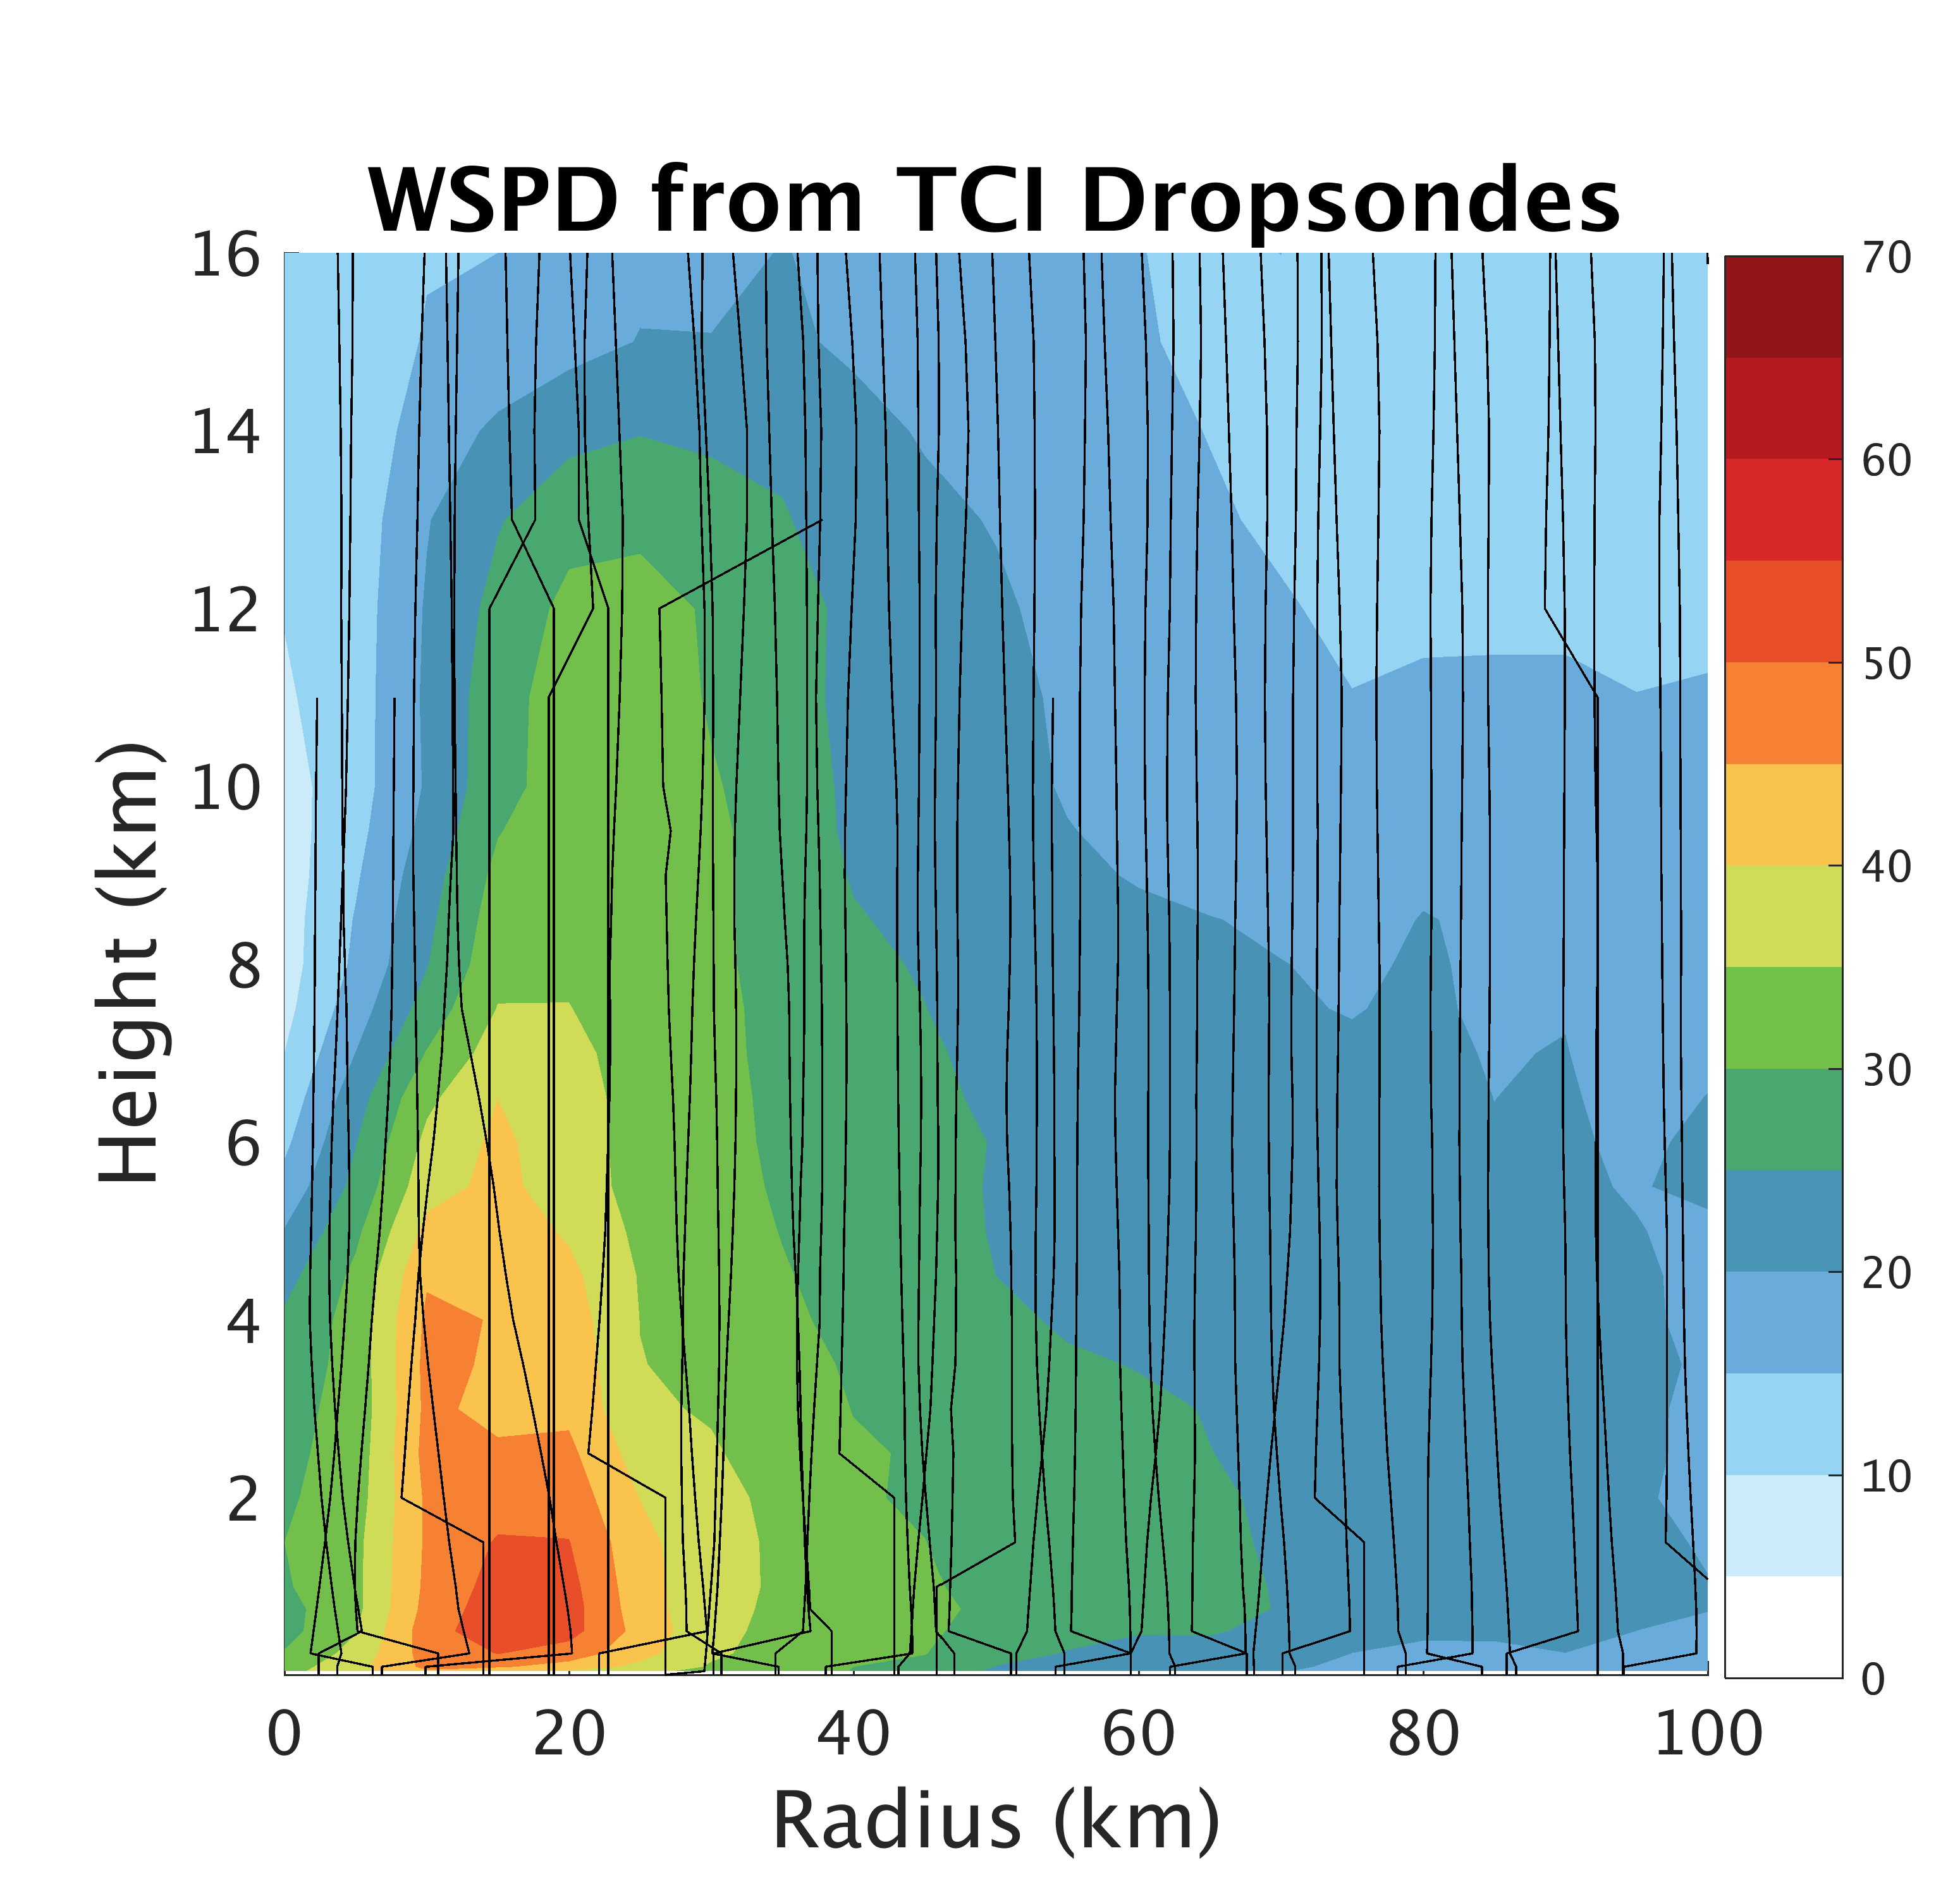
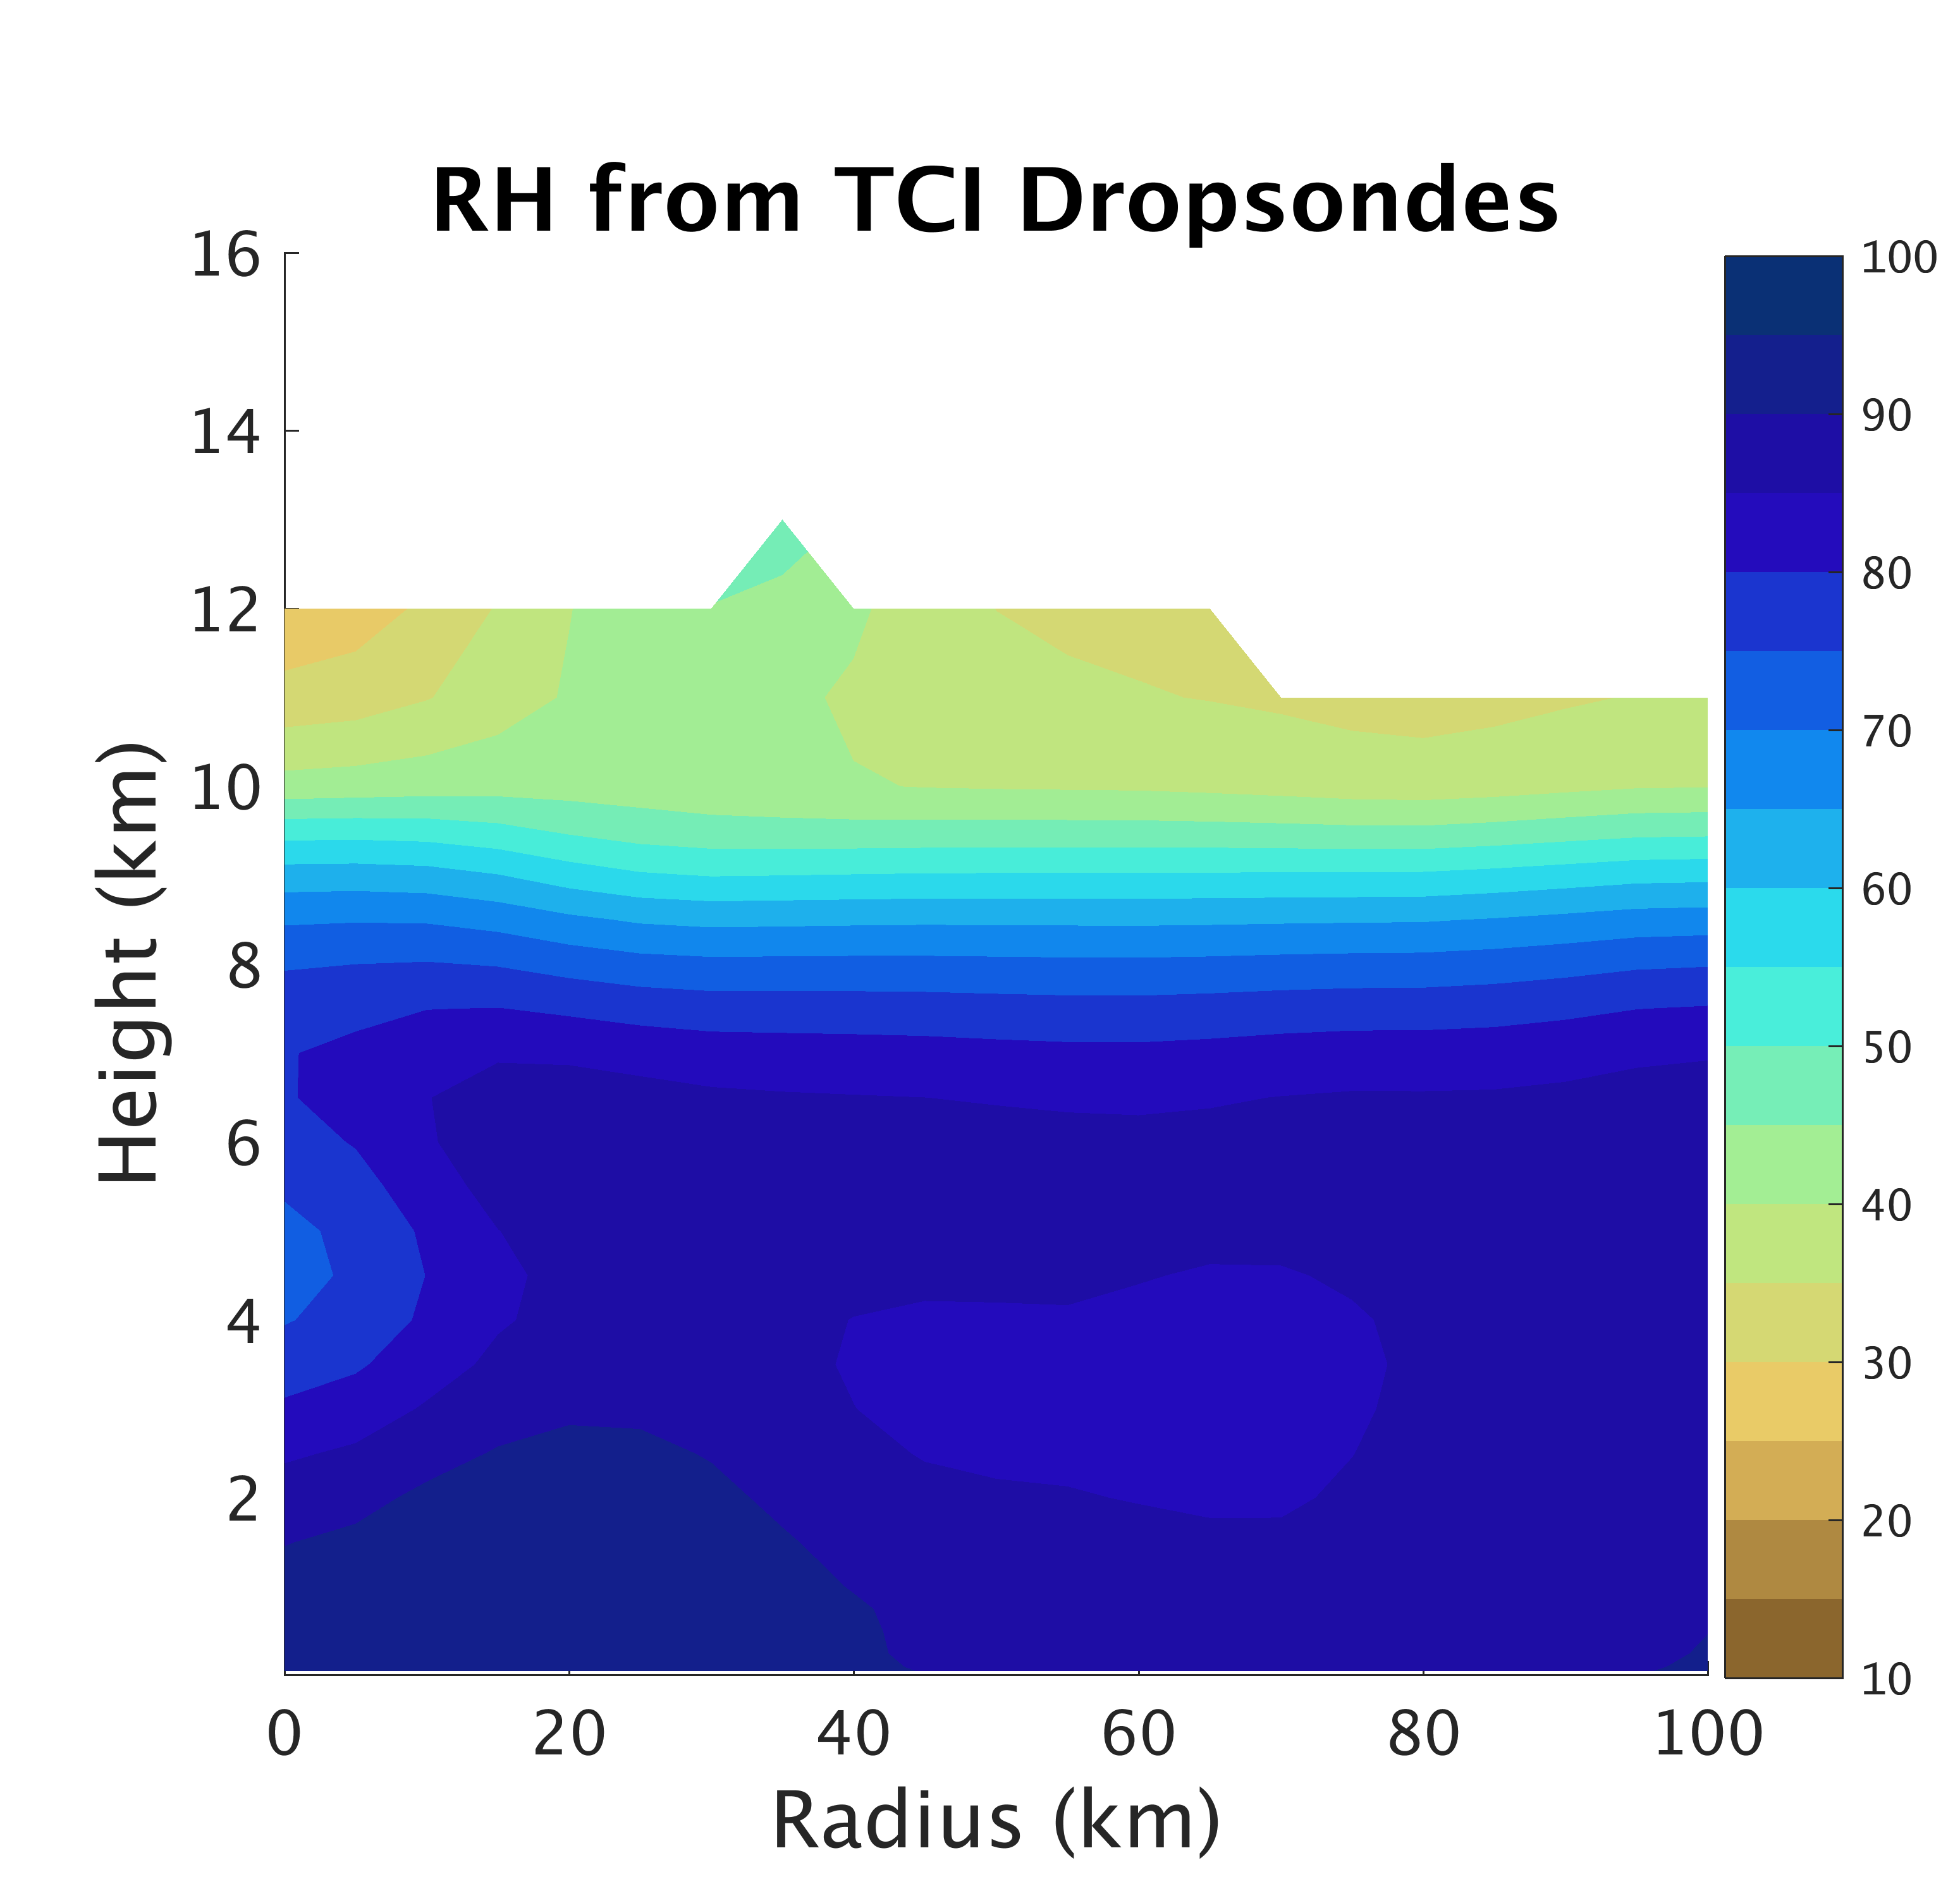
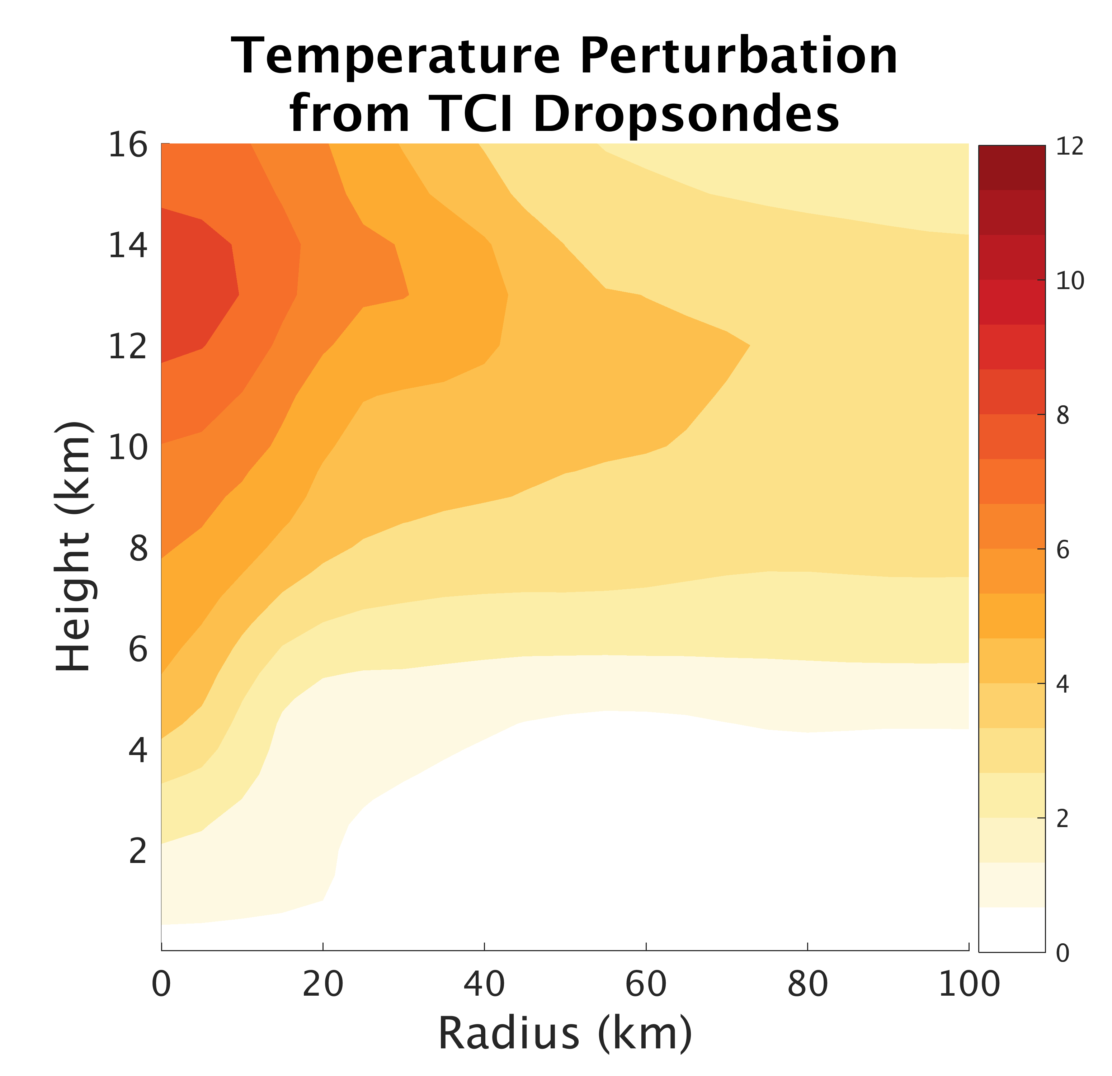
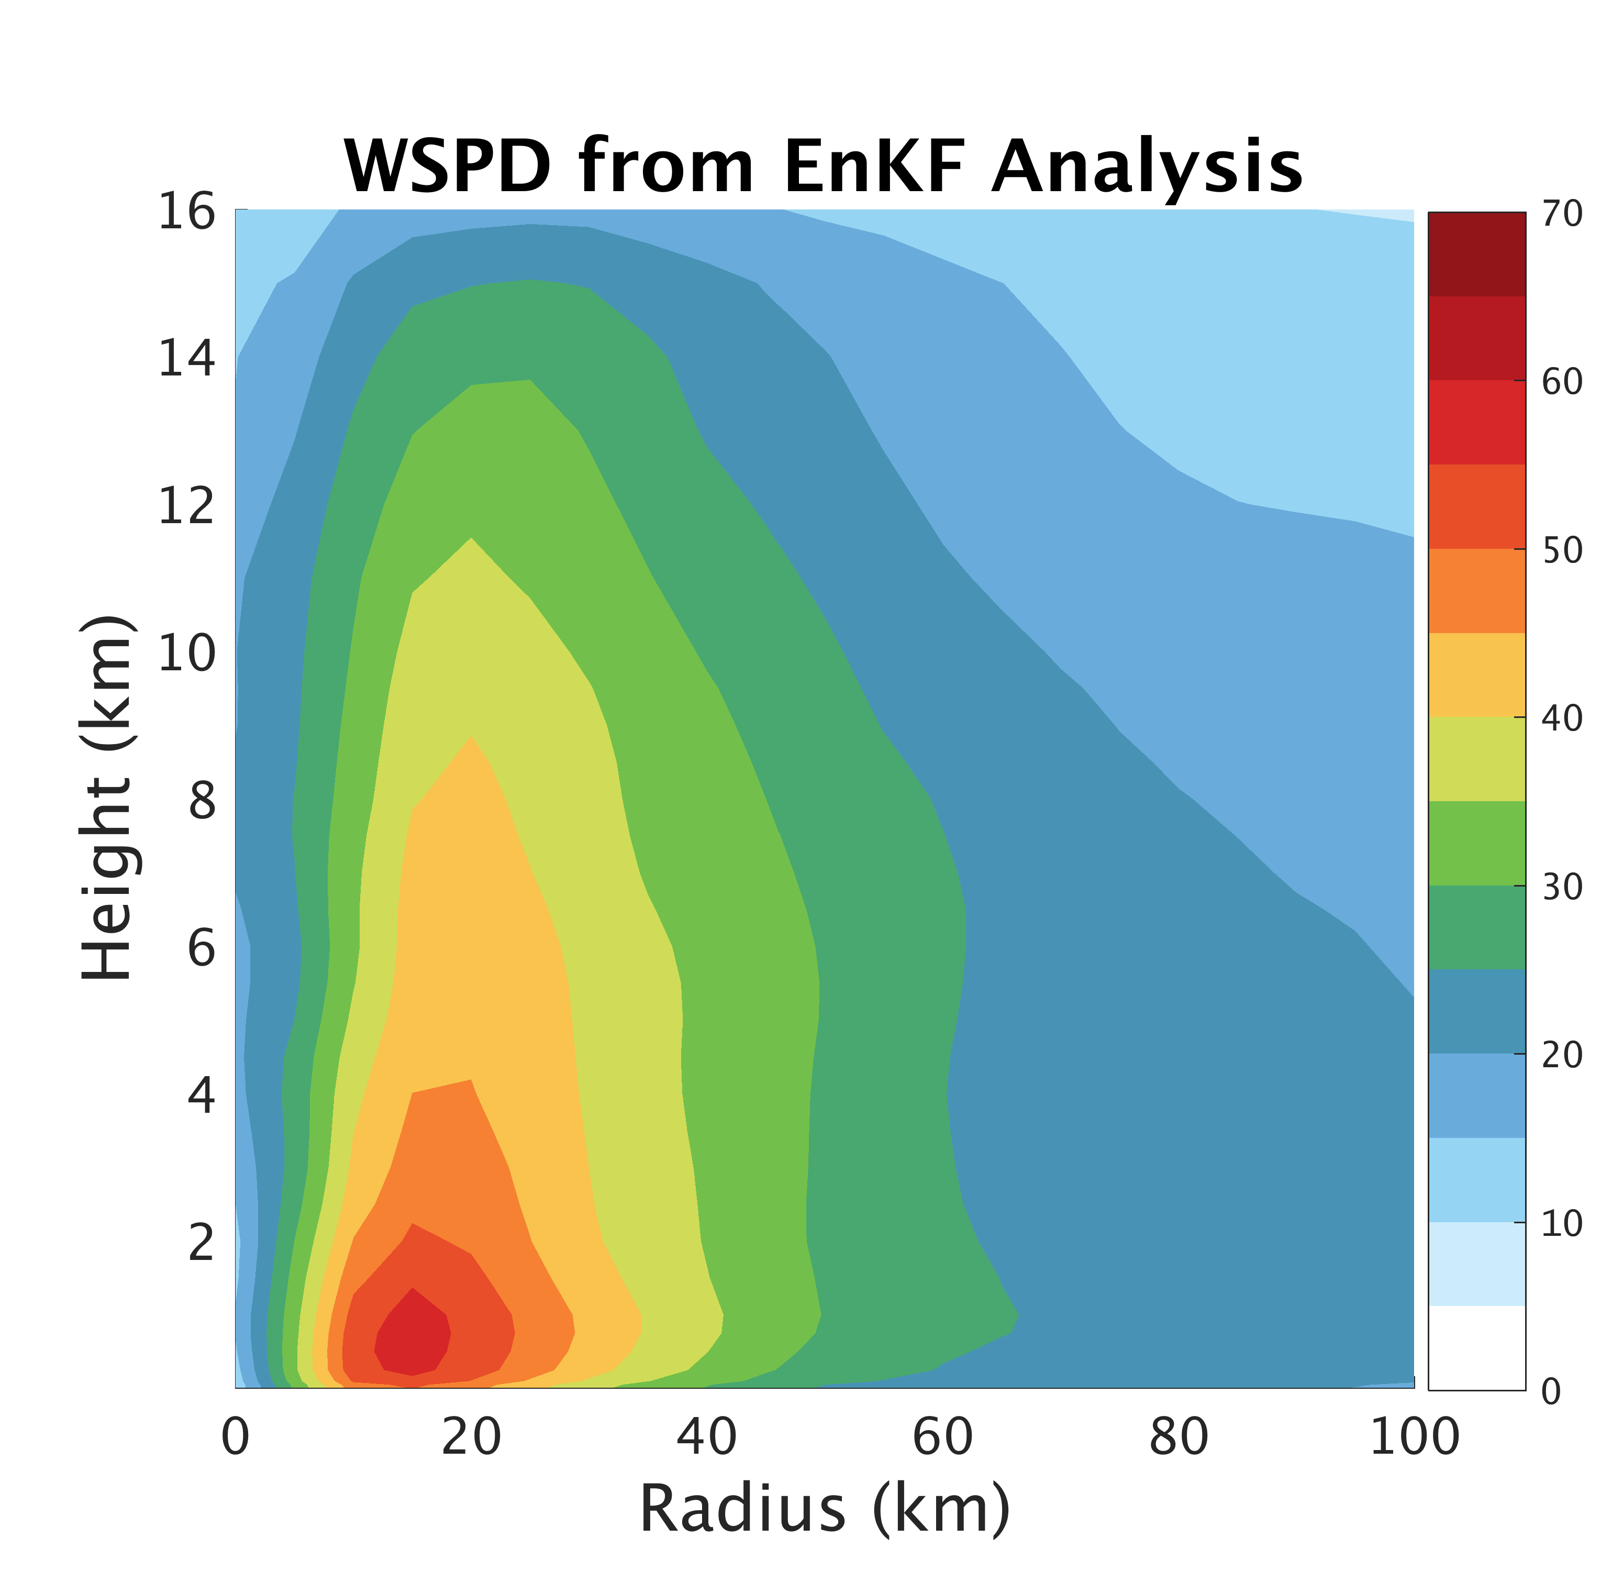
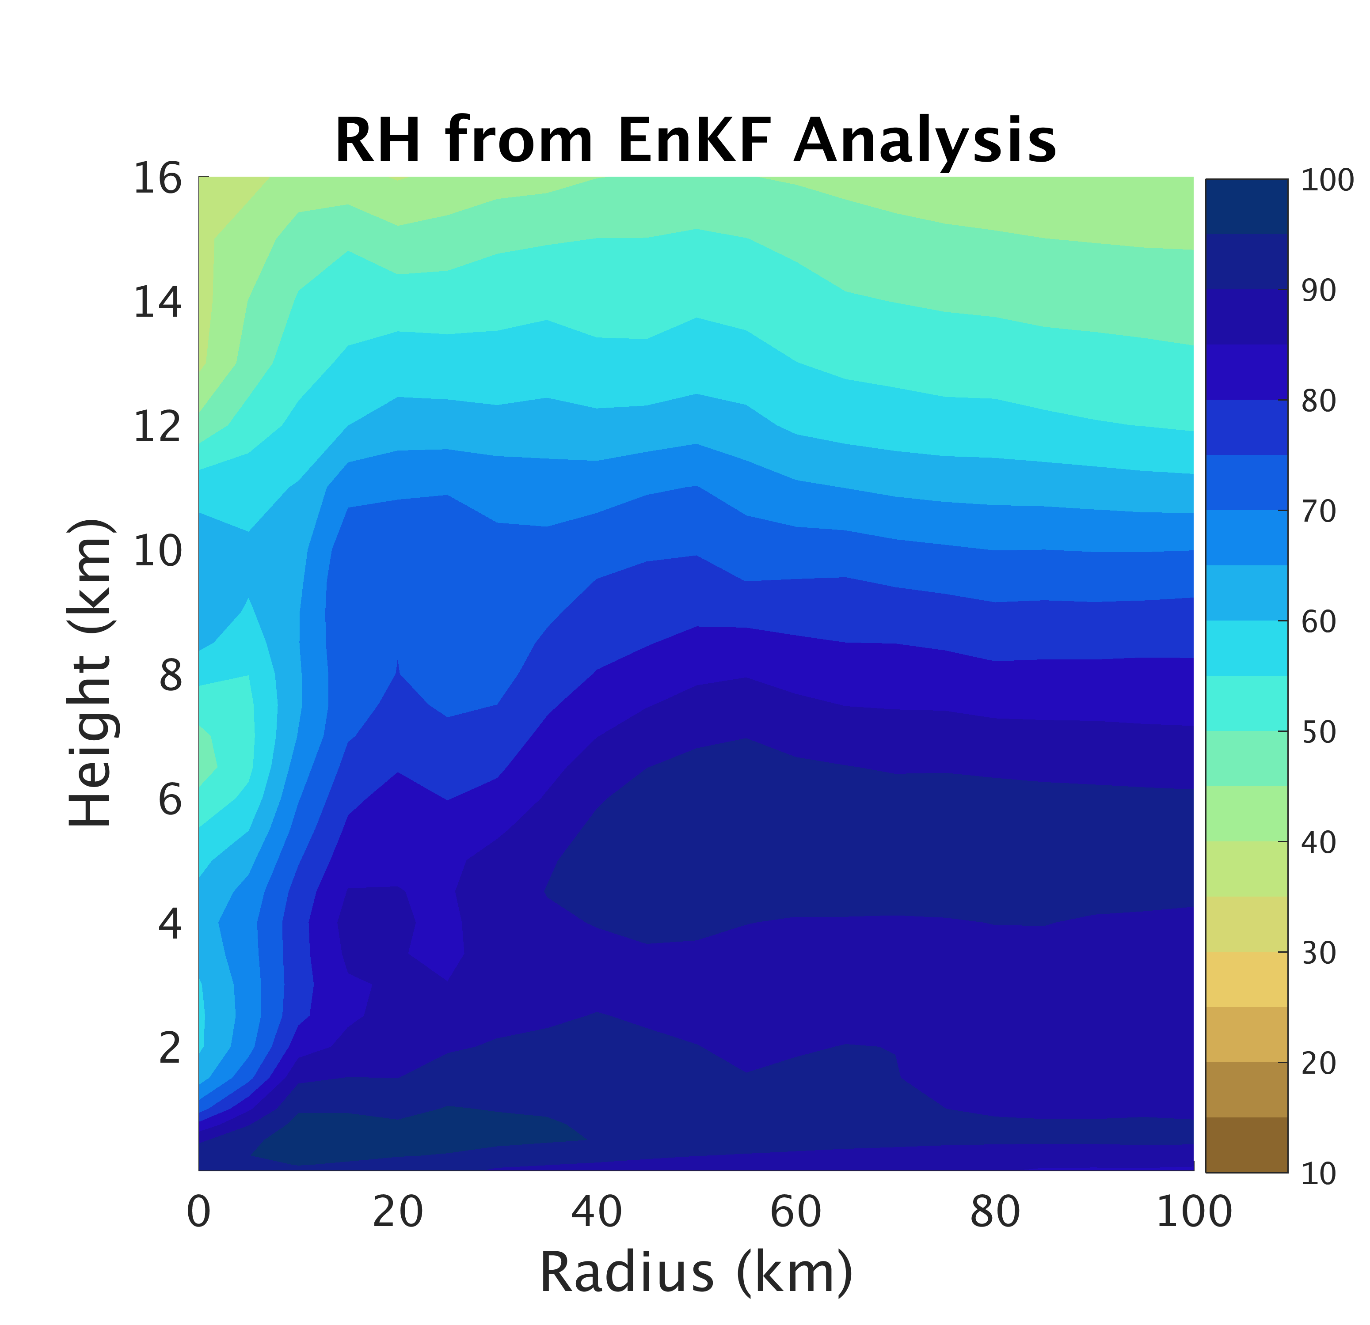
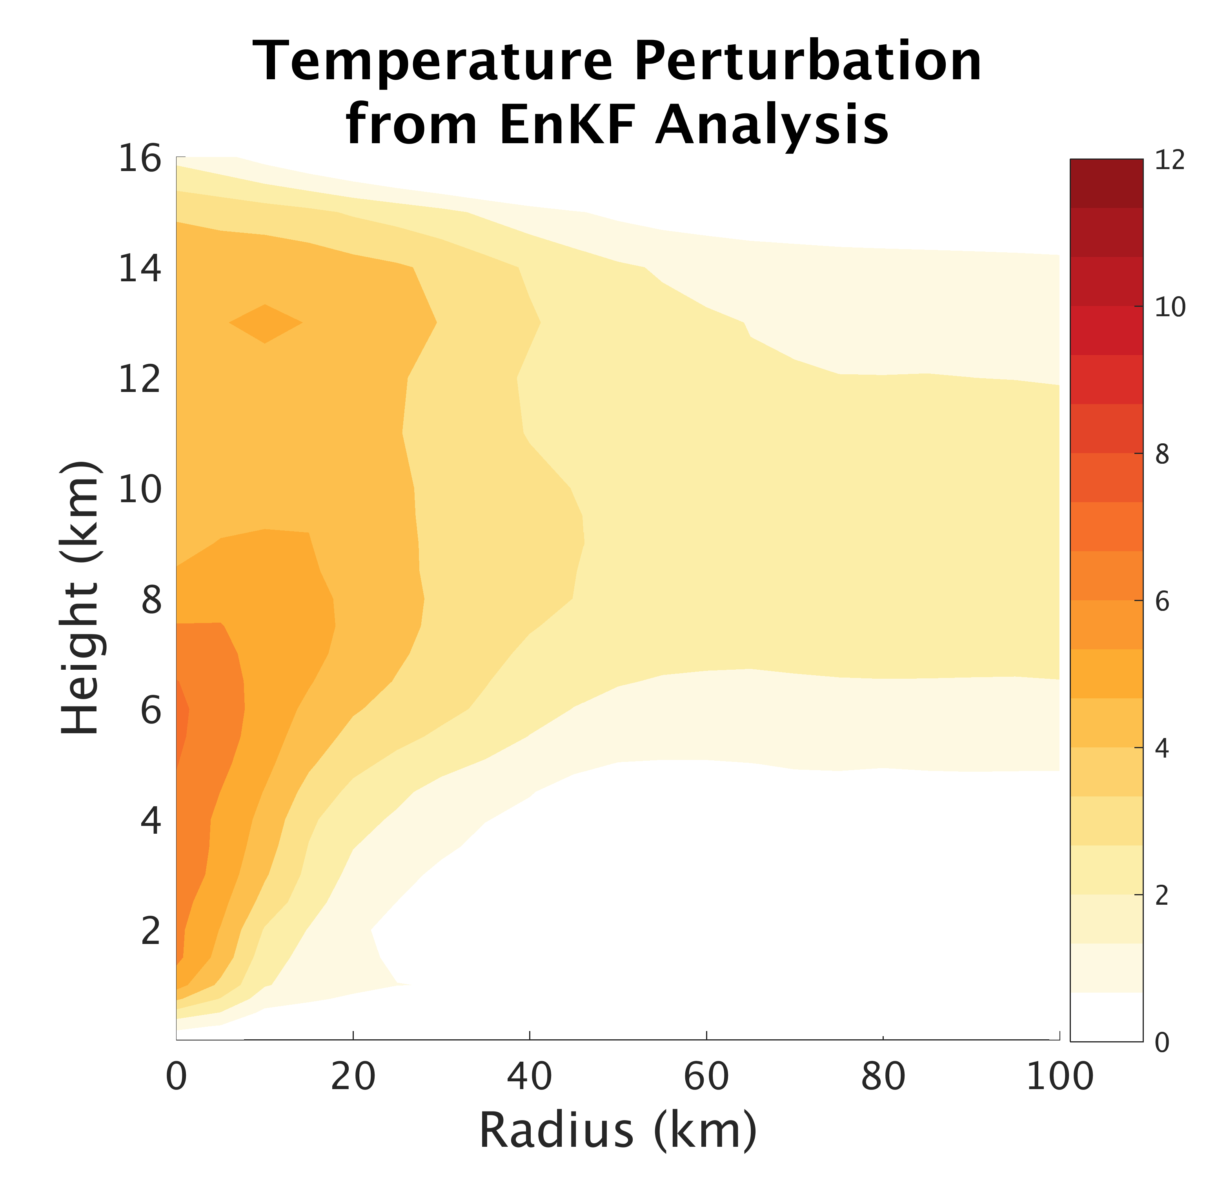
Good Agreement between EnKF Analysis
and TCI Dropsondes
a)
b)
c)
Observations
d)
e)
f)
Analysis 22nd 18z
Notes:
Flight 2, 22nd 17-19z compared with EnKF Analysis at 22z 22nd

Slide 7
20 Member Ensemble Forecast Performance
Notes:
Some confidence from ensemble forecast in RI of Patricia but uncertainty in timing and rate. Plan to look into this further in the near future.

Slide 8
Strong Forecast Sensitivity to Resolution
3 km
1 km
Notes:
-same ICs
-small inner-core for Patricia

Slide 9
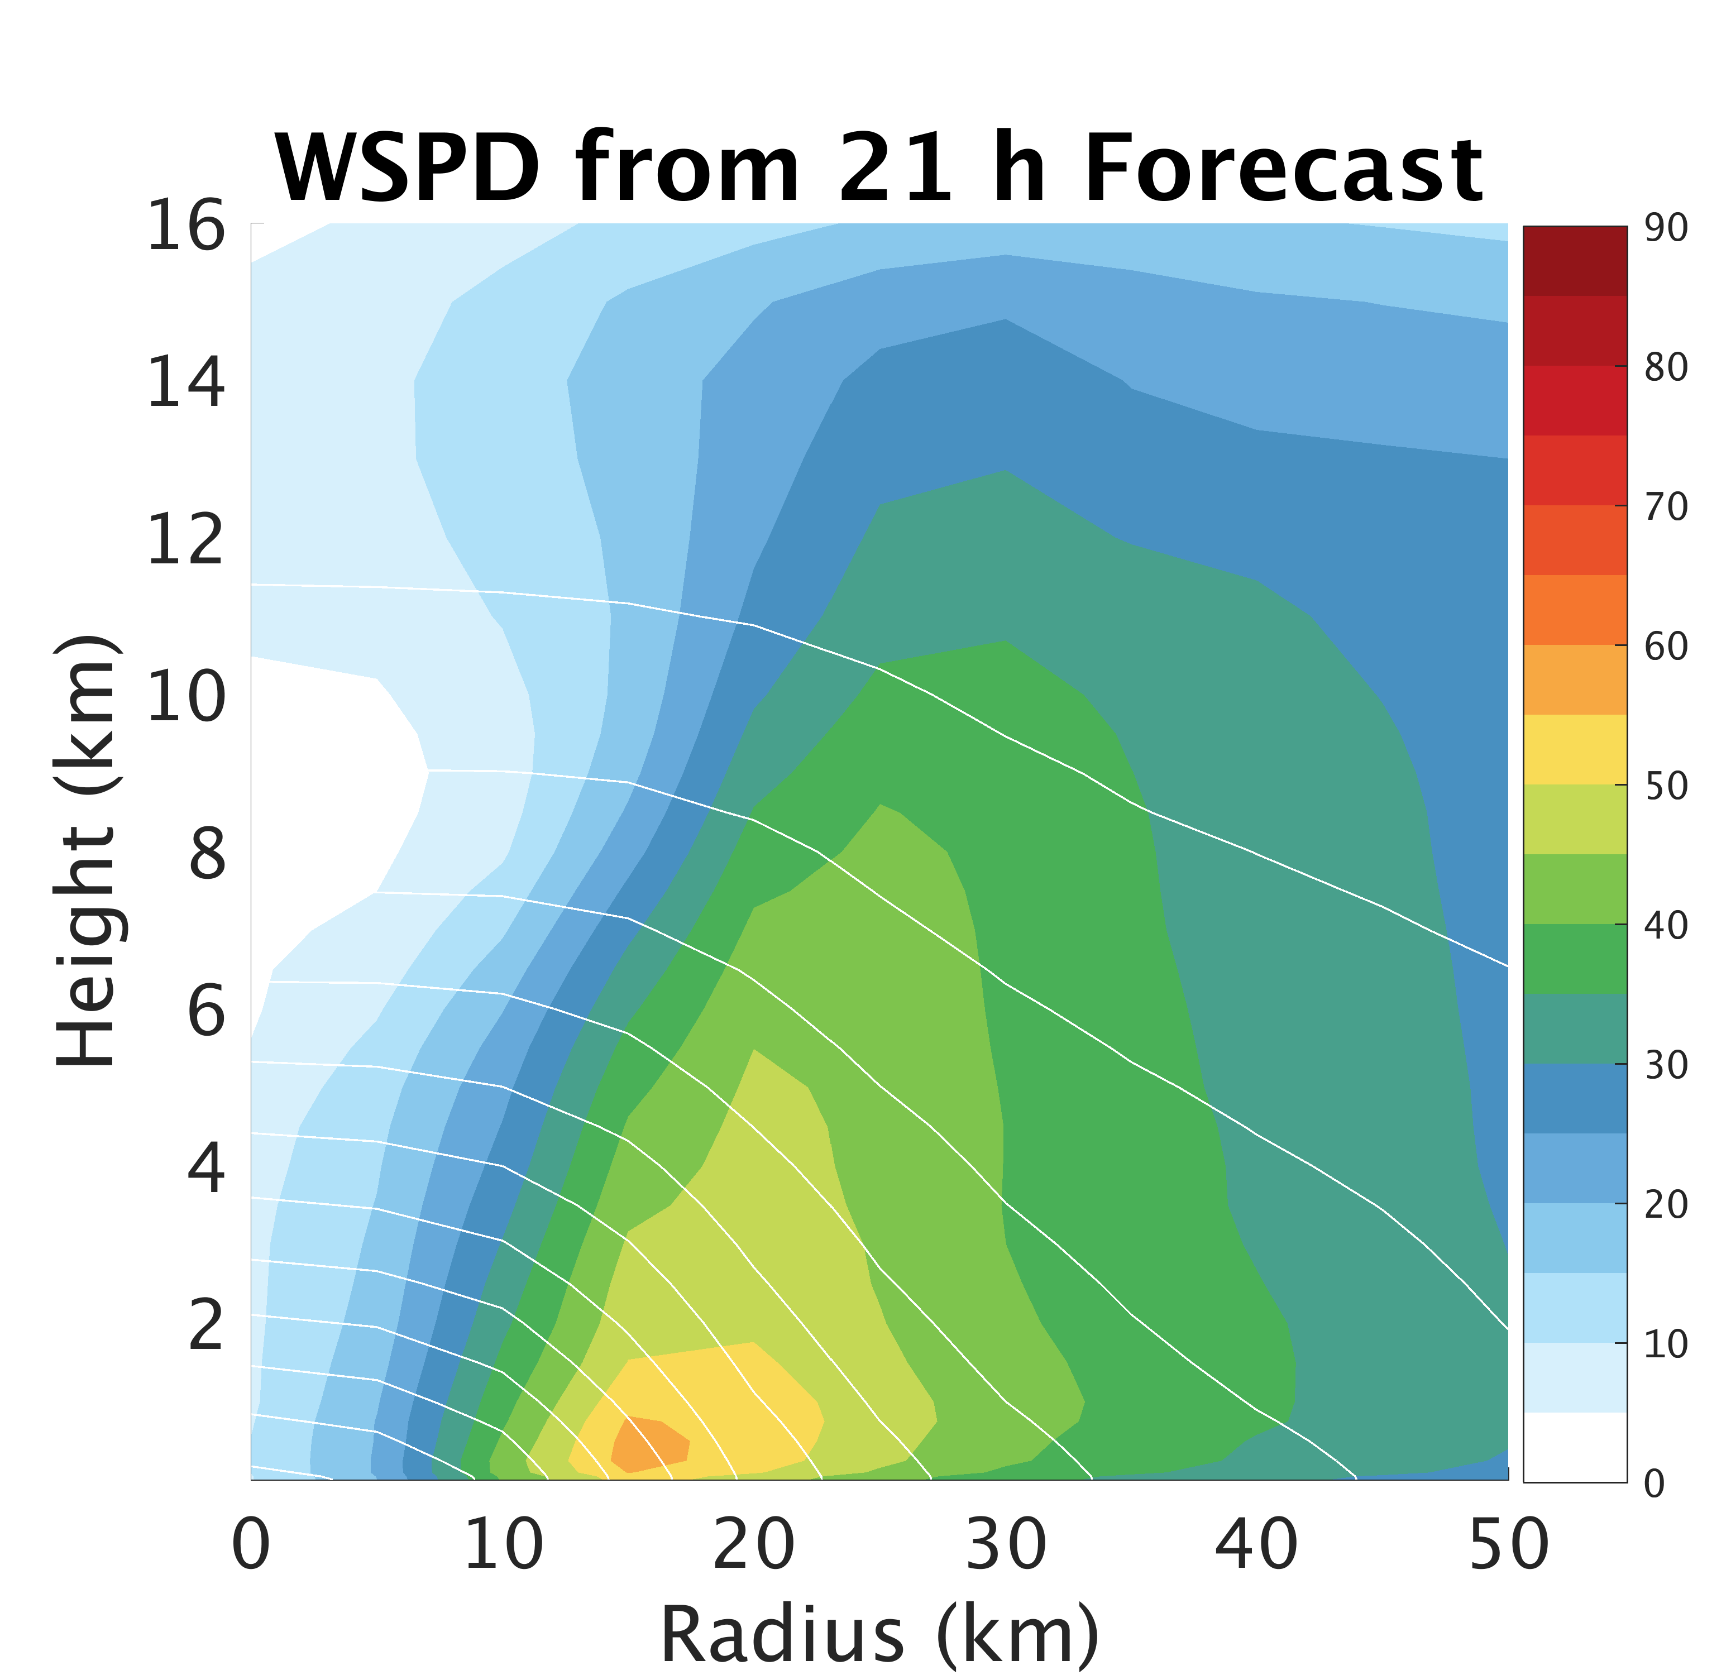
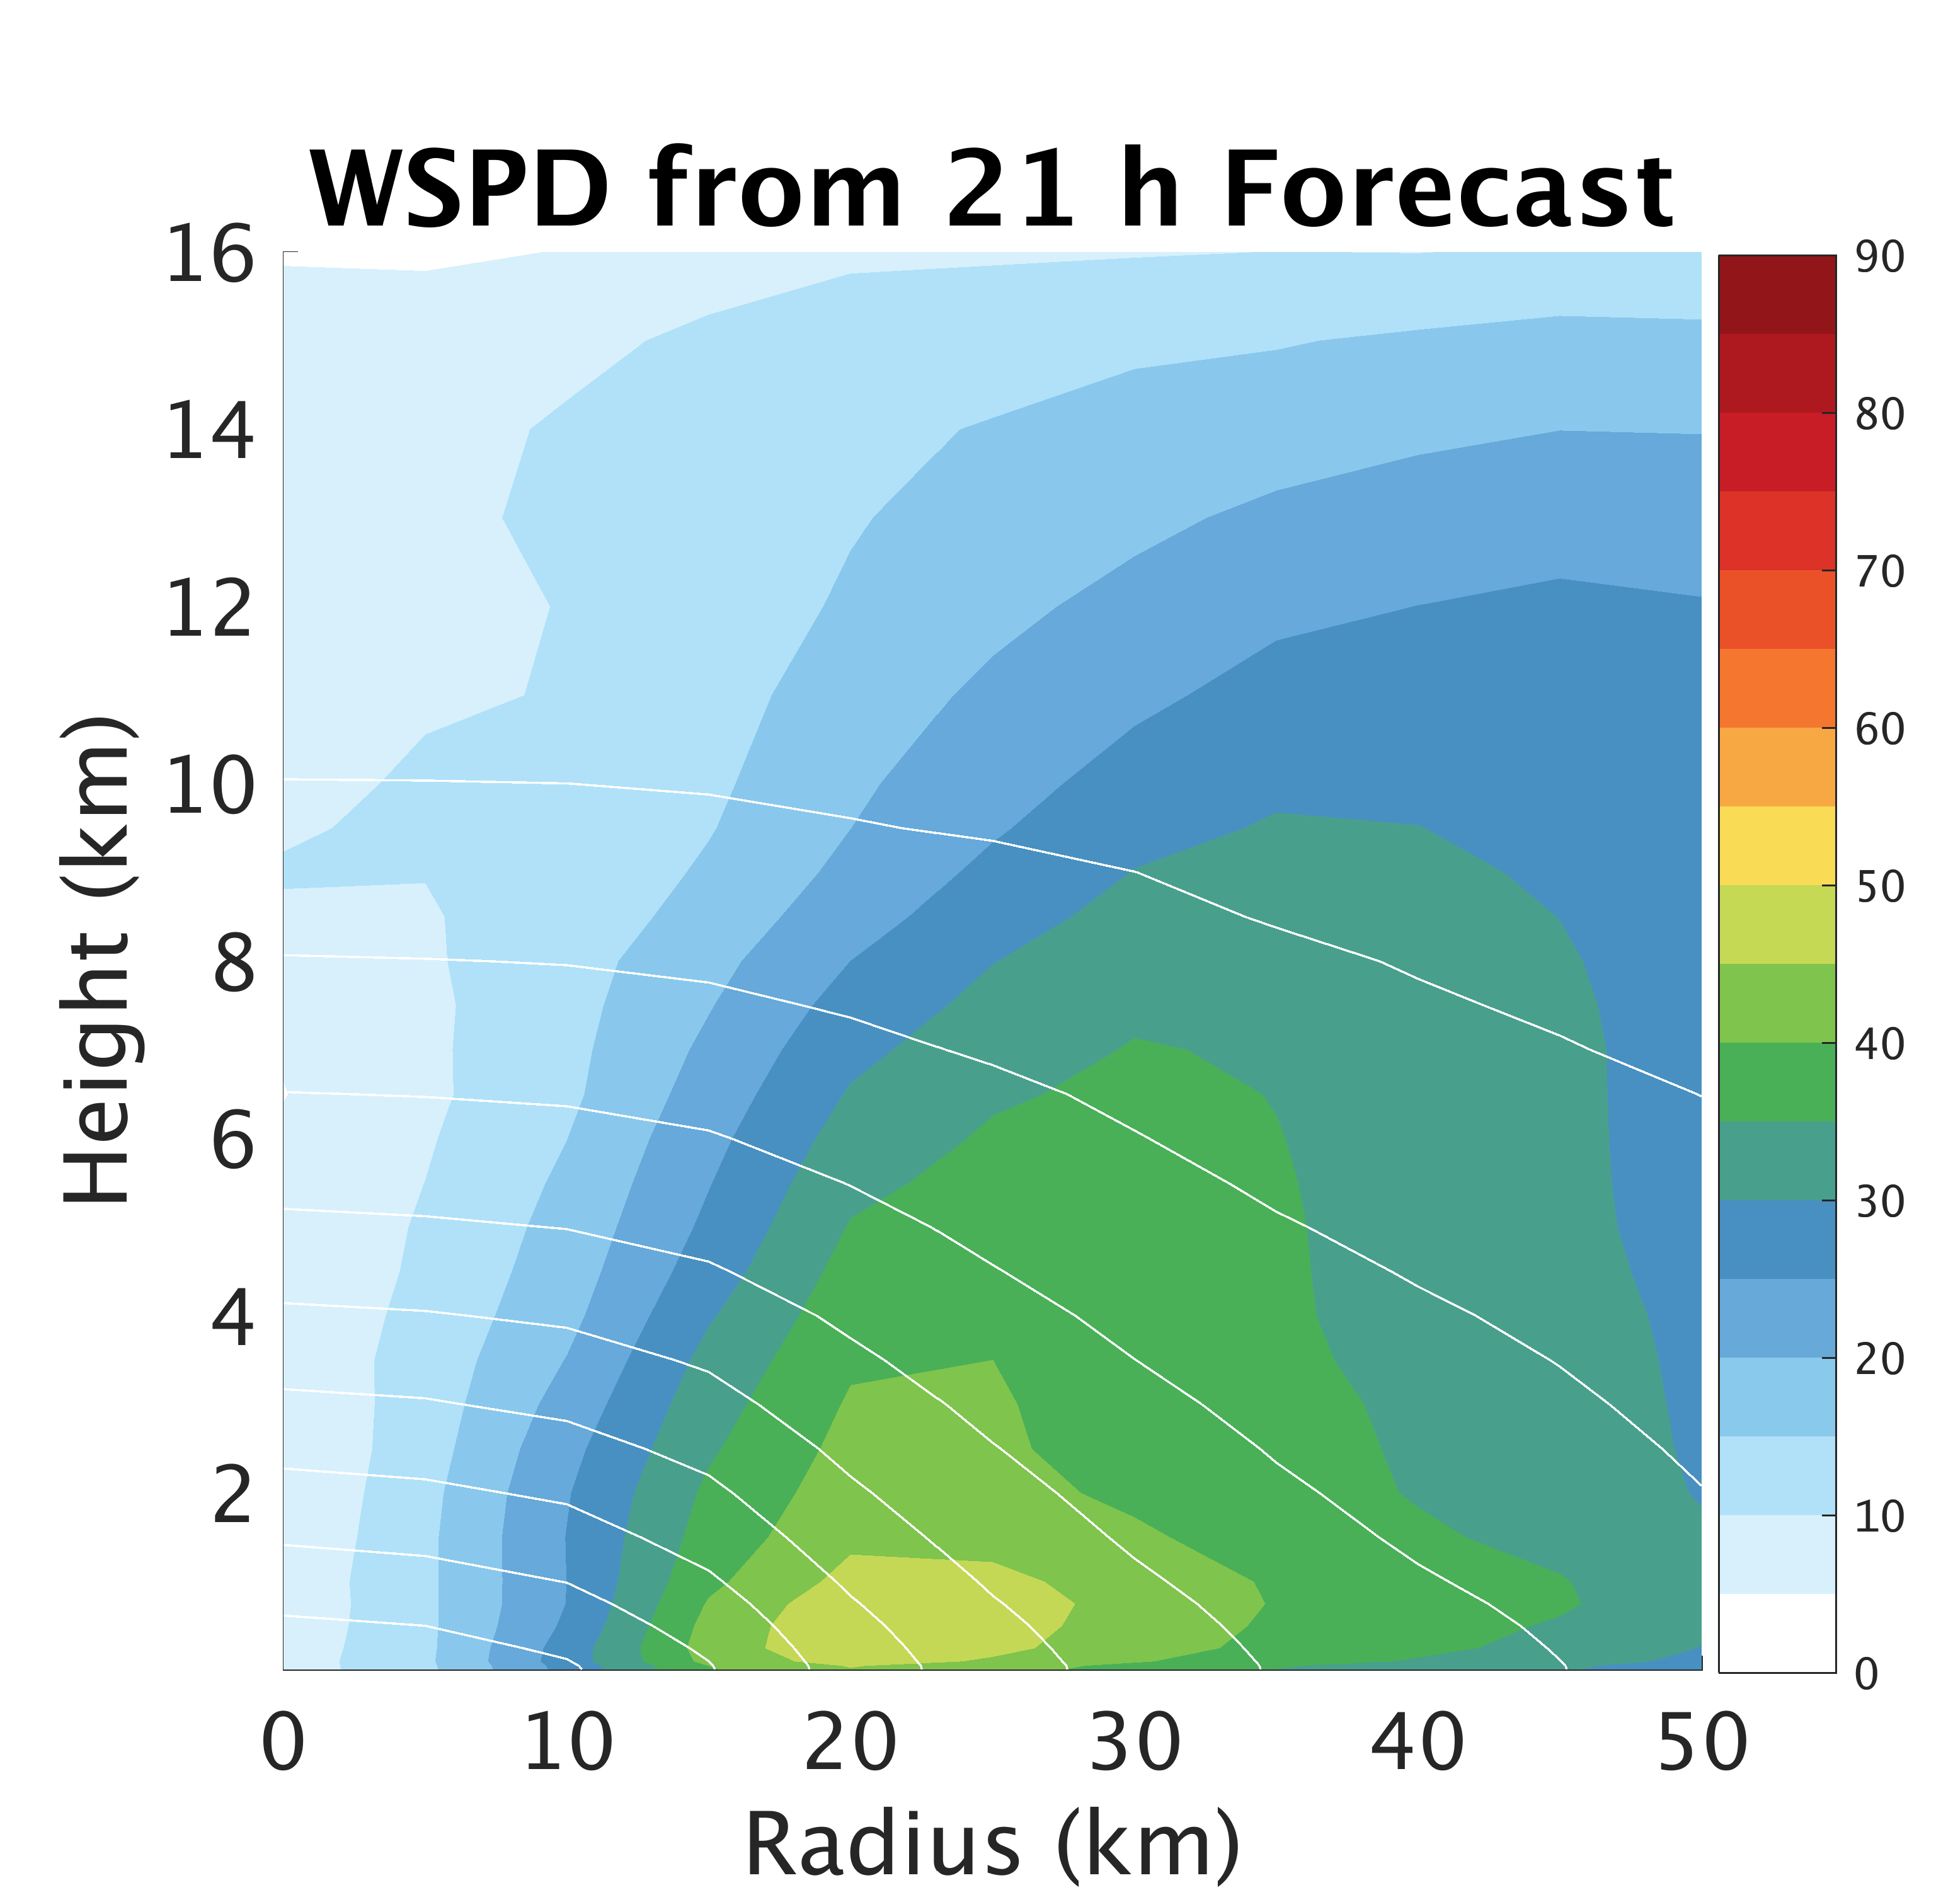
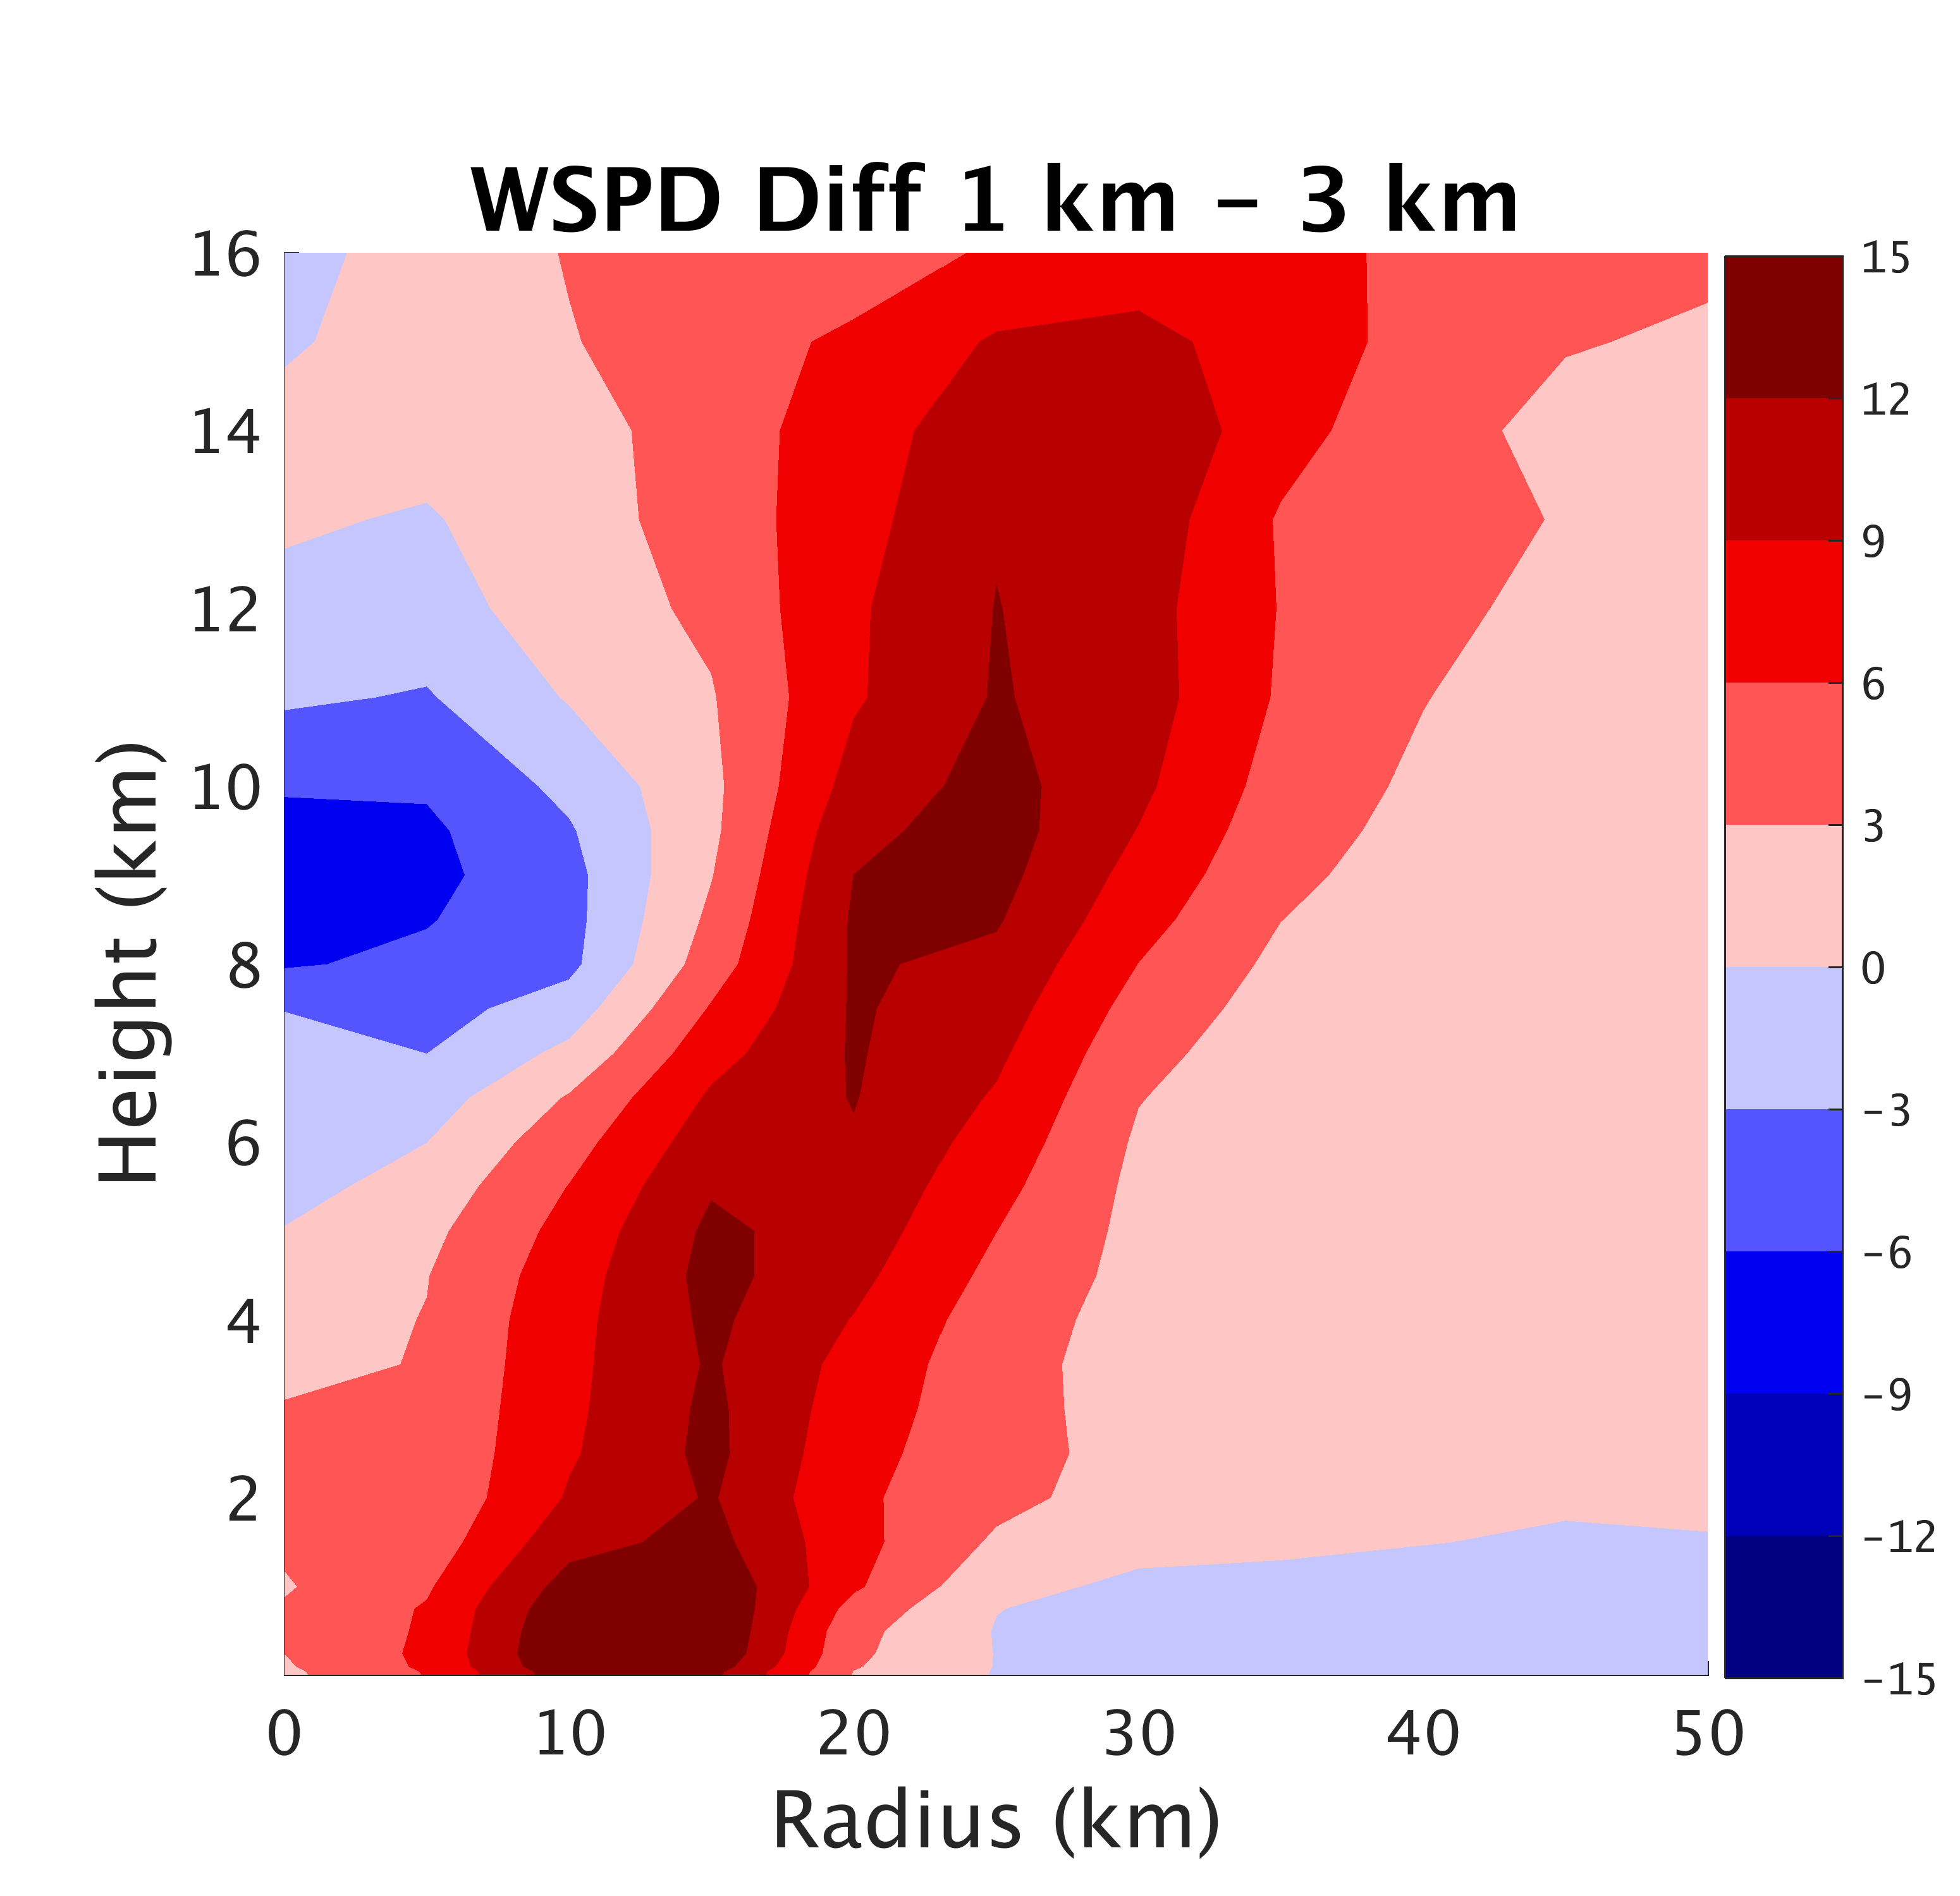
Higher resolution improves inner-core structure/size
1 km
3 km
1km – 3km
Notes:
-small inner-core for Patricia
-white lines are pressure perturbation from environment (helps depict radial pressure gradient)

Slide 10
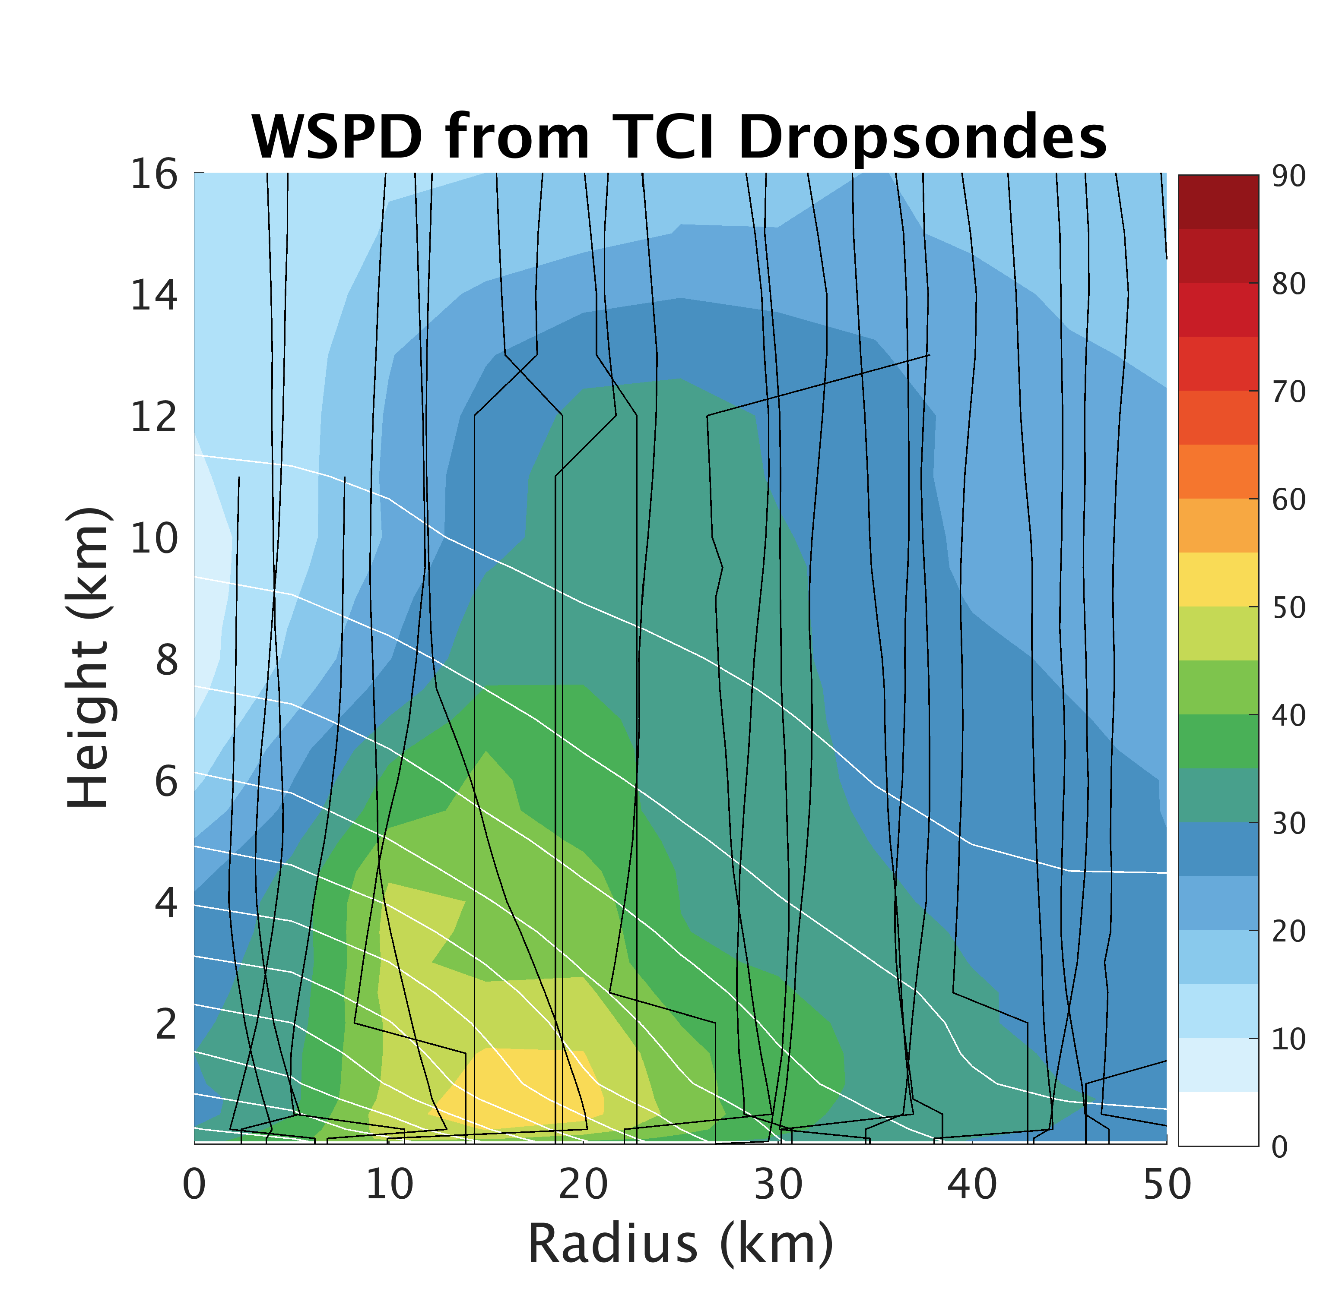
Higher resolution improves inner-core structure/size
obs
1 km
3km
Notes:
-small inner-core for Patricia
-white lines are pressure perturbation from environment (helps depict radial pressure gradient)

Slide 11
Forecasts Very Sensitive to Surface Flux Param.
Green and Zhang (2013)
Chen et al. (2016)
Notes:
-only difference is surface flux parameterization (mainly Cd wind speed relationship)

Slide 12
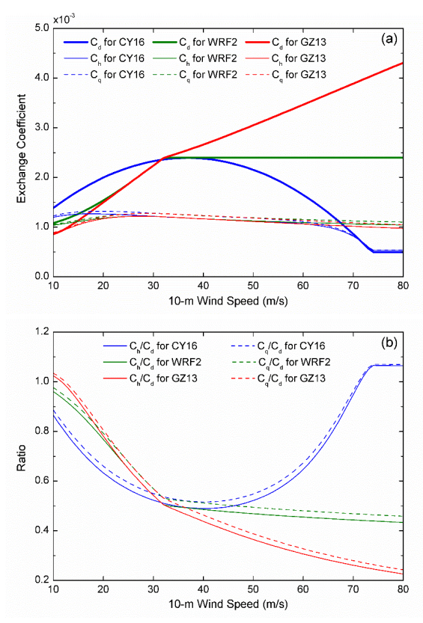
Why Model Surface Flux Param. Matters
Potential intensity increases w/ C_{k}/C_{d}
Expect potentially stronger storm with lower C_{d}
MPI: |V_{m}|²=C_{k}/C_{d} * εT_{s}*(S₀*-S_{b})
[Emanuel, 1997]
[Chen et al. 2018]

Slide 13
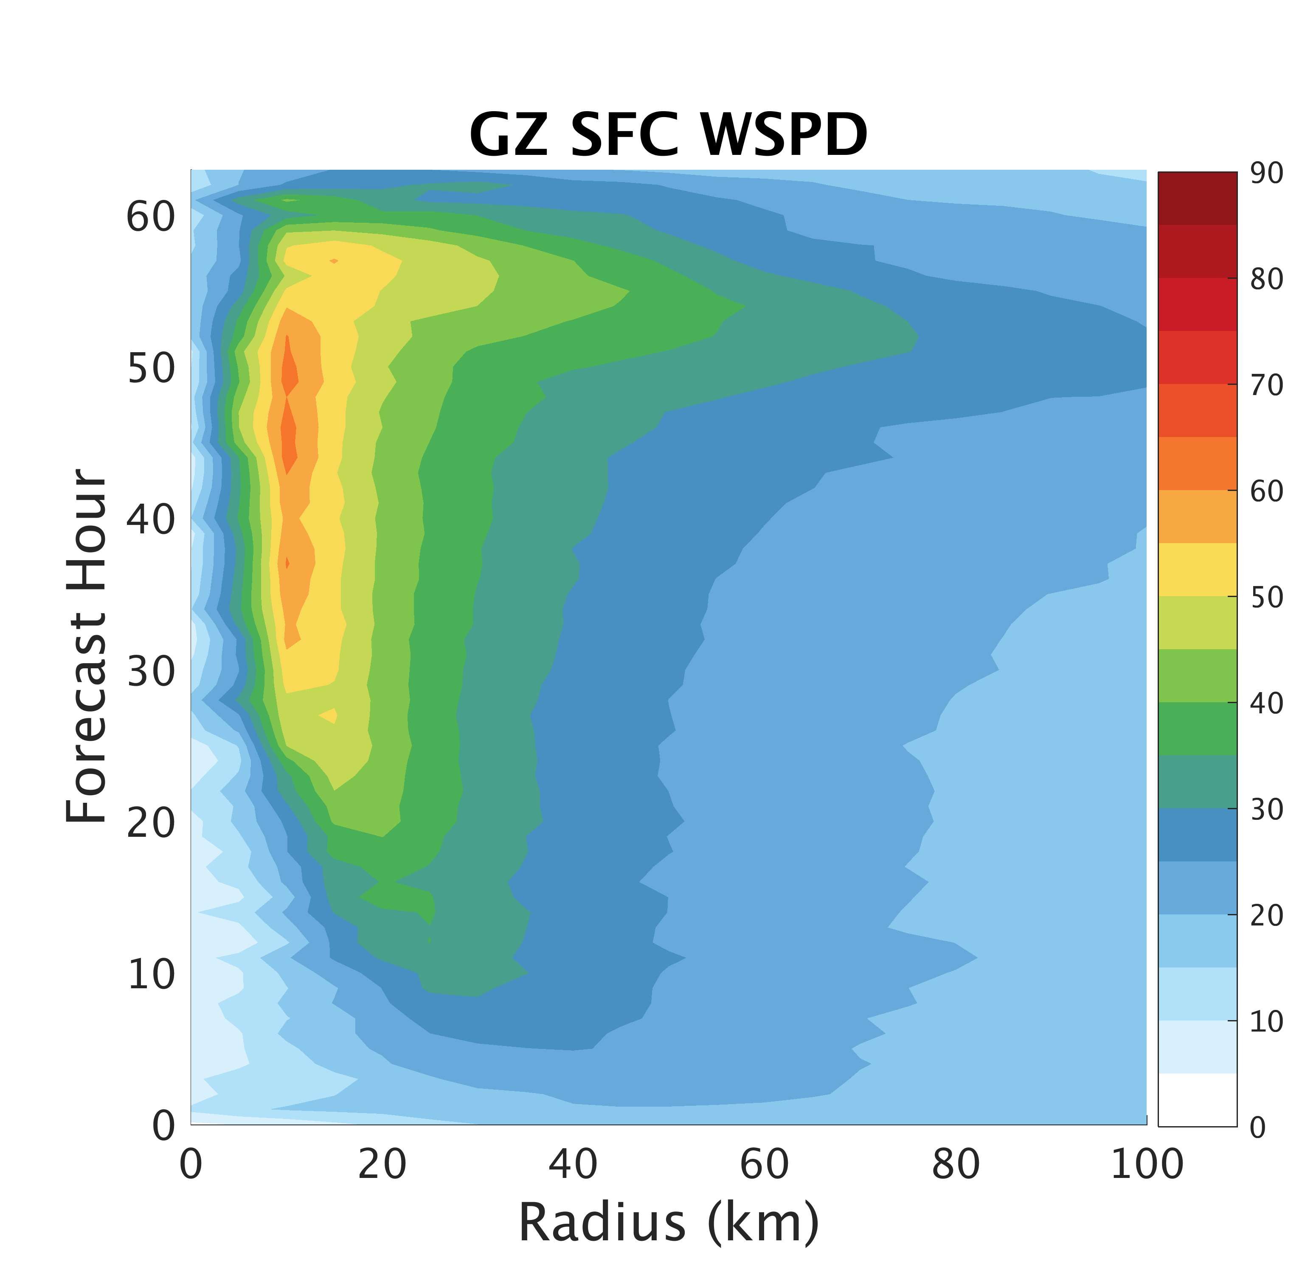
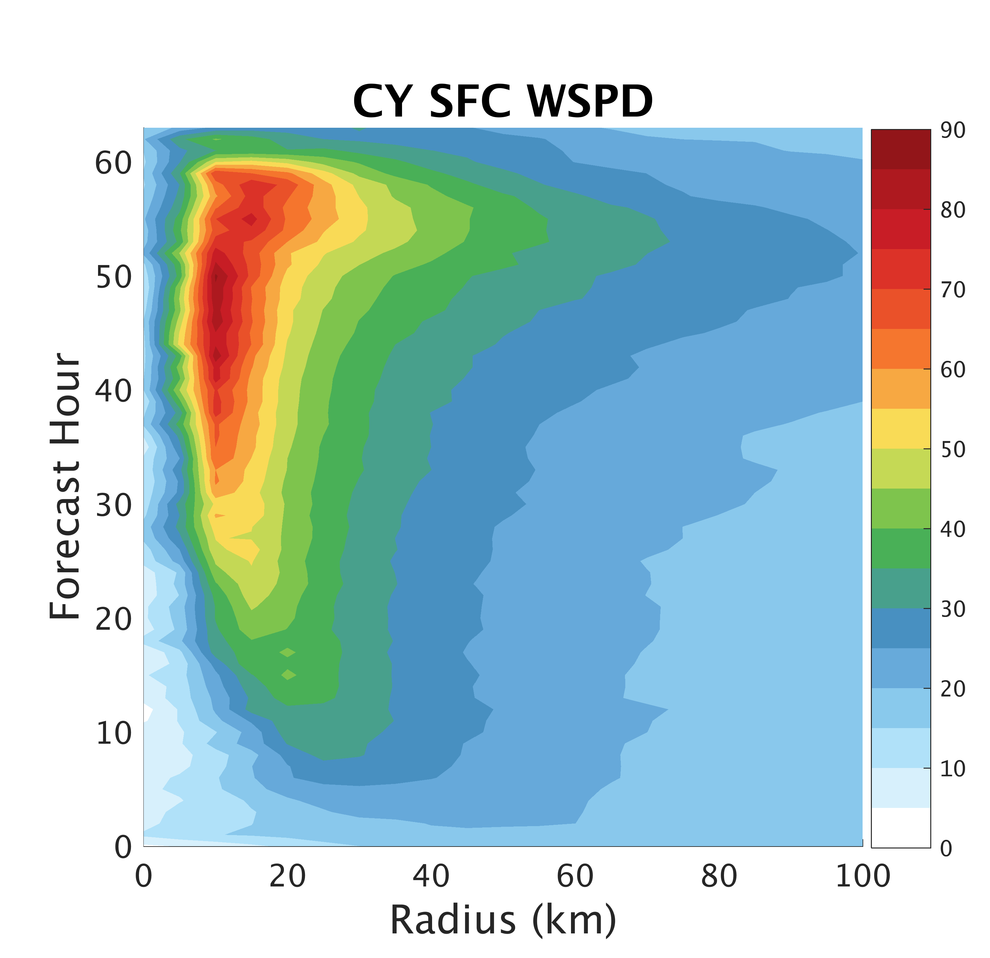
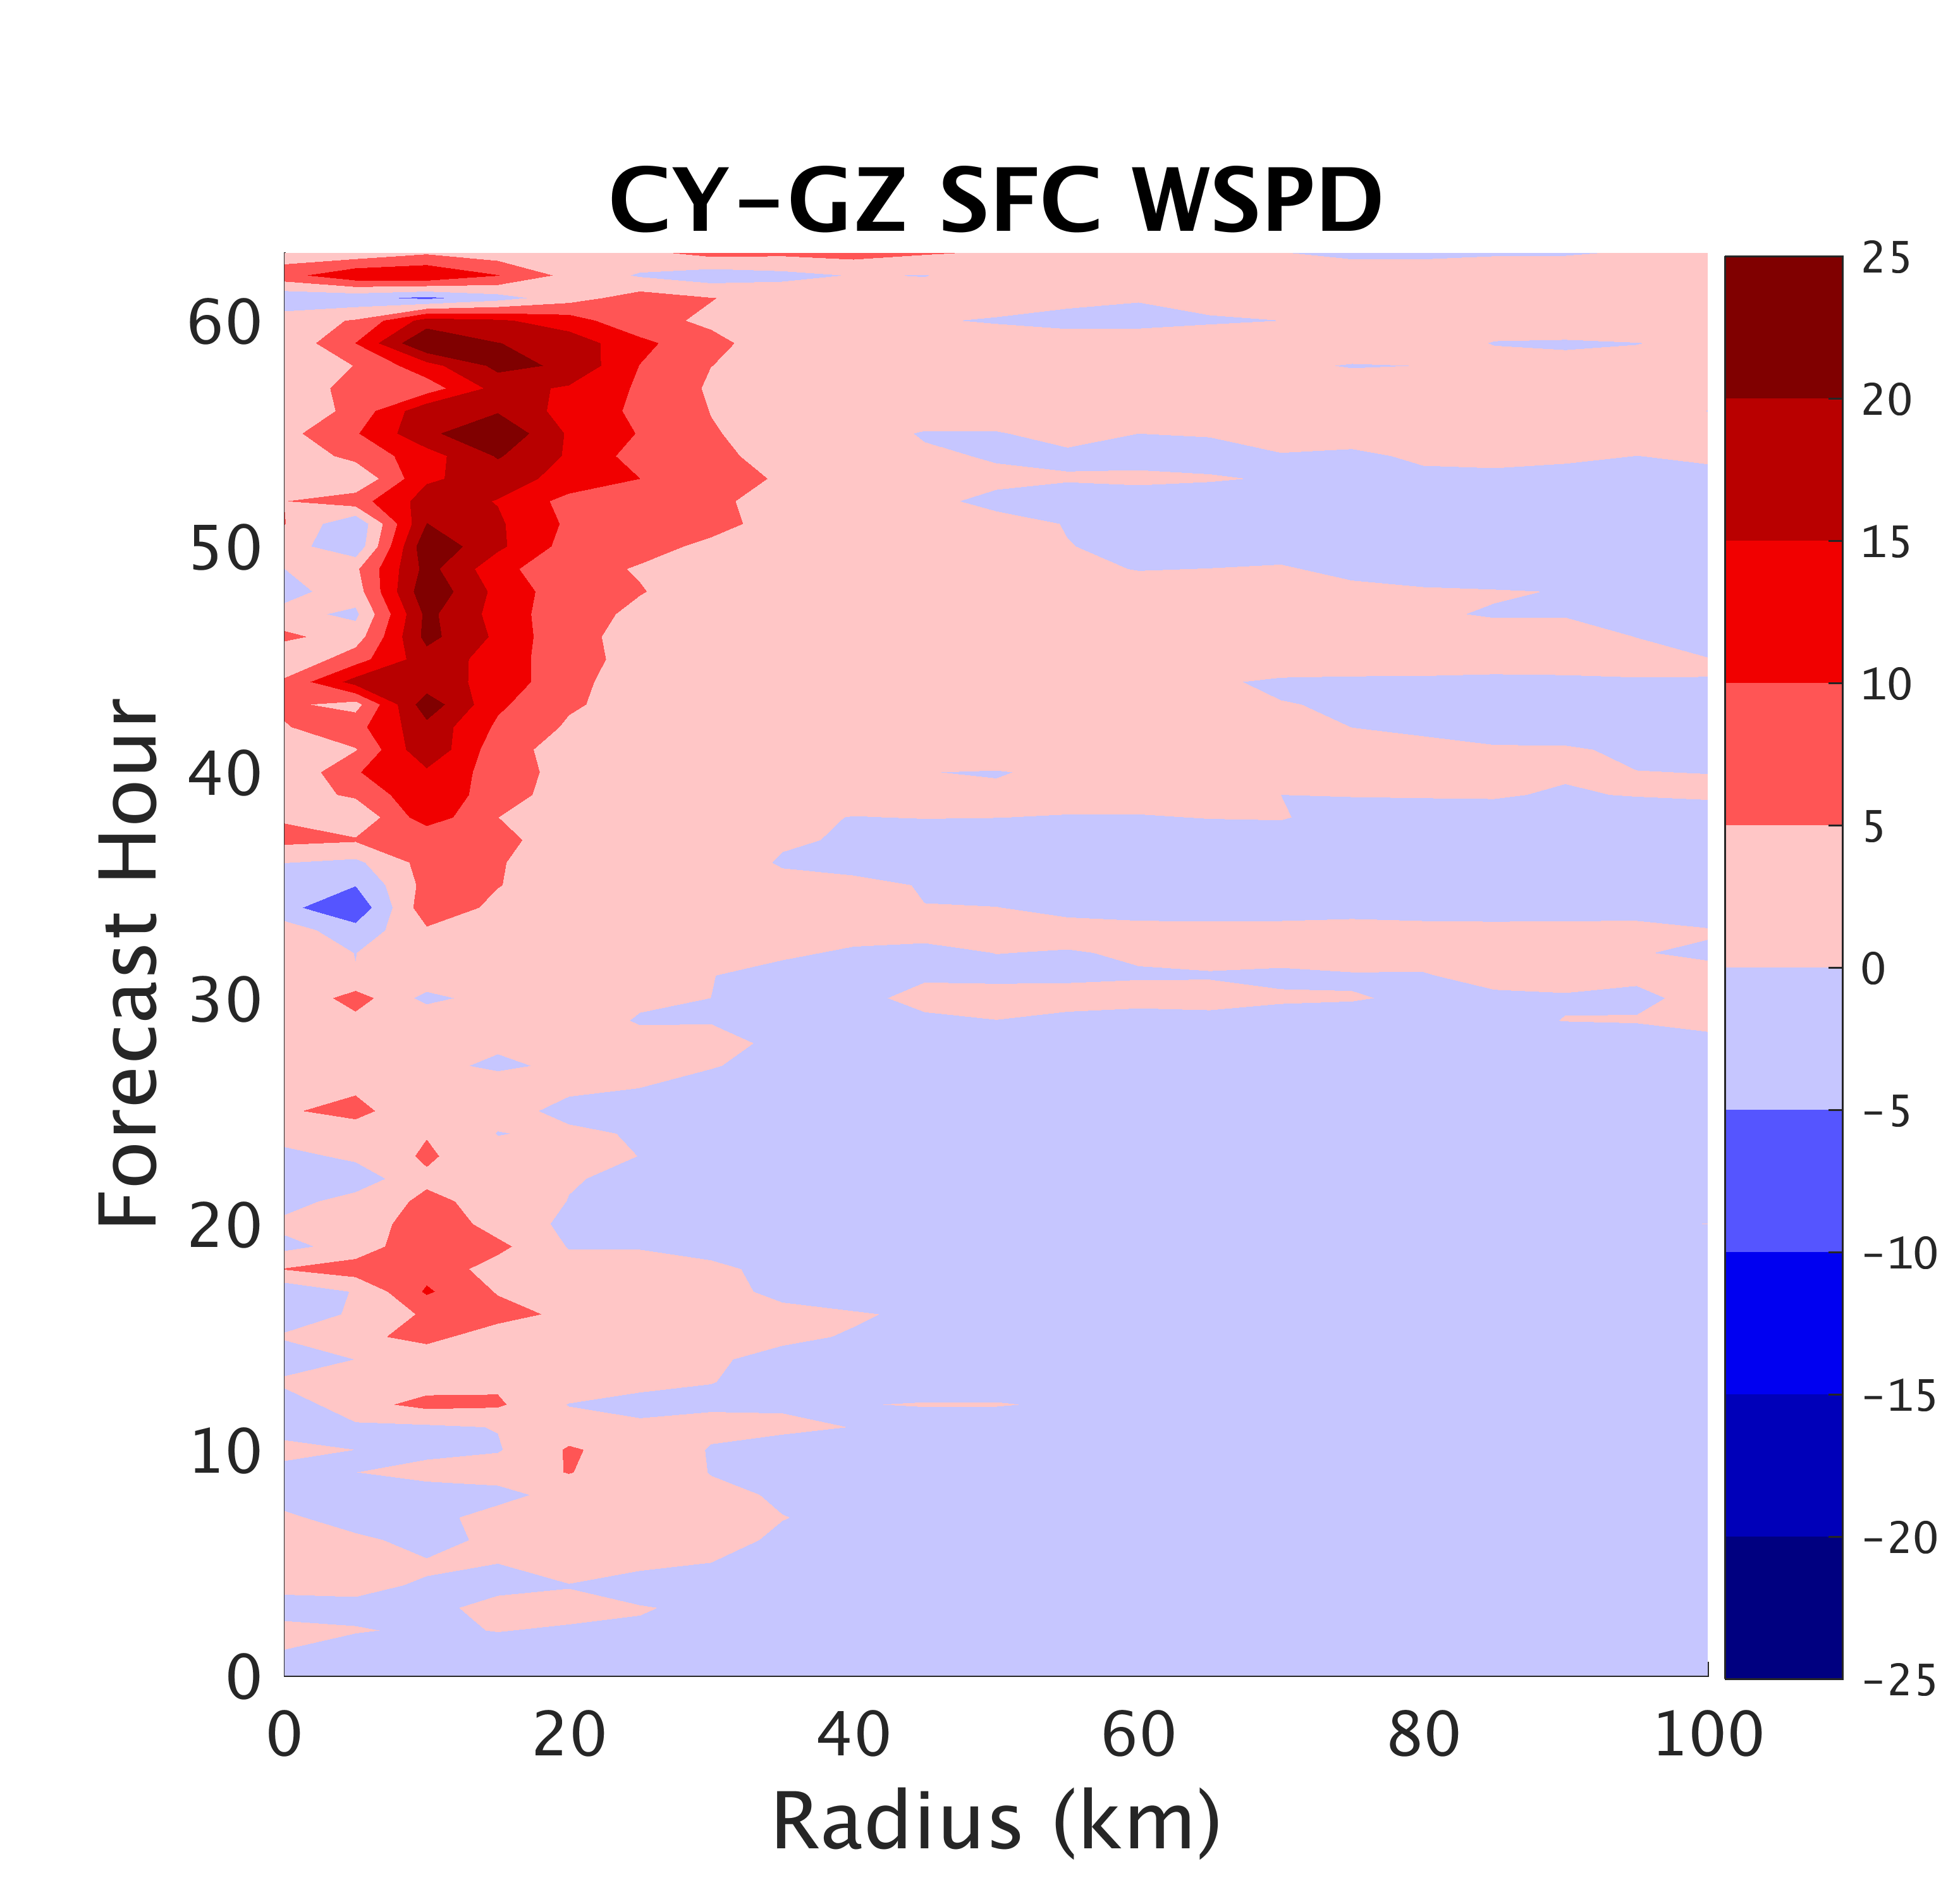
Surface Flux:
Impacts on Structure
Surface winds speeds always larger in CY
Notes:
-

Slide 14
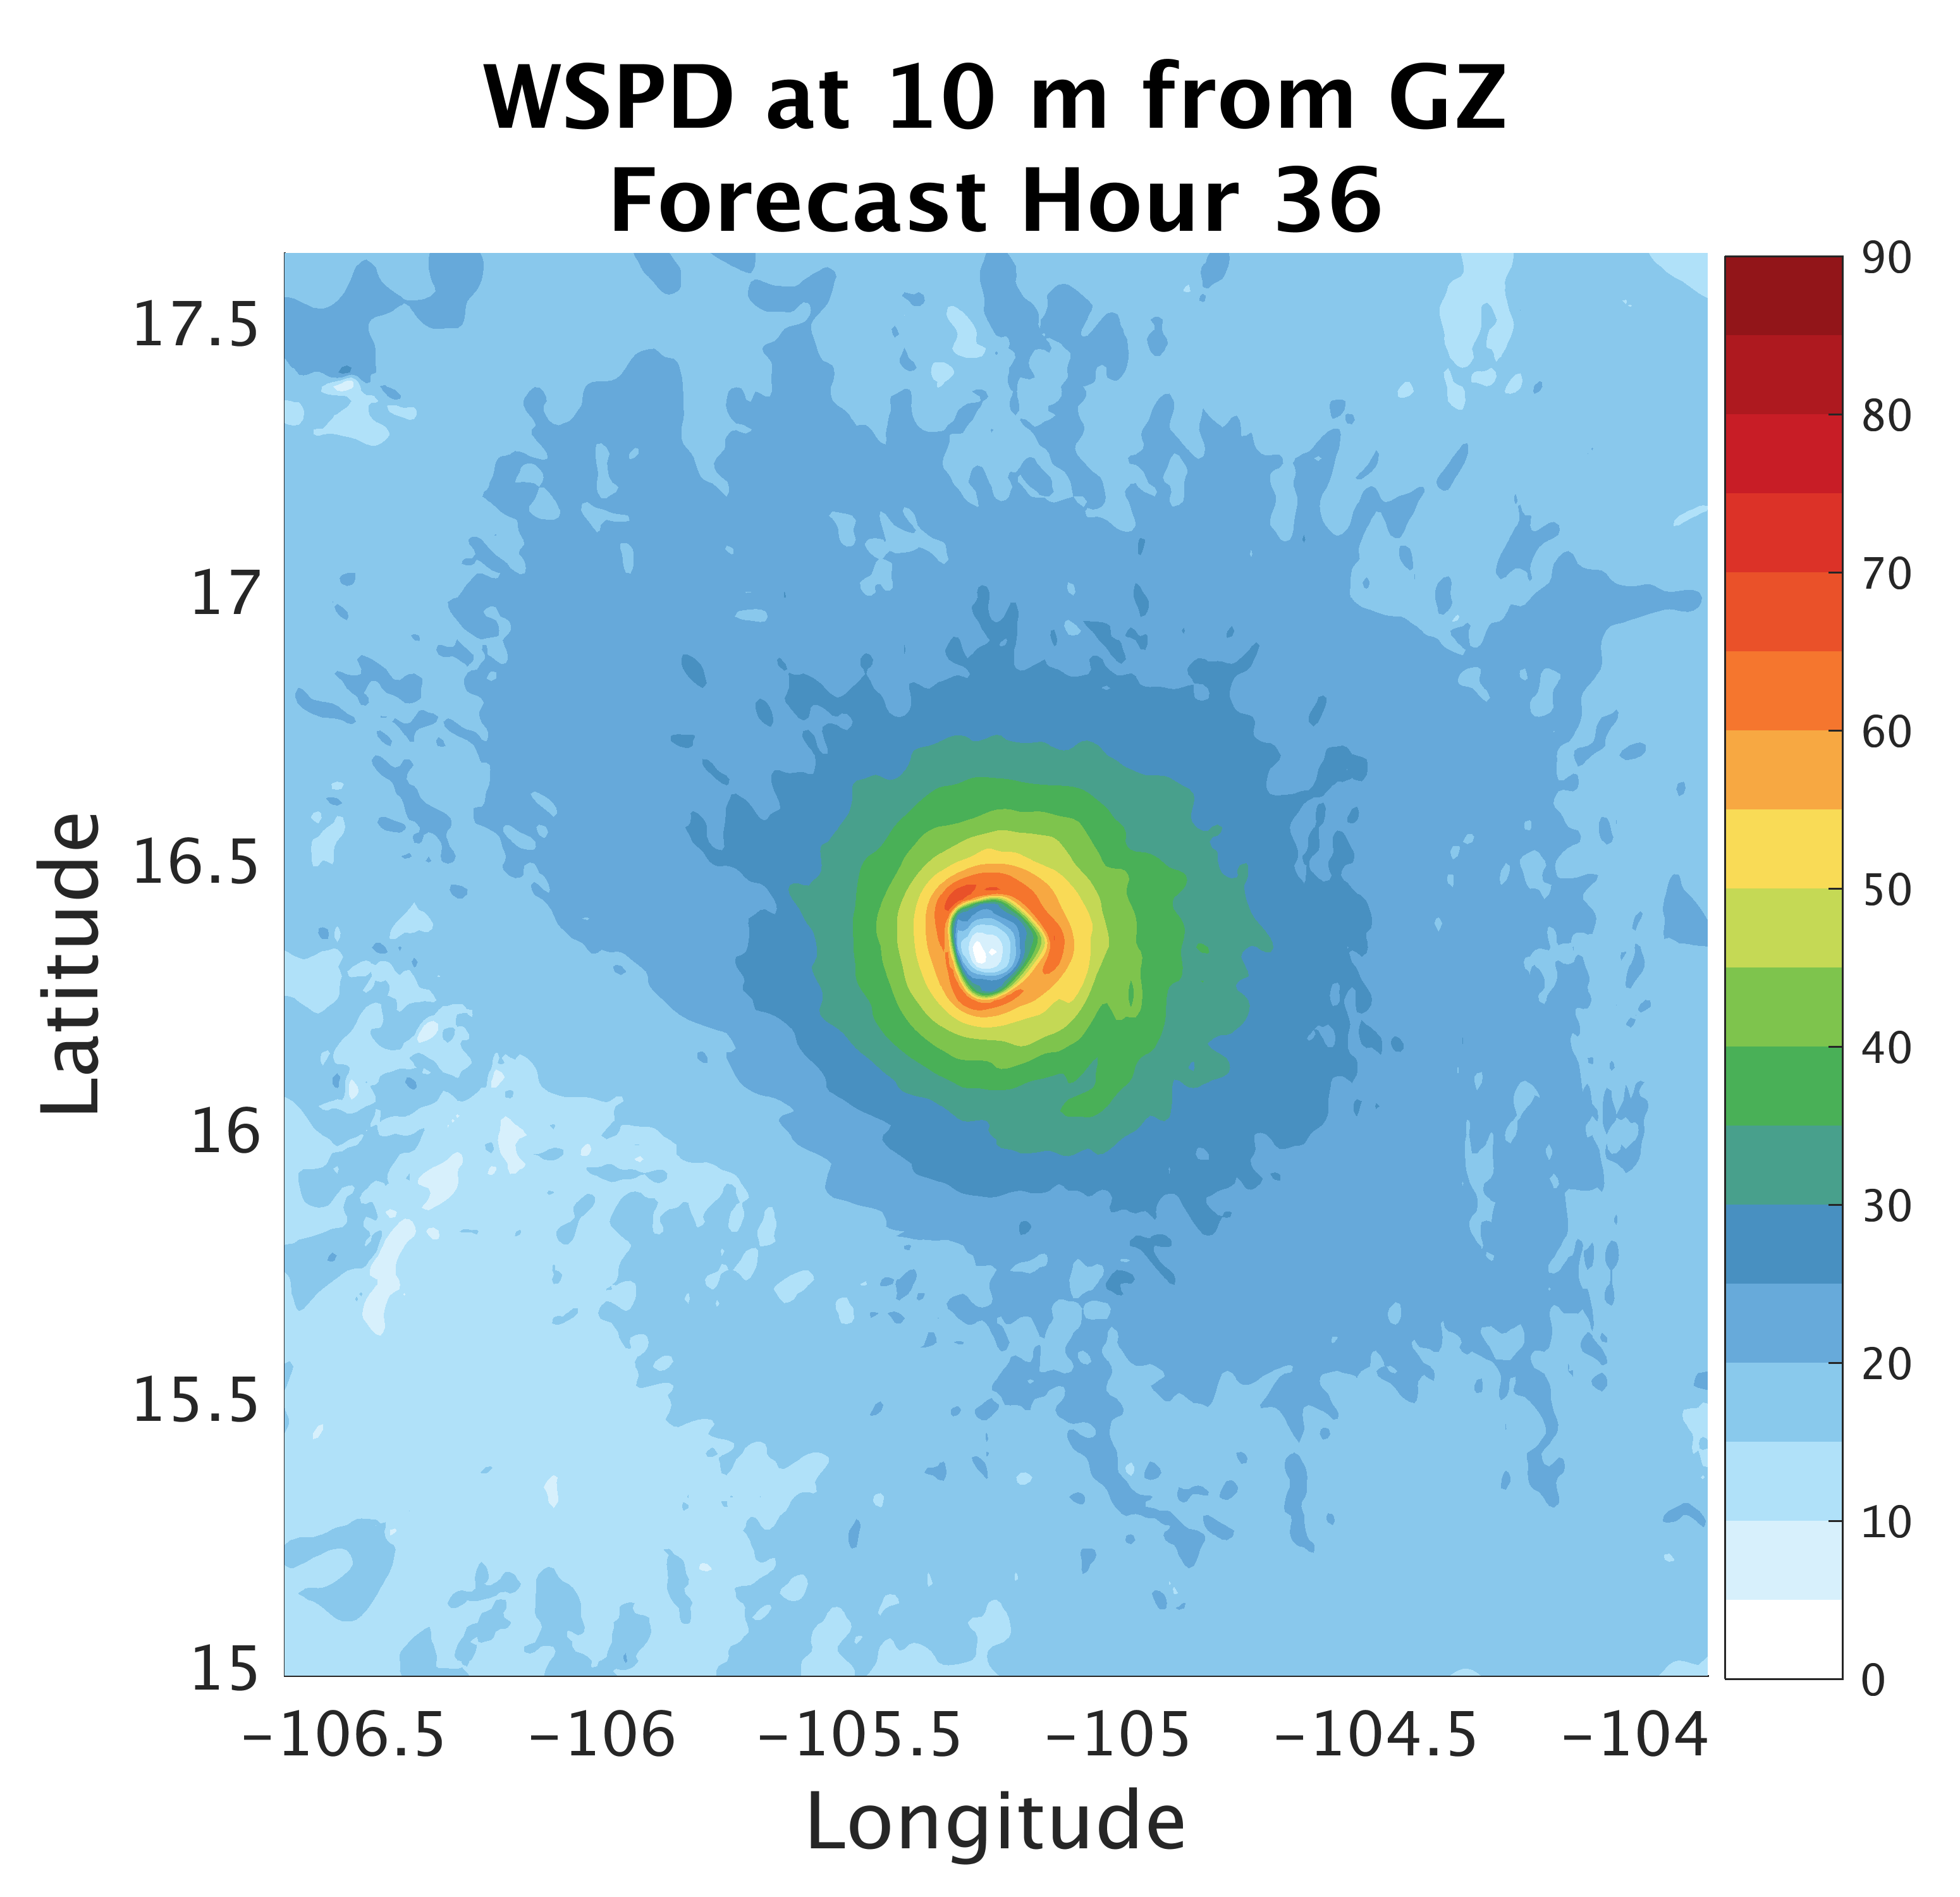
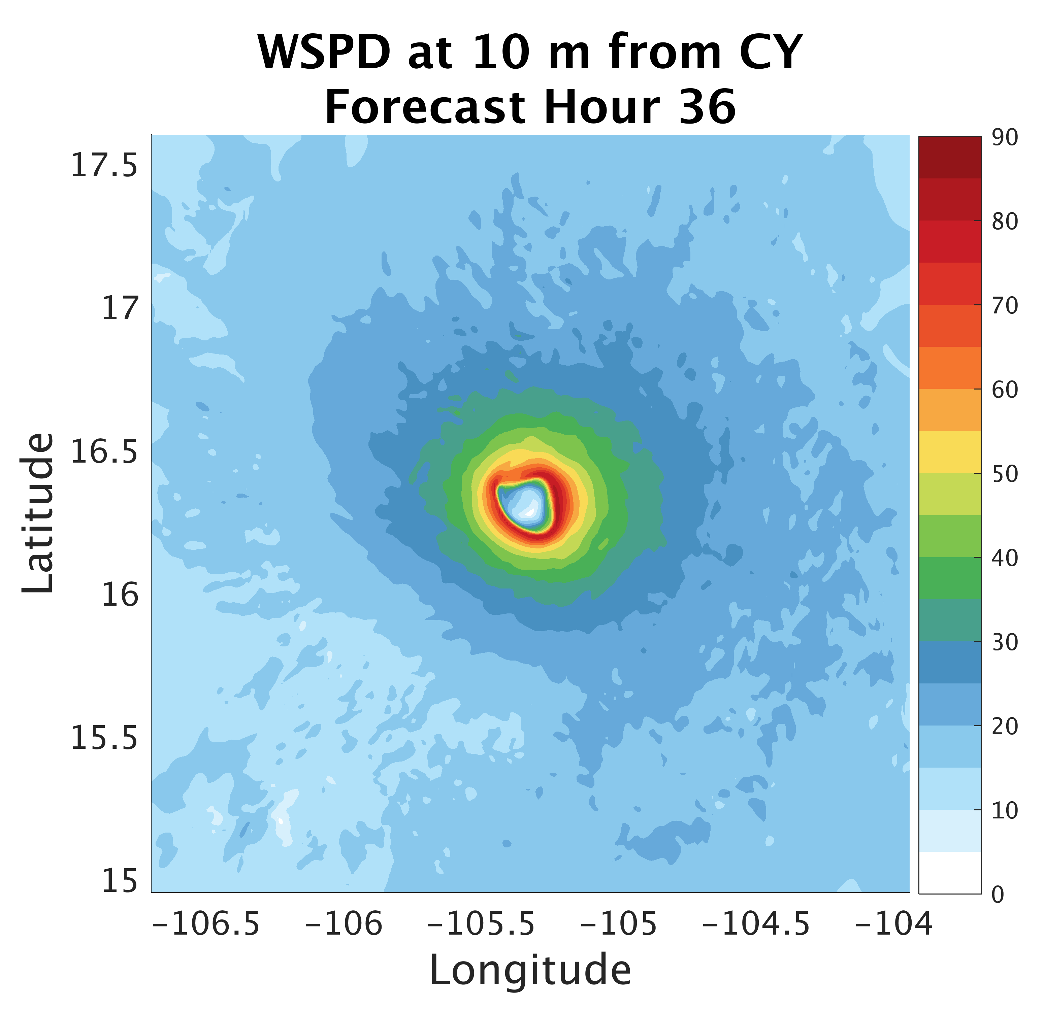
Surface Flux:
Impacts on Structure
Notes:
-

Slide 15
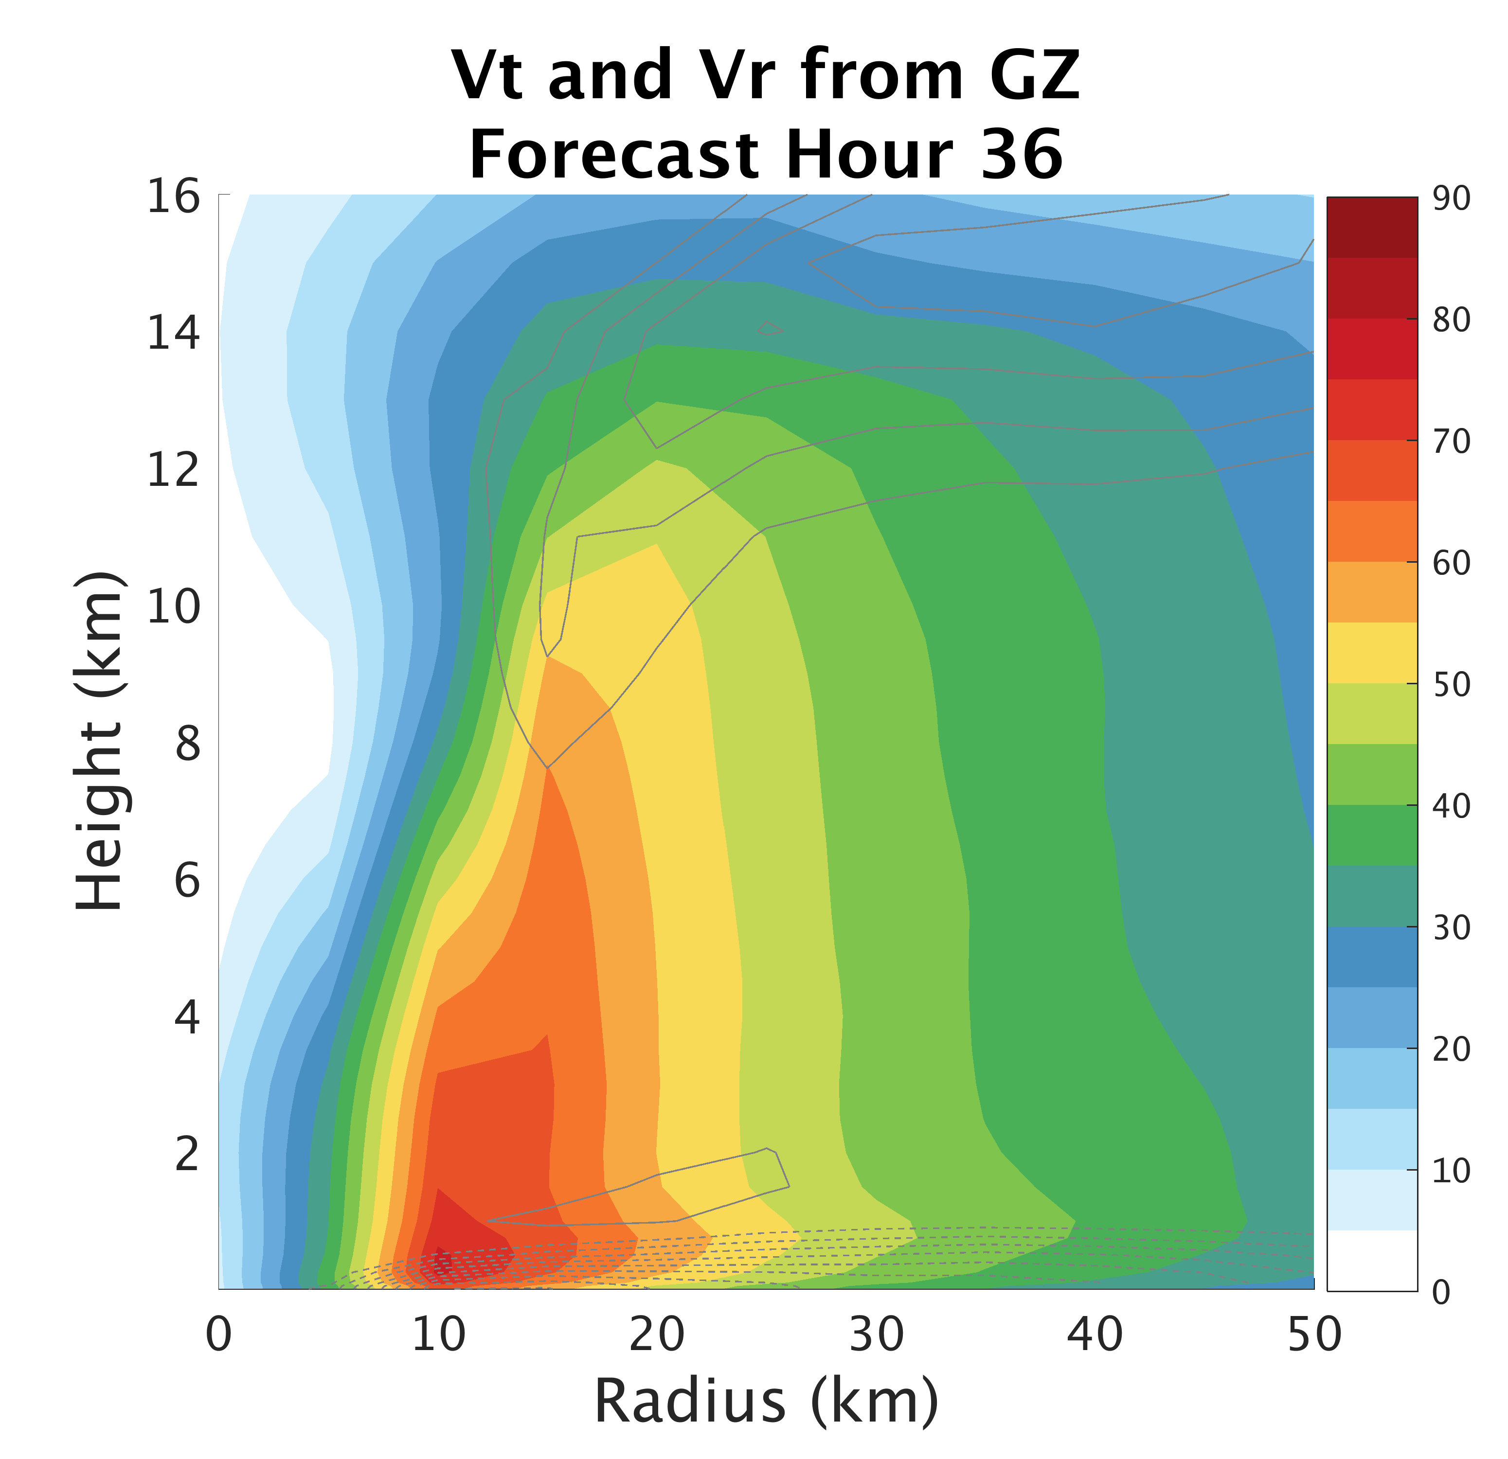
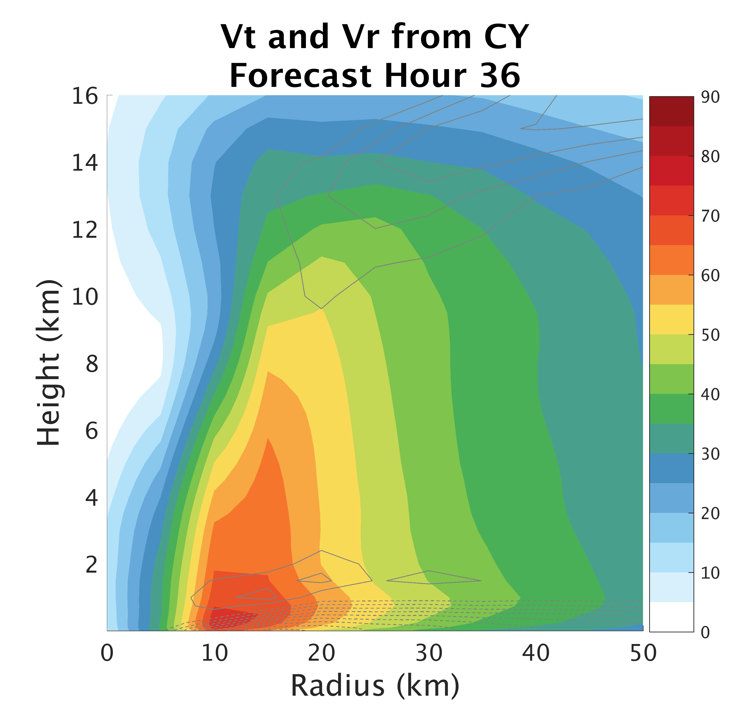
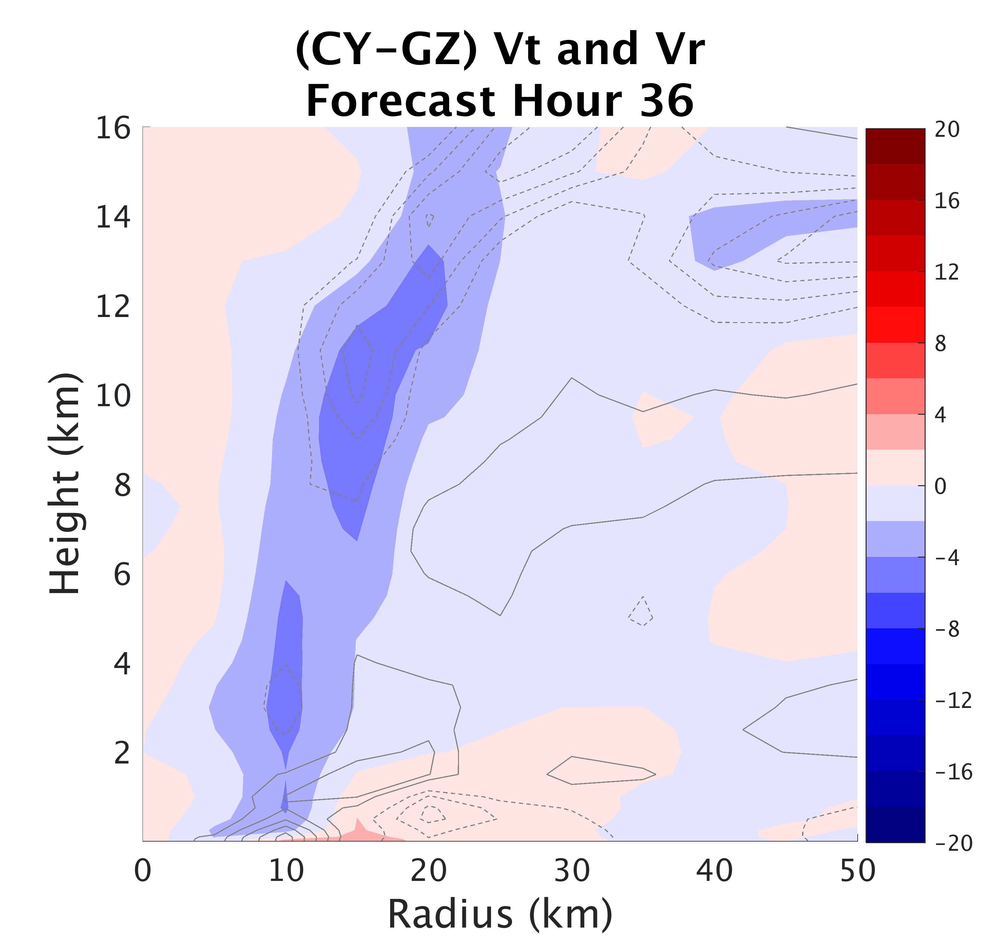
Surface Flux:
Impacts on Structure
Notes:
-stronger eyewall surface convergence from larger Cd → increased frictional effect
-also stronger outflow from larger Cd (GZ)

Slide 16
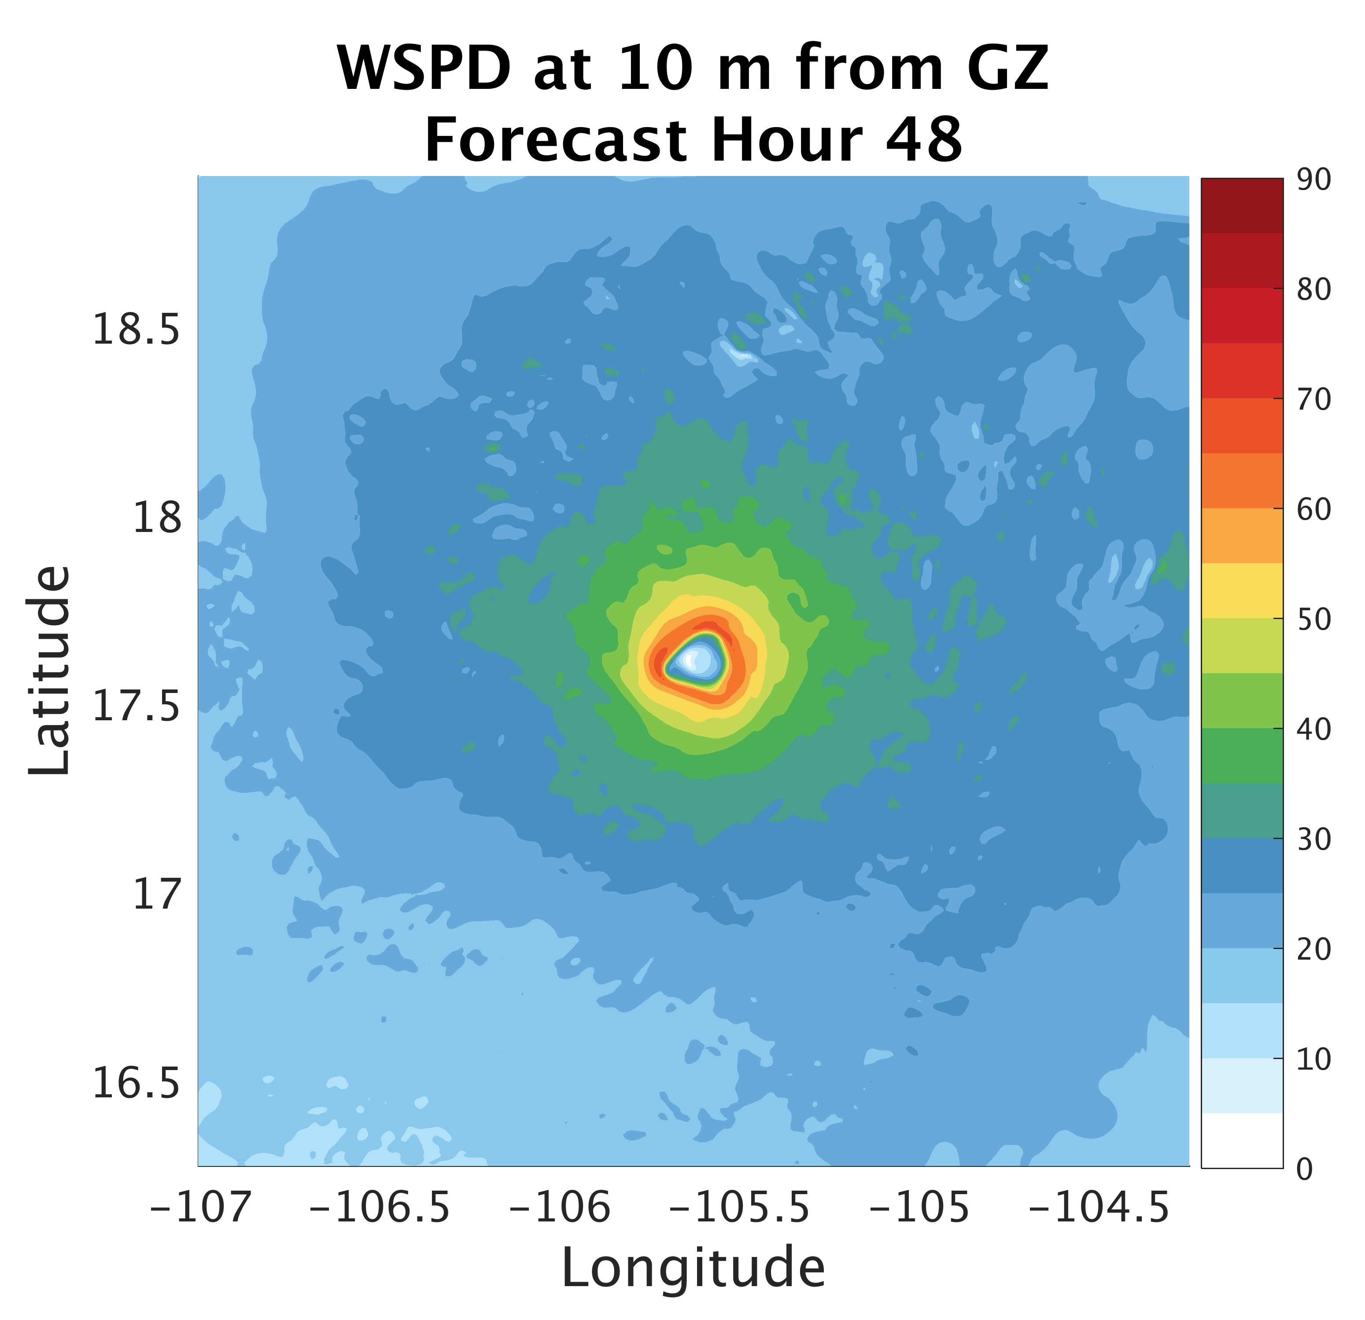
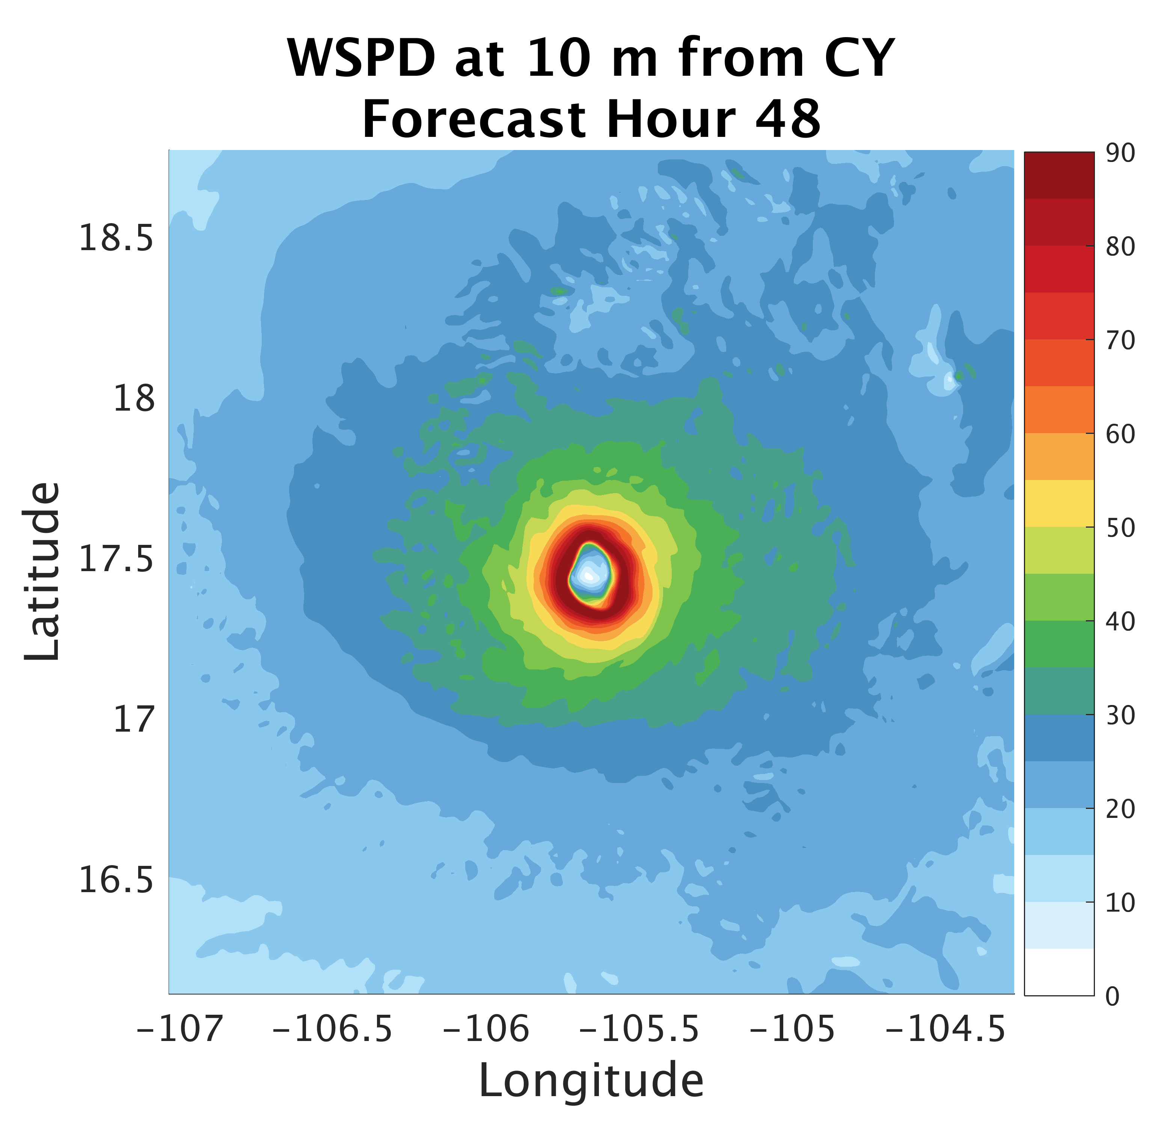
Surface Flux:
Impacts on Structure
Notes:
-

Slide 17
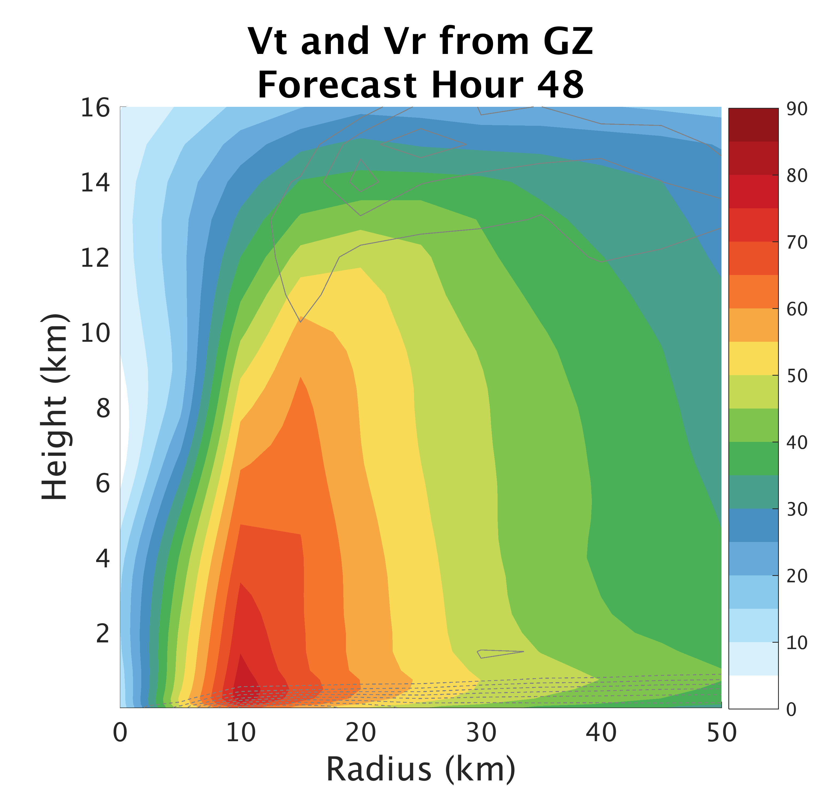
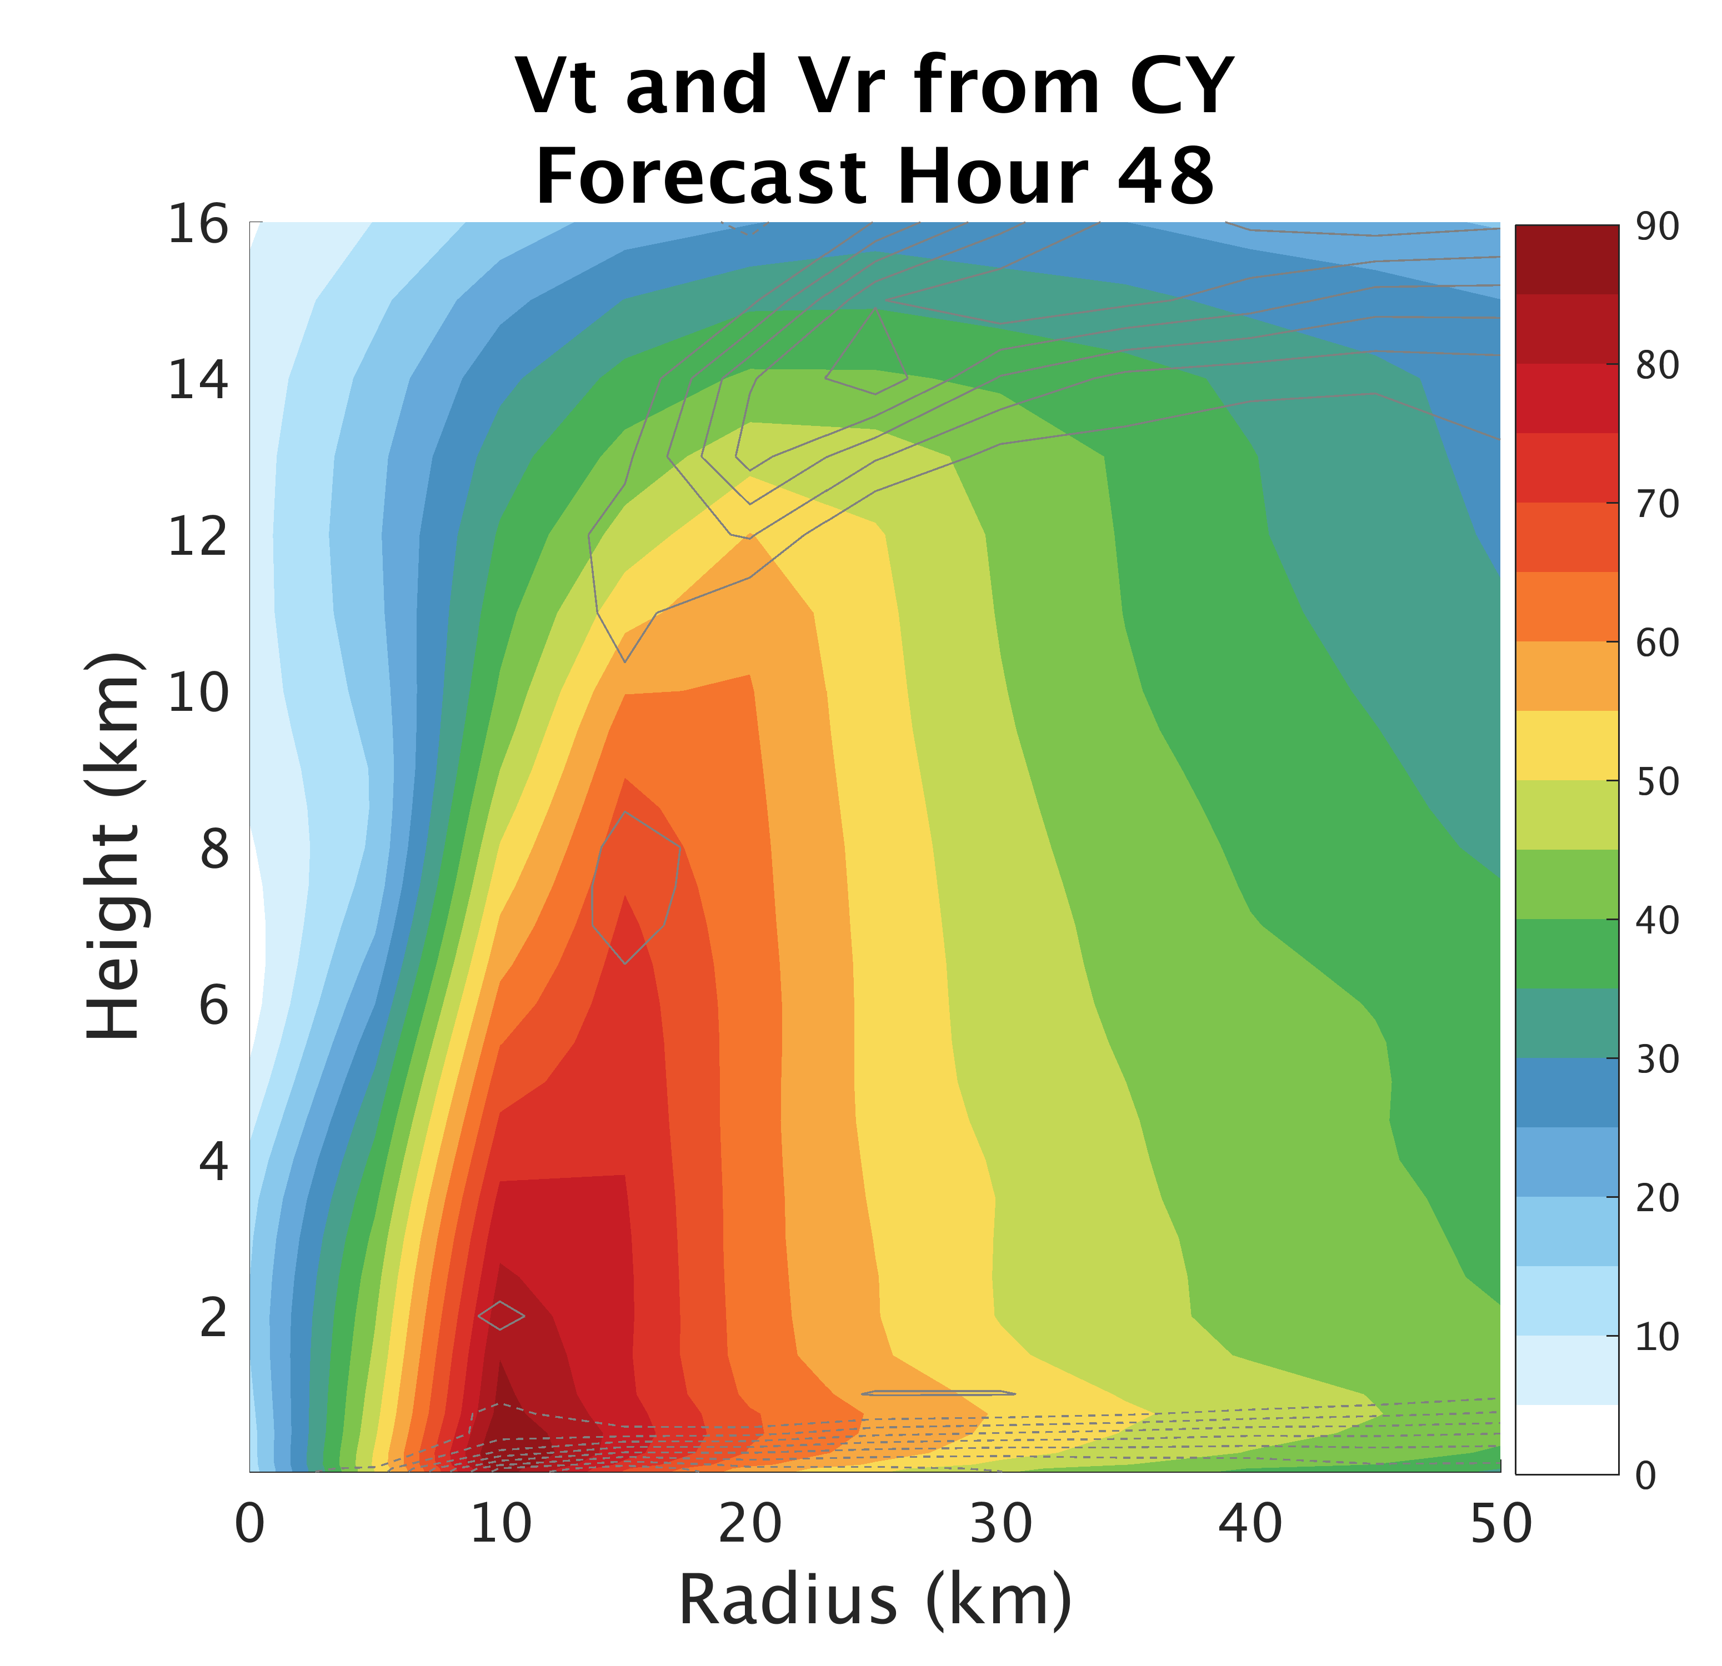
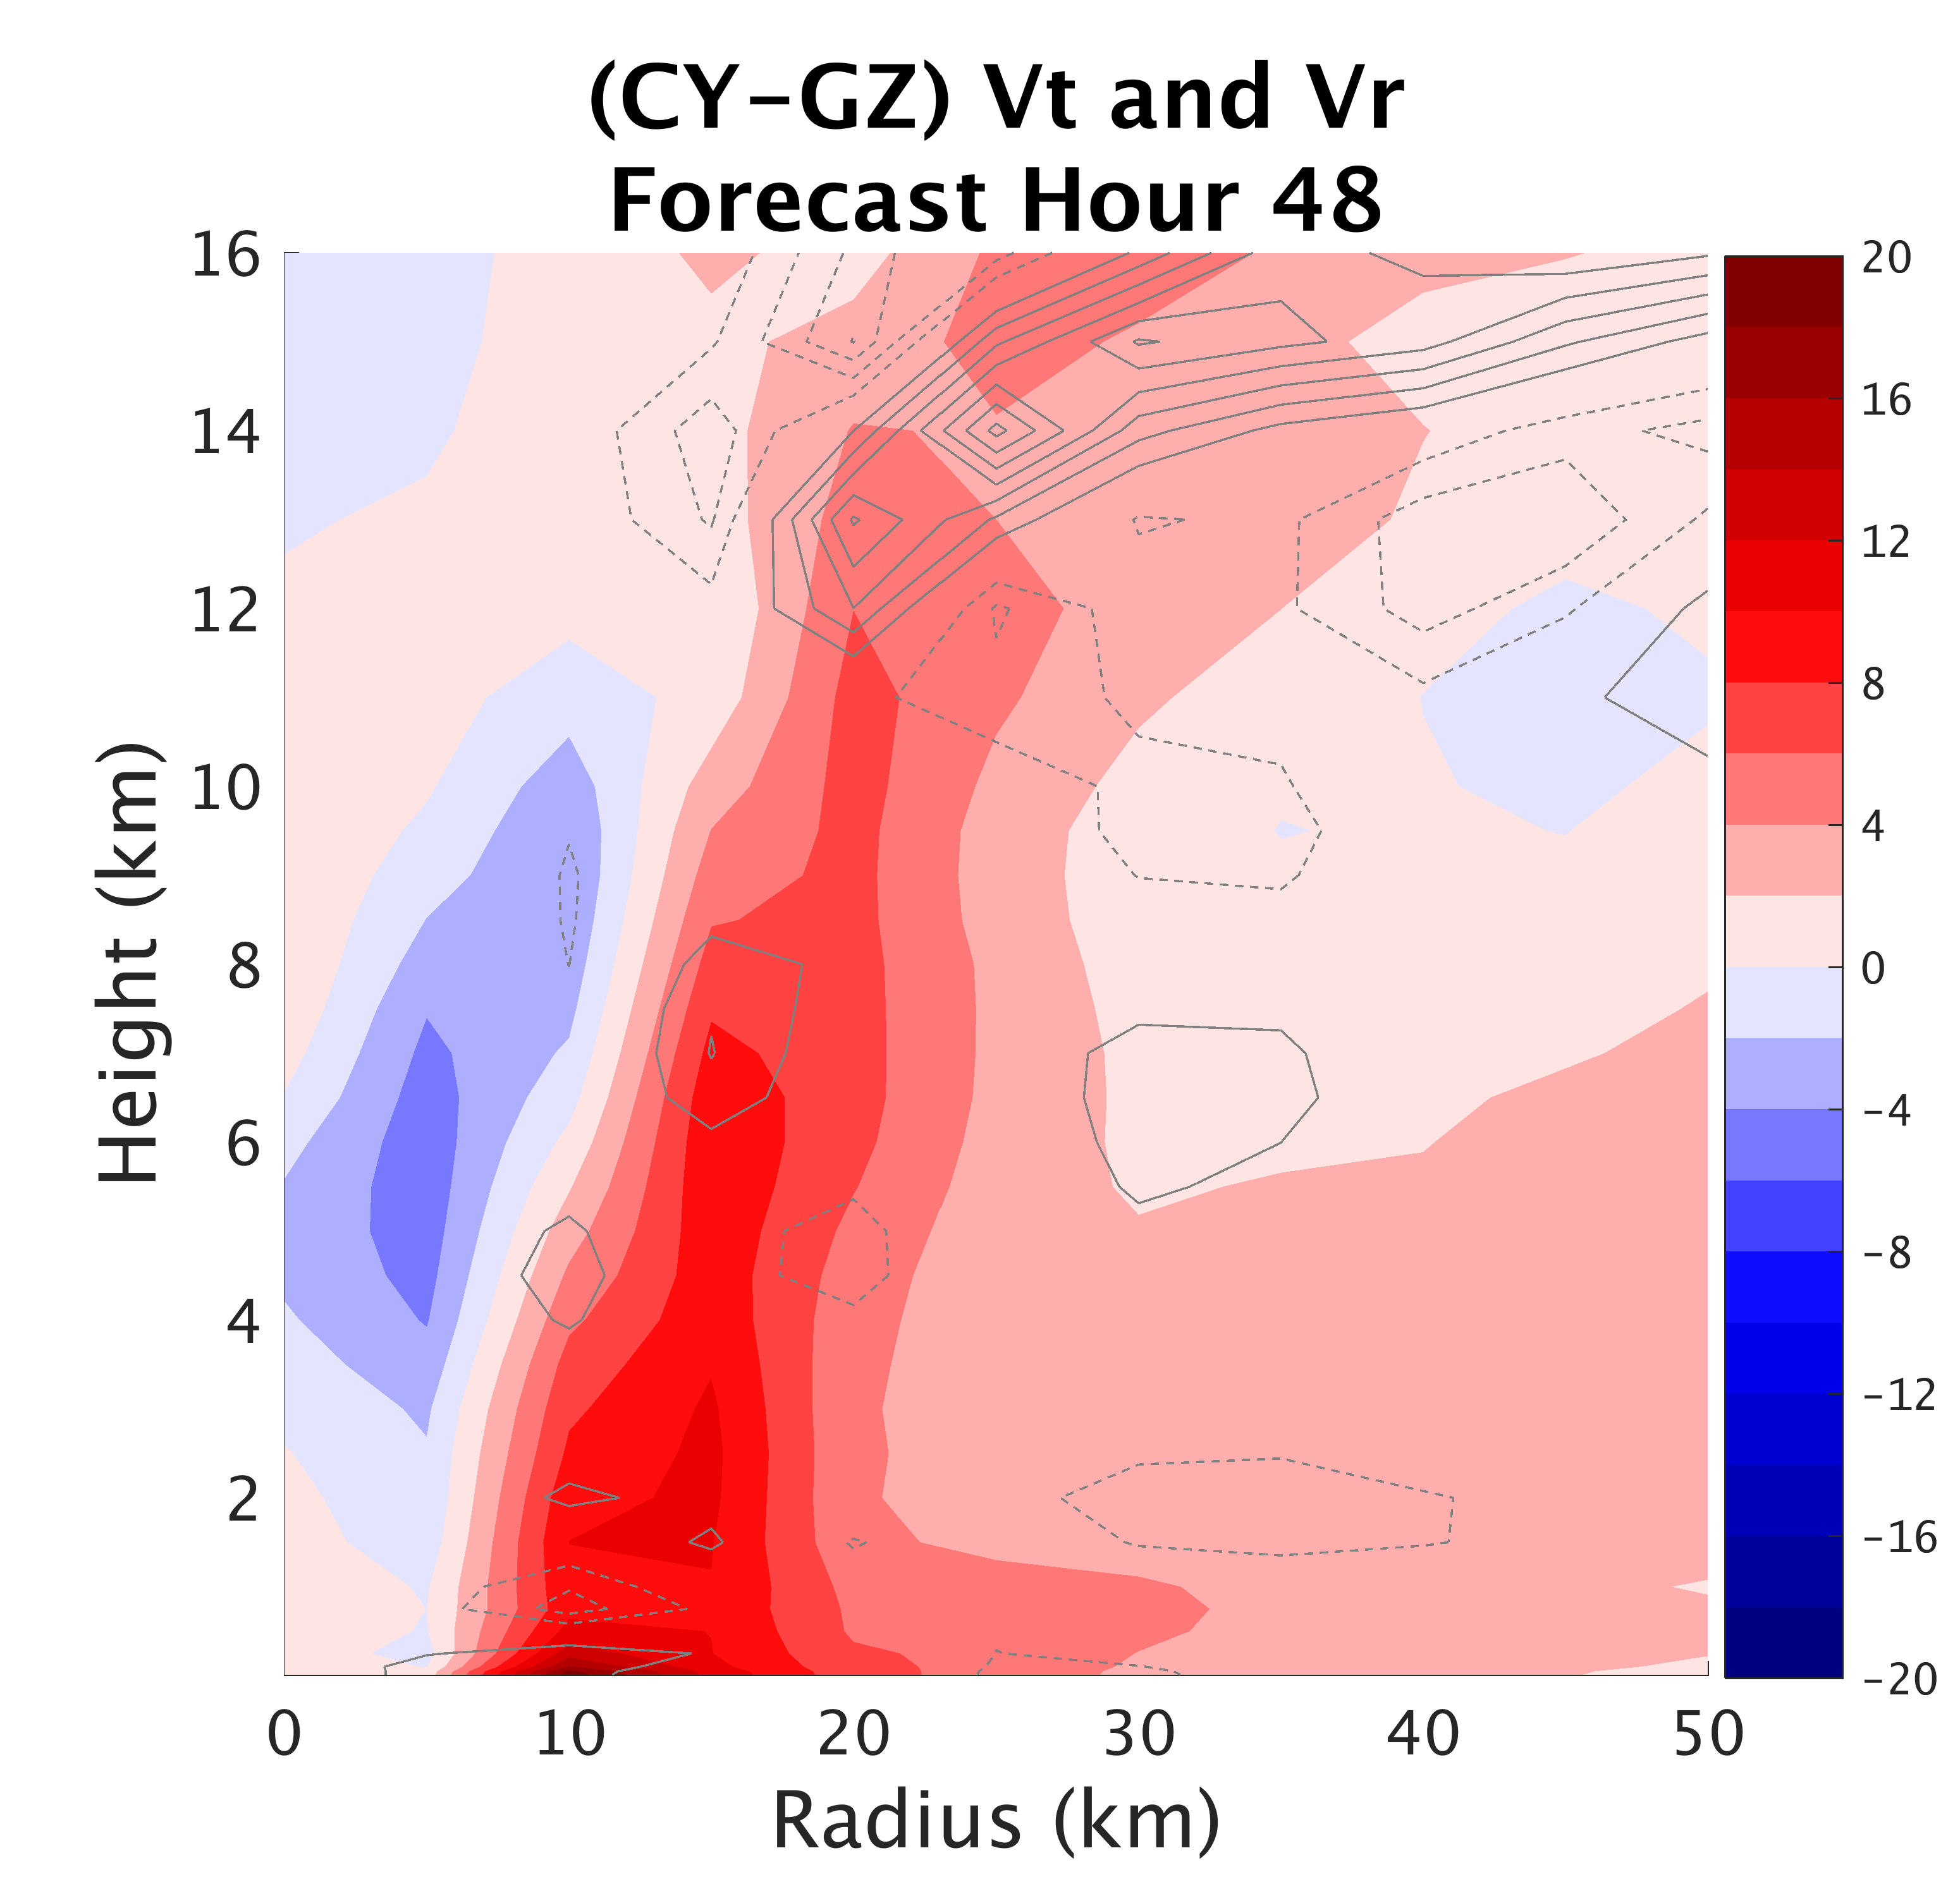
Surface Flux:
Impacts on Structure
Notes:
-Now, smaller Cd has stronger Vt at surface and throughout vertical extent of vortex

Slide 18
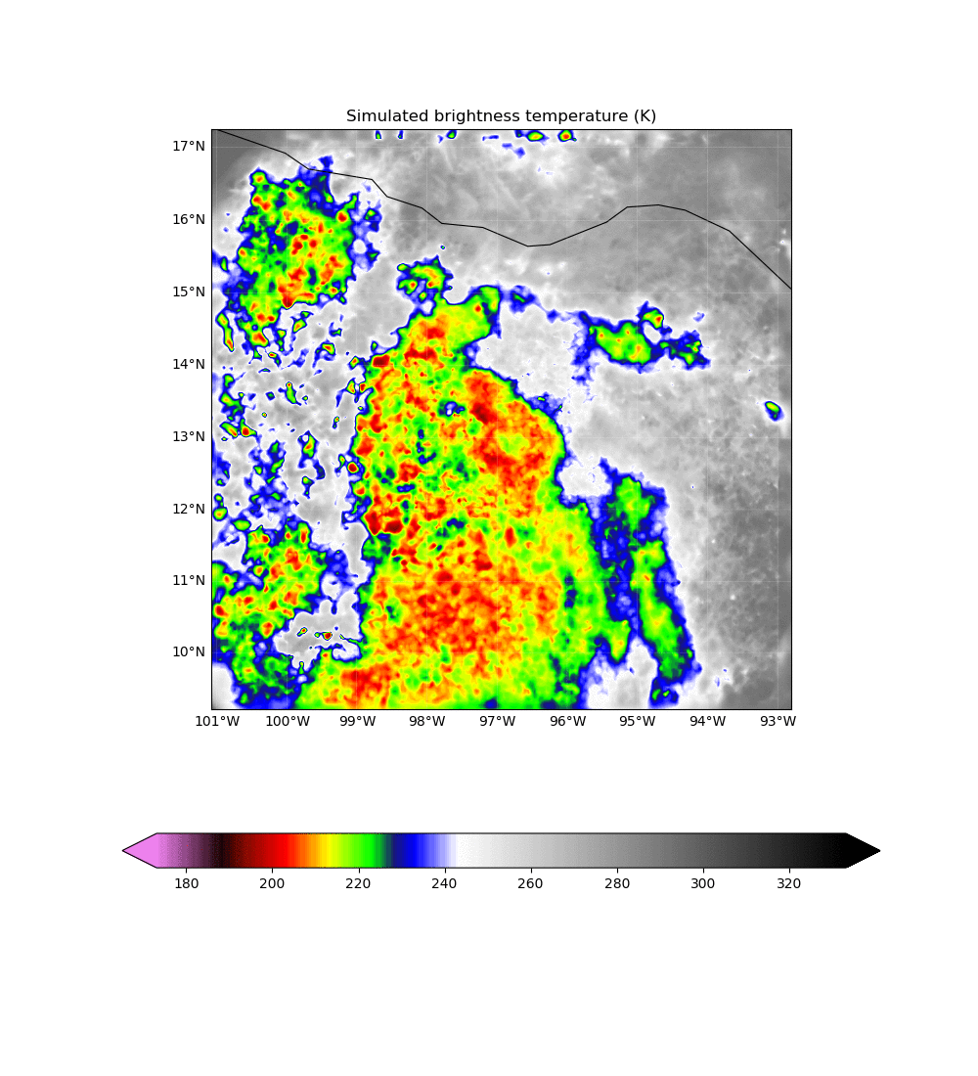
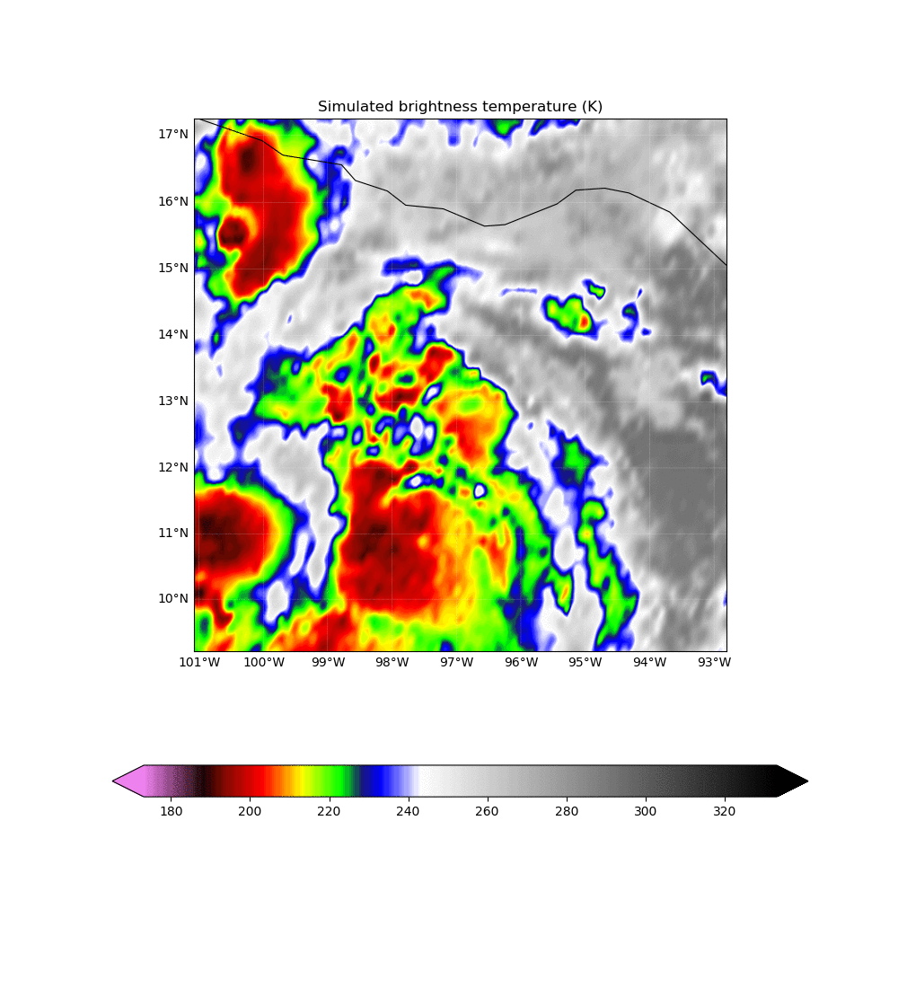
All-Sky GOES-13 assimilation
AOEI [Minamide and Zhang, 2017]
ABEI [Minamide and Zhang, 2018 submitted]
EnKF Analysis
GOES-13 Observations
Notes:
-AOEI and ABEI

Slide 19
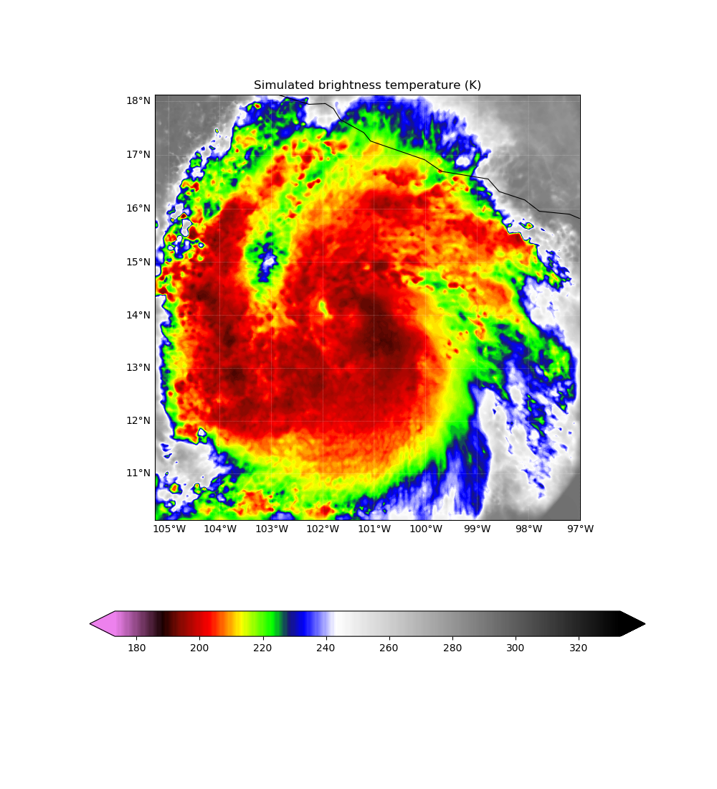
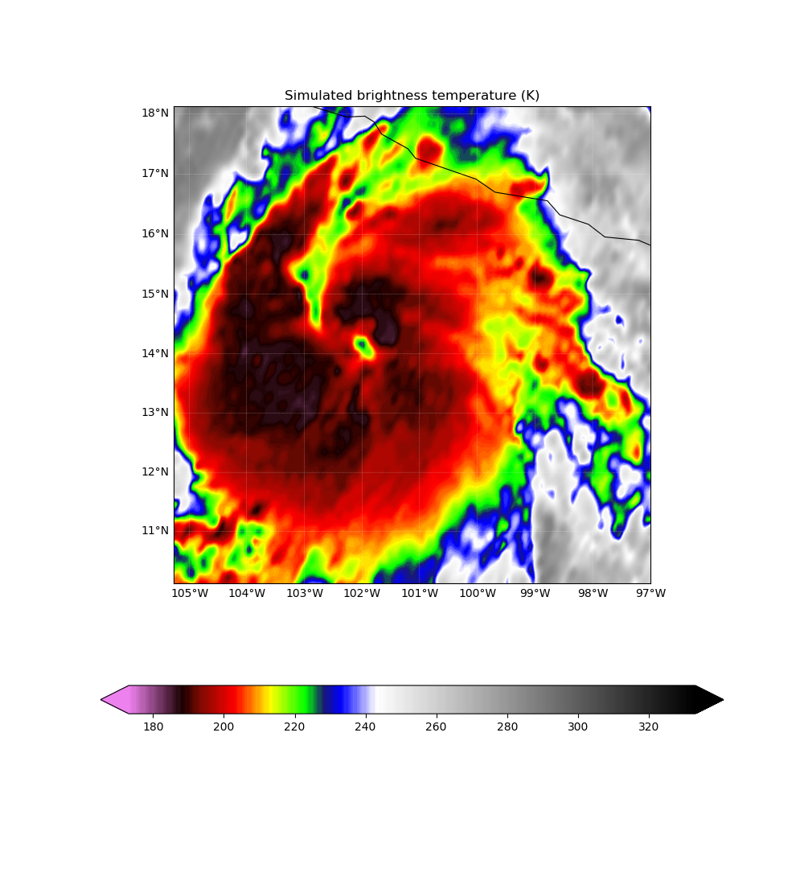
All-Sky GOES-13 assimilation
EnKF Analysis 6z 22nd
GOES-13 Observations 6z 22nd
Notes:
-AOEI and ABEI

Slide 20
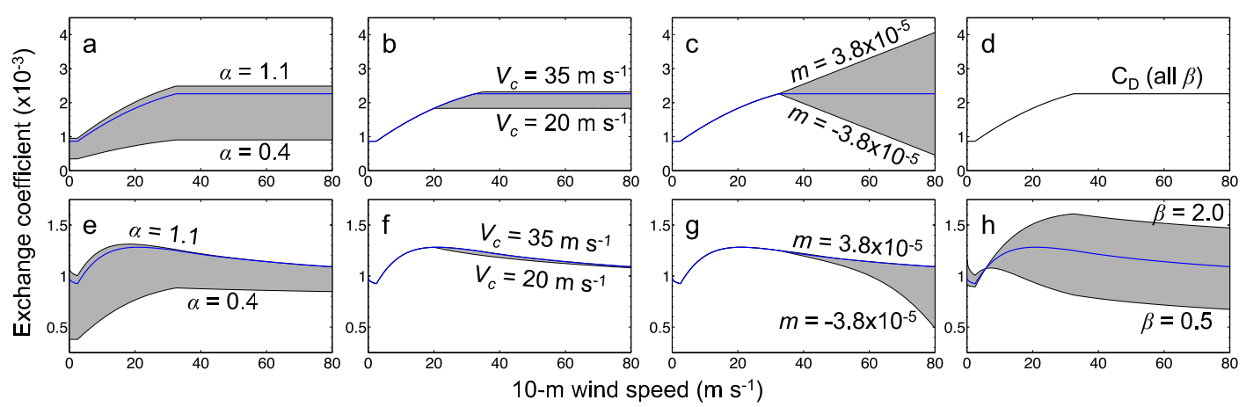
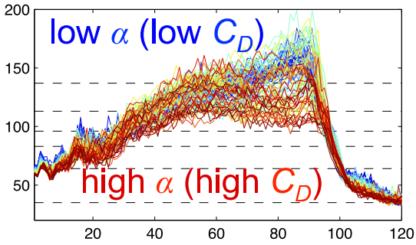
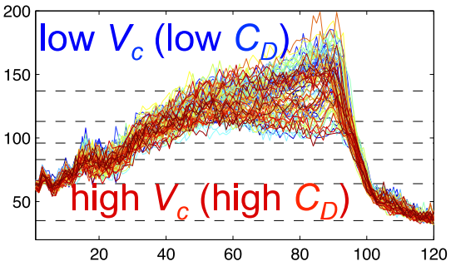
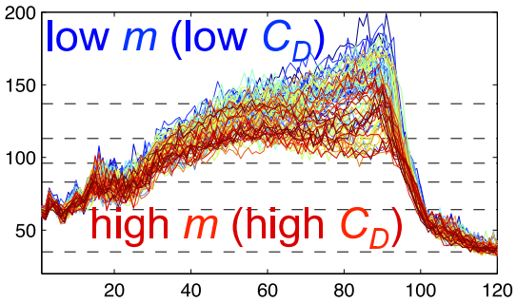
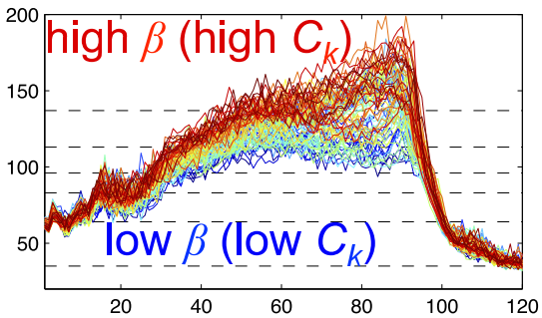
Green and Zhang (2014)
Wind Speed (kts)
Forecast Hour
Notes:
Well demonstrated sensitivity between surface flux parameterization and wind speed (shown) and minimum SLP (not shown here)

Slide 21
Correlation between Simulated GOES-16 IR radiance and surface flux model parameters
Notes:
Significant correlation between BT and Alpha all over
BT and m correlation only significant in eyewall region where winds are strongest

Slide 22
Correlation between Simulated GOES-16 IR radiance and surface flux model parameters
Notes:
Significant correlation between BT and Alpha all over
BT and m correlation only significant in eyewall region where winds are strongest

Slide 23
Summary and Ongoing Work
Cycling DA w/ modified Cd and 1 km horizontal resolution able to well simulate the historic RI and peak intensity of Patricia following P-3 flights
Examine the ensemble predictability of Patricia
  Inner-core and environmental ICs necessary for peak intensity and RI
Very strong sensitivity between Patricia’s intensification and surface flux parametrization
Forecast intensity and inner-core structure/size also sensitive to horizontal resolution
Plan to investigate opportunity for Simultaneous State and Parameter Estimation of surface flux parameters

Slide 24
Supplemental Patricia Slides

Slide 25
GOES-13+Airborne Forecasts

Slide 26
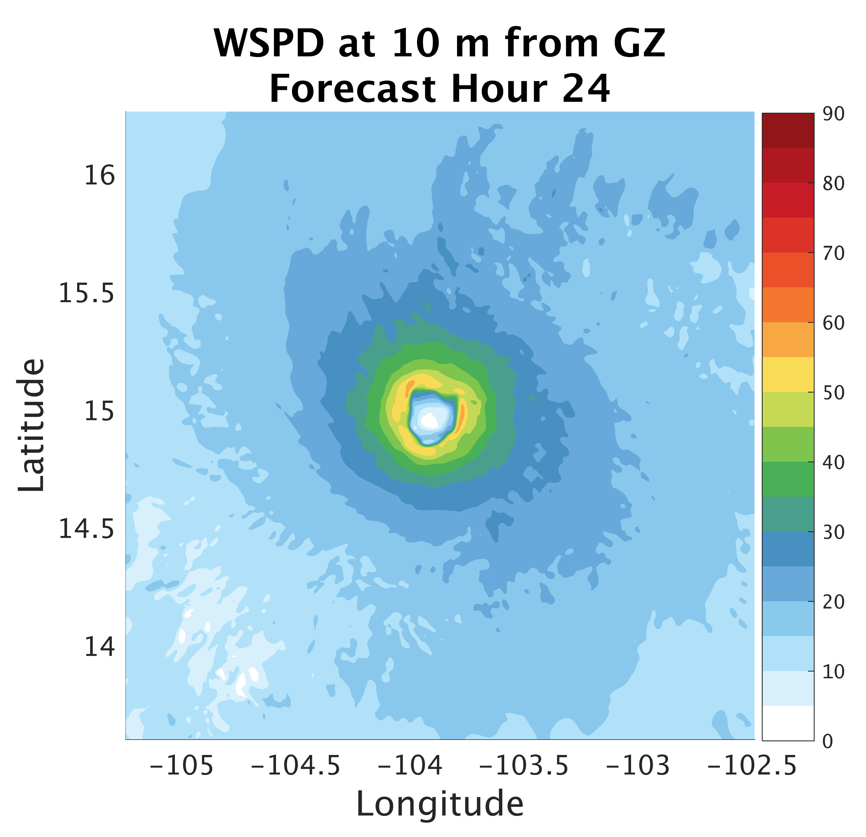
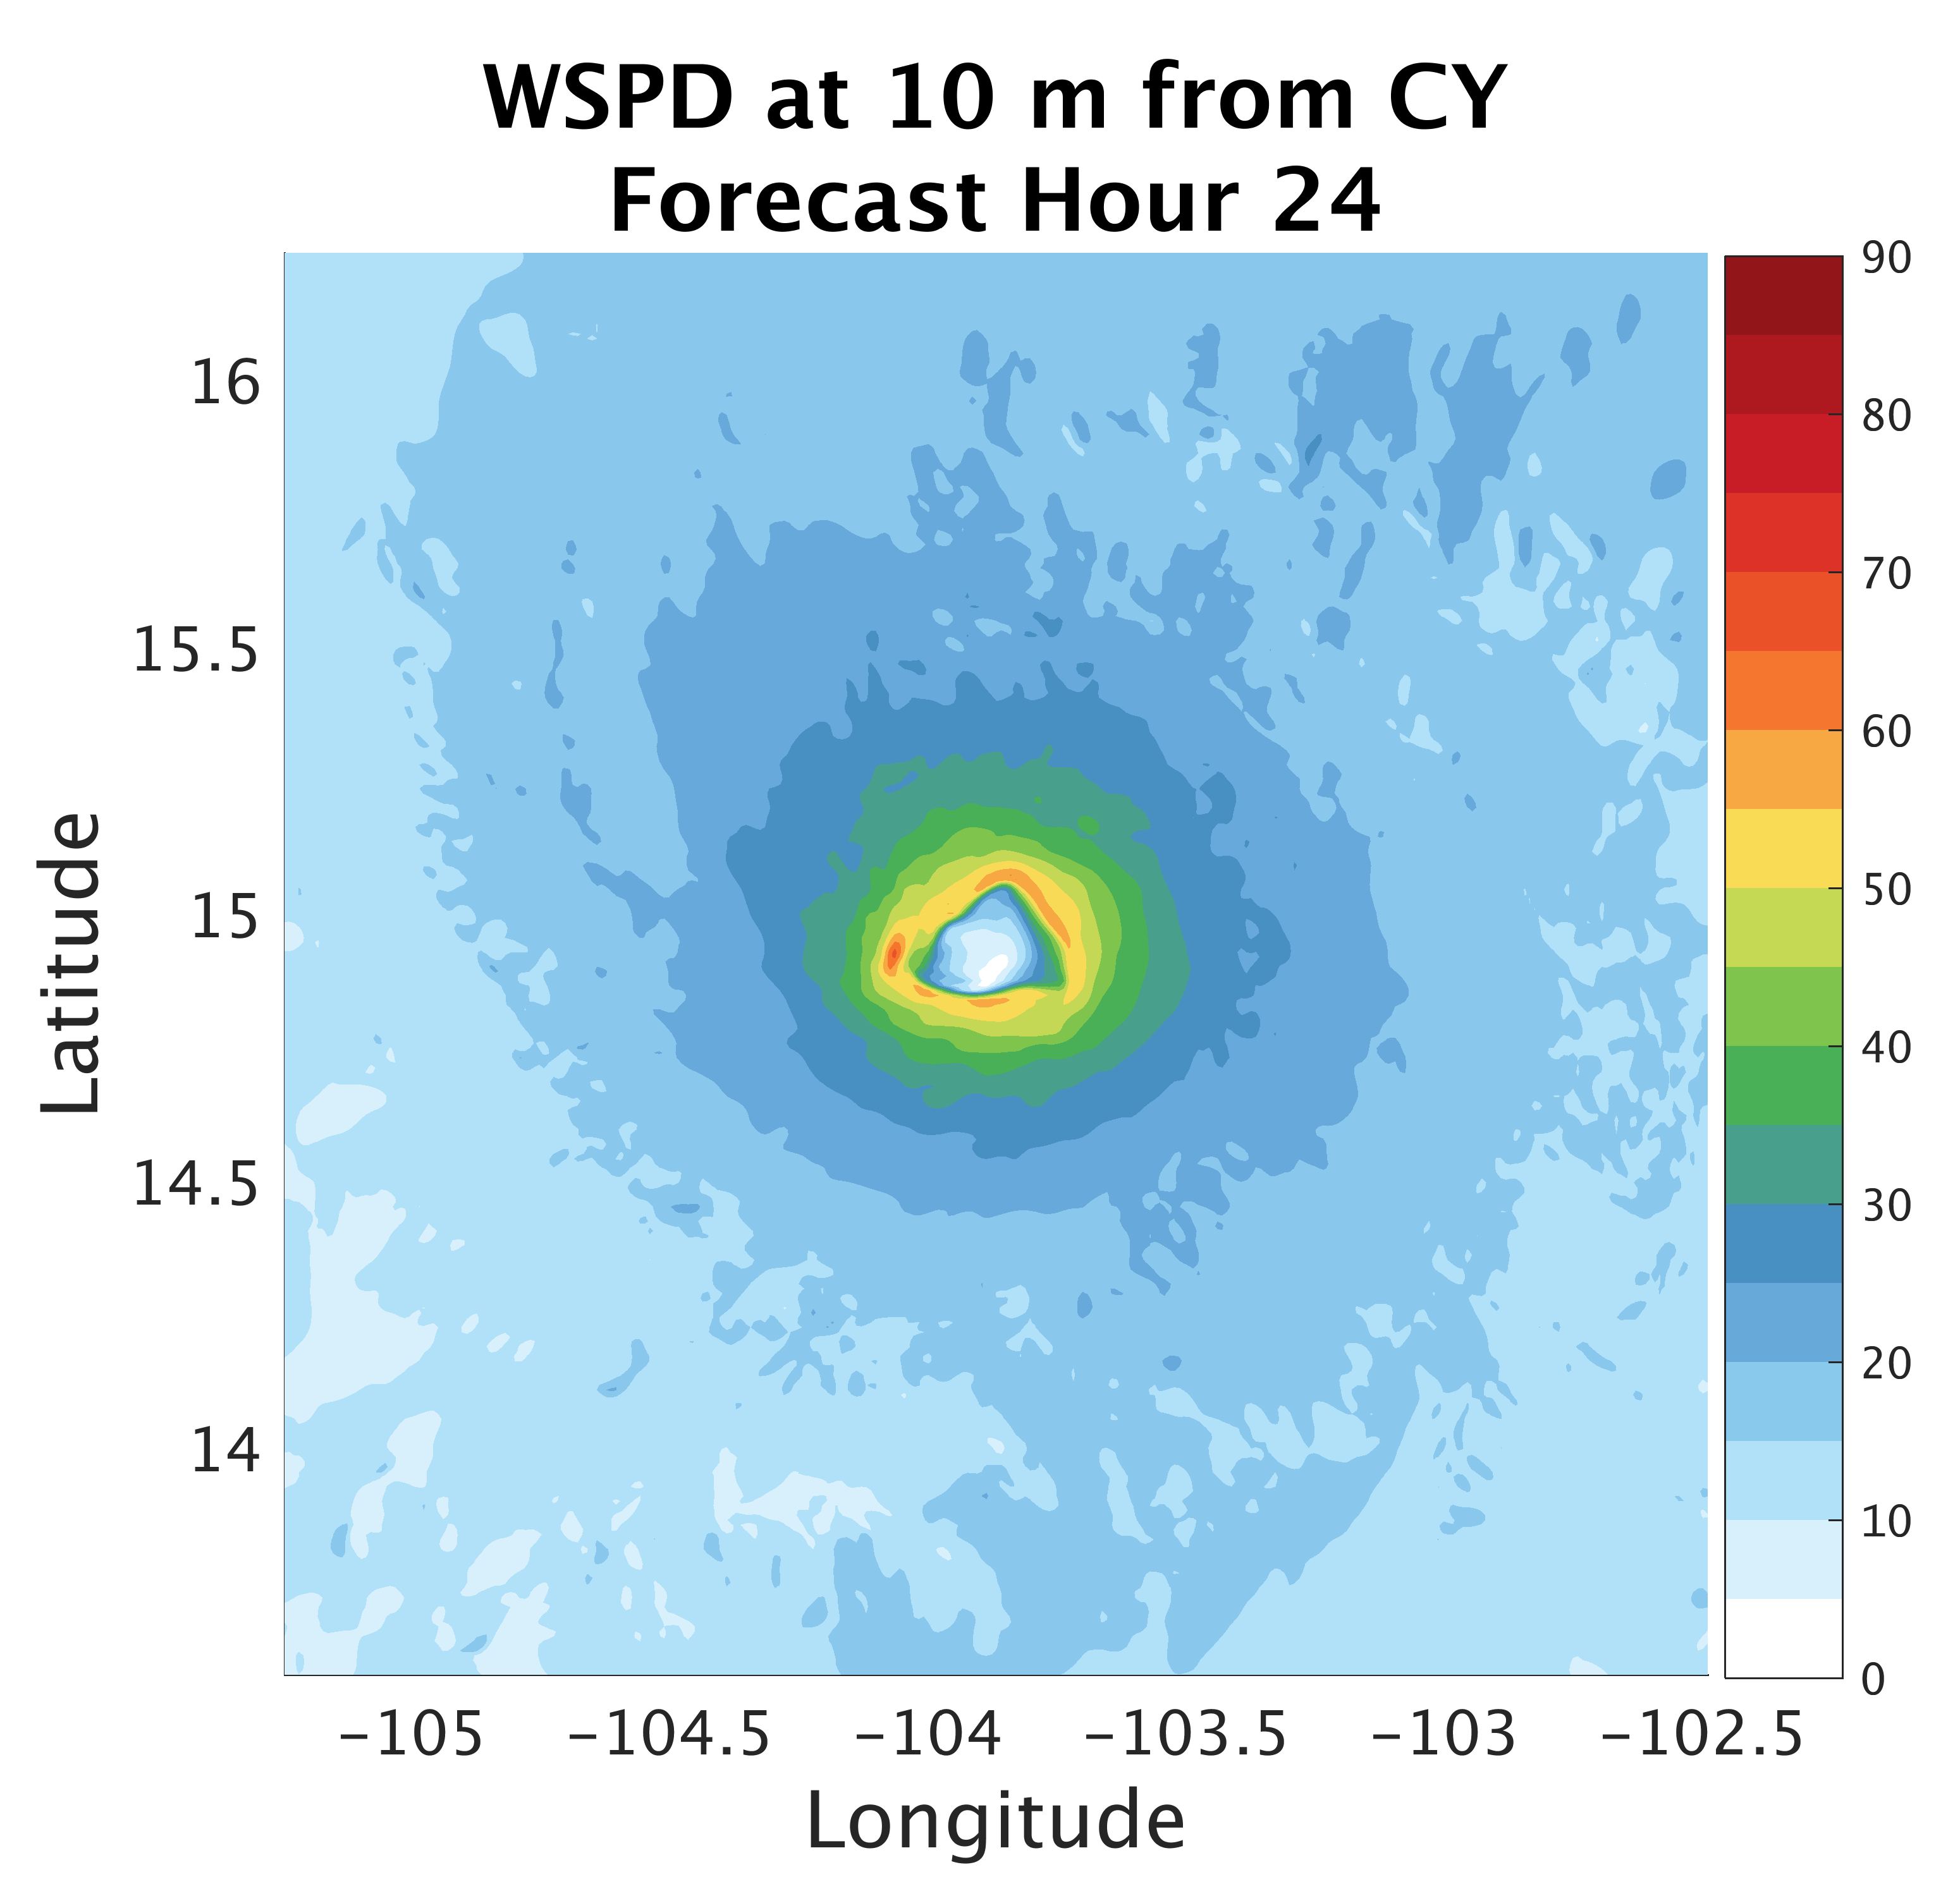
Surface Flux:
Impacts on Structure
Notes:
-

Slide 27
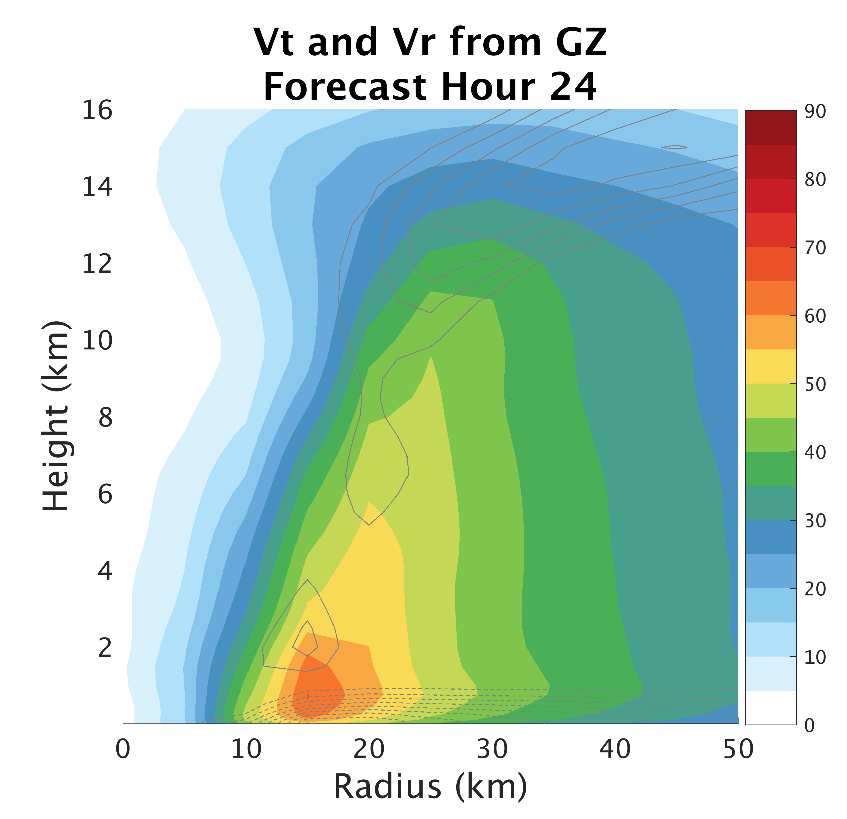
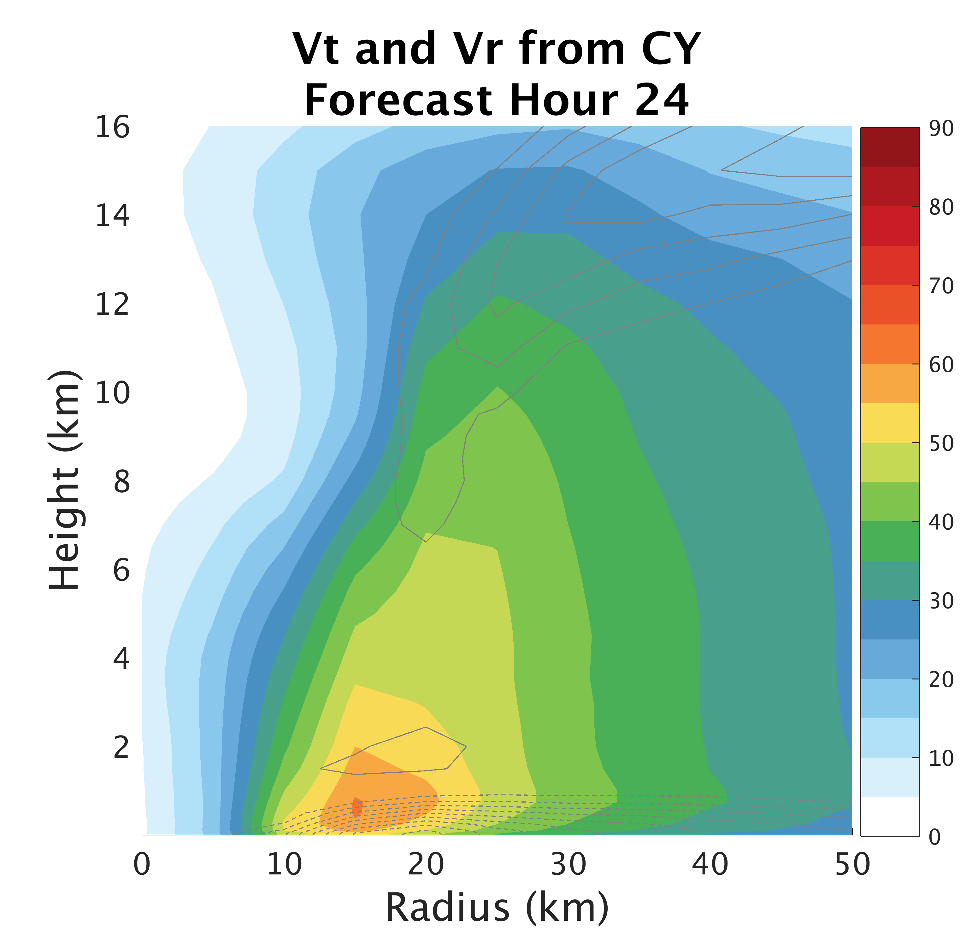
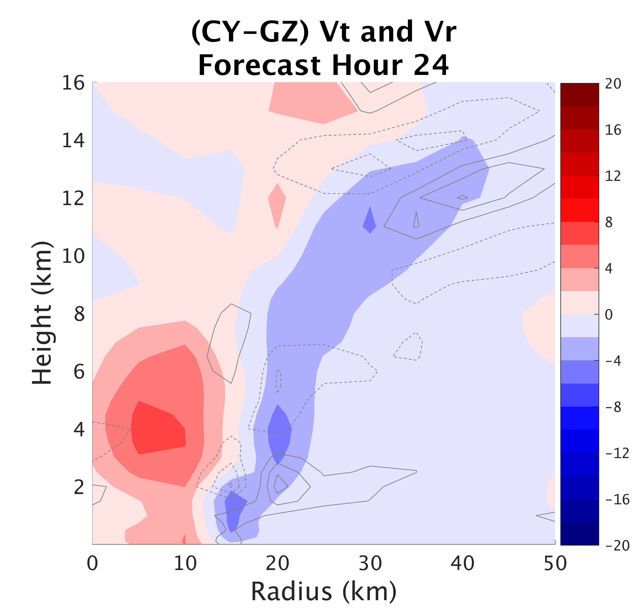
Surface Flux:
Impacts on Structure
Notes:
-

Slide 28
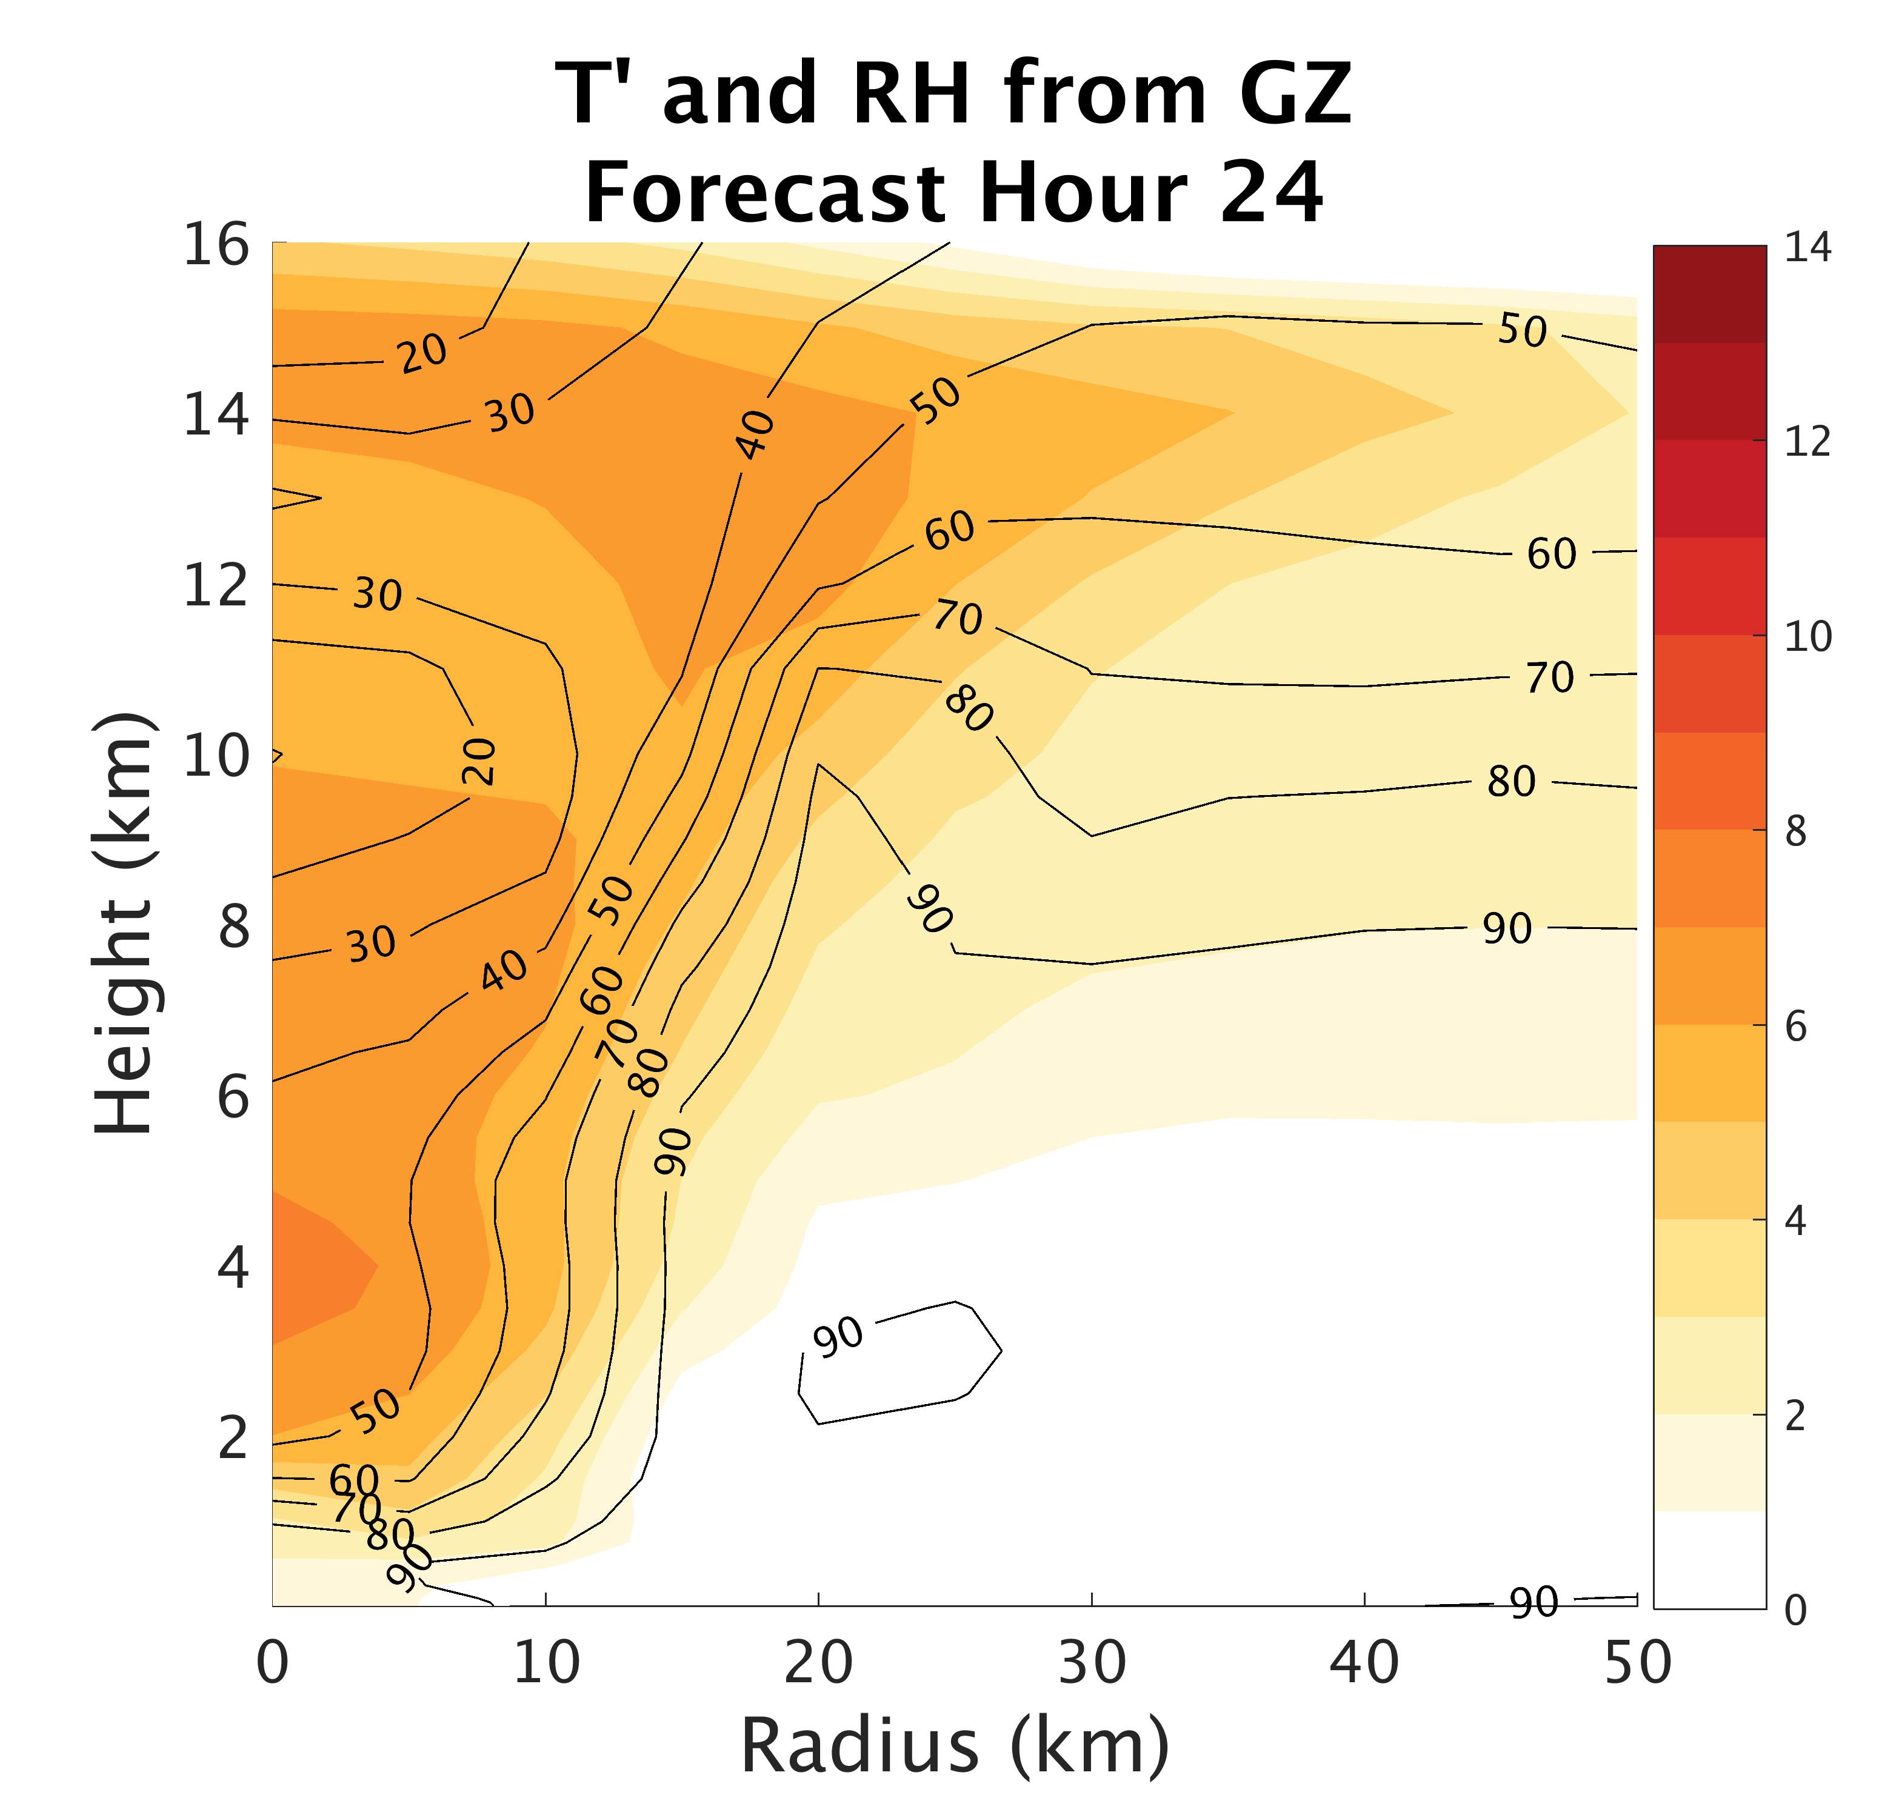
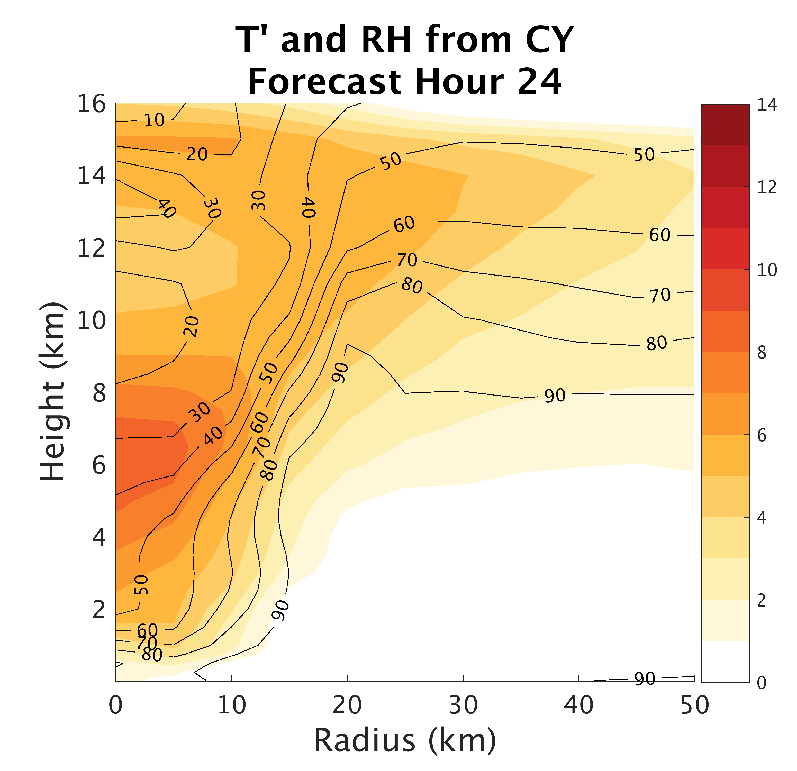

Surface Flux:
Impacts on Structure
Notes:
-

Slide 29



Surface Flux:
Impacts on Structure
Notes:
-

Slide 30



Surface Flux:
Impacts on Structure
Notes:
-

Slide 31


Surface Fluxes
Chen et al. 2013

Slide 32


Surface Fluxes
Chen et al. 2013

Slide 33


Surface Fluxes
Chen et al. 2013

