Slide 1
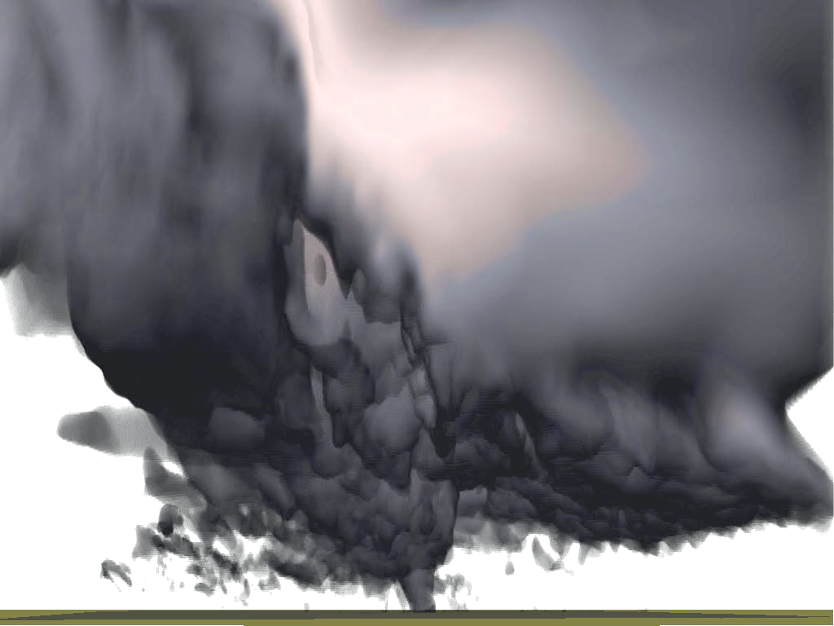

Hybrid En3DVar Radar Data Assimilation and Comparisons with 3DVar and EnKF with Observing System Simulation Experiments (OSSEs) and a Real Case
Presented by Rong Kong
Center for Analysis and Prediction of Storms
Ming Xue and Chengsi Liu
Center for Analysis and Prediction of Storms
May 8, 2018
rkong@ou.edu

Slide 2
Outline
Background & motivations
Perfect-model OSSEs
Imperfect-model OSSEs
Real case studies
Future work

Slide 3
Background
The advantages of the hybrid algorithms over traditional EnKF and 3DVar have been demonstrated for large-scale and mesoscale weather systems.
For convective scale radar DA, development/testing of hybrid ensemble-variational (EnVar) algorithm have been more limited.

Slide 4
Background (continued)
Gao et al. (2013, 2014, 2016): 3DVar, EnKF, and hybrid En3DVar in radar DA are compared for a simulated supercell storm using OSSEs.
  HEn3DVar50%B outperforms (underperforms) EnKF for the hydrometeor (dynamic) variables for single radar DA.
  Smaller ensemble sizes would benefit from a higher weight of B (consistent with earlier findings for larger scale applications).
  Incorporating mass continuity constraint as a weak constraint into En3DVar algorithm can improve the analyses when radial velocity observations contain large errors.
Notes:
Results indicate that the En3DA analyses are quite sensitive to differences in the microphysics scheme, suggesting that ensemble forecasts with multiple microphysics schemes could reduce uncertainty related to model physics errors.
Gao et al. (2013). The method is first applied to the assimilation of simulated radar data for a supercell storm. Results obtained using 3DVAR (with static covariance entirely), hybrid 3DVAR-EnKF, and the EnKF are compared. When data from a single radar are used, the EnKF method provides the best results for the model dynamic variables, while the hybrid method provides the best results for hydrometeor related variables in term of rms errors. Although storm structures can be established reasonably well using 3DVAR, the rms errors are generally worse than seen from the other two methods. With two radars, the results from 3DVAR are closer to those from EnKF. Our tests indicate that the hybrid scheme can reduce the storm spin-up time because it fits the observations, especially the reflectivity observations, better than the EnKF and the 3DVAR at the beginning of the assimilation cycles.
Gao et al. (2014)
The method is applied to the assimilation of simulated data from two radars for a supercell storm. Some sensitivity experiments are performed to answer questions about how ﬂow-dependent covariance estimated from the forecast ensemble can be best used in the hybrid 3DEnVAR scheme. When the ensemble size is relatively small (with 5 or 10 ensemble members), it is found that experiments with a weaker weighting value for the ensemble covariance leads to better analysis results. Even when severe sampling errors exist, introducing ensemble-estimated covariances into the variational method still beneﬁts the analysis. For reasonably large ensemble sizes (50–100 members), a stronger relative weighting (>0.8) for the ensemble covariance leads to better analyses from the hybrid 3DEnVAR. In addition, the sensitivity experiments also indicate that the best results are obtained when the number of the augmented control variables is a function of three spatial dimensions and ensemble members, and is the same for all analysis variables.

Slide 5
Questions
In principle, pure En3DVar and EnKF that use 100% ensemble covariance should be identical (under linearity and Gaussian error assumption), will their analyses actually be very close? If not, why?
Does the relative performance of 3DVar, EnKF, pure/hybrid En3DVar change, if algorithms are tuned to their optimal states?
In what situation that the static covariance in the hybrid algorithm does help, if any, for convective storms?
What is relative performance of the algorithms for a real storm case?

Slide 6
Part I: Perfect-model OSSEs
In principle, pure En3DVar and EnKF that use 100% ensemble covariance should be identical (under linearity and Gaussian error assumption), will their analyses actually be very close? If not, why?
Compare pure En3DVar with EnKF and identify sources of the difference.
Does the relative performance of 3DVar, EnKF, pure/hybrid En3DVar change, if algorithms are tuned to their optimal states?
Obtain the optimal configurations for 3DVar, EnKF, pure and hybrid En3DVar and compare them using their own optimal configurations.

Slide 7
The assimilating system, prediction model, and truth simulation
Prediction model: Advanced Regional Prediction System (ARPS)
Assimilating system: ARPS 3DVar, EnKF, and hybrid En3DVar systems.
Truth simulation (follows Tong and Xue 2005):
  A classic supercell storm of 20 May 1977 in Del City, OK (Ray et al. 1981).
  Single-moment, three category ice scheme of Lin et al. (1983).
  35x35x35 model grid, 2 km and 0.5 km horizontal and vertical grid spacing.
  Truth simulation was initialized using a thermal bubble.

Slide 8
Data assimilation algorithms
EnKF: Ensemble Squared Root Filter (Whitaker and Hamill 2002).
Hybrid En3DVar: Follows Lorenc (2003).
Introduce DfEnKF algorithm that updates a single deterministic forecast using the mean updating equation of EnKF, so that EnKF and pure En3DVar can be better compared.
Notes:
The hybrid en3dvar algorithm follows Lorenc (2003), in which the static and ensemble covariance are combined through introduction a set of extended control variables that are preconditioned upon the square root of the ensemble covariance. The total analysis increment &x can be expressed as a combination of the increments related to the static and ensemble parts. Beta12 and beta22 are the weights given to the static and ensemble covariance respectively. B is the static background error covariance. C is the correlation matrix used to localize the ensemble covariance. C’ is a decomposed matrix related to C. A is the extended control variable, and a~ is the new control variables that are related to a via C’. The final analysis increment is obtained by minimizing this cost function.

Slide 9
Flow charts of DfEnKF and En3DVar algorithms(one-way coupled with EnKF)

Slide 10
Simulation of the radar observations
Tong and Xue (2005)
A WSR88D radar located at the southwest corner of the domain
Unbiased, Gaussian distributed errors (1ms⁻¹ for vr and 3dBZ for Z)

Slide 11
Experimental diagram
Assimilating radar
data every 5 min for 1 hour.
DfEnKF
En3DVar
Radar DA
EnKF:
21:20 21:25
22:30

Slide 12
Compare DfEnKF with PEn3DVar
DfEnKF and pure En3DVar perform differently when using the same localization radii.
The serial (EnKF) versus global (pure En3DVar) nature of algorithms is one reason for the difference.

Slide 13
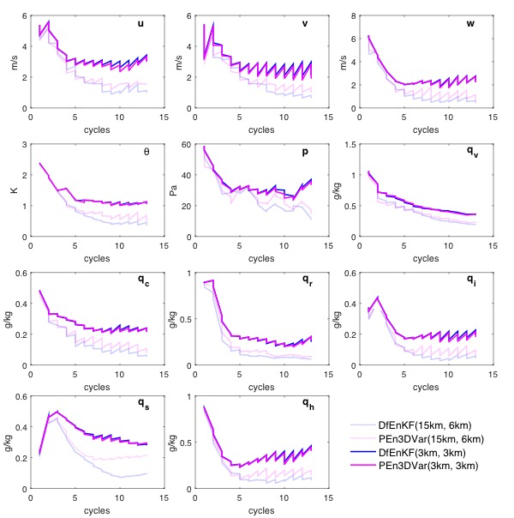
Comparison between DfEnKF and PEn3DVar
(only Vr DA)
(15km; 6km)
(3km; 3km)

Slide 14
Differences between DfEnKF and PEn3DVar and the reasons
Direct filter update (EnKF) versus variational minimization (En3DVar) is also responsive for the differences.

Slide 15
Single point reflectivity assimilation for DfEnKF and pure En3DVar
Truth Background analysis(DfEnKF) analysis(PEn3DVar)
Small difference!
Big difference!
Hail
Snow
Z_{e}(mm⁶/m³)
Algorithm difference are creating
significant differences in analyses
of individual hydrometeor fields.
17.7%
54.7%
13.5%
4.5%
Errors relative to the truth

Slide 16
Possible reasons for qs analysis difference
Variational minimization tends to adjust hail more than snow because reflectivity
is more sensitive to hail than to dry snow in the reflectivity observation operator.

Slide 17
The optimal localization radii for DfEnKF/EnKF
Optimal cutoff radii
(15km; 6km)
Minimum scaled RMSE

Slide 18
The optimal localization radii for DfEnKF/EnKF
Optimal cutoff radii
(15km; 6km)
Minimum scaled RMSE

Slide 19
Comparisons among 3DVar, EnKF, pure and hybrid En3DVar based on own optimal configurations

Slide 20
Major conclusions based on perfect-model OSSEs
When the algorithms are tuned optimally, hybrid En3DVar does not outperform EnKF and pure En3DVar in perfect-model OSSEs, though their analyses are all much better than 3DVar.
When ensemble background error covariance is a good estimation of the true error distribution, pure ensemble-based DA methods can do a good job, and the advantage of static B is not obvious in hybrid DA.
R. Kong, M. Xue, and C. Liu, 2018: Development of a hybrid en3DVar data assimilation system and comparisons with 3DVar and EnKF for radar data assimilation with observing system simulation experiments. Mon. Wea. Rev., 146, 175-198.

Slide 21
Part II: Imperfect-model OSSEs
Do the results change after considering model errors? In what situation that the static covariance in the hybrid algorithm does help, if at all, for convective-scale DA?
Model errors are introduced by using different microphysical schemes in nature run (Lin scheme, Lin et al. 1983) and forecasts (WSM6 scheme, Hong and Lim 2006) within the DA window.
Assimilating system and experiment design are the same as perfect-model OSSEs.
Optimal configurations for 3DVar, EnKF, pure and hybrid En3DVar algorithms are obtained before they are compared.

Slide 22
The optimal localization radii for DfEnKF/EnKF
Optimal cutoff radii
(15km; 6km)
Minimum scaled RMSE

Slide 23
Optimal hybrid weights in hybrid En3DVar as a function of ensemble sizes
W_{B}=1.0(3DVar), W_{B}=0 (PEn3DVar)
Hybrid En3DVar obviously outperforms 3DVar, pure En3DVar and the optimal hybrid weight is 30%~40%.
Minimum scaled RMSE

Slide 24
Comparisons of RMSEs among different algorithms based on own optimal configurations (with ensemble size of 40)
EnKF
DfEnKF
3DVar
PureEn3DVar
HybridEn3DVar30%B

Slide 25
Comparisons of the reflectivity (through maximum vertical velocity of the truth)
Weaker!

Slide 26
Analyzed reflectivity calculated based on hydrometeor mixing ratios (Z_{r}, Z_{s}, Z_{h})
Weaker!
low level spread!
missing!
missing!
missing!
Advantage of Hybrid DA!

Slide 27
Major conclusions based on imperfect-model OSSEs
Hybrid En3DVar outperforms EnKF and pure En3DVar (3DVar) for better capturing the the hail analyses below the freezing level (intensity) of the storm in the analysis.
The advantage of hybrid En3DVar over pure ensemble-based methods for storm analysis is most obvious when ensemble background errors are systematically underestimated.

Slide 28
Part III: Real case studies
Case overview
Experimental design
Compare performance of the analyses and forecasts from hybrid En3DVar with those from 3DVar, EnKF, and DfEnKF.

Slide 29
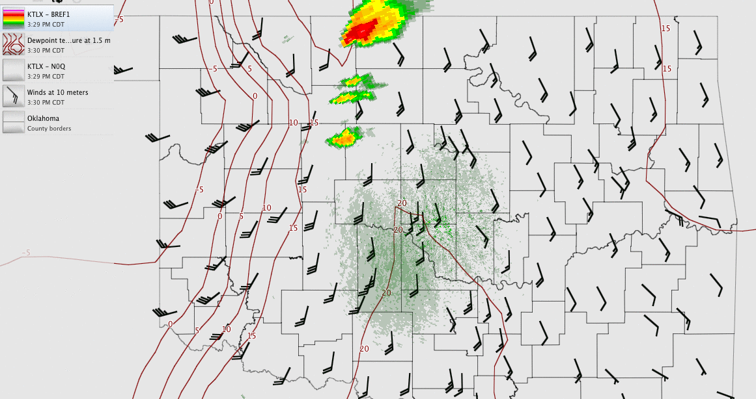
Case overview: dry line induced multi-cell (including tornadic supercell) storm on 10 May 2010
Generated using WeatherScope

Slide 30
Model configuration
Prediction model: ARPS.
Assimilating system: ARPS 3DVar, EnKF, and hybrid En3DVar systems.
363x363x53 model grid, horizontal and vertical grid spacing are 1 km and 0.4 km on average for stretching grid (with minimum resolution of 20 m).
Single-moment, three category ice scheme of Lin et al. (1983).
1.5-order turbulent kinetic energy (TKE) based subgrid-scale turbulence parameterization.
Two-layer soil model and a simplified surface radiation physics.
Notes:
Having 363x363x53 grid points at a 1 km grid spacing. Mean vertical grid spacing is 0.4 km with stretching from 20 m at surface.

Slide 31
Initial and boundary conditions
40 member ensemble analyses (that assimilate surface, upper-air, profiler, and radar observations) with a 40-km horizontal resolution and valid at 21:00 Z May 10, 2010 and its corresponding hourly forecasts are interpolated to the testing domain to serve as the initial ensemble perturbations and boundary conditions (Jung et al. 2012).

Slide 32
Flow diagram of the experiments
The first analysis is conducted after 30-minute integration of the initial perturbations at 21:00 UTC to allow spin up of initial perturbations.
Oklahoma Mesonet, Vr and Z data from four 88d radars (KTLX, KINX, KVNX, KFDR) from 21:30 to 22:30 UTC are assimilated very 5 min for an hour. One-hour following up forecasts are made as well.

Slide 33
Simulation domain and truncated radar coverage

Slide 34
Experiment configurations
20% mutilpicative inflation.
Localization radii for EnKF/DfEnKF and pure/hybrid En3DVar (6km, 3km).
Background error decorrelation scales for 3DVar (3.6 km;1.1 km).
Observational error: 5 dBZ for reflectivity and 2 m s⁻¹ for radial velocity
Notes:
5dBZ, 3 m/s

Slide 35
Tests on hybrid weights
CNTL
PEn3DVar (0%B)
HEn3DVar5%B
HEn3DVar25%B
HEn3DVar50%B
HEn3DVar75%B
3DVar (100%B)
5%B performs the worst.
50%B and 75%B perform
better and similar to 3DVar.

Slide 36
Reflectivity analyses after 1-hr DA at 1km AGL
Got similar analyses!

Slide 37
45-minute reflectivity forecasts at 1km AGL
(0%B)
Less organized!
(100%B)
50%B and 75%B better capture the
hook echo signature.
Too linear!

Slide 38
1-hour Vr forecasts at 0.5º tilt (KTLX)
50%B and 75%B better capture the
Low-level mesocyclone.

Slide 39
Comparisons among CNTL, 3DVar, EnKF, DfEnKF, pure and hybrid En3DVar
CNTL
EnKF
DfEnKF
PEn3DVar
HEn3DVar75%B
Notes:
EnKF and DfEnKF perform similar and are poorer than the others for reflectivity analyses and forecasts within the DA cycles (except CNTL).

Slide 40
Reflectivity analyses (60 min DA) at 1km AGL
Similar!

Slide 41
1-hr reflectivity forecasts at 1km AGL
Too linear! Too weak!
Hook echo structure not clear! Less organized! Best!

Slide 42
1-hr Forecasts of updraft intensity
w(m s⁻¹)
Too weak!
The forecast of updraft intensity from 3DVar is too weak!.

Slide 43
1-hr Forecasts of the low-level mesocyclone (0.5º tilt of KTLX)
Mesocyclone is more clearly captured in the 60-min radial velocity forecasts at the lowest elevation angle of KTLX radar by HEn3DVar than other methods, suggesting stronger rotation and a larger tornado threat in the forecast.

Slide 44
Part IV: conclusion & future work
When EnKF is underdispersive or EnKF is not configured optimally, hybrid En3DVar may perform better.

Slide 45
1-hour Vr forecasts at the lowest two elevation angles (KTLX)
0.5º 1.5º
Obs 3DVar EnKF
DfEnKF PEn3DVar HEn3DVar
(f)HEn3DVar
Mesocyclone is more clearly captured in the 60-min radial velocity forecasts at the lowest two elevation angles of KTLX radar by HEn3DVar than other methods, suggesting stronger rotation and a larger tornado threat in the forecast.

Slide 46
Major conclusions based on the real case application
For this case, hybrid En3DVar outperforms 3DVar (EnKF) in better capturing the hook echo structure, rotating updraft (intensity) of the main tornadic supercell.
The low-level mesocyclone is better forecasted when using hybrid En3DVar than other methods, suggesting stronger rotation and a larger tornado threat in the forecast.

Slide 47
Part IV: conclusion & future work
Compare the one-way coupling HEn3DVar with those of two-way coupling.
Apply the hybrid En3DVar to more real storm cases to further examine the performance of different algorithms.
Test hybrid 4DEnVar algorithm (Liu and Xue, 2016) through OSSEs and real case for fast-moving supercell storms.

Slide 48
Thank you for your attention!

