Slide 1
Assimilation of Phased Array Radar Data with the 4-Dimensional Ensemble Square Root Filter
Timothy A. Supinie, Youngsun Jung, Nusrat Yussouf, and Ming Xue
8 May 2018

Slide 2
Motivation
The Warn-on-Forecast program
Aims to provide warnings for severe convective hazards based on numerical forecasts
Need high temporal and spatial frequency observations
The Spectrum Efficient National Surveillance Radar (SENSR) program
Aims to consolidate all US radar usage (weather + air traffic control) into a single network
Phased-Array Radar (PAR) is the front-runner for this network

Slide 3
Unique Aspects to PAR Observations
Beam is electronically steered
~1 minute temporal frequency of observations
The NWRT PAR only scans over a 90-degree sector
Can’t suppress convection outside of the scan sector
Sector can move, which can start observing new storms in the middle of a DA period

Slide 4
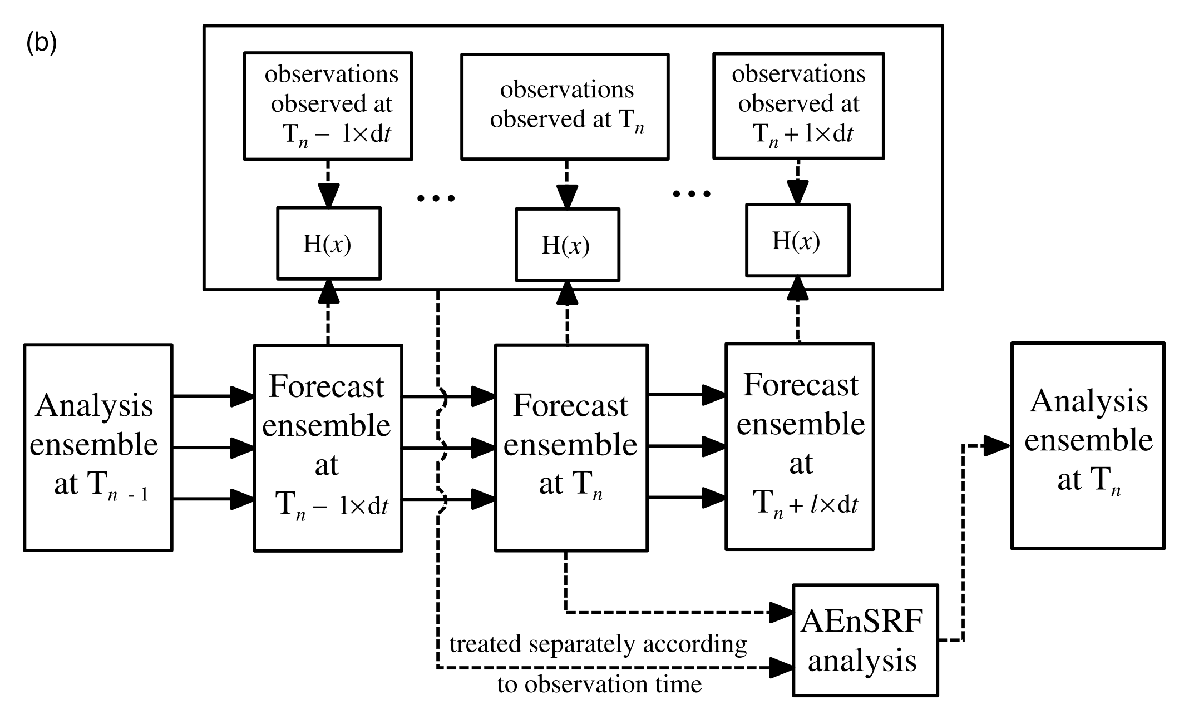
4D Ensemble Square Root Filter
Kalman gain is constructed using covariances in time, as well as space
Corresponding time localization parameter
Wang et al. 2013 implementation

Slide 5
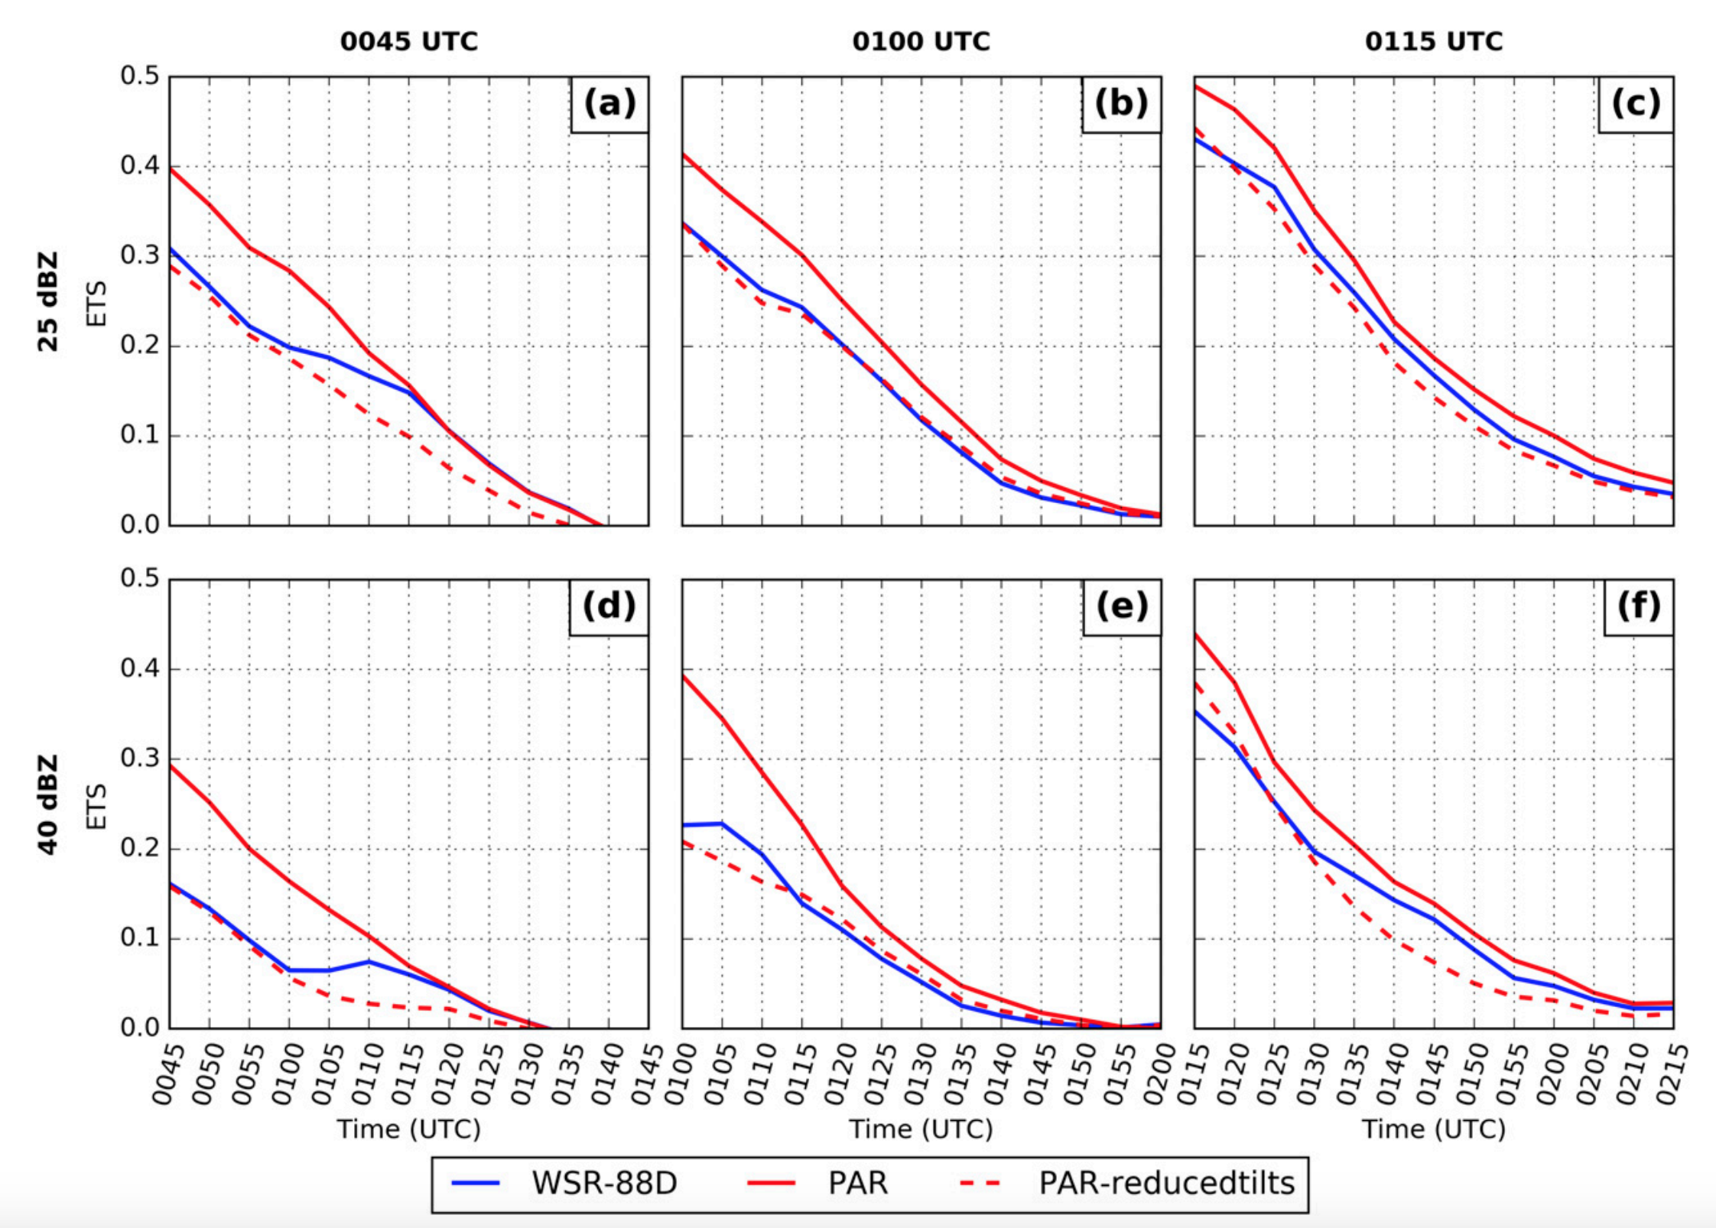
Previous Work with PAR + 4DEnSRF (Supinie et al. 2017)

Slide 6
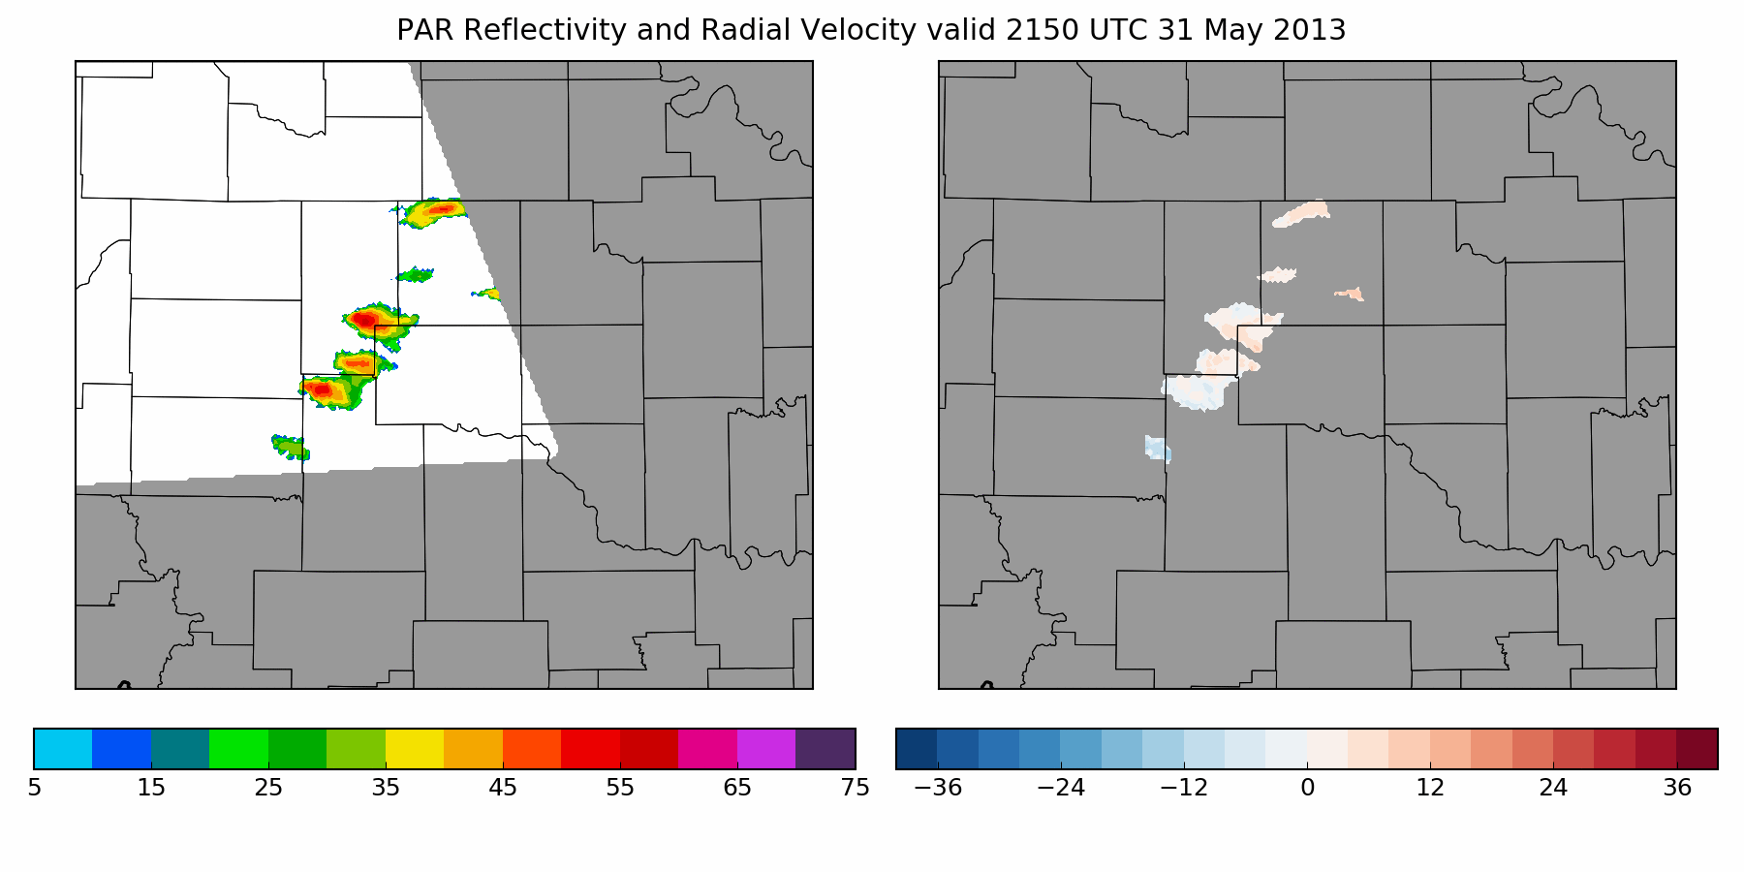
Test Case: 31 May 2013
Supercell and flash flood in central Oklahoma

Slide 7
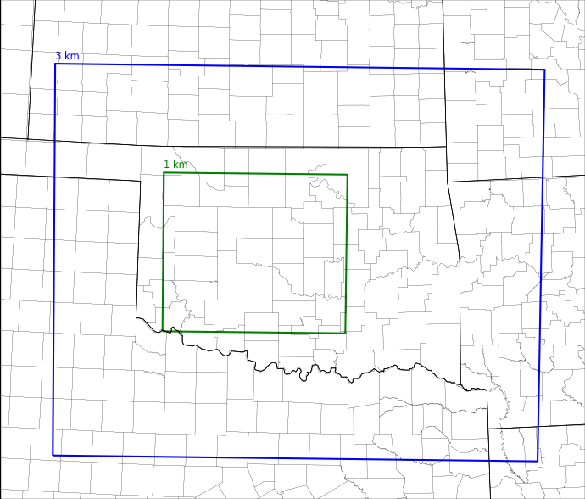
Experimental Configuration
4D EnSRF
36 members
6 km localization radius, 5-minute localization in time
5 dBZ, 3 m s⁻¹ observation errors
Multiplicative (prior) + RTPS (posterior) inflation
WRF v3.9.1.1
1 km grid spacing
Thompson microphysics
KTLX
PAR

Slide 8
Experimental Timeline
2200
2215
2230
2245
2300
2315
2230
2345
0000 UTC
A
B
C
D
A (2200 UTC): Ensemble initialized
B (2225 UTC): Radar DA begins, analyses produced every 5 minutes
C (2310 UTC): Radar DA ends, free forecast begins
D (0000 UTC): Free forecast ends

Slide 9
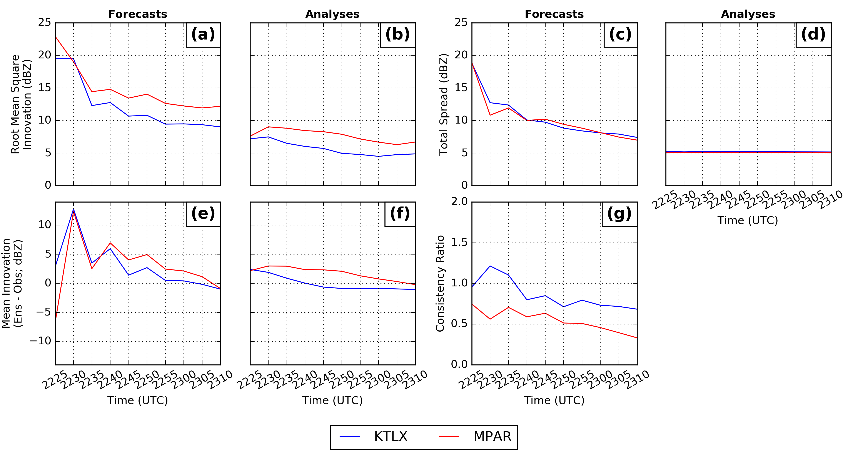
Observation Space Statistics (Assimilation Period)

Slide 10
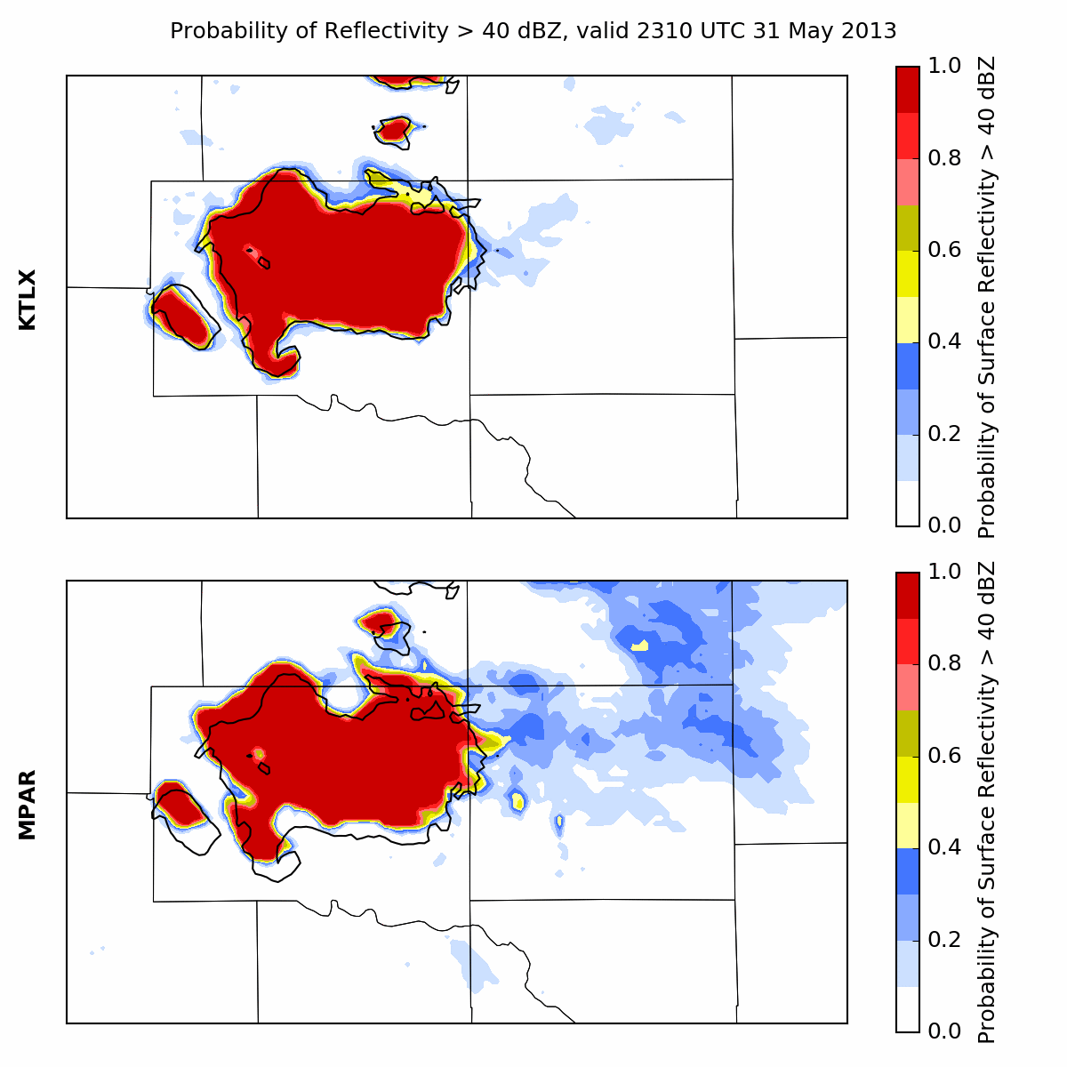
Reflectivity Probability
(Forecast Initialized 2310 UTC)

Slide 11
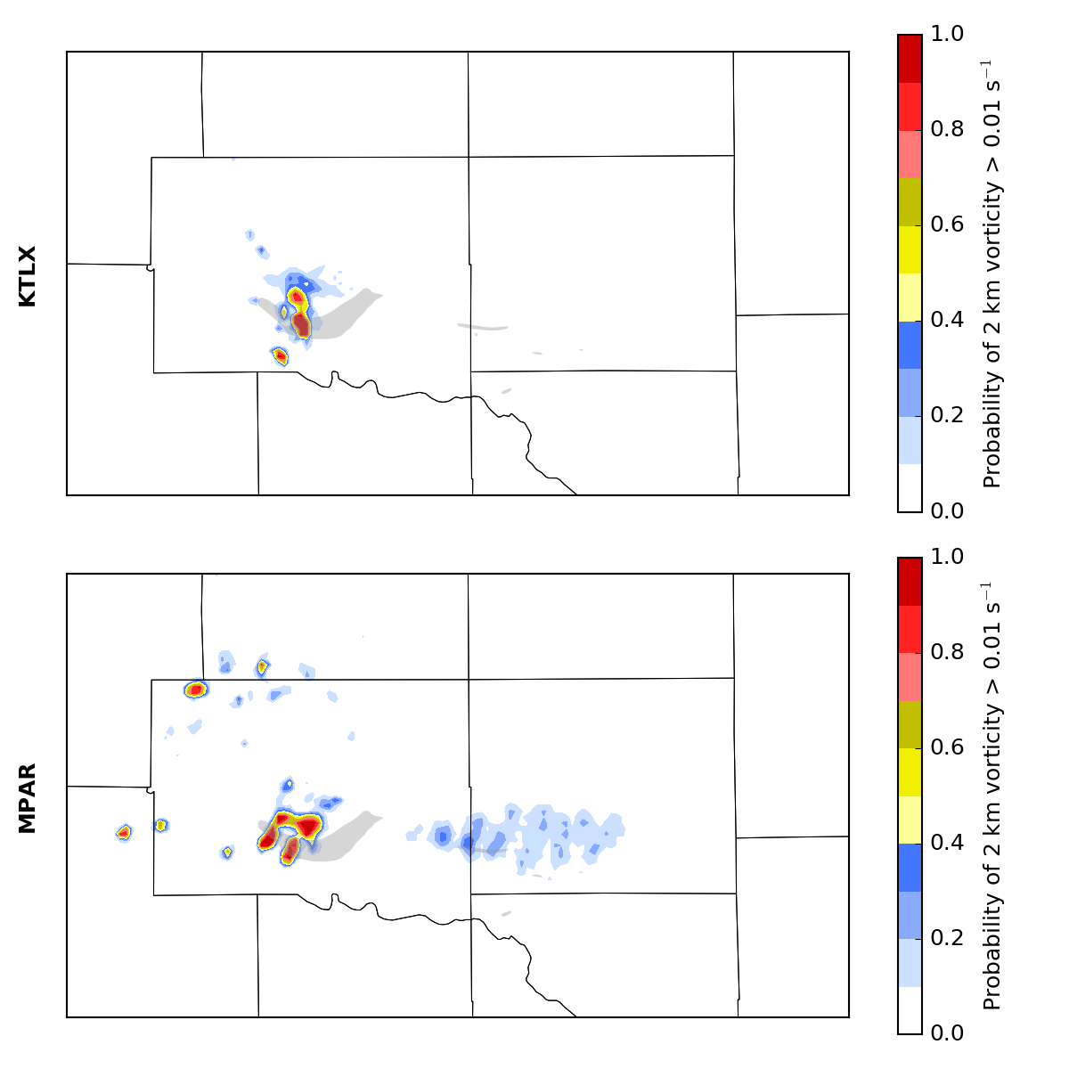
Vorticity Probability Swath (Forecast Initialized 2310 UTC)

Slide 12
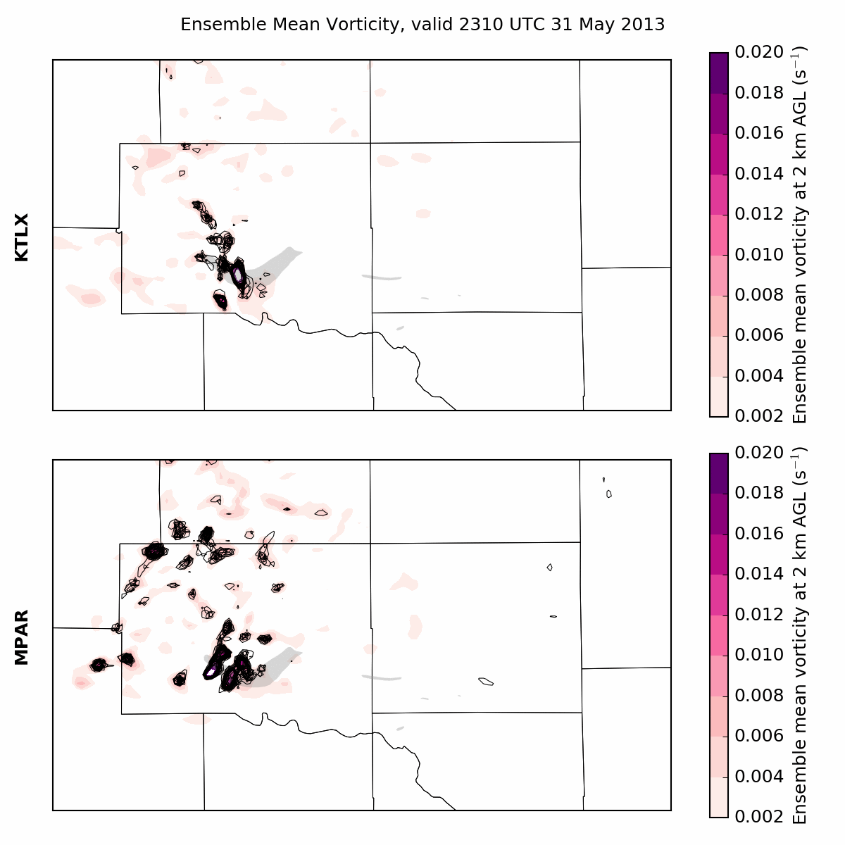
Mean and Member Vorticity (Forecast Initialized 2310 UTC

Slide 13
Conclusions (So Far …)
Both experiments occlude the first mesocyclone way too early
PAR better captures second mesocyclone over southwest Oklahoma City
Neither experiment captures the redevelopment of convection behind initial supercell
PAR assimilation is a bit noisier than KTLX
Need to tweak some of the assimilation parameters

Slide 14
Future Work (Lots of It)
Transplant zero-reflectivity observations from KTLX to suppress convection outside the PAR scan area
Run more forecasts
Try experiments assimilating surface data
Look at more cases

