Slide 1


Development of the GSI-based hybrid 4DEnVar system with multi-resolution ensembles
and multi-scale covariance localization for global numerical weather prediction
Xuguang Wang¹, Junkyung Kay¹, Bo Huang¹,
Daryl Kleist² and Ting Lei²
¹Multiscale data Assimilation and Predictability (MAP) Lab
School of Meteorology, University of Oklahoma
²NOAA/NCEP/EMC, College Park, MA
8th EnKF workshop, Montreal, May 7-10, 2018

Slide 2

Background and Motivation
GSI-based 4DEnVar hybrid is implemented operationally for GFS at NCEP beginning May 2016 (Wang and Lei 2014, Kleist and Ide 2015).
Due to the constraints of limited computational resources, background ensemble is run at a lower resolution.
In the current GSI-based operational 4DEnVar update, analysis increments are generated at a reduced low resolution (hereafter, Single Resolution-Low, SRL).
In the mean time, current GSI based 4DEnVar has a capability to generate the analysis increment at high resolution using high-resolution static BEC and low-resolution ensemble BEC (hereafter, Dual Resolution, DR).
Therefore in SR-Low and DR 4DEnVar, flow-dependent ensemble covariance does not contribute to the increments of small scales.

Slide 3
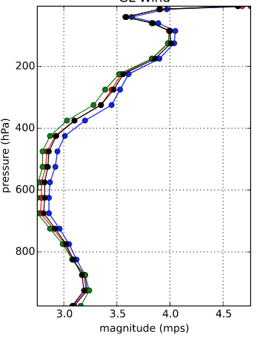
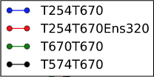
Background and Motivation
6hr WIND RMSE
Huang and Wang (2018)
Lei and Whitaker (2017)
Lei and Whitaker (2017) showed improved analysis and forecasts by directly increasing the ensemble size from 80 to 320 and increasing ensemble resolution from T254 to T670 in the GFS hybrid 4DEnVar system, but the cost was significantly increased. Under the constraints of computing cost, Increasing ensemble resolution improved the analysis and forecasts more than increasing ensemble size.
Huang and Wang (2018) investigated an inexpensive, valid time shifting (VTS) method to increase the ensemble size within GFS 4DEnVar system and found this method can improve both global and hurricane forecast without incurring too much cost

Slide 4
Background and Motivation
Questions:
Is there a way to still include flow-dependent high-resolution background covariance while not incurring too much additional cost? Such as including the cost-free initial time lagged high resolution control members or only directly increase resolution for part of the members?
How does this relatively inexpensive method compare to directly increasing resolution of all members?
Objectives:
Develop a new multi-resolution ensemble 4DEnVar hybrid system to include capability of using multi-resolution ensemble BEC from a mixture of high- and low-resolution ensemble backgrounds
Compare the new multi-resolution ensemble 4DEnVar with (a) single low resolution (SR_Low), (b) dual resolution (DR) 4DEnVar and (c) the full high-resolution ensemble 4DEnVar
Diagnostics to understand differences

Slide 5
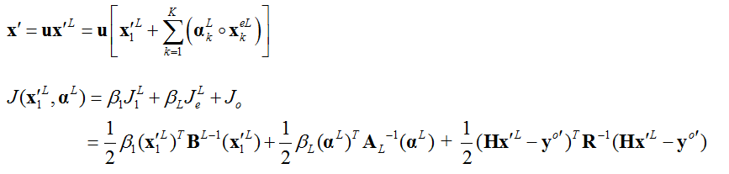
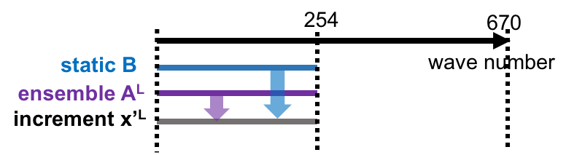
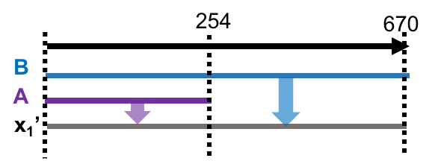
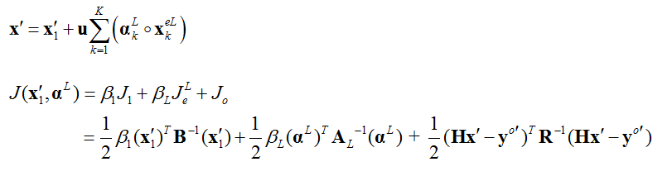
Various flavors of 4DEnVar Method
Single Resolution – Low (SR-Low)
(Wang et al. 2007; Wang 2010; Wang et al. 2013; Wang and Lei 2014)
High resolution control backgrounds (x) are transformed to low resolution (x^{L}) using transform matrix (u^{T})
DA is performed using low-resolution static (B^{L}) and low-resolution ensemble BECs
Analysis increments are transformed from low- to high-resolution using (u)
Dual Resolution (DR)
(Kleist and Ide 2015)
Low-resolution ensemble based increments are transformed to high resolution using transform matrix (u) in the minimization process
DA is performed using high-resolution static BEC (B) and low-resolution ensemble BEC

Slide 6
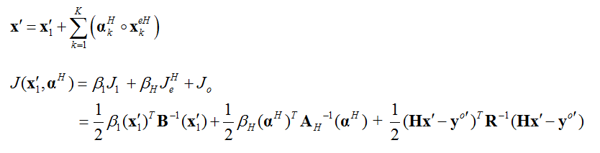
Various flavors of 4DEnVar Method
Single Resolution – High (SR-High)
wave number
254
670
static B
ensemble A
increment x’
4DEnVar DA is performed using high-resolution static (B) and high-resolution ensemble BECs

Slide 7
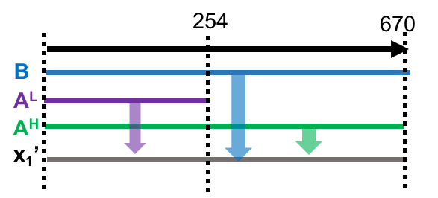
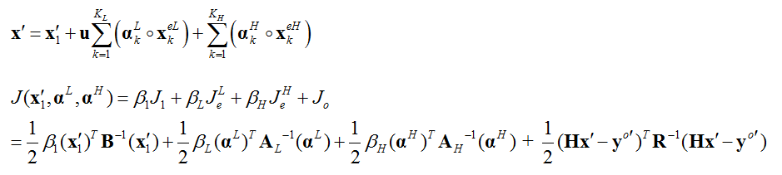
New multi-resolution ensemble 4DEnVar formula
Kay and Wang 2018
Multi-Resolution Ensemble (MR-ENS)
Extra increment associated with high-resolution ensemble
Extra term associated with high-resolution extended control variable
Introduces new increment term associated with high-resolution ensemble x_{k}^{eH} and extended control variables a_{k}^{H} for high-resolution ensemble
The analysis increment x′ is obtained by minimizing the new hybrid cost function, which is weighted sum of J¹ with high-resolution static BEC (B), J_{e}^{L} with low-resolution ensemble BEC and J_{e}^{H} with high-resolution ensemble BEC

Slide 8
Experimental Design
Configuration
 | Background for 4DEnVar |  | Analysis | Ctl FCST | Background ensemble size | Weighting on BEC
 | ctl back | ens back | ctl anl in 4DEnVar | ctl fcst | T254/T670 | static/ensemble
SR-Low | T254 | T254 | T254 | T670 | 80/0 | 0.125/0.875
DR | T670 | T254 | T670 | T670 | 80/0 | 0.125/0.875
MR-ENS | T670 | T254 T670 | T670 | T670 | 40/40 | 0.125/0.4375/ 0.4375
SR-High | T670 | T670 | T670 | T670 | 0/80 | 0.125/0.875
Model and DA parameters configured the same as the NCEP 4DEnVar pre-implementation test system
The cycling DA experiments were conducted during a 5-week period, 2400 UTC July – 0000 UTC 30 August 2013
The last 30 days were used for the verification due to the spin-up

Slide 9
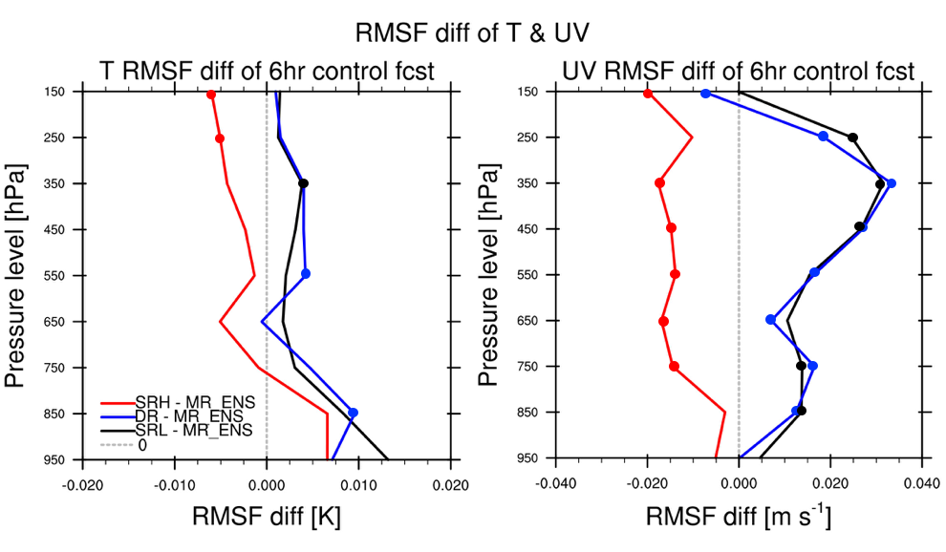
Results
- RMS fit of 6hr forecasts to the rawinsondes
SR-Low and DR show small differences in terms of 6 hour forecast fit to observations
For wind:
MR-ENS improves the fitting of 6hr forecast to obs. at almost all pressure levels compared to SR-Low and DR
SR-High shows better fit to the observation than MR-ENS for wind
For temp:
MR-ENS shows less difference compared to other experiments

Slide 10
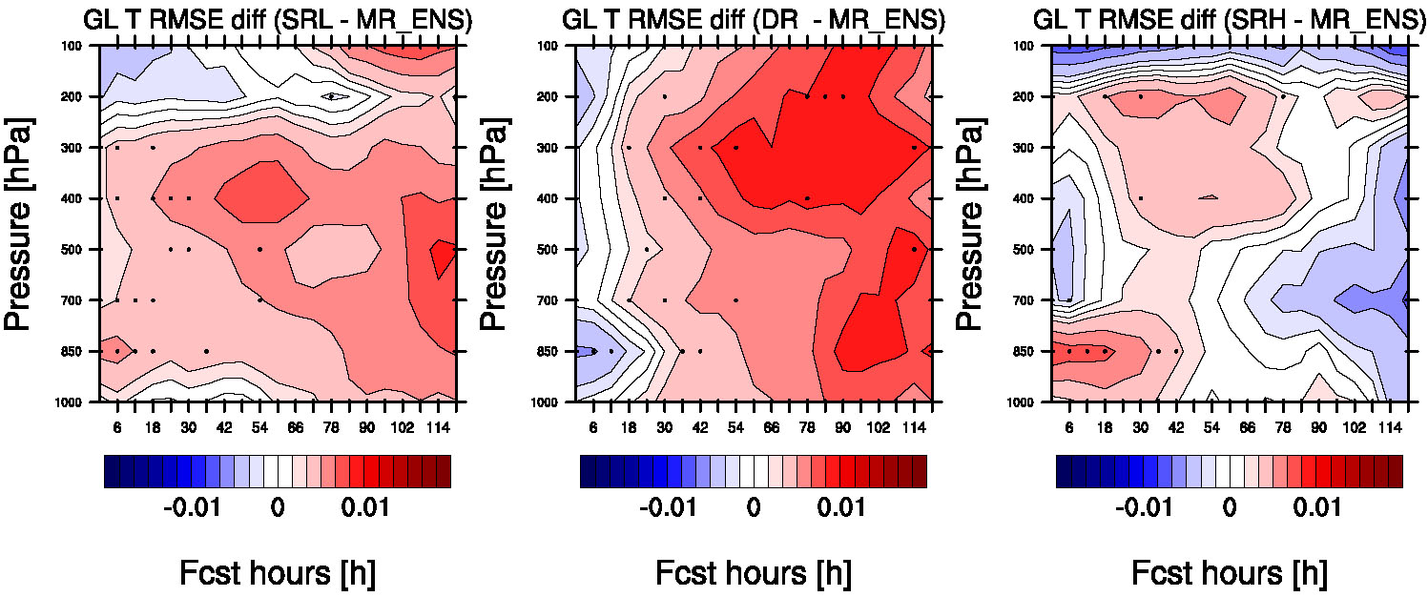
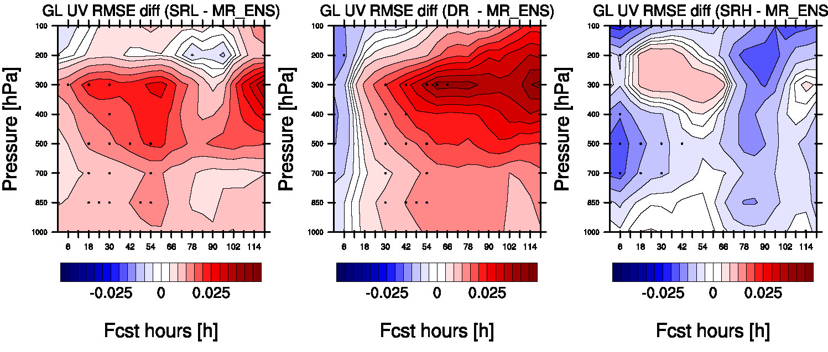
Results
-RMSE of forecasts up to 5-day against EC analysis
TEMP
SRL – MR_ENS
DR – MR_ENS
SRH – MR_ENS
MR-ENS improves TEMP and WIND forecasts for almost all forecast lead times below 200 hPa compared to SR-Low
MR-ENS shows statistically significant improvement than DR in all levels after 12 h lead time
Difference between MR-ENS SR-High is not consistent and is mostly statistically insignificant (except for TEMP forecast short forecast time at lower level and for wind at mid-level at short lead time
WIND

Slide 11
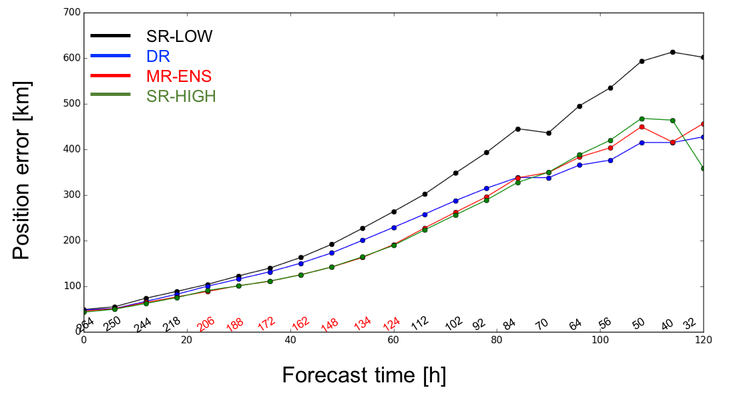
Results
- Hurricane track forecasts
red: significantly different between DR & MR
Total 12 TC cases during the experimental period
MR-ENS and SR-High performed similarly and both improve the track forecasts by 84 hours compared to DR
DR outperforms SR-LOW especially at longer lead times.

Slide 12
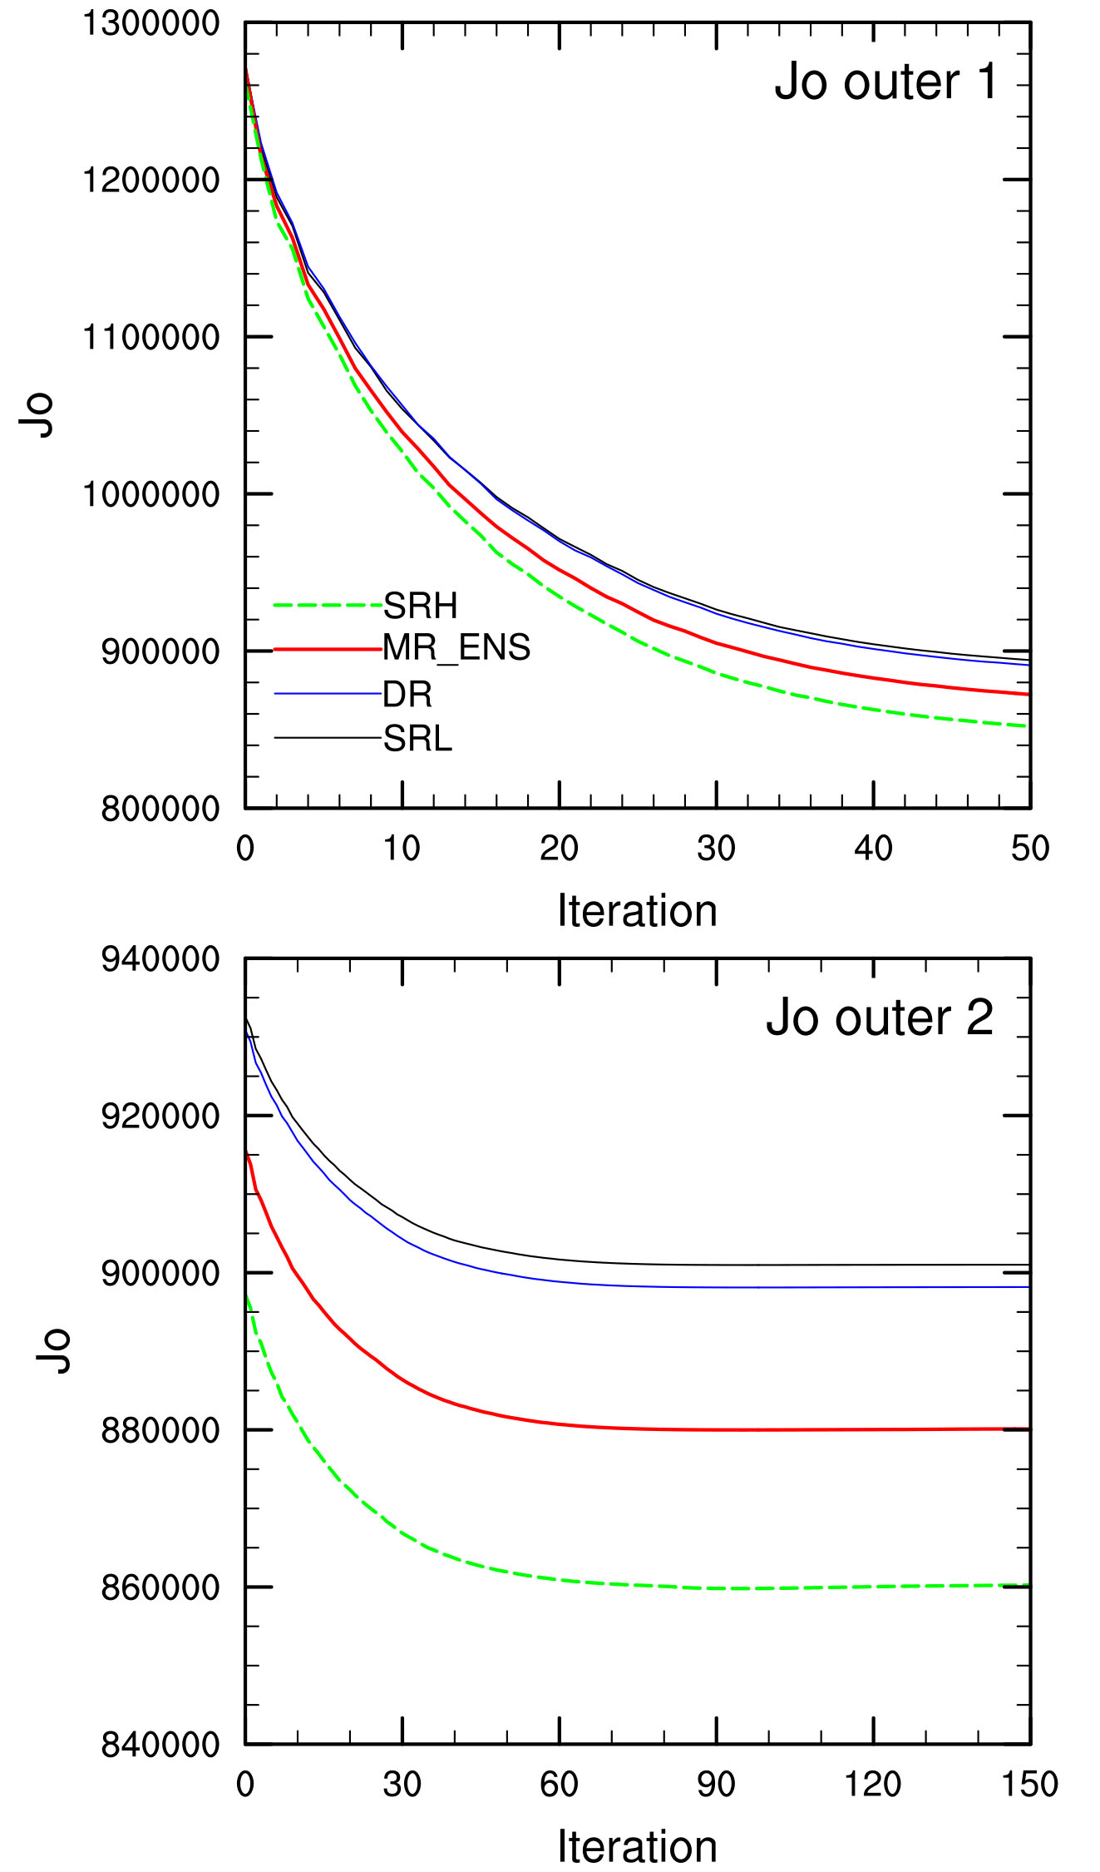
Results
- Observation term of cost function
1st outer loop
Jo term
MR-ENS more strongly fits to observations than SR-Low and DR
SR-High shows the smallest observation term (Jo) after iteration, and followed by MR-ENS
DR shows more fit to observations than SR-Low
2nd outer loop

Slide 13
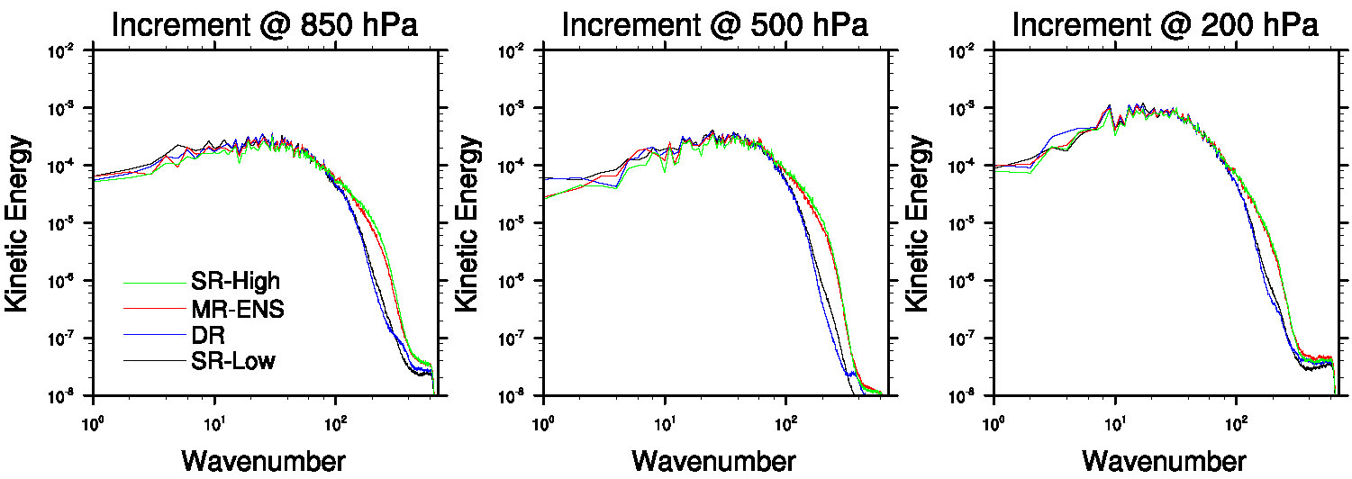
Results
- Power spectrum of analysis increments
Global KE of Analysis increment
0.0214421
0.02064686
0.02285128
0.02220631
MR-ENS shows comparable KE of analysis increment with SR-High, and has larger power of analysis increment than DR and SR-Low at higher wave numbers (>100)

Slide 14
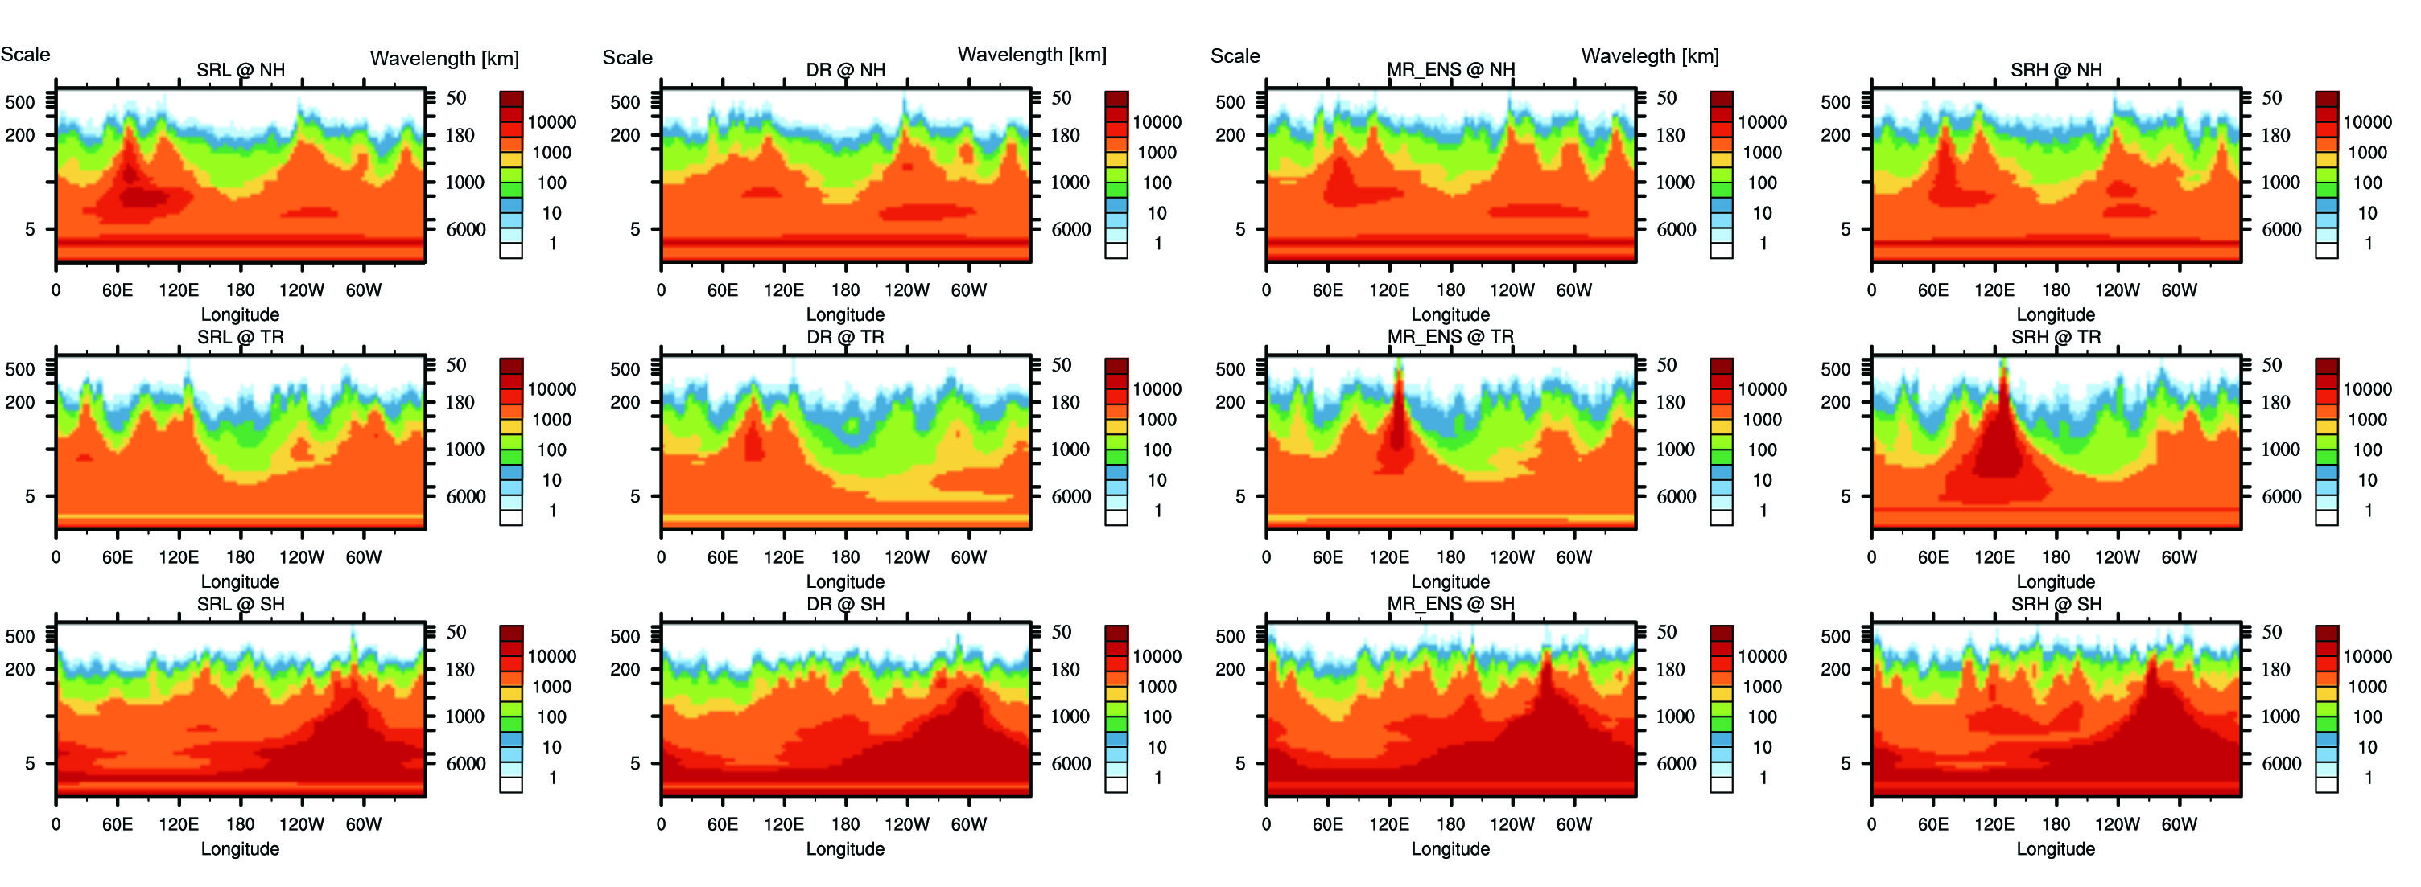
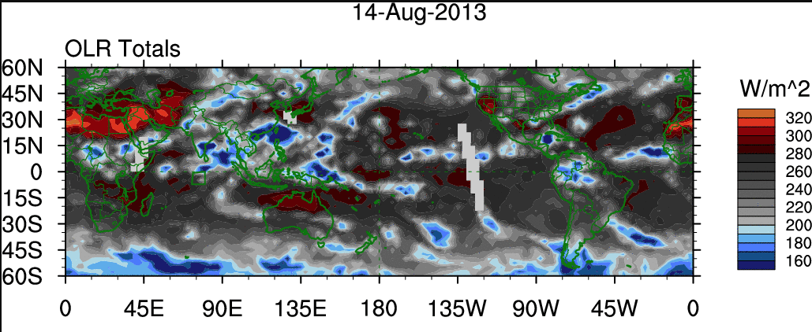
Results
- analysis increment as a function of scales and longitude
Wavelet power spectrum of KE of analysis increment @ 500 hPa (10 Aug – 20 Aug 2013)
SR-Low
DR
MR-ENS
SR-High
NH
TR
SH
from NCICS
In TR region where convection associated with typhoons is active (UTOR, TRAMI), MR_ENS has larger power of analysis increment than SR-Low and DR at small scales

Slide 15
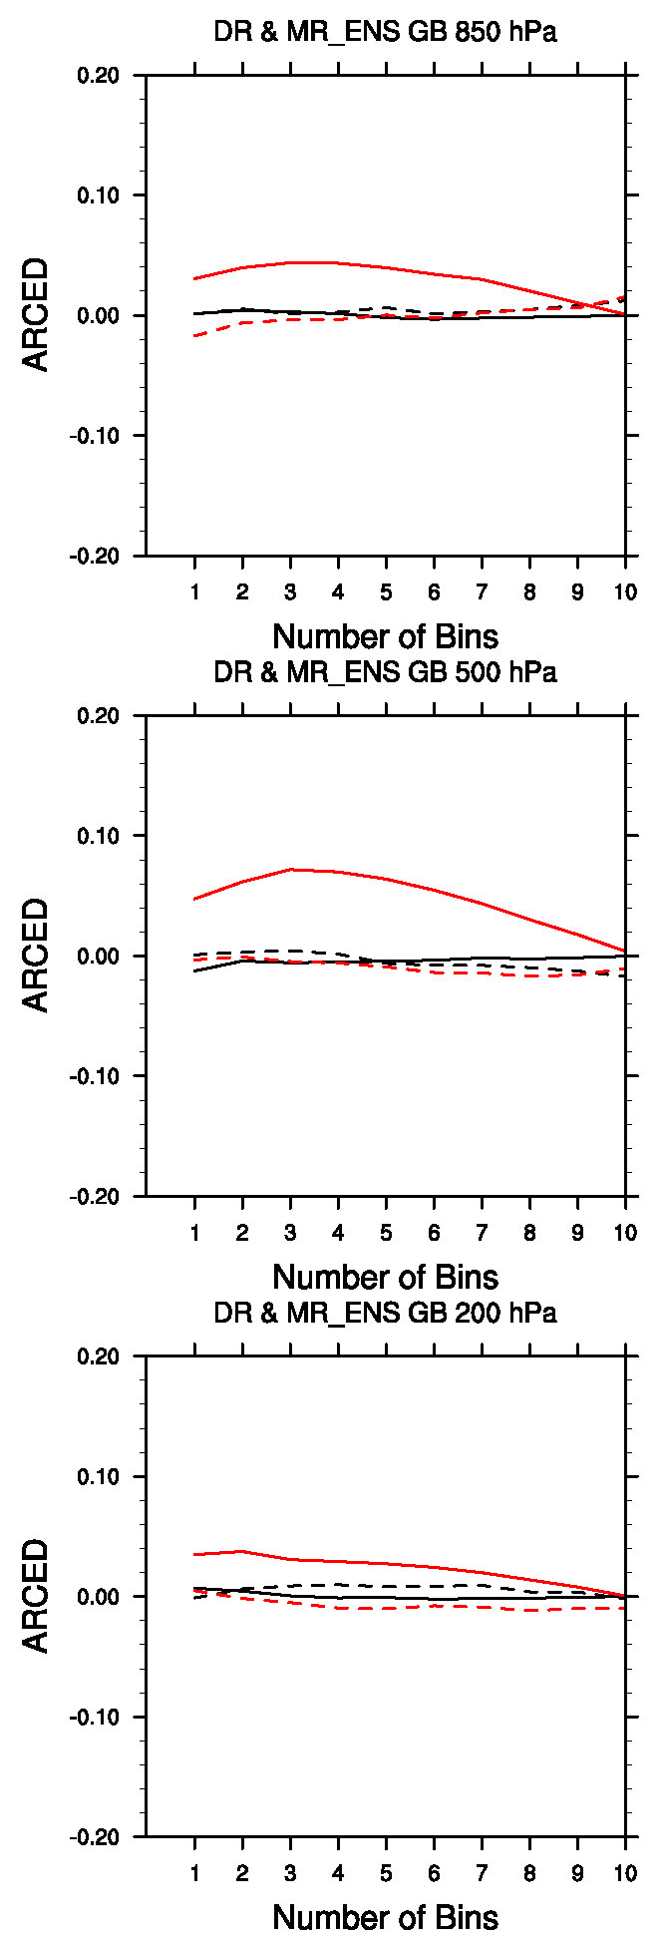
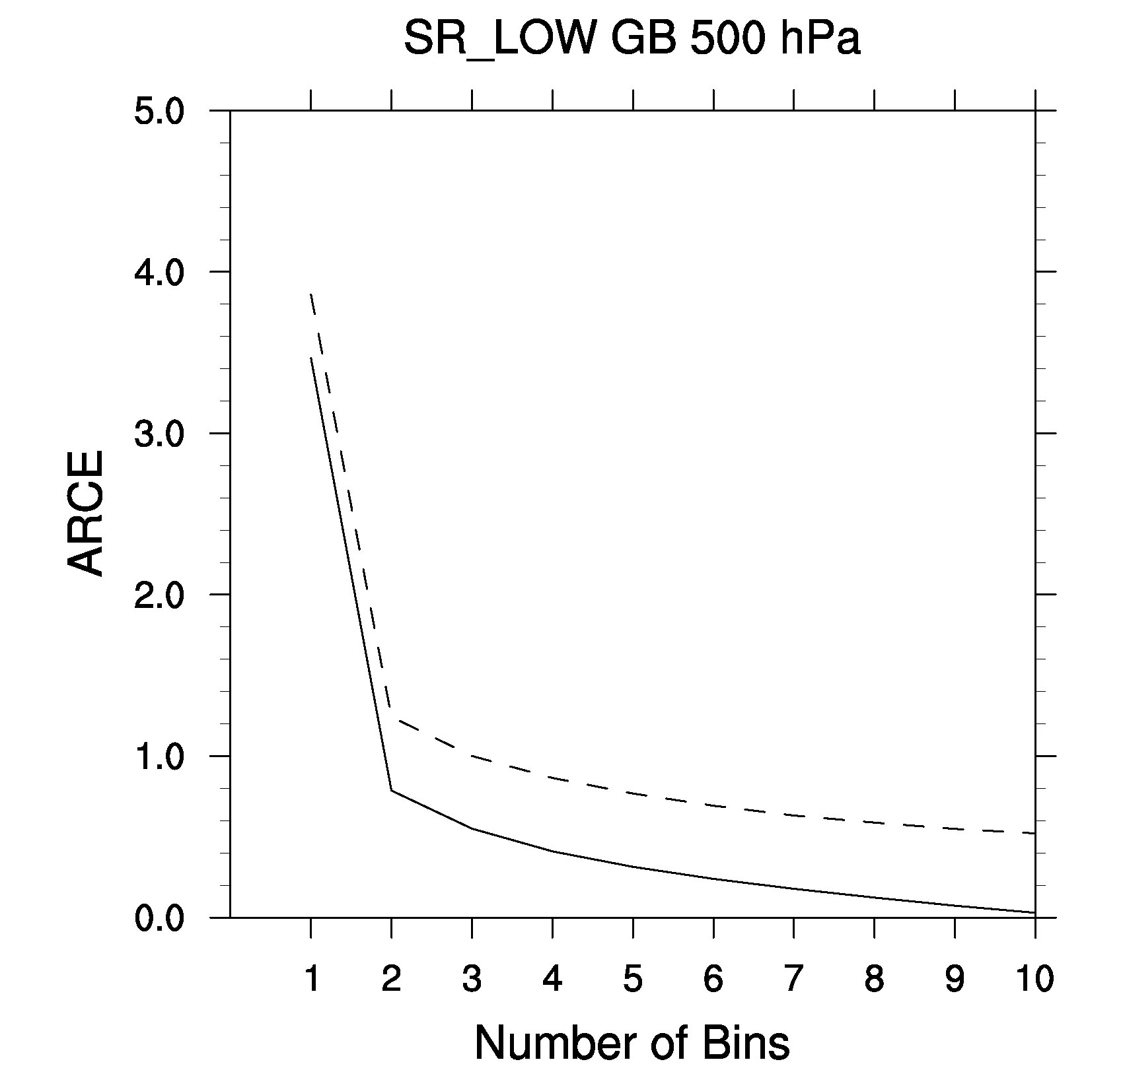
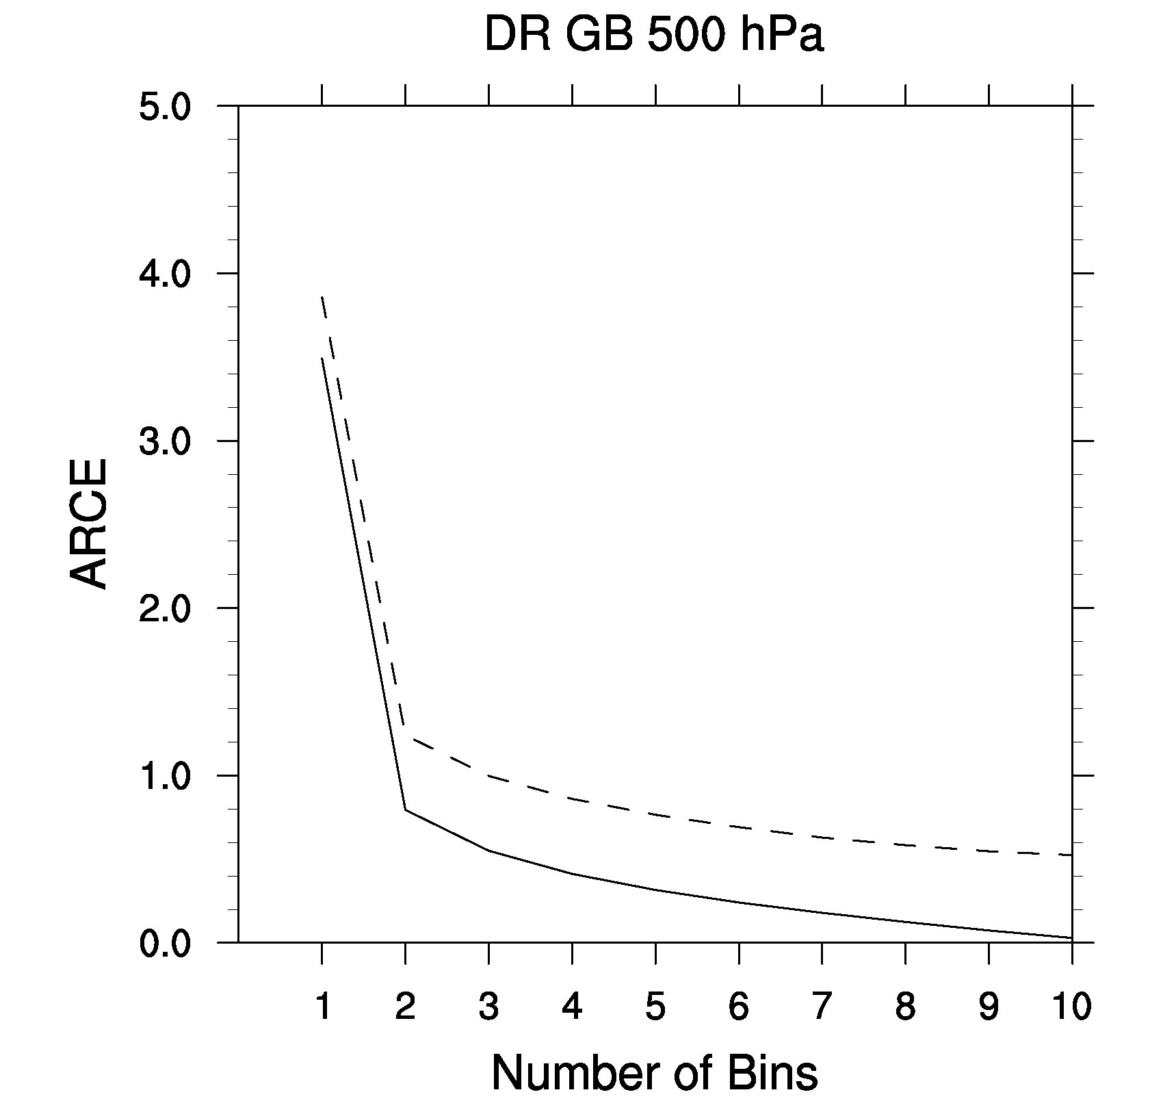

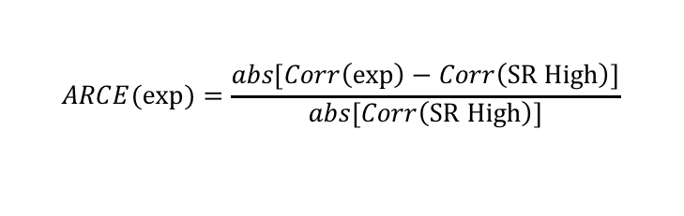
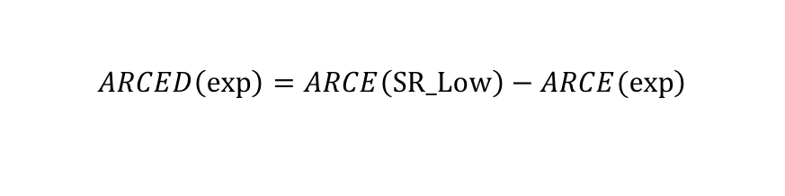
Results
- Accuracy of background ensemble correlation
Absolute value of the Relative Correlation Error (ARCE)
ARCED
$$ARCE(exp)=\frac{\left.abs[Corr\left(exp\right)−Corr\left(SR High\right)\right]}{\left.abs[Corr\left(SR High\right)\right]}$$
Huang and Wang 2018
850 hPa
ARCE
@ 500 hPa
UU (DR)
UT (DR)
UU (MR-ENS)
UT (MR-ENS)
SR-Low
DR
MR-ENS
UU
UT
500 hPa
ARCE Difference from SR-Low (ARCED)
Positive/negative: improved/degraded correlations
$$\left.ARCED\left(exp\right)=ARCE\left(SR_Low\right)−ARCE(exp\right)$$
MR-ENS improves the auto-correlation accuracy for almost all correlations values
MR-ENS show no improvement of the cross-correlation than DR and SR-Low
DR and SR-Low show comparable accuracy of correlation for both auto- and cross-correlation
200 hPa

Slide 16
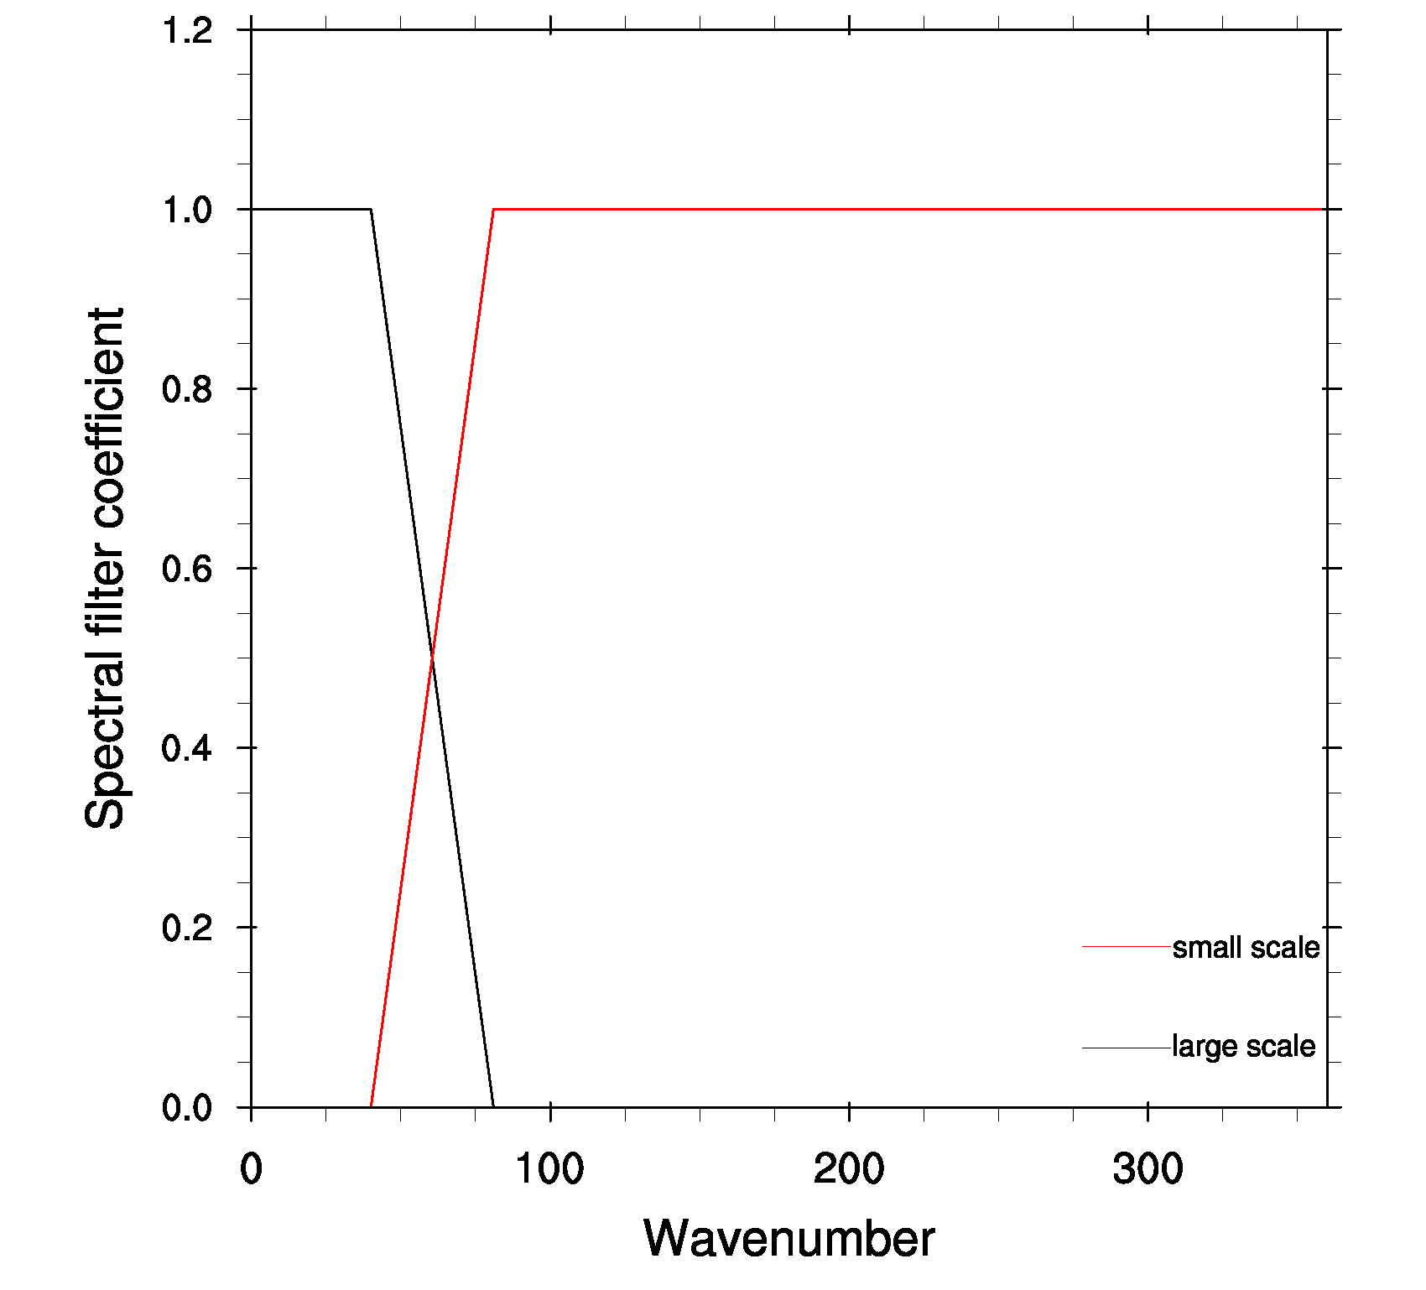
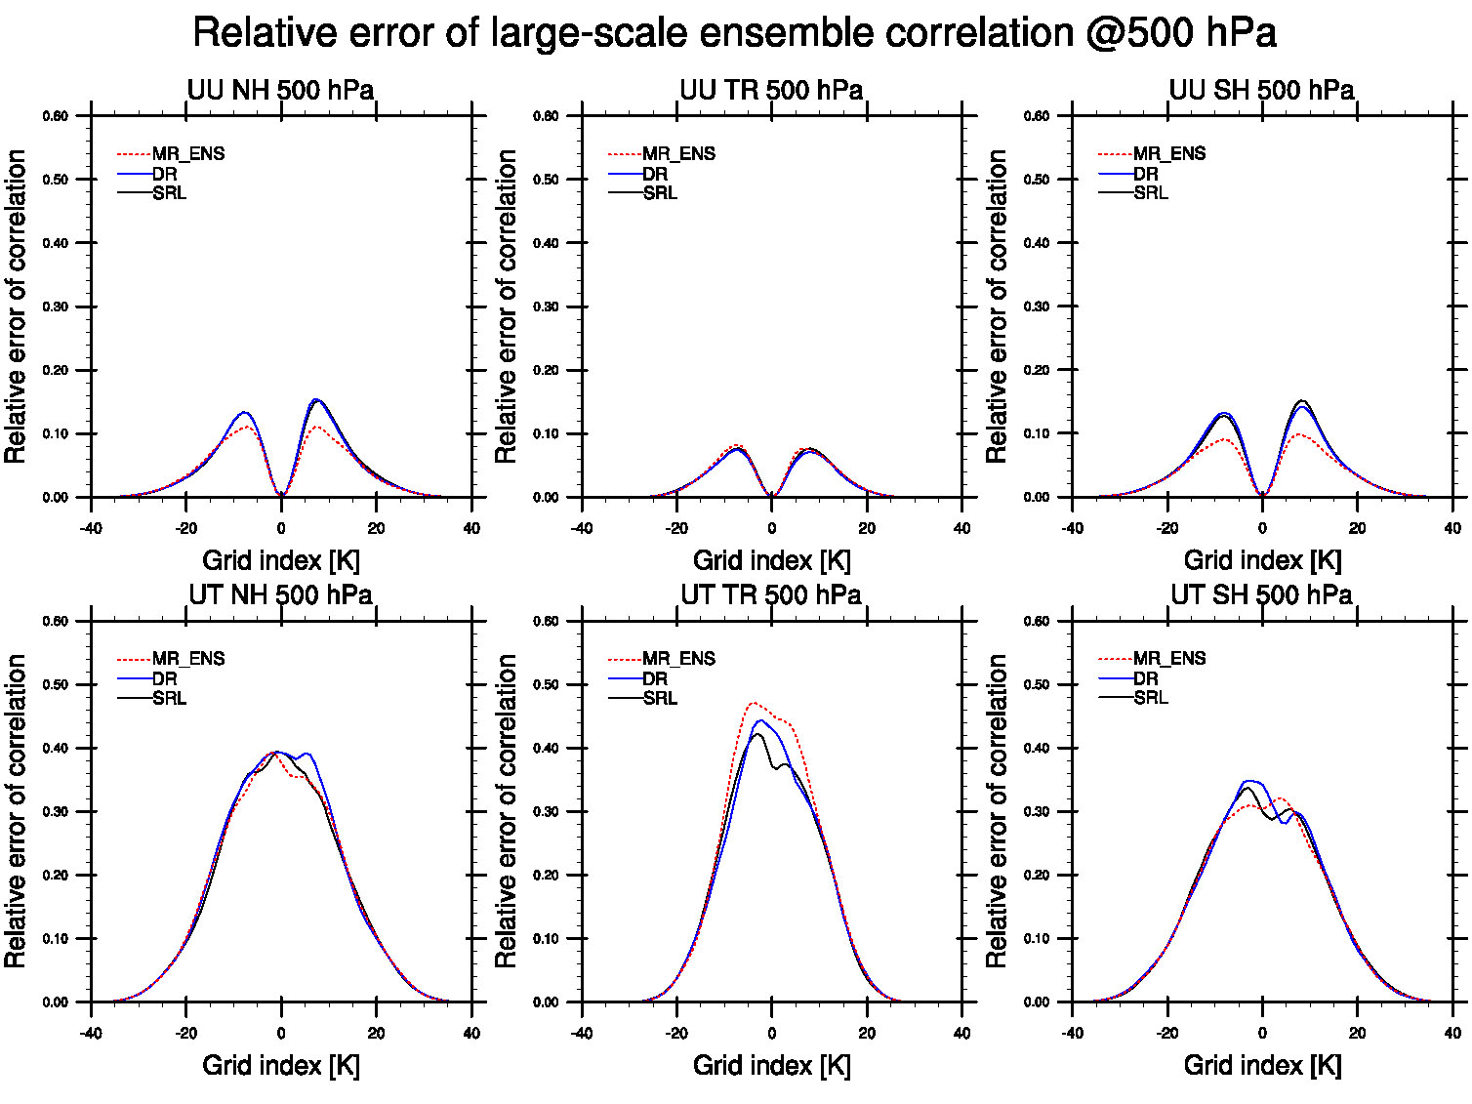
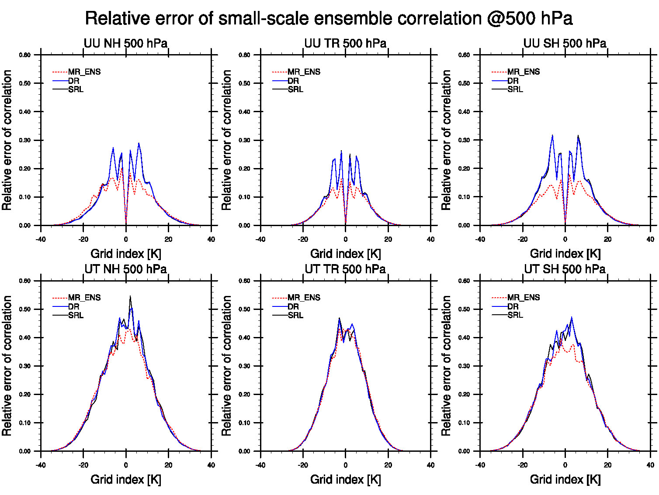
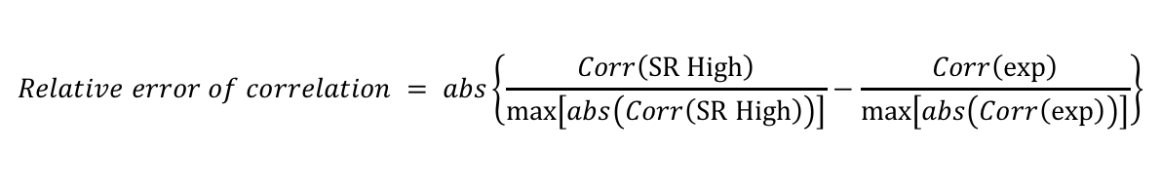
Results
- Accuracy of background ensemble correlation
X = [X_{L} + X_{S}]:
X_{L} : >500 km
X_{S} : <=500 km
$$Relative error of correlation = abs\left\{\frac{Corr\left(SR High\right)}{max⁡\left[abs\left(Corr\left(SR High\right)\right)\right]}−\frac{Corr\left(exp\right)}{max⁡\left[abs\left(Corr\left(exp\right)\right)\right]}\right\}$$
X_{L}X_{L}^{T}
X_{S}X_{S}^{T}
MR-ENS improved accuracy of auto-correlation especially for small scales at all hemispheres and it also improved auto-correlation for large scale over NH and SH
MR-ENS improved accuracy of cross-correlation for small scales for NH and SH

Slide 17
Results
- Computing cost
Cost (theoretical)
Expts | Cost ratio relative to SR-Low
SR-Low | 1
DR | 1
MR-ENS | 3.625
SR-High | 6.25
* Cost is estimated theoretically with only including 4DEnVar and background ensemble forecasting computing time. I/O is ignored.

Slide 18
Summary and ongoing work
GSI based 4DEnVar is further developed to have capability to ingest ensemble with multi-resolutions
Overall MR-ENS improves the TEMP, WIND, and hurricane track forecasts compared to SR-Low and DR
At small scale, MR-ENS analysis increment has larger power than the SR-Low and DR
Wavelet diagnostics show MR-ENS has larger increment for small scales in convectively active regions over TR
MR-ENS improves especially the auto-correlation and cross-correlation of small scale background ensemble correlation compared to SR-Low and DR
Although SR-High needs about twice as much cost as MR-ENS, SR-High does not show significant improvement in forecast compared to MR-ENS.
Ongoing work in collaboration with EMC
Application of scale-dependent weights to the multi-resolution ensemble 4DEnVar
Develop scale dependent localization

Slide 19


Implementation of scale-dependent localization in GSI hybrid 4DEnVar system
Idea similar to Buehner and Shlyaeva (2015)
SDL formula is derived for full B preconditioning and implemented in GSI 4DEnVar
Scale-dependent localization matrix for 2 scales
2D wind at Scale 1
2D wind Full field
2D wind at Scale 2

Slide 20
2D wind increment
(applying a +2m/s V wind innovation)
(Localization scales are the e-folding scales )
Loc-1500km
SSDL-1500km
CSDL-1500km
No-Loc
SSDL-1500/500km
CSDL-1500/500km

Slide 21
2D wind increment
(Localization scales are the e-folding scales )
Increment for scales >4000km
Increment for scales < 4000km
CSDL-1500/500km
CSDL-1500/500km

Slide 22
References
Wang, X., C. Snyder, and T. M. Hamill, 2007: On the theoretical equivalence of differently proposed ensemble/3D-Var hybrid analysis schemes. Mon. Wea. Rev., 135, 222–227.
Wang, X., 2010: Incorporating Ensemble Covariance in the Gridpoint Statistical Interpolation Variational Minimization: A Mathematical Framework, Mon. Wea. Rev., 138, 2990- 2995.
Wang, X., D. Parrish, D. Kleist, J. Whitaker, 2013: GSI 3DVar-based ensemble–variational hybrid data assimilation for NCEP Global Forecast System: Single-resolution experiments. Mon. Wea. Rev., 141(11), 4098-4117.
Wang, X., and T. Lei, 2014: GSI-based four dimensional ensemble- variational (4DEnsVar) data assimilation: Formulation and single-resolution experiments with real data for NCEP global forecast system. Mon. Wea. Rev., 142, 3303–3325, doi:10.1175/ MWR-D-13-00303.1.
Huang, B., and X. Wang, 2018: On the use of valid time lagging (VTL) ensembles to increase ensemble size in the GFS hybrid 4DEnVar system. Mon.Wea. Rev., in review.
Buehner, M., and A. Shlyaeva, 2015: Scale-dependent background-error covariance localisation. Tellus A, 67, 1373–1395.
Kleist, D. T., and K. Ide, 2015: An OSSE-based evaluation of hybrid variational–ensemble data assimilation for the NCEP GFS. Part II: 4D EnVar and hybrid variants. Mon. Wea. Rev., 143, 452–470, doi:10.1175/MWR-D-13-00350.1.
Lei, L., and J. S. Whitaker, 2017: Evaluating the trade-offs between ensemble size and ensemble resolution in an ensemble-variational data assimilation system, J. Adv. Model. Earth Syst., 9, doi:10.1002/2016MS000864.

