Slide 1
Ensemble Transform Kalman Incremental Smoother and its Impact on Severe Weather Prediction
Shu-Chih Yang, Zhe-Hui Lin and Kuan-Jen Lin
Dept. Of Atmospheric Science, National Central University, Taiwan
8th EnKF workshop@ Mont Gabriel, Canada

Slide 2
Background
Strong analysis corrections can result in model shock and imbalanced model state.
Incremental analysis update (IAU, Bloom et al. 1996) is a common strategy to reduce model shock and imbalance. IAU applies a constant incremental update and has a low-pass filtering property. However, strong nonlinearity (e.g. severe weather) imposes difficulty for IAU applications.
4DIAU (Lorenc et al. 2015) uses the trajectory from 4DEnVar to get time-varying increments. Li et al. (2016) proposes an alternative 4DIAU scheme for EnKF to calculate analysis increments at different times of the assimilation window, and interpolates into time-varying increment.
4DIAU allows the incremental update to change in time and improves the application of IAU under nonlinear dynamics. 4DIAU also better keeps the signals and avoids over smoothing with IAU.
When interpolating the coarse-resolution analysis to high-resolution grids, the weight-interpolated analysis shows a higher accuracy than the increment-interpolated analysis (Yang et al., 2009).
Notes:
In IAU, the displacement of increment in time will cancel the high frequency signal

Slide 3
Concept of IAU and 4DIAU
IAU (Bloom et al. 1996)
4DIAU (Lei et al. 2016)
-
+
-
+
-
+
-
+
Correction from IAU lacks evolution in time.
It could perform badly with fast evolving weather system.
color block: increment of v wind
Notes:
使用移動速度較快颱風作為例子，說IAU、4DIAU方法所可能帶有的缺點
在這個同化週期中，颱風將以黑色虛線前進
同化週期的中間時間點進行同化，有將颱風加強的v風場增量
在整個週期，IAU的都是固定的，所以他對颱風強度的修正位置會有偏差
4DIAU則藉由其隨時間變化的修正量，使風場增強的位置維持在移動中的颱風上

Slide 4
Concept of IAU and 4DIAU, and their cons
4DIAU (Lei et al. 2016)
-
+
interpolated increment
could not follow the later background dynamics
-
+
-
+
The model state may have
different evolution after correction
-
+
-
+
color block: increment of v wind
Notes:
但4DIAU也還可能有一些問題
在Lei的版本中，分析增量是時間內插出來的，所以他的修正量在空間上還不是最理想的
並且在非線性較強的情況下，前段的修正可能會使後來的發展有很大的不同
舉例來說，原本往西北方向前進的颱風變成往北走
使得修正量變成不在颱風的位置上

Slide 5
Background
Strong analysis corrections can result in model shock and imbalanced model state.
Incremental analysis update (IAU, Bloom et al. 1996) is a common strategy to reduce model shock and imbalance. IAU applies a constant incremental update and has a low-pass filtering property. However, strong nonlinearity (e.g. severe weather) imposes difficulty for IAU applications.
4DIAU (Lorenc et al. 2015) uses the trajectory from 4DEnVar to get time-varying increments. Lei et al. (2016) proposes an alternative 4DIAU scheme for EnKF to calculate analysis increments at different times of the assimilation window, and interpolates into time-varying increment.
4DIAU allows the incremental update to change in time and improves the application of IAU under nonlinear dynamics. 4DIAU also better keeps the signals and avoids over smoothing with IAU.
When interpolating the coarse-resolution analysis to high-resolution grids, the weight-interpolated analysis shows a higher accuracy than the increment-interpolated analysis (Yang et al., 2009).
Notes:
In IAU, the displacement of increment in time will cancel the high frequency signal

Slide 6
Motivations
Ensemble Transform Kalman Incremental Smoother (ETKIS) based on no-cost smoother and LETKF framework: Instead of working on increments, we interpolates the weights for linearly combining the ensemble. Keep the weights, but allow ensemble to evolve.
Evaluating the impact under conditions with strong nonlinearity and imbalance using simple models
The Lorenz 3-variable model: strong nonlinearity
The shallow-water model: imbalance
Evaluating the impact on TC prediction with a regional NWP model
Weather Research and Forecasting (WRF) model
Notes:
LETKF with R localization result in imbalance analysis increment
Shallow water model follows geostrophic balance and has much weaker nonlinearity. Without others influence, this is suitable for investigate the difference of balance impaction between DA schemes and how gradually-correct schemes reduce the impaction.

Slide 7
Methodology of ETKIS
ETKF
ETKIS
=
-
+
$${\overline{x}}_{a}={\overline{x}}_{b}+X_{b}^{′}{\overline{w}}_{ETKF}$$
$${\overline{x}}_{a}={\overline{x}}_{b}+X_{b}^{′}{\overline{w}}_{ETKIS}$$
$${X_{a}^{′}=X}_{b}^{′}W_{ETKF}^{′}$$
×N
$${X_{a}^{′}=X}_{b}^{′}W_{ETKIS}^{′}$$
$$\overline{x}$$ | : | $$mean state$$
$$X^{′}$$ | : | $$perturbation state$$
$$\overline{w}$$ | : | $$mean weighting$$
$$W^{′}$$ | : | $$perturbation weighting$$
$$N$$ | : | $$total steps$$
$$n$$ | : | $$passed steps$$
$${\overline{w}}_{ETKIS}=\frac{1}{N}{(W_{ETKIS}^{′})}^{−n}×{\overline{w}}_{ETKF}$$
we want to make the correction
Better corresponding to state evolution
$$W_{ETKIS}^{′}={(W_{ETKF}^{′})}^{1/N}$$
what we do is to
use the newest background ensemble
to estimate analysis increment
Notes:
我們所想的理想狀況是，分析增量要適合於逐漸更新的過程中當下的模式狀態
並且這也表示，即使有不同於背景場的發展時，修正量也能有對應當下的狀況
想到的解決方法很簡單，不同於IAU、4DIAU使用逐漸更新前的背景場計算分析增量
我們使用當下的模式狀態來估計分析增量
所以基於LETKF方法進行修改，分析增量依舊是系集擾動的線性組合
但對他的權重係數給進行修改，使這個計算過程在更新多次之後會相等於原本LETKF的結果

Slide 8
Experiment with Lorenz 3-variable model
Assimilation schemes
4DLETKF (Hunt et al. 2007)
4DIAU (Li et al. 2016)
ETKIS
★
Direct update
●
●
t-6
t
t+6
t+12
t+18
t+24
t+30
δx_{a}

Slide 9
Experiment with Lorenz 3-variable model
Assimilation schemes
4DLETKF (Hunt et al. 2007)
4DIAU (Lei et al. 2016)
ETKIS
Full update
●
●
t-6
t
t+6
t+12
t+18
t+24
t+30
δx_{a,1}
δx_{a,2}
δx_{a,3}

Slide 10
Experiment with Lorenz 3-variable model
Assimilation schemes
4DLETKF (Hunt et al. 2007)
4DIAU (Lei et al. 2016)
ETKIS
Early update
●
●
t-6
t
t+6
t+12
t+18
t+24
t+30
δx_{a,1}
δx_{a,2}
δx_{a,3}

Slide 11
Experiment with Lorenz 3-variable model
Assimilation schemes
4DLETKF (Hunt et al. 2007)
4DIAU (Lei et al. 2016)
ETKIS
Full update
Early update
●
●
t-6
t
t+6
t+12
t+18
t+24
t+30
δx_{a,1}
δx_{a,2}
δx_{a,3}

Slide 12
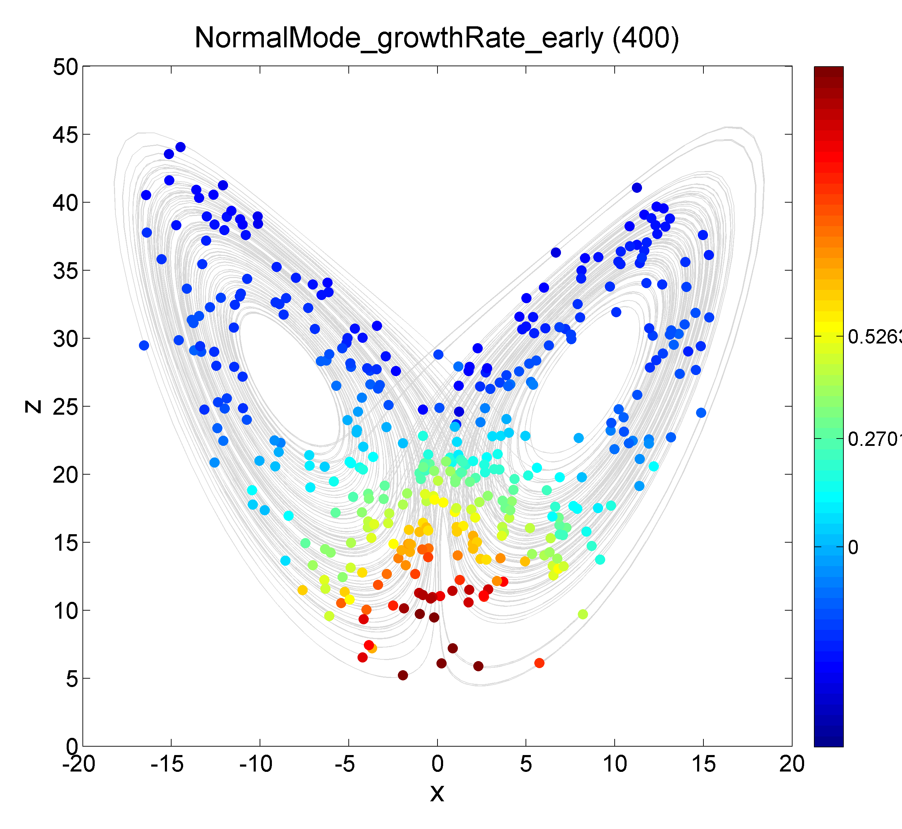
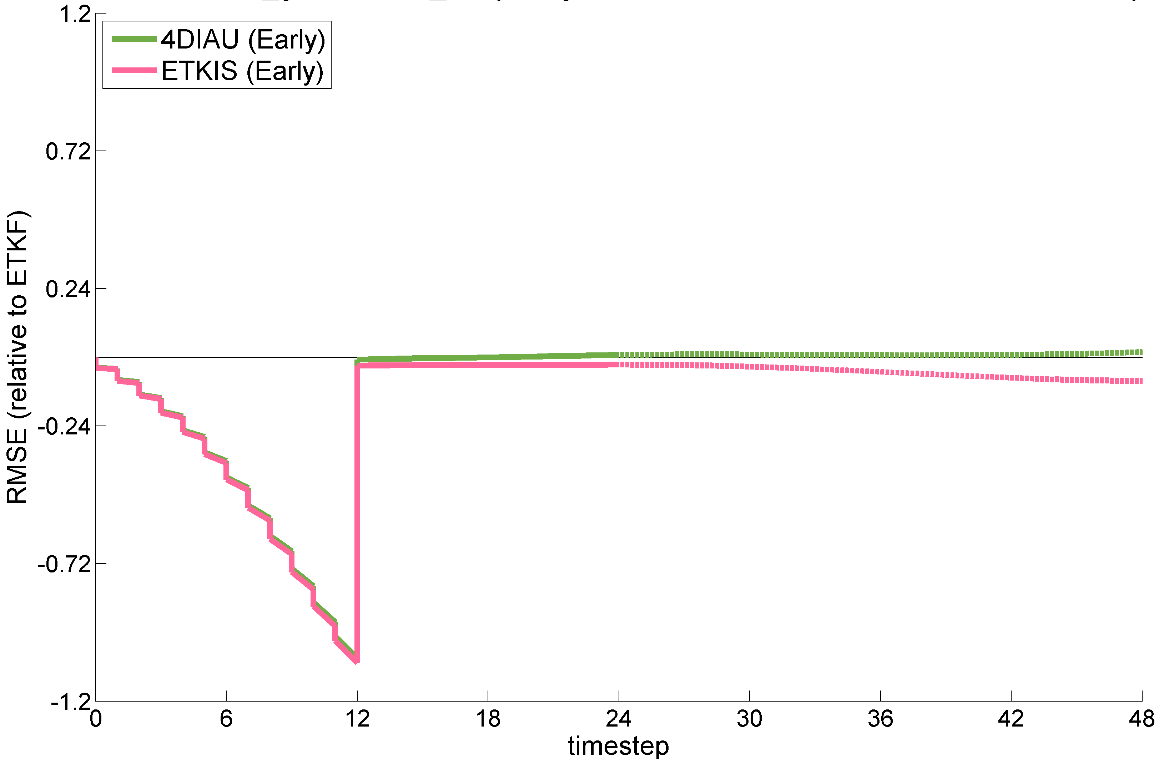
Experiments with L63 (Offline test)
DA interval: 24 time-step
Ensemble size: 10
Observation interval: 12 time-step
RMSE_{ETKIS} vs. RMSE_{4DIAU} at different growth rates
RMSE at the end of assimilation window
(cases with large growth rate)
Data Assimilation
Ensemble Forecast
Baseline:
4DETKF
Mean RMSE

Slide 13
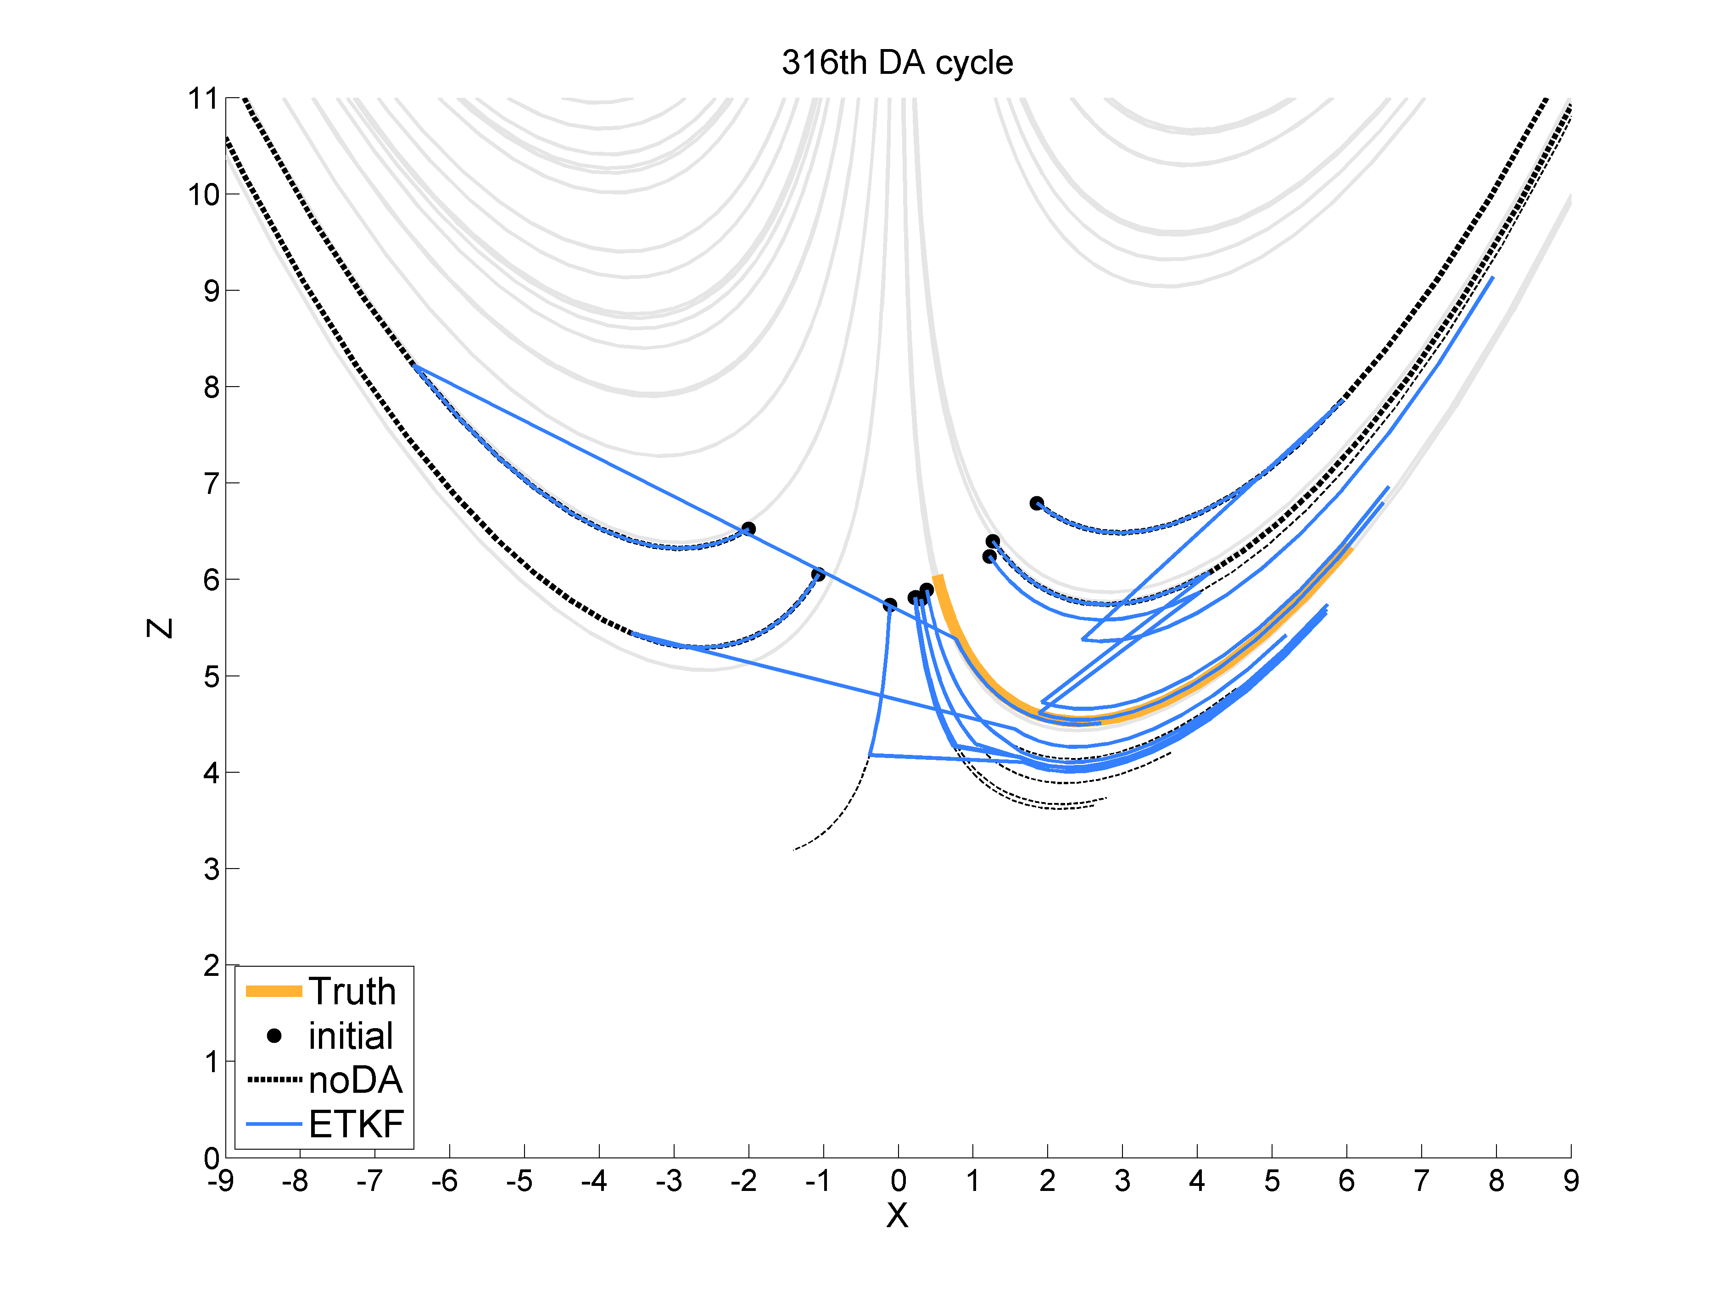
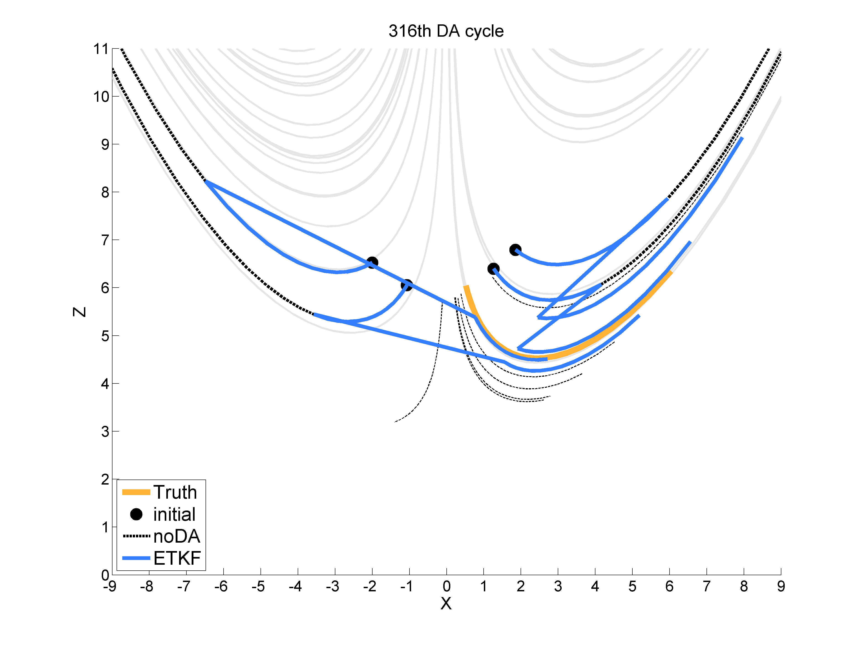
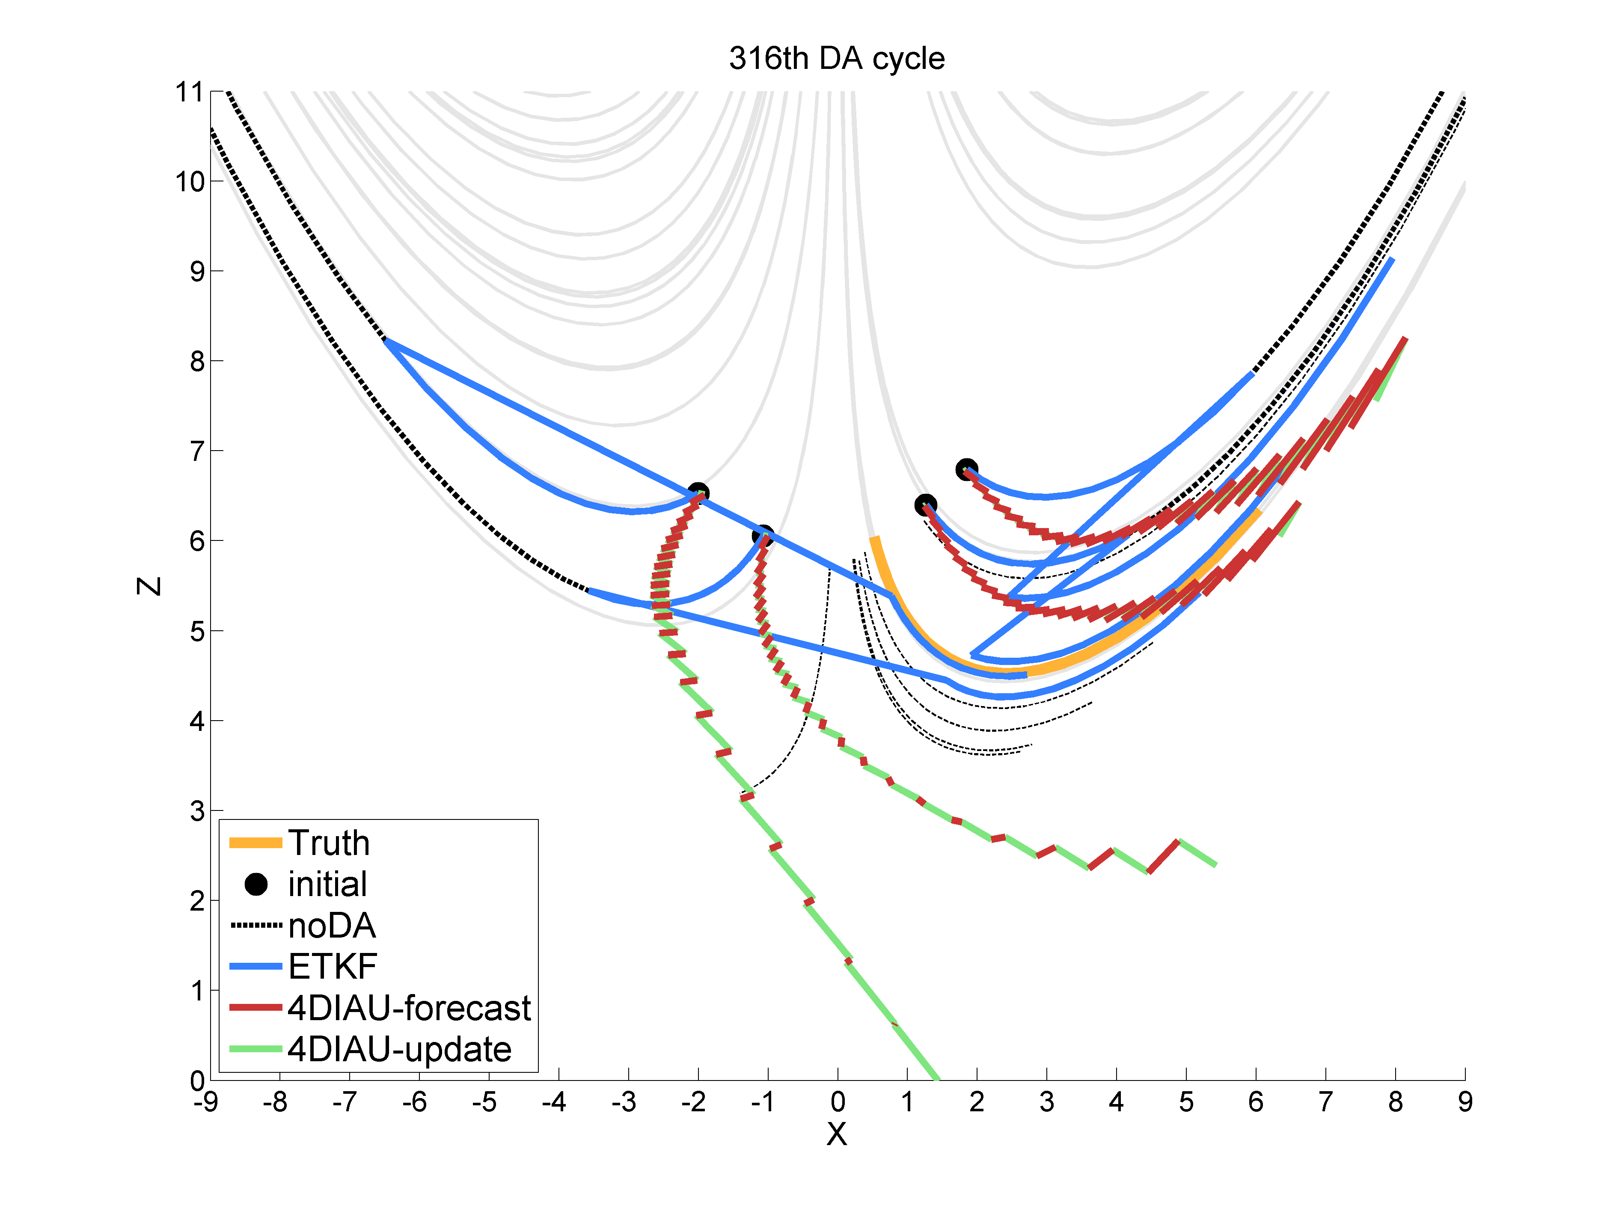
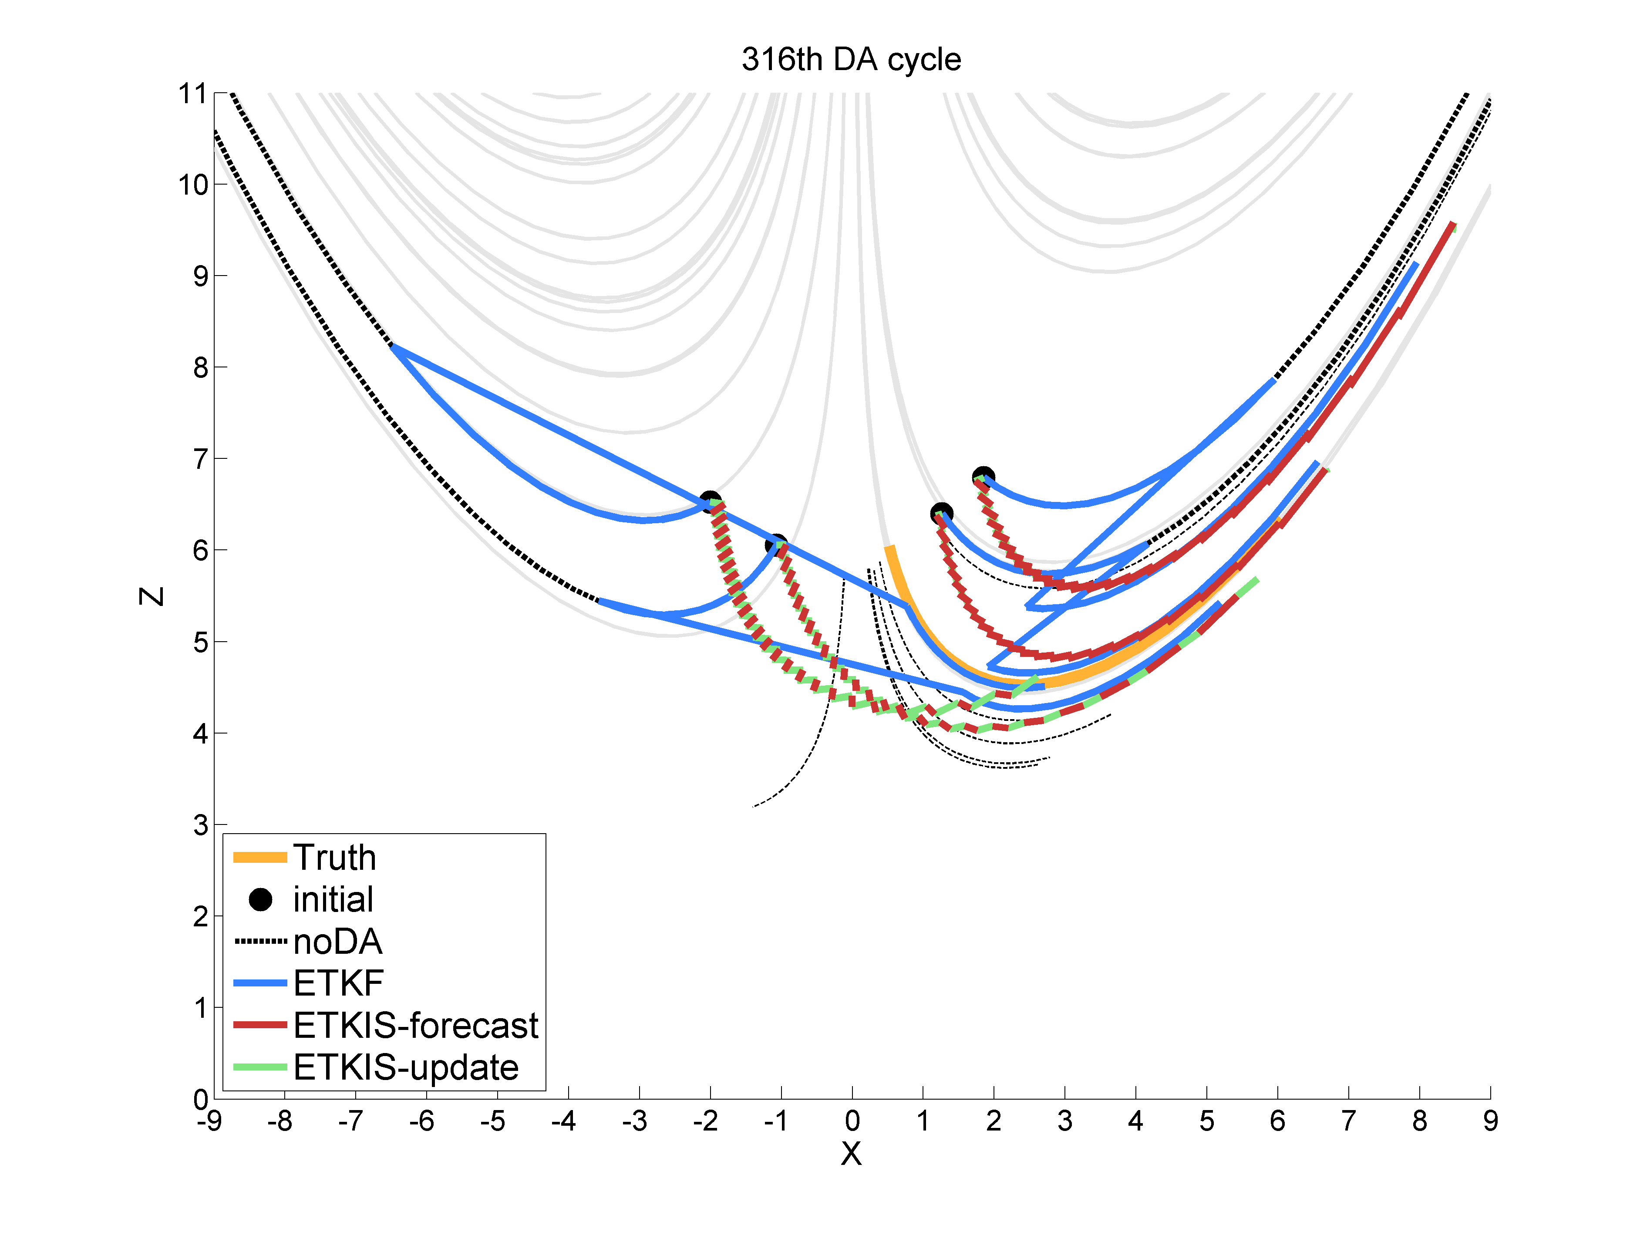
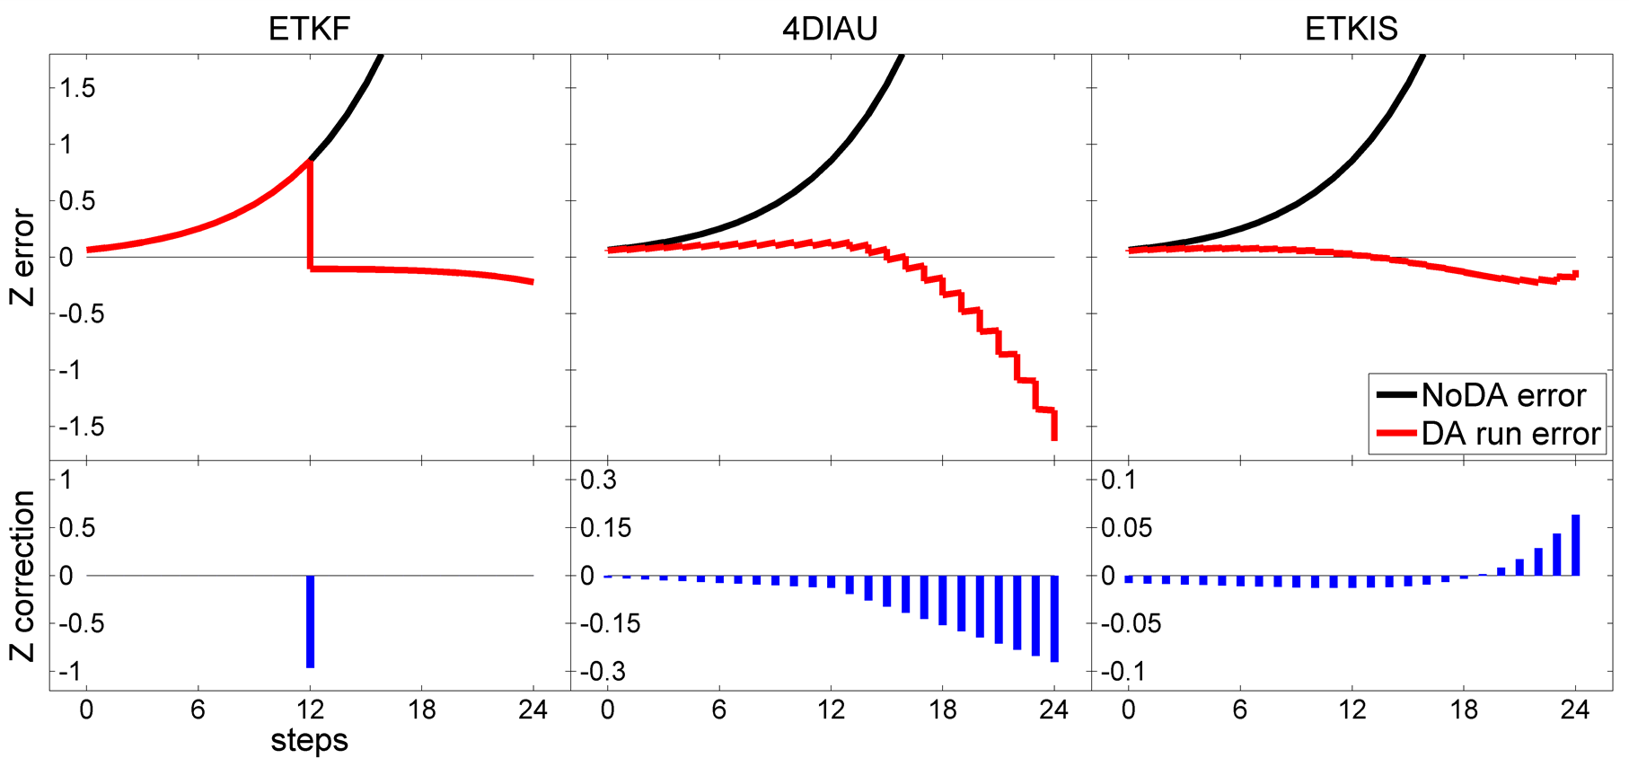

Slide 14
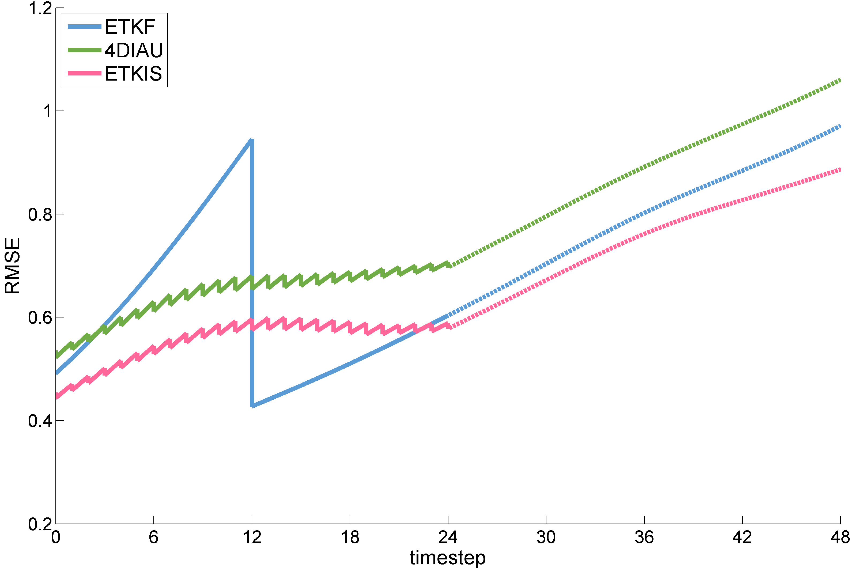
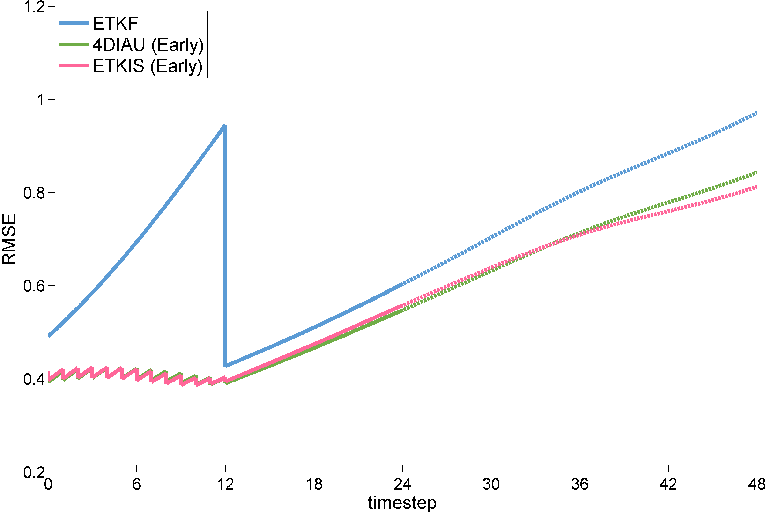
Experiments with L63 (500 DA cycling)
Full update
Early update
With cycling DA, both 4DIAU and ETKIS can improve 4DETKF’s performance using early update.
4DIAU is sensitive to the update strategy.

Slide 15
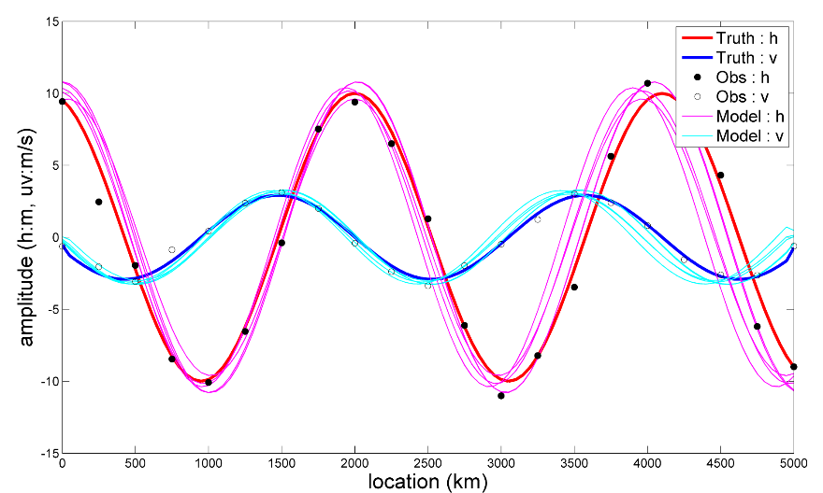
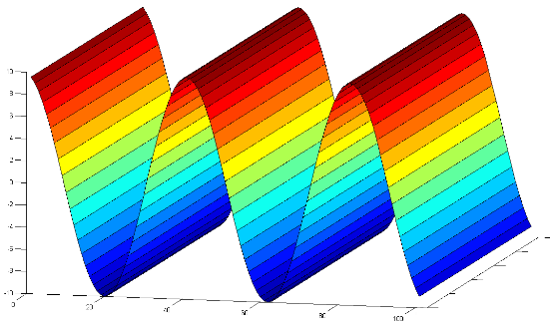
Shallow Water Model
Experiment 1: balanced initial condition
IC: balanced h, u, v
Can it smooth out ageostrophic wind?
Experiment 2: imbalanced initial condition
IC: only h
Can it better represent real signal?
homogenous in y-axis
Data Assimilation
Forecast
0
6
12
18
24
30
36
42
48
Model
resolution | 50 km
domain | 101 (5000km)
time step | 900 (15min)
boundary | non-periodical
ensemble members | 5
Initial condition - h
 | Truth | Model
wave length | 2100 km | 1950 ~ 2050 km
phase shift | -100 km | -50 ~ 50 km
amplitude | 10 m | 9 ~ 11 m
mean height | 500m | 500m
Observation
variable | h | v
density | 250 km (each 5 grid point)
observation error | 1 m | 0.2932 m/s
Data Assimilation
DA interval | 24 steps (6hr)
DA cycles | 4 cycles
R localization | 500 km
multiple inflation | off
Greybush S. J., E. Kalnay, T. Miyoshi, K. Ide and B. R. Hunt, 2011: Balance and Ensemble Kalman Filter Localization Techniques. Mon. Wea. Rev., 139, 511–522
Notes:
為了檢驗ETKIS是不是具有剛剛所說的選擇性濾波效果
接下來使用淺水波模式來進行驗證
實驗分成兩個部分，分別檢驗
ETKIS是否依舊能夠減少因為使用局地化產生的非地轉風
以及ETKIS是否能夠做到正確的修正量不被濾除，進而保持較好的修正效果
第一個部分使用一個符合地轉平衡的初始場，如此一來，模式中的非地轉風的是在資料同化過程產生的
第二個部分使用一個不平衡的初始場，將風處去除，使他的波動會震盪並傳遞
被傳遞、移動的誤差對於逐漸更新的同化方法會是一個挑戰，藉此評估同化方法估計出的修正量是不是也有隨時間傳遞
使用的淺水波模式延續Greybush等人的實驗的設計，y方向均值
初始場如圖，粉紅、紅、淺藍、深藍，觀測
會進行4個同化週期，以及一段24小時的預報

Slide 16
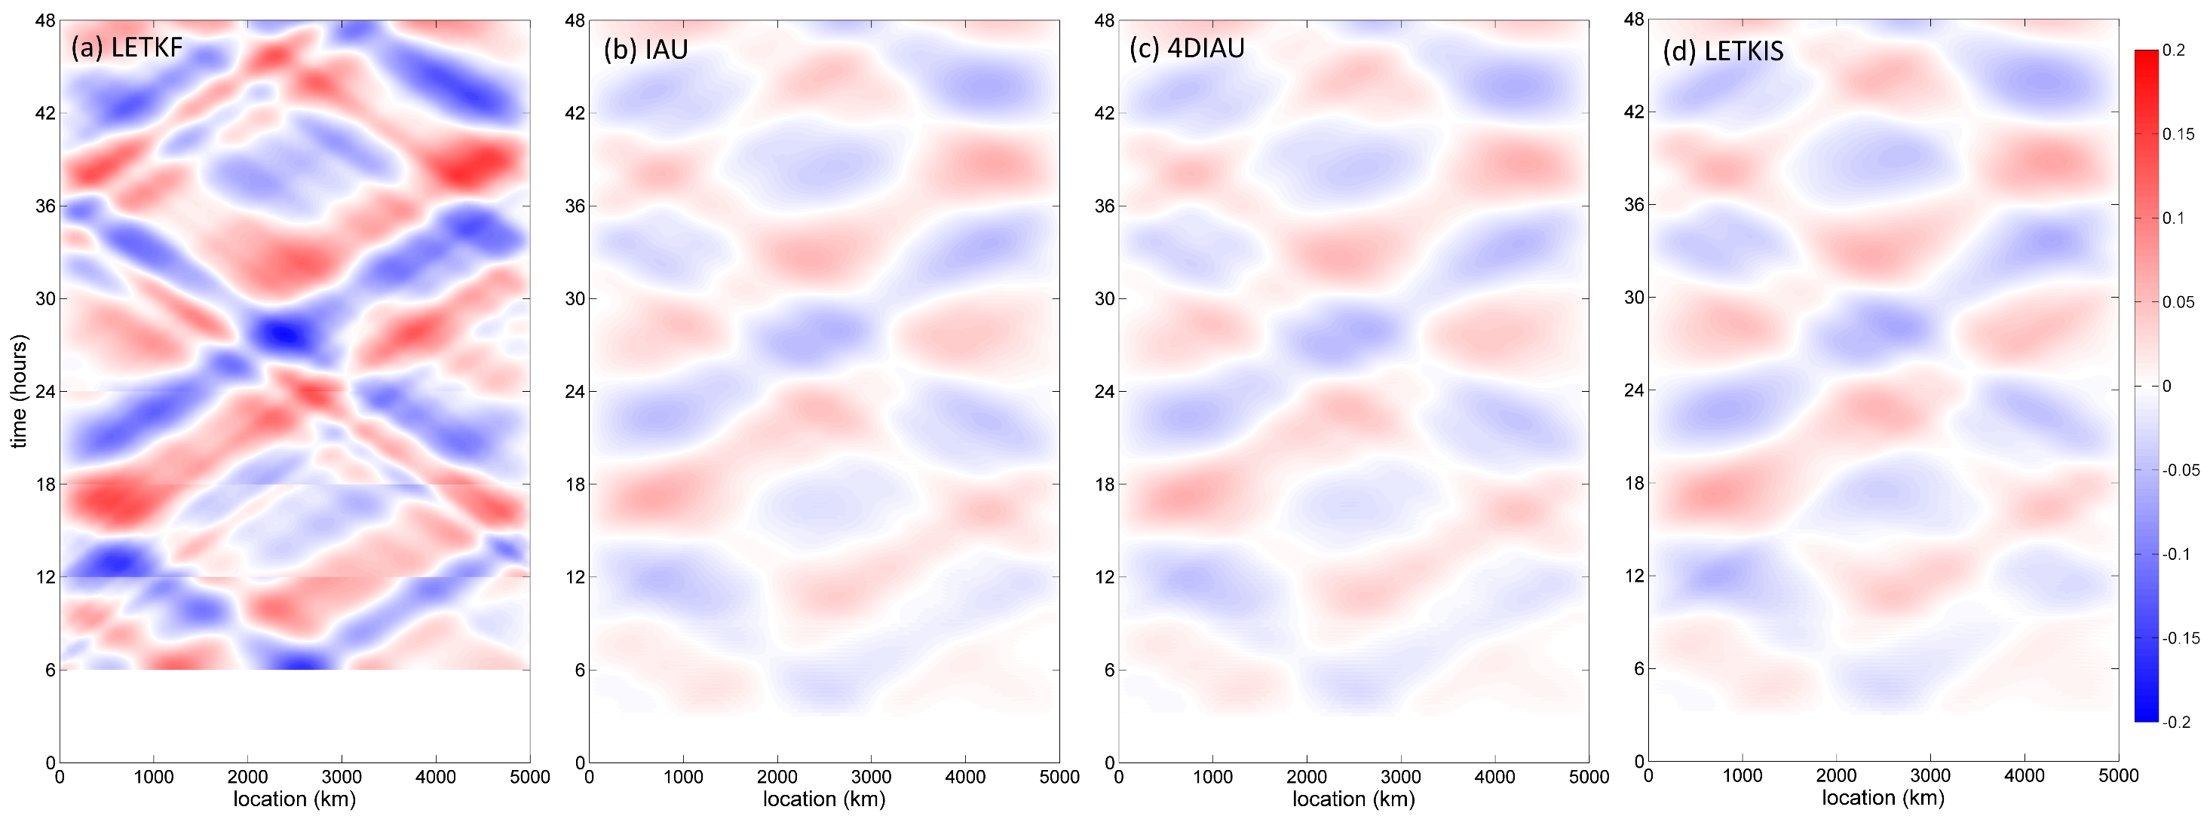
Shallow Water: experiment with the balanced initial condition
ageostrophic v wind ( generated due to the use of localization)

Slide 17
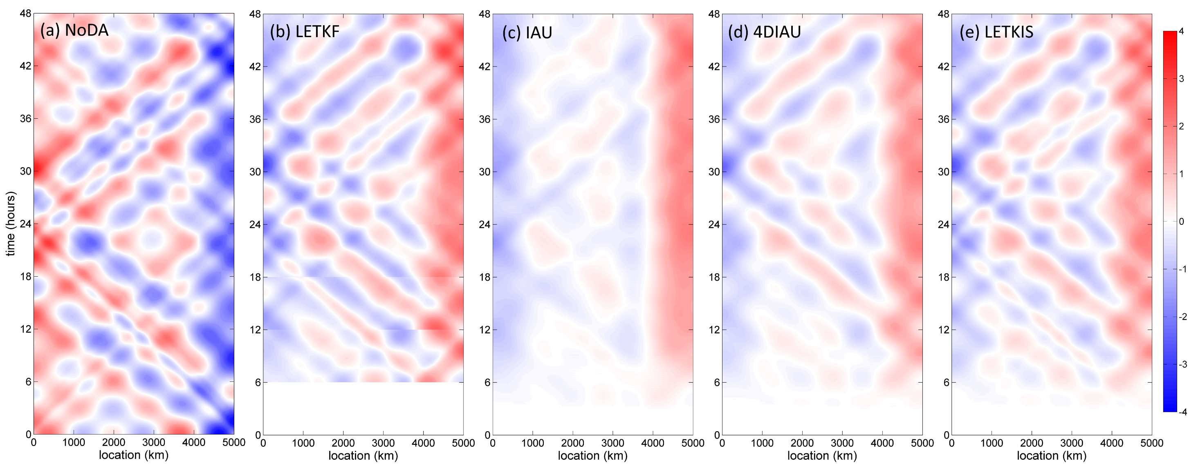
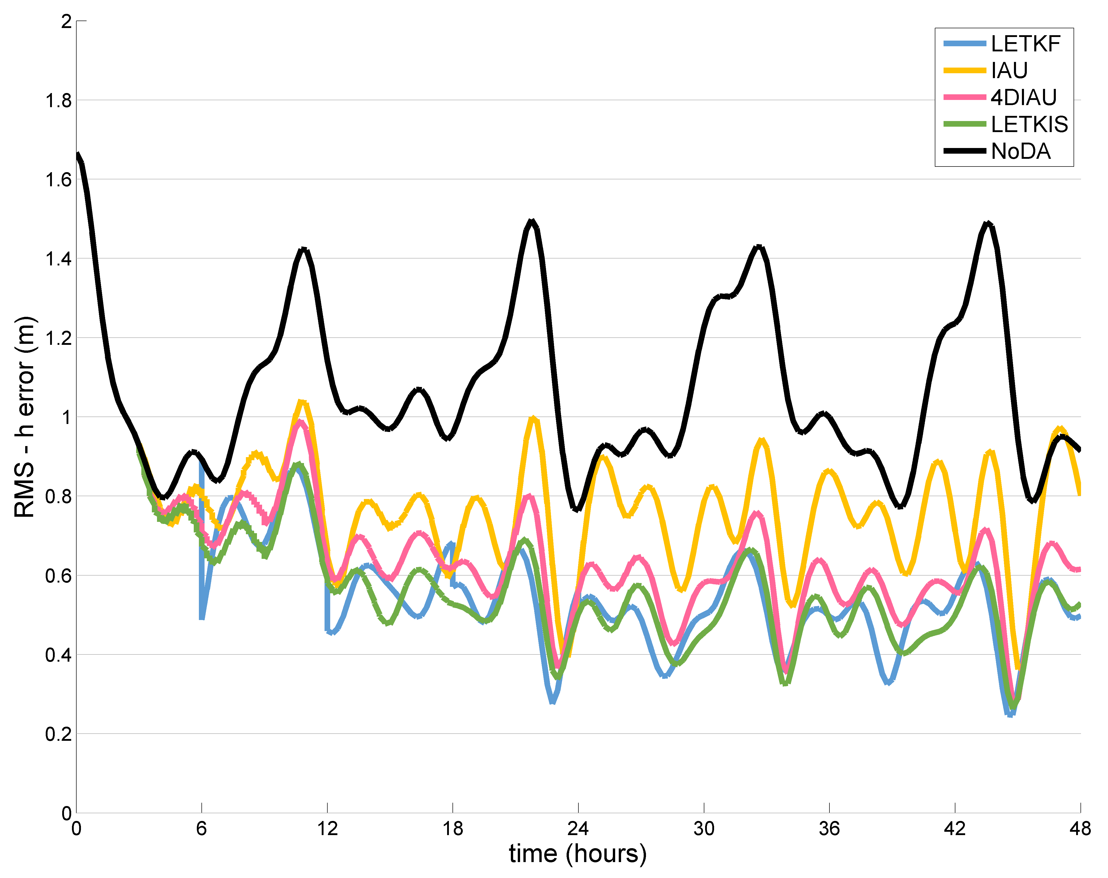
Shallow Water: experiment with the imbalanced initial condition
error
accumulative correction (～-error is better)
Reserve the correction without over smoothing

Slide 18
Typhoon Fanapi (2010) track prediction
Typhoon assimilation and prediction experiments conducted with WRF-LETKF
36 ensemble (12km) cycled with a 6-h analysis interval
Assimilate convectional, dropsondes, satellite winds (AMV), MSLP
Due to spin-down, large track and structure variations occur during the first 6-h forecast
TC Track
TC structure
CNTL
JTWC

Slide 19
Application of ETKIS on TC assimilation and prediction
With the 6-h LETKF weights, incremental update with ETKIS is applied every 1-h. Only variables in the lower troposphere are updated.
In terms of TC movement and structure, the model shock/spin-down issue is alleviated.
Early update
TC Track
TC structure
●
●
ETKIS
CNTL
JTWC
t-3
t
t+3

Slide 20
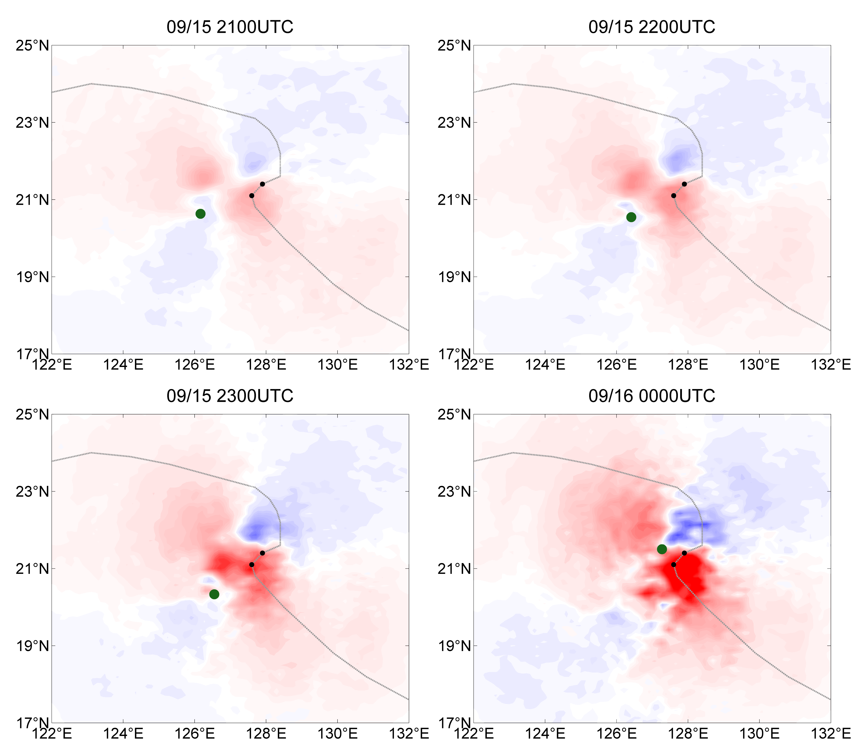
U analysis increment at 850hPa
2100 UTC
2200 UTC
Obs. TC
Model TC
Analysis increment is flow-dependent; sensitive to the TC location.
2300 UTC
0000 UTC

Slide 21
Summary
Schemes of incremental update are developed for purpose of improving balance in the initial condition. However, the advantage of 3D/4D-IAU can be limited for cases with strong nonlinearity.
ETKIS: Incremental update using interpolated weights has the great potential with cases of strong nonlinearity and imbalance.
Weights are applied on a improved ensemble.
Weights are stable and useful when spread is large.
Selective filtering that reserves the effective corrections without over smoothing.
Preliminary results with a regional model show that ETKIS can help to alleviate model shock/spin-down in predicting the TC structure and movement.

