Slide 1

Modeling model uncertainty due to unresolved dynamics
Jeff Whitaker and Phil Pegion
<jeffrey.s.whitaker@noaa.gov>
Notes:
When we think about model uncertainty in the context of ensembles, we mostly focus on physics uncertainty. However, dynamics uncertainity is an important component, particularly outside the tropics in the winter hemisphere. My colleague Phil Pegion and I are in the process of porting the model uncert params from the old global spectral model to the soon to be opnl FV3 core. We weren’t entirely happy with the stochastic backscatter scheme in the GSM, so we though this would be a good opportunity to step back review and reassess options. Acknowledge cecile penland, who help us understand the stochastic partial diff equation theory involved.

Slide 2
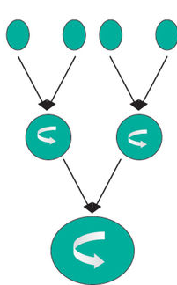
Effect of unresolved scales on resolved scales
Nonzero even if resolved dynamics modelled perfectly
  Needs to be accounted for in ensemble systems.
Upscale energy transfers (turbulent cascade).
  Addressed with ‘backscatter’ schemes (Berner et al 2009, http://dx.doi.org/10.1175/2008JAS2677.1)
’Location uncertainty’: unresolved motions resulting in uncertainty in the advection of resolved features
  Addressed with ‘randomized transport’ (Resseguier et al 2016, https://arxiv.org/abs/1611.03041)
Notes:
Of course, model dynamics uncertainity is nonzero even if the resolved dynamics is modeled perfectly. This is because the unresolved scales interact with the resolved scales. Traditionally this is though of in the context of upscale energy transfers, where nonlinear interactions between unresolved eddies project onto resolved scales. The theory behind this was developed in the 90’s by Leith and others, and led to the development of stochastic kinetic energy backscatter schemes, such as the one developed for the ECMWF IFS by Judith Berner. More recently, Ressguier and colleagues at Inria proposed that dynamics uncertainty can be framed as ’location uncertainty’ arising from the advection of resolved features by the unresolved flow. They developed a stochastic transport formulation that includes the effect of random subgrid-scale velocity pertrubations. These two approaches start from a different view of how subgrid scale variablity affects the resolved dynamics. Here I’m going to compare the two approaches, first in a simple turbulence model and then in the FV3 model now undergoing pre-operational testing at NCEP

Slide 3
A simple QG turbulence model testbed
‘surface quasi-geostrophic’ dynamics (SQG – Tulloch and Smith, 2009 DOI: 10.1175/2008JAS2921.1).
Differences with ‘regular’ QG are:
  Flow dies away from point vortex like r⁻¹ not r⁻².
  Turbulence is 3D-like, with shallower -5/3 KE spectrum, instead of -3.
  More energy at small scales, stronger inverse energy cascade.
Impact of unresolved scales on resolved scales stronger than in 2D QG turbulence – tougher test for model uncertainty parameterization.
Focus on atmospheric regime (scales at which baroclinic instability occurs fairly well resolved, just missing tail of spectrum).
Written with a few hundred lines of python, available at https://github.com/jswhit/sqgturb
Notes:
The simple model is a baroclinic sqg model (aka nonlinear eady turbulence, aka blumen model).
In contrast to the oceanic case, where main energy containing eddies are barely resolved.

Slide 4
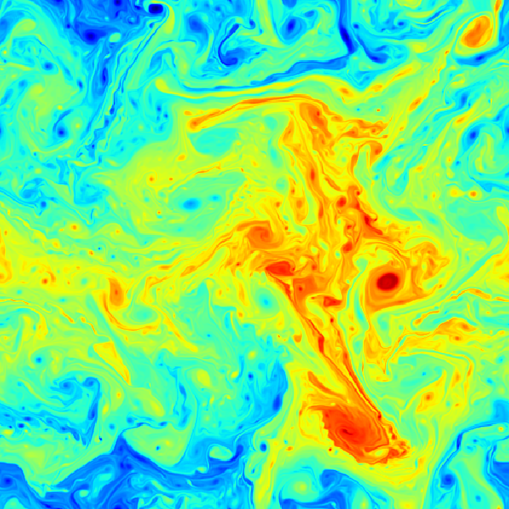
Movie of 512² solution: θ at z=H for 20 days
Notes:
Flow governed by advection of temperature at two boundaries, driven by relaxation to a cosine zonal jet with vertical shear. This is an animation of the temperature at the upper boundary
20,000 km square doubly periodic domain, dynamic range about 50K. Note the filaments becoming unstable and breaking up into mesoscale vorticies, these vortices merge into larger vortices – this is the upscale cascade. Pattern is fractal (looks the same if you zoom in, until you get near the truncation scale and dissipation dominates.)

Slide 5
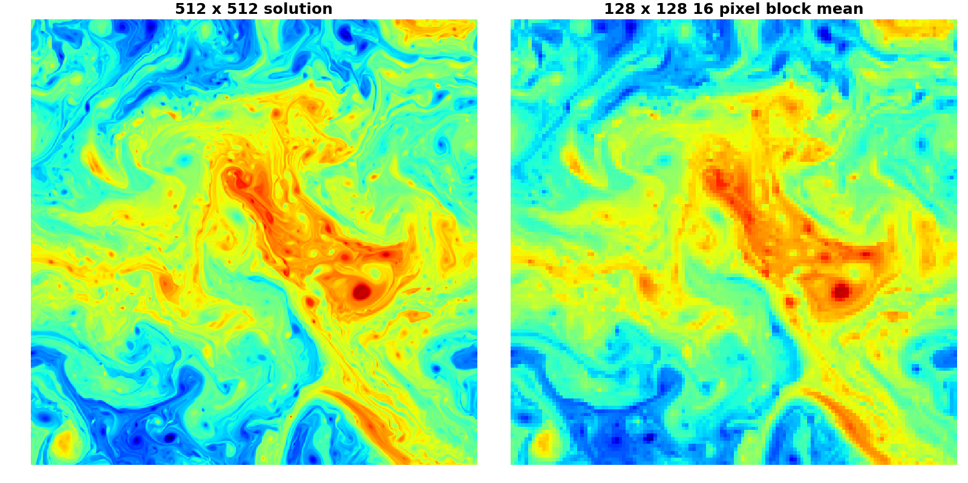
‘Upscaled’ solution
Notes:
128x128 model initialized with ‘upscaled’ 512x512 solution – forecast errors only due to effect of unresolved scales (resolved scales are initialized perfectly)

Slide 6
Model uncertainty parameterizations tested
Stochastic Kinetic Energy Backscatter (SKEB): random PV forcing scaled by diffusion magnitude – injects energy where it is being dissipated to simulate missing upscale energy transfer.
  Designed to represent the effect of nonlinear interactions between unresolved waves.
Randomized transport (RANTRAN): models location uncertainty by adding a random component to the velocity field used in advection.
  Designed to represent ‘location uncertainty‘ due to unresolved motions on the advection of resolved features.
3 tunable parameters: amplitude, spatial and temporal correlation scales.
  Using temporally correlated noise avoids the need for using a stochastic time integration scheme.
Test with
  Ensemble forecasts (10 members): every member starts from and is verified against upscaled ‘truth’.
  Hyper-diffusion set to accurately model KE spectrum down to truncation scale (e-folding time 12 hours, not 1.5 hours as in deterministic forecast).
Notes:
Easy to justify randomized transport since any sub-grid eddy tracer flux can be decomposed into a part that acts like advection of resolved tracer and a part that acts like downgradient transport, or mixing of the resolved tracer. Randomized transport deals only with the advective part and treats it stochastically.

Slide 7
Stochastic ensemble forecast results
Start forecasts from upscaled “truth” (no initial condition uncertainty), see how well estimated uncertainty matches actual forecast error (for scales resolved by model).
For randomized transport: Random streamfunction pattern converted to u and v, added to velocity used to compute advection of boundary θ. Acts as a multiplicative forcing (does nothing where gradient of θ is zero).
For SKEB: Random streamfunction pattern converted to PV (boundary θ) perturbation, modulated by diffusion estimate. Acts as a multiplicative forcing if diffusion estimate is state dependent.
Spatial and temporal correlations specified for Gaussian perturbations, with specified e-folding scales.

Slide 8
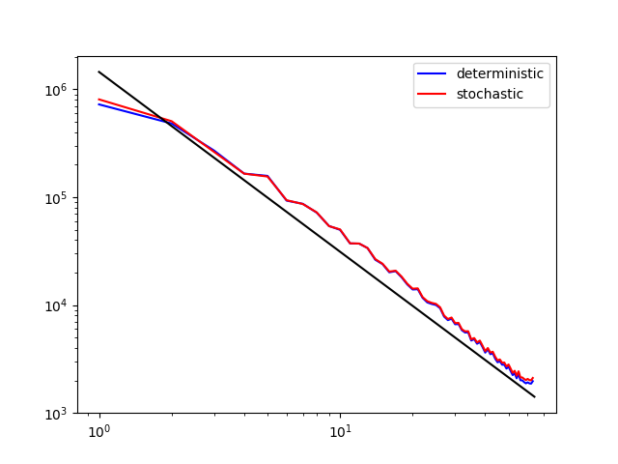
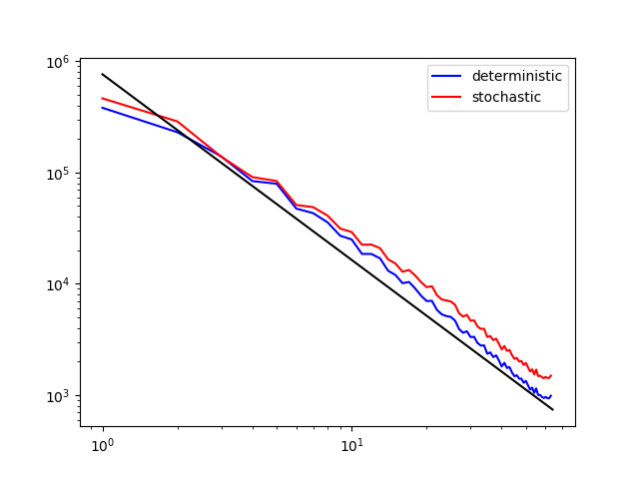
Spectra for 128x128 model (deterministic vs stochastic)
Randomized Transport
SKEB
Randomized transport does not change energy spectrum (SKEB injects energy at small scales).
Lower diffusion than 512x512 model, so no fall-off at tail end of spectrum.
Notes:
SKEBS may be more appropriate for marginally resolved eddies (ocean models), where much of energy spectra is missing because dynamics is not resolved and/or dissipated by numerics.

Slide 9
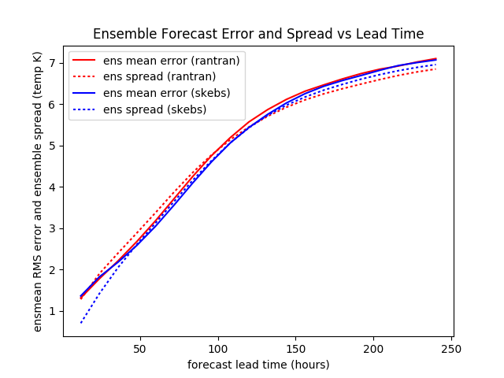
Ens mean error and spread (10 members) temporal corr = 3h, horizontal corr = 2Δx amplitudes tuned to calibrate spread/error at day 4
Faster initial spread growth for SKEB (due to energy injection at small scales?).
Difficult to calibrate spread/error at both long and short leads with a single spatial length scale in covariance. Longer lengths increase (decrease) spread at long (short) leads.
Notes:
Amp: skebs=5, rantran=2.75x10⁵
hcorr=2,tcorr=18,psi norm

Slide 10
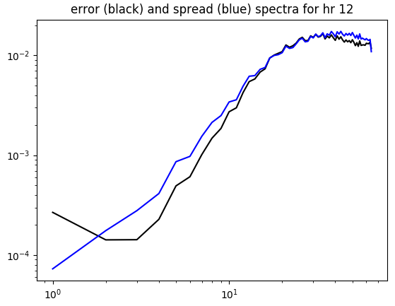
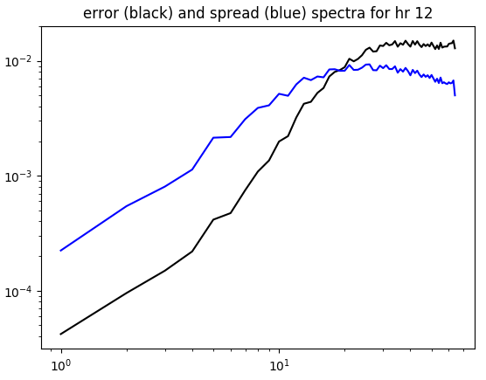
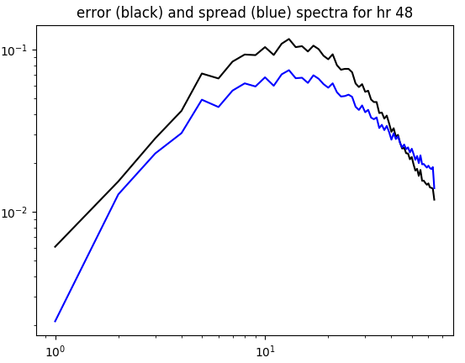
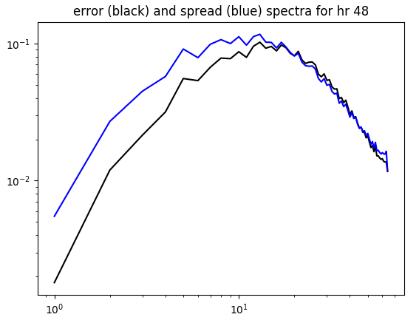
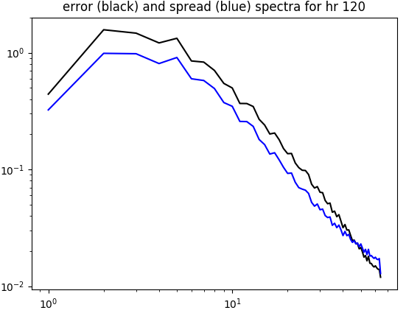
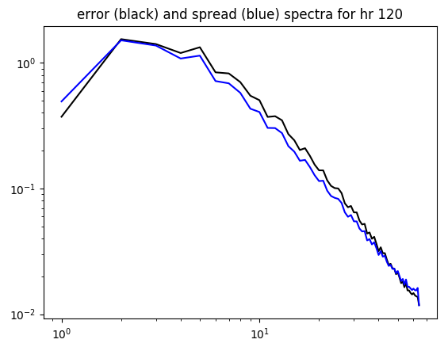
Error and Spread Spectra (Randomized Transport)
(12-h, hcorr=1Δx,3Δx)
(48-h, hcorr=1Δx,3Δx)
(120-h, hcorr=1Δx,3Δx)
both spread and error exhibit upscale cascade.
hcorr = 3Δx (1Δx) produces too much (not enough) spread at large scales for short leads.

Slide 11
Summary (simple model)
Both SKEBS and randomized transport appear to simulate model uncertainty due to unresolved dynamics well in this simple (but high-dimensional) model.
  In both cases, most of the modelled uncertainty appears to come from displacement of resolved features by unresolved motions
Randomized transport does not inject energy like SKEB. Initial spread growth faster with SKEB.
Randomized transport does not require a dissipation estimate (which can be expensive to compute every timestep, especially when a lot of smoothing is desired).
Randomized transport can easily be applied to all tracers, not just (potential) vorticity equation.
Both require amplitude, spatial scales to be tuned carefully to get accurate calibration for short and long forecast leads (need multiple scales?). Relatively insensitive to temporal scale (if >> Δt).

Slide 12
Implementation in FV3
Finite-volume discretization (Lin and Rood 1997, Lin 2004). Transport calculations utilize C-grid staggered winds (interpolated from D-grid winds to compute fluxes).
Random non-divergent C-grid winds with specified correlation structure added added to interpolated C-grid winds when computing fluxes.
Fluxes of potential temperature, mass, humidity, vertical vorticity, hydrometeors and ozone are perturbed.
A single random pattern of streamfunction is used to generate random winds – no vertical structure. No smoothed dissipation estimate needed.

Slide 13
FV3 experiments
31 5-day 20 member forecasts run every 00UTC from 1 Jan to 31 Jan 2014 at ~50 km resolution using operational GFS EnKF initial conditions.
3 experiments:
  Control (no stochastic component)
  RANTRAN (randomized transport). 250 km/6-h correlation scales.
  SKEB. 250 km/6-h correlation scales using smoothed kinetic energy numerical dissipation estimate.

Slide 14
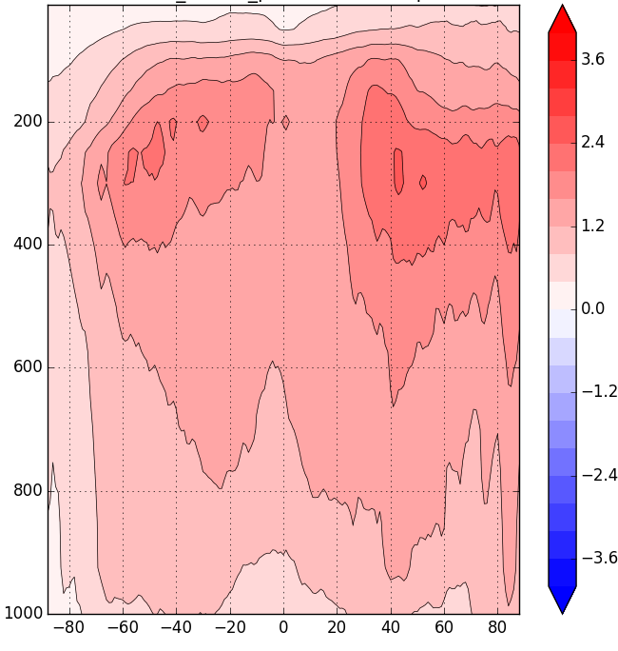
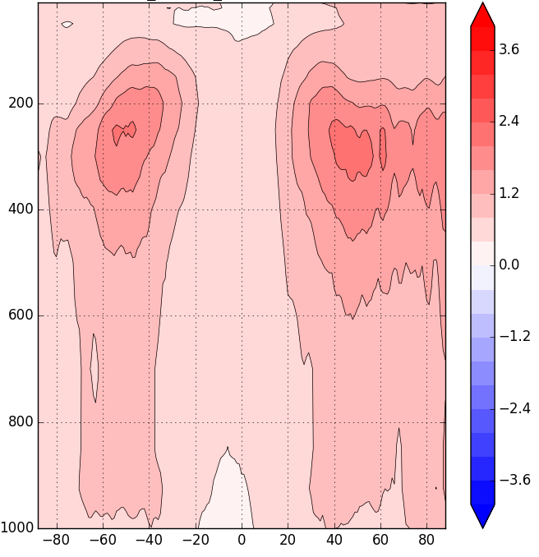
U spread difference day 5
(relative to control)
SKEB
RANTRAN
Notes:
Both increase spread mainly in mid-lat jet/storm track regions.

Slide 15
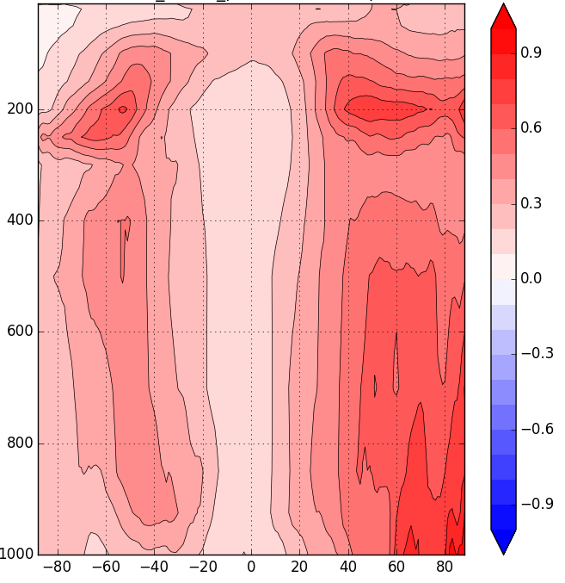
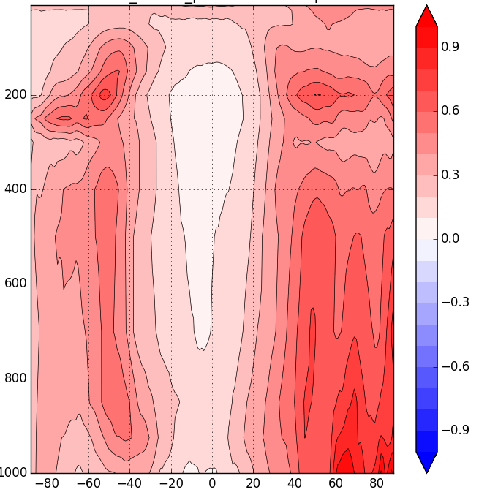
T spread difference day 5
(relative to control)
SKEB
RANTRAN
Notes:
Effect on temp greater for rantran - unlike SKEBS it acts directly in thermo equation (SKEBS only in momentum equation)

Slide 16
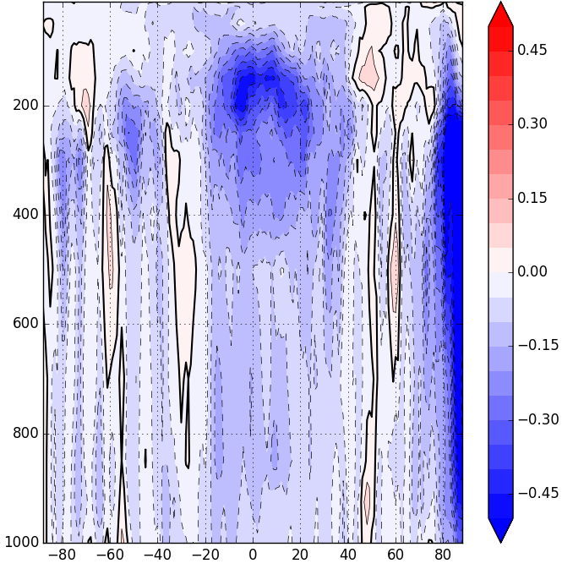
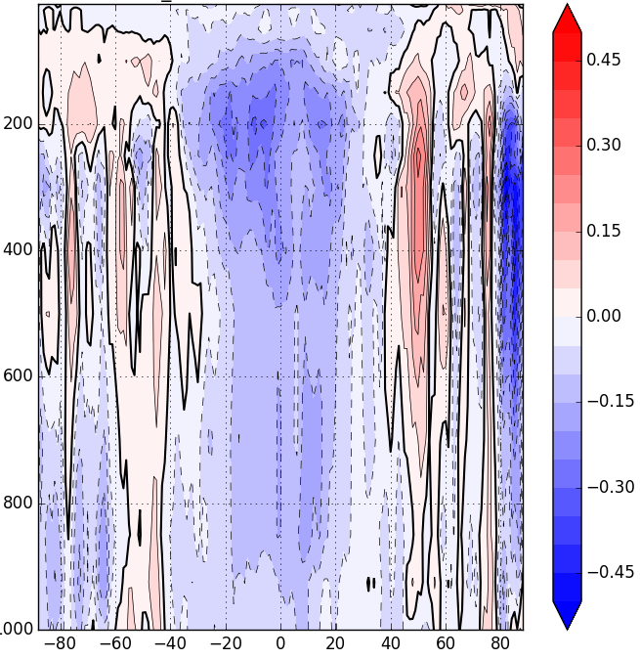
Ensemble mean vector wind RMS error differences (relative to control)
SKEB
RANTRAN
Notes:
Both decrease ensemble mean error, esp in tropics where ensemble is very under-dispersive.

Slide 17
Data assimilation results
Experiments: C192 (~50 km) single-res hybrid 4DEnVar with FV3GFS.
  Control: no stochastic physics, relaxation-to-prior spread inflation (α=0.85)
  SPPT/SHUM: Add SPPT and perturbed boundary layer humidity schemes.
  SPPT/SHUM/SKEB
  SPPT/SHUM/RANTRAN
Look at effect on ensemble spread in 6-hour background forecast, innovation statistics.

Slide 18
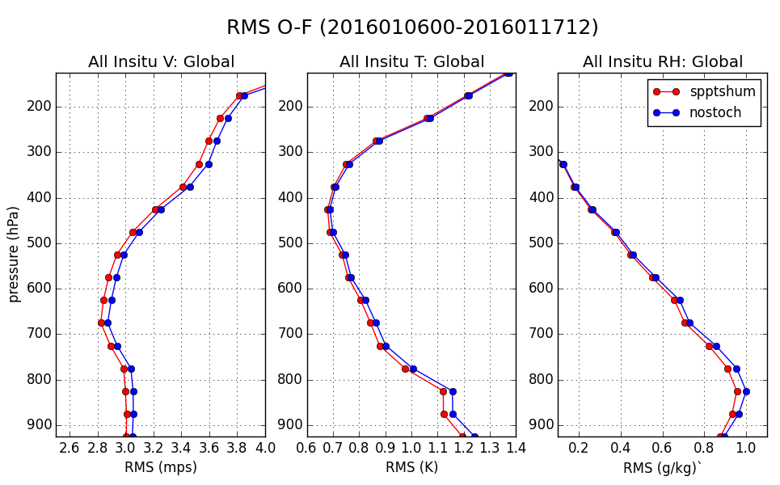
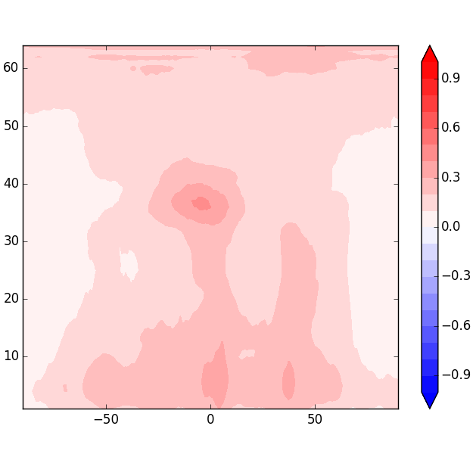
Control vs SPPT/SHUM
(left innov stats, right spread difference)
Wind spread difference
SPPT+SHUM - nostoch
model level
latitude
Notes:
Adding sppt, shum has a positive impact, spread increases are modest and maximized in tropics.

Slide 19
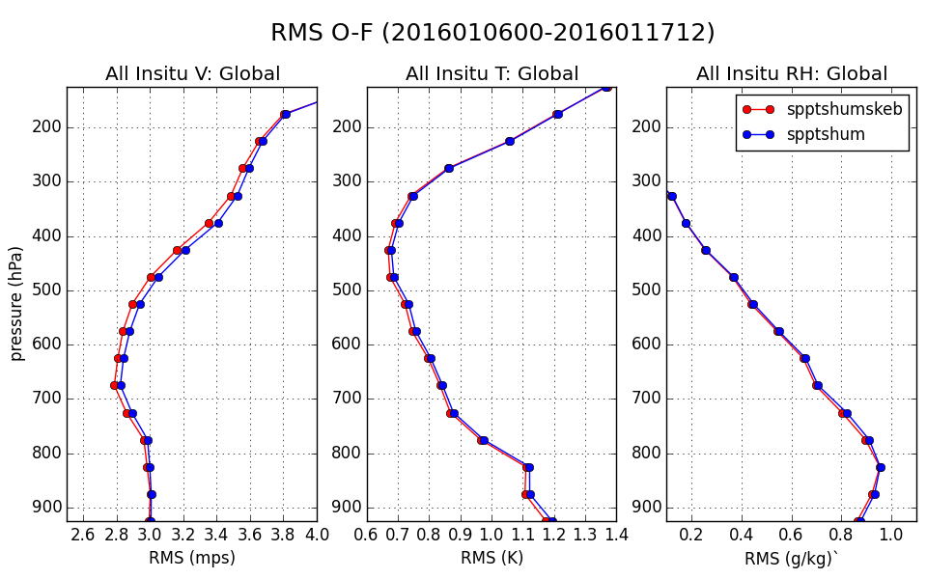
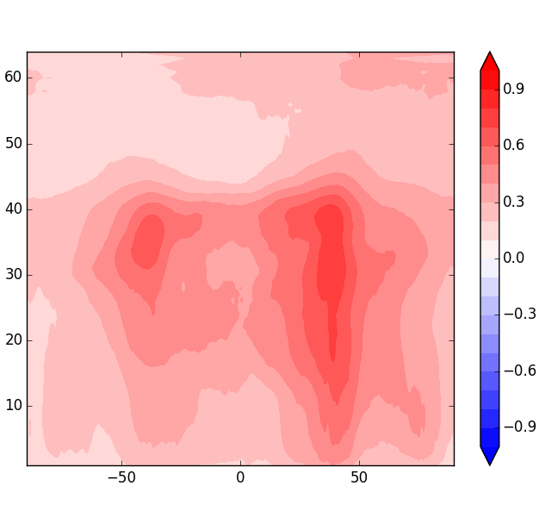
SPPT/SHUM vs SPPT/SHUM/SKEB
(left innov stats, right spread difference)
Wind spread difference
SPPT+SHUM+SKEB – SPPT+SHUM
model level
latitude
Notes:
Adding SKEB increases wind spread in regions of high dissipation (around jets, but also in tropics). Improves fit to wind obs.
SKEB=0.65, tau=6-h,L=250km

Slide 20
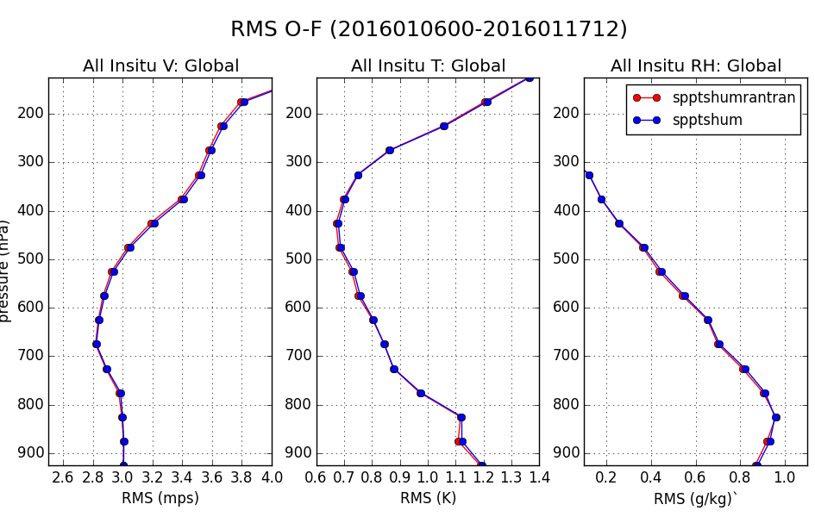
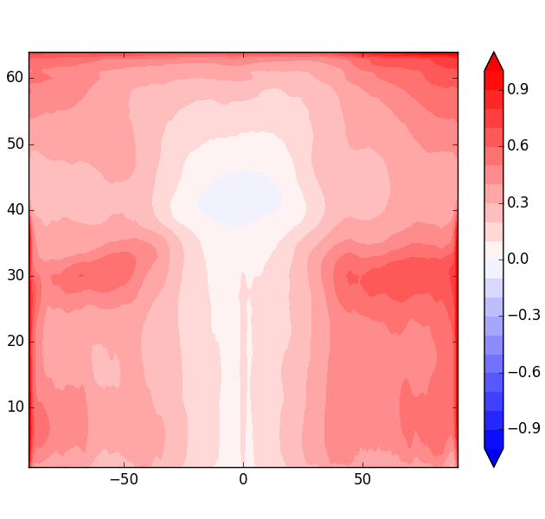
SPPT/SHUM vs SPPT/SHUM/RANTRAN
(left innov stats, right spread difference)
Wind spread difference
SPPT+SHUM+RANTRAN – SPPT+SHUM
model level
latitude
Notes:
Randomized transport increases spread everywhere in extratropics, not much in tropics. Mysterious increase in upper atmosphere (even though random patterns are tapered to zero above 150 hPa)
RNDA=3

Slide 21
Summary (FV3 model)
Randomized transport is a viable alternative to SKEB for parameterizing uncertainty in unresolved dynamics.
Slightly simpler and cheaper to implement.
  No dissipation estimate needed (no smoothing required).
Assumes uncertainty comes from the effect of unresolved motions on the advection of resolved scales (somewhat different than backscatter).
Initial cycling DA experiments do not show an improvement over SKEB, although the geographical distribution of spread produced by the two schemes is different.
  SKEB spread more localized in regions of high dissipation
How to specify statistics of sub-grid motions?
  Should amplitude of random winds depend on resolved quantities?

Slide 22
Backup slides

Slide 23
The numerical model
Square doubly-periodic domain (20000 km on a side).
Linear thermal relaxation of cos(2*pi*y/L) boundary θ field with a time scale of 10 days.
8th-order hyper-diffusion of boundary θ.
Fourier spectral method with RK4 time differencing – nonlinear terms de-aliased using 3/2 rule.

Slide 24
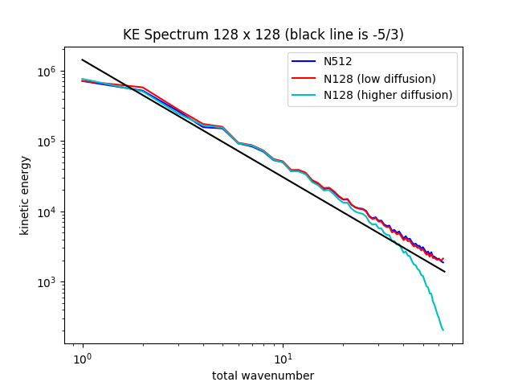
Kinetic Energy Spectrum 128²
Notes:
Diffusion in 128x128 model tuned to give the best representation of 512x512 spectrum. Ensemble forecasts run with different representations of model uncert (no spread in initial condition).
Low diffusion – efolding time scale 12 hours
High diffusion – efolding time scale 1.5 hours
(N512 used ½ hour)
Min RMS error diffusion does not produce best estimate of spectrum – missing variability near truncation scale (bad for ensembles)
High diffusion produces lower RMS errors in deterministic forecasts, lower diffusion produces better spread/error calibration and lower ens mean RMS errors in ensemble forecasts.
In ensembles, unpredictable small scales will be uncorrelated within the ensemble, will average out in the ensemble mean.

Slide 25
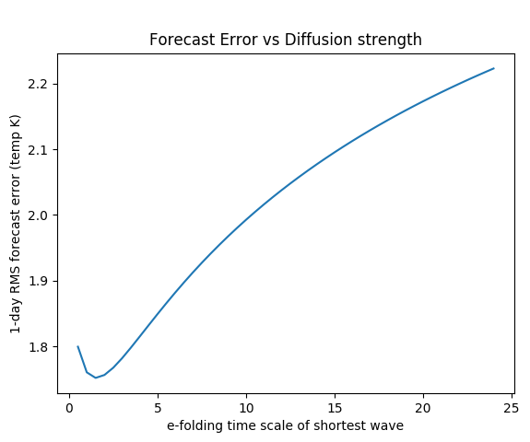
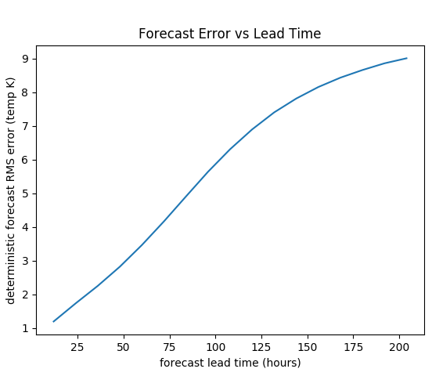
Deterministic Forecast Errors
Single 128² forecast initialized from ‘upscaled’ 512² soution.
Left: 1 day forecast error as a function of 8-th order hyper-diffusion magnitude (e-folding time scale of shortest resolvable wave).
Right: Forecast error vs lead time using minimum error diffusion.
Notes:
Min error diffusion time scale 1.5 hours 0.6-0.7K
Error saturates at around day 10 (growth nearly linear at about 1.2K per day for 1st 5 days). Error doubles in 36-h.

Slide 26
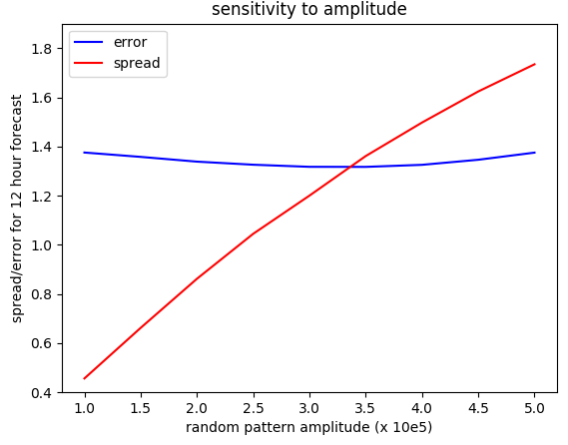
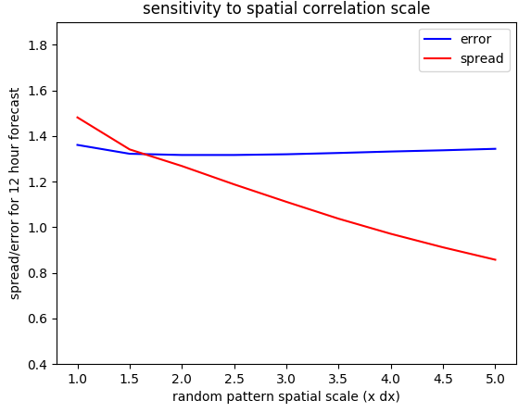
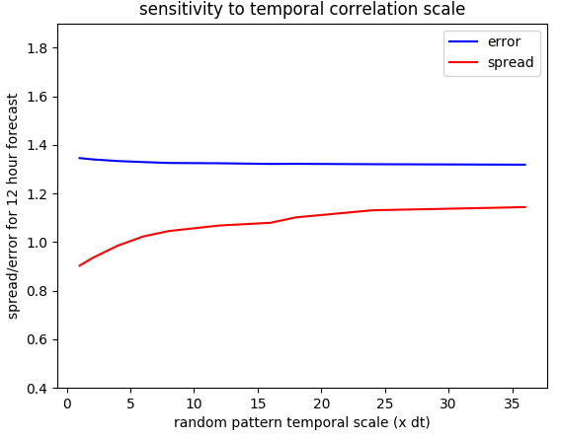
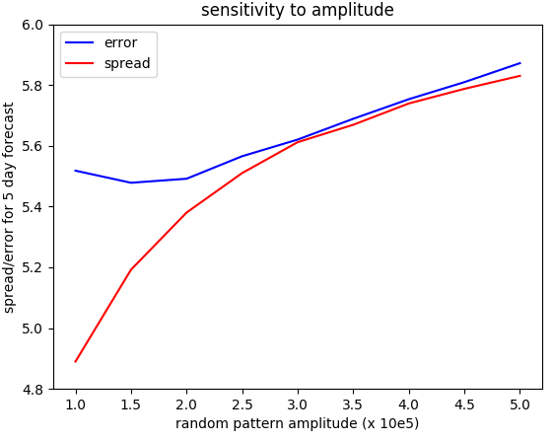
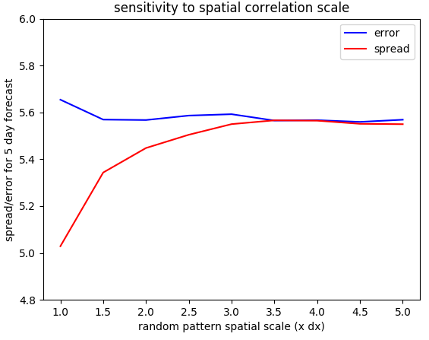
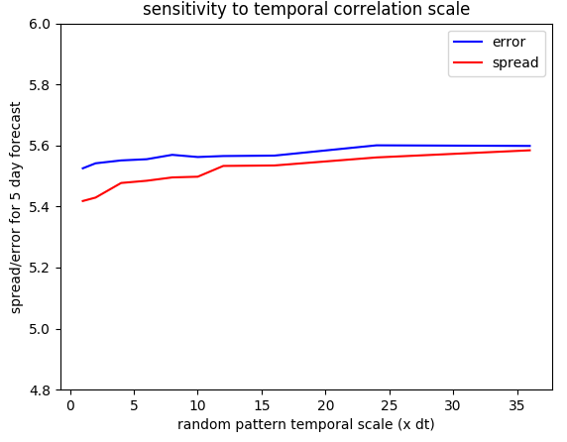
Sensitivity to amplitude, spatial and temporal scales of random patterns (top row 12-h, bottom row 120-h)
hcorr=3Δx,tcorr=3h
A=2.7,tcorr=3h
A=2.7, hcorr=3Δx
Notes:
Not very sensitive to time scale. Sensitivity to spatial scale different at short and long leads. Increasing amplitude beyond 2.0 increases ensemble mean error.

Slide 27
Randomized Transport
Notes:
a is expected KE of random velocity divided by time step. Drift correction is zero if a is homogeneous (div(a) = 0).
Derivation assumes random velocity is white in time – we relax this and model random velocity as an AR1 process with a specified temporal autocorrelation.
Diffusion term is very small, negligible in this case.

Slide 28
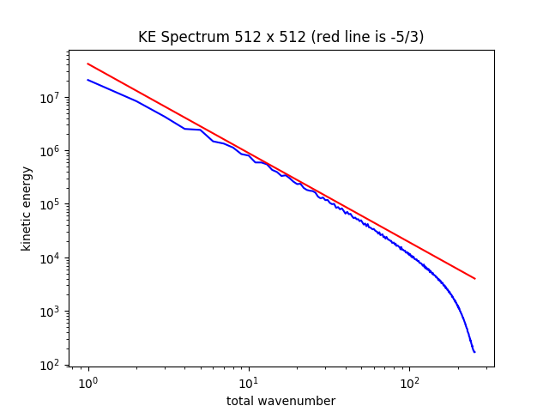
Kinetic Energy Spectrum 512²
Notes:
Spectrum very close to -5/3 power law, except at small scales where numerical diffusion kicks in

Slide 29
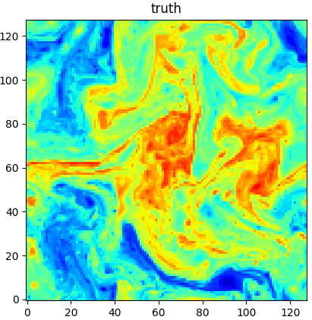
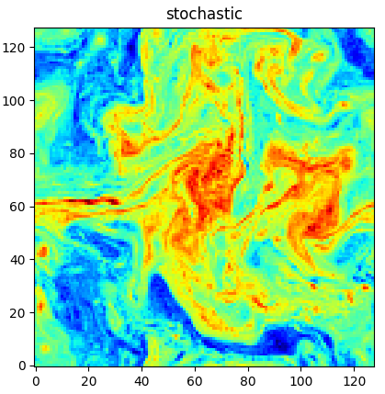
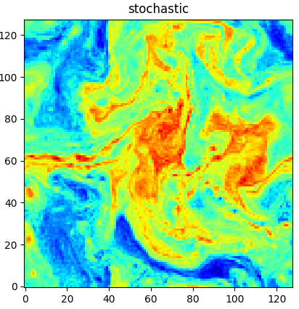
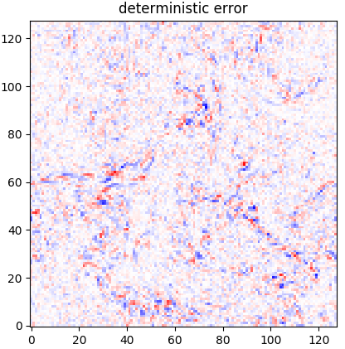
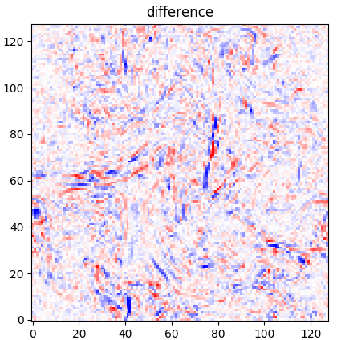
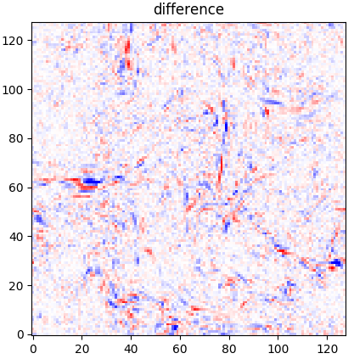
Example 1 day forecast
SKEB
Randomized Transport
Notes:
Randomized transport 2.5e5, skebs 10
Hcorr,tcorr = 2,18 for both
Much of spread in SKEB coming from displacement of resolved features
Actual error looks more like feature displacements, as does randomized transport. SKEBS also includes a ‘bath’ of background noise (consistent with spectrum).

Slide 30
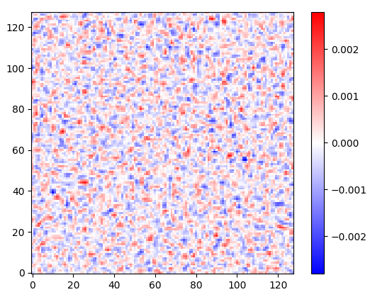
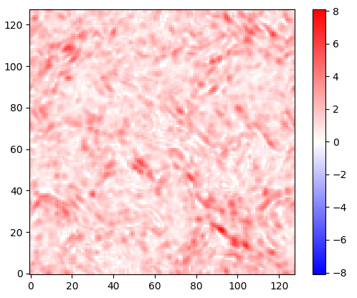
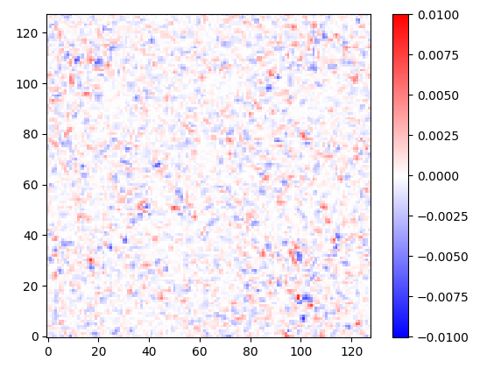
Stochastic Kinetic Energy Backscatter SKEB
Random PV pattern
Dissipation estimate
SKEBS PV forcing
X
=
Notes:
Random pv pattern can be created in PV or PSI norm. Gaussian smoother for dissip estimate has same scale as random pattern.

Slide 31
Randomized Transport
Add a random component to advecting velocity
https://hal.inria.fr/hal-01391420, https://hal.inria.fr/hal-013914276
Notes:
Noise-induced rift and diffusion terms in Resseguier papers are neglected. Drift term is mathematically zero since variance of unresolved velocity is homogeneous.
Diffusion term found to be much smaller than explicit numerical diffusion – and Cecile has pointed out that it disappears if Stratanovich calculus is used instead of Ito to derive the stochastic transport equations. (Kunita 1990 section 3.3)
Also, unlike the Resseguier formulation we use red (not white) noise process used to define random velocity which greatly simplifies the numerical implementation.

Slide 32
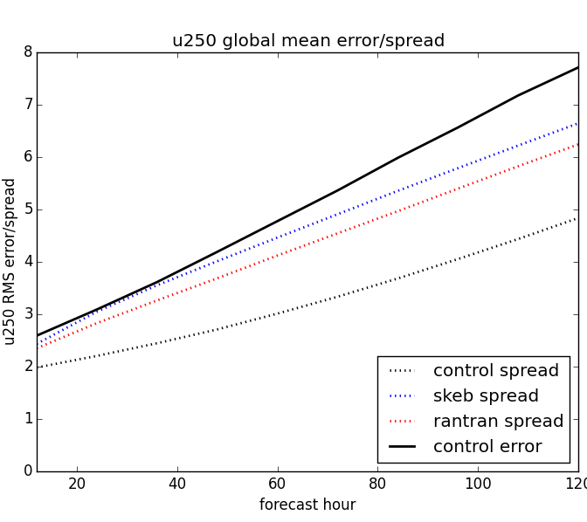
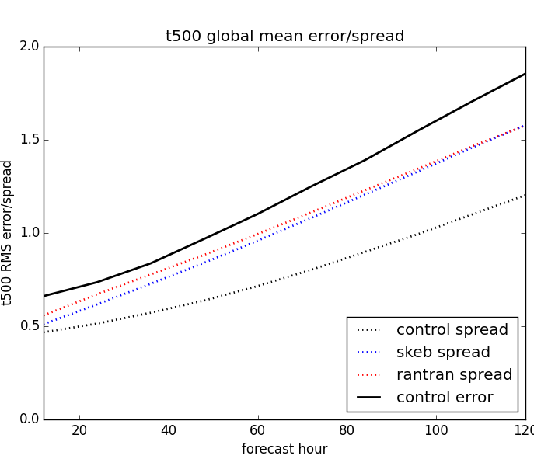
Global mean error/spread
• faster wind spread growth initially for SKEB
• relatively more spread in temperature for RANTRAN
Notes:
Even with SKEBS or RANTRAN, ensemble is under-dispersive (to be expected since we are not treating physics errors here)

