Slide 1


Recent applications of the hybrid particle-ensemble Kalman filter in Lagrangian data assimilation
Laura Slivinski¹, Amit Apte², Elaine Spiller³
¹CIRES/NOAA/ESRL; Boulder, Colorado
²TIFR International Centre for Theoretical Sciences; Bangalore, India
³Marquette University; Milwaukee, Wisconsin
laura.slivinski@noaa.gov

Slide 2
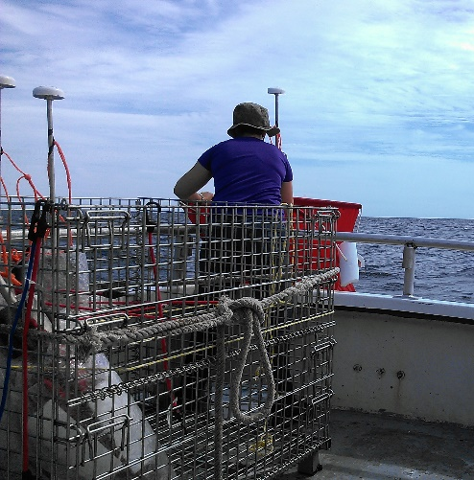
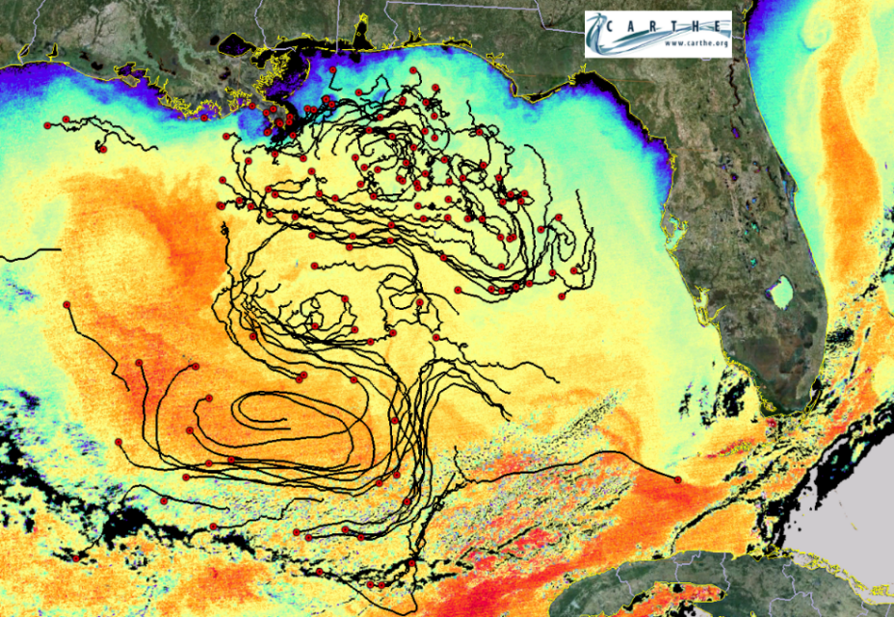
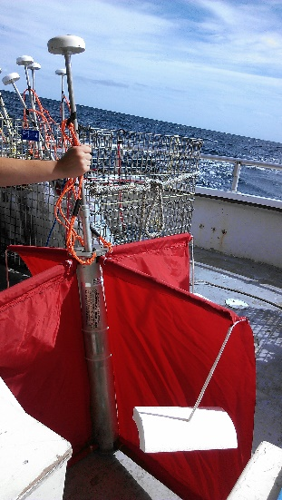
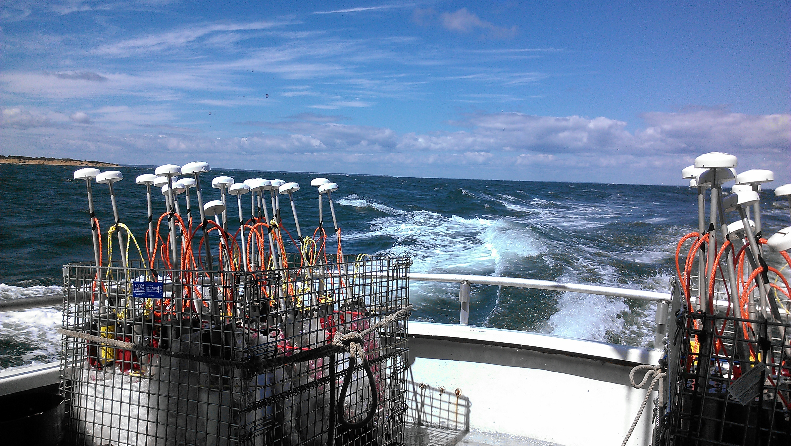
Lagrangian Data Assimilation – assimilate trajectories from passive drifters to estimate the underlying currents

Slide 3
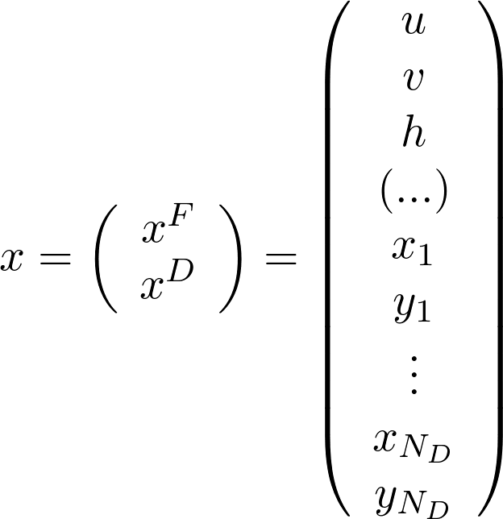
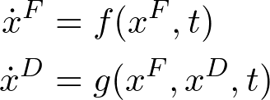
Fully Lagrangian data assimilation
Directly use drifter position data in order to estimate flow variables
(eg. velocity)
Augmented vector approach – include drifters as variable in state vector
Observation operator:
H = [ 0 I ]
Kuznetsov et al (2003)

Slide 4
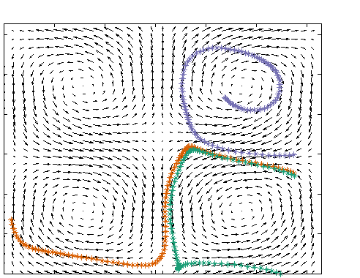
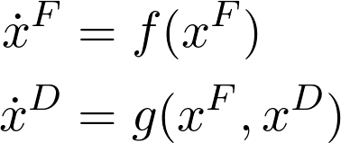
Non-linearity and non-Gaussianity
Lagrangian data assimilation can lead to non-Gaussian priors
Flow may solve linear system, but drifters solve nonlinear system:
y
[linear or nonlinear]
x
[often nonlinear]
Trajectories from linear shallow water equations

Slide 5
Particle Filter (PF)
Weighted ensemble members (“particles”)
Assimilation step updates the weights (according to Bayes’ Rule)
Even with large ensemble, particle filter methods require resampling to avoid weight converging on single particle
x
time

Slide 6
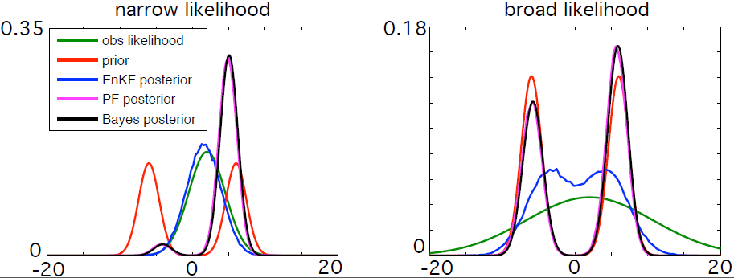
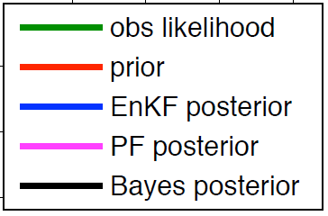
Non-linearity and non-Gaussianity
Lagrangian data assimilation can lead to non-Gaussian priors
Flow may solve linear system, but drifters solve nonlinear system:
y
[linear or nonlinear]
[often nonlinear]
x
Trajectories from linear shallow water equations

Slide 7
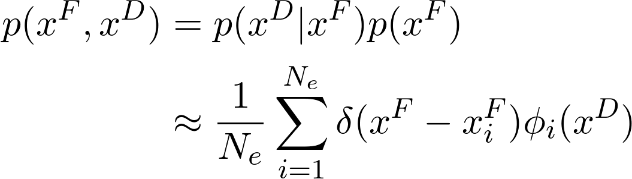
Motivation: hybrid grid/particle filter
H. Salman (2008), A hybrid grid/particle filter for Lagrangian data assimilation
Use laws of conditional probability to decompose and approximate joint distribution

Slide 8

Motivation: hybrid grid/particle filter
H. Salman (2008), A hybrid grid/particle filter for Lagrangian data assimilation
Use laws of conditional probability to decompose and approximate joint distribution
Approximate with ensemble of realizations

Slide 9

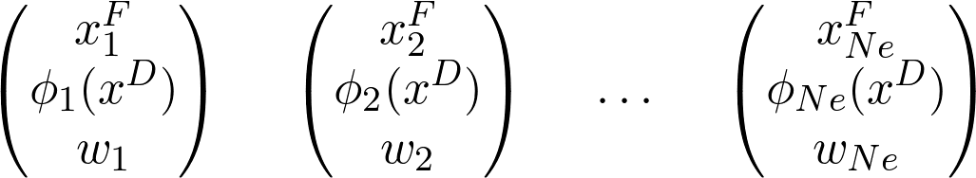
Hybrid grid/particle filter
Particle filter on flow variables
Exact probability density function on drifter variables:
Particle weights defined in terms of drifter pdf
Salman (2008)

Slide 10
Hybrid particle-ensemble Kalman filter
Disadvantages of grid/particle filter:
Requires enough particles to estimate (possibly high-dimensional) flow variable
Solving exact drifter pdf’s can be computationally intensive

Slide 11
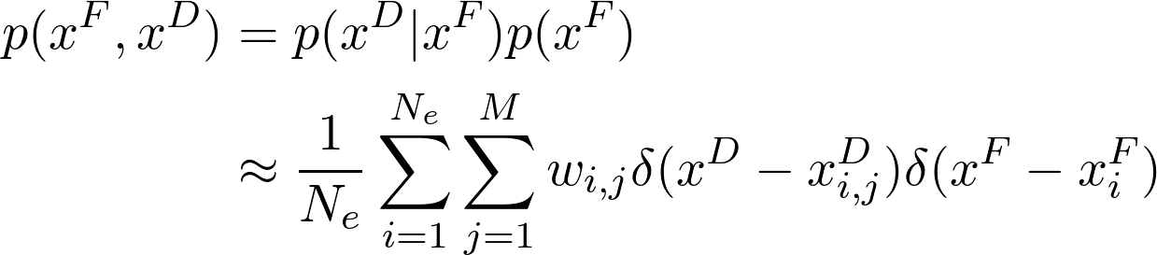
Hybrid particle-ensemble Kalman filter
Disadvantages of grid/particle filter:
Requires enough particles to estimate (possibly high-dimensional) flow variable
Solving exact drifter pdf’s can be computationally intensive
Further approximation: replace exact drifter distribution with weighted ensemble
Slivinski et al (2015)

Slide 12
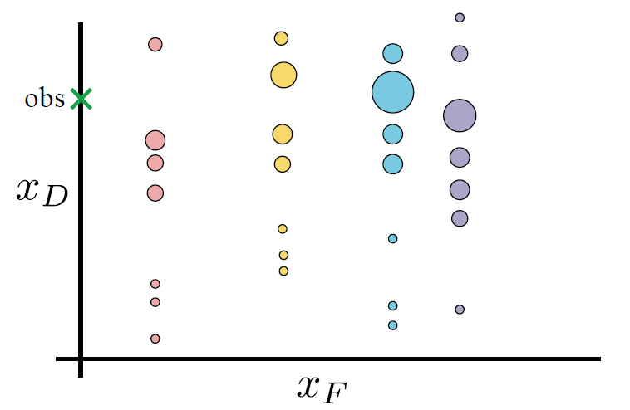
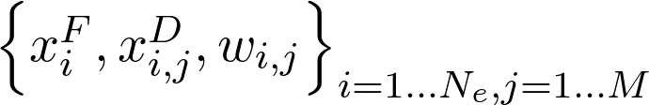
EnKF on flow, PF on drifters

Slide 13
EnKF on flow, PF on drifters
Update weights via standard particle filter update, and at resampling times, update flow according to EnKF analysis.

Slide 14
Hybrid PF-EnKF algorithm
Forecast
Update weights via standard PF methods. Monitor “effective ensemble size” N_{eff.}
When N_{eff} falls below threshold:
  update flow ensemble members using EnKF (weighted covariances).
  update drifter weights.
  resample flow ensemble and drifter ensemble (separately) to reset weights to equal.
Repeat

Slide 15
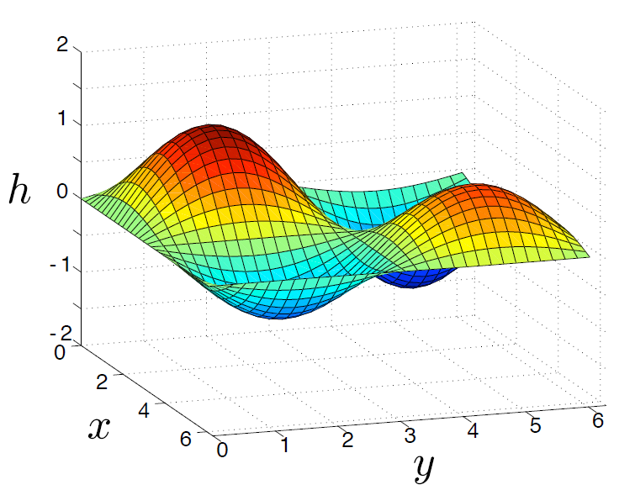
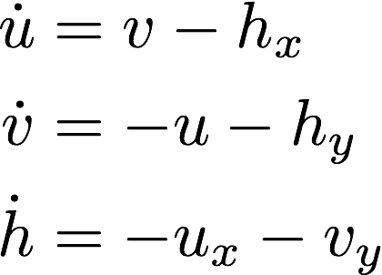
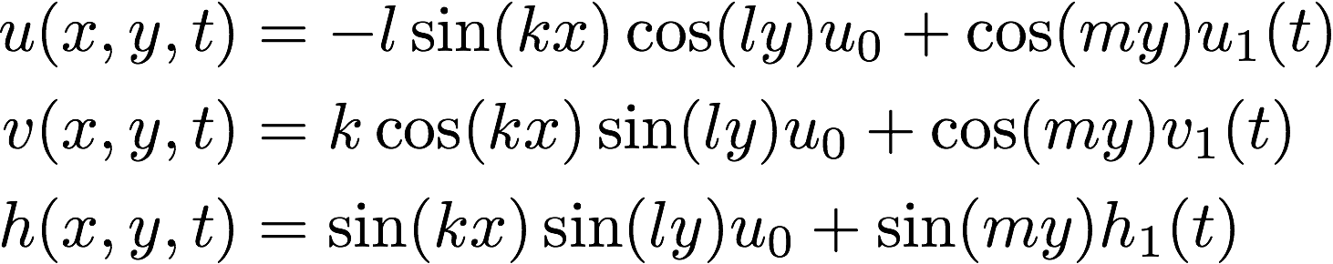
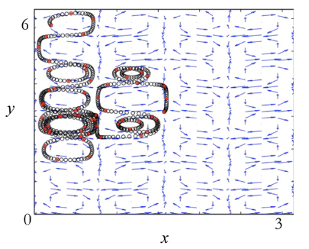
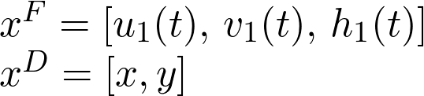
Low-dimensional example: linear shallow water equations
system:
(periodic B.C.)
solution:
estimate:
k=l=m=4
High observation frequency – black circles
Low observation frequency – red dots

Slide 16
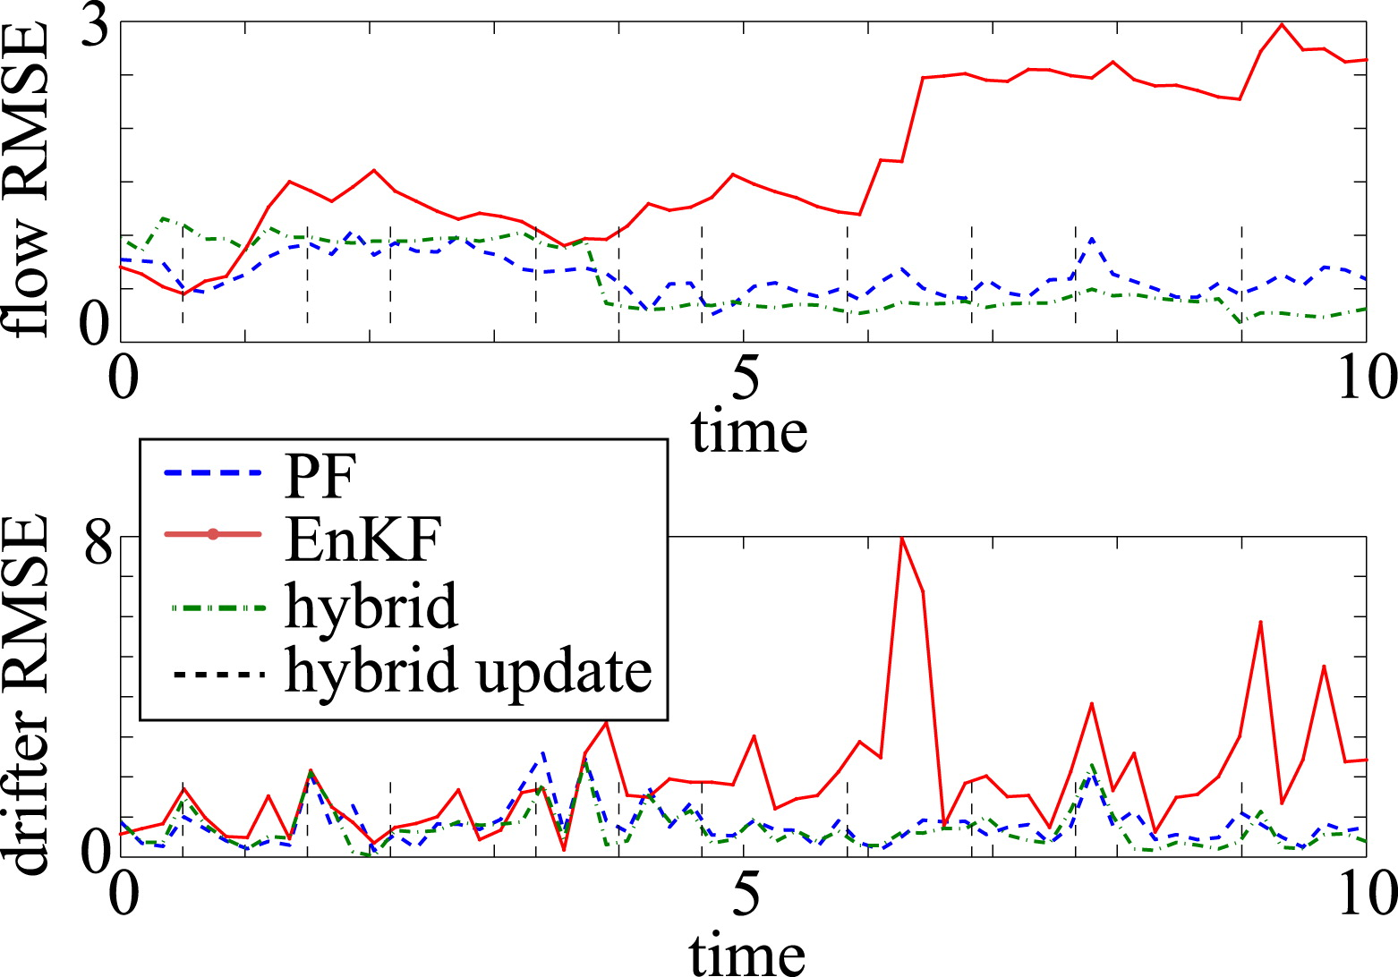
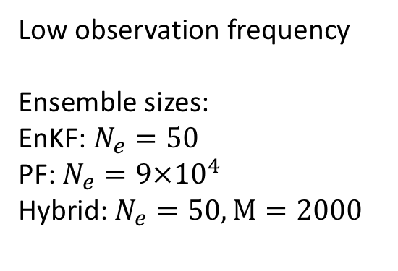
Low-dimensional example: linear shallow water equations
Low observation frequency
Ensemble sizes:
EnKF: $N_{e}=50$
PF: $N_{e}={9×10}^{4}$
Hybrid: $N_{e}=50,M=2000$
Slivinski et al (2015)

Slide 17
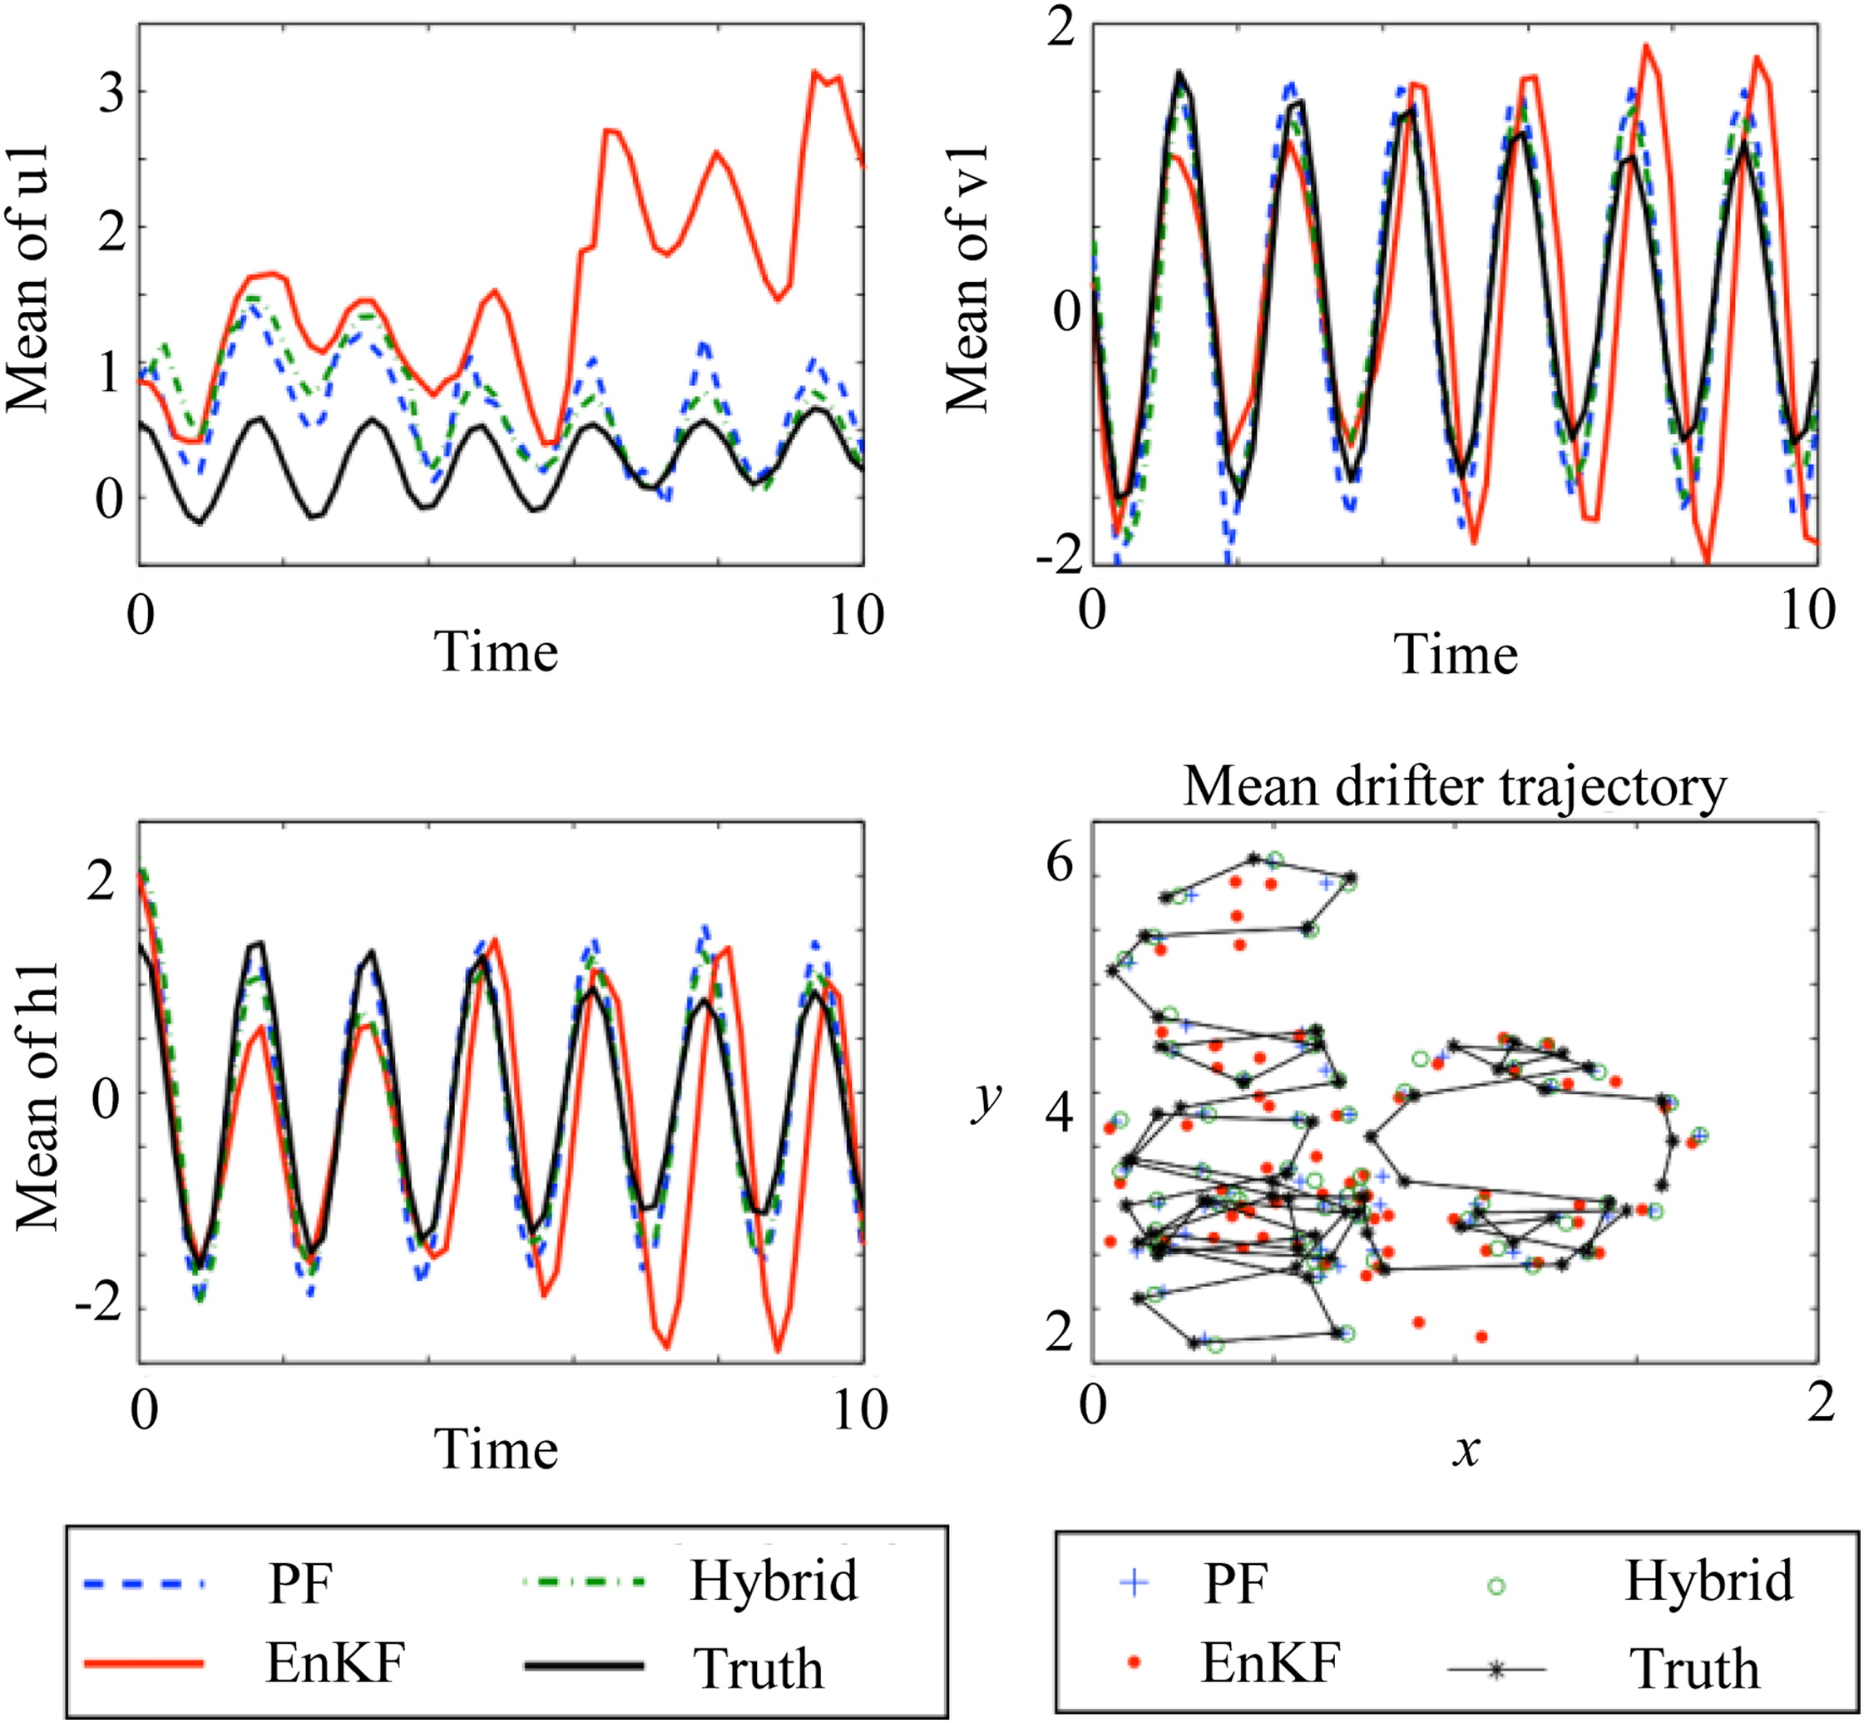
Low-dimensional example
Slivinski et al (2015)

Slide 18
Low-dimensional example
Hybrid tracks both flow and drifter;
EnKF does not.
Slivinski et al (2015)

Slide 19
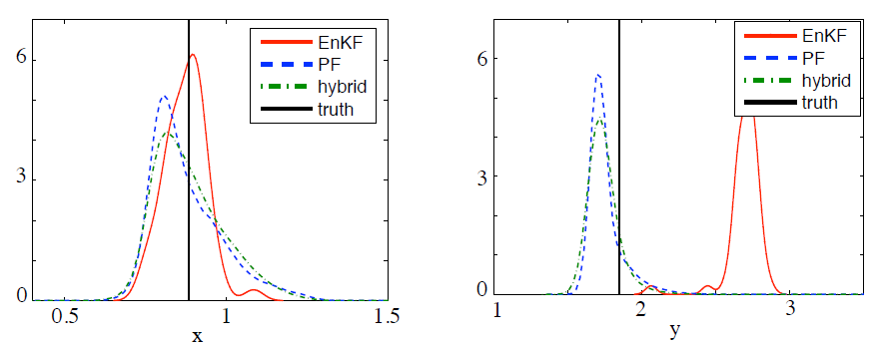
A look at drifter PDFs (one assimilation step)
probability
x
y

Slide 20
A look at drifter PDFs (one assimilation step)
probability
x
y

Slide 21
Considerations in high-dimensional flows
Generating initial flow ensemble
  don’t want to just add spatial white noise to velocity field
  sample in time from a long “climatology”; use different forcing for ensemble vs truth
Resampling from high-dimensional flow ensemble
  need to avoid multiple copies of same flow
Multiple drifters
  curse of dimensionality
  what happens in hybrid algorithm when drifters get close to each other?

Slide 22
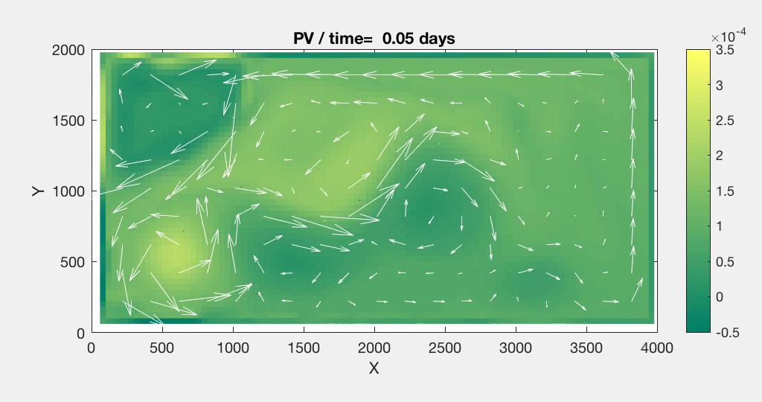
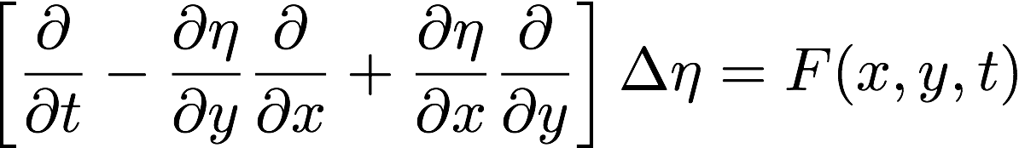

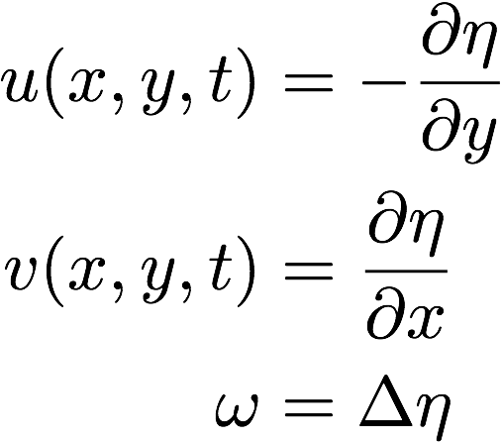

High dimensional example: quasi-geostrophic double gyre flow
= surface height,
Velocity (u,v) and vorticity
No-slip BC, 100x50 grid
G. Roullet (2013) 2D versatile model
http://stockage.univ-brest.fr/~roullet/codes.html
shading represents vorticity; arrows represent velocity.

Slide 23
High dimensional example: quasi-geostrophic double gyre flow
= surface height,
Velocity (u,v) and vorticity
No-slip BC, 100x50 grid
G. Roullet (2013) 2D versatile model
http://stockage.univ-brest.fr/~roullet/codes.html
shading represents vorticity; arrows represent velocity.

Slide 24
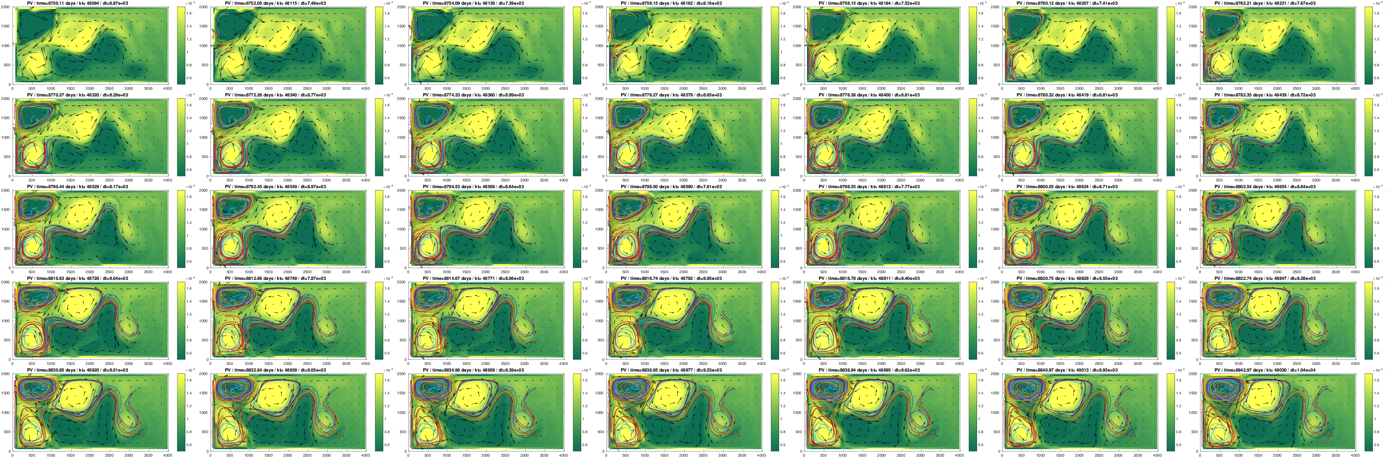
Considerations in high-dimensional flows
Generating initial flow ensemble
  don’t want to just add spatial white noise to velocity field
  sample in time from a long “climatology”; use different forcing for ensemble vs truth

Slide 25
Considerations in high-dimensional flows
Generating initial flow ensemble
  don’t want to just add spatial white noise to velocity field
  sample in time from a long “climatology”; use different forcing for ensemble vs truth
Resampling from high-dimensional flow ensemble
  need to avoid multiple copies of same flow
    “reorganize” hybrid algorithm
Multiple drifters
  curse of dimensionality
  what happens in hybrid algorithm when drifters get close to each other?

Slide 26
Updated Hybrid PF-EnKF algorithm
Forecast
Update weights via standard PF methods. Monitor “effective ensemble size” N_{eff.}
When N_{eff} falls below threshold:
  resample flow ensemble, then update flow members using EnKF (weighted covariances). [avoids perturbation of copies of flow]
  update drifter weights and resample.
  reset weights to equal.
Repeat

Slide 27
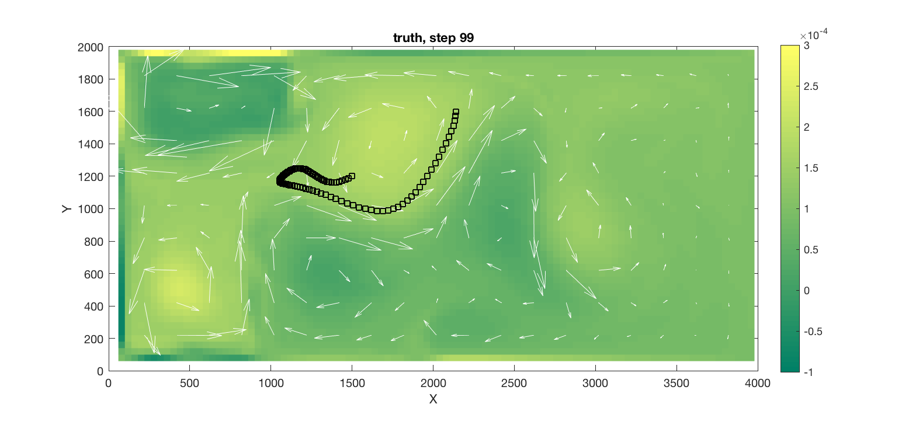
High-dimensional results – single drifter
Relative kinetic energy error of ensemble means
True flow at end of window; true drifter trajectory
1
2e6
3e-4
Free run
EnKF
Hybrid PF-EnKF
s⁻¹
0
0
100
Observation
0
-1e-4
4e6
localization (EnKF) = 5e6
localization (hybrid) = 5e5
shading represents vorticity; arrows represent velocity.
△t = 0.5*day, ob error = 1e3
Notes:
relative KE error of ens mean (wrt truth) – FORECAST
In this case where drifter approaches saddle point (kind of), and time between obs is “.5 days”, error is 1e3 (much less than autocorrelation time scale), hybrid does better than enkf.

Slide 28
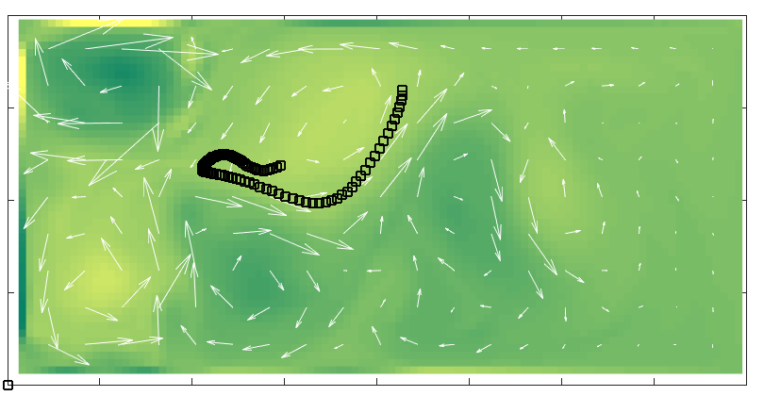
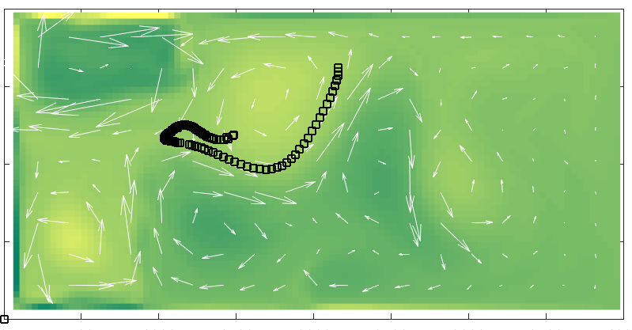
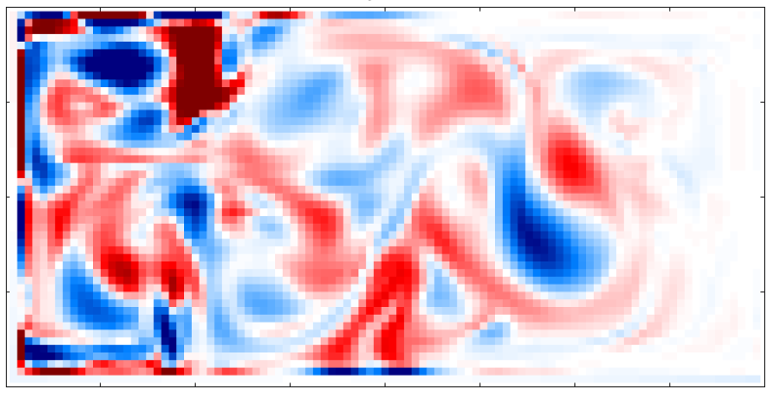
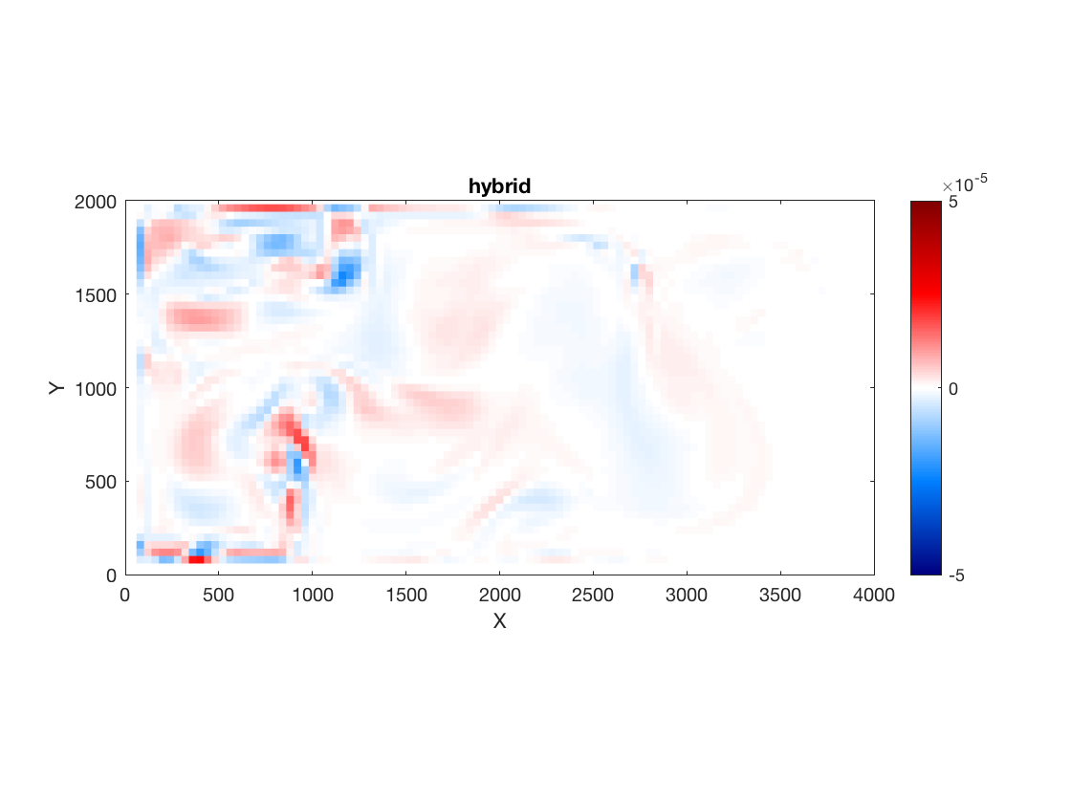
High-dimensional results – single drifter
3e-4
Truth
EnKF
Hybrid
s⁻¹
1e-4
EnKF ensemble mean minus true vorticity;
end of assimilation window
Hybrid ensemble mean minus true vorticity;
end of assimilation window
-1e-4
5e-5
0
s⁻¹
-5e-5
Notes:
Though the mean fields don’t look that different, the difference felds demonstrate the errors. (caveat: not showing ensemble spread. Preliminary results suggest that the hybrid may have collapsed onto essentially one member, and thus is under-spread.)

Slide 29
Considerations in high-dimensional flows
Generating initial flow ensemble
  don’t want to just add spatial white noise to velocity field
  sample in time from a long “climatology”; use different forcing for ensemble vs truth
Resampling from high-dimensional flow ensemble
  need to avoid multiple copies of same flow
    “reorganize” hybrid algorithm
Multiple drifters
  curse of dimensionality
  what happens in hybrid algorithm when drifters get close to each other?

Slide 30
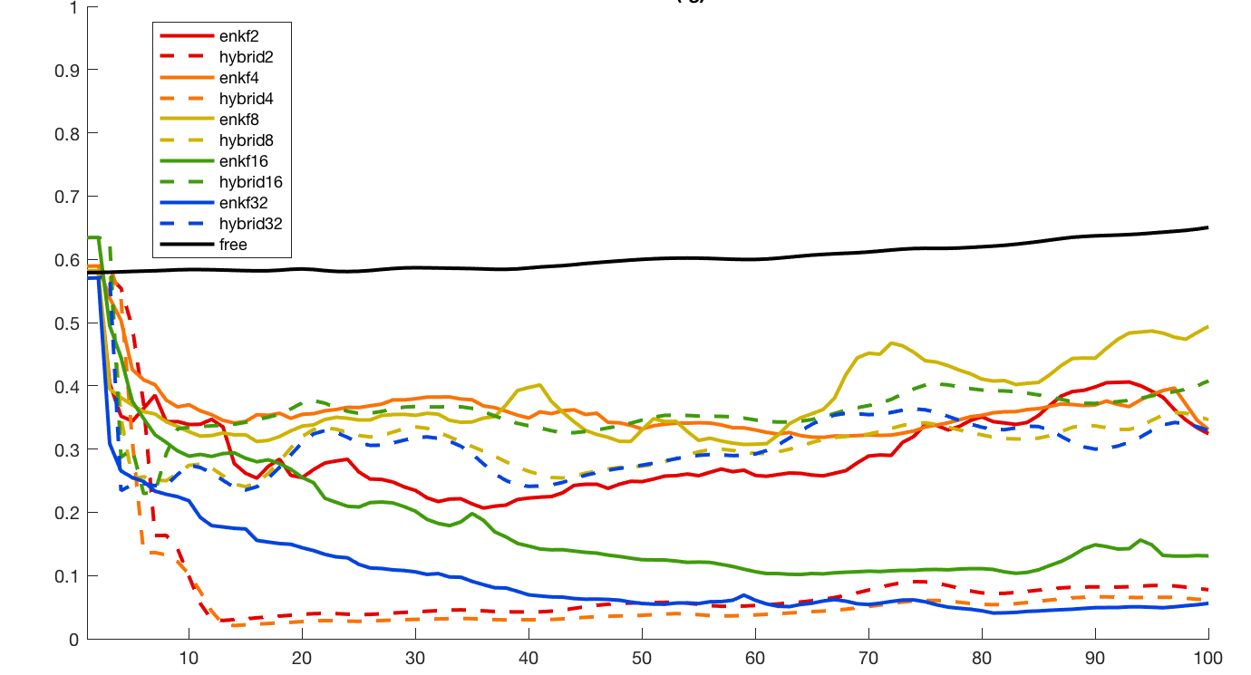
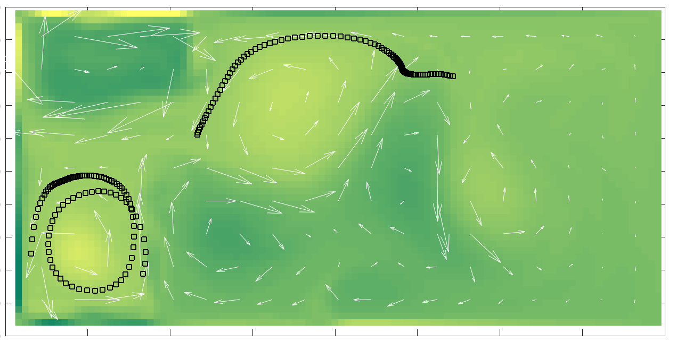
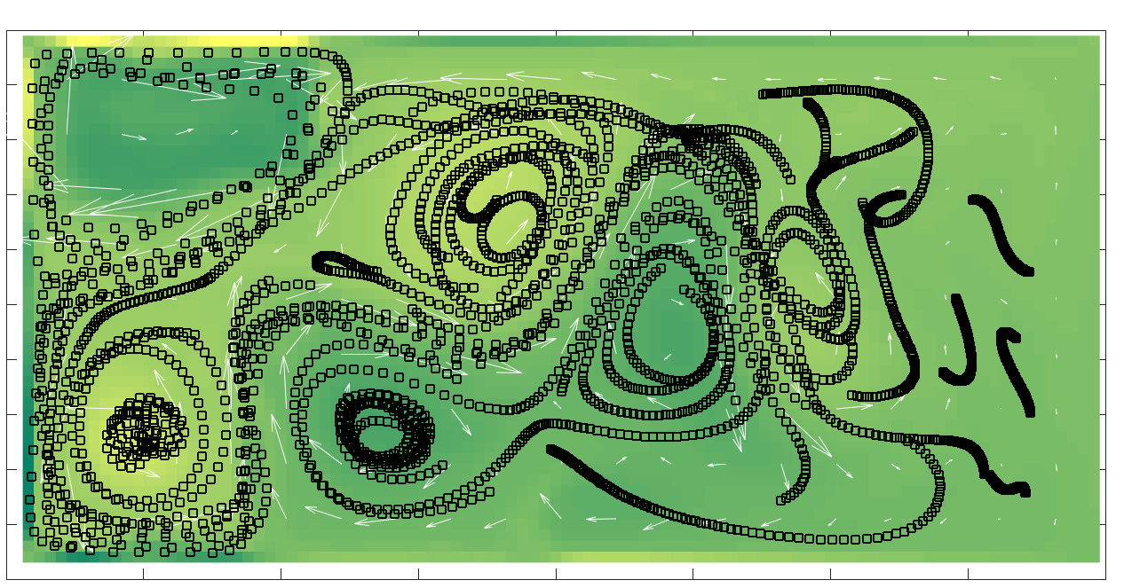
High-dimensional results – multiple drifters
Solid: EnKF
Dashed: Hybrid
Black: free run (no assim.)
num. drifters = 2, 4, 8, 16, 32
△t = 0.5*day, ob error = 1e3
Relative kinetic energy error
2 drifters
Observation
32 drifters
Notes:
As number of drifters increases, the enkf is able to do better (for relatively small delta t)
The hybrid, with its naïve implementation for multiple drifters, does not improve with increasing drifters.
Need to improve hybrid algorithm to handle many drifters
Further experiments would then be completed, similar to low dim case, for increasing time between obs. Expect enkf to begin to break down in this case, hopefully hybrid will not.

Slide 31
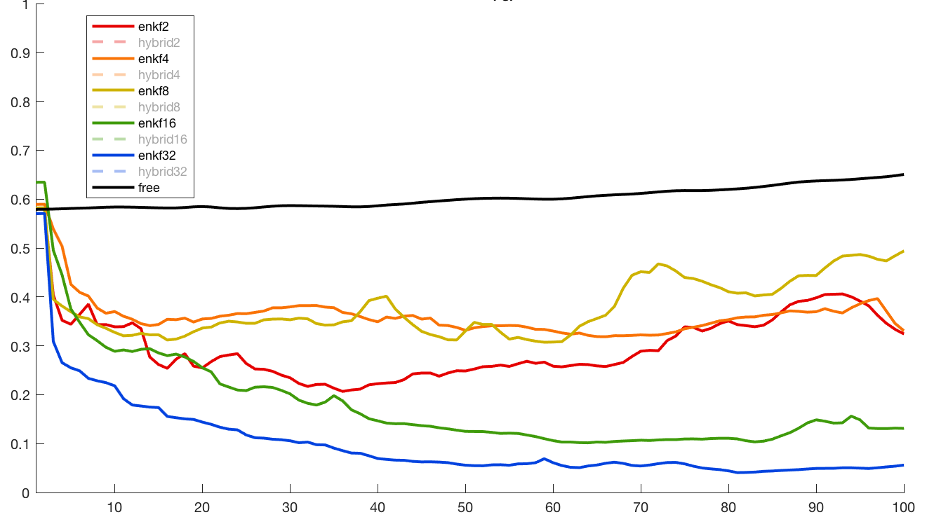
High-dimensional results – multiple drifters
Solid: EnKF
Dashed: Hybrid
Black: free run (no assim.)
num. drifters = 2, 4, 8, 16, 32
△t = 0.5*day, ob error = 1e3
Relative kinetic energy error
As the number of drifters increases, the performance of the EnKF improves. (More spatial information is available.)
Observation
Notes:
As number of drifters increases, the enkf is able to do better (for relatively small delta t)
The hybrid, with its naïve implementation for multiple drifters, does not improve with increasing drifters.
Need to improve hybrid algorithm to handle many drifters
Further experiments would then be completed, similar to low dim case, for increasing time between obs. Expect enkf to begin to break down in this case, hopefully hybrid will not.

Slide 32
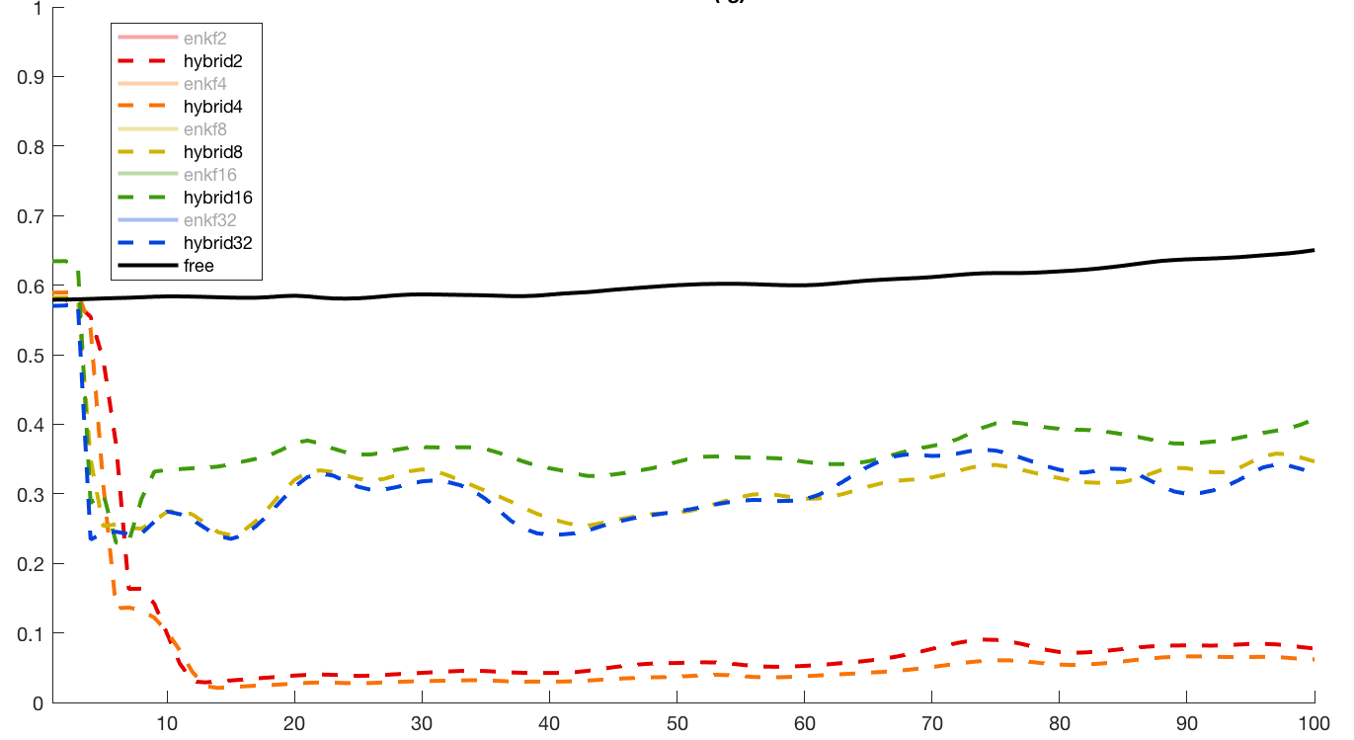
High-dimensional results – multiple drifters
Solid: EnKF
Dashed: Hybrid
Black: free run (no assim.)
num. drifters = 2, 4, 8, 16, 32
△t = 0.5*day, ob error = 1e3
Relative kinetic energy error
The performance of the hybrid filter degrades with more drifters.
Need to improve the hybrid filter’s handling of multiple drifters.
Address collapse of ensemble.
Observation
Notes:
note: enkf uses decreasing localization as N_D increases, but hybrid keeps rel. large loc radius (less localization)
Further experiments would then be completed, similar to low dim case, for increasing time between obs. Expect enkf to begin to break down in this case, hopefully hybrid will not.

Slide 33
Summary
Lagrangian data assimilation uses full information about drifter trajectories, but methods must handle strong nonlinearity.
The hybrid filter combines advantages of EnKF and PF.
Successfully tested on low-dimensional simple model – greatest gain in performance when time between obs is long.
Ongoing applications to high-dimensional models
  Multiple drifters: can curse of dimensionality be avoided? should weights have a spatial structure?
  Experiments with increasing time between observations

Slide 34
Summary
Lagrangian data assimilation uses full information about drifter trajectories, but methods must handle strong nonlinearity.
The hybrid filter combines advantages of EnKF and PF.
Successfully tested on low-dimensional simple model – greatest gain in performance when time between obs is long.
Ongoing applications to high-dimensional models
  Multiple drifters: can curse of dimensionality be avoided? should weights have a spatial structure?
  Experiments with increasing time between observations
Thank you!

Slide 35
Extra slides

Slide 36
References
L. Kuznetsov, K. Ide, and C. K. R. T. Jones (2003). A method for assimilation of Lagrangian data. Mon. Wea. Rev. 131:2247 – 2260.
H. Salman (2008). A hybrid grid/particle filter for Lagrangian data assimilation. Q. J. R. Meteorol. Soc. 134:1539 – 1550.
L. Slivinski, E. Spiller, A. Apte, and B. Sandstede (2015). A hybrid particle-ensemble Kalman filter for Lagrangian data assimilation. Mon. Wea. Rev. 143(1):195 – 211.
laura.slivinski@noaa.gov

Slide 37
High-dimensional results
Notes:
relative KE error of ens mean (wrt truth)

Slide 38
Num. drifters = 1
Num. drifters = 8
Num. drifters = 32

Slide 39
Ensemble covariance; obs step 75

Slide 40
Notes:
Obstep=75

Slide 41
Lagrangian Data Assimilation – assimilate trajectories from passive drifters to estimate the underlying currents

Slide 42
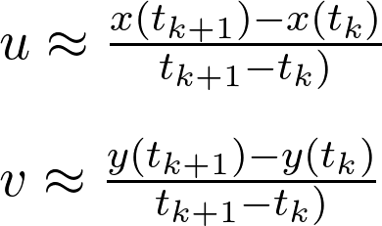

What it is not (pseudo-Lagrangian DA)
Approximate velocities as finite differences of subsequent drifter locations
Valid for short times between observations
Doesn’t use info about full drifter trajectory

Slide 43
What it is (fully Lagrangian DA)
Directly use drifter position data in order to estimate flow variables
(eg. velocity)
Augmented vector approach – include drifters as variable in state vector
Observation operator:
H = [ 0 I ]
Kuznetsov et al (2003)

Slide 44
What it is not (pseudo-Lagrangian DA)
Approximate velocities as finite differences of subsequent drifter locations
Valid for short times between observations
Doesn’t use info about full drifter trajectory

Slide 45
Traditional DA algorithms
Ensemble Kalman Filter (EnKF) | Particle Filter (PF)
Unweighted ensemble | Weighted ensemble
Updated ensemble members | Update weights
Can work well in high dimensions | Suffers from the “curse of dimensionality”
Based on a Gaussian scheme | Directly approximates Bayes’ rule

Slide 46
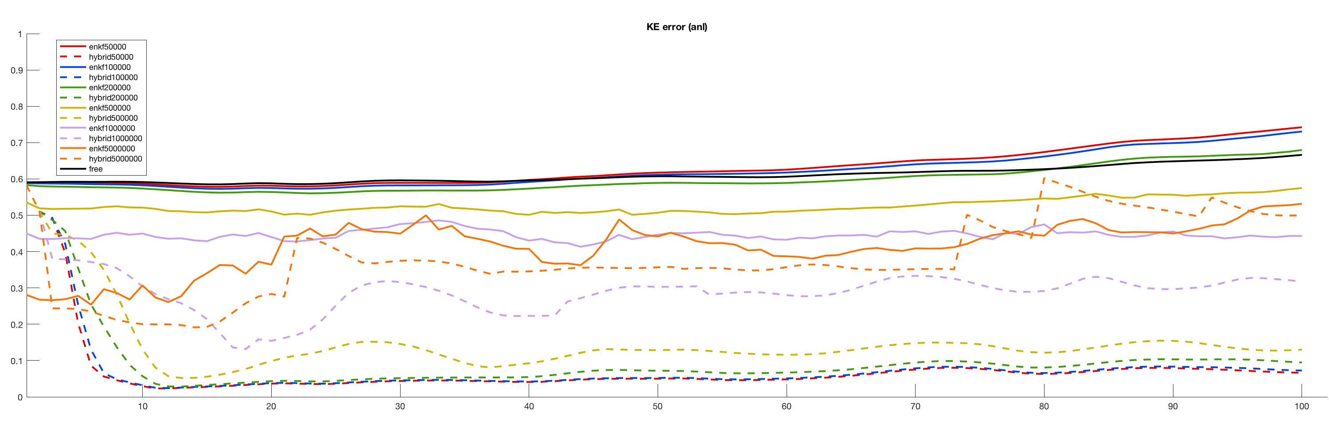
High-dimensional results
Notes:
relative KE error of ens mean (wrt truth)

