Slide 1
Incorporating Prior Knowledge in Observability-Based Path Planning for Ocean Sampling
Kayo Ide, University of Maryland
Frank Lagor and Derek Paley, University of Maryland
Art Krener, US Naval Postgraduate School
David Groff, University of Maryland, NOAA/NCEP, STC
8th EnKF Workshop
May 2018

Slide 2
Background
Motivation: Lagrangian observation in ocean
Observability algorithms
Applications to Lagrangian path planning
Implications to Lagrangian observing system design for data assimilation and autonomous vehicle control
Concluding Remarks

Slide 3
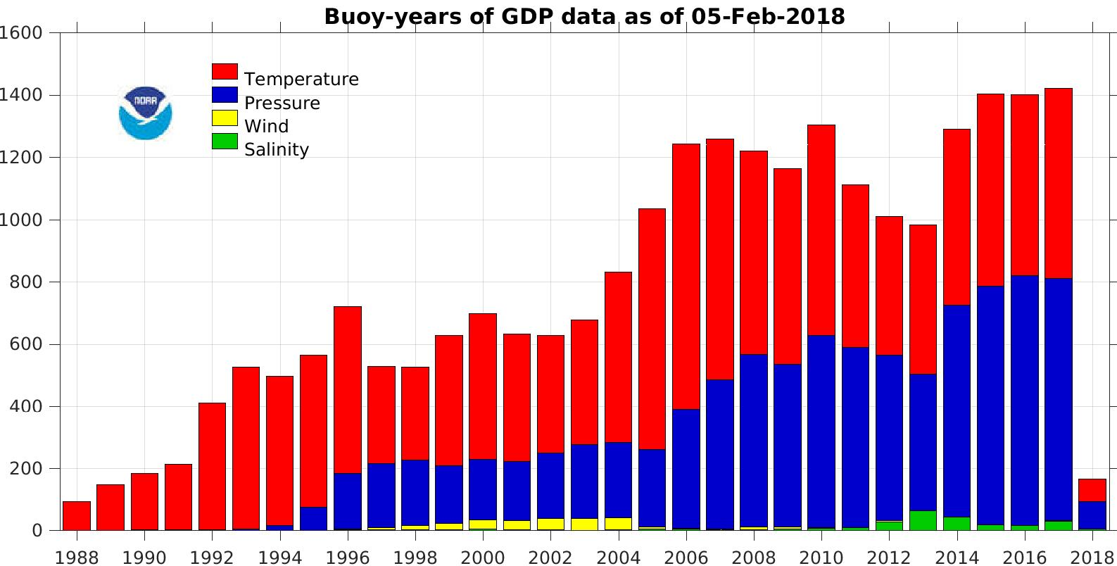
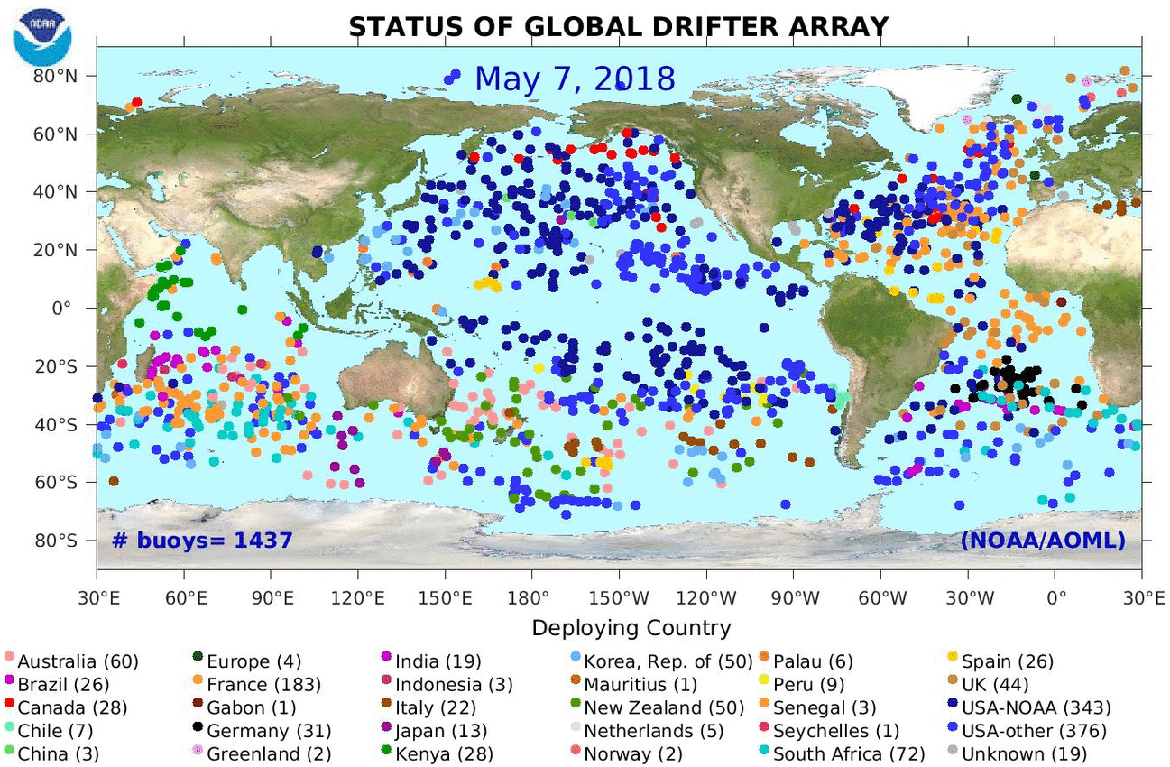
Global Ocean Observing System by Drifters
Global Data Product: 1250 drifters ~ 5ºx5º resolution
Drifters are used as the platform of T (SLP, Wind)
http://www.aoml.noaa.gov/phod/dac/gdp.html

Slide 4
Information within Lagrangian Observations?
How much information can we extract from floating (Lagrangian) drifters or self-propelling (Underwater Autonomous) vehicles (with control)?
Do they carry more/similar/less information than Eulerian (measured at stations) observations?

Slide 5
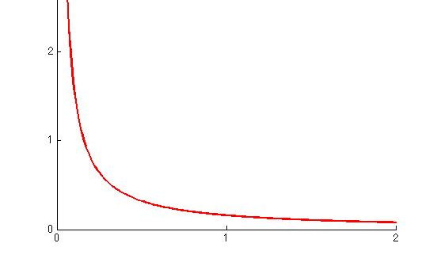
Idealized Example of Observability
Can a flow with an eddy represented by a point vortex (x_{v}, Γ)
be determine uniquely using an Eulerian/Lagrangian observation?
ICDF12
Velocity u
(x_{v}, Γ)
Distance r
Point vortex (x_{v}, Γ) :
Highly idealizer Lagrangian Structure

Slide 6
Basic Idea: Observability of the Flow with an Eddy
Flow with an eddy represented by a point vortex (x_{v}, Γ)
Given an observation u, can we determine the vortex config. uniquely?
Eulerian obs
u_{F}

Slide 7
Basic Idea: Observability of the Flow with an Eddy
Flow with an eddy represented by a point vortex (x_{v}, Γ)
Given an observation u, can we determine the vortex config. uniquely?
Eulerian obs
NO
u_{F}

Slide 8
Basic Idea: Observability of the Flow with an Eddy
Flow with an eddy represented by a point vortex (x_{v}, Γ)
Given an observation, can we determine the vortex config. uniquely?
Eulerian obs
Lagrangian obs
NO
u_{F}
YES
x_{D}
(x_{v}, Γ)
But not instantaneously by default

Slide 9
Basic Idea: Observability of the Flow with an Eddy
Flow with an eddy represented by a point vortex (x_{v}, Γ)
Given an observation, can we determine the vortex config. uniquely?
Eulerian obs
Lagrangian obs
NO
u_{F}
YES
x_{D}
(x_{v}, Γ)
Eulerian obs along Lagrangian trajectory
YES
u_{F}(x_{D})
(x_{v}, Γ)

Slide 10
Basic Idea: Observability of the Flow with an Eddy
Flow with an eddy represented by a point vortex (x_{v}, Γ)
Given an observation, can we determine the vortex config. uniquely?
Eulerian obs
Lagrangian obs
NO
u_{F}
YES
x_{D}
(x_{v}, Γ)
In this simple setting:
Lagrangian observation has an advantage over time because it moves with the flow
Eulerian observation along a trajectory is as good, if the observation is accurate & the flow estimation is the goal
These seem to hold in more complex environment
Eulerian obs along Lagrangian trajectory
YES
u_{F}(x_{D})
(x_{v}, Γ)

Slide 11
Background
Motivation: Lagrangian observation in ocean
Observability algorithms
Applications to Lagrangian path planning
Implications to Lagrangian observing system design for data assimilation and autonomous vehicle control
Concluding Remarks

Slide 12
Observability: Classic
Main objective: Given a set of observation {y}
Can we determine the state x
How easily can we determine the state x
Instantaneous: 3D Linear
y₀ = H₀ x₀
Observable if the linear observability Gramian W_{o}
W_{o} =H₀^{T} H₀
is full rank, equivalently Wronskian [det(W_{o})]$≠$0.
Then H₀^{T} y₀ =H₀^{T} H₀ x₀ can be solved.
(W_{o})⁻¹ H₀^{T} y₀ = x₀
Note:
No DA. Forward operator only. No real data involved.
Assessing the rank of W_{o} is a boolean test
Corresponds to the Hessian of Jº(x₀) of 3DVar with no specification of R₀

Slide 13
Observability: Classic
Schematic view
Observable
Unobservable
J(x₀)
space of x₀
W_{o}=Hessian of J(x₀)

Slide 14
Observability: Classic
Along path over [t, t₀], : 4D linear
Observation Dynamic model
y (t) = H(t) x(t) x (t) = F(t) x(t)
path
x(t;x₀, t₀)=M(t, t₀) x₀
Observable if the linear observability Gramian W_{o}(t; t₀) is full rank
W_{o}(t; t₀) = $\int_{t0}^{t}{\left[H\left(τ\right)M\left(τ,t0 \right)\right]TH\left(τ\right)M\left(τ,t0 \right)dτ}$
Then x₀ can be determined uniquely.
Note:
No DA. Dynamic model and forward operator only.
Reference trajectory is needed to compute W_{o}(t; t₀).
Straightforward modification for time-discrete systems.

Slide 15
Observability: Nonlinear
Along path over [t, t₀], : 4D nonlinear
Observation & TLM Dynamic model & TLM
y (t) = h(x(t), t) x (t) = f(x(t), t)
$δ$y(t;x₀, t₀)=H(t; x₀, t₀) $δ$x₀ $δ$x(t;x₀, t₀)=M(t;x₀, t₀) $δ$x₀
along path x(t;x₀, t₀)
Observable if the local observability Gramian W_{o}(t; x₀, t₀) is full rank
W_{o}(t; x₀, t₀) = $\int_{t0}^{t}{}$[H($τ$; x₀, t₀) M($τ$;x₀, t₀)]^{T} [H($τ$; x₀, t₀) M($τ$;x₀, t₀)]d$τ$
using TLMs in both forward and dynamic models.
Note:
No DA. Forward and dynamic models along with their TLM only.
Reference trajectory is needed.
Objective may be thought as evaluating the path’s potential, intrinsic capabilities.

Slide 16
Observability: Var Extensions
Incorporation of observation noise v(t)~N(0,R(t))
y (t) = h(x(t), t)+ v(t)
Observable if the local W_{o}(t; x₀, t₀) is full rank
W_{o}(t; x₀, t₀) = $\int_{t0}^{t}{}$[H($τ$; x₀, t₀) M($τ$;x₀, t₀)]^{T} (Rº(t))⁻¹[H($τ$; x₀, t₀) M($τ$;x₀, t₀)]d$τ$
Note
Corresponds to the Hessian of Jº(x₀, t₀) of 4DVar
Incorporation of IC error e(t₀)~N(0,P₀ ) in x₀
Observable if the augmented W_{ao}(t; x₀ ,P₀, t₀ ) is full rank
W_{ao}(t; x₀ ,P₀, t₀ ) = P₀⁻¹ + W_{o}(t; x₀, t₀)
Note
Corresponds to the Hessian of J(x₀)
Catching up with the 4DVar community (Lagor, Paley, Ide, 2015)

Slide 17
Observability: Computational Extensions for Path Planning
Empirical approach using
Ensemble path X($\text{t}$;X_{e0}, t₀) with gridded initial ensemble X_{e0}
Empirical Jacobian H($\text{t}$; X_{e0}, t₀) to approximate H($\text{t}$; x₀, t₀) M($\text{t}$;x₀, t₀)
Note
X($\text{t}$;X_{e0}, t₀) is not for uncertainty estimate
Incorporation of observation noise v(t)~N(0,R(t))
Observable if the empirical W_{eo}(t; X_{e0}, t₀) is full rank
W_{eo}(t; X_{e0}, t₀) = $\int_{t0}^{t}{}$[H($τ$;X_{e0}, t₀)]^{T} (Rº(t))⁻¹ [H($τ$; X_{e0}, t₀)] d$τ$
(Krener and Ide, 2009)
Note
e stands for empirical, not really ensemble
Use of ensemble for uncertainty estimate is on the way
^
^
^

Slide 18
Observability: Extensions
Note:
Simultaneous implementation of
augmented approach (P₀)
empirical approach (X₀)
Is possible to 4D observability, linear W_{o}(t, t₀ ) or nonlinear W_{o}(t; x₀, t₀ )
Full use of ensemble is desirable for ensemble data assimilation (work in progress)

Slide 19
Observability: Unobservability Index
With augmentation (P₀)
v(W_{ao}) =
= v(W_{o})
<v(W_{o})
Unobservability index v_{o}(W_{o}) for any W_{o} using min eigenvalue $λ$ _{min}(W_{o})
Without augmentation (P₀)
v(W_{o}) =
Note:
The smaller v(W_{o}), the more observable
By incorporating P_{0,} more observable
1
$λ$ _{min}(W_{o})
1
s _{min}(W_{o}+ P₀⁻¹)
1
1+ v(W_{o}) /s _{max}(P₀)
(Krener and Ide, 2009)
(Lagor, Paley, Ide, 2015)
J(x₀)
space of x₀
W_{o}=Hessian of J(x₀)

Slide 20
Background
Motivation: Lagrangian observation in ocean
Observability algorithms
Applications to Lagrangian path planning
Implication to Lagrangian observing system design and control for autonomous vehicles
Concluding Remarks

Slide 21
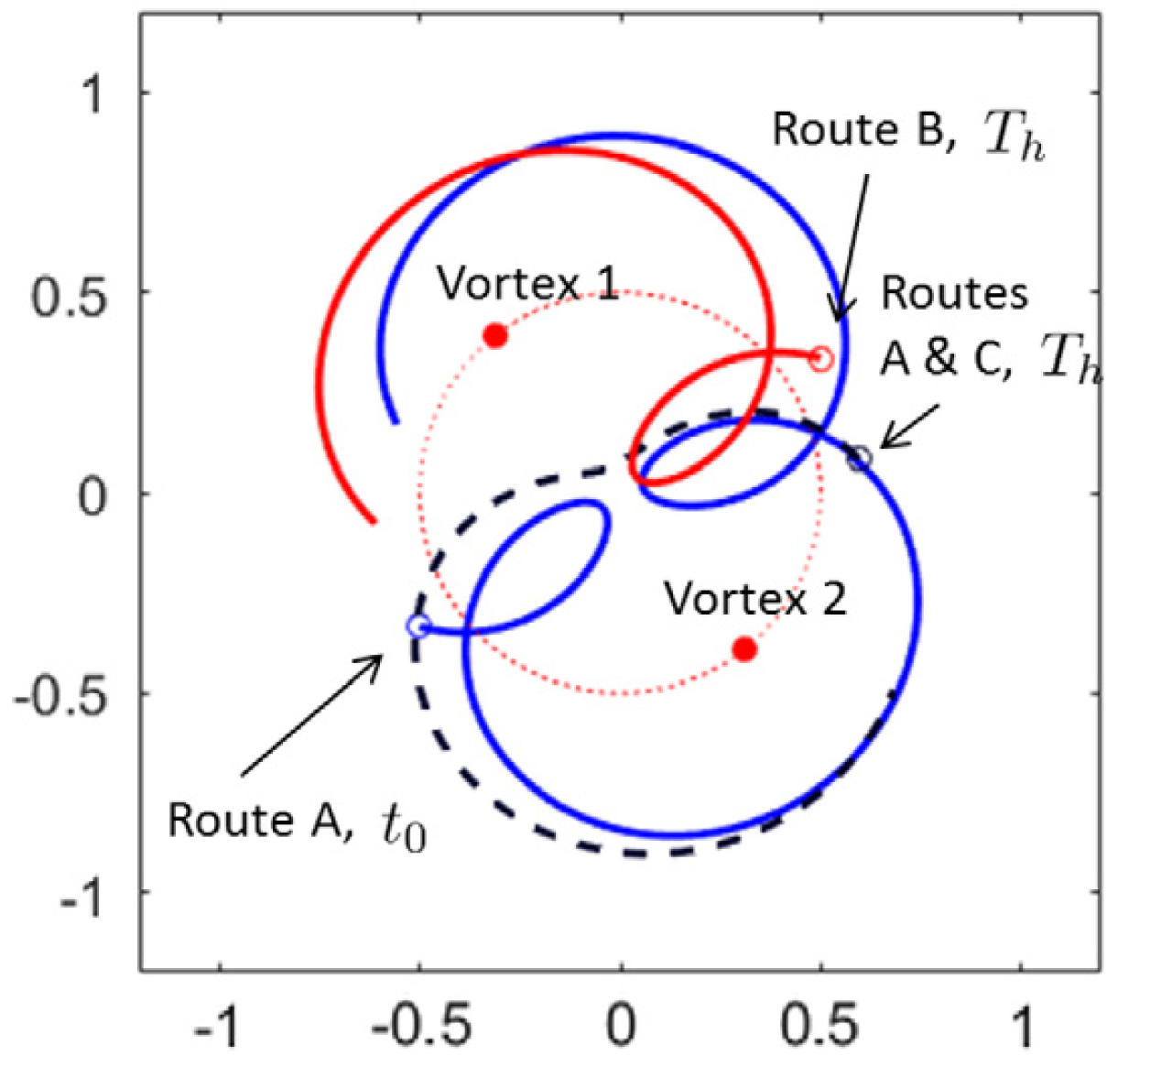
Application to Lagrangian Path Planning
Idealized application
Model: Two point vortex
x={2D position, circulation}_{n=1,2.}
[N=6 dim]
Observation: one Lagrangian route
y={2D position along trajectory}
[L=2 dim in t]
Case 1:
A over [0,T_{h}]
Case 2:
A over [0,T_{h}]
A over [T_{h}, 2T_{h}]
Case 3
A over [0,T_{h}]
C over [T_{h}, 2T_{h}]
T_{h}=8.44

Slide 22
Application to Lagrangian Path Planning
Questions:
By observing the position along the route, can we recover x₀?
How stable is the inversion?
How do the Lagrangian coherent structures play a role in path planning?
T_{h}=8.44: 1 round along path A

Slide 23
Application to Lagrangian Path Planning
Unobservability Index for W_{eo} using 4 ensemble members without P₀
Time span | [0,T_{h}] |  | [T_{h}, 2T_{h}] |  | [0,T_{h}] [T_{h}, 2T_{h}]
Route | Unob.Index | Route | Unob.Index | Route | Unob.Index
A | 6.222 | A | 8.444 | {A,A} | 0.2927
C | -- | C | 27.50 | {A,C} | 0.2537

Slide 24
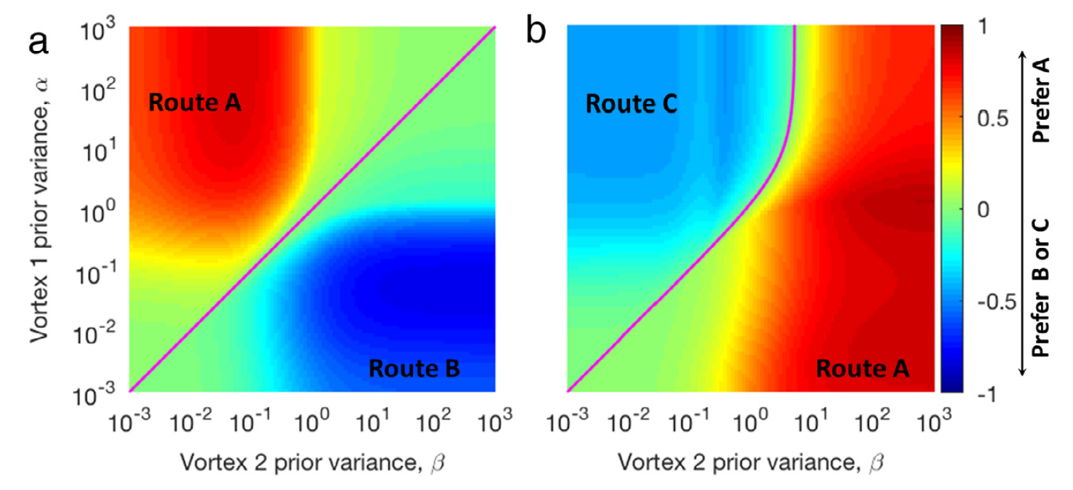
Application to Lagrangian Path Planning
Example of simple path planning strategy
Given initial P₀: Vortex 1 ($α$I), Vortex 2 ($β$I), Path (0.001 I)
For a given ($α$,$β$)
[0,T_{h}]: Go around route A Choose based on smaller observability
[T_{h}, 2T_{h}]: Choose A or C Based on the smaller observability

Slide 25
Background
Motivation: Lagrangian observation in ocean
Observability algorithms
Applications to Lagrangian path planning
Implication to Lagrangian observing system design and control for autonomous vehicles
Does this help DA system?
Concluding Remarks

Slide 26
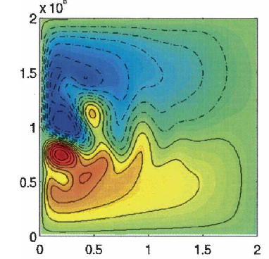
Working Hypothesis for the Optimal Deployment Strategy
With knowledge of Lagrangian flow dynamics
For eddy tracking
Deploy drifters in the eddy
For estimation of the large-scale flow
Deploy drifters that spread quickly (high dispersion: by hyperbolic point targeting) and visit various regions of the large-scale flow
For balanced performance
Use the combination of the two
Alternately (if possible)
Deploy drifters uniformly
Instantaneous streamfunction
Directed deployment should be based on the (Lagrangian) manifolds, not instantaneous streamfunction

Slide 27
Lagrangian Flow Structures and Drifter Motion
Gray: instantaneous streamlines
Purple/Black lines: Stable/unstable manifolds
Color triangles: Tracers
Eddy (yellow)
Dispersion targeting (red/blue/green)

Slide 28
Distinct Drifter Trajectories by the Deployment Strategies
Uniform launch
Fast Dispersion Targeting
Eddy Targeting
Mixed
Directed deployment

Slide 29
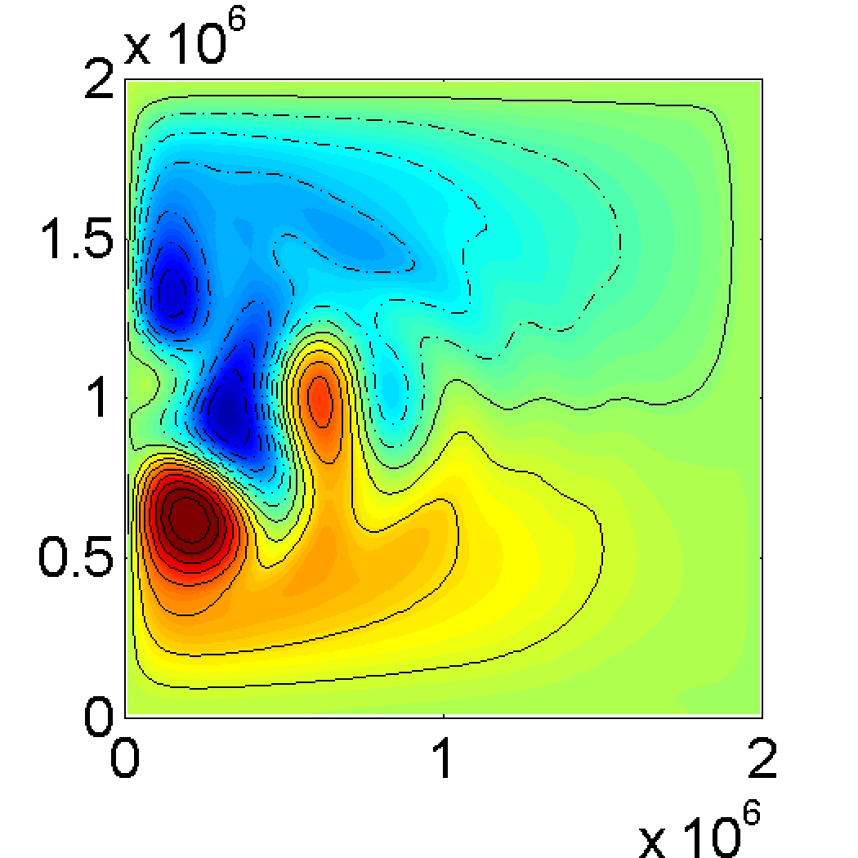
Convergence of the Basin-Scale Error Norms
Kinetic Energy Error Norm
Height Field Error Norm
Drifter Separation Error Norm
no LaDA
no LaDA
Uniform
Eddy targeting
Eddy targeting
Fast Disp.
Uniform
Mixed targeting
Fast Disp.
Mixed targeting
Energy error is concentrated in the western basin where the eddies are active
Directed deployment strategies are all effective
Height error is global over the entire flow domain
Uniform deployment works the best initially but fast disp & mixed strategies catch up.

Slide 30
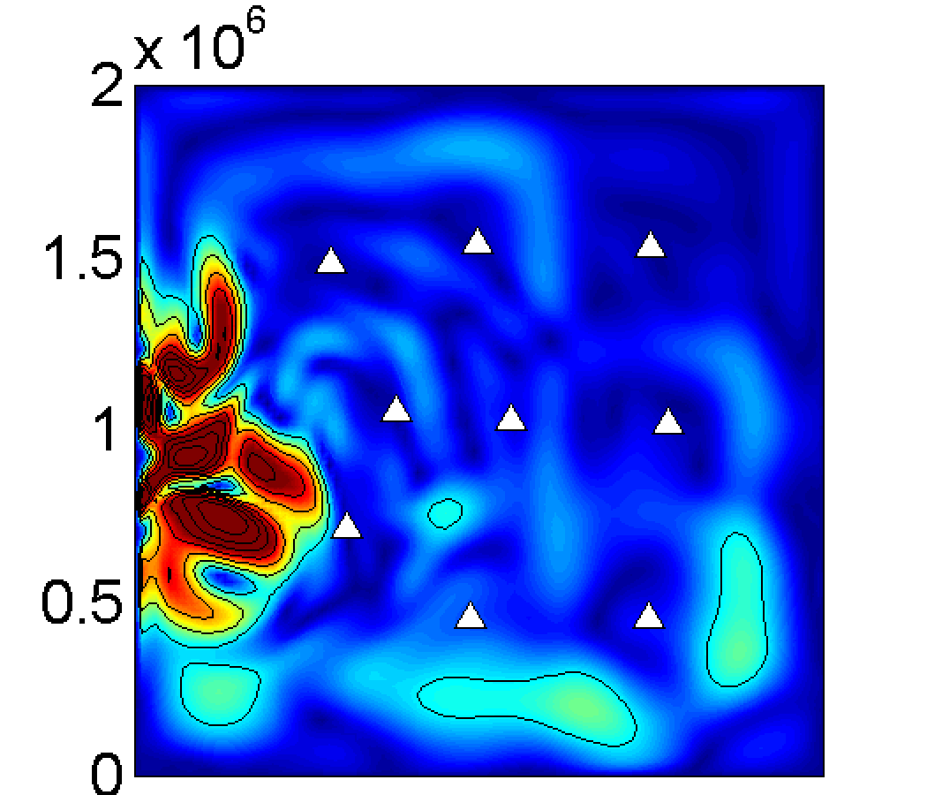
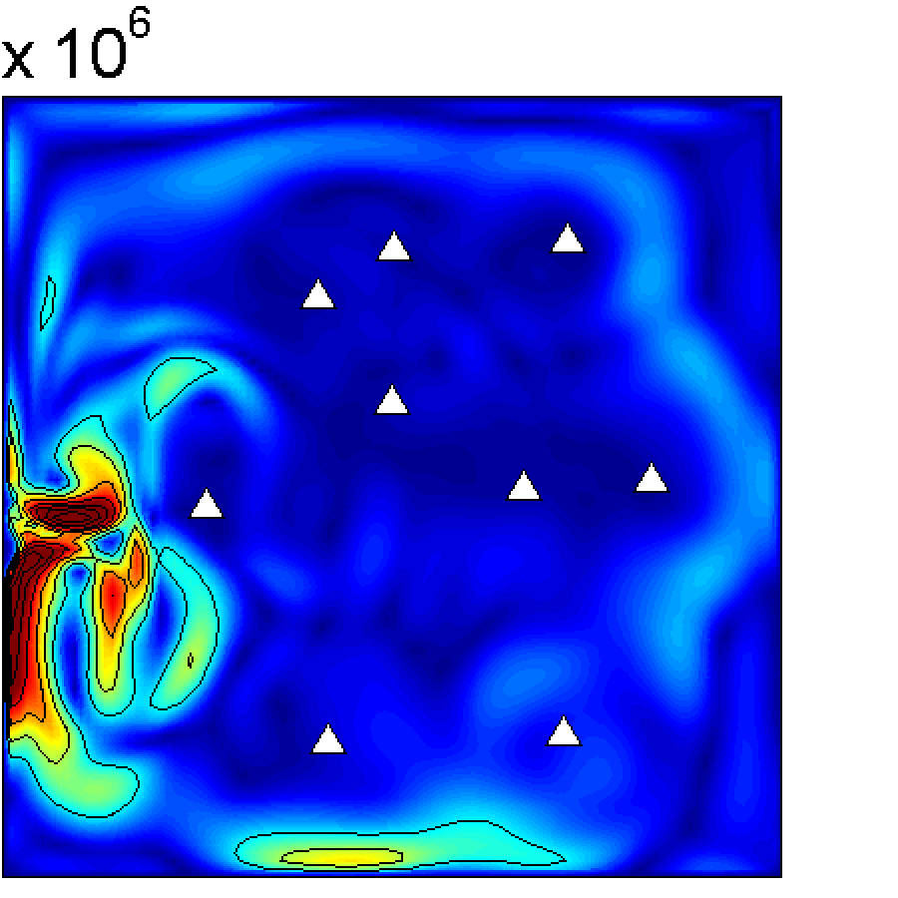
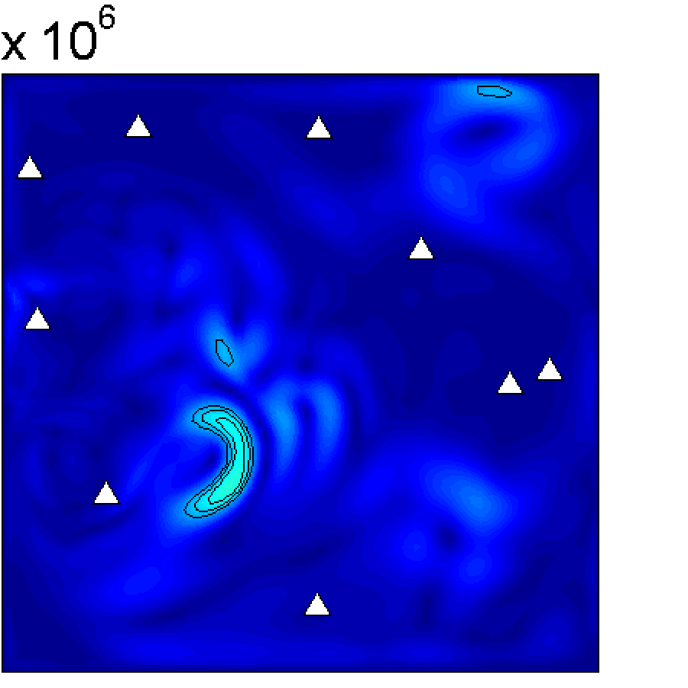
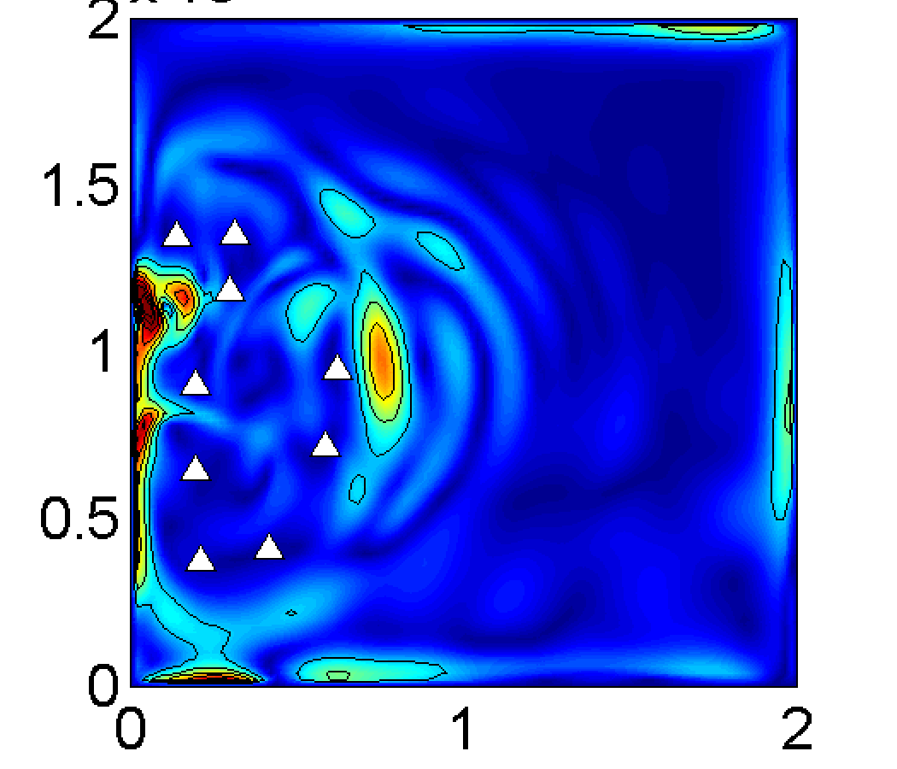
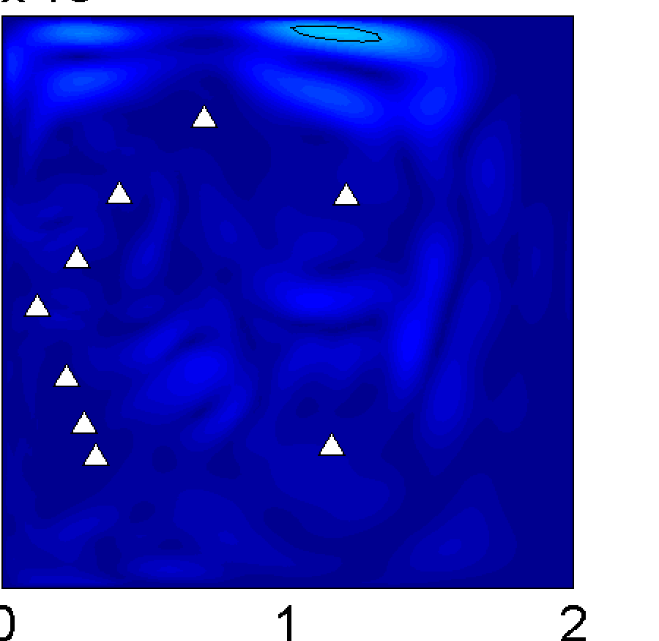
RMSE Spatial Pattern in KE: Uniform and Mixed Strategies
Day 25
Day 100
Day 300
Uniform
Mixed

Slide 31
Concluding Remarks
Observability algorithms:
Current extensions
Inclusion of P₀
Use of ensemble approximations
Further extensions are needed to be fully useful to data assimilation applications
Application to Lagrangian path planning suggest that ”prior” knowledge of Lagrangian coherent structures makes difference, which is consistent with earlier study.

