Slide 1
Inflation considerations for a continuously-cycled mesoscale EnKF analysis system
Presented by Glen Romine (NCAR)
Collaborators: Jeff Anderson, Craig Schwartz, and Kate Fossell
8th EnKF Workshop
May 7, 2018
Supported by NOAA JTTI NA17OAR4590182, NCAR is sponsored by the NSF

Slide 2
Why we need inflation
Cycled data assimilation systems require algorithms (here, inflation) to account for sampling deficiencies in the analysis system, in particular systematic model errors that lead to bias and inadequate error growth
Model errors are complex – varying spatially, temporally, seasonally
Are there particular inflation methods that are more or less effective?
Demonstrated in a mesoscale regional EnKF analysis system (NCAR ensemble) over portions of North America with the WRF model

Slide 3
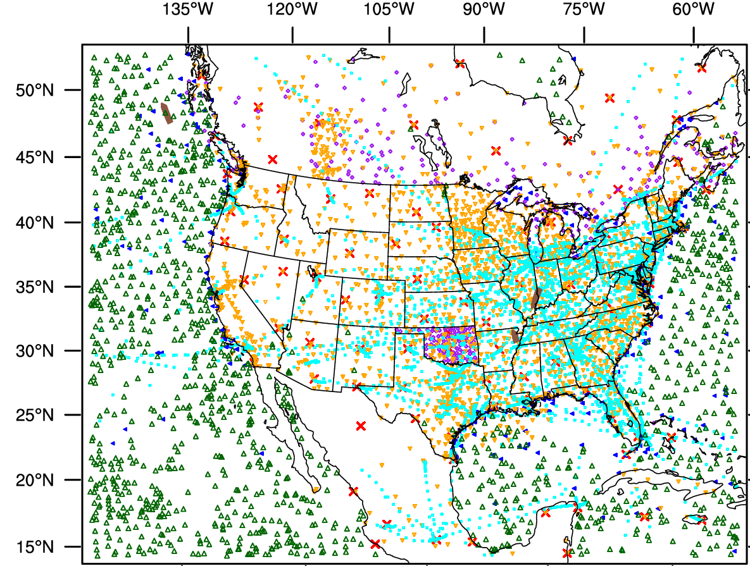
Analysis system components
DART EAKF, 50 members
WRF v3.6.1
15 km analysis grid
Cycled every 6 hours
May 1-31 2015
Conventional observations
NCAR ensemble configuration*
Radiosonde
Aircraft
Satellite wind
METAR
MESONET
Marine
GPSRO
* Schwartz et al. (2015) for NCAR ensemble configuration details

Slide 4
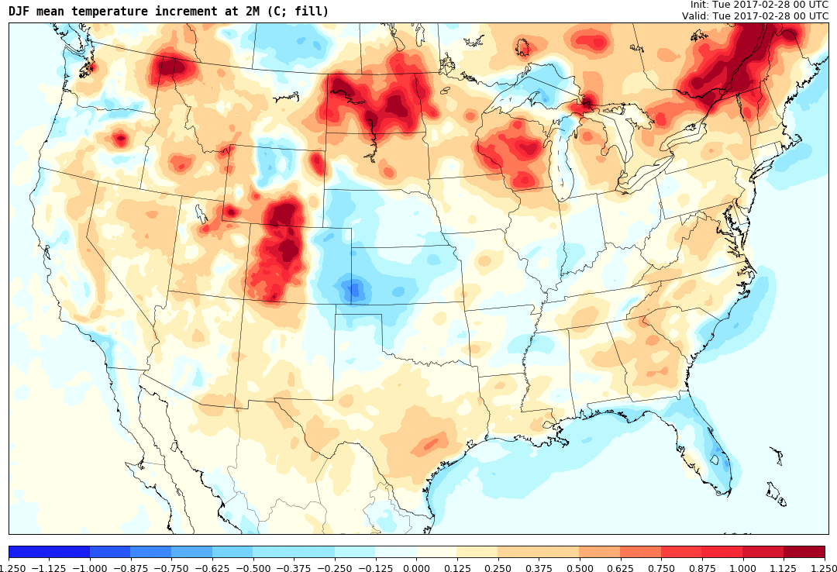
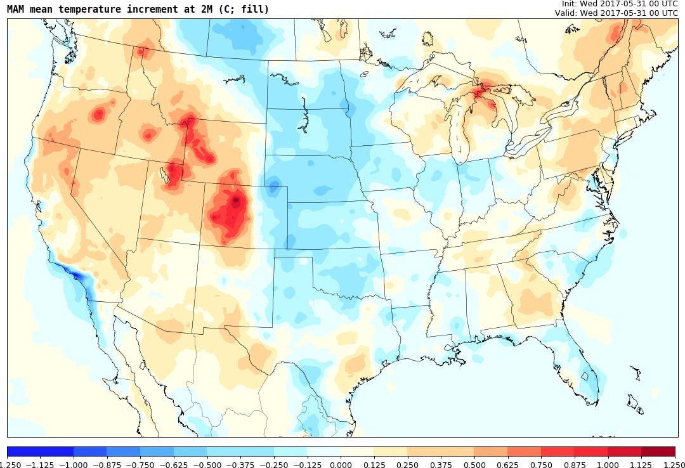
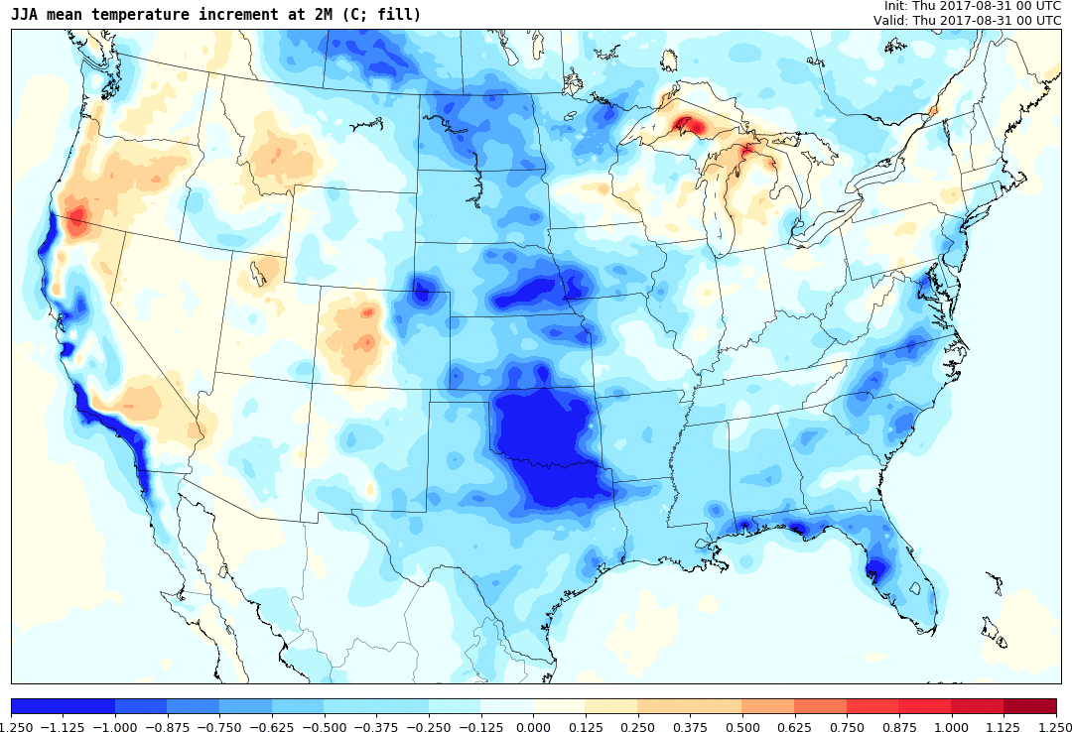
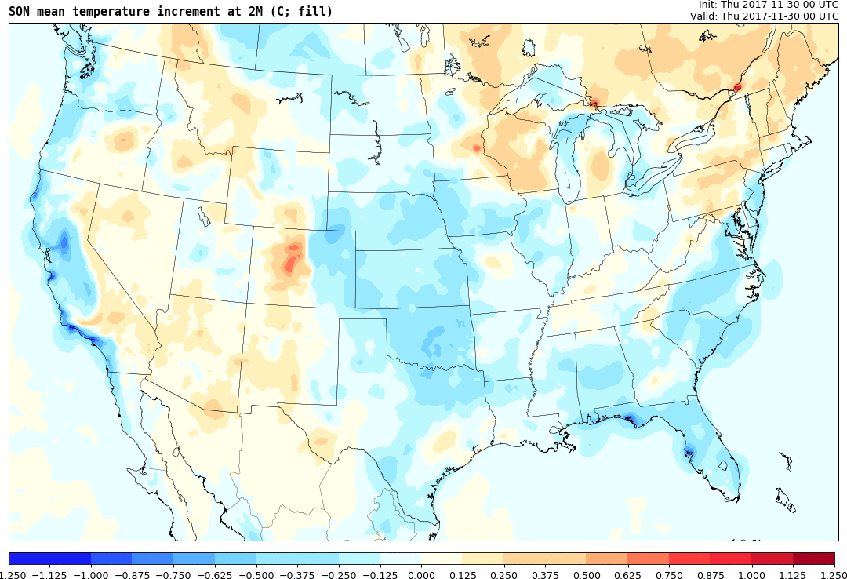
Seasonal variability in model error
Seasonal variability varies spatially, so care must be taken in correcting model error based on short
(seasonal) samples
a) DJF
b) MAM
c) JJA
d) SON
2M temperature mean analysis increment (C)

Slide 5
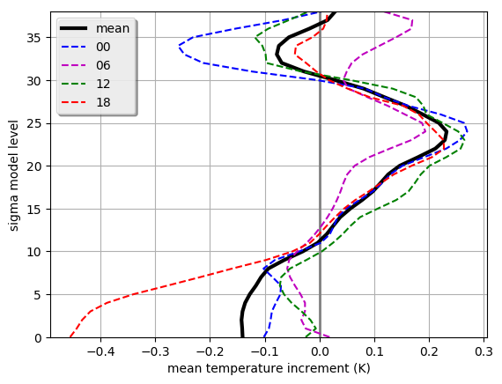
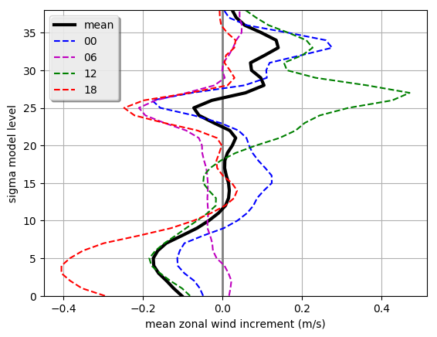
Diurnal variability between model and obs
Temperature
Zonal wind
Analysis increments also vary diurnally, and are different for each state vector type. Notably,
the observing network also varies considerably during the day (e.g., sondes, ACARS).

Slide 6
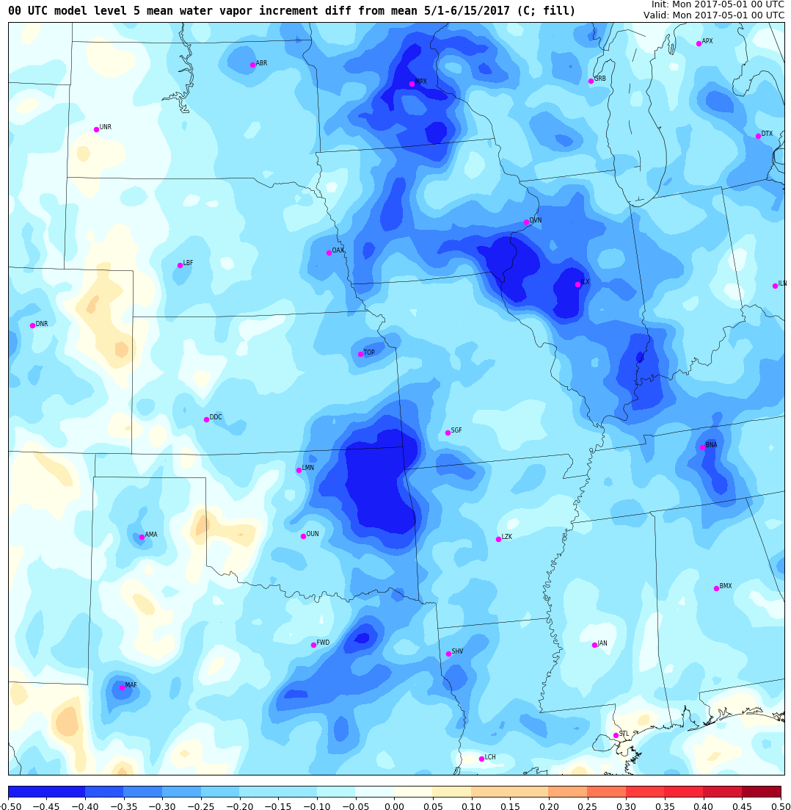
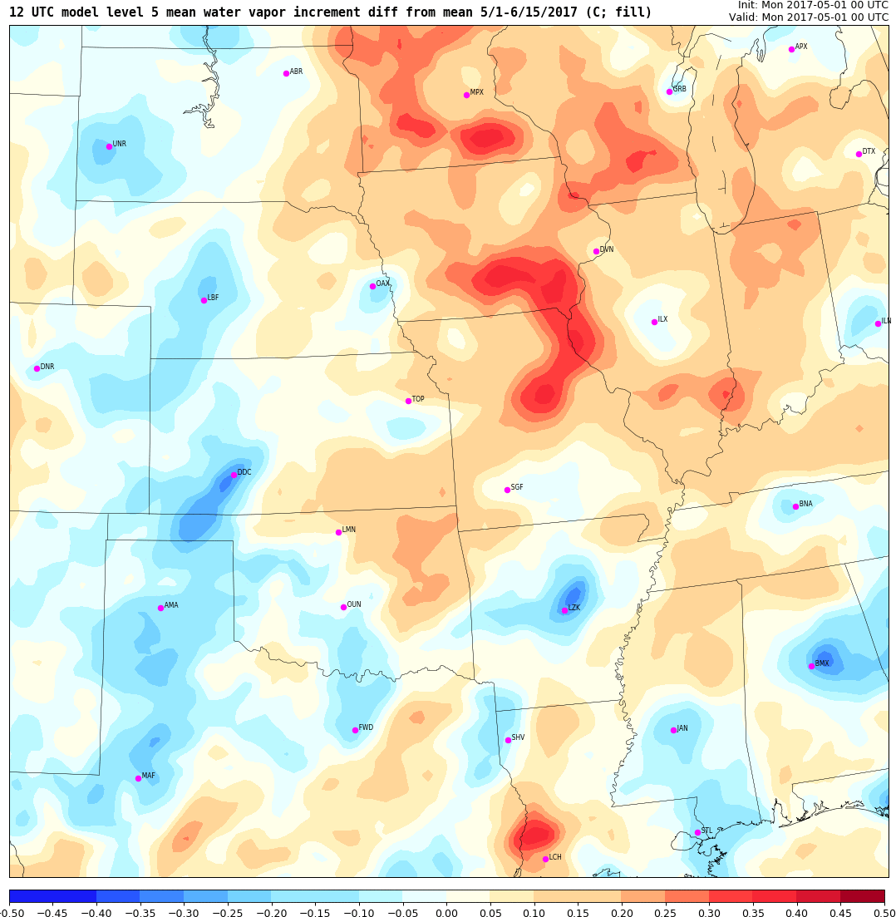
Diurnal variability in model error, spatial
Model level 5
water vapor increment
Drying during the evening, moistening during the morning
00 UTC
12 UTC
Analysis increments vary spatially as well by diurnal cycle

Slide 7
Inflation options considered
Multiplicative spatially and temporally adaptive prior inflation (Anderson 2009)
  Widely used option in Data Assimilation Research Testbed (DART) applications
Prior inflation (above) with a “spread restore” option applied during the analysis
  Undocumented and not yet demonstrated option in DART
Multiplicative spatially and temporally adaptive posterior inflation
  An undocumented and not well tested option in DART
Relaxation to prior spread posterior inflation (Whitaker and Hamill 2012)
  Approach used in GSI-EnKF system, recent option in DART
Notes:
A simple representation of continuously cycled data assimilation is shown in the cartoon. Observations are used by the analysis to correct a first guess field, where the first guess is a short forecast from the previous analysis. This approach is routine used global systems and with ensemble analysis systems provides flow-dependent background error covariances that are essential to spread observation information to state variables that are not directly observed. Of course, models are simplified representations of the real atmosphere, and can be prone to systematic errors. Systematic errors in the model have been shown in several studies to degrade the analysis system, and subsequently degrades the skill of the forecasts. Thus, an essential part of forecast system design is mitigating systematic model errors.
It is worth noting that while continuous cycling is routinely done in global analysis and prediction systems, regional models are most often partially cycled, where the partial wording means that periodically the background analysis is replaced by an external global analysis. This has been shown to improve forecast skill, yet little is known on why continuous cycling with a regional model is inferior.

Slide 8
Prior versus Posterior inflation
Observations
Analysis
Prior inflation
Posterior inflation
Background
Before inflation
Short ensemble forecast
After inflation
Prior inflation is applied before the analysis to the background, posterior inflation
is applied after the analysis, and spread restoration occurs during the analysis

Slide 9
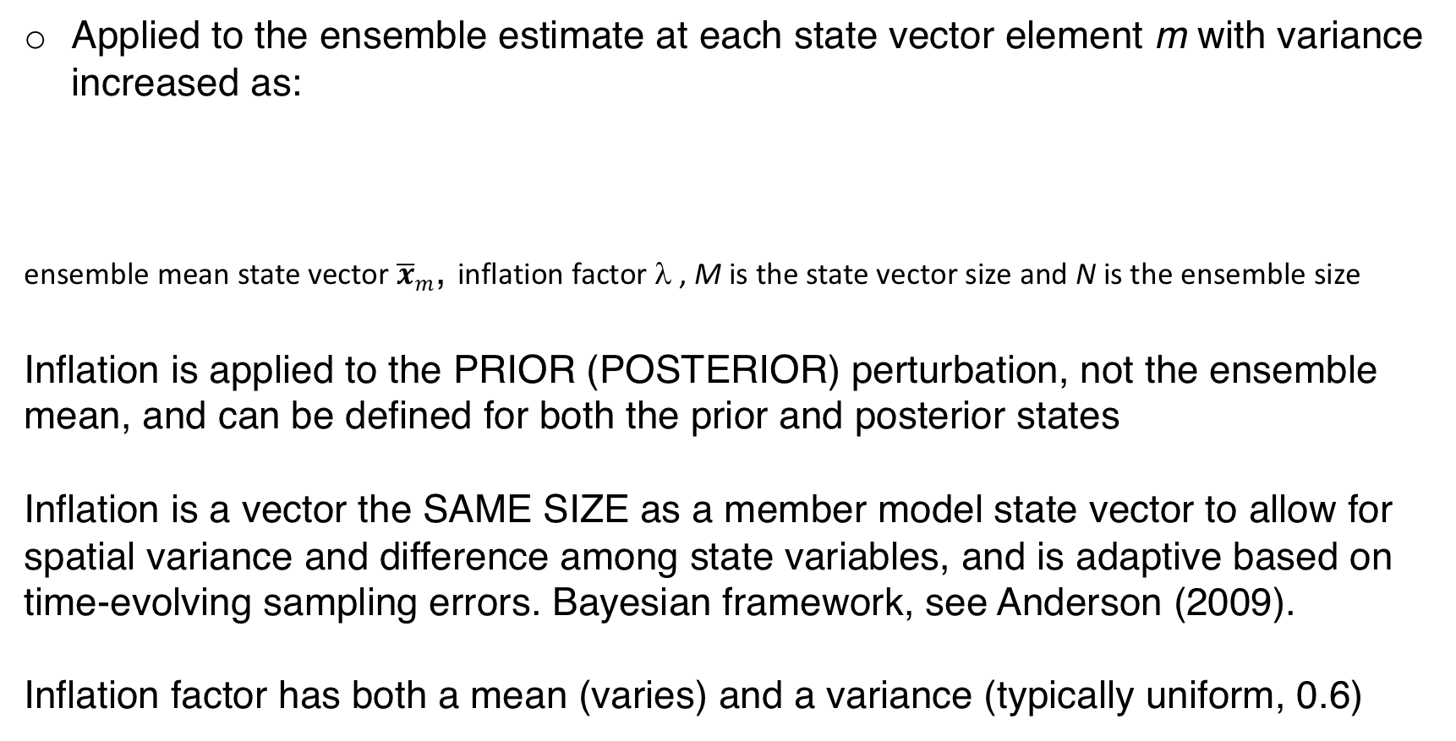
Multiplicative adaptive covariance inflation
Applied to the ensemble estimate at each state vector element m with variance increased as:
ensemble mean state vector ${\overline{x}}_{m}$, inflation factor λ , M is the state vector size and N is the ensemble size
Inflation is applied to the PRIOR (POSTERIOR) perturbation, not the ensemble mean, and can be defined for both the prior and posterior states
Inflation is a vector the SAME SIZE as a member model state vector to allow for spatial variance and difference among state variables, and is adaptive based on time-evolving sampling errors. Bayesian framework, see Anderson (2009).
Inflation factor has both a mean (varies) and a variance (typically uniform, 0.6)
Notes:
A simple representation of continuously cycled data assimilation is shown in the cartoon. Observations are used by the analysis to correct a first guess field, where the first guess is a short forecast from the previous analysis. This approach is routine used global systems and with ensemble analysis systems provides flow-dependent background error covariances that are essential to spread observation information to state variables that are not directly observed. Of course, models are simplified representations of the real atmosphere, and can be prone to systematic errors. Systematic errors in the model have been shown in several studies to degrade the analysis system, and subsequently degrades the skill of the forecasts. Thus, an essential part of forecast system design is mitigating systematic model errors.
It is worth noting that while continuous cycling is routinely done in global analysis and prediction systems, regional models are most often partially cycled, where the partial wording means that periodically the background analysis is replaced by an external global analysis. This has been shown to improve forecast skill, yet little is known on why continuous cycling with a regional model is inferior.

Slide 10
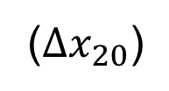

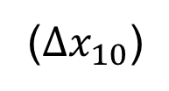

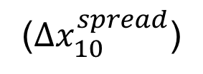




Spread restoration
Demonstrated here as a complement to prior adaptive covariance inflation
The updated analysis increment from the assimilation of each observation at each state vector point is adjusted as:
Total
increment
=
Traditional
increment
+
Spread restore
increment
(${Δx}_{10}$)
(${Δx}_{20}$)
$$x_{10}^{m}$$
$$x_{10}^{u}$$
$${\overline{x}}^{m}$$
yº
$$x_{20}^{u}$$
$$x_{20}^{m}$$
Effectively relaxes the updated ensemble
perturbation restoring some of the prior spread,
acts during the assimilation of each observation
(${Δx}_{10}^{spread}$)
(${Δx}_{20}^{spread}$)
Notes:
A simple representation of continuously cycled data assimilation is shown in the cartoon. Observations are used by the analysis to correct a first guess field, where the first guess is a short forecast from the previous analysis. This approach is routine used global systems and with ensemble analysis systems provides flow-dependent background error covariances that are essential to spread observation information to state variables that are not directly observed. Of course, models are simplified representations of the real atmosphere, and can be prone to systematic errors. Systematic errors in the model have been shown in several studies to degrade the analysis system, and subsequently degrades the skill of the forecasts. Thus, an essential part of forecast system design is mitigating systematic model errors.
It is worth noting that while continuous cycling is routinely done in global analysis and prediction systems, regional models are most often partially cycled, where the partial wording means that periodically the background analysis is replaced by an external global analysis. This has been shown to improve forecast skill, yet little is known on why continuous cycling with a regional model is inferior.

Slide 11
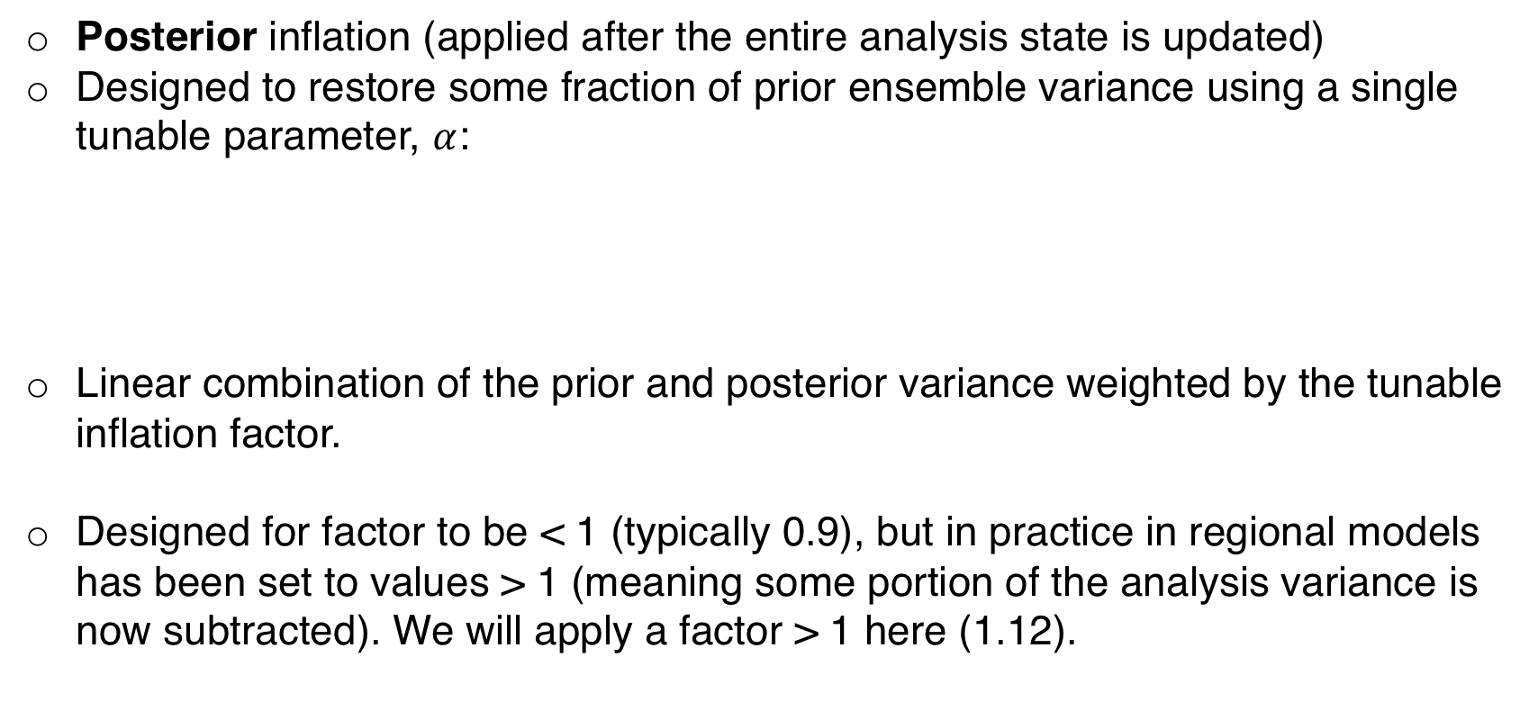
Relaxation to prior spread
Posterior inflation (applied after the entire analysis state is updated)
Designed to restore some fraction of prior ensemble variance using a single tunable parameter, $α$:
Linear combination of the prior and posterior variance weighted by the tunable inflation factor.
Designed for factor to be < 1 (typically 0.9), but in practice in regional models has been set to values > 1 (meaning some portion of the analysis variance is now subtracted). We will apply a factor > 1 here (1.12).
Notes:
A simple representation of continuously cycled data assimilation is shown in the cartoon. Observations are used by the analysis to correct a first guess field, where the first guess is a short forecast from the previous analysis. This approach is routine used global systems and with ensemble analysis systems provides flow-dependent background error covariances that are essential to spread observation information to state variables that are not directly observed. Of course, models are simplified representations of the real atmosphere, and can be prone to systematic errors. Systematic errors in the model have been shown in several studies to degrade the analysis system, and subsequently degrades the skill of the forecasts. Thus, an essential part of forecast system design is mitigating systematic model errors.
It is worth noting that while continuous cycling is routinely done in global analysis and prediction systems, regional models are most often partially cycled, where the partial wording means that periodically the background analysis is replaced by an external global analysis. This has been shown to improve forecast skill, yet little is known on why continuous cycling with a regional model is inferior.

Slide 12
Select comparisons of inflation option impacts
Background fit to assimilated observations
Rejection rate of assimilated observations (passing outlier threshold check)
Amplitude of mean analysis increments and change in spread during the analysis
Skill and reliability of precipitation forecasts initialized with analyses using different inflation algorithms

Slide 13
Fit to assimilated radiosondes – zonal wind
Prior
Posterior
Observation space diagnostics are after application of inflation
Similar bias and RMSE, but smallest RMSE with RTPS
Larger spread with RTPS, especially in posterior
Number of measurements
prior adaptive
prior+post adaptive
prior+sprd restore
RTPS

Slide 14
Rejection rate of surface observations
RTPS
Prior adaptive
Posterior adaptive
Prior + Posterior
Spread restore
Lower rejection
rate is assumed
better
Dewpoint
Altimeter
Temperature
Meridional
wind
Zonal wind

Slide 15
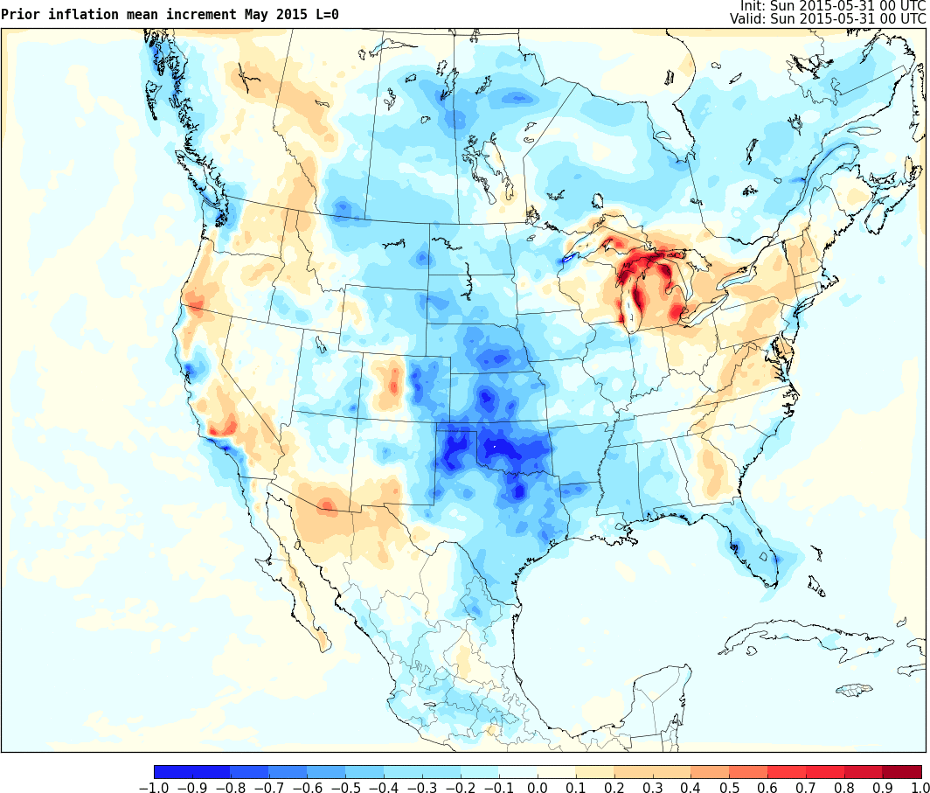
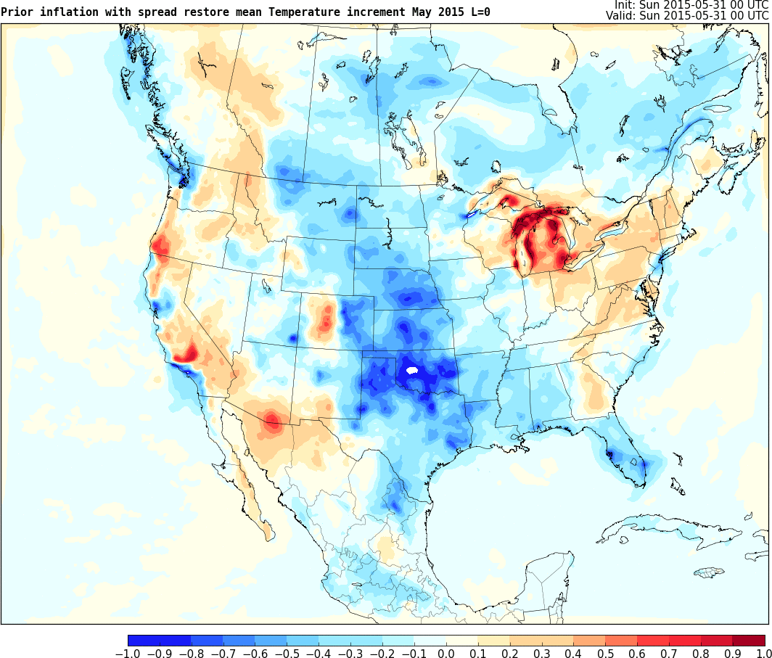
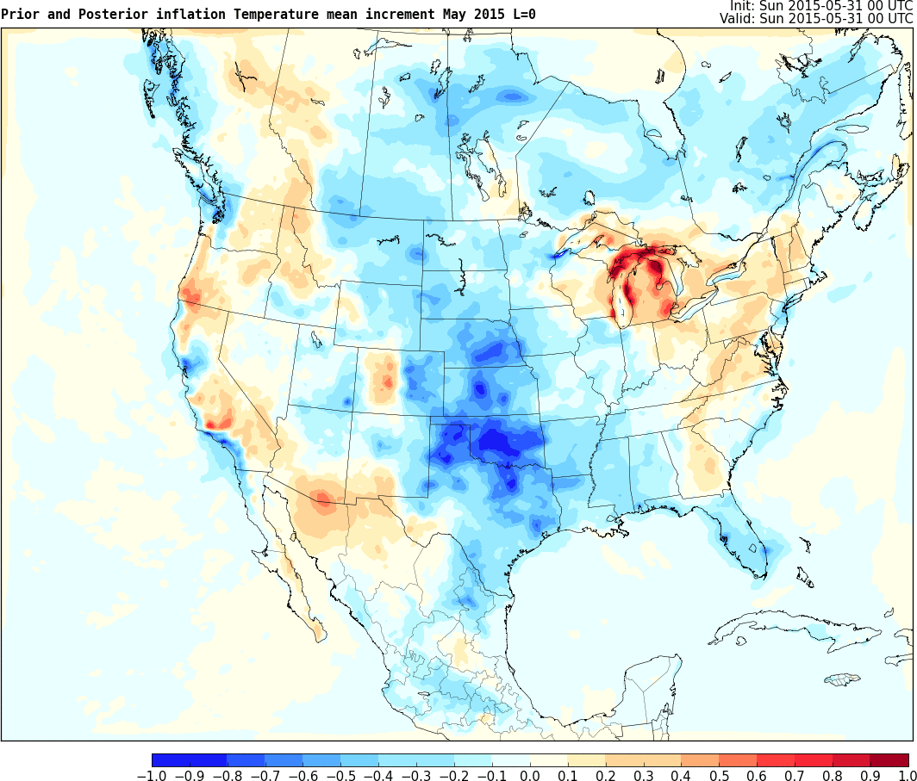
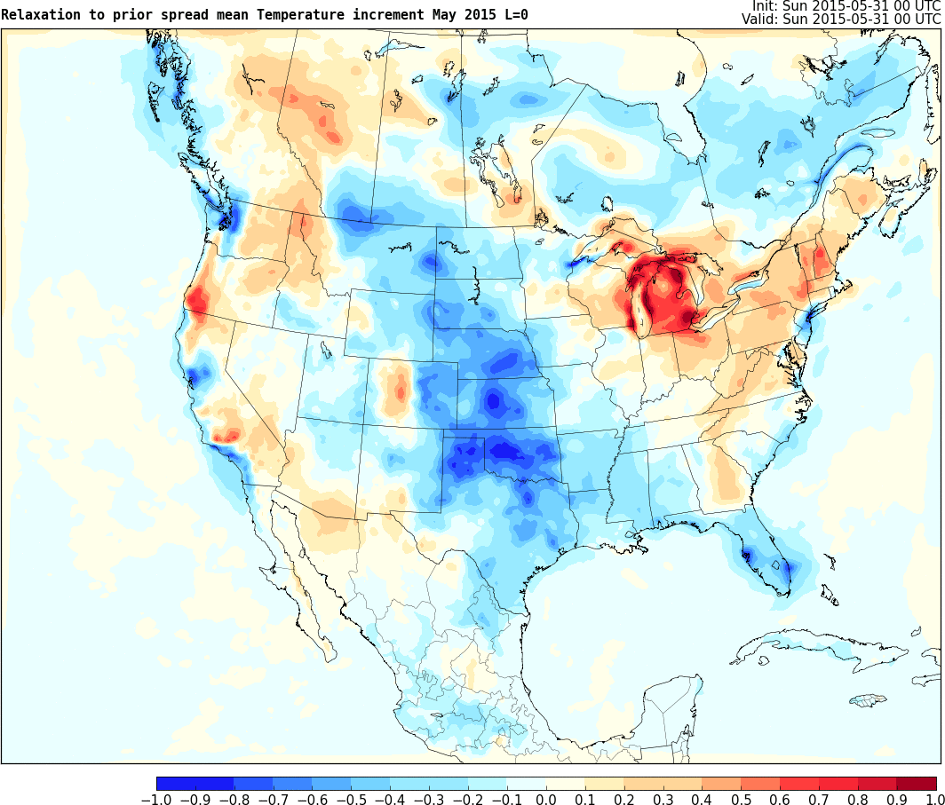
Time-averaged analysis increments - surface T
Overall very similar patterns, but
differences in the amplitude of the
mean increments. In rank order:
1) Spread restoration
2) Relaxation to prior spread (RTPS)
3) Posterior+Prior adaptive inflation
4) Prior adaptive inflation
Prior adaptive
Spread restoration
Prior + Posterior
RTPS

Slide 16
Time-mean background spread in 700 hPa Temperature
Prior Inflation
Spread restoration
Relaxation to Prior Spread
00 UTC priors only
Inflation Method | Prior Adaptive | Prior + Posterior | Spread Restore | RTPS
Spatially averaged % change in spread during analysis | 89.2% | 92.0% | 94.1% | 103.1%

Slide 17
Time-average analysis spread in 700 hPa Temperature
Prior Inflation
Spread restoration
Relaxation to Prior
00 UTC analyses only
Reduced range, same color scale
Low quality AMVs, sonde locations evident in analyses with adaptive inflation
Inflation Method | Prior Adaptive | Prior + Posterior | Spread Restore | RTPS
Spatially averaged % change in spread during analysis | 89.2% | 92.0% | 94.1% | 103.1%

Slide 18
Precipitation forecast skill – ROC area
hours 1-12
18-36-h forecasts
Larger values better,
RTPS and spread restore
are best
Differences from changing inflation are most evident during the first 12 hours of forecast
prior adaptive
prior adaptive
prior+sprd restore
prior+sprd restore
prior+post adaptive
prior+post adaptive
RTPS
RTPS

Slide 19
Precipitation forecast reliability – attributes
prior adaptive
prior+post adaptive
Closer to 1:1 line better
RTPS and spread restore
are again the best
prior+sprd restore
RTPS
Most notable differences during the first 12 hours of the forecast (shown)

Slide 20
Next step – Finding roots of systematic error
Reducing systematic errors is the most evident benefit from changing to more aggressive inflation algorithms
A better long-term solution would be to reduce the errors in the model
Ad hoc and/or meteorological approaches can be applied to reduce systematic error (e.g., Torn and Davis 2012; Romine et al. 2013)
A promising alternative approach is to investigate the time averaged tendencies from the forecast model within a continuously cycled DA system (e.g., Cavallo et al. 2016)

Slide 21
Time averaged physics tendencies
Time-averaged analysis increments are dominated by the sum of physics errors, so diagnose physics tendency components to find sources of systematic error
Analysis cycle (i)
i=0
i=1
i=2
i=3
•••
i=m
θº(t)
Tendencies include:
dynamics, radiation, PBL, microphysics, cumulus scheme, etc…
θ_{2,2}
θ_{3,3}
θ_{1,1}
•
•
θ_{m,n}
•
•
θ_{0,0}
INC₂
INC₃
INC_{m}
•
INC₁
TEND₂
■
TEND₃
■
■
θ_{2,1}
θ_{3,2}
TEND_{m}
θ_{m,n-1}
TEND₁
■
θ_{1,0}
t=0
t=1
t=2
t=3
•••
t=n
Model advance (t)
Notes:
A key tool to understanding potential differences in the forecasts will be achieved by leveraging information from the mean analysis system adjustments, shown in the cartoon as a time series of increments (the red arrows), and then as the model forecasts drift away from the observations during the integration, shown by the green arrows, the tendencies in the state fields can be broken down into the physics components that drive the forecast system away from observations. On average, the tendencies are expected to roughly balance the mean analysis increments, as the analysis system corrects for the systematic bias in the forecasts.

Slide 22
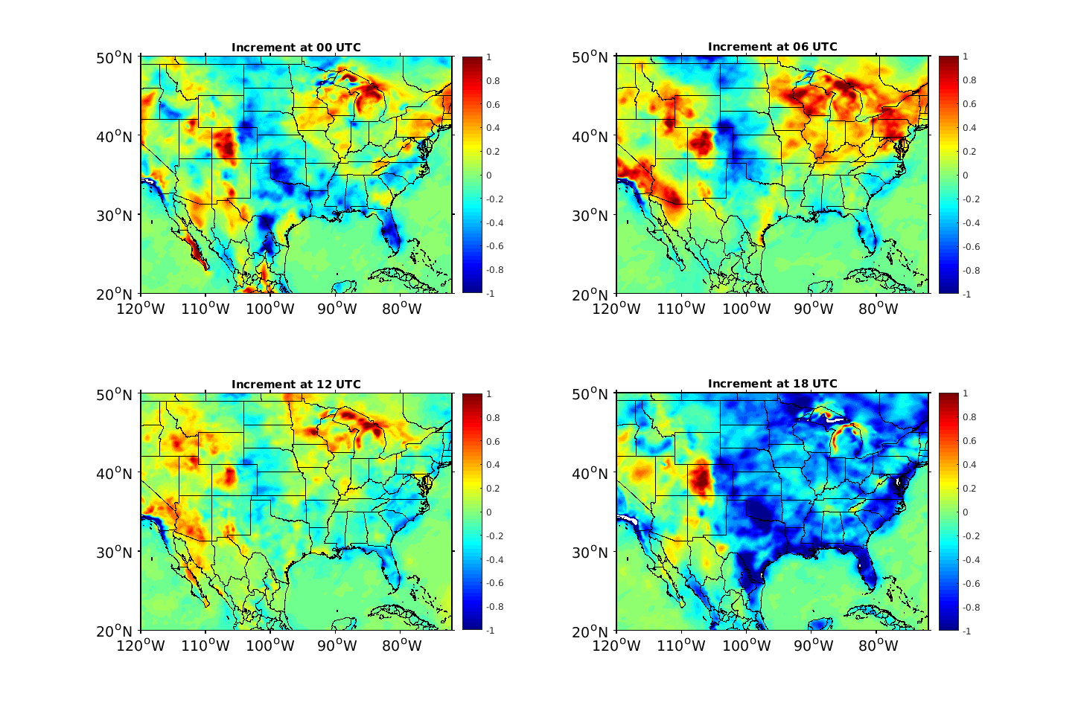
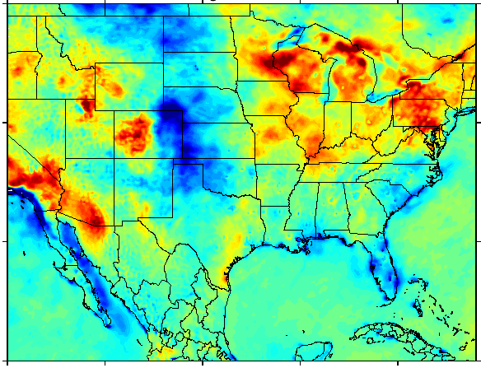
Analysis increments and cumulative tendencies
Average analysis increment -1 *Average accumulated tendency
at 6 UTC during 0-6 UTC forecast
Appears qualitatively true – thus can explore use of this method to investigate systematic model errors. This work is underway….
Notes:
Here is a demonstration in a spatial plot of mean analysis increments on the left versus mean accumulated tendency for the temperature variable over a 46 day period comparing 06 UTC analysis adjustments and 0-6 UTC accumulated tendencies. The agreement is qualitatively quite good, supporting the use of the tendency analysis to investigate systematic model errors.

Slide 23
Summary
Model error is complex, varying in time (long and short scales) as well as spatially
Inflation aids an EnKF in combatting model error with varying effectiveness for different algorithms and differences most evident during the first 12 hours of forecasts
Adaptive prior inflation only marginally benefits from the addition of posterior inflation
Spread restoration improves the analysis and forecast performance when added to the adaptive prior inflation algorithm without degrading spread/error ratios
Relaxation to prior spread, configured to exaggerated posterior spread, improves analysis and forecast performance but degrades spread/error ratio, not responsive to persistent observation errors
Accumulated physics tendencies offer a promising approach to investigate sources of systematic model error

