Slide 1
State-dependent Additive Covariance Inflation for Radar Reflectivity Assimilation
^{*1}Yokota. S., ^{1,2}H. Seko, ^{3,1}M. Kunii, ^{4,1}H. Yamauchi, ¹E. Sato
¹Meteorological Research Institute, JMA
²Japan Agency for Marine-Earth Science and Technology
³Numerical Prediction Division, Forecast Department, JMA
⁴Administration Division, Observation Department, JMA
2018/5/8 EnKF workshop
Notes:
This talk is about suggestion of the new error covariance inflation scheme of EnKF for direct assimilation of radar reflectivity.

Slide 2
How to Assimilate Radar Reflectivity Directly
Introduction
1/16
Atmospheric State
(wind, temperature, pressure, humidity)
Hydrometeor
(cloud water, cloud ice, rain, snow, graupel)
Forecast
Cause
Result
should be modified by reflectivity assimilation
observed by radars
To improve rainfall forecast by “direct” assimilation of radar reflectivity, atmospheric state should be modified based on correlation between the Atmospheric State and Hydrometeor
[3DVar] given climatologically (difficult to be estimated)
[4DVar] calculated by linear model (difficult to make the model)
[EnKF] calculated by ensemble forecasts (not difficult, but …)
Notes:
Radar reflectivity observes the information of hydrometeor.
However, it is the result of rainfall, and the cause of rainfall is mainly the atmospheric state.
So, to improve rainfall forecast with data assimilation, the atmospheric state should be modified.
Then, in most operational centers, radar reflectivity is not directly assimilated.
Instead of it, they use cloud analysis, latent heat nudging, assimilation of relative humidity retrieved with 1DVAR, and so on.
However, “direct” assimilation of radar reflectivity should be developed to use the sophisticated radar obs.
To improve rainfall forecast by “direct” assimilation of radar reflectivity, correlation between the atmospheric state and the hydrometeor should be correctly estimated, and the atmospheric state should be modified based on the correlation.
In 3DVAR, this correlation is given climatologically, but the estimation is difficult.
In 4DVAR, it can be calculated by linear model, but making the linear model is very complicated.
So, in this study, we use EnKF, which can calculate the reasonable correlation with ensemble forecasts.

Slide 3
Problem of Reflectivity Assimilation with EnKF
Introduction
2/16
Reflectivity assimilation with EnKF
First guess:
mean of ensemble forecasts
(u^{f}, v^{f}, w^{f}, T^{f}, p^{f}, q_{v}^{f}, q_{c}^{f}, q_{ci}^{f}, q_{r}^{f}, q_{s}^{f}, q_{g}^{f})
Analysis
Kalman gain:
weight of average between first guess and observation
Observed reflectivity (dBZ)
Forecasted reflectivity (dBZ)
calculated from (q_{r}^{f}, q_{s}^{f}, q_{g}^{f} )
Obs. error covariance (given)
Forecast error covariance
(calculated by ensemble forecast)
Problem: If rainfall is not forecasted, δZ_{H}^{f}=0 (no impact of Z_{H} assimilation)
→ One solution: Inflation of δZ_{H}^{f}
Notes:
However, radar reflectivity assimilation with EnKF also has a problem.
This is the basic equation of EnKF.
Analysis is made by first guess plus this analysis increment.
In EnKF, this “K” is calculated with ensemble forecasts like this.
But this delta ZH is 0 if rainfall is not forecasted in all ensemble members at the obs. point.
So, at such points, there is no impact of reflectivity assimilation.
It is a big problem to assimilate radar reflectivity.
To solve this problem, generally, error covariance inflation is required.

Slide 4
3-type Error Covariance Inflation
Introduction
3/16
1. Multiplicative
(Anderson and Anderson 1999)
→ If δZ_{H}^{f}=0, BH^{T}=0
2. Additive
(Mitchell and Houtekamer 2000)
→ If δZ_{H}^{f}=0, BH^{T}=E[δx_{i}^{f}q_{i}]=0
because q_{i} is random perturbation
3. Relaxation to prior
(Zhang et al. 2004)
→ If δZ_{H}^{f}=0, BH^{T}=0
→ We propose to introduce
non-random δZ_{H} that has reasonable correlation with δx^{f}
Notes:
However, general inflation cannot solve this problem.
Multiplicative or relaxation to prior inflation cannot enlarge perturbations because forecasted ensemble perturbations are completely 0.
Additive inflation, which introduces additional random perturbations, also cannot solve this problem because covariance between the atmospheric state and random perturbations of reflectivity is 0 after all.
So, we propose introducing additive perturbations only to focus forecasted reflectivity, delta ZH, which is non-random and reasonably correlated with the atmospheric state.

Slide 5
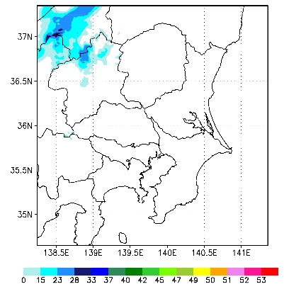
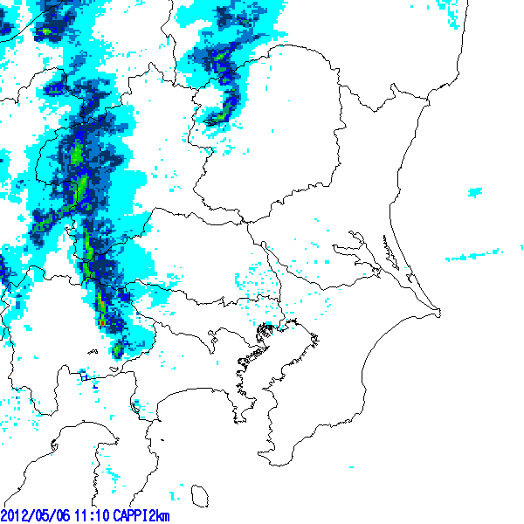
State-dependent Additive Perturbation of Z_{H}^{f}
Introduction
4/16
Z_{H}^{f} of member i is replaced with following δZ_{H}^{f(i)} before assimilation
if rainfall is not forecasted at obs. points in all members
water vapor mixing ratio
Z_{H}^{f} @z*=2km
(2012/5/6 1110JST)
zonal wind
meridional wind
vertical wind
temperature
Slope of regression line of q_{v}^{f} for Z_{H}^{f} calculated with all grids in each vertical level
This term is calculated in points where rainfall is not forecasted
Z_{H}^{f}
Member 2
Grid (1,1)
Z_{H}^{f}
Slope:
∂Z_{H}^{f}/∂q_{v}^{f}
Slope:
∂Z_{H}^{f}/∂q_{v}^{f}
(∂Z_{H}^{f}/∂q_{v}^{f} )δq_{v}^{f(i)}
Member 1
Grid (1,1)
q_{v}^{f}
JMA Radar (2km-CAPPI)
δq_{v}^{f(i)}
Member i
Member 1
Grid (1,2)
Perturbation from ensemble mean
q_{v}^{f}
→ Additional δZ_{H}^{f} is not random but correlated with (u^{f}, v^{f}, w^{f}, T^{f}, q_{v}^{f})
→ Atmospheric state can be modified by Z_{H} assimilation
Notes:
If we assume that reflectivity is the function of wind, temperature, and water vapor mixing ratio, and that these variables are independent each other, reflectivity perturbations can be written like this.
These ensemble perturbations are introduced before assimilation only if rainfall is not forecasted at obs. points in all members; for example, here and here.
These delta u, v, w, T, qv are ensemble perturbations of atmospheric state in each member and these coefficients are calculated as slope of regression lines.
For example, this is the slope of regression line of water vapor for reflectivity calculated with all grid in each vertical level at the analysis time.
Using this slope and this ensemble perturbation of water vapor, this term is calculated at each obs. point.
These additional perturbations created with this way are not random but correlated with the atmospheric state.
So, the atmospheric state can be modified by reflectivity assimilation.

Slide 6
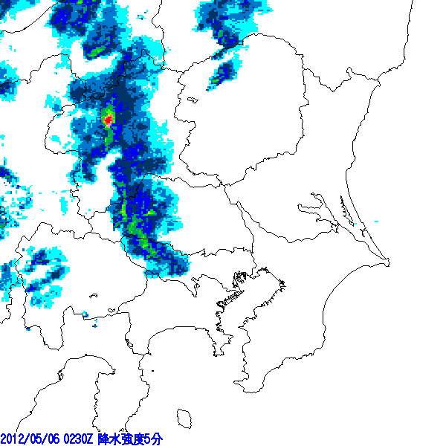
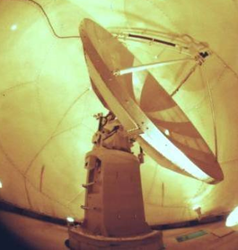
Target: Tornadic Supercell in 6 May 2012
Experiment to Check Impact of δZ_{H}^{f}
5/16
3 tornadoes were generated almost simultaneously at 1230 JST.
South one is estimated F3 (70-92 m/s).
There were dense radar and surface observations.
JMA radar
MRI advanced C-band solid-state polarimetric (MACS-POL) radar
Damaged area
MRI
→ Development of the tornadic supercell was observed in detail by MACS-POL
→ Suitable for investigating assimilation impact of the polarimetric radar
Notes:
To confirm the effect of this perturbation, we performed assimilation experiments.
As a target of this study, we chose the tornadic supercell in 6 May 2012.
In this case, 3 tornadoes were generated almost simultaneously, and south one is estimated F3.
Development of this supercell was observed in detail by the C-band solid-state polarimetric radar operated in our research institute from about 15 km.
So, this case is very suitable for investigating the assimilation impact of radar reflectivity.

Slide 7
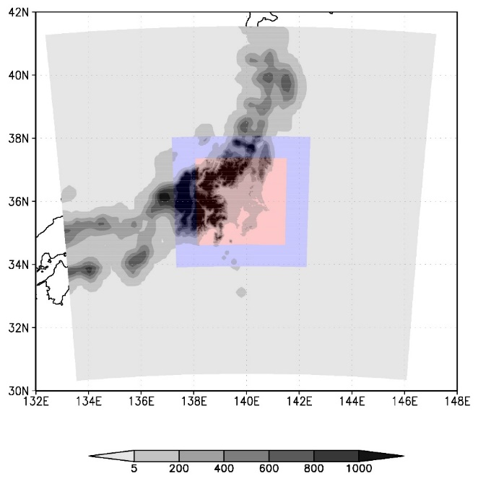
Assimilation Experiments with LETKF
Experiment to Check Impact of δZ_{H}^{f}
6/16
Local ensemble transform Kalman filter
6 May 03 JST
6 May 09 JST
From 3 May 09 JST
LETKF Analysis
LETKF Analysis
6 May 13 JST
15km-LETKF
Grid interval: 15 km
Ensemble size: 50
6 hour analysis window
(Observation every hour)
Boundary Condition every hour
Downscaling
5km-LETKF
Grid interval: 5 km
Ensemble size: 50
1 hour analysis window
(Observation every 10 minutes)
Boundary Condition every 10 minutes
Downscaling
Hourly operational obs. are assimilated every 6 hours
11 JST
1km-LETKF/EXT
Grid interval: 1 km
Ensemble size: 50
10 minutes analysis window
(Observation every minute)
Extended forecasts from 1130JST
10-min radar (radial wind) and surface obs. are assimilated every 1 hour
15km-LETKF
1-min radar (radial wind and reflectivity of MACS-POL) and surface obs. are assimilated every 10 minutes
5km-LETKF
: Ensemble forecasts with JMA non-hydrostatic model
: LETKF analysis
: Abbreviation of 6-hour forecast-analysis cycle
1km-LETKF/EXT
Operational obs.: Surface (pressure), Radiosondes (wind / temperature / humidity), Aircrafts (wind / temperature), Radars (Doppler wind / humidity), Wind profiler radars (wind), Microwave scatterometers (wind), Visible / infrared imagers (wind), and GNSS (precipitable water vapor)
(m)
Notes:
We used 50-member LETKF and these are experimental design and calculation domain.
In 15-km LETKF, hourly operational conventional observations are assimilated every 6 hours.
Next, in 5-km LETKF, 10-min radar Doppler velocity and surface observations are assimilated every 1 hour.
After that, in 1-km LETKF, reflectivity of the polarimetric radar is additionally assimilated every 10 min using the additional state-dependent perturbations introduced in previous slides.
After 3 forecast-analysis cycle, extended ensemble forecasts were performed from 1130JST.

Slide 8
How to Assimilate Z_{H}^{obs}
Experimental Design
7/16
Z_{H}^{f}[dBZ] is calculated from forecasted rain, snow, and graupel (q_{r}^{f}, q_{s}^{f}, q_{g}^{f})
Observation error variance of Z_{H}^{obs}: σ_{Z}²=(5dBZ)²
Attenuation of Z_{H}^{obs} is corrected by (Jameson 1992)
Z_{H}^{obs} is interpolated to 2-km grid (influence radius: 1km) before assimilation
Z_{H}^{obs}=0dBZ [σ_{Z}²=(50dBZ)²] is assimilated at points of Z_{H}^{obs}<15dBZ
rain
Set to be 1
if T ≥ 0℃
(bright band)
Number concentration
rain
snow
snow
graupel
Theoretical formulation in 1-moment cloud microphysics
Mass density
graupel
rain
snow
graupel
cf., Dowell et al. (2011)
Notes:
We used JMA non-hydrostatic model as the forecast model, and in this model, single moment cloud microphysics is used.
In this scheme, reflectivity is calculated only from forecasted density RHO and mixing ratio of rain QR, snow QS, and graupel QG like this.
The other parameters written here are constant.
If temperature is more than 0 degree celsius, here is set to 1.
It corresponds to the bright band.
This forecasted reflectivity ZHf is compared with each observation ZHobs.
Observation error variance is set to 5dBZ.
Rain attenuation is corrected by differential phase PHI-DP with this empirical equation.
After that, it is interpolated to 2-km grid before assimilation.
At points of less than 15dBZ, 0dBZ is assimilated.

Slide 9
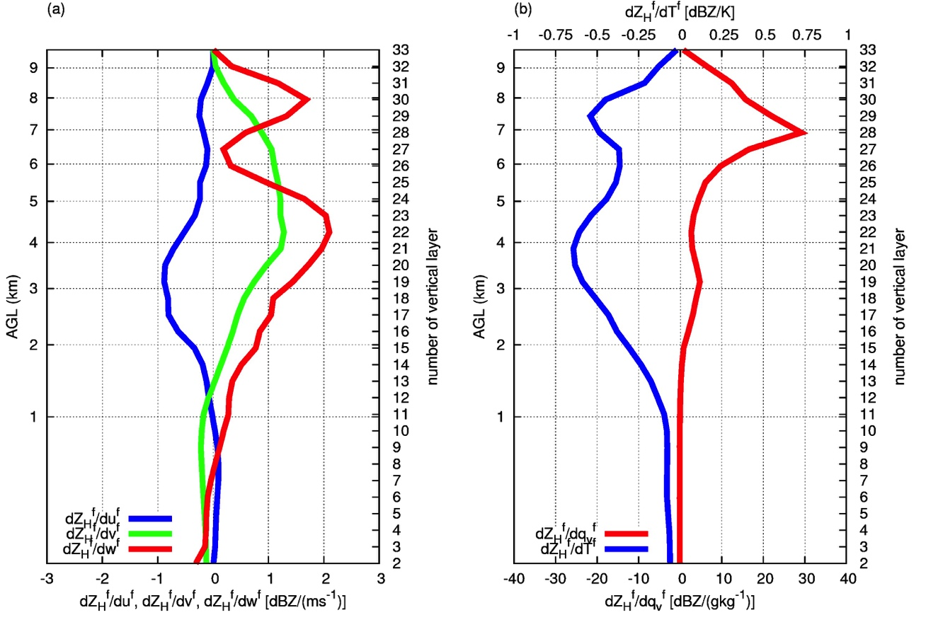
Characteristic of Added δZ_{H}^{f}
Results (2012/5/6)
8/16
Slope of regression line (δZ_{H}^{f}/δx^{f}) in 1110JST
Large Z_{H}^{f}
⇔ Strong w^{f}
∂Z_{H}^{f}/∂q_{v}^{f}
∂Z_{H}^{f}/∂u^{f}
Large Z_{H}^{f}
⇔ Strong v^{f}
∂Z_{H}^{f}/∂w^{f}
∂Z_{H}^{f}/∂T^{f}
Large Z_{H}^{f}
⇔ large q_{v}^{f}
∂Z_{H}^{f}/∂v^{f}
Notes:
Here is the result of the assimilation experiment.
This is vertical profile of slope of regression line in the first assimilation cycle, which is calculated with all grid of whole calculation domain in each vertical level.
As you can see, slopes about meridional wind, vertical wind, and water vapor are positive.
So, large reflectivity is correspond to large meridional wind, vertical wind, and water vapor.
This is reasonable relationship, and based on this slope, perturbation is created.

Slide 10
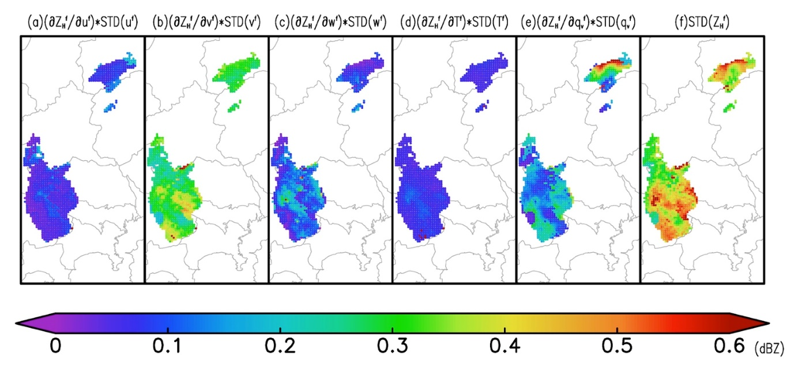
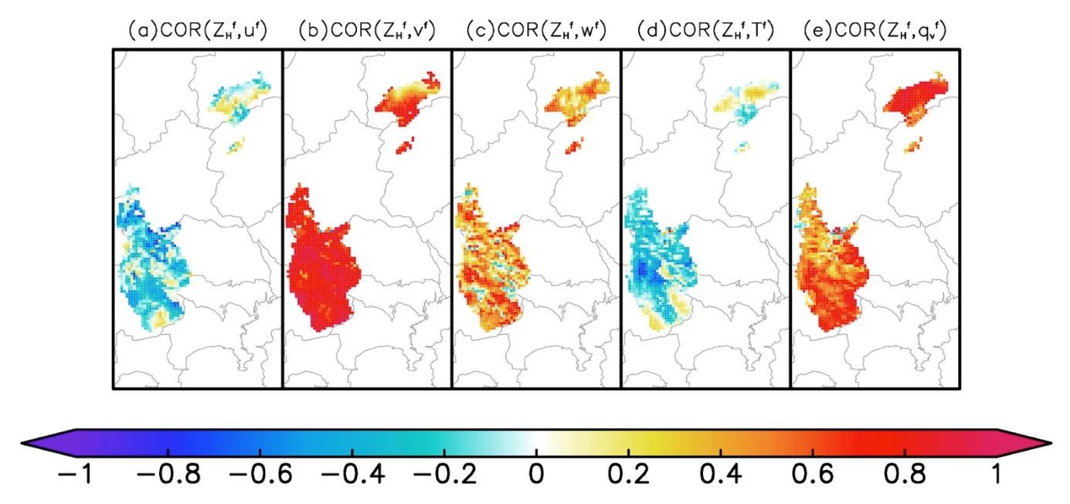
Characteristic of Added δZ_{H}^{f}
Results (2012/5/6)
9/16
Each term of standard deviation of δZ_{H}^{f(i)} (dBZ) in 1110JST @5-km AGL
Contributions of δv^{f} and δq_{v}^{f} are larger
u^{f}
v^{f}
w^{f}
T^{f}
q_{v}^{f}
TOTAL
Correlation between
x^{f}=(u^{f}, v^{f}, w^{f}, T^{f}, q_{v}^{f}) and δZ_{H}^{f}
in 1110JST @5-km AGL
Large correlation of δv^{f} and δq_{v}^{f}
u^{f}
v^{f}
w^{f}
T^{f}
q_{v}^{f}
Notes:
Each term of standard deviation of this ensemble perturbation is shown here.
You can see that contribution of meridional wind and water vapor is larger than the other terms.
This means that larger reflectivity is mainly correlated with larger meridional wind and water vapor.
In fact, correlations between the atmospheric state and the additional reflectivity perturbations are especially large for meridional wind and water vapor.

Slide 11
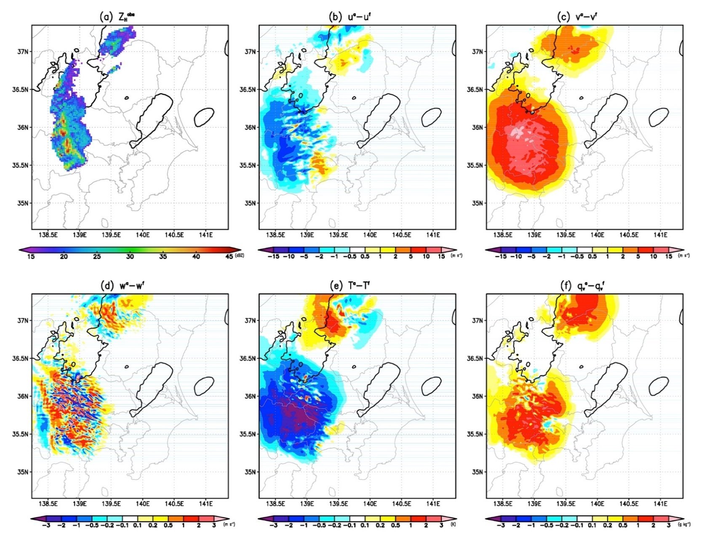
Modification of Atmospheric State by Additional δZ_{H}^{f}
Results (2012/5/6)
10/16
Z_{H}^{obs} assimilated with perturbations
Analysis increment (xª–x^{f}) in 1110JST @5-km AGL （Contour shows Z_{H}^{f}=0dBZ）
uª−u^{f}
vª−v^{f}
Positive increment of δv^{f} and δq_{v}^{f} where rainfall is not forecasted
wª−w^{f}
Tª−T^{f}
q_{v}ª−q_{v}^{f}
Notes:
Based on these correlation, the atmospheric state is modified through reflectivity assimilation.
This panel is the reflectivity obs. assimilated with perturbations.
And these are analysis increments of the atmospheric state.
Blue contours show forecasted rainfall.
At points where rainfall is not forecasted, reflectivity is assimilated with state-dependent perturbations.
As you can see, these reflectivity obs. create positive analysis increments of meridional wind and water vapor.

Slide 12
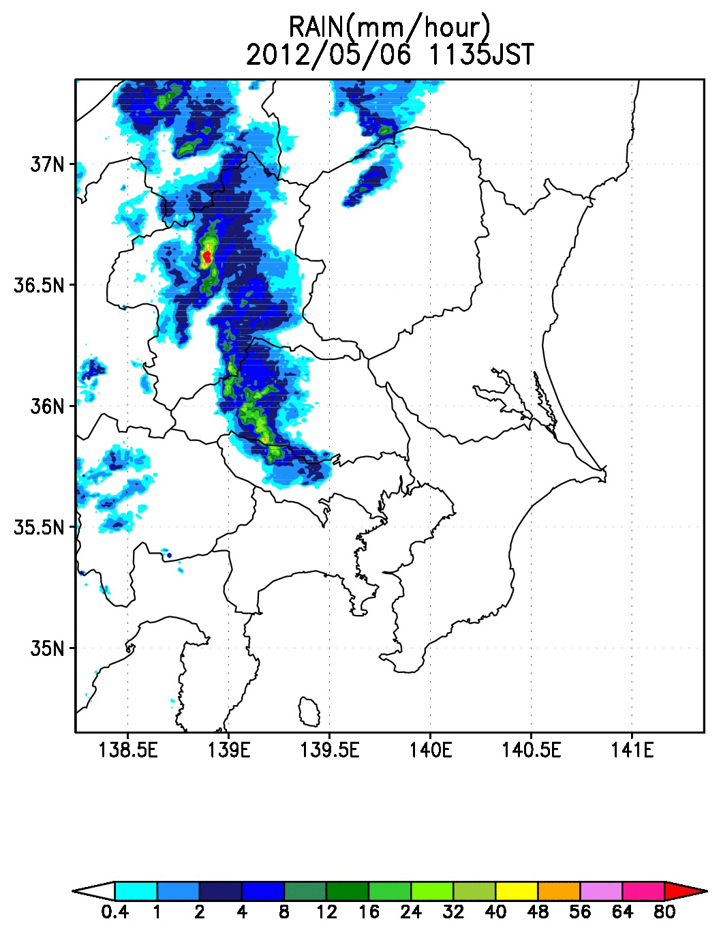
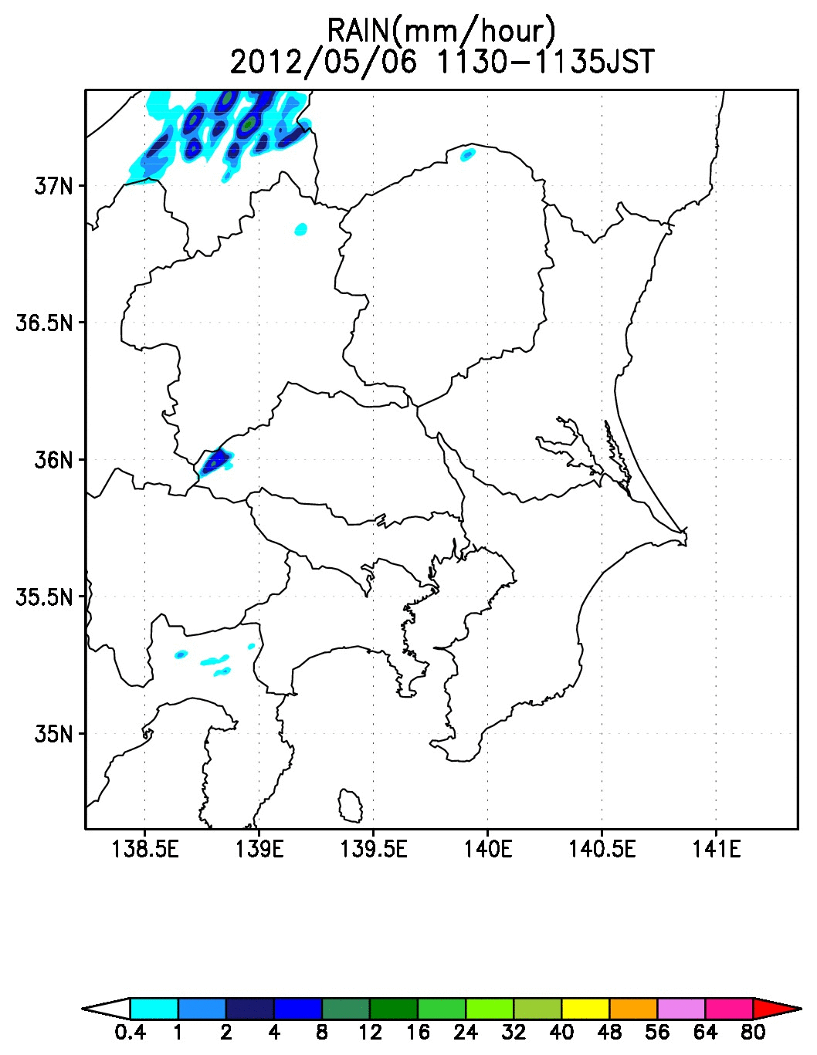
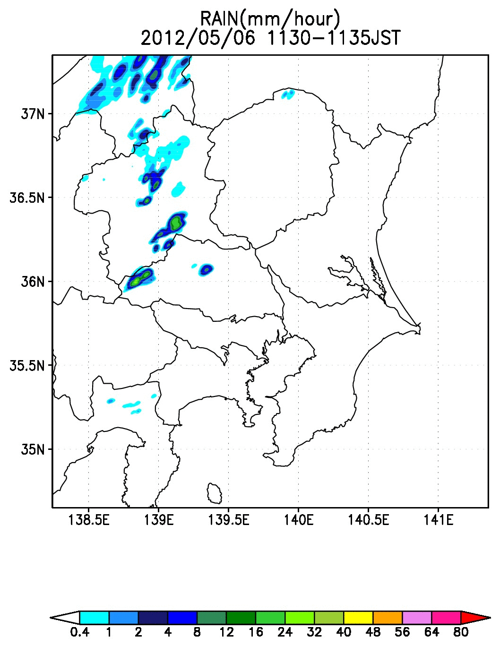
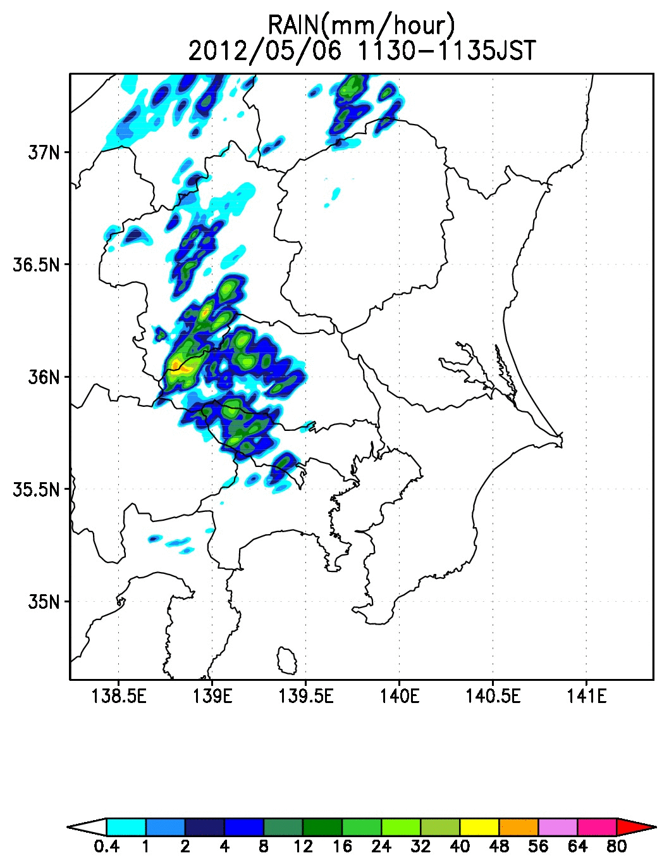
Change of Rainfall Forecast by Additional δZ_{H}^{f}
Results (2012/5/6)
11/16
Rainfall in 1130-1300JST
(mm/hour)
Assimilate Z_{H}^{obs}
without additional δZ_{H}^{f}
Assimilate Z_{H}^{obs}
with additional δZ_{H}^{f}
Not assimilate Z_{H}^{obs}
JMA Radar observation
Notes:
These analysis increments largely affect the rainfall forecast.
This is the result of rainfall forecast from the analysis in the experiment where reflectivity is not assimilated.
In this experiment, rainfall is weak and not enough.
This is forecast from the experiment where reflectivity is assimilated without additional perturbation.
In this experiment, rainfall is stronger, but rainfall region is still small.
This is forecast from the experiment where reflectivity is assimilated WITH additional perturbation.
Actual F3 tornado was generated at south edge of this strong rainfall at this time.
In this experiment, this strong rainfall is successfully forecasted.

Slide 13
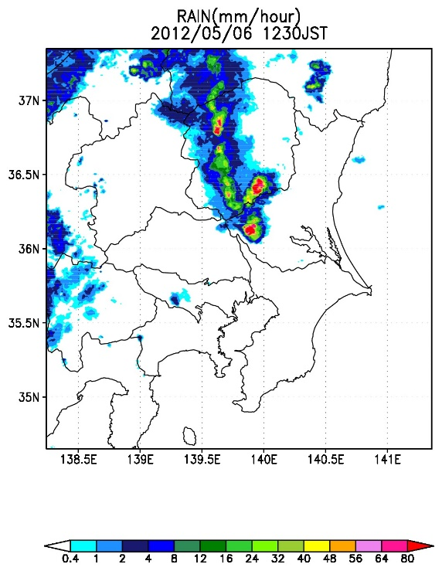
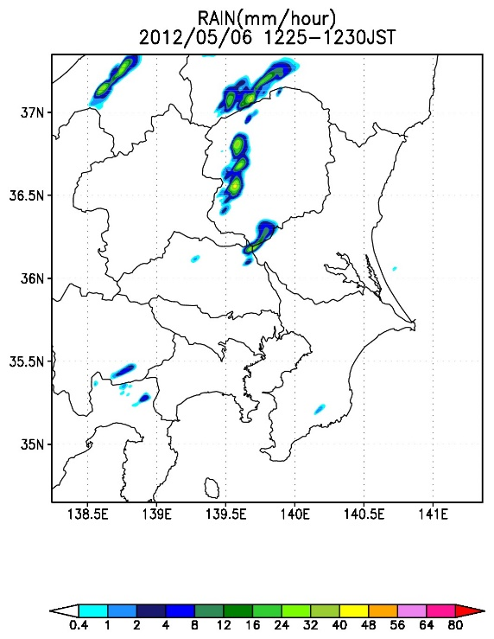
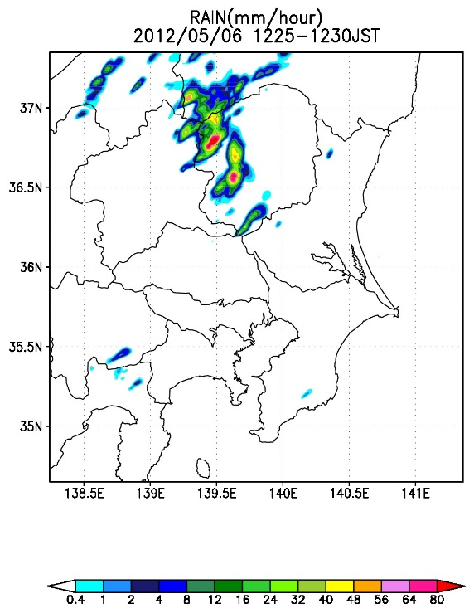
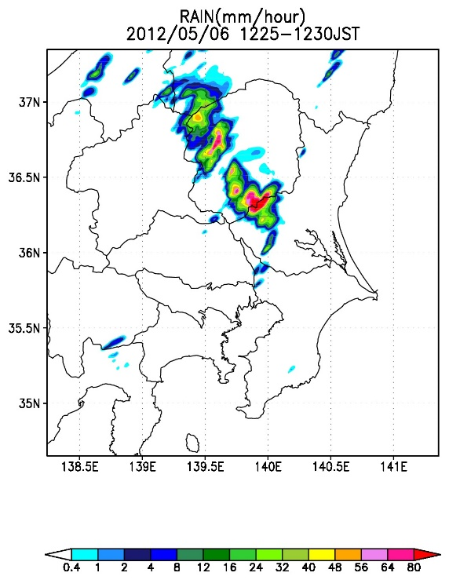
Change of Rainfall Forecast by Additional δZ_{H}^{f}
Results (2012/5/6)
12/16
Rainfall in 1225-1230JST
(mm/hour)
Assimilate Z_{H}^{obs}
without additional δZ_{H}^{f}
Assimilate Z_{H}^{obs}
with additional δZ_{H}^{f}
Not assimilate Z_{H}^{obs}
JMA Radar observation
F3 tornado was generated here at this time
Strong rainfall was successfully forecasted
Notes:
These analysis increments largely affect the rainfall forecast.
This is the result of rainfall forecast from the analysis in the experiment where reflectivity is not assimilated.
In this experiment, rainfall is weak and not enough.
This is forecast from the experiment where reflectivity is assimilated without additional perturbation.
In this experiment, rainfall is stronger, but rainfall region is still small.
This is forecast from the experiment where reflectivity is assimilated WITH additional perturbation.
Actual F3 tornado was generated at south edge of this strong rainfall at this time.
In this experiment, this strong rainfall is successfully forecasted.

Slide 14
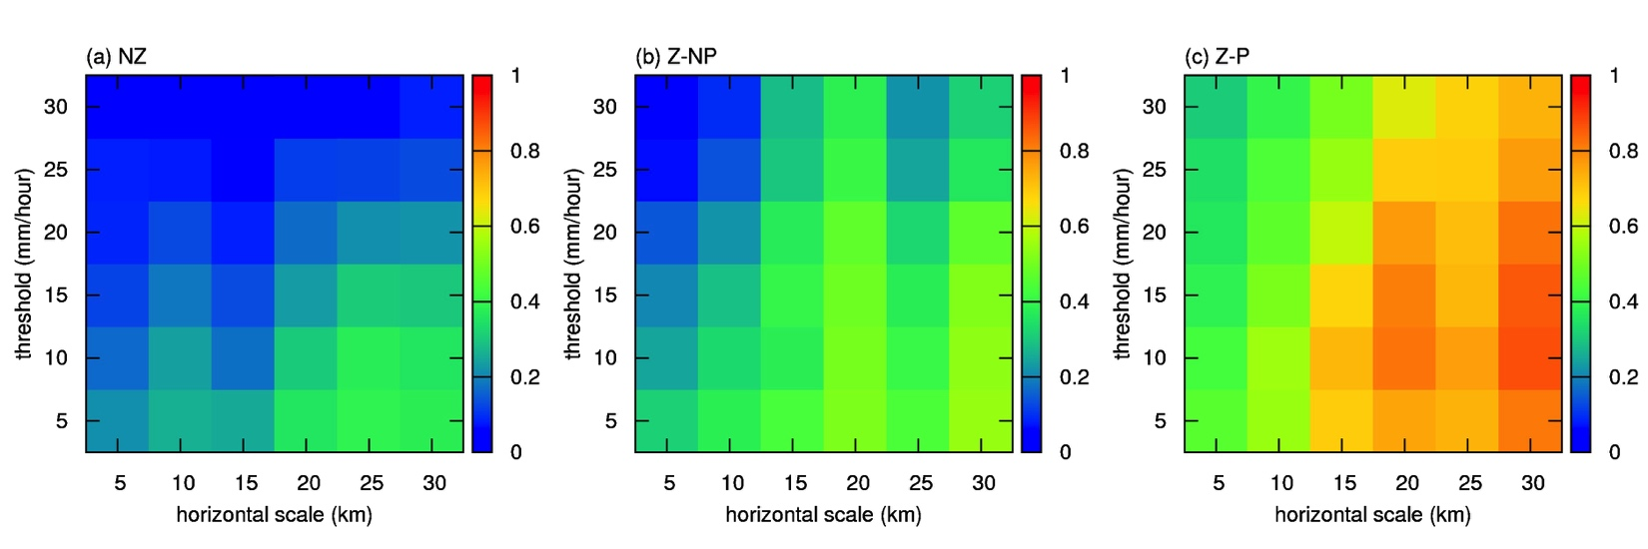
Fractions Skill Score Verification
Results (2012/5/6)
13/16
To compare rainfall estimated by JMA radars at 1230JST
Assimilate Z_{H}^{obs}
without additional δZ_{H}^{f}
Assimilate Z_{H}^{obs}
with additional δZ_{H}^{f}
Not assimilate Z_{H}^{obs}
JMA Radar observation
strong
weak
small
large
small
large
small
large
Notes:
We verify these rainfall forecasts in this timing using the fractions skill score.
Top of each panel is FSS calculated only with strong rainfall.
Right is FSS permitting large position shift.
You can see that forecasts of both weak and strong rainfall are improved in this experiment.
Moreover, the position of the rainfall is also well forecasted.

Slide 15
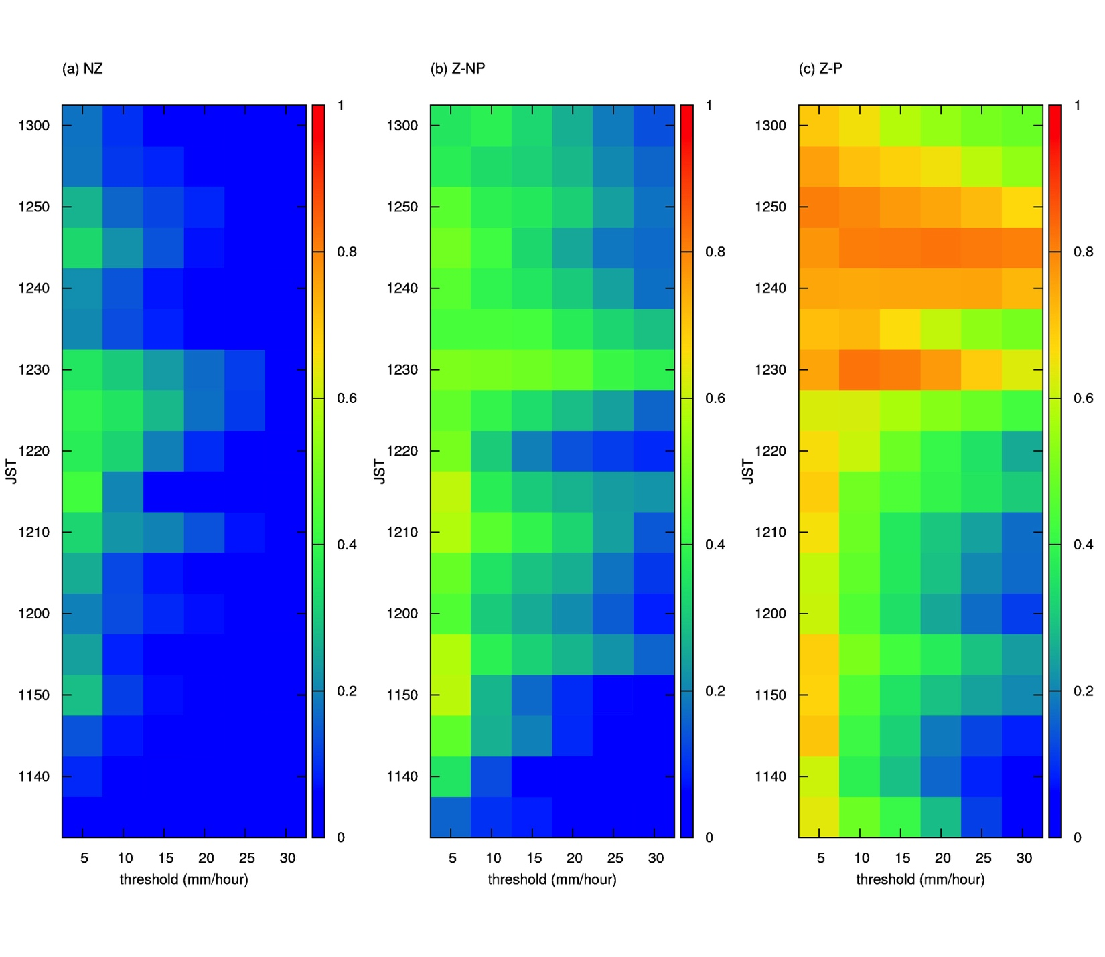
Fractions Skill Score Verification
Results (2012/5/6)
14/16
Verification using rainfall estimated by JMA radars between 1130-1300JST
(horizontal scale=20km)
Assimilate Z_{H}^{obs}
without additional δZ_{H}^{f}
Assimilate Z_{H}^{obs}
with additional δZ_{H}^{f}
Not assimilate Z_{H}^{obs}
Improvement starts from the initial time and remains for 90 min.
weak
strong
weak
strong
weak
strong
Notes:
These are time series of FSS during whole 90 min. forecasts.
Generally, the effect of radar reflectivity assimilation is limited only to hydrometer near initial analysis time.
However, in this experiment, improvement of the rainfall forecast remains during 90 min. from the initial time.
This means that the initial atmospheric state and associated rainfall forecast are fundamentally improved.

Slide 16
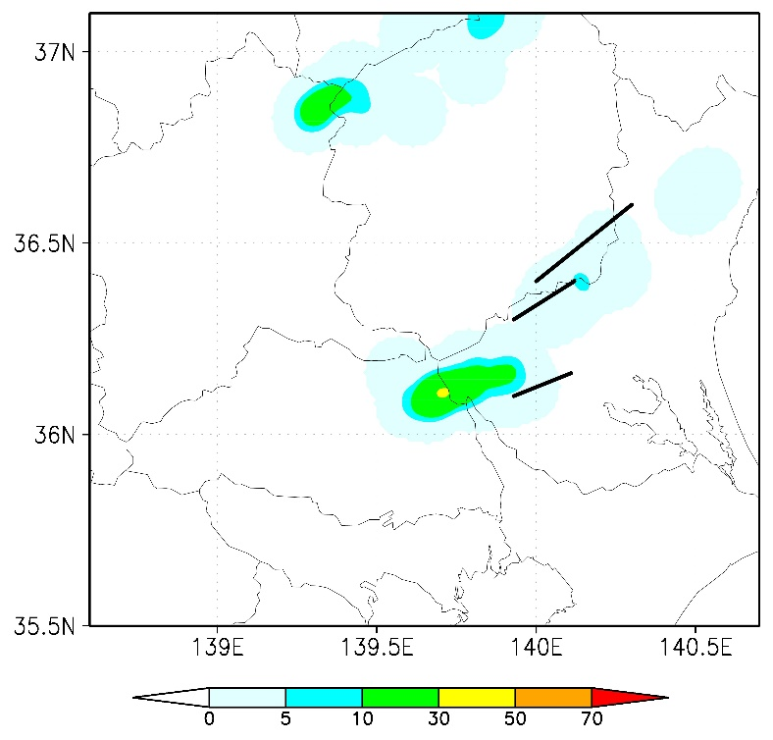
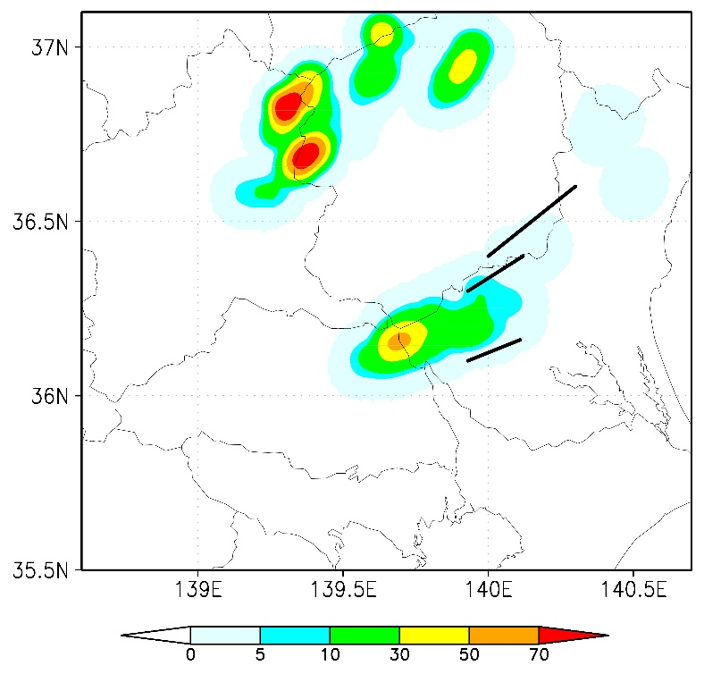
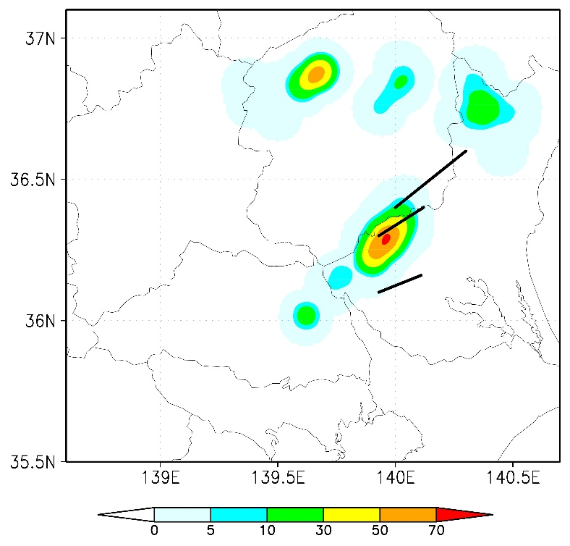
Probabilistic Forecasts of Low-level Mesocyclones
Results (2012/5/6)
15/16
Probability that high-vorticity area (>0.01/s) appears within the radius of 10km in 1200-1300JST @z*=1km using 51 ensemble members
Assimilate Z_{H}^{obs}
without additional δZ_{H}^{f}
Assimilate Z_{H}^{obs}
with additional δZ_{H}^{f}
Not assimilate Z_{H}^{obs}
Black lines: Damaged area
Earlier than the actual case
False
More realistic
Notes:
Because the rainfall forecast is improved, the forecasts of low-level mesocyclones, which is generated at the southern tip of the rainfall region, are also improved.
This is the probability map of high-vorticity area appearing within the radius of 10km using 51-member ensemble forecasts of 1-km resolution.
If ZH is not assimilated, mesocyclones are generated earlier than the actual case and the probability is low.
If ZH is assimilated without additional state-dependent perturbations, false high-vorticity is appeared in the north area.
If ZH is assimilated with these perturbations, mesocyclones are forecasted more realistically like this.

Slide 17
Summary
16/16
Summary
  To improve rainfall forecast by “direct” assimilation of Z_{H}, atmospheric state should be modified based on correlation between the Atmospheric State and Hydrometeor
  However, there is no impact of assimilation of Z_{H} at points where rainfall is not forecasted
  → We suggest to add Z_{H} perturbations correlated with the atmospheric state before assimilation at points where rainfall was not forecasted. (It has possibly to improve short-term rainfall forecast.)
Future issues
  Applying to other cases (local rainfall, snow, and so on)
  Improving making perturbations when the number of samples is small
  Improving attenuation correction of snow and graupel
Acknowledgements: This work was supported in part by “Social and Scientific Priority Issues (Theme 4) to Be Tackled by Using Post K Computer of the FLAGSHIP2020 Project” (ID: hp160229, hp170246, hp180194), “Tokyo Metropolitan Area Convection Study for Extreme Weather Resilient Cities (TOMACS),” and JSPS KAKENHI Grant Number JP16K17804 and JP16H04054. Radar data were provided from JMA and Ministry of Land, Infrastructure, Transport and Tourism. Surface data were provided from JMA and NTT DOCOMO, Inc.
Notes:
In summary, to improve direct reflectivity assimilation, the atmospheric state should be modified based on correlation between the atmospheric state and hydrometeor.
But this correlation cannot be estimated in EnKF if rainfall is not forecasted.
At such points, there is no impact of reflectivity assimilation.
So, we suggest to add reflectivity perturbations correlated with the atmospheric state before assimilation there.
And it has possibility to improve short-term rainfall and vorticity forecast.
Today, I introduced only one case. But we confirmed positive impact of this additional perturbation in another supercell case.
I think this scheme has advantage especially for the local rainfall.
So, now we try to apply this scheme to the case of local rainfall.

Slide 18
Supplement

Slide 19
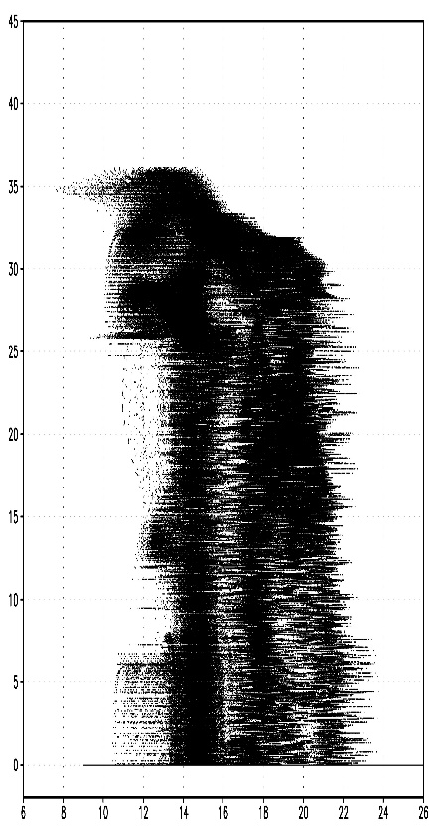
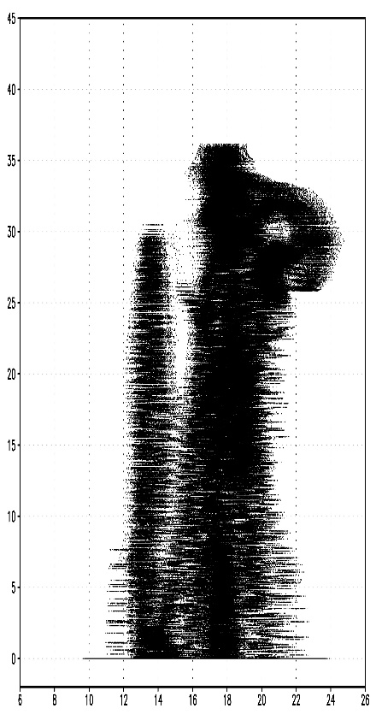
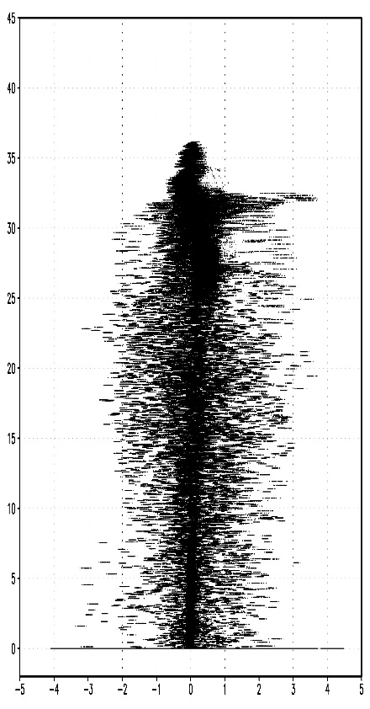
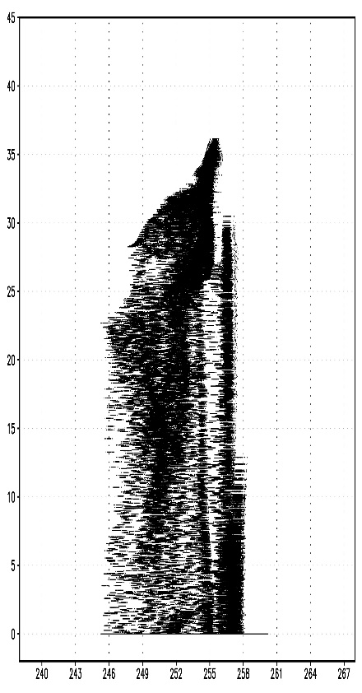
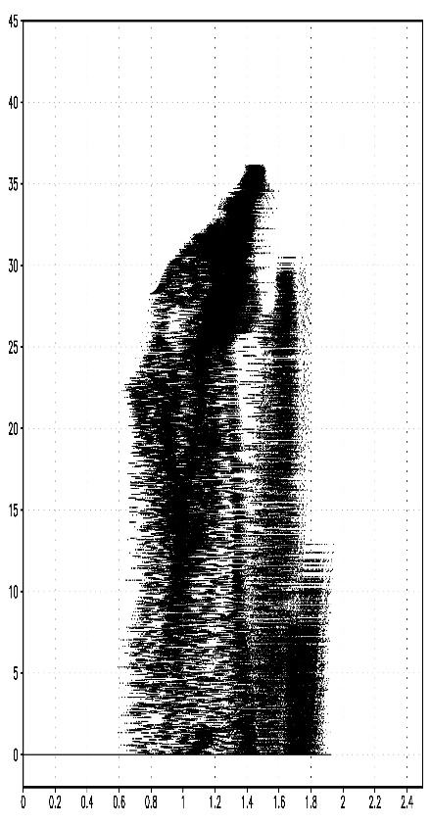
Characteristic of Added δZ_{H}^{f}
Results (2012/5/6)
18/16
Slope of regression line (δZ_{H}^{f}/δx^{f}) based on scatter plots of Z_{H}^{f} and x^{f} in 1110JST @5-km AGL
Correlation
coefficient
∂Z_{H}^{f}/∂u^{f}
∂Z_{H}^{f}/∂v^{f}
∂Z_{H}^{f}/∂w^{f}
∂Z_{H}^{f}/∂T^{f}
∂Z_{H}^{f}/∂q_{v}^{f}
(dBZ)
–0.093
+0.461
+0.095
–0.171
+0.262
(m s^{–1})
(m s^{–1})
(m s^{–1})
(K)
(g kg^{–1})

Slide 20
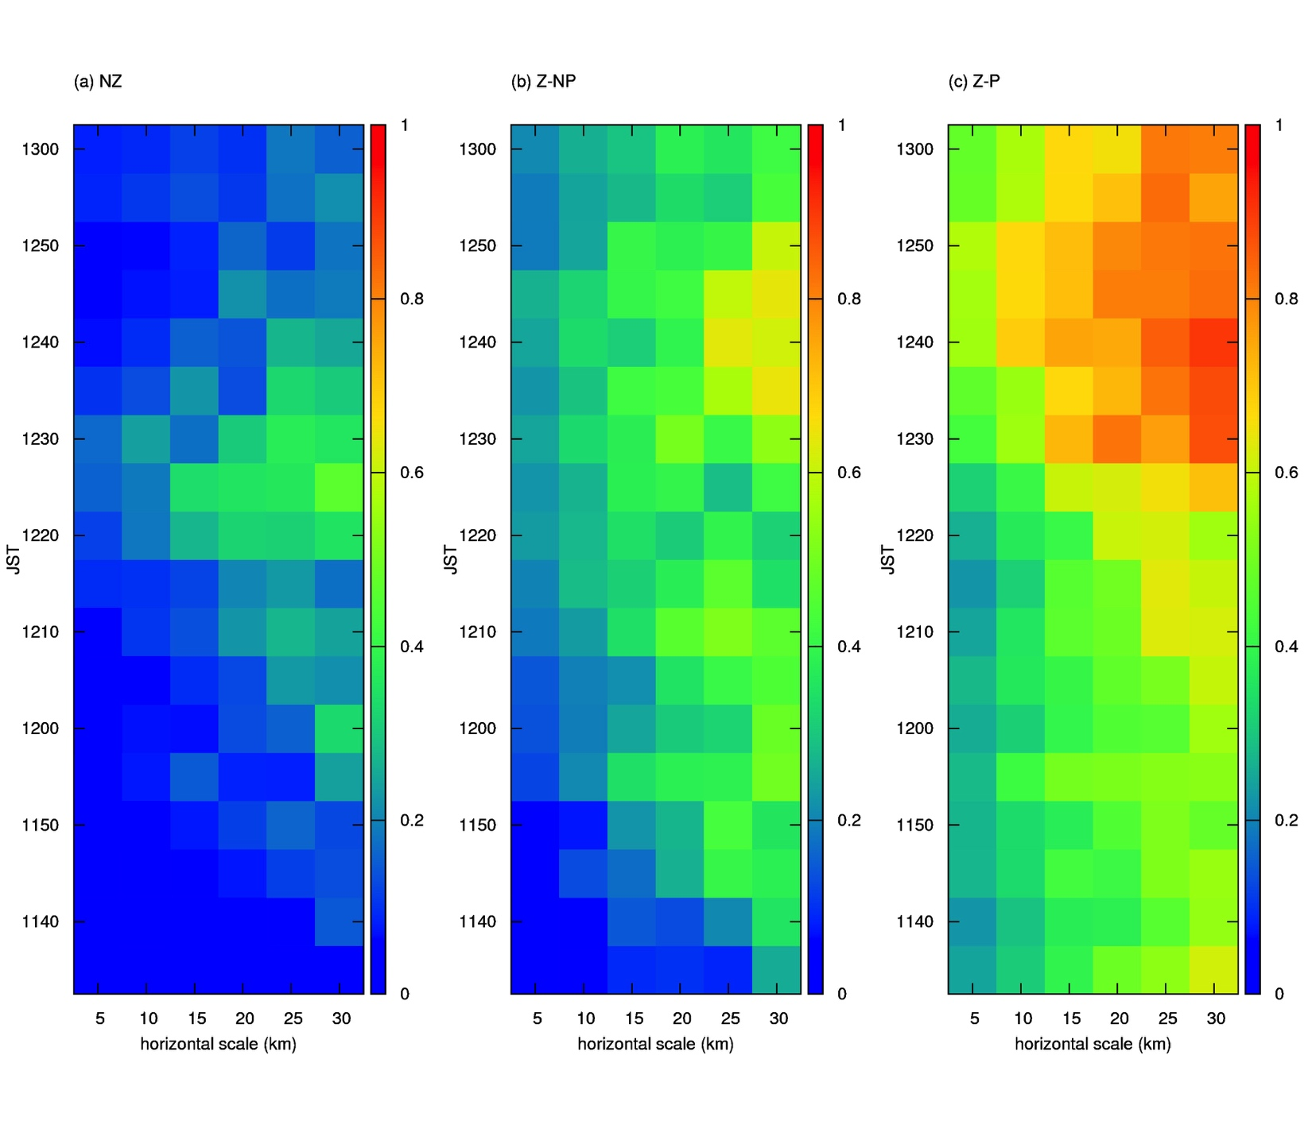
Fractions Skill Score Verification
Results (2012/5/6)
19/16
Verification using rainfall estimated by JMA radars between 1130-1300JST
(threshold=10mm/hr)
Assimilate Z_{H}^{obs}
without additional δZ_{H}^{f}
Assimilate Z_{H}^{obs}
with additional δZ_{H}^{f}
Not assimilate Z_{H}^{obs}

Slide 21
Assimilation Experiments with LETKF (2013/9/2)
Comparison with the case in 2012/5/6
20/16
システムの概要（矢印：アンサンブル予報、楕円：LETKF解析）
メンバー数50+1(平均)
8/30, 09JST～
9/2, 03JST
9/2, 09JST
9/2, 15JST
親LETKF
- 格子間隔15km
- 局所化半径200km
Downscaling
9/2 03JST～
1時間間隔の
現業観測を
6時間おきに
同化
子LETKF
- 格子間隔5km
- 局所化半径100km
孫LETKF
- 格子間隔1km
- 局所化半径20km
Downscaling
9/2 13JST～
1330JSTから
1500JSTまで延長予報
10分間隔の
レーダー動径風と
地上観測を
1時間おきに同化
1分間隔の
レーダー観測（動径風・
反射強度）と地上観測を
10分おきに同化
※モデルの雲物理は1-momentバルク法
現業観測： 地上観測 (気圧), ラジオゾンデ (風, 湿度, 気温), 航空機観測 (風, 気温),
レーダー (風, 湿度), ウインドプロファイラ (風)
レーダー観測： 東京・羽田・成田・XRAIN(関東・新横浜・香貫山・富士宮・静岡北)の動径風,
XRAINの偏波間位相差で減衰補正した反射強度
地上観測： 気象官署・アメダス・NTTドコモ環境センサーネットワークの風, 気温, 湿度

Slide 22
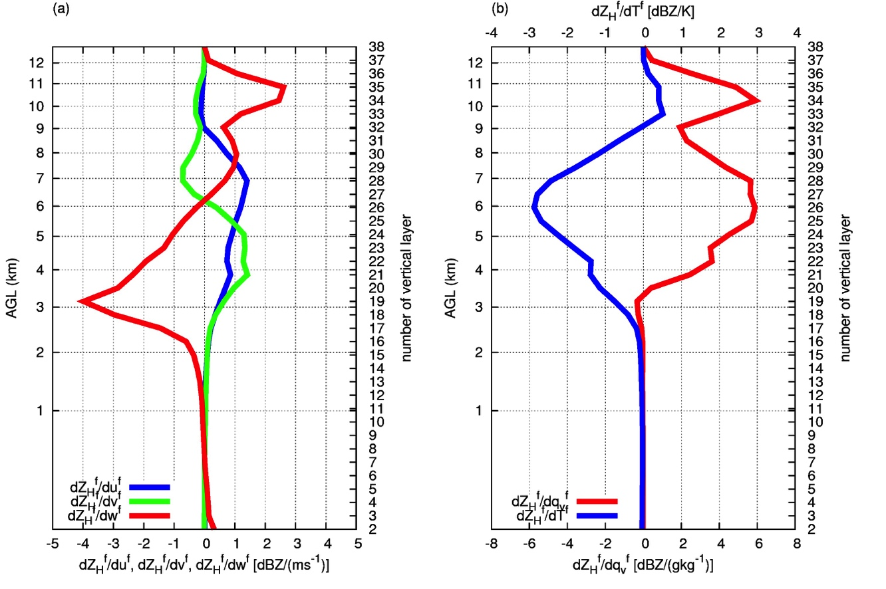
Characteristic of Added δZ_{H}^{f}
Results (2013/9/2)
21/16
Slope of regression line (δZ_{H}^{f}/δx^{f}) in 1310JST
∂Z_{H}^{f}/∂q_{v}^{f}
∂Z_{H}^{f}/∂u^{f}
∂Z_{H}^{f}/∂w^{f}
∂Z_{H}^{f}/∂v^{f}
∂Z_{H}^{f}/∂T^{f}
Large Z_{H}^{f}
⇔ large q_{v}^{f}

Slide 23
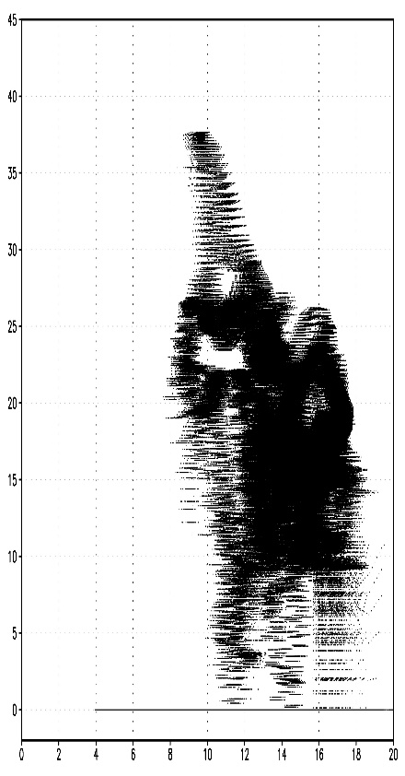
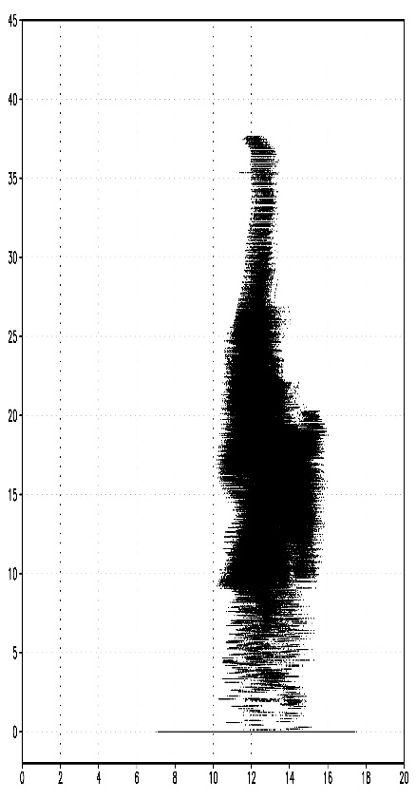
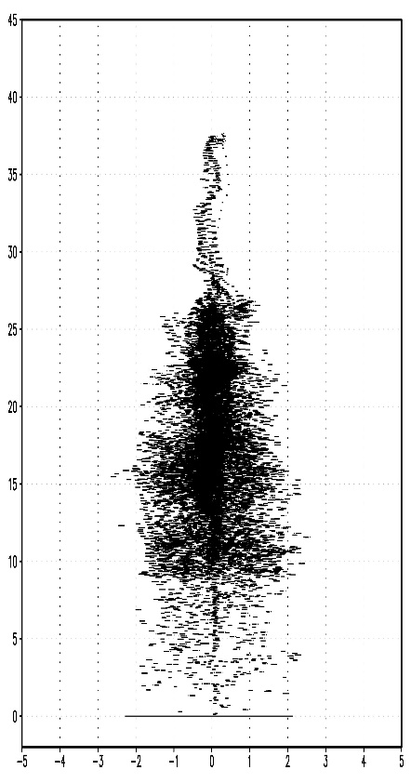
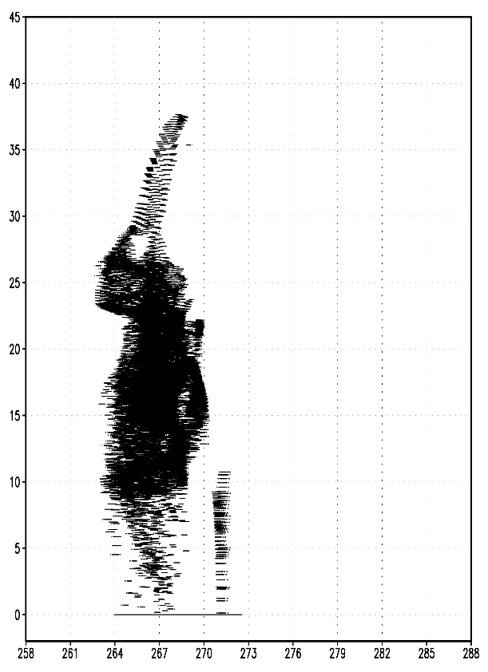
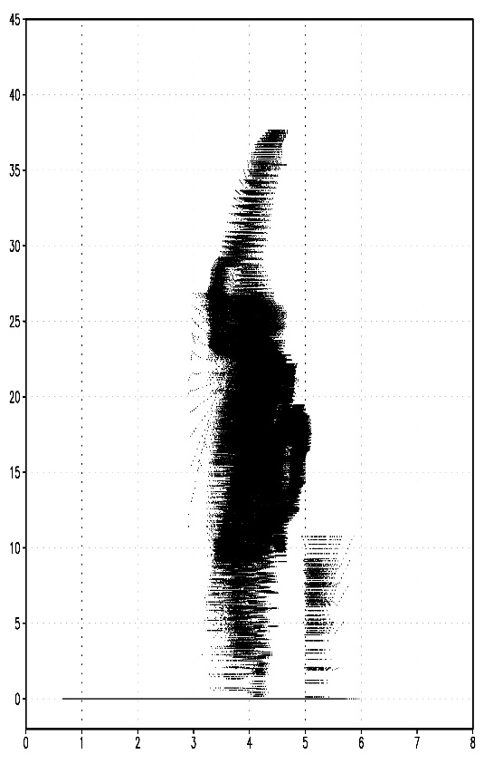
Characteristic of Added δZ_{H}^{f}
Results (2013/9/2)
22/16
Slope of regression line (δZ_{H}^{f}/δx^{f}) based on scatter plots of Z_{H}^{f} and x^{f} in 1310JST @5-km AGL
Correlation
coefficient
∂Z_{H}^{f}/∂u^{f}
∂Z_{H}^{f}/∂v^{f}
∂Z_{H}^{f}/∂w^{f}
∂Z_{H}^{f}/∂T^{f}
∂Z_{H}^{f}/∂q_{v}^{f}
(dBZ)
+0.431
+0.321
–0.048
–0.670
+0.597
(m s^{–1})
(m s^{–1})
(m s^{–1})
(K)
(g kg^{–1})

Slide 24
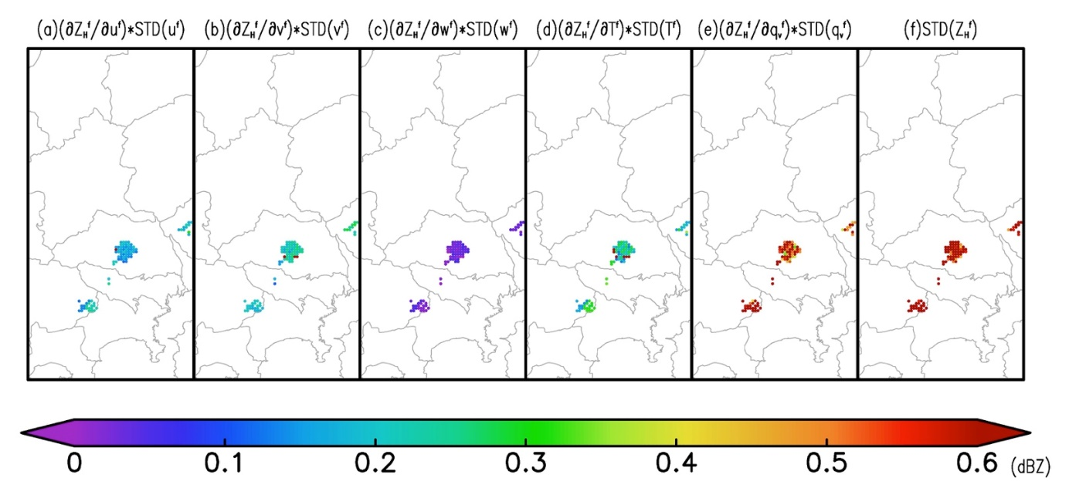
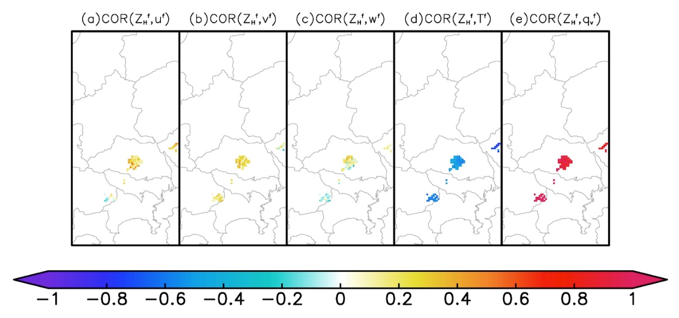
Characteristic of Added δZ_{H}^{f}
Results (2013/9/2)
23/16
Each term of standard deviation of δZ_{H}^{f(i)} (dBZ) in 1310JST @5-km AGL
Contribution of δq_{v}^{f} is larger
Correlation between
x^{f}=(u^{f}, v^{f}, w^{f}, T^{f}, q_{v}^{f}) and δZ_{H}^{f}
in 1310JST @5-km AGL
Large correlation of δq_{v}^{f}

Slide 25
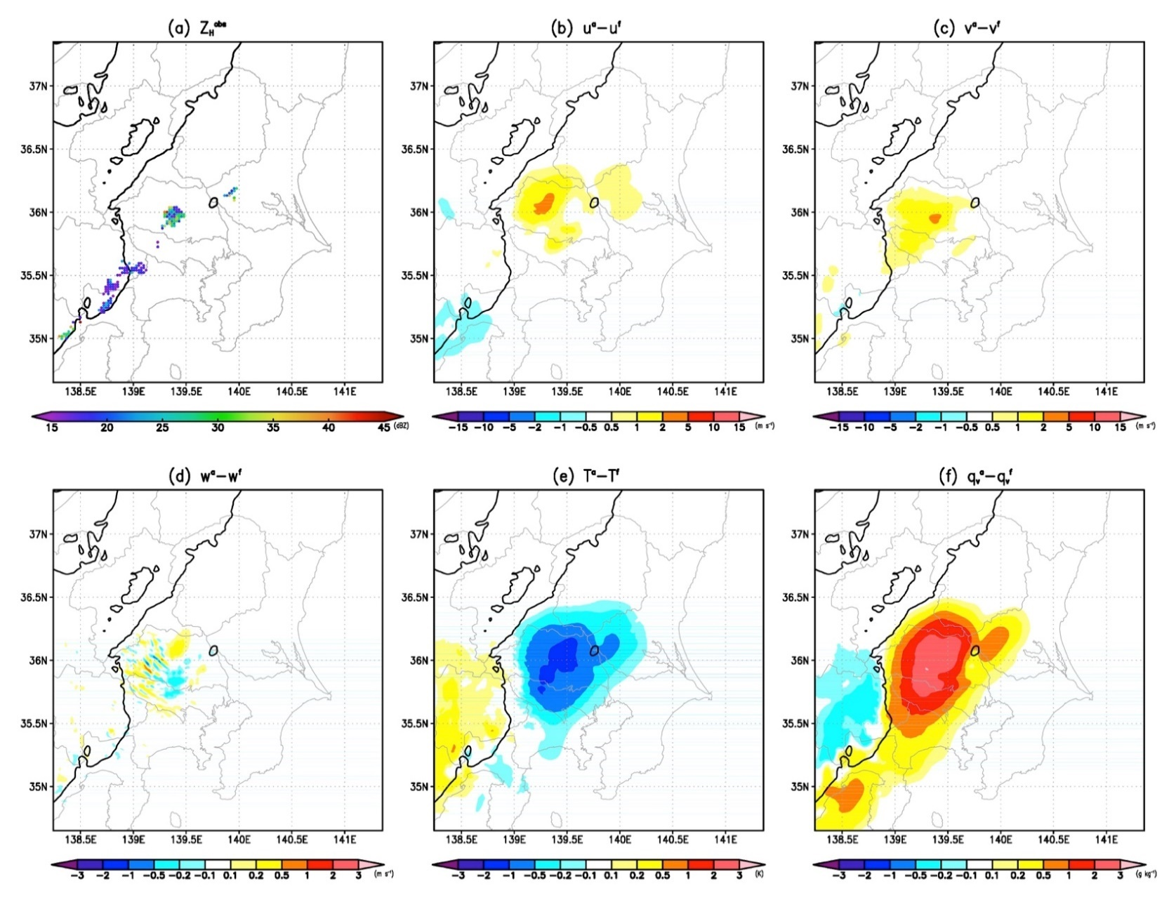
Modification of Atmospheric State by Additional δZ_{H}^{f}
Results (2013/9/2)
24/16
Analysis increment (xª–x^{f}) in 1310JST @5-km AGL （Blue contour shows Z_{H}^{f}=0dBZ）
uª−u^{f}
vª−v^{f}
Z_{H}^{obs} assimilated with perturbations
Positive increment of δq_{v}^{f} where rainfall is not forecasted
wª−w^{f}
Tª−T^{f}
q_{v}ª−q_{v}^{f}

Slide 26
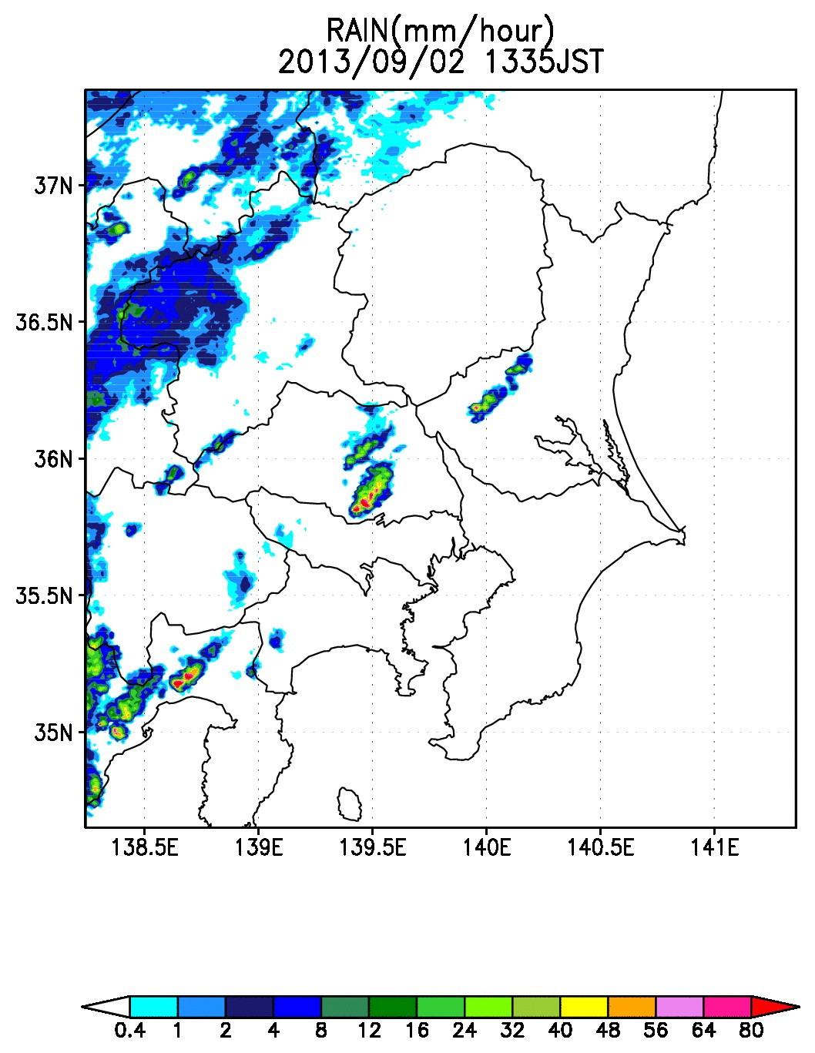
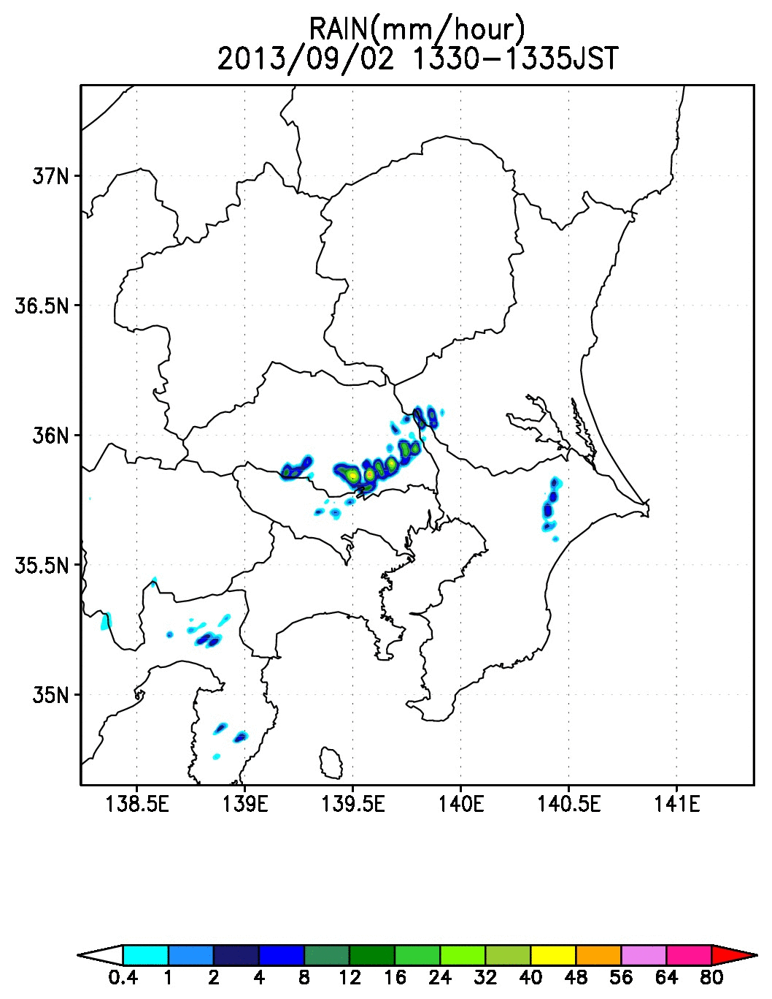
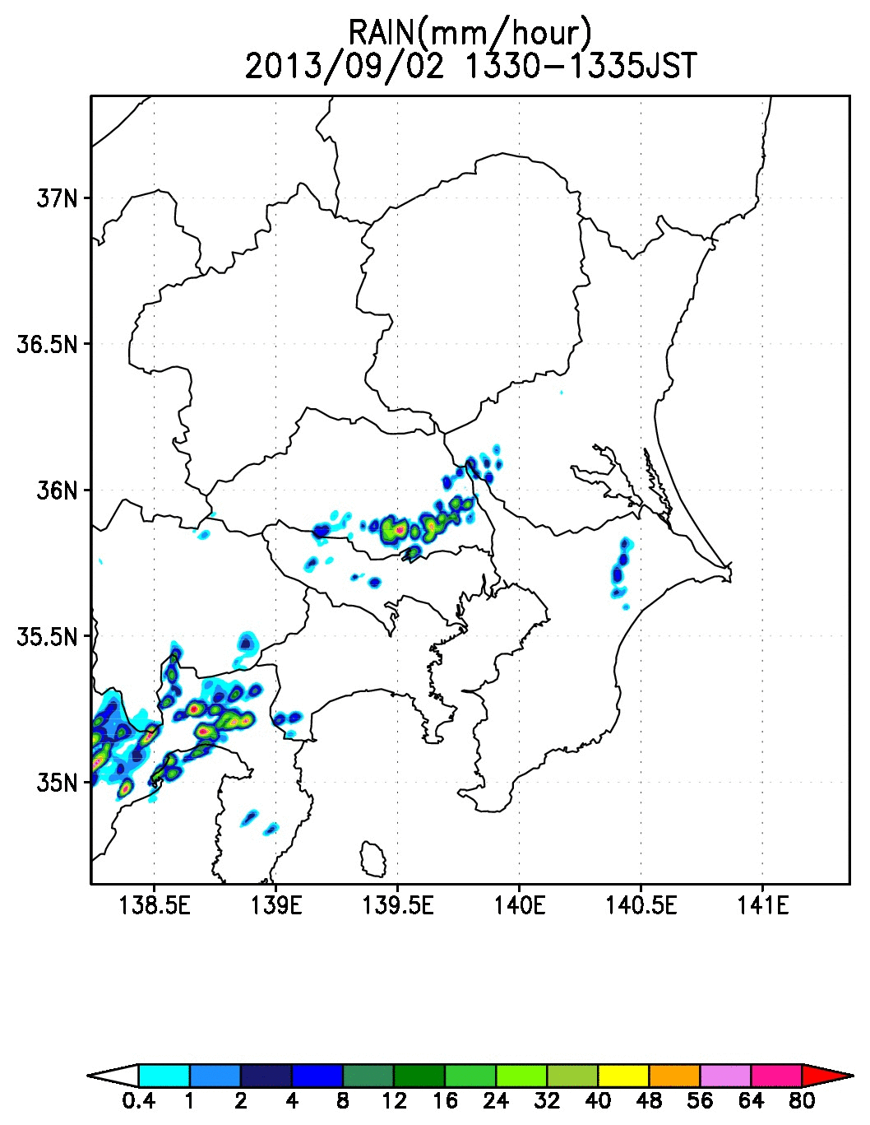

Change of Rainfall Forecast by Additional δZ_{H}^{f}
Results (2013/9/2)
25/16
Rainfall in 1330-1500JST
(mm/hour)
Assimilate Z_{H}^{obs}
without additional δZ_{H}^{f}
Assimilate Z_{H}^{obs}
with additional δZ_{H}^{f}
Not assimilate Z_{H}^{obs}
JMA Radar observation

Slide 27
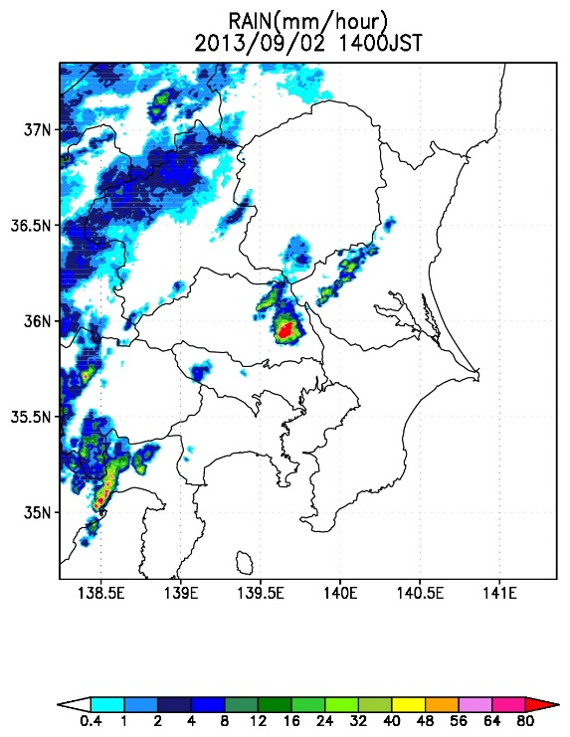
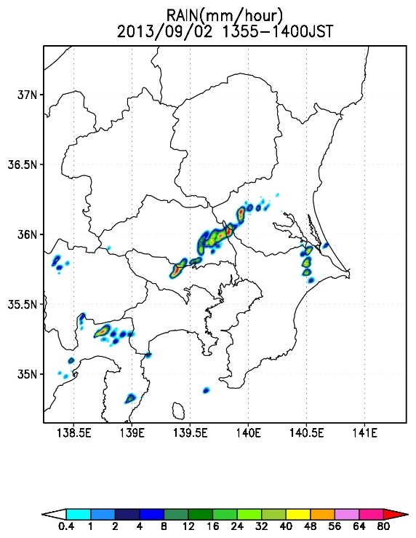
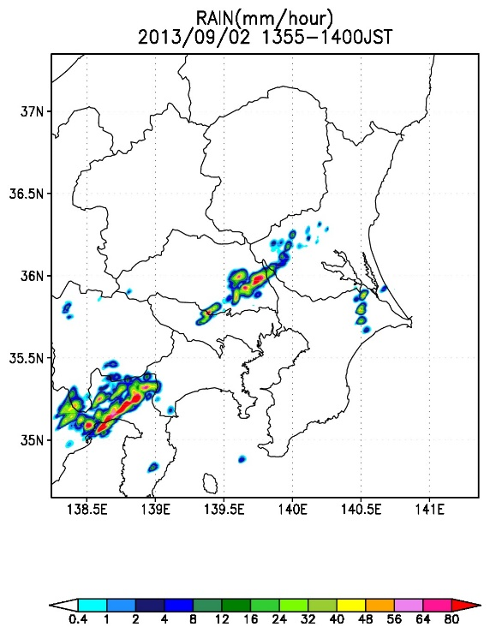
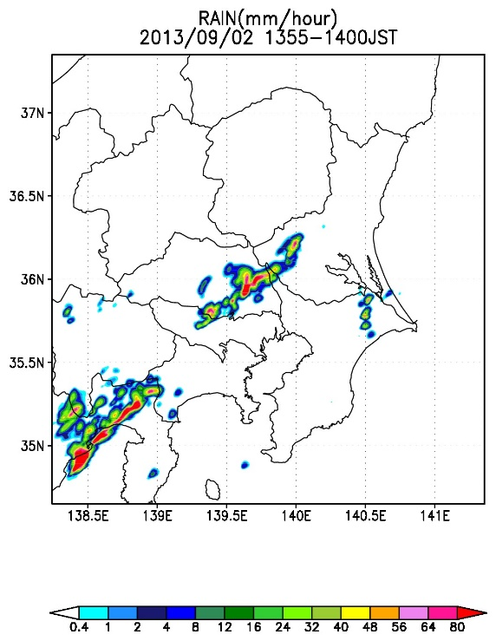
Change of Rainfall Forecast by Additional δZ_{H}^{f}
Results (2013/9/2)
26/16
Rainfall in 1355-1400JST
(mm/hour)
Assimilate Z_{H}^{obs}
without additional δZ_{H}^{f}
Assimilate Z_{H}^{obs}
with additional δZ_{H}^{f}
Not assimilate Z_{H}^{obs}
JMA Radar observation
F2 tornado was generated here at this time
Strong rainfall was successfully forecasted

Slide 28
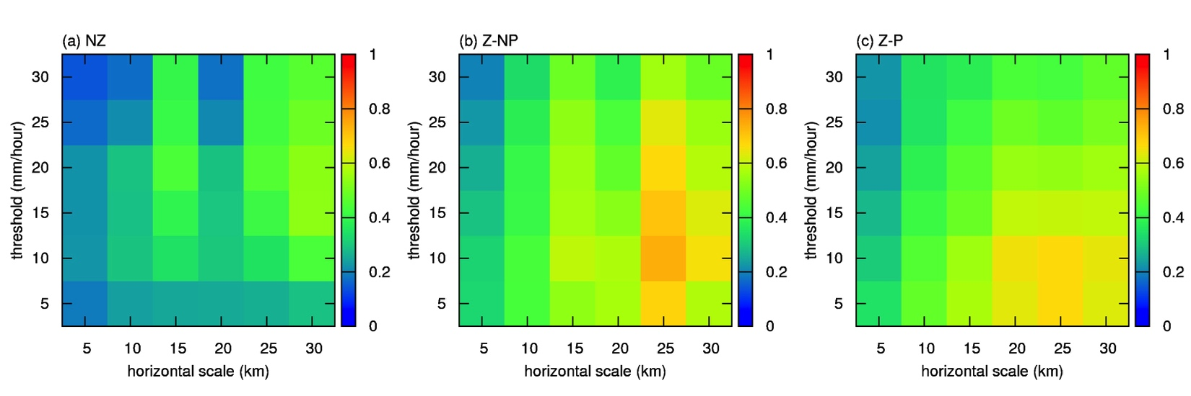
Fractions Skill Score Verification
Results (2013/9/2)
27/16
To compare rainfall estimated by JMA radars at 1400JST
Assimilate Z_{H}^{obs}
without additional δZ_{H}^{f}
Assimilate Z_{H}^{obs}
with additional δZ_{H}^{f}
Not assimilate Z_{H}^{obs}
JMA Radar observation

Slide 29
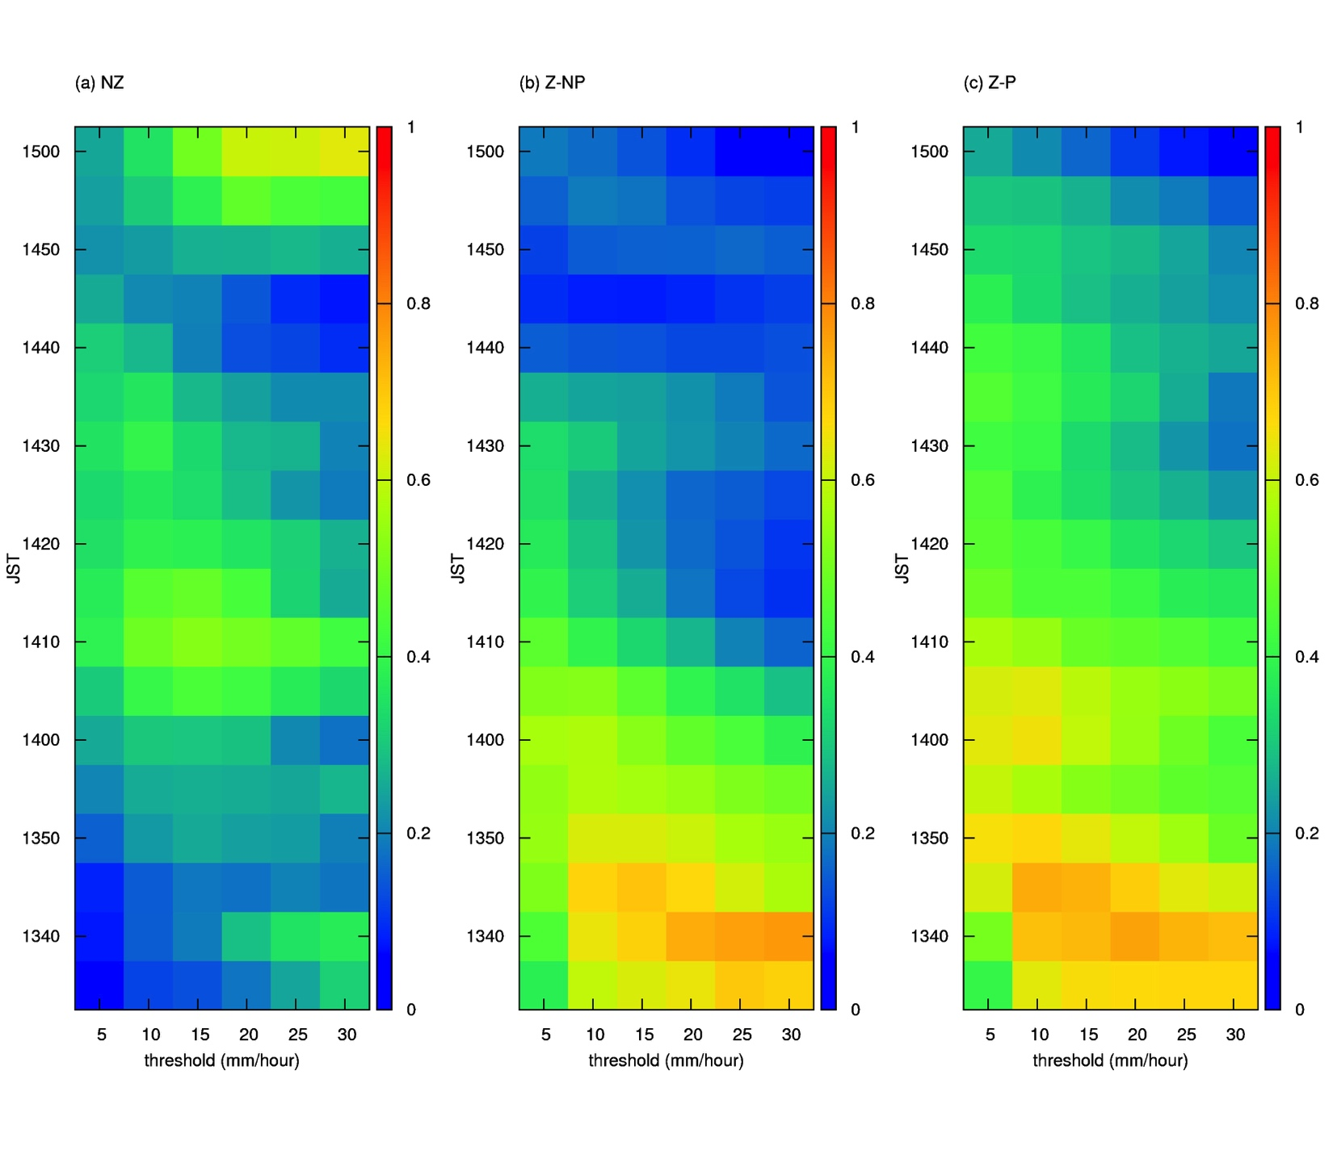
Fractions Skill Score Verification
Results (2013/9/2)
28/16
Verification using rainfall estimated by JMA radars between 1330-1500JST
(horizontal scale=20km)
Assimilate Z_{H}^{obs}
without additional δZ_{H}^{f}
Assimilate Z_{H}^{obs}
with additional δZ_{H}^{f}
Not assimilate Z_{H}^{obs}

Slide 30
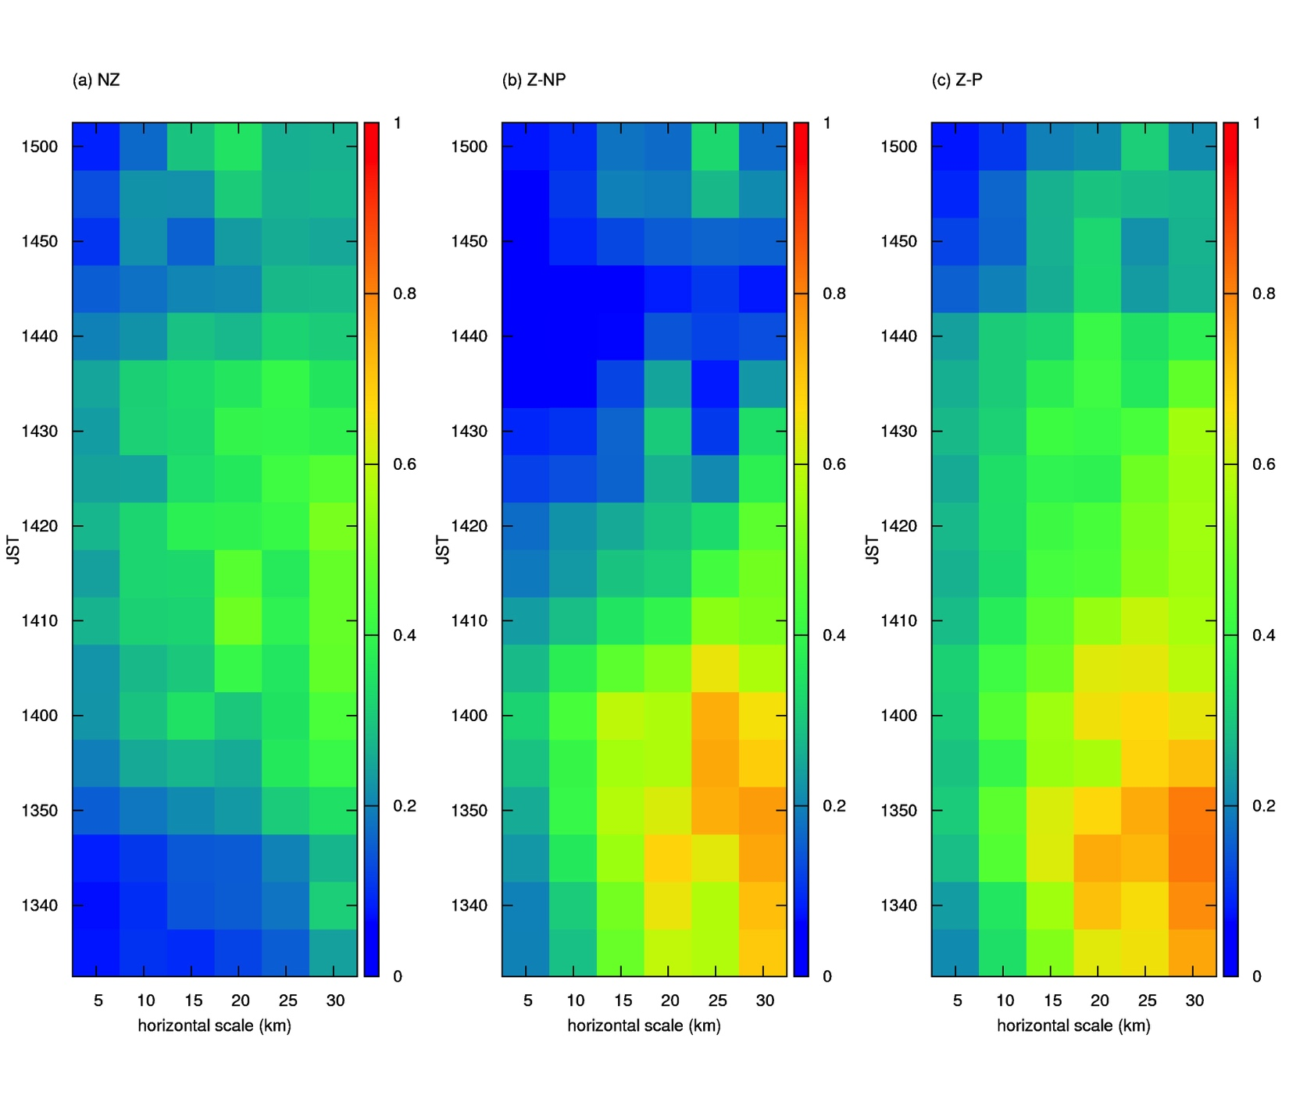
Fractions Skill Score Verification
Results (2013/9/2)
29/16
Verification using rainfall estimated by JMA radars between 1330-1500JST
(threshold=10mm/hr)
Assimilate Z_{H}^{obs}
without additional δZ_{H}^{f}
Assimilate Z_{H}^{obs}
with additional δZ_{H}^{f}
Not assimilate Z_{H}^{obs}

Slide 31
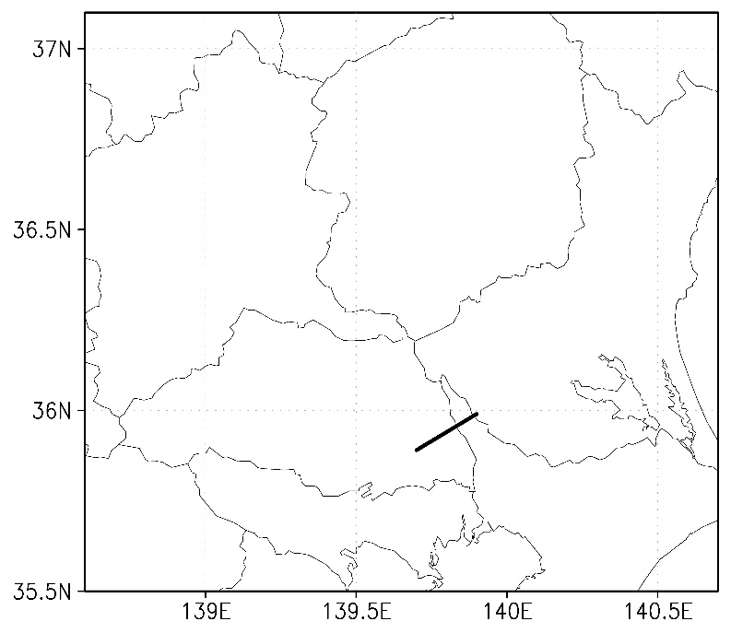
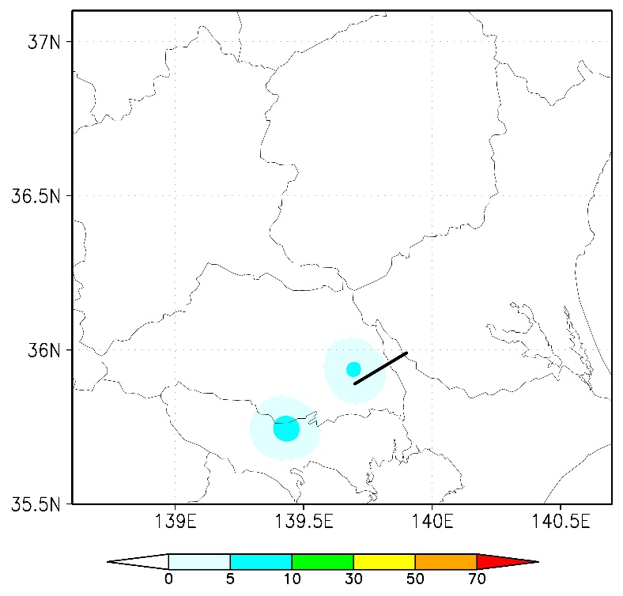
Probabilistic Forecasts of Low-level Mesocyclones
Results (2013/9/2)
30/16
Probability that high-vorticity area (>0.01/s) appears within the radius of 10km in 1330-1430JST @z*=1km using 51 ensemble members
Assimilate Z_{H}^{obs}
without additional δZ_{H}^{f}
Assimilate Z_{H}^{obs}
with additional δZ_{H}^{f}
Not assimilate Z_{H}^{obs}
Black lines: Damaged area
Realistic forecasts in a few members

