Slide 1
Assimilating All-Sky Himawari-8 Satellite Infrared Radiances: A Case of Typhoon Soudelor (2015)
*Takumi Honda¹,
Takemasa Miyoshi¹, Guo-Yuan Lien¹, Seiya Nishizawa¹, Ryuji Yoshida¹, Sachiho A. Adachi¹, Koji Terasaki¹, Kozo Okamoto^{2,1}, Hirofumi Tomita¹, and Kotaro Bessho³
¹RIKEN, Center for Computational Science, Kobe, Japan
²Meteorological Research Institute, Japan Meteorological Agency, Tsukuba, Japan
³Japan Meteorological Agency, Tokyo, Japan

Slide 2
Himawari-8: A new geostationary satellite
2nd generation
2.5 generation
3rd generation
Himawari-6/7 (JMA)
GOES-13/14/15 (NOAA)
and many others
MSG/SEVIRI (EUMETSAT)
Himawari-8/9 (JMA)
GOES-R(16) (NOAA)
and many others
High spatiotemporal resolution
~ 2.5 min & 2 km
High spectral resolution
~3 VIS, 3 NIR, & 10 IR bands
Every 30 min (e.g., Himawari-7)
Every 10 min (Himawari-8)
Notes:
MTSATs
2005–2015

Slide 3
All-sky IR radiance DA
Truth
w/o IR DA
w/ IR DA
GOES-R:
Proof of concept in OSSE by
Zhang et al. (2016)
NoHim8
Him8
OBS
Himawari-8:
Real-world heavy rainfall by
Honda et al. (2018)
Notes:
Synoptic condition

Slide 4
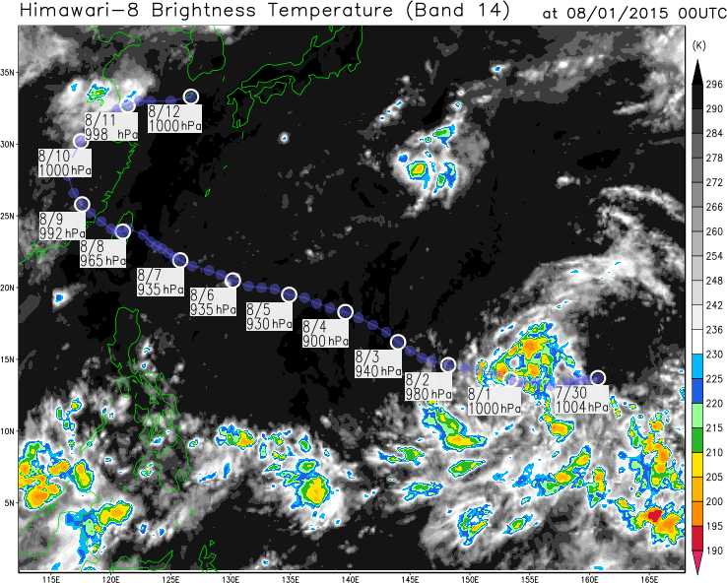
Typhoon Soudelor (2015)
The strongest northwestern Pacific TC in 2015 (~900 hPa).
Himawari-8 observed successfully!
Goals:
To assimilate the Himawari-8 all-sky infrared radiance observations and investigate their impact on the TC analyses and forecasts
To explore benefits of the enhanced observing frequency of Himawari-8
Notes:
Synoptic condition

Slide 5
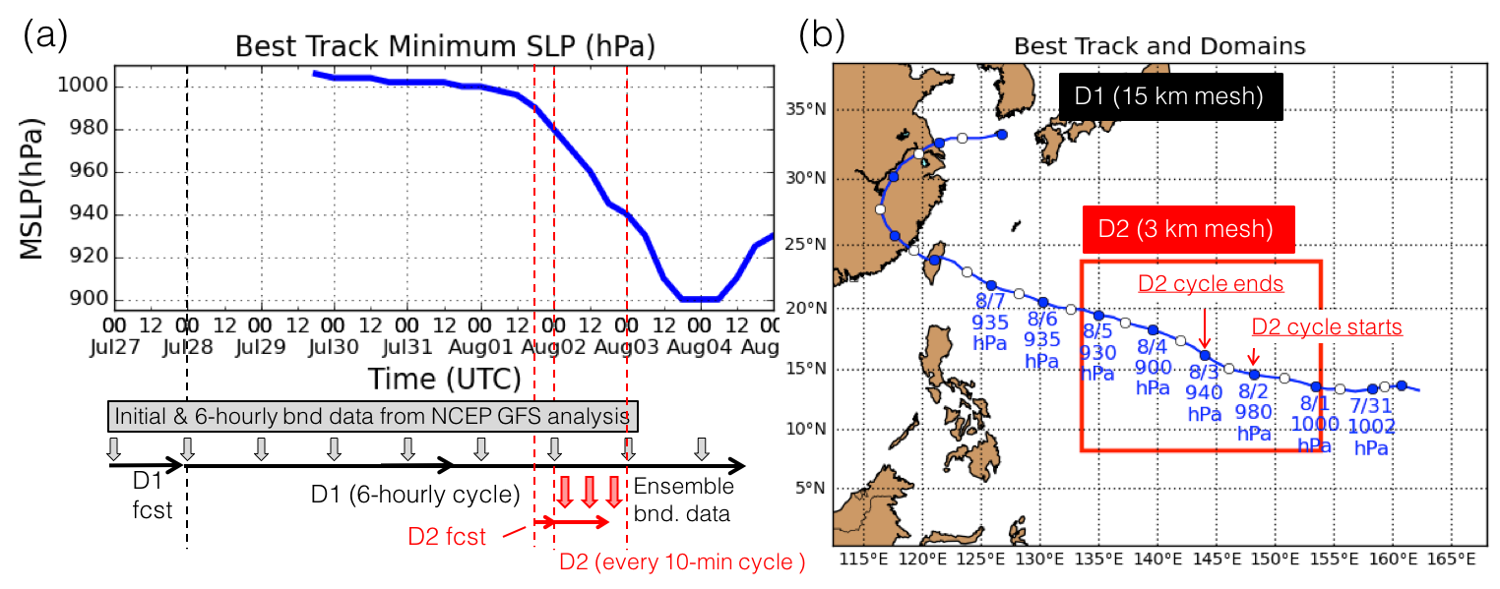
Experimental design
SCALE-LETKF (Lien et al. 2017)
Atmos. model
DA
LETKF
(Nishizawa et al. 2015;
Sato et al. 2015)
(Hunt et al. 2007;
Miyoshi and Yamane 2007)
Observations
D1 (15-km mesh): 6-hourly PREPBUFR
D2 (3-km mesh): Every 10 min PREPBUFR
+ hourly TC vital (Min. SLP and position)
+ every 10 min Himawari-8 (band 9, 6.9 µm)
Localization scale:
$σ_{H}=$60 km, $σ_{V}=$0.5 lnp
Observation error:
3 K (clear sky)/ 6 K (cloudy sky)
Observation error for Him8
3 K: clear sky ($C_{A}≤1.0$)
6 K: cloudy sky ($C_{A}>1.0$)
$C_{A}:$Cloud effect
Okamoto et al. (2014) Okamoto (2017)
Cloud condition is diagnosed by the Cloud effect parameter C_{A} (Okamoto et al. 2014)

Slide 6
Analysis (Him8 radiance)
Himawari-8 radiances dramatically improve cloud patterns.
Not directly assimilated band (B13 , 10.4µm)
NoHim8
Him8
OBS
*A few Him8 obs were missing due to attitude control.

Slide 7
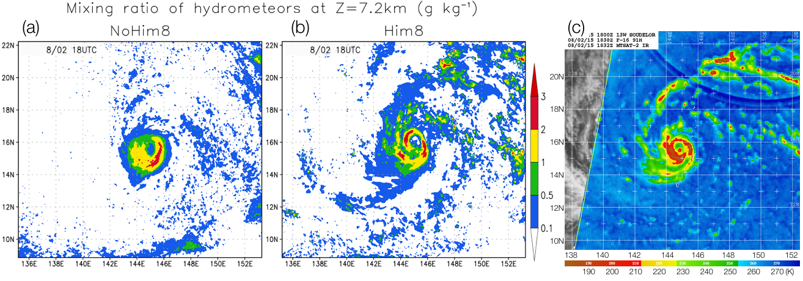
Analyzed hydrometeors
Himawari-8 radiances dramatically improve cloud patterns.
NoHim8
Him8
OBS (SSMIS)

Slide 8
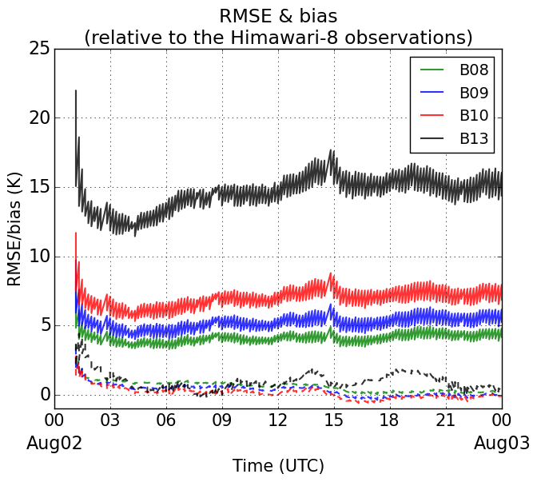
Time series of RMSE & bias
B08 (6.2 µm)
B09 (6.9 µm)
B10 (7.3 µm)
B13 (10.4 µm)
Solid curves:
RMSE
Dashed curves:
bias

Slide 9
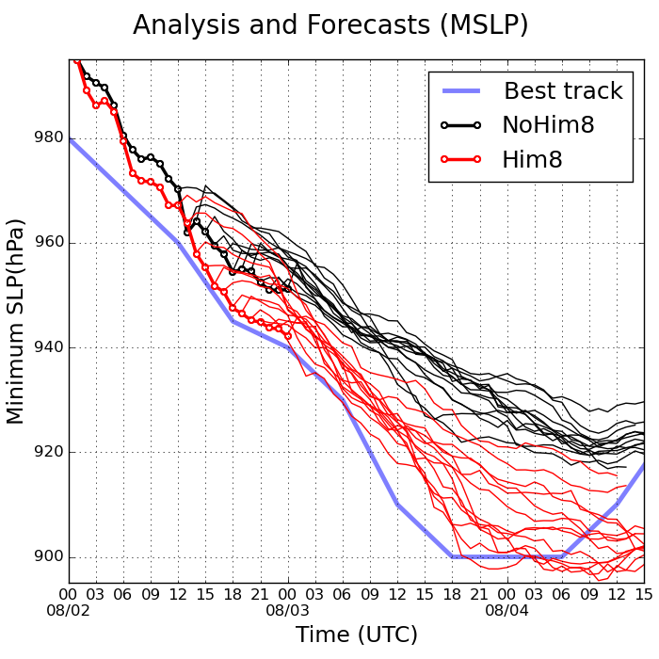
Impact on TC intensity forecast
Forecasts from the analysis mean at 13 initial times
Him8 forecasts successfully capture rapid intensification

Slide 10
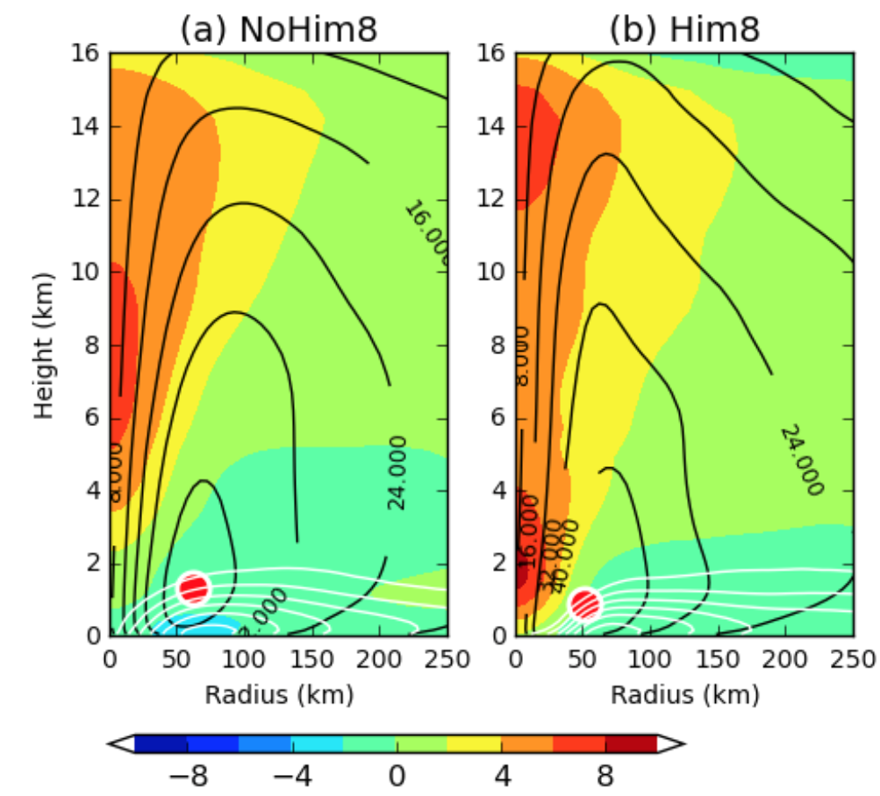
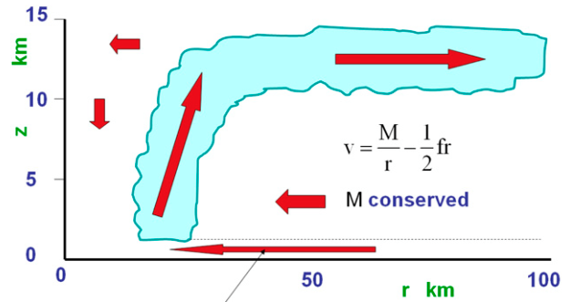
Impact on the TC structure
Him8 DA modulates the TC inner core structure
Schematic of a TC
(Adapted from Smith and Montgomery 2015)
Composite of analyzes
Shade: T anomaly (K),
black/while contours: tangential/radial winds(m s^{–1})
Warm core
NoHim8
Him8
Height
(km)
RMW: Radius of Maximum Wind
TC center
Distance from the TC center (km)
The inner core structure is important to TC intensification
(Zhang and Chen 2012; Miyamoto and Takemi 2013)
RMW
cool
warm

Slide 11
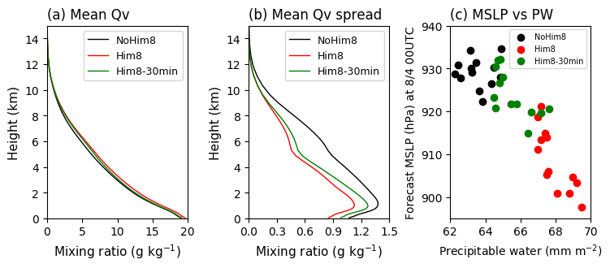
Impact on inner-core moisture
The inner-core moisture error causes the intensity forecast error (Emanuel and Zhang 2017)
Him8 DA reduces a dry bias and ensemble spread (uncertainty) of moisture.

Slide 12
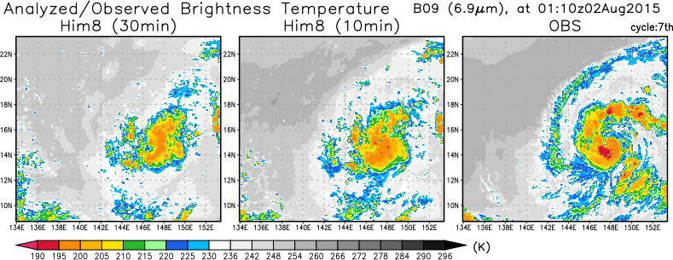
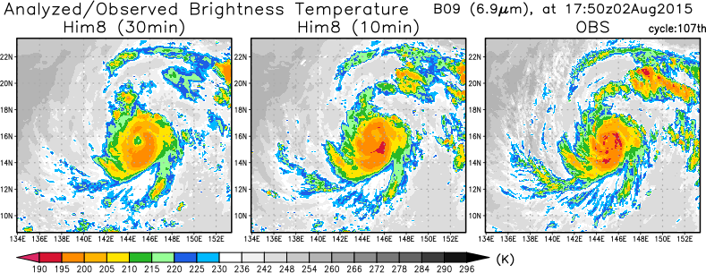
Benefits of frequent updates
Every-30-min DA
Every-10-min DA
OBS
Additional exp assimilating the Himawari-8 obs every 30 min
Him8 (every 10 min)
Every-30-min DA cannot capture detailed structure!
e.g., outer rainbands and near the TC center

Slide 13
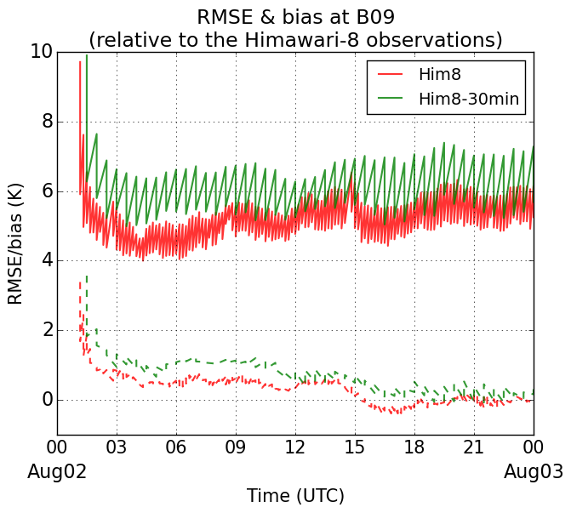
Time series of RMSE & bias
Solid curves:
RMSE
Dashed curves:
bias

Slide 14
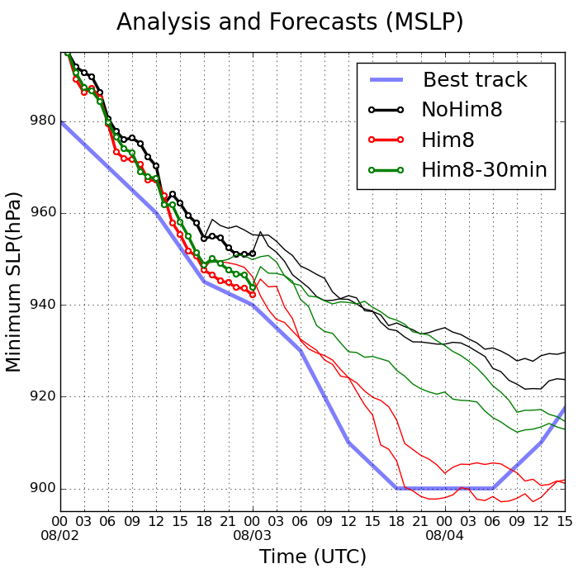
Impact on TC intensity forecast
Every-30-min DA failed to predict TC intensity!

Slide 15
Summary
The Himawari-8 observations improved both the TC analyses and forecasts significantly.
The enhanced observing frequency of Himawari-8 enabled much better TC representation.
Honda et al. (2018): Assimilating All-Sky Himawari-8 Satellite Infrared Radiances: A Case of Typhoon Soudelor (2015), Mon. Wea. Rev.

Slide 16
Thank you for your kind attention!
Questions?
Takumi.Honda@riken.jp
Honda et al. (2018): Assimilating All-Sky Himawari-8 Satellite Infrared Radiances: A Case of Typhoon Soudelor (2015), Mon. Wea. Rev.

Slide 18
The 1st case study: Typhoon Soudelor (2015)
Every-10-minute Himawari-8 radiances improve the TC analyses and forecasts.
Honda et al. (2018a): Assimilating All-Sky Himawari-8 Satellite Infrared Radiances: A Case of Typhoon Soudelor (2015), Mon. Wea. Rev., in press.
TC intensity
weak
TC analyses
NoHim8
Him8
OBS
strong

Slide 19
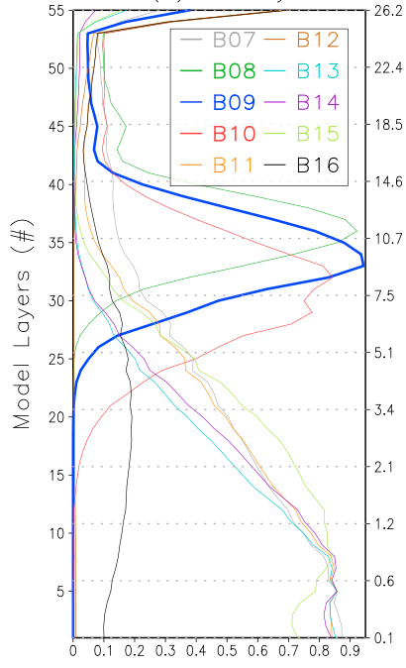
Observation operator
Model variables (t, q_{v}, q_{c}…)
Brightness Temp.
Forward RTM (RTTOV 11.2)
Weighting Function
Band # | Wave length (μm) | Supposed Uses
7 | 3.9 | moisture at lower levels
8 | 6.2 | moisture at mid / upper levels
9 | 6.9 | moisture at mid levels
10 | 7.3 | moisture at mid levels
11 | 8.6 | SO₂
12 | 9.6 | O₃
13 | 10.4 | cloud imagery / cloud top
14 | 11.2 | cloud imagery / SST
15 | 12.4 | cloud imagery / SST
16 | 13.3 | cloud top
Assimilated
Model Height (km)
http://www.jma-net.go.jp/msc/ja/
Weighing function

